Slide 1
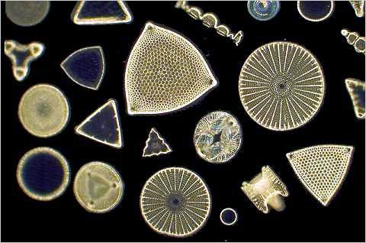
Diatoms
Diatoms

Slide 2
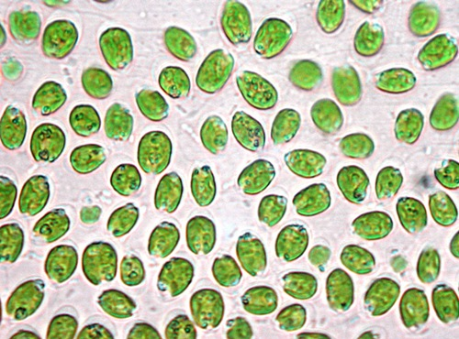
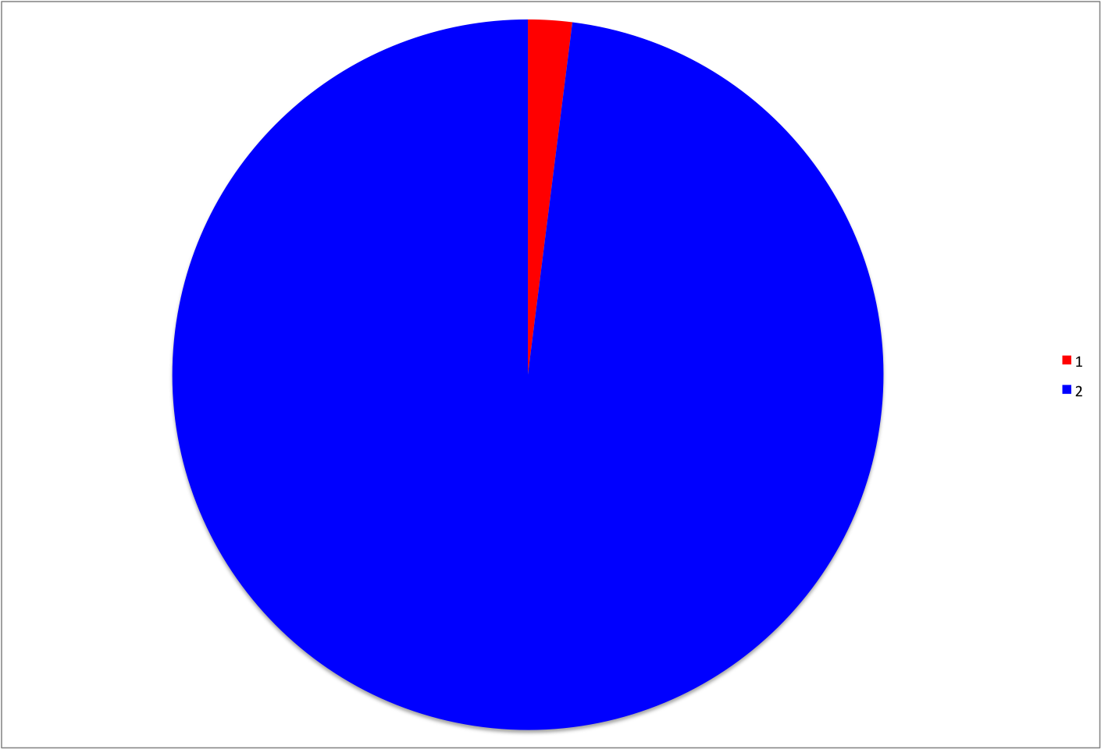
Algae
Algae

Slide 3
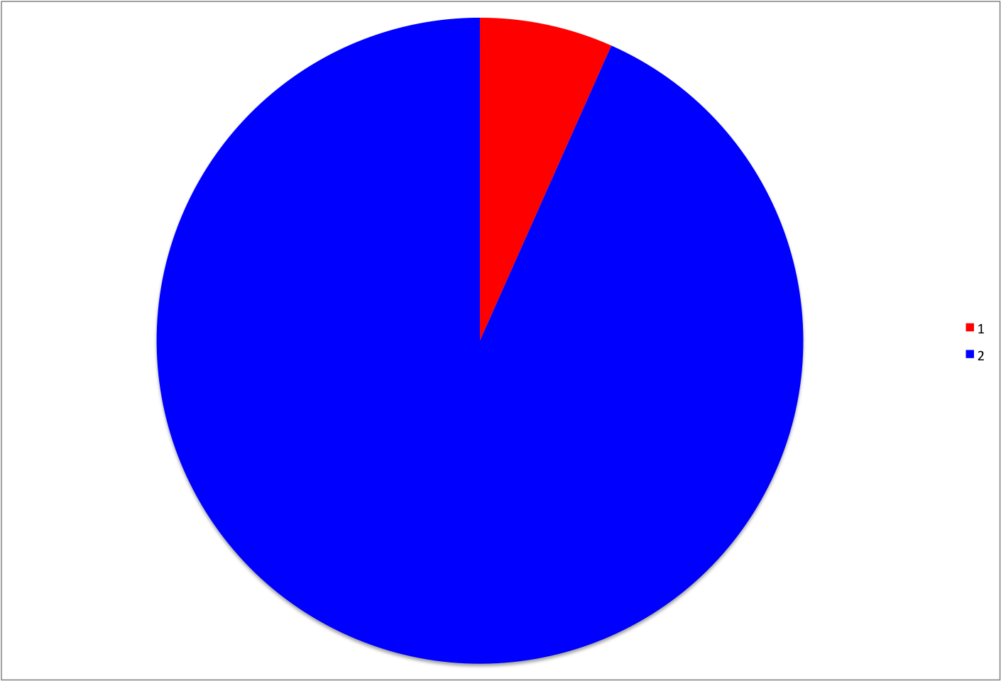
Moss
Moss

Slide 4
Liverwort
Liverwort

Slide 5
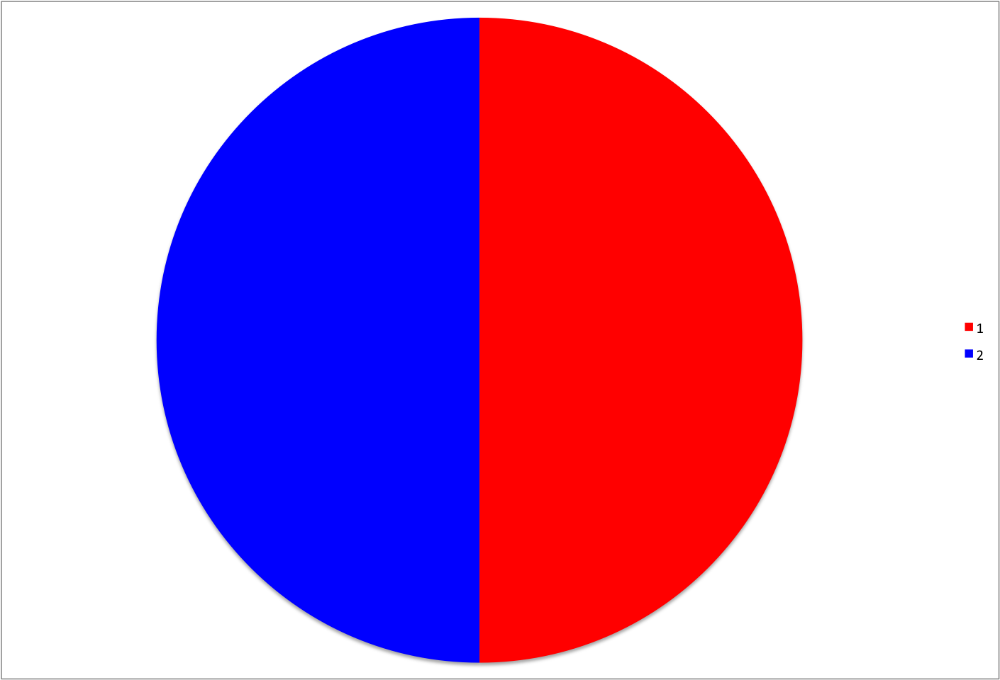
Fern
Fern

Slide 6
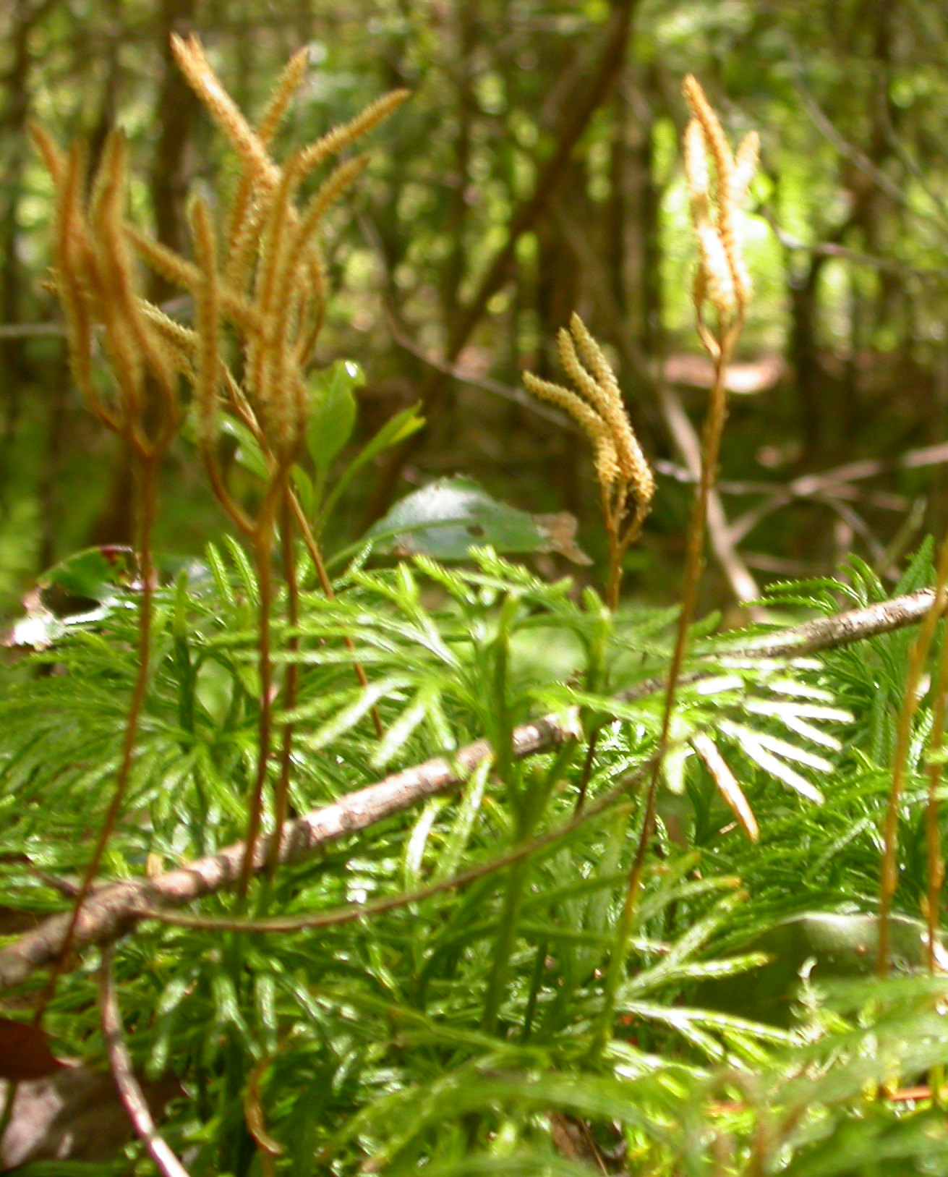
Club Moss
Club Moss

Slide 7
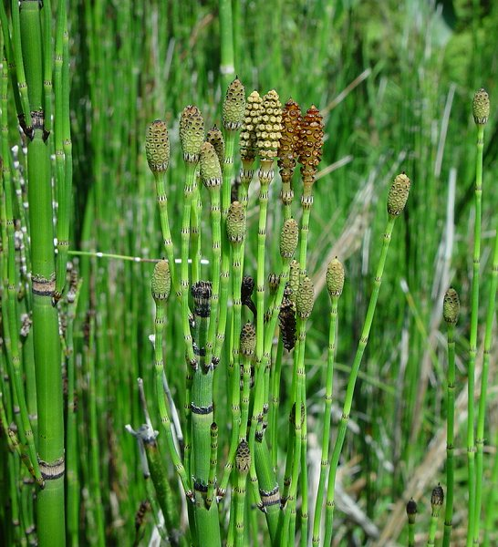
Horsetail
Horsetail

Slide 8
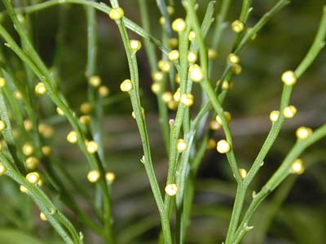
Whisk Fern
Whisk Fern

Slide 9
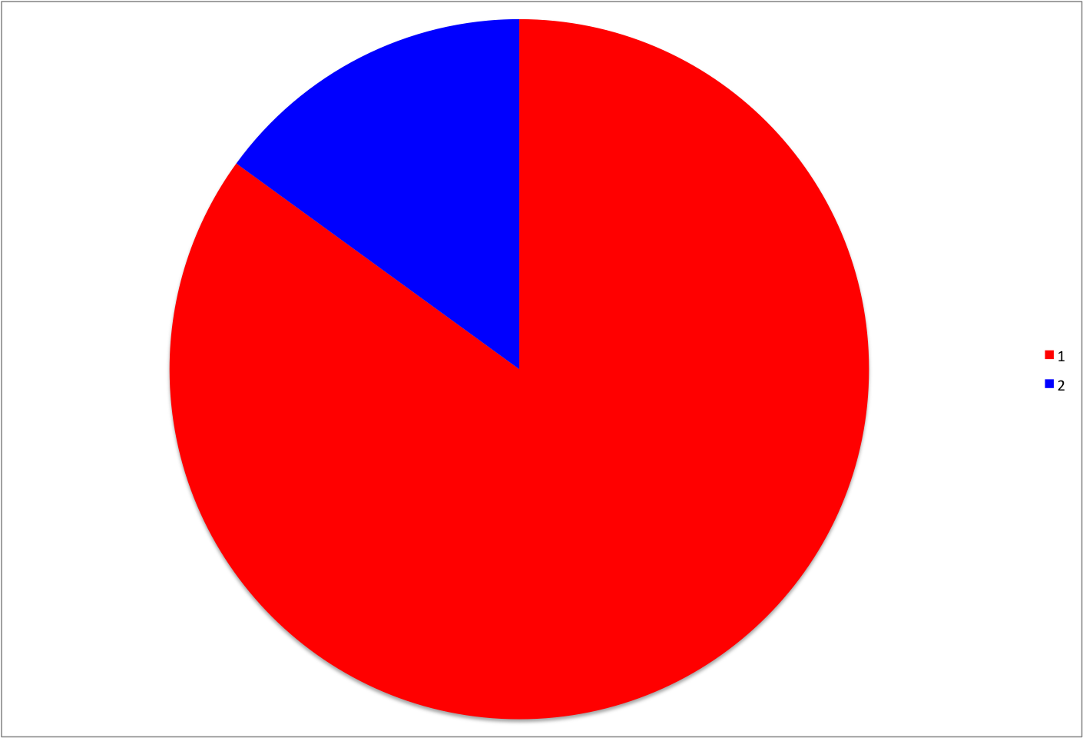
Red Cedar
Red Cedar

Slide 10
Engelmann Spruce
Engelmann Spruce

Slide 11
Ephedra
Ephedra

Slide 12
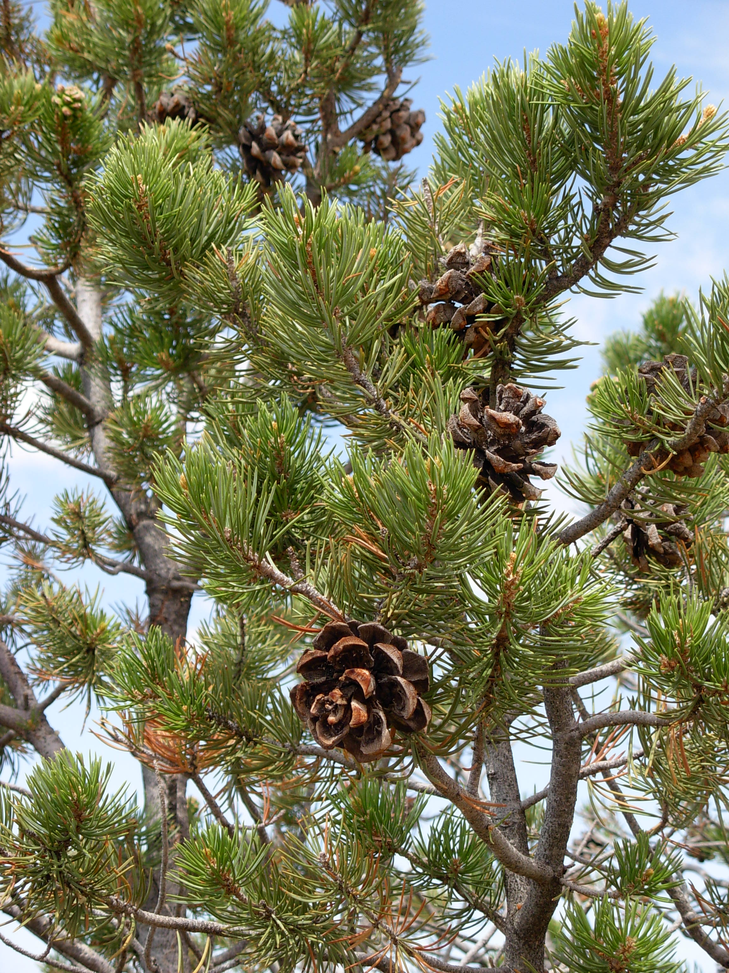
Piñon Pine
Piñon Pine

Slide 13
Douglas Fir
Douglas Fir

Slide 14
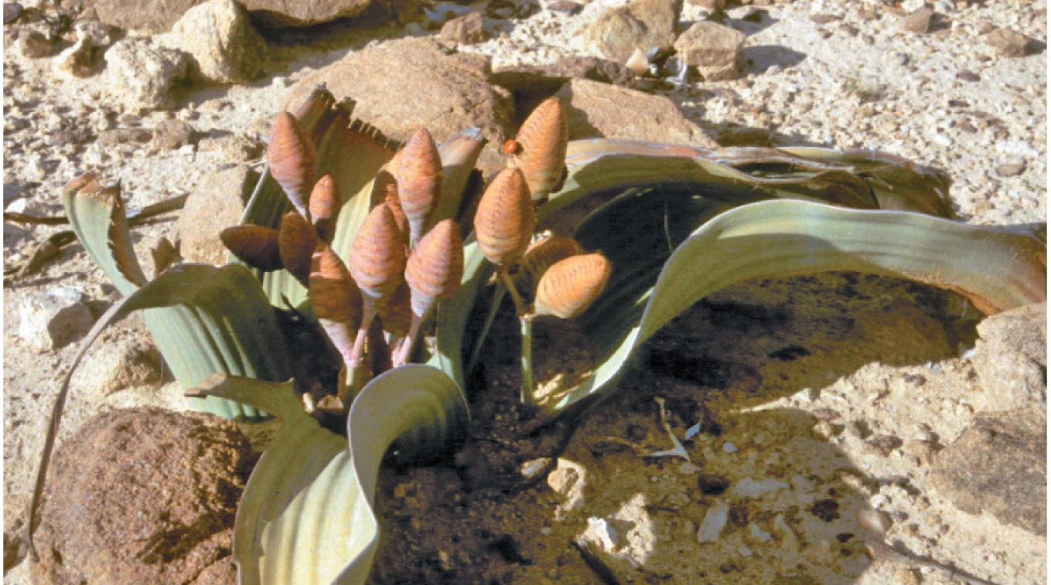
Welwitschia
Welwitschia

Slide 15
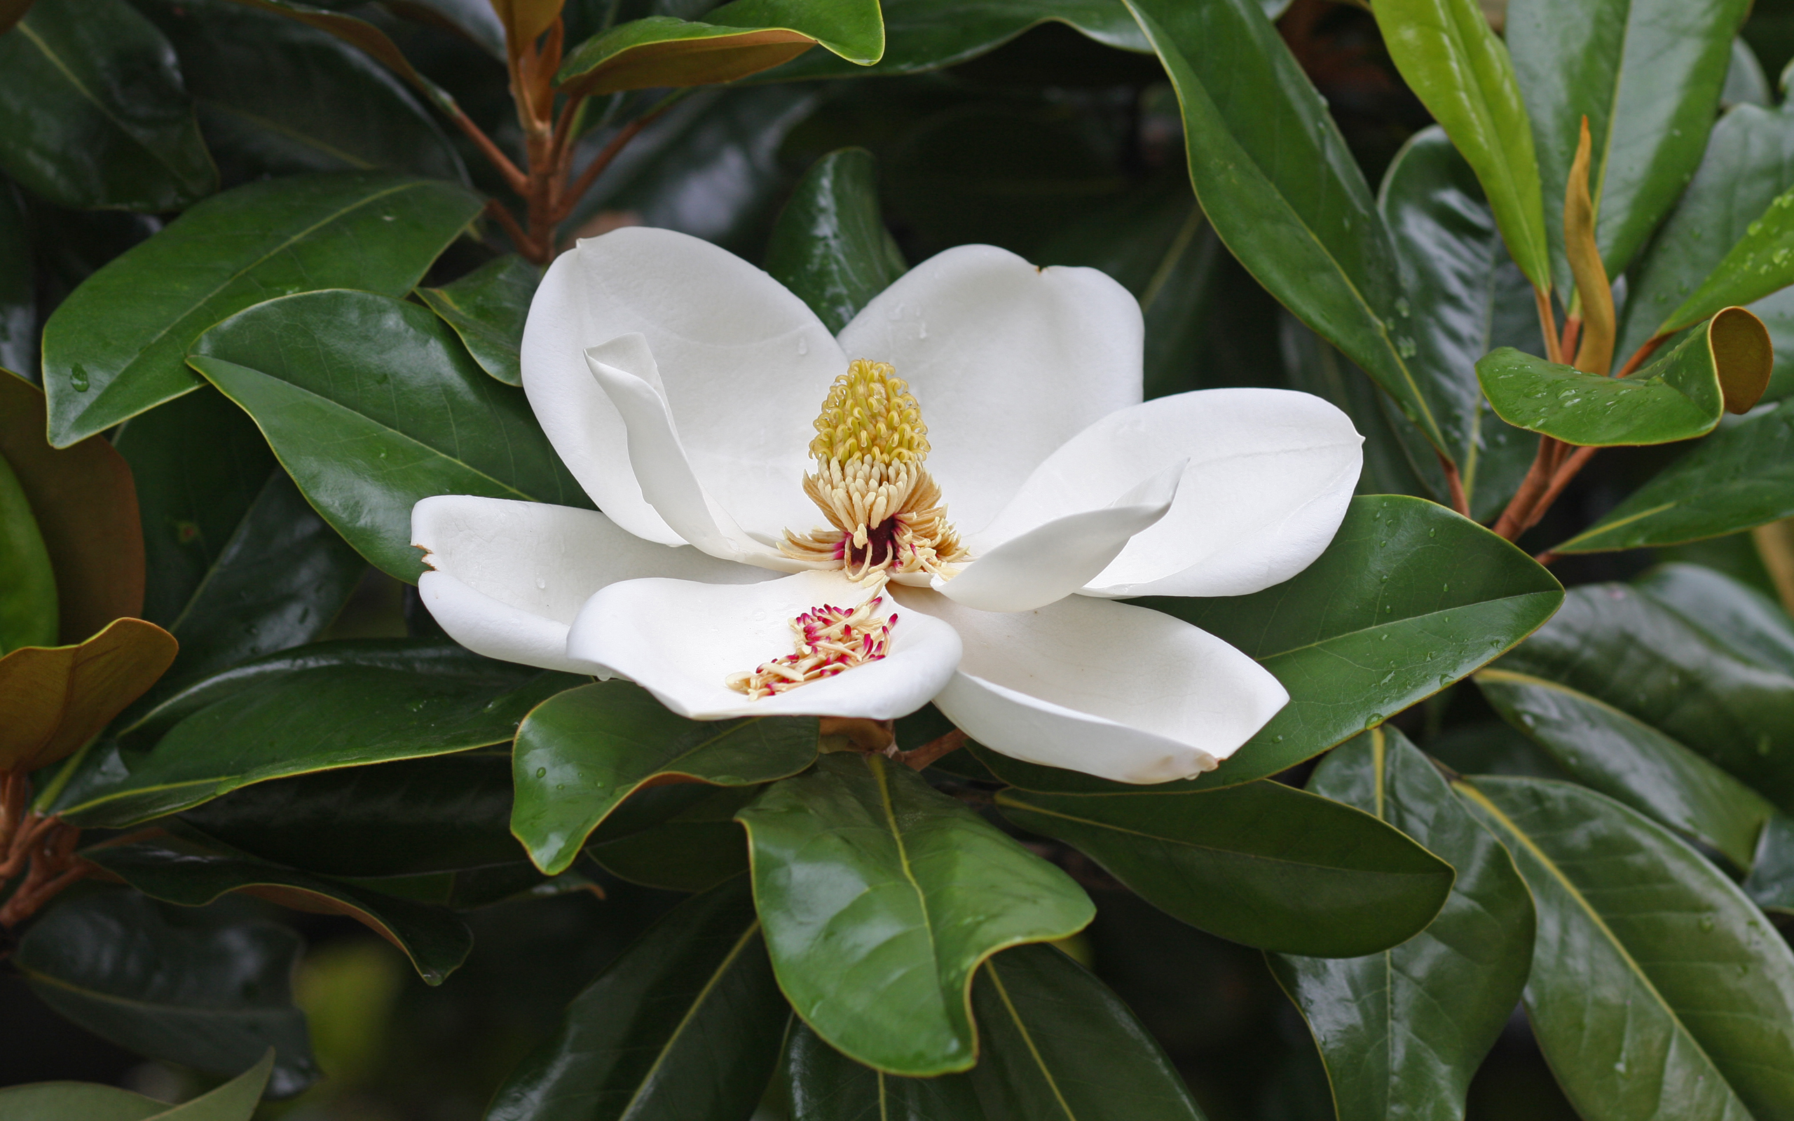
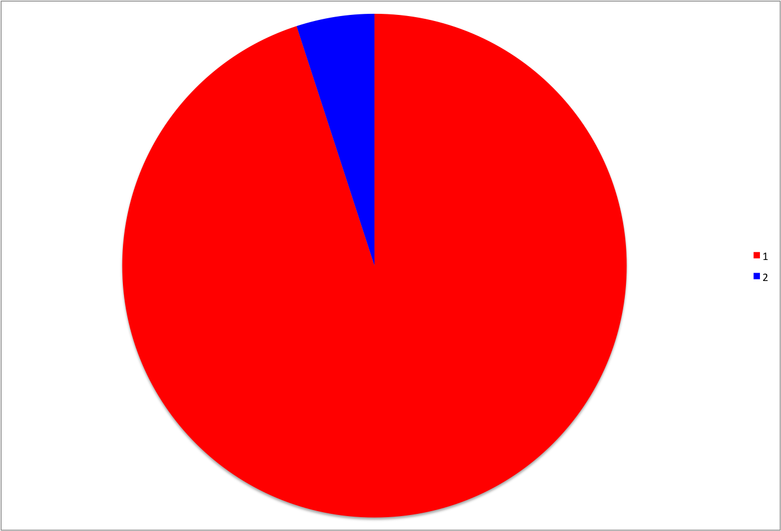
Magnolia
Magnolia

Slide 16
Spice Bush
Spice Bush

Slide 17
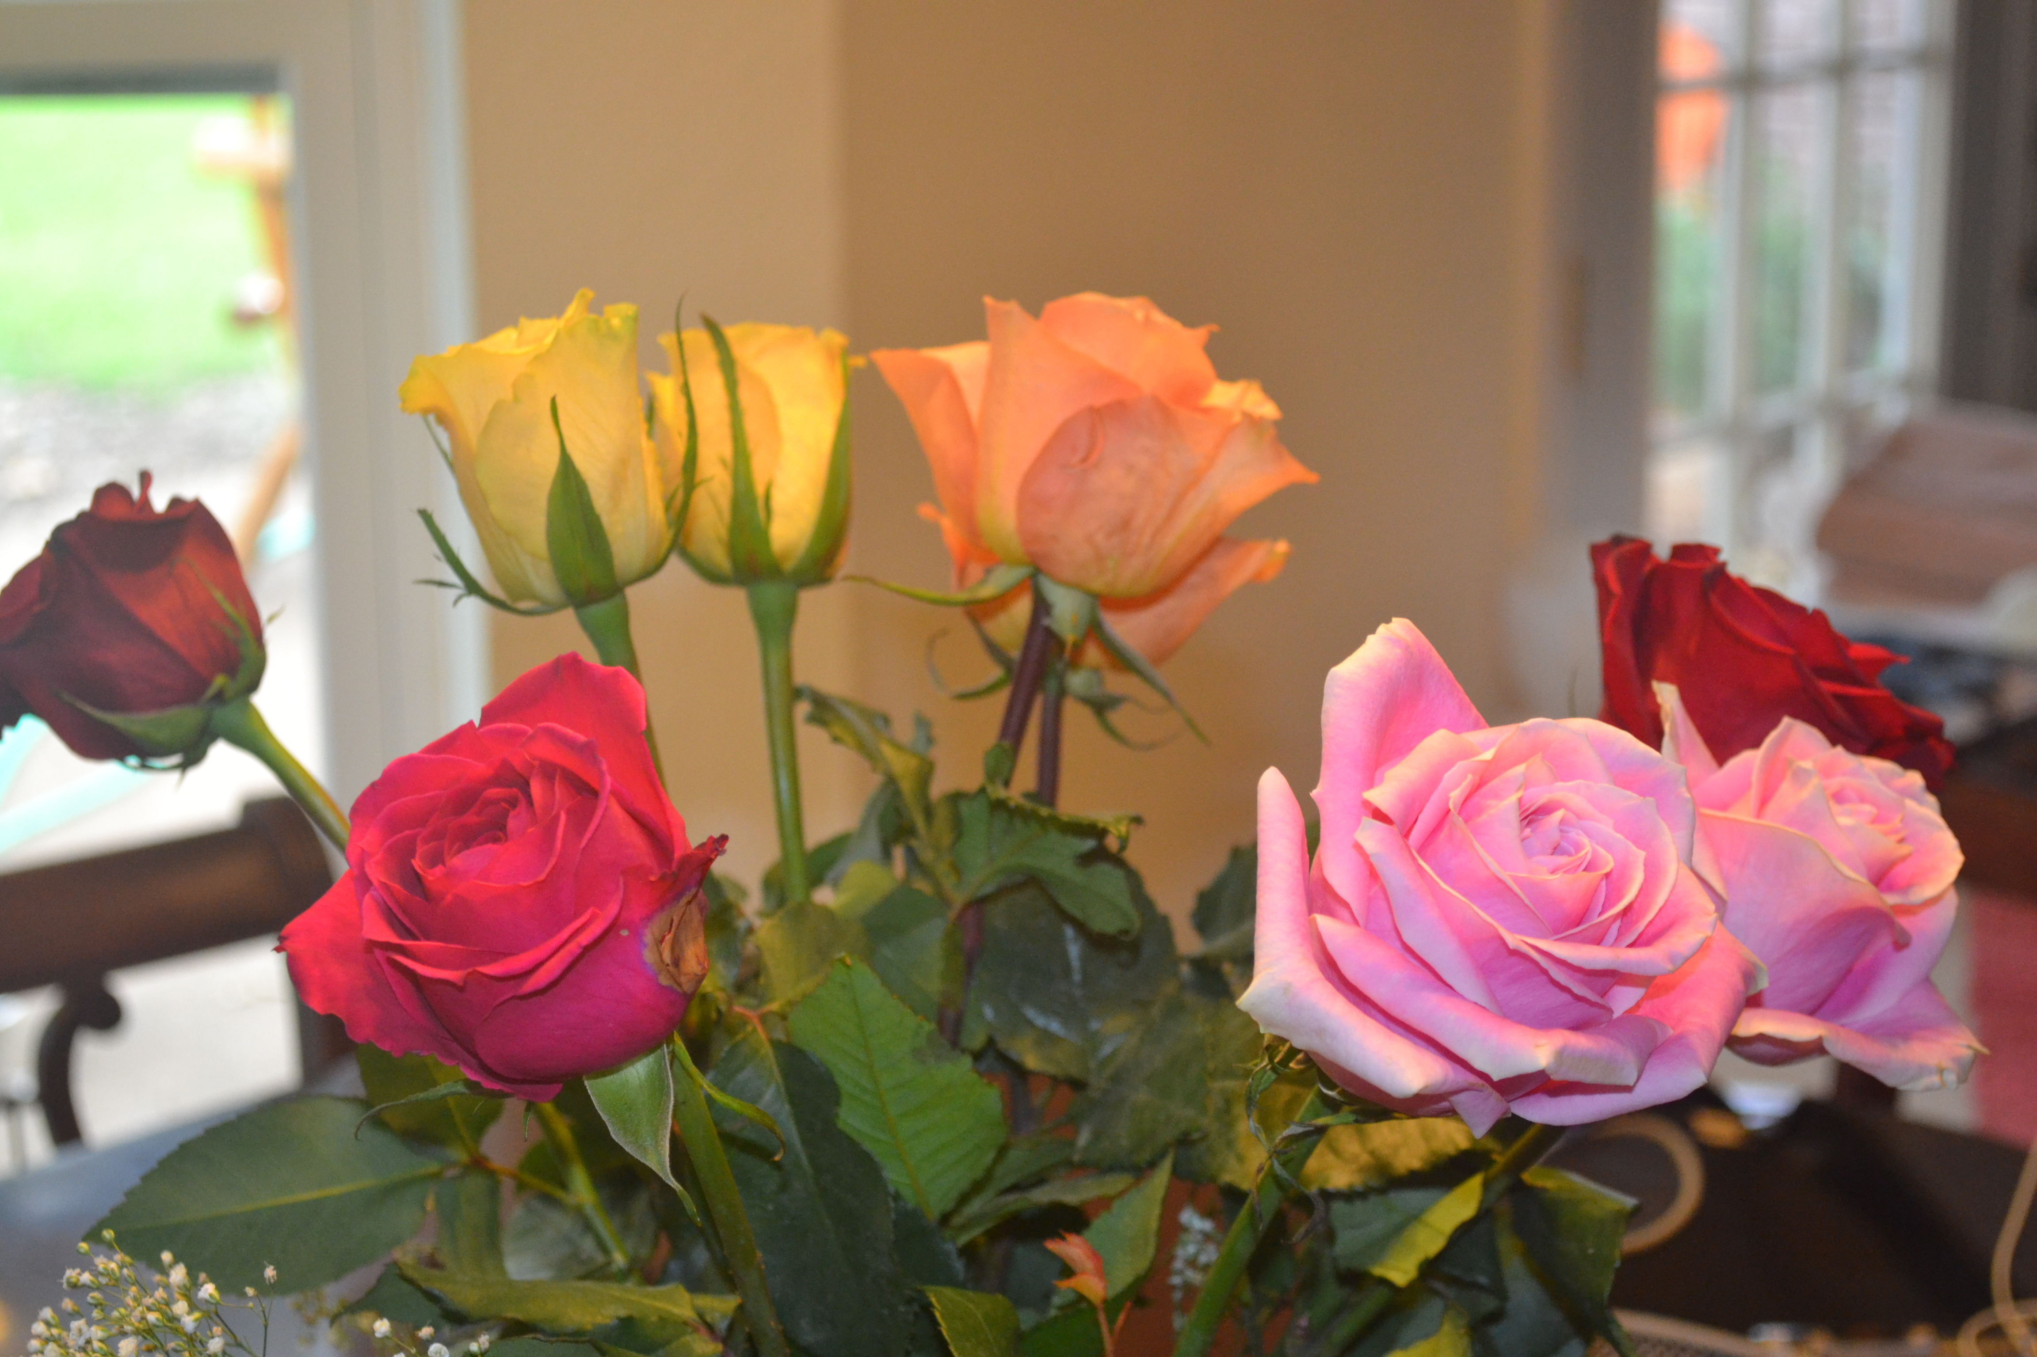
Rose
Rose

Slide 18
Cactus
Cactus

Slide 19
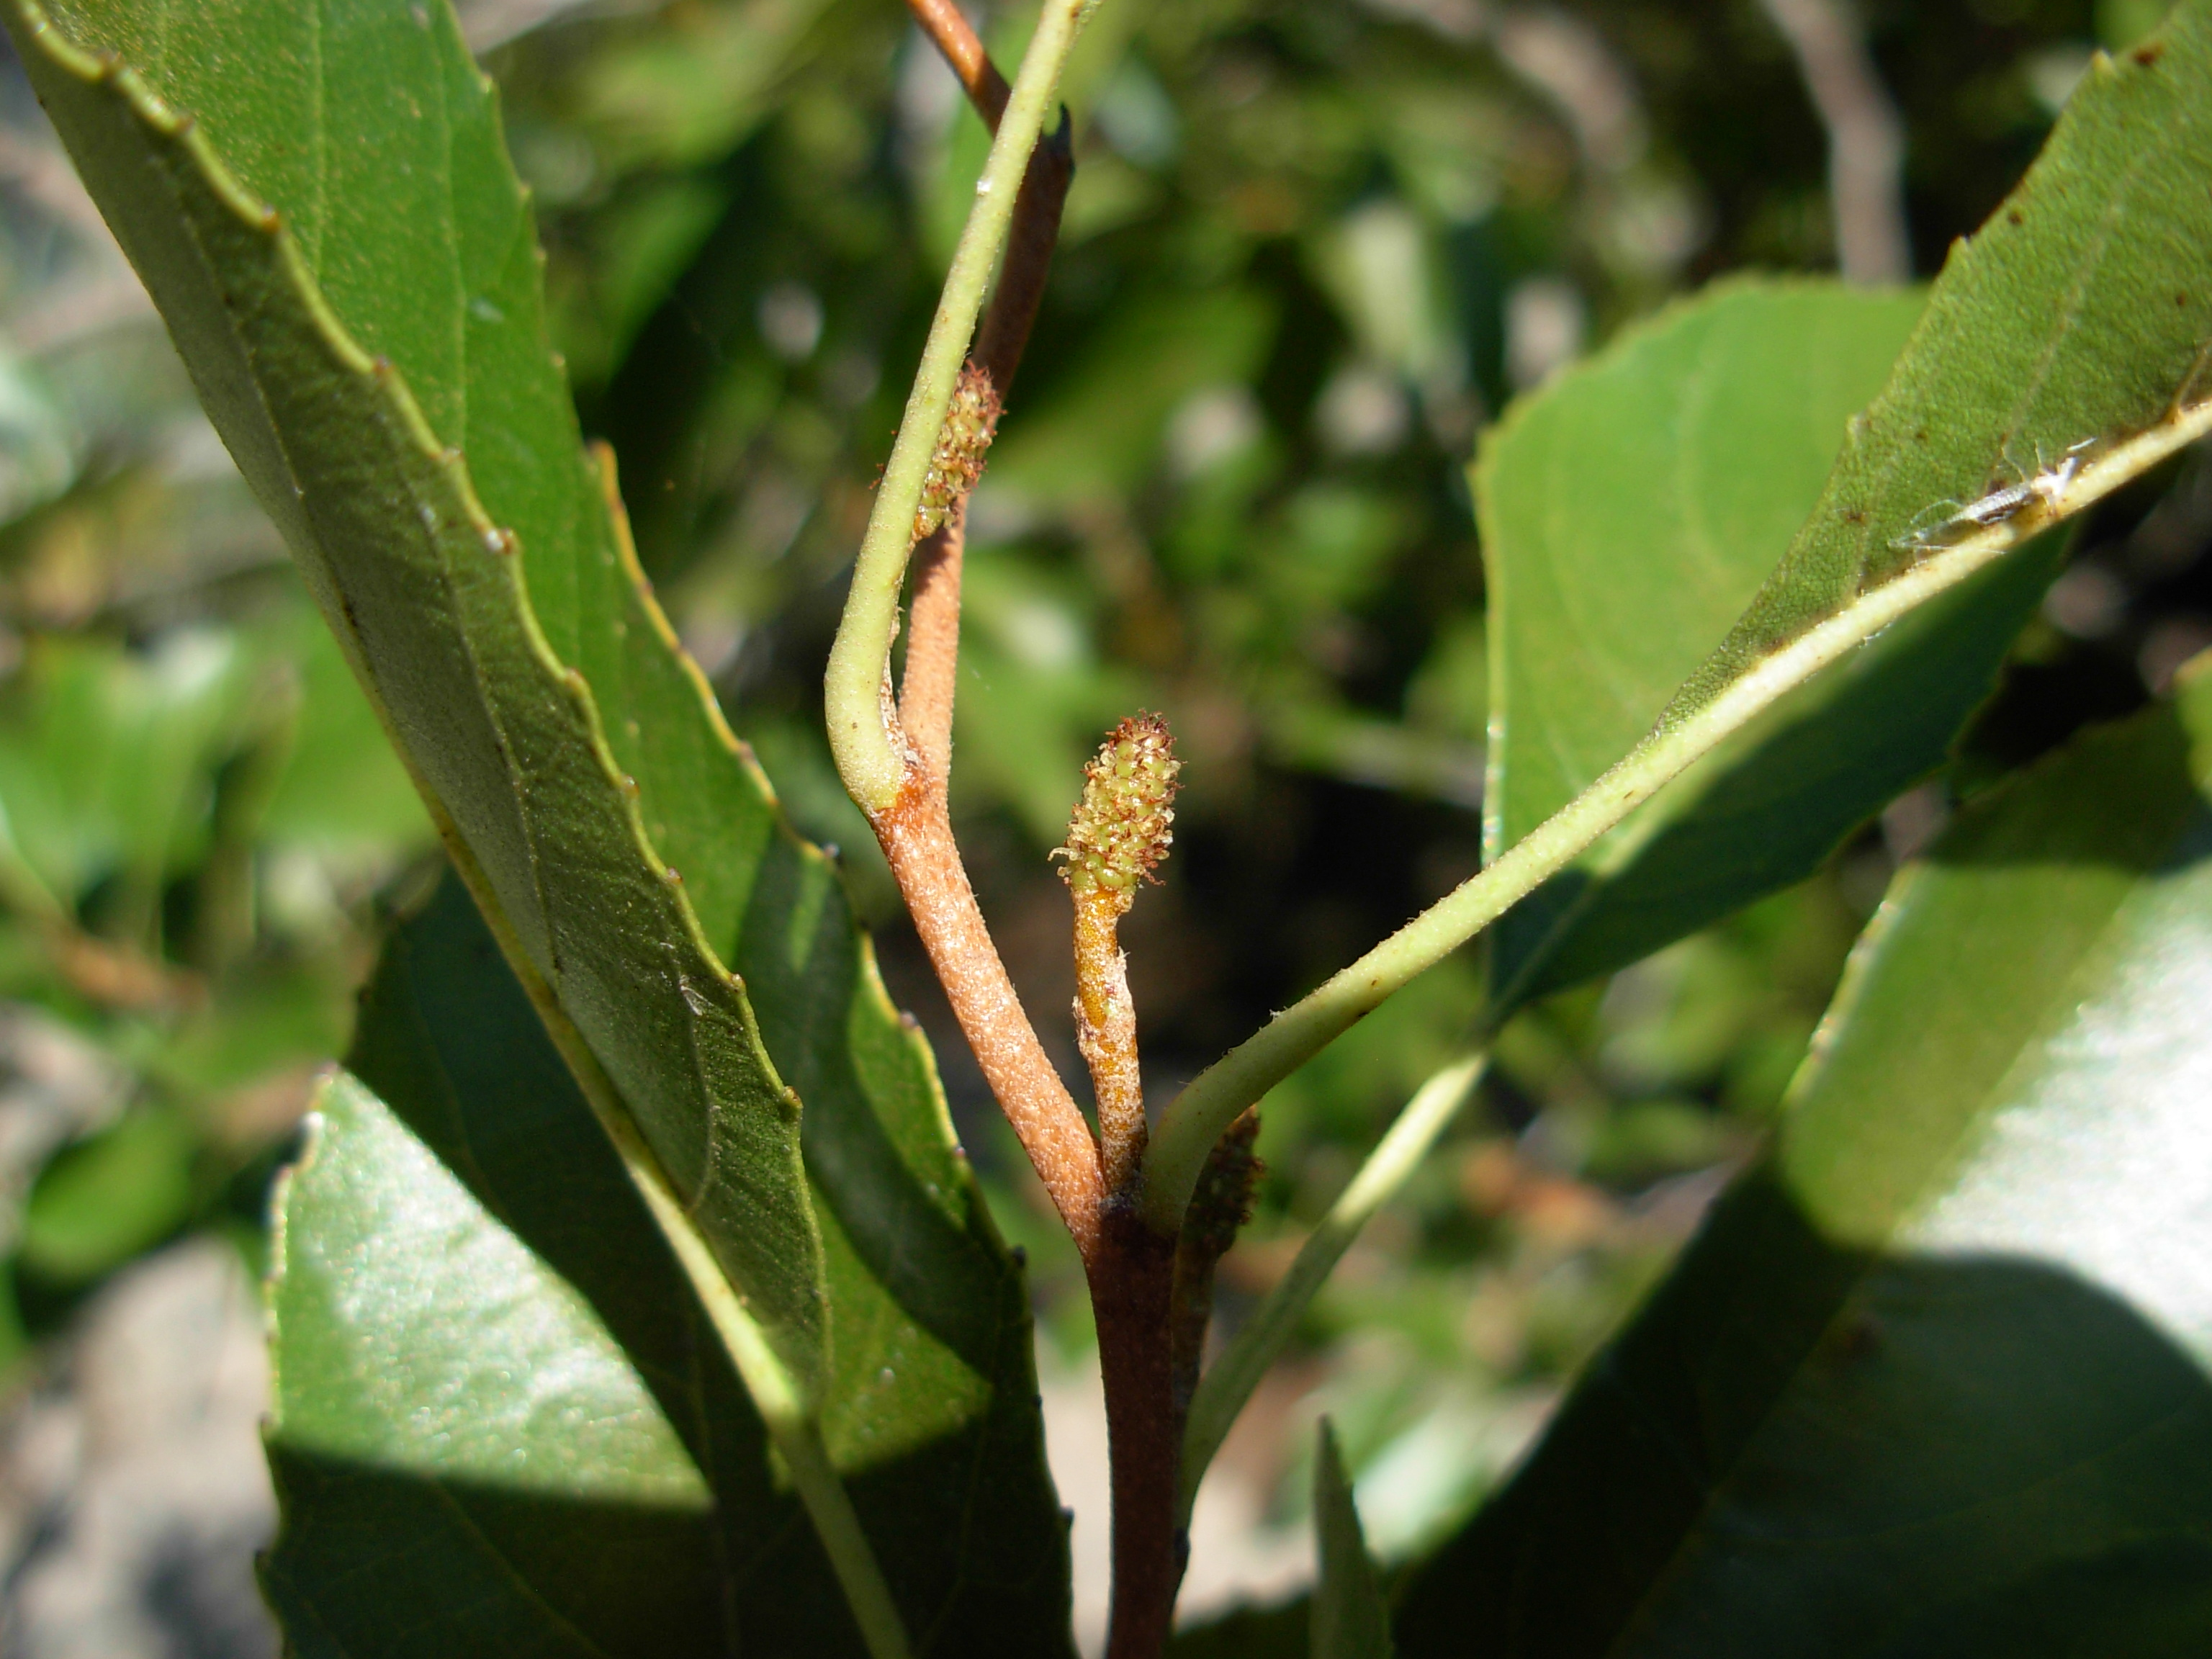
Seaside Alder
Seaside Alder

Slide 20
Columbine
Columbine

Slide 21
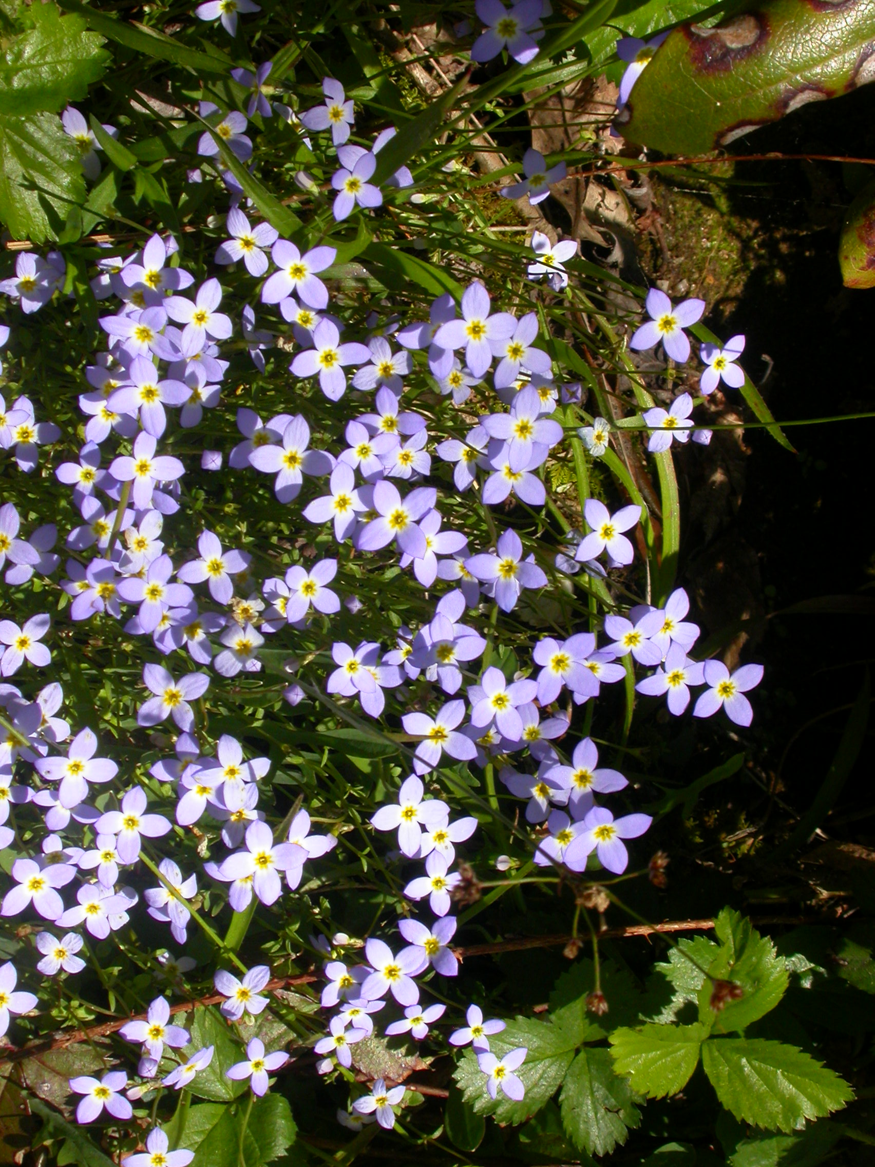
Bluets
Bluets

Slide 22
Sunflower
Sunflower

Slide 23
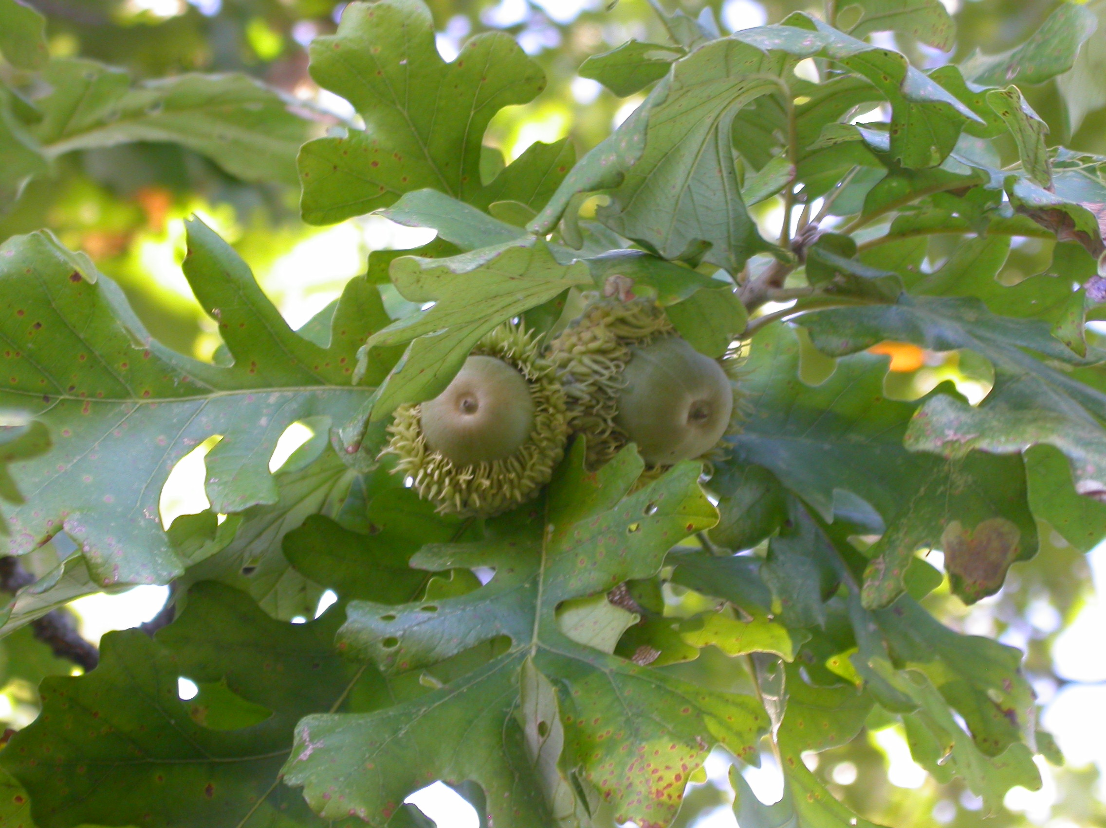
Oak
Oak

Slide 24
Coconut Palm
Coconut Palm

Slide 25
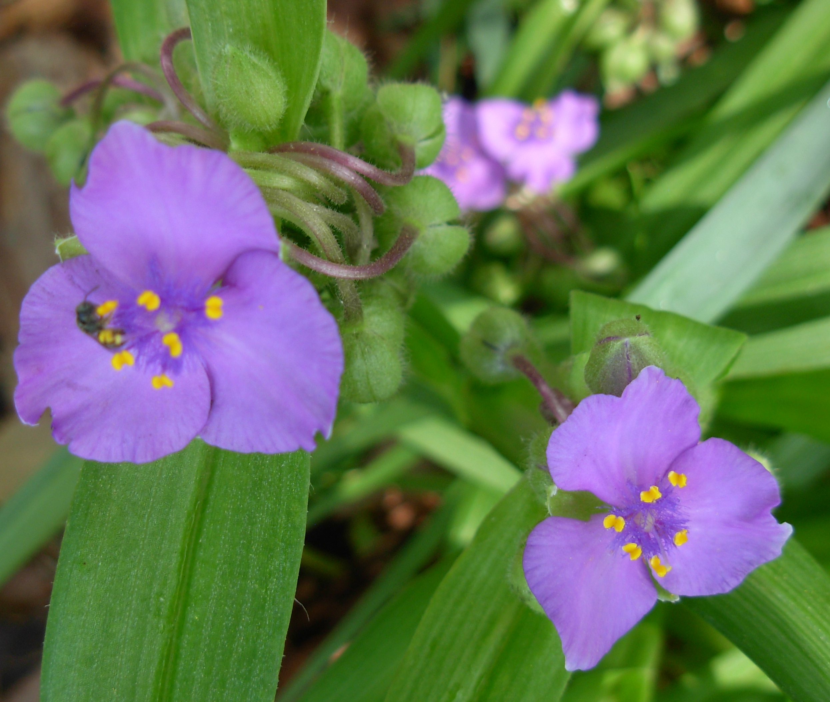
Spiderwort
Spiderwort

Slide 26
Corn
Corn

Slide 27
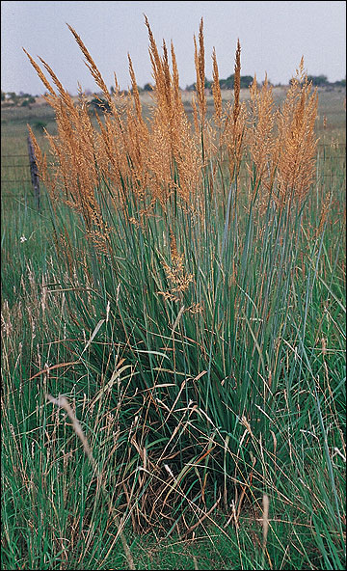
Indian Grass
Indian Grass

Slide 28
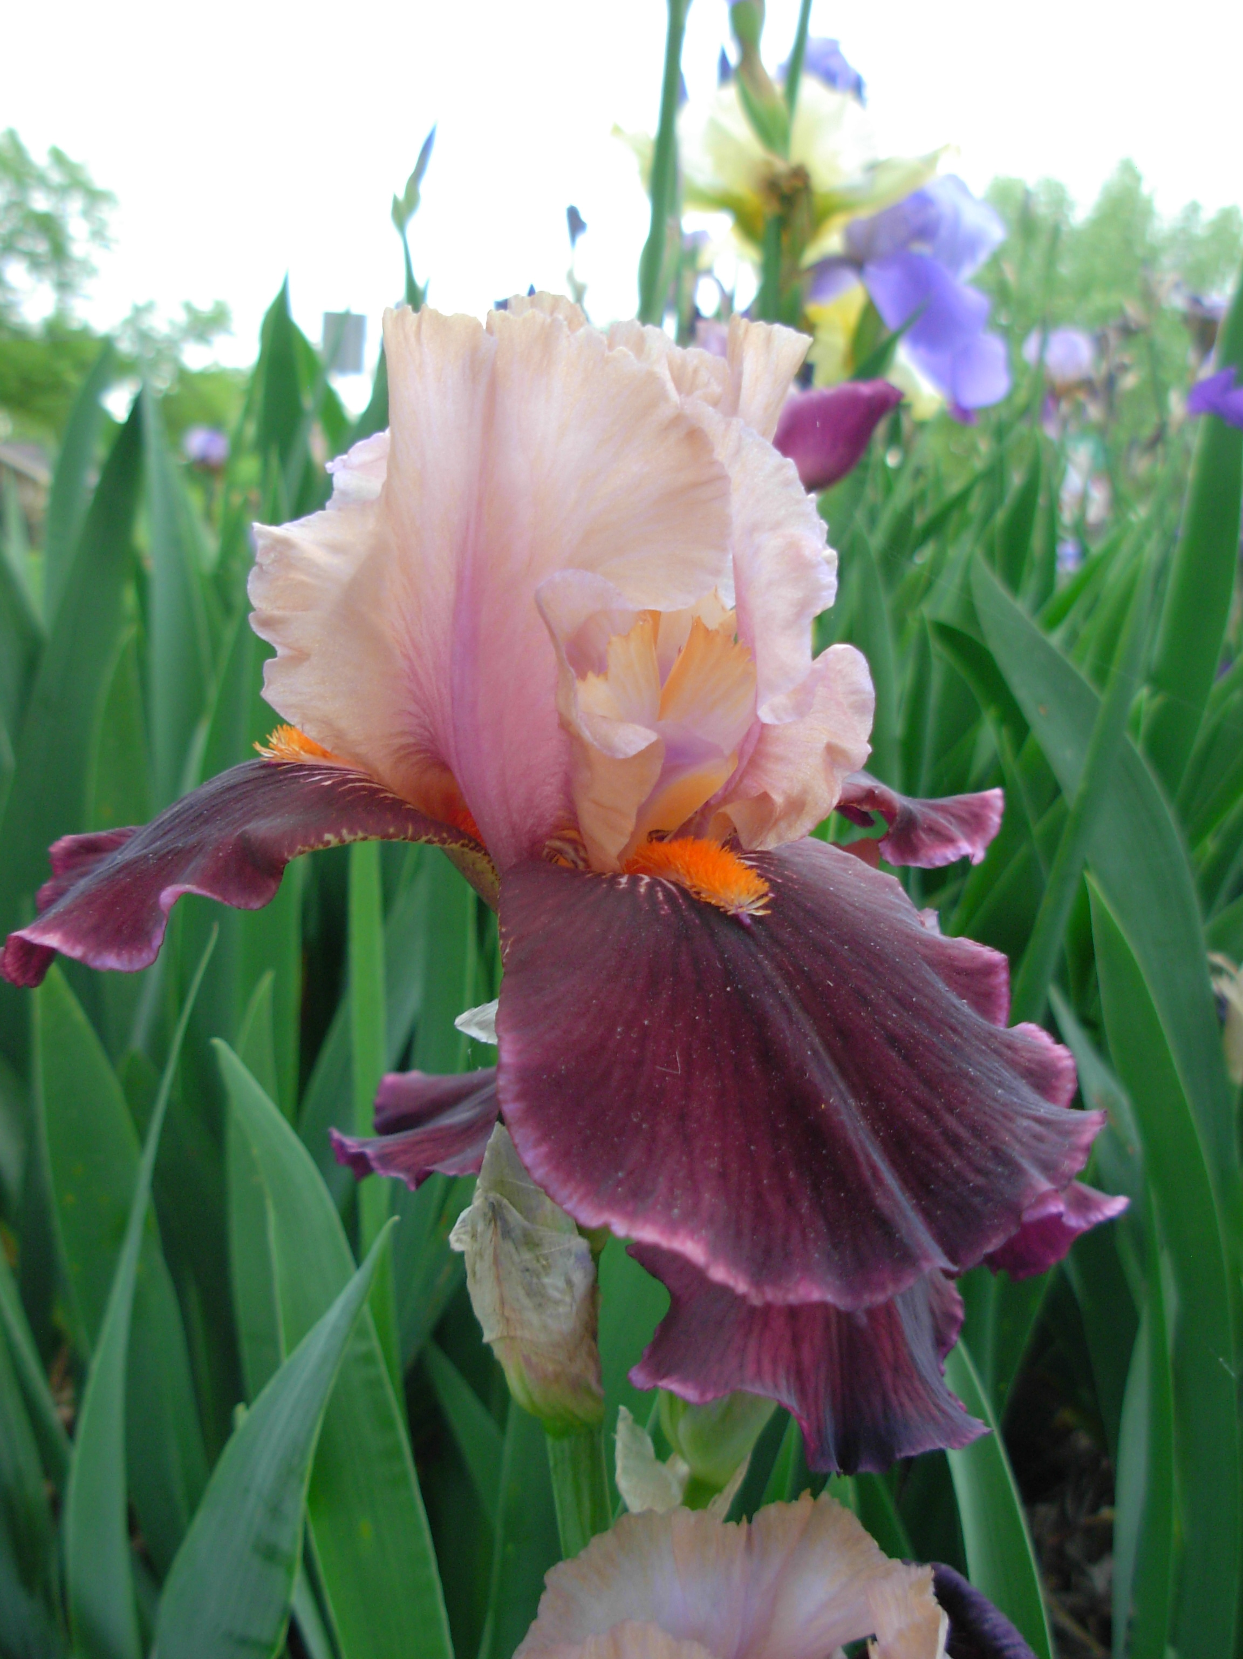
Iris
Iris

Slide 29
Algae

Slide 30
Moss
Liverwort

Slide 31
Fern
Club Moss

Slide 32
Horsetail
Whisk Fern

Slide 33
Red Cedar
Engelmann Spruce

Slide 34
Ephedra
Piñon Pine

Slide 35
Douglas Fir
Welwitschia

Slide 36
Spice Bush
Magnolia

Slide 37
Cactus
Rose

Slide 38
Columbine
Seaside Alder

Slide 39
Sunflower
Bluets

Slide 40
Iris
Oak

Slide 41
Coconut Palm
Spiderwort

Slide 42
Corn
Indian Grass

