Slide 1
Protocol specific slides

Slide 2
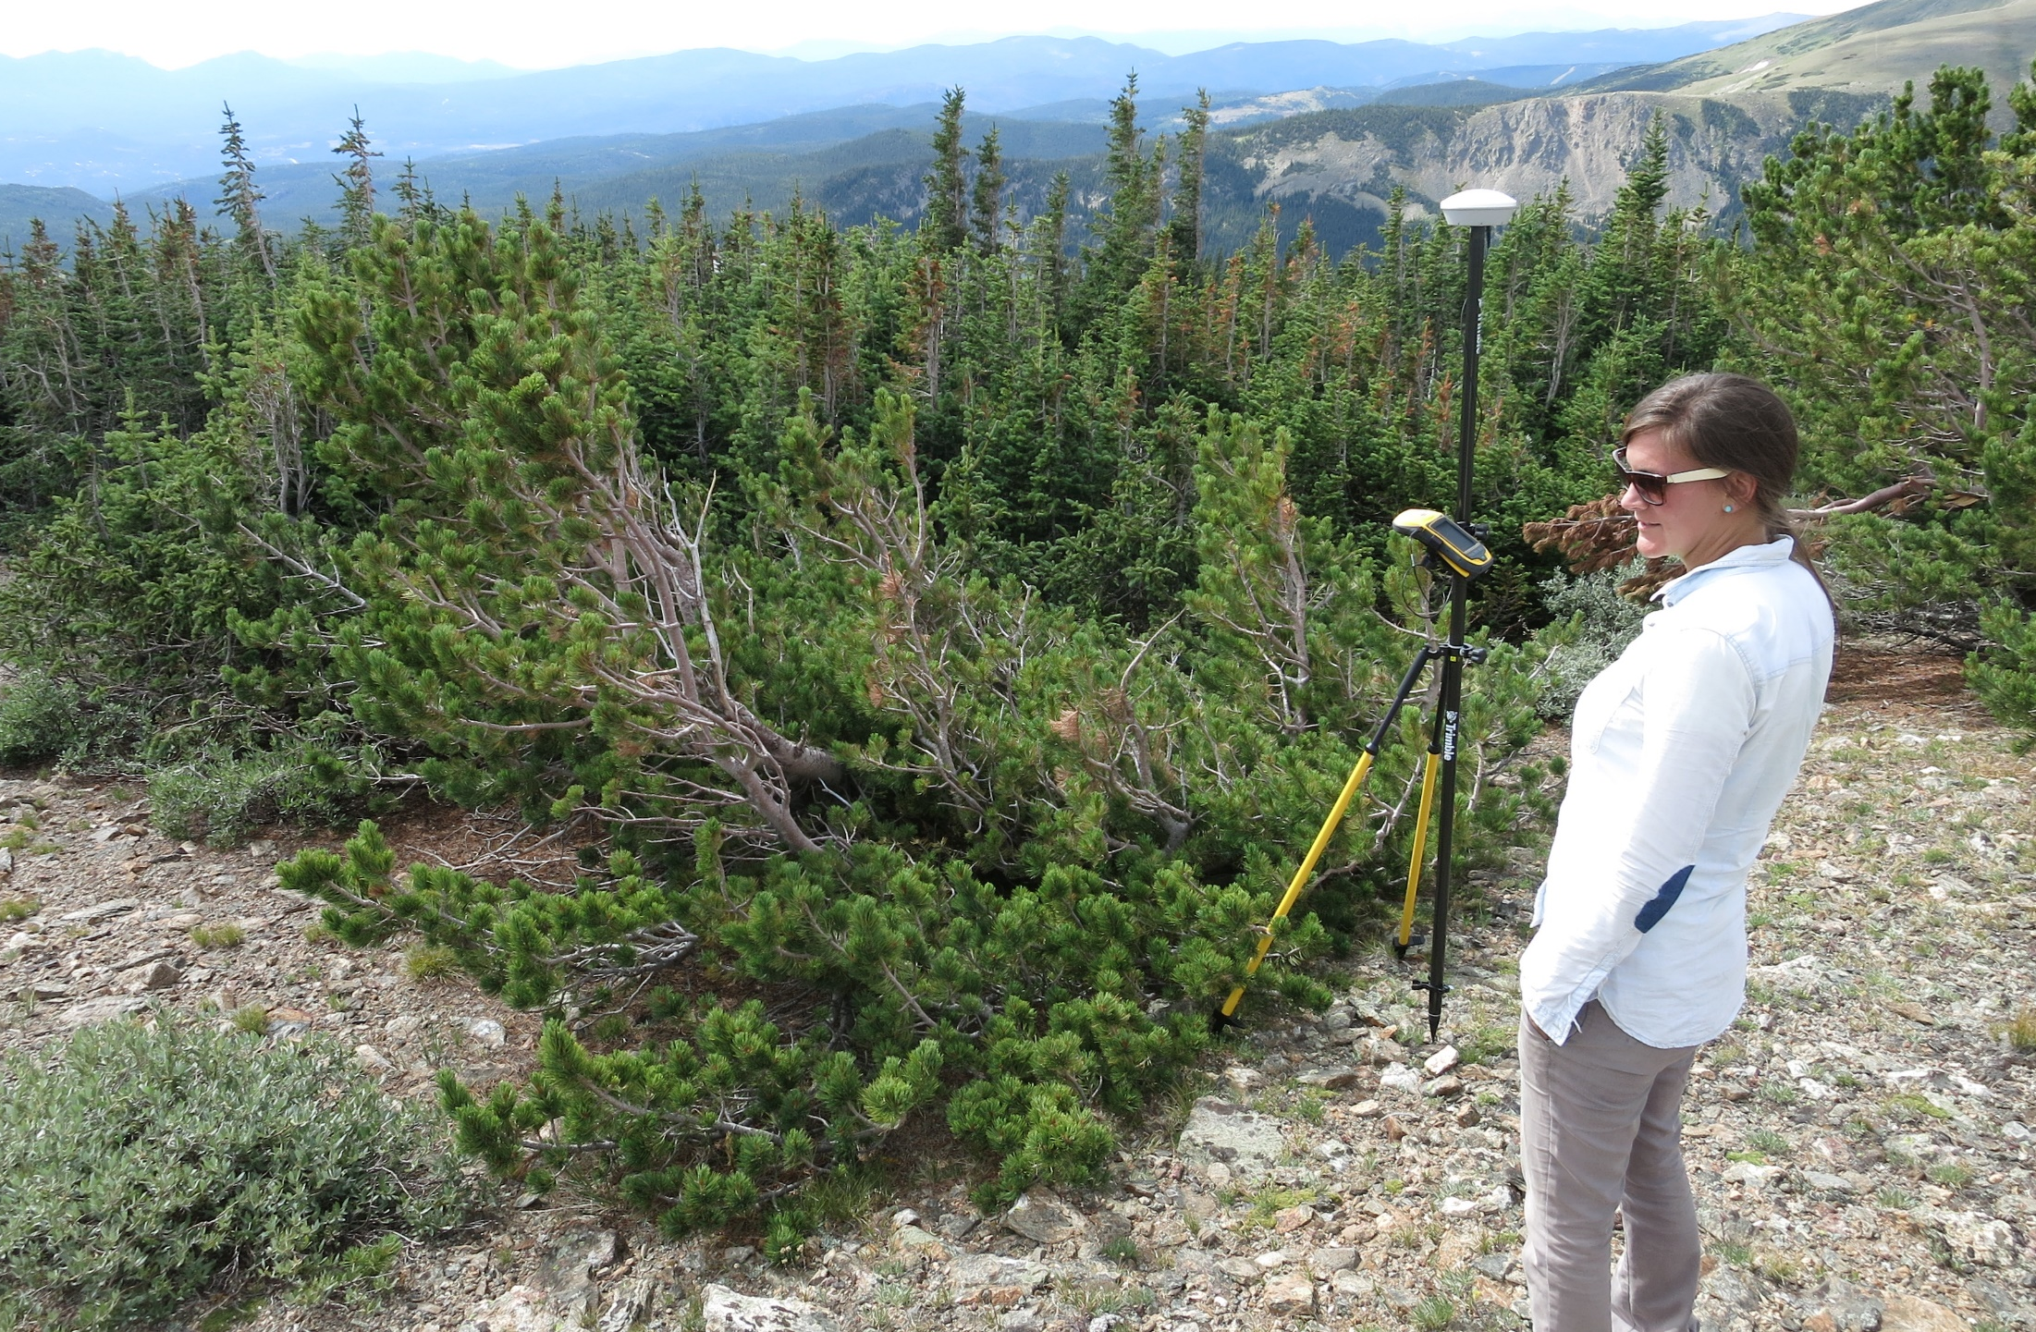
Plot establishment at NIWO

Slide 3
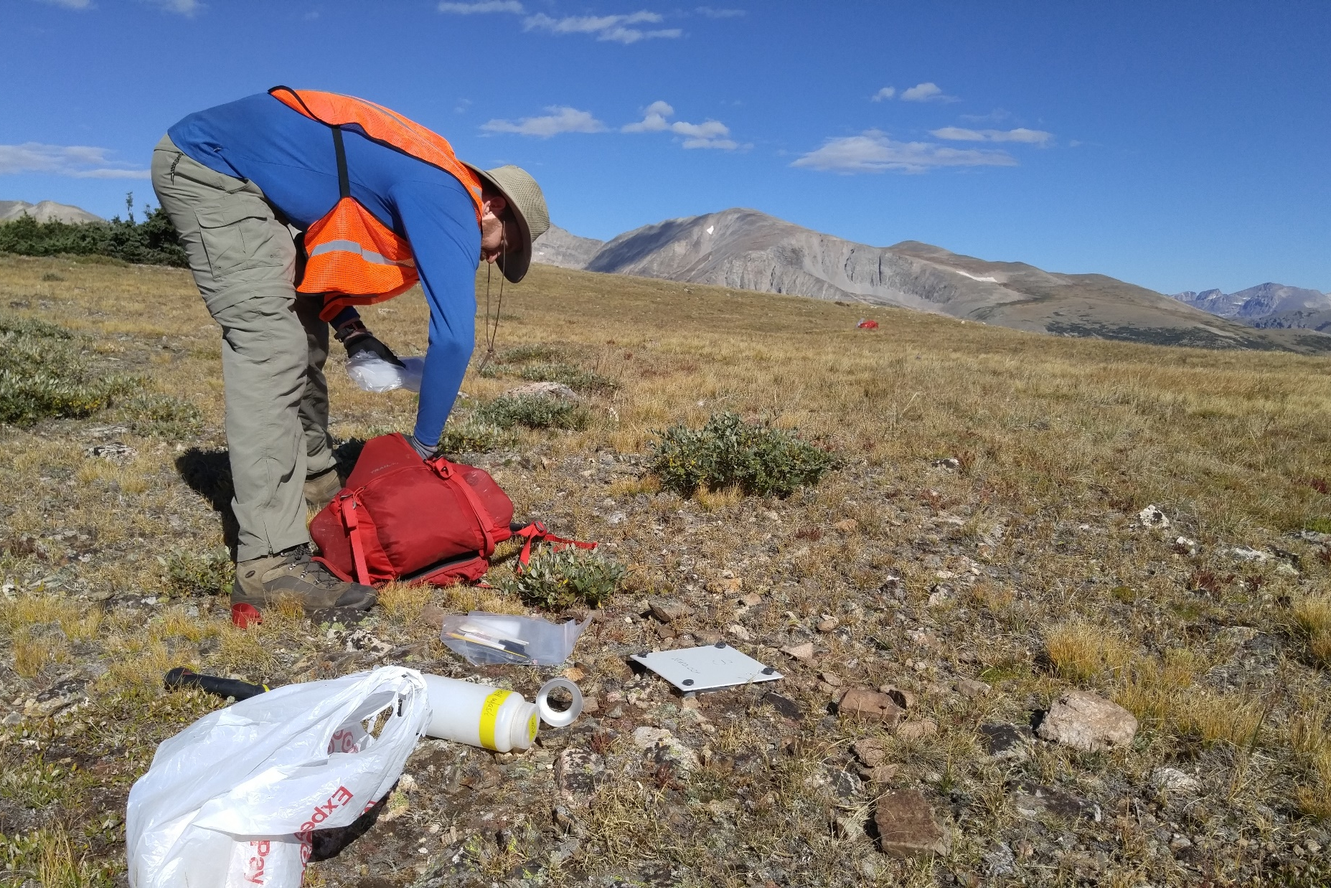
Terrestrial Observation System (TOS)
Beetle collections at NIWO
Notes:
Beetles are collected every 2 weeks, start and ending of sampling is dictated by when plants at the sites begin and end their growing season. Our sites range from 6-10 collections/site/year. Collected beetles are brought back into the lab for processing and identification. Samples are then shipped to taxonomists…

Slide 4
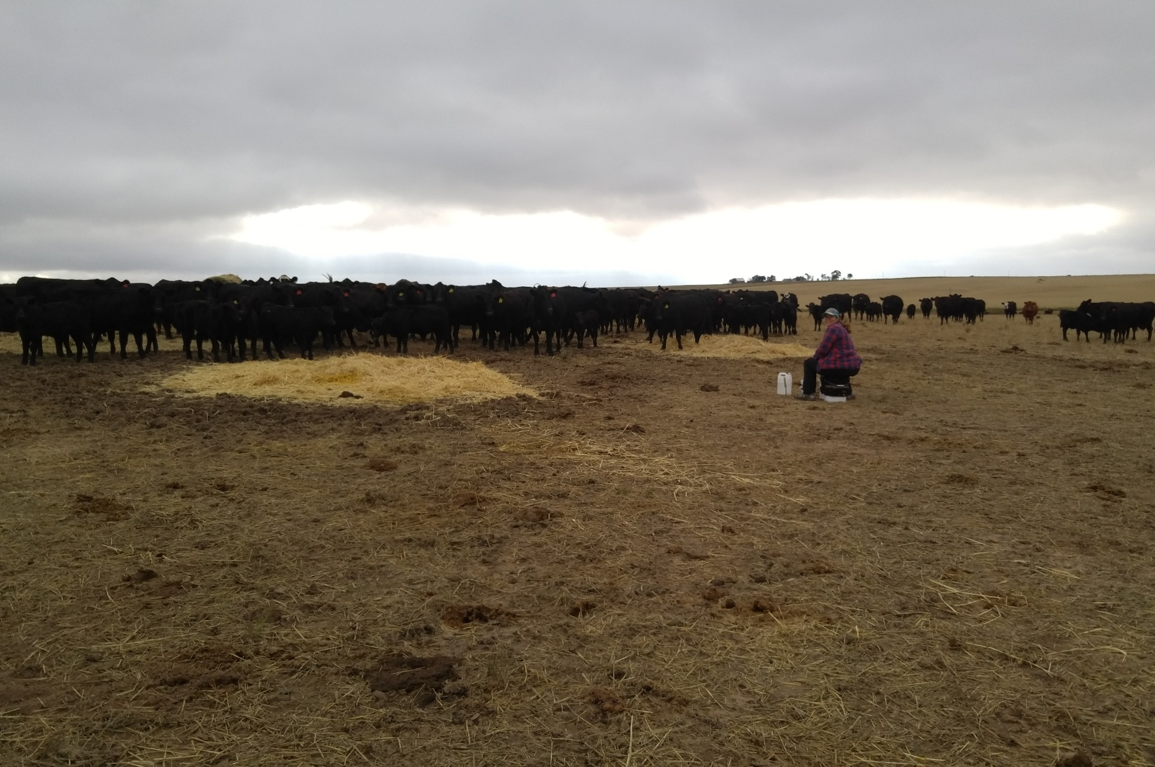
Terrestrial Observation System (TOS)
Beetle collections at STER
Beetle collections at NIWO

Slide 5
Mosquito collections at CPER
Notes:
Mosquitoes are samples to gather data on species abundance, diversity, and pathogen presence. Mosquitoes are sampled bi-weekly at core sites and monthly at relocatable sites. Samples are transported from the field on dry ice, stored in ultra-low freezers in the lab, and then shipped to external laboratories for species identification and pathogen analyses.

Slide 6
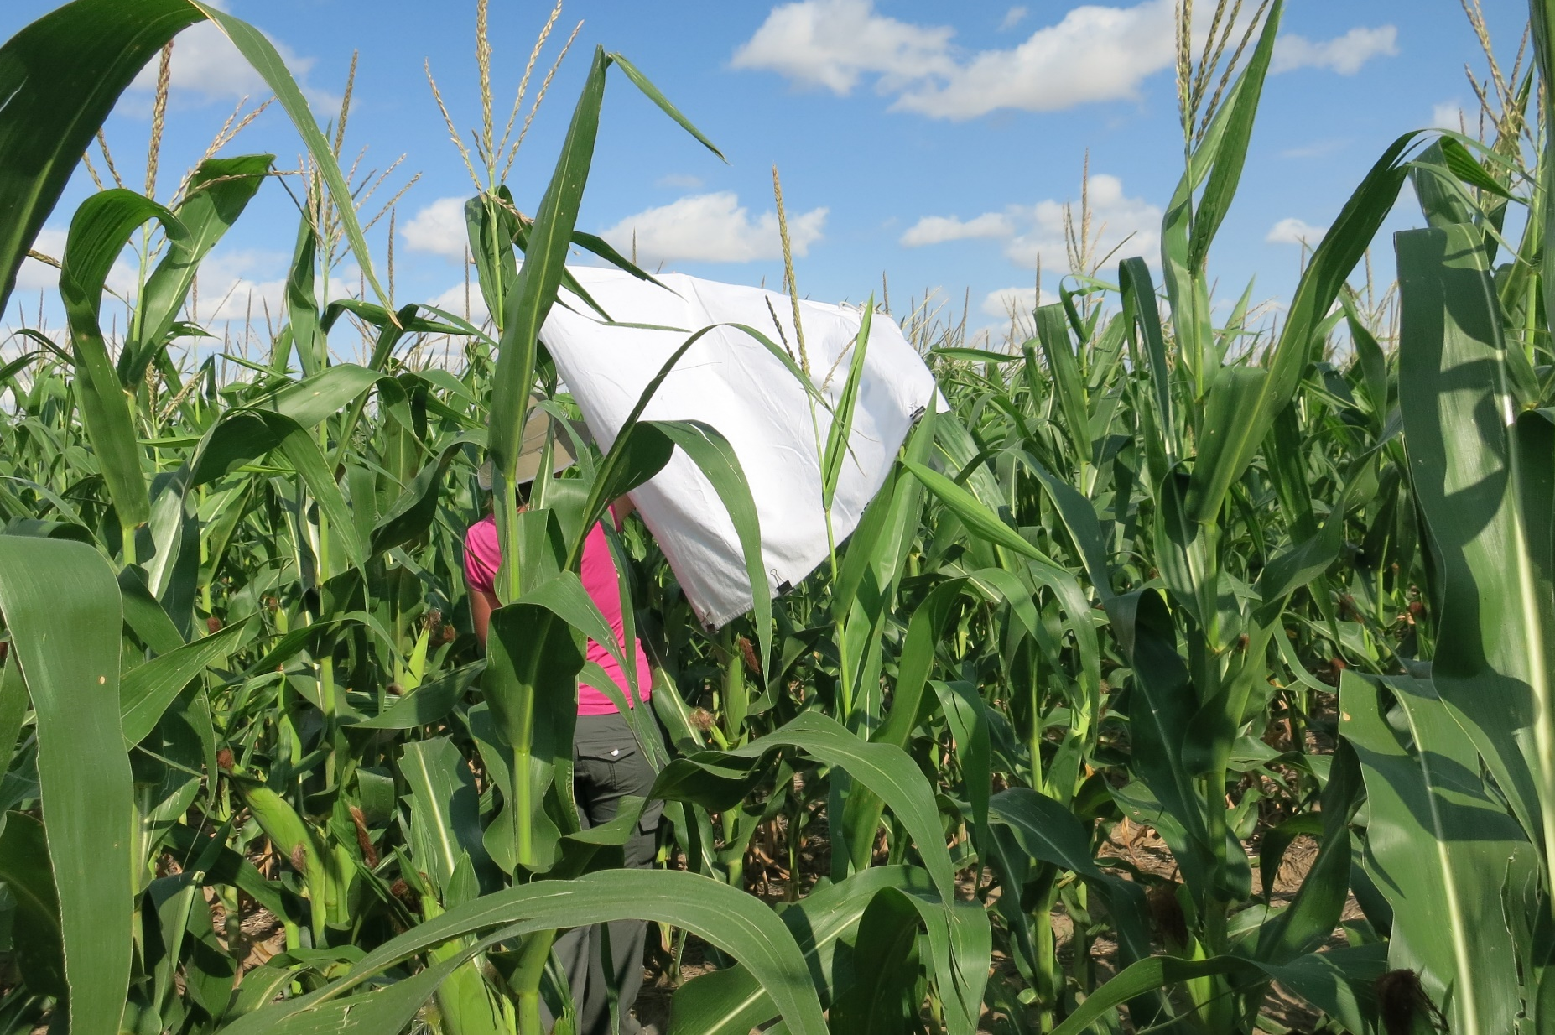
Tick dragging at STER
Beetle collections at NIWO
Notes:
Ticks are sampled at all sites at either 3 or 6 week intervals.

Slide 7
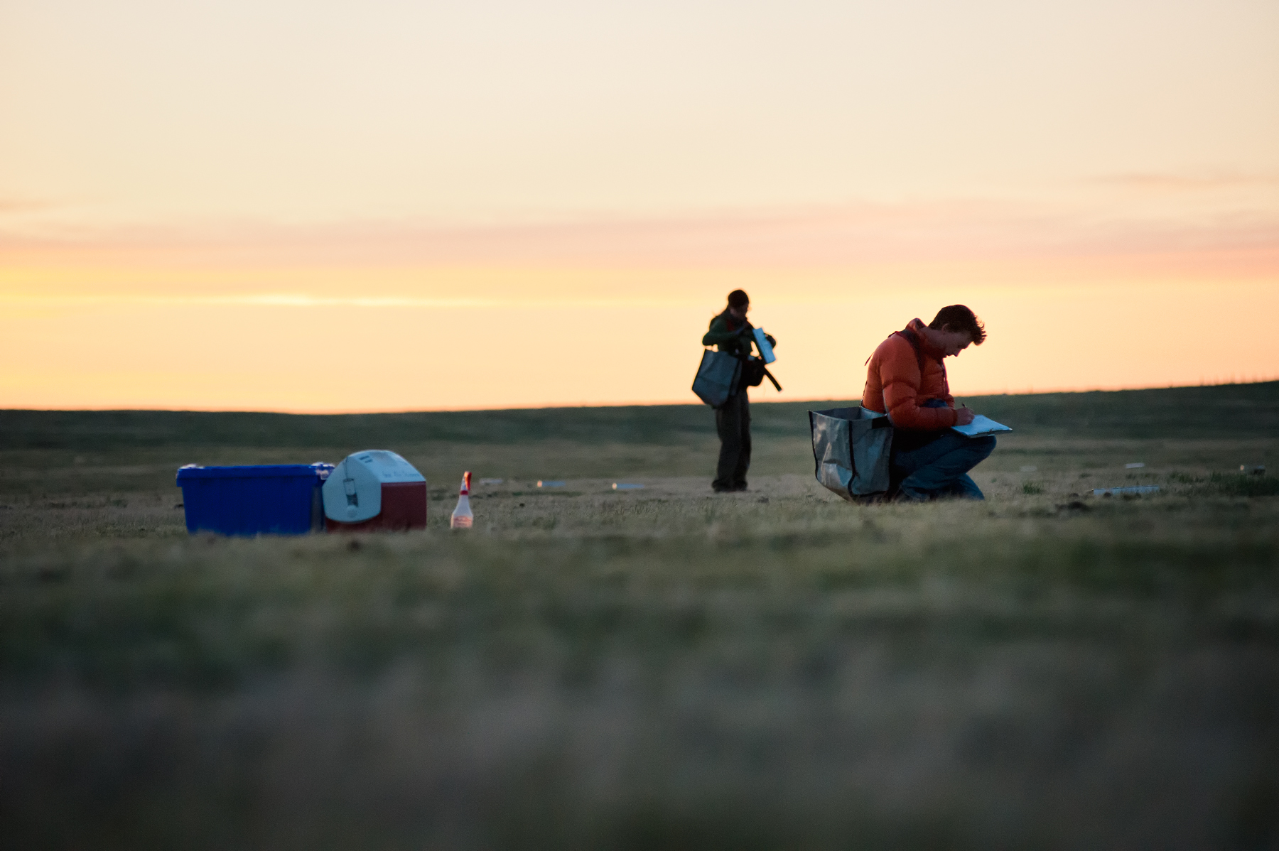
Early morning small mammal trapping at CPER
Notes:
Small mammal sampling is conducted around the new moon. We sampling monthly at core sites (CPER and NIWO) and bi-monthly at relocatables (STER, RMNP). The goal is to conduct 6 trapping bouts at core sites and 4 at relocatables.

Slide 8
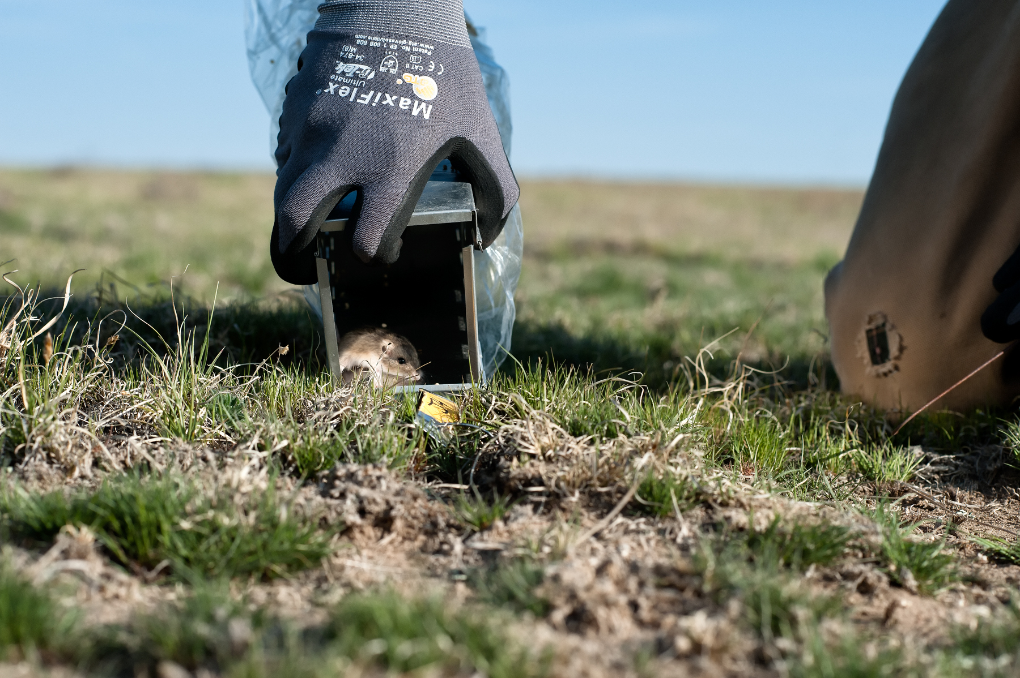
small mammal trapping at CPER

Slide 9
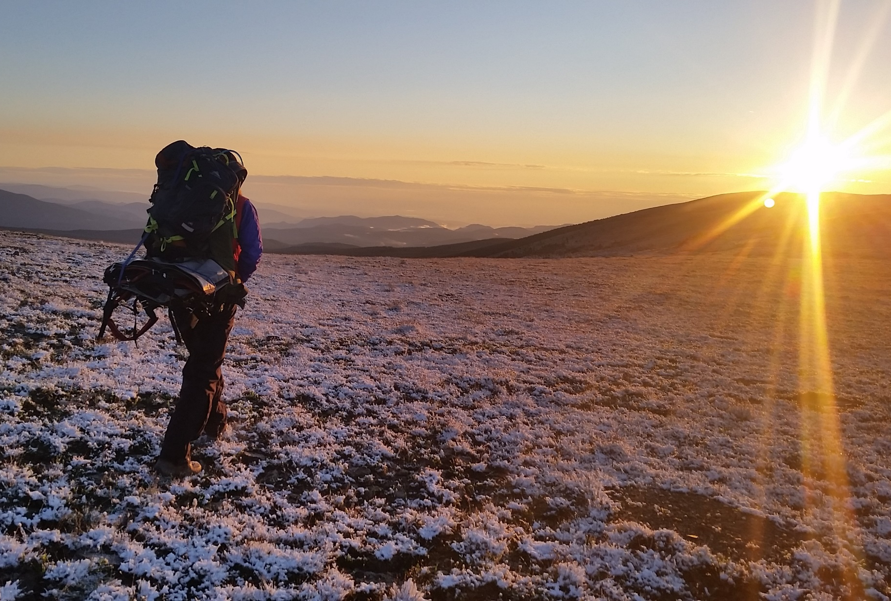
Small mammal trapping at NIWO

Slide 10
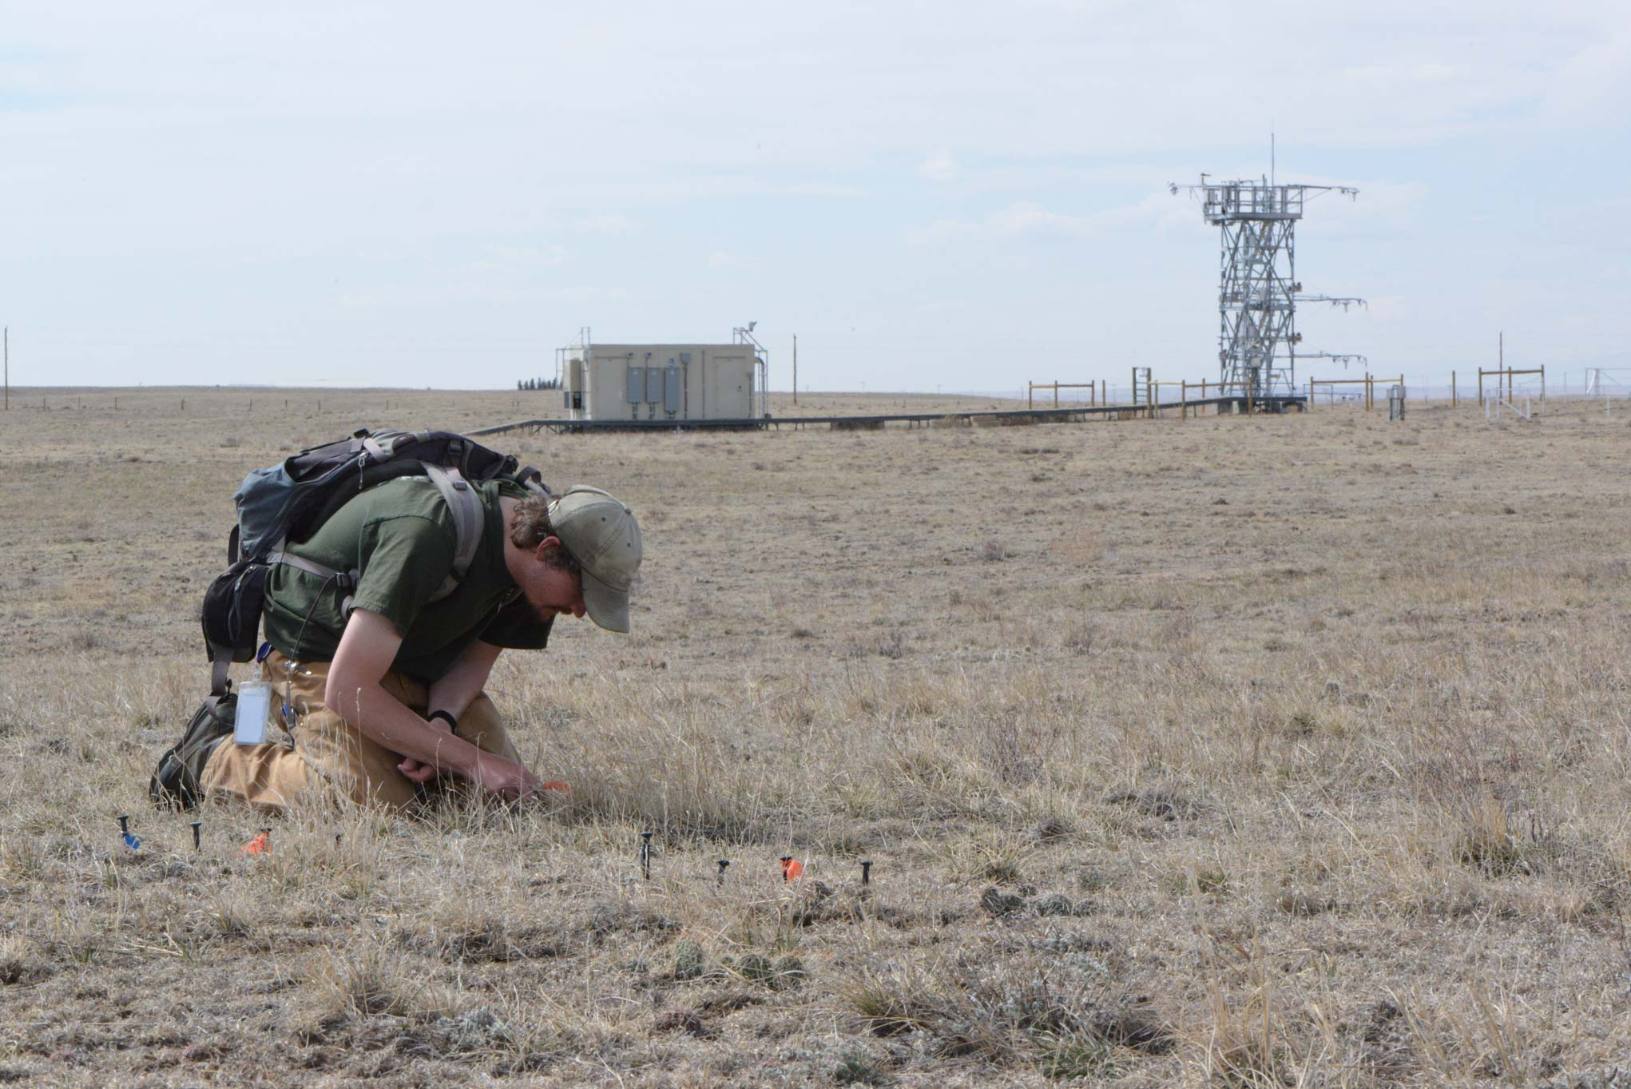
Terrestrial Observation System (TOS)
Plant phenology at CPER

Slide 11
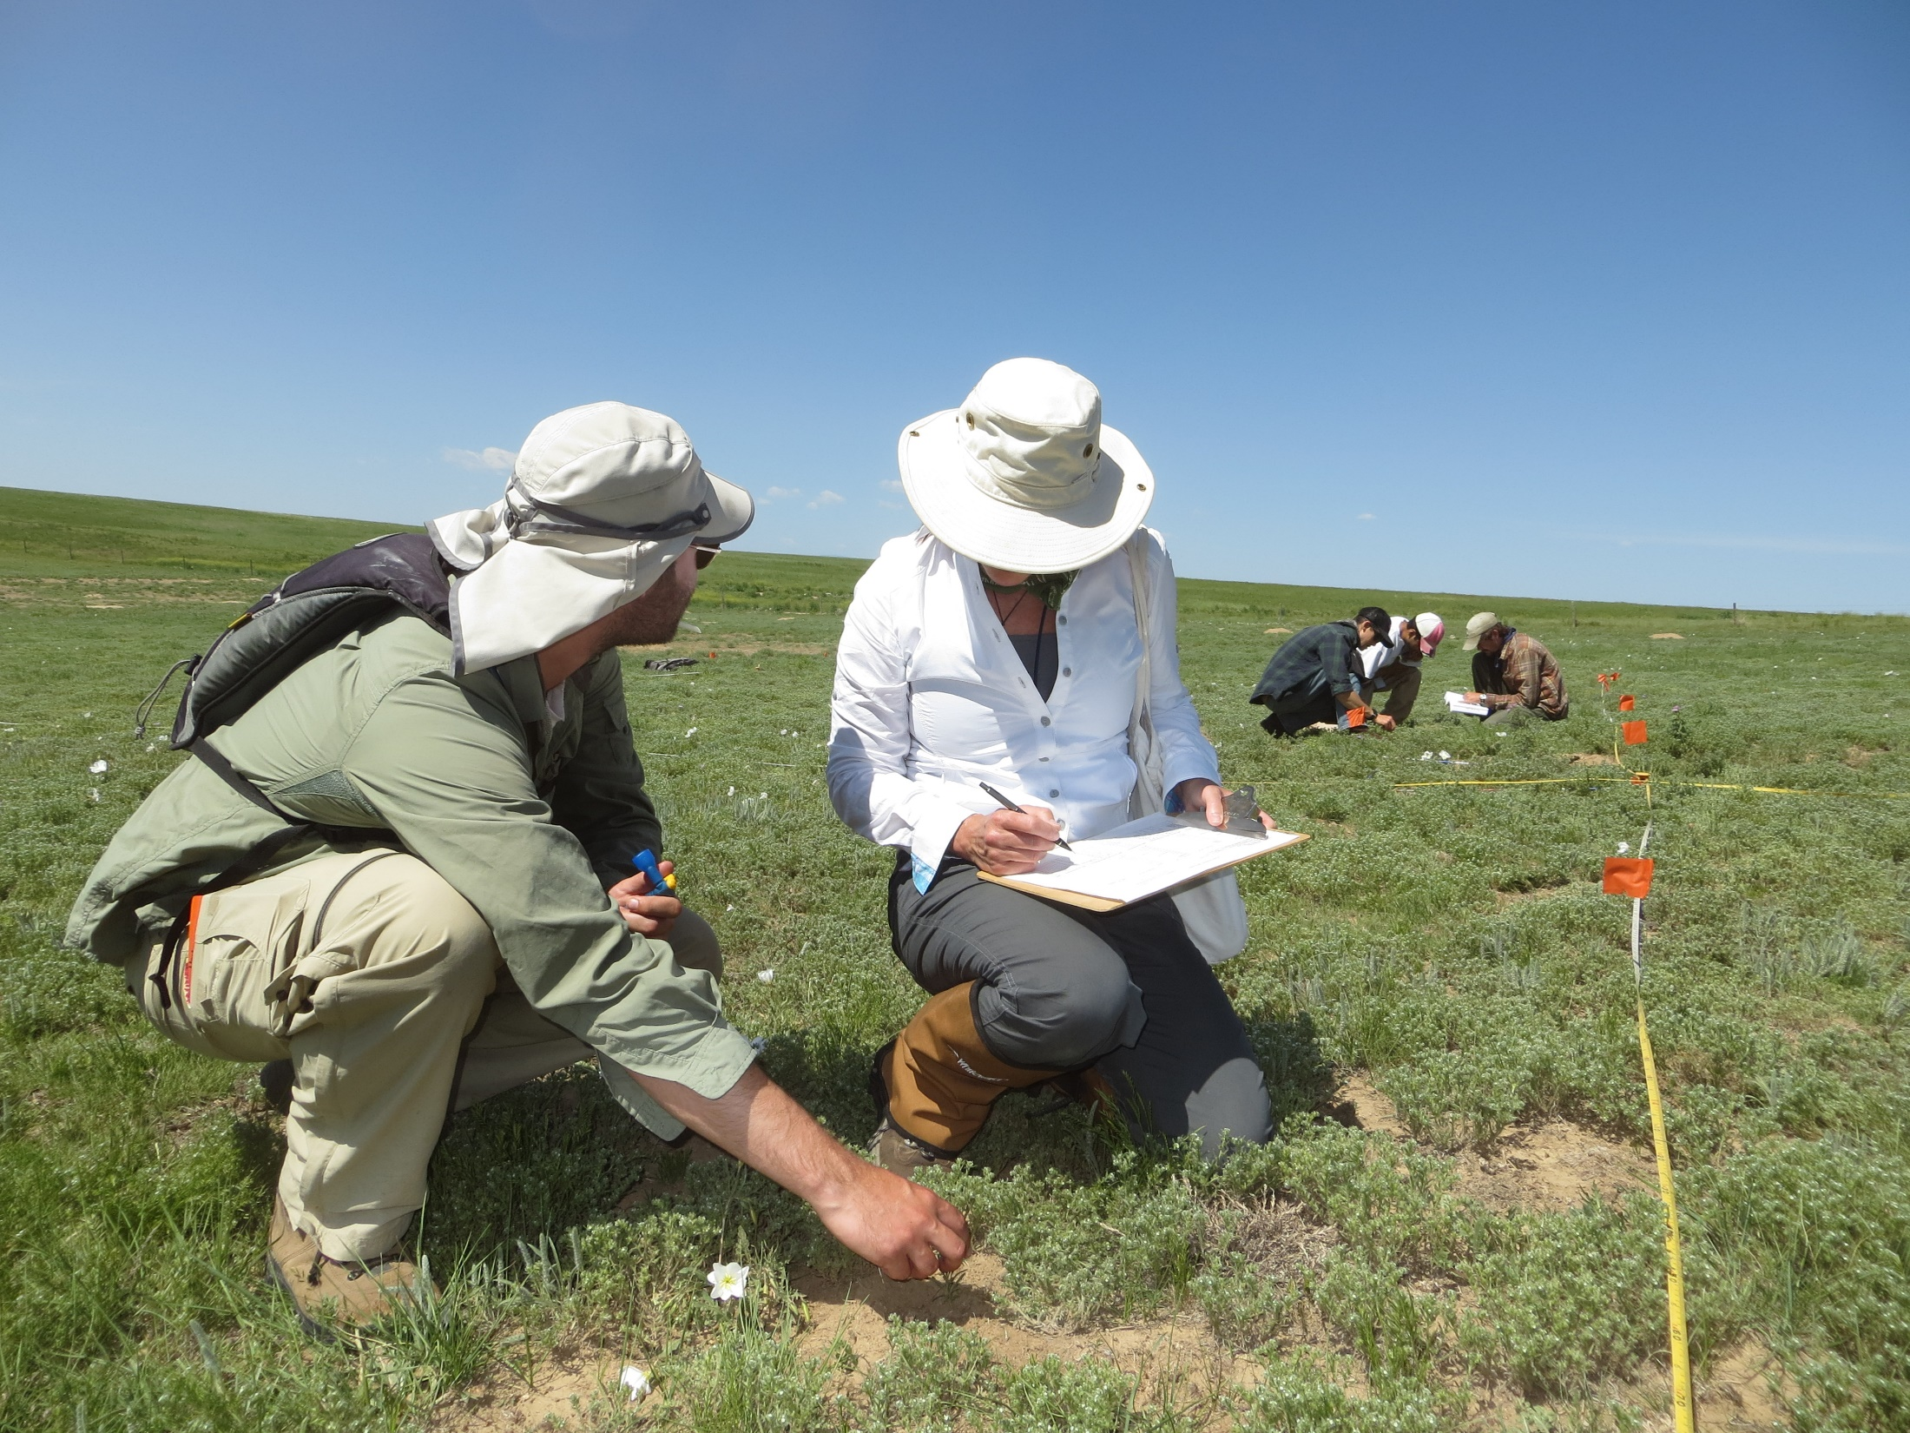
Plant diversity at CPER

Slide 12
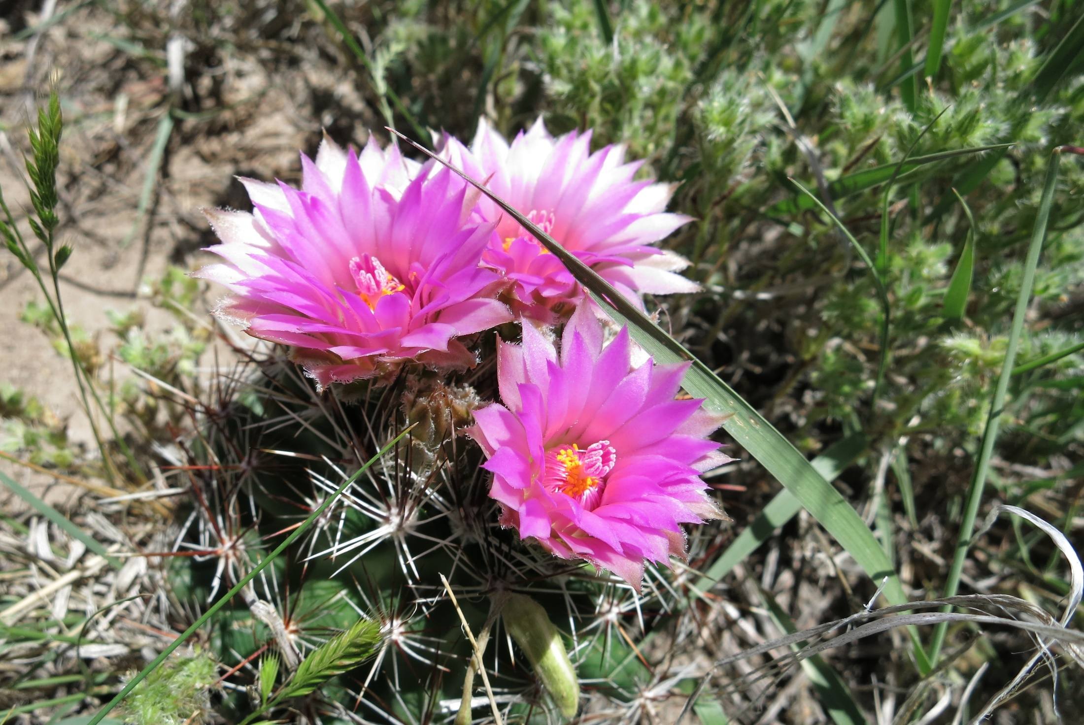
Terrestrial Observation System (TOS)
Plant diversity at CPER

Slide 13
Herbaceous clip harvest at CPER

Slide 14
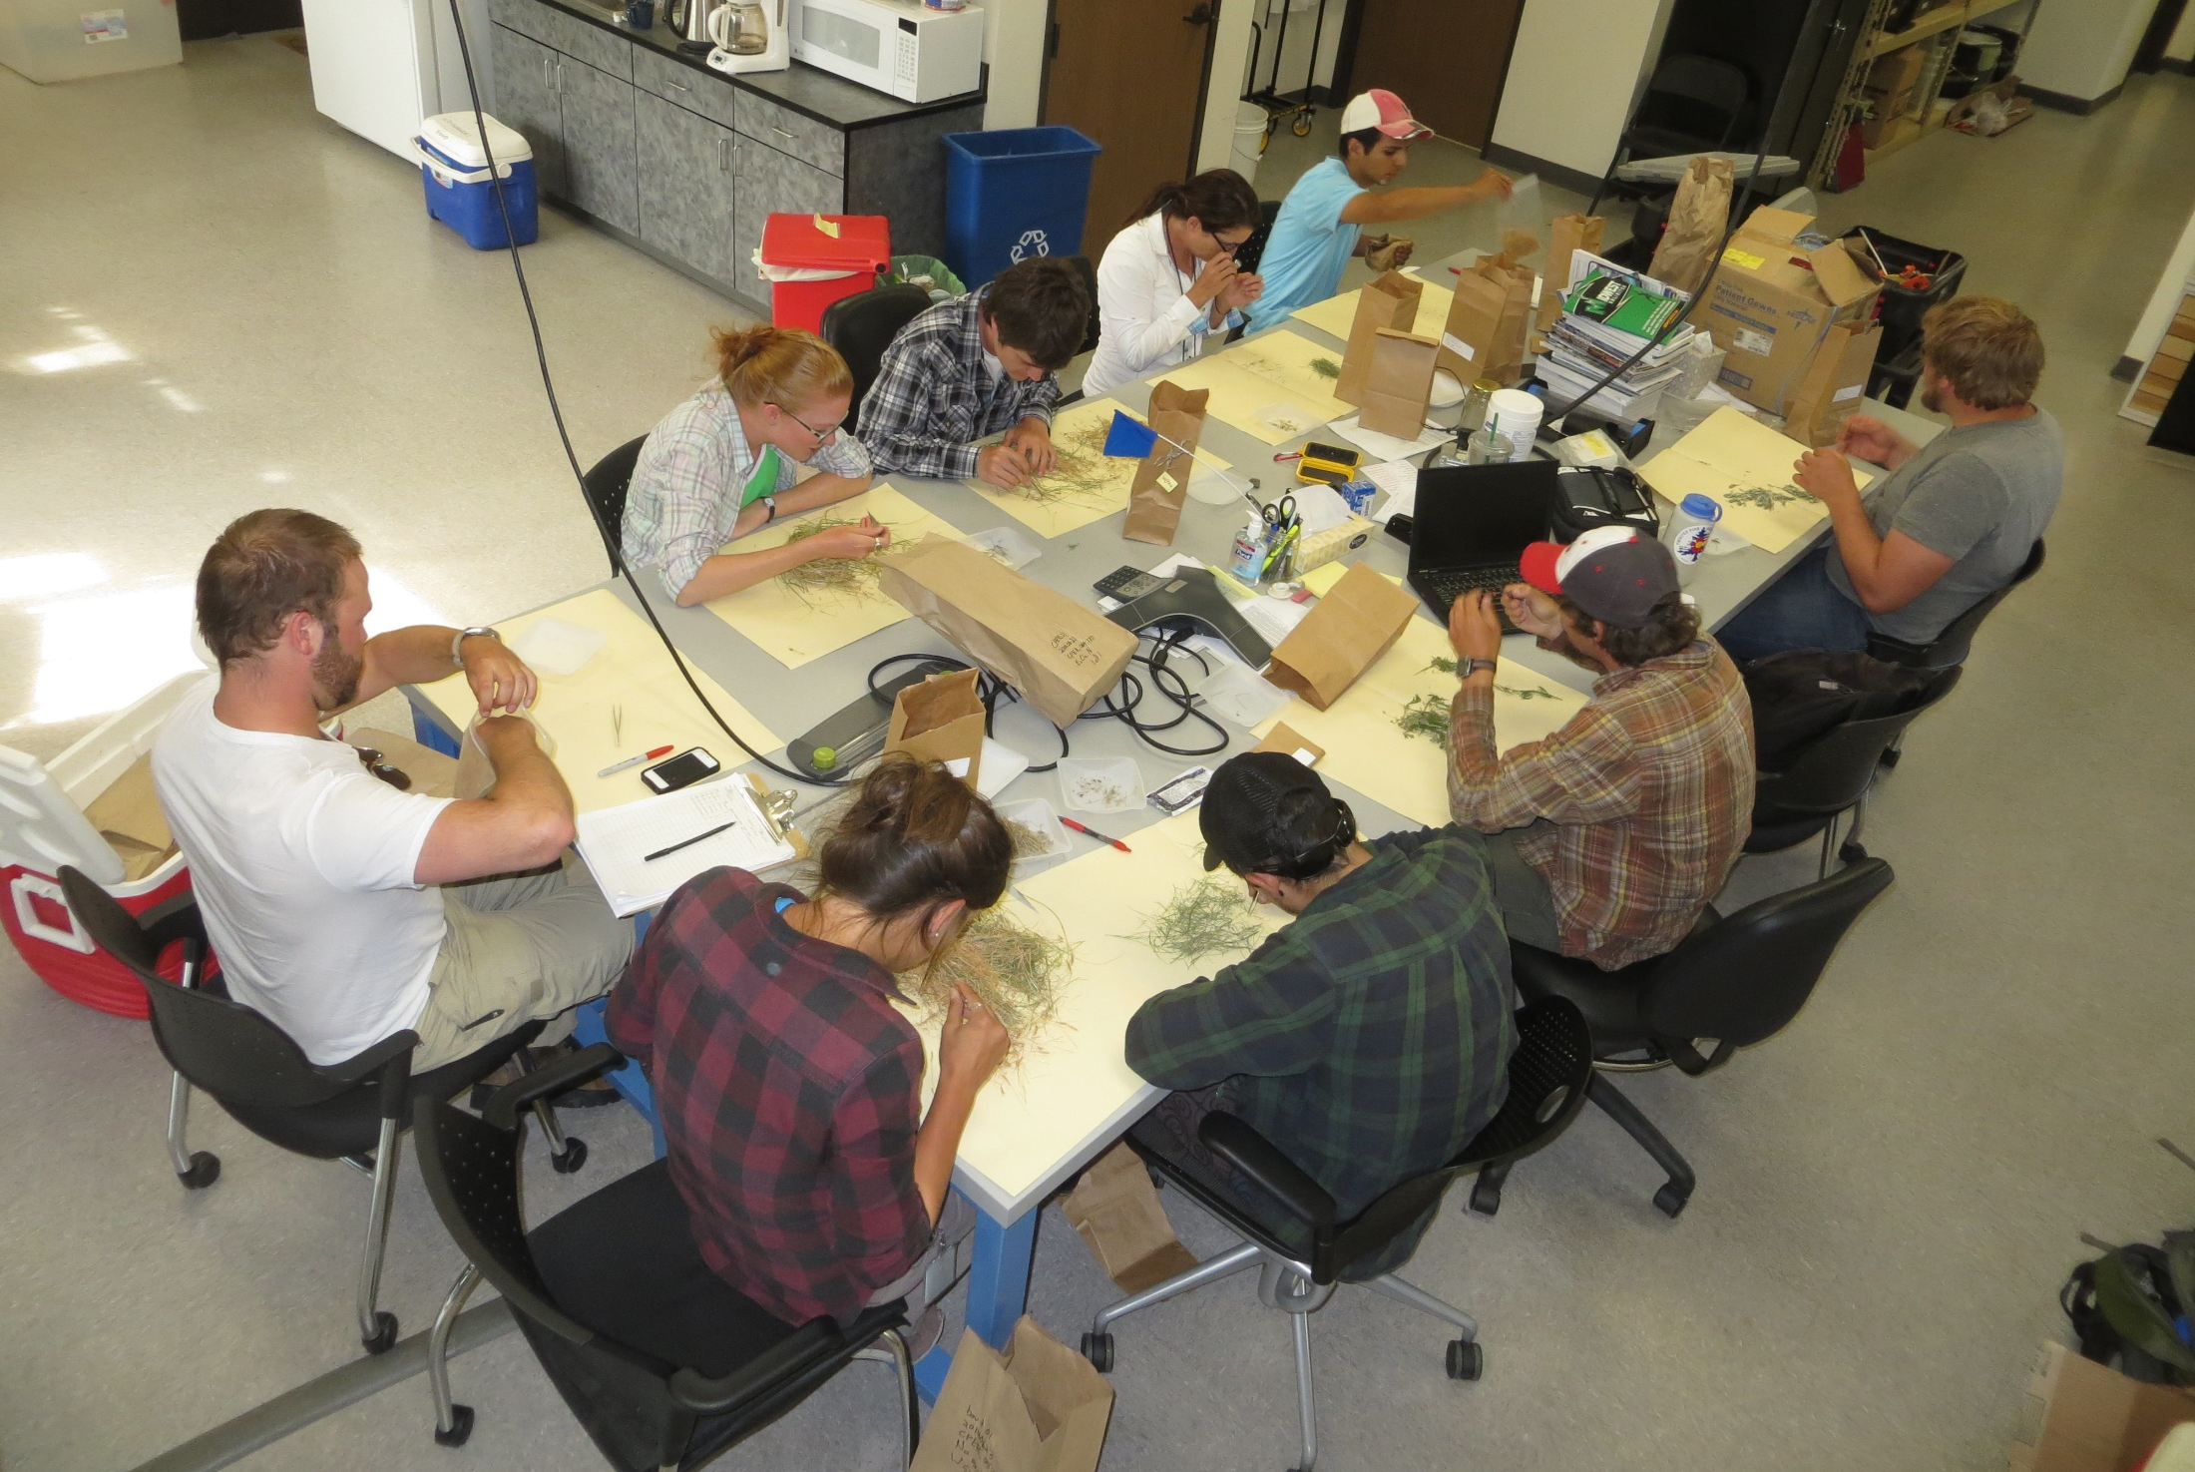
Sorting herbaceous clip harvest in the lab

Slide 15
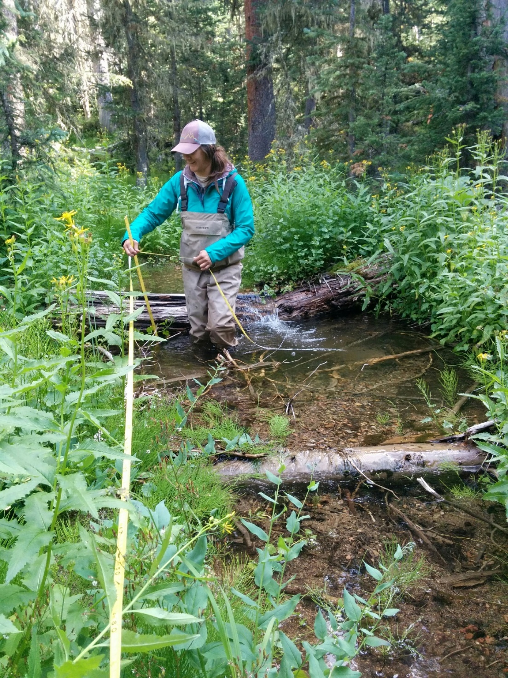
Riparian surveys

Slide 16
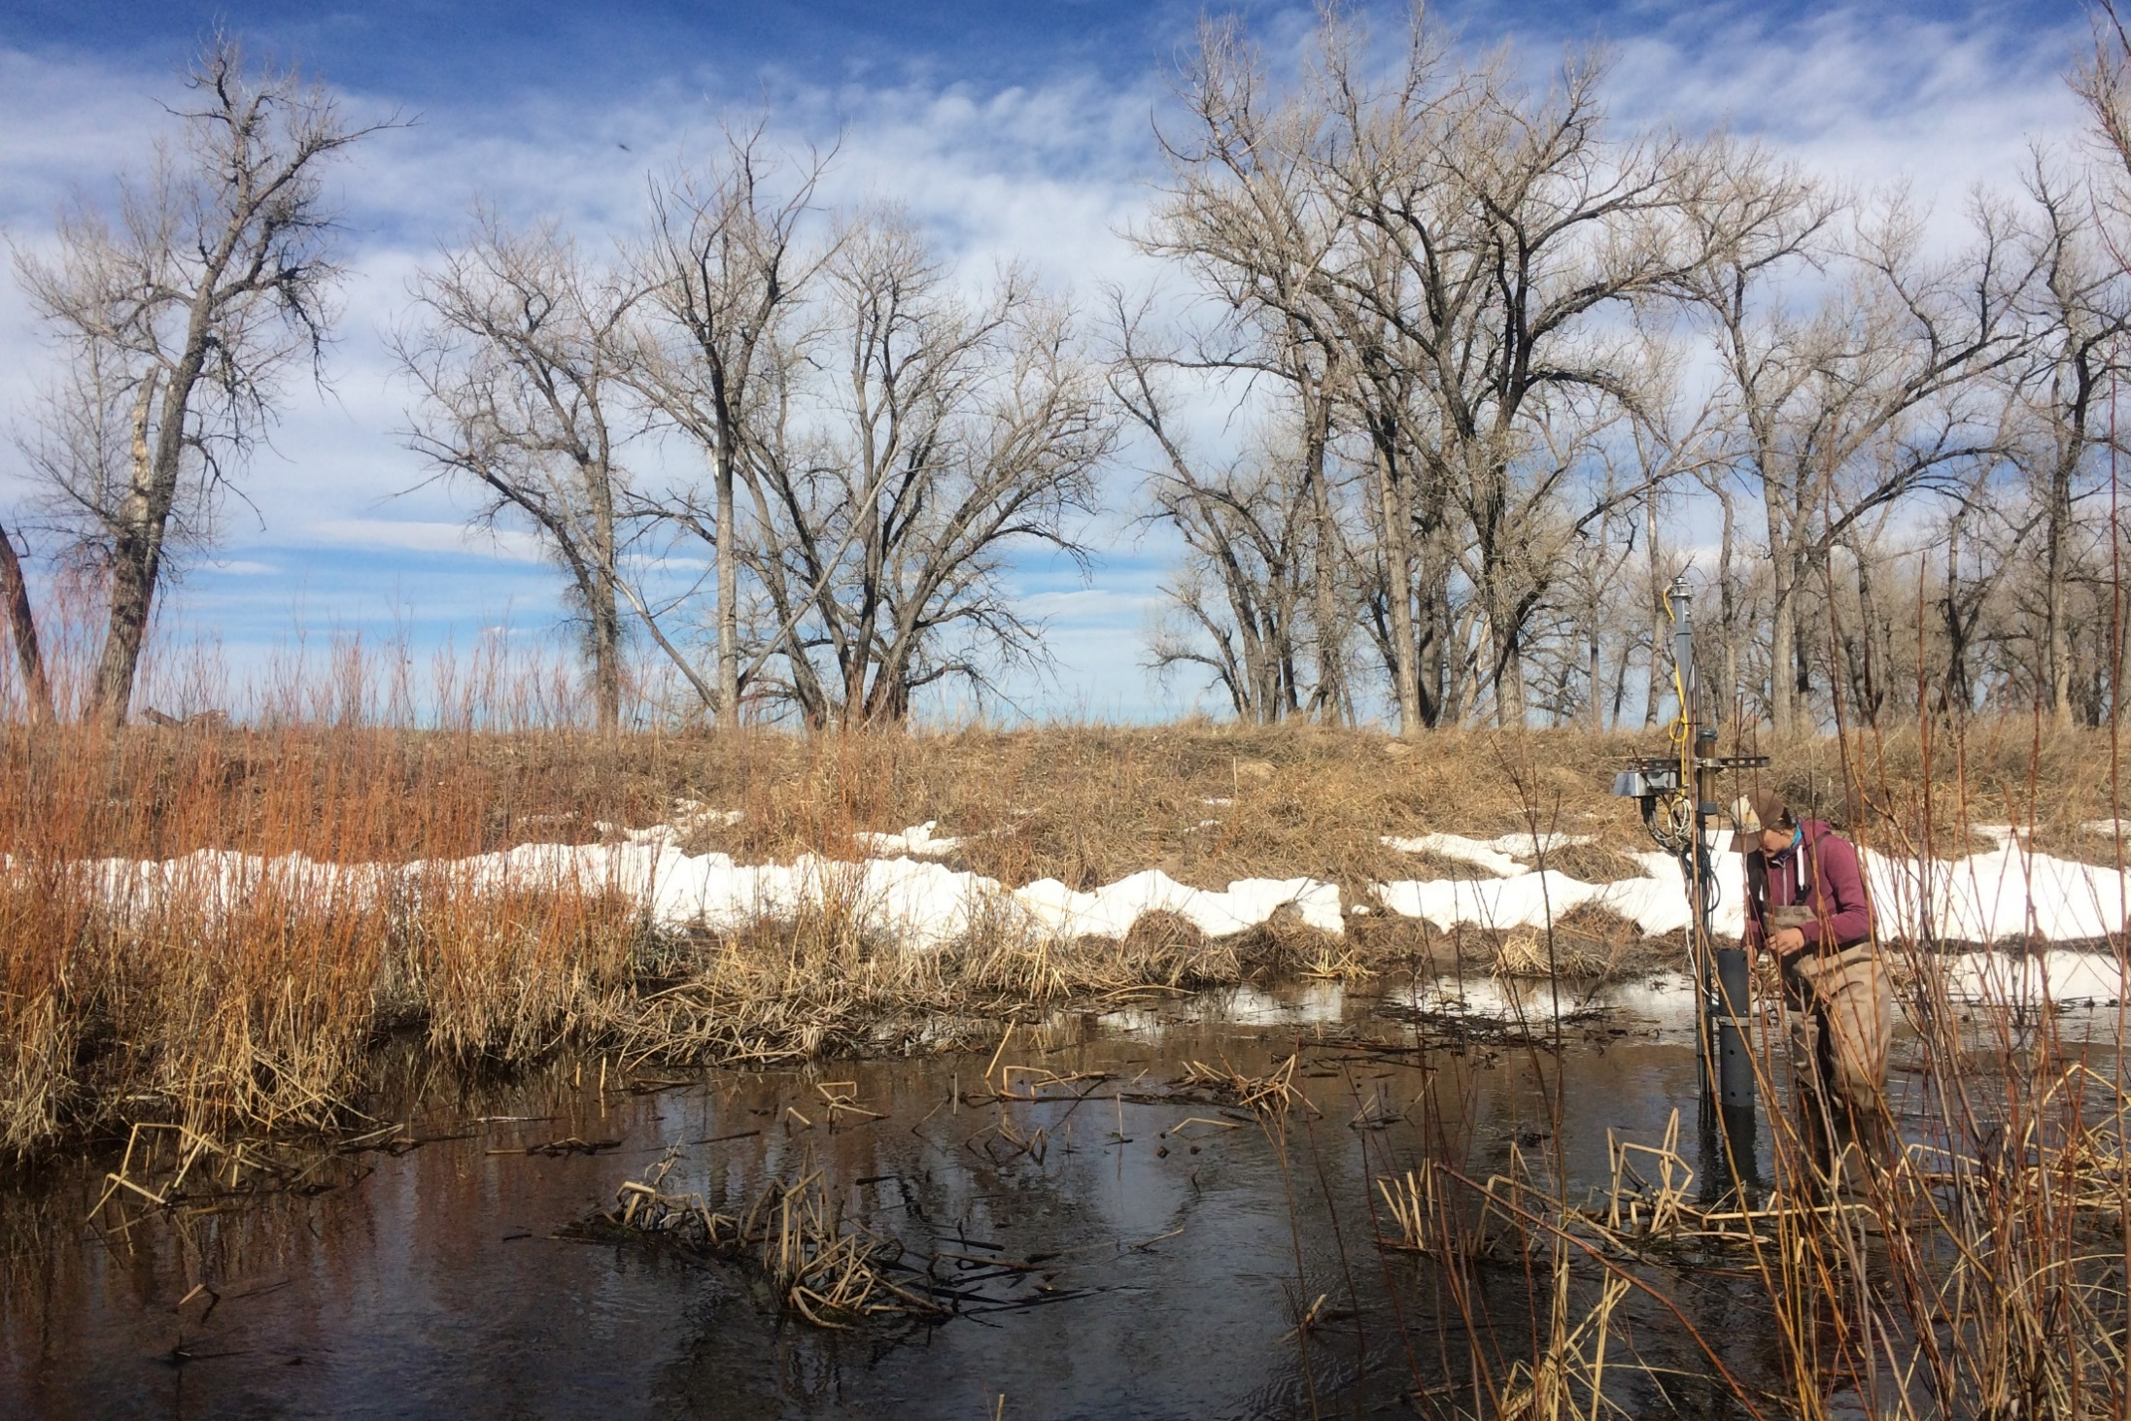
Preventative maintenance of in-stream sensors at ARIK
Notes:
Preventative maintenance is conducted bi-weekly and corrective maintenance as needed.

