Slide 1
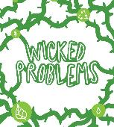

An Invitation to Modeling: Exploring the Process of Science through the Process of Modeling
Kam D. Dahlquist (Loyola Marymount University) Carrie D. Eaton (Bates College)
June 19, 2018

Slide 2
Think – Write – Pair – Share
What is a model?
What is modeling?

Slide 3
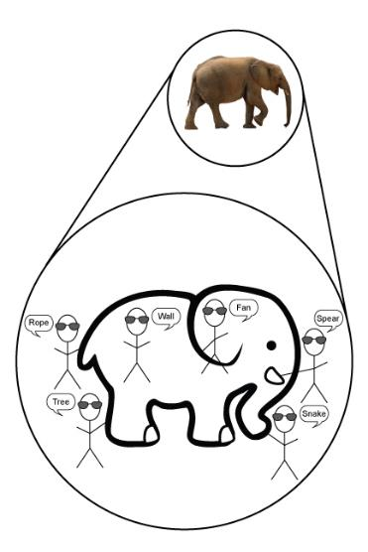
A model is a simplified, abstract or concrete representation of relationships and/or processes in the real world, constructed for some purpose
  Models can serve several purposes:
  Models are used to communicate ideas between scientists.
  Simple, unrealistic models help scientists explore complex systems.
  Models can lead to the development of conceptual frameworks and causal explanations (i.e., understanding)
  Models can make accurate predictions.
Eaton et al. (2018); Odenbaugh (2005)

Slide 4
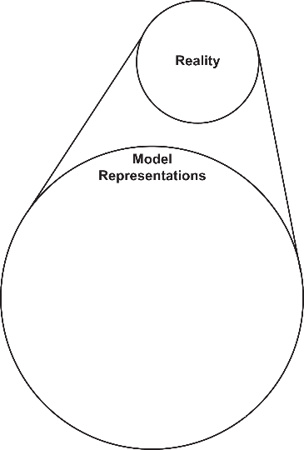
We aim to be both more expansive and more inclusive of what counts as models
What’s the big deal?
Models are not only formulas.
Understanding is strengthened when students can make connections between different representations.
Students may prefer working with certain representations, but benefit most from seeing and using multiple representations and from moving between them.
Experiential
Verbal
Numerical
Symbolic
Visual

Slide 5
Verbal Representation
Hypothesis: A mutation in a particular gene will reduce the rate of bacterial growth because the mutation impairs DNA replication.
Prediction: On average global temperature will increase.
Assumption: We assume that the population is well mixed.
Simple descriptions of observations: The rate of increase is decreasing; we observe far more of the blue flower type than the purple flower type.
Qualitative data: Spiciness ratings by tasters of chili peppers.
Experiential
Animations & simulations
Physical models
Experiments & observations
Verbal
Hypotheses
Predictions
Qualitative experimental data
Numerical
Simulated data
Derived data
Quantitative experimental data
Symbolic
Equations
Parameters & state variables
Visual
Graphs
Schematics
Data visualizations

Slide 6
Visual Representation
Graph: relative growth rate versus population
Schematic: SIR epidemic model; stock-and-flow diagrams
Data visualizations: histograms, scatter plots, infographics, etc.
Experiential
Animations & simulations
Physical models
Experiments & observations
Verbal
Hypotheses
Predictions
Qualitative experimental data
Numerical
Simulated data
Derived data
Quantitative experimental data
Symbolic
Equations
Parameters & state variables
Visual
Graphs
Schematics
Data visualizations

Slide 7
Symbolic Representation
a.k.a. mathematical model
Equations: Discrete difference equation for geometric growth x_{n+1} = λx_{n} and continuous differential equation for exponential growth dP/dt = rP
Parameters: If in HWE, p = frequency of one allele, p² = frequency of homozygotes for that allele
State variable: P(t) = population at time t (in years)
Equation (stats): linear regression
Equation (stats): probability distribution
Experiential
Animations & simulations
Physical models
Experiments & observations
Verbal
Hypotheses
Predictions
Qualitative experimental data
Numerical
Simulated data
Derived data
Quantitative experimental data
Symbolic
Equations
Parameters & state variables
Visual
Graphs
Schematics
Data visualizations

Slide 8
Numerical Representation
Simulated data: Numbers of infected individuals calculated from a Symbolic epidemic model
Derived data: low density growth rate and carrying capacity calculated from plotting relative growth rate versus population for logistic growth
Quantitative Experimental Data: Measured population counts from experiments
Experiential
Animations & simulations
Physical models
Experiments & observations
Verbal
Hypotheses
Predictions
Qualitative experimental data
Numerical
Simulated data
Derived data
Quantitative experimental data
Symbolic
Equations
Parameters & state variables
Visual
Graphs
Schematics
Data visualizations

Slide 9
Experiential Representation
Animations & simulations:
A video of bacterial growth; beanbag biology; virtual laboratories (e.g, SimBio, the BUGBOX-predator virtual laboratory)
Experiential
Animations & simulations
Physical models
Experiments & observations
Verbal
Hypotheses
Predictions
Qualitative experimental data
Numerical
Simulated data
Derived data
Quantitative experimental data
Symbolic
Equations
Parameters & state variables
Visual
Graphs
Schematics
Data visualizations
Notes:
I had an extra slide for this one in case this hyperlink didn’t work or if we didn’t have internet.

Slide 10
Experiential Representation
Animations & simulations:
A video of bacterial growth; beanbag biology; virtual laboratories (e.g, SimBio, the BUGBOX-predator virtual laboratory)
Experiential
Animations & simulations
Physical models
Experiments & observations
Verbal
Hypotheses
Predictions
Qualitative experimental data
Numerical
Simulated data
Derived data
Quantitative experimental data
Symbolic
Equations
Parameters & state variables
Visual
Graphs
Schematics
Data visualizations
Notes:
I had a movie of this netlogo model in another slide.

Slide 11
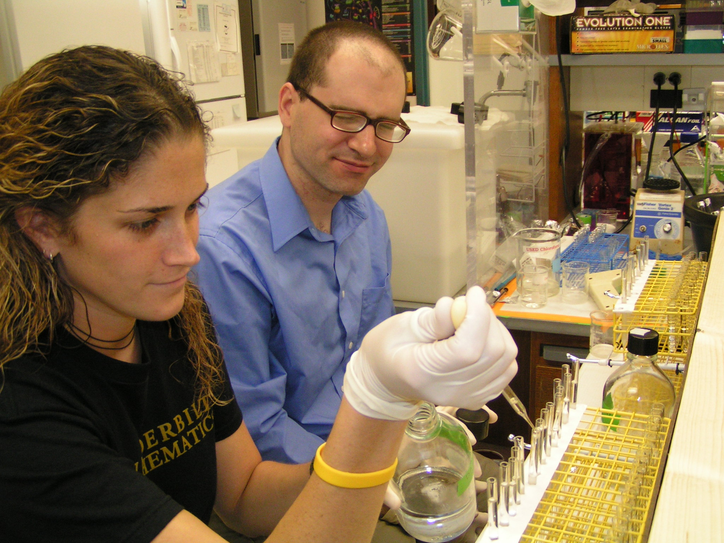
Experiential Representation
Experiments & observations: measure bacterial growth in the laboratory
Experiential
Animations & simulations
Physical models
Experiments & observations
Verbal
Hypotheses
Predictions
Qualitative experimental data
Numerical
Simulated data
Derived data
Quantitative experimental data
Symbolic
Equations
Parameters & state variables
Visual
Graphs
Schematics
Data visualizations

Slide 12
Experiential Representation
Physical model: structure of DNA
Experiential
Animations & simulations
Physical models
Experiments & observations
Verbal
Hypotheses
Predictions
Qualitative experimental data
Numerical
Simulated data
Derived data
Quantitative experimental data
Symbolic
Equations
Parameters & state variables
Visual
Graphs
Schematics
Data visualizations

Slide 13
Multiple Representations of Logistic Growth
Verbal:
  Statements about growth rate: “relative growth rate is a decreasing linear function of population”
  Statements linking math model to biological concepts: “absolute growth rate is proportional to population and the remaining capacity for population growth”
Symbolic: logistic growth equation
Numerical:
  population data
  Absolute and relative growth rates (derived data)
Visual:
  Graph of population size vs time
  Graph of per capita population rate of change vs population size
Experiential: Experiments measuring growth of bacteria
  Actual lab experiment
  Manipulating a simulation
  Viewing results of a time-lapse or animation
  BONUS: no prior knowledge needed

Slide 14
Multiple Representations of Genes

Slide 15
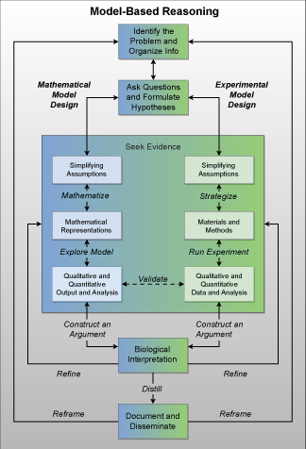
The Process of Science as the Process of Modeling
Dahlquist et al. (2018), submitted

Slide 16
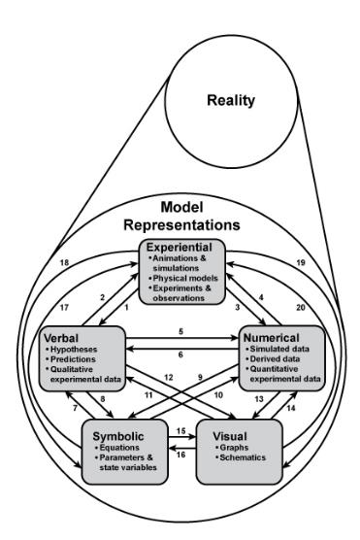
But Really, the Process of Modeling (and Science!) is Messier than That
  We redefine modeling as individual activities such as:
  Moving from observations of reality to a model representation, either as an initial step in developing a model or as part of a model revision;
  Moving from one model representation to another representation of the same model;
  Comparing models to each other (model selection) or to reality (model validation).
  We aim to be both more expansive and more inclusive of what counts as modeling.
Eaton, et al. (2016)

Slide 17
Recommendations for the Introductory Biology Classroom and Beyond
  Be explicit, using authentic modeling language
  Facilitate metacognition: “metamodeling”
  Use anchoring phenomena
  Scaffold the progression to mathematical modeling by moving between representations:
    experiential
    verbal
    visual
    numerical
    symbolic
  Encourage students to ask their own questions
  Provide repeated opportunities to practice

Slide 18
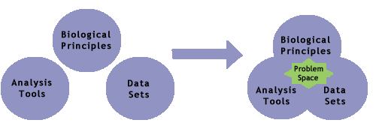
Problem Spaces Are Flexible, Open-Ended, and Dynamic
A brief introduction to a biological problem with references and links to background materials
A collection of “open research questions” that might be addressed
Examples of curricular materials used by other faculty
Data, analysis tools, and other research resources
Example of student work that explore the problem space
http://bioquest.org/bedrock/

Slide 19
Resources & Links
Eaton, C.D., Highlander, H.C., Dahlquist, K.D., LaMar, M.D., Ledder, G., Schugart, R.C. (2018) A “Rule of Five” Framework for Models and Modeling to Unify Mathematicians and Biologists and Improve Student Learning, PRIMUS: Problems, Resources, and Issues in Mathematics Undergraduate Studies, in press, preprint available at https://arxiv.org/abs/1607.02165v2
Dahlquist, K.D., Aikens, M.L., Dauer, J.T., Donovan, S.S., Eaton, C.D., Highlander, H.C., Jenkins, K.P., Jungck, J.R., LaMar, M.D., Ledder, G., Mayes, R.L., Schugart, R.C. (2018) Peeking into the Black Box: Modeling as an Epistemic Tool for Building Student Disciplinary Knowledge and Scientific Inquiry Skills, submitted to CBE—Life Sciences Education on 8 May 2018, under review. Available on QUBESHub at https://qubeshub.org/qubesresources/collections/post/5544/download/Dahlquist-et-al_Peeking-into-Black-Box_2018-05-08_submitted-version.pdf
  An earlier version of this manuscript is available as a preprint at PeerJ Preprints 5:e3215v1 https://doi.org/10.7287/peerj.preprints.3215v1.
Carrie’s HWE model lesson plan: https://docs.google.com/document/d/1Re58_Gs1SMEEPhXUwcvgblpHG2mC6LT0vzhigjtPBoA/edit
PopGen: http://www.radford.edu/~rsheehy/Gen_flash/popgen/
Glenn’s Resource-limited Population Growth materials: https://qubeshub.org/collections/post/3101

