Slide 1
Are you interested in helping your students develop stronger mathematical intuition and quantitative reasoning skills?
1
of 10

Slide 2
Have you tried using online modules with mixed success?
Or are you thinking about using online modules but wondering how best to incorporate them into your course?
2
of 10

Slide 3
FMN: Building mathematical intuition with online MathBench Biology Modules
3
of 10

Slide 4
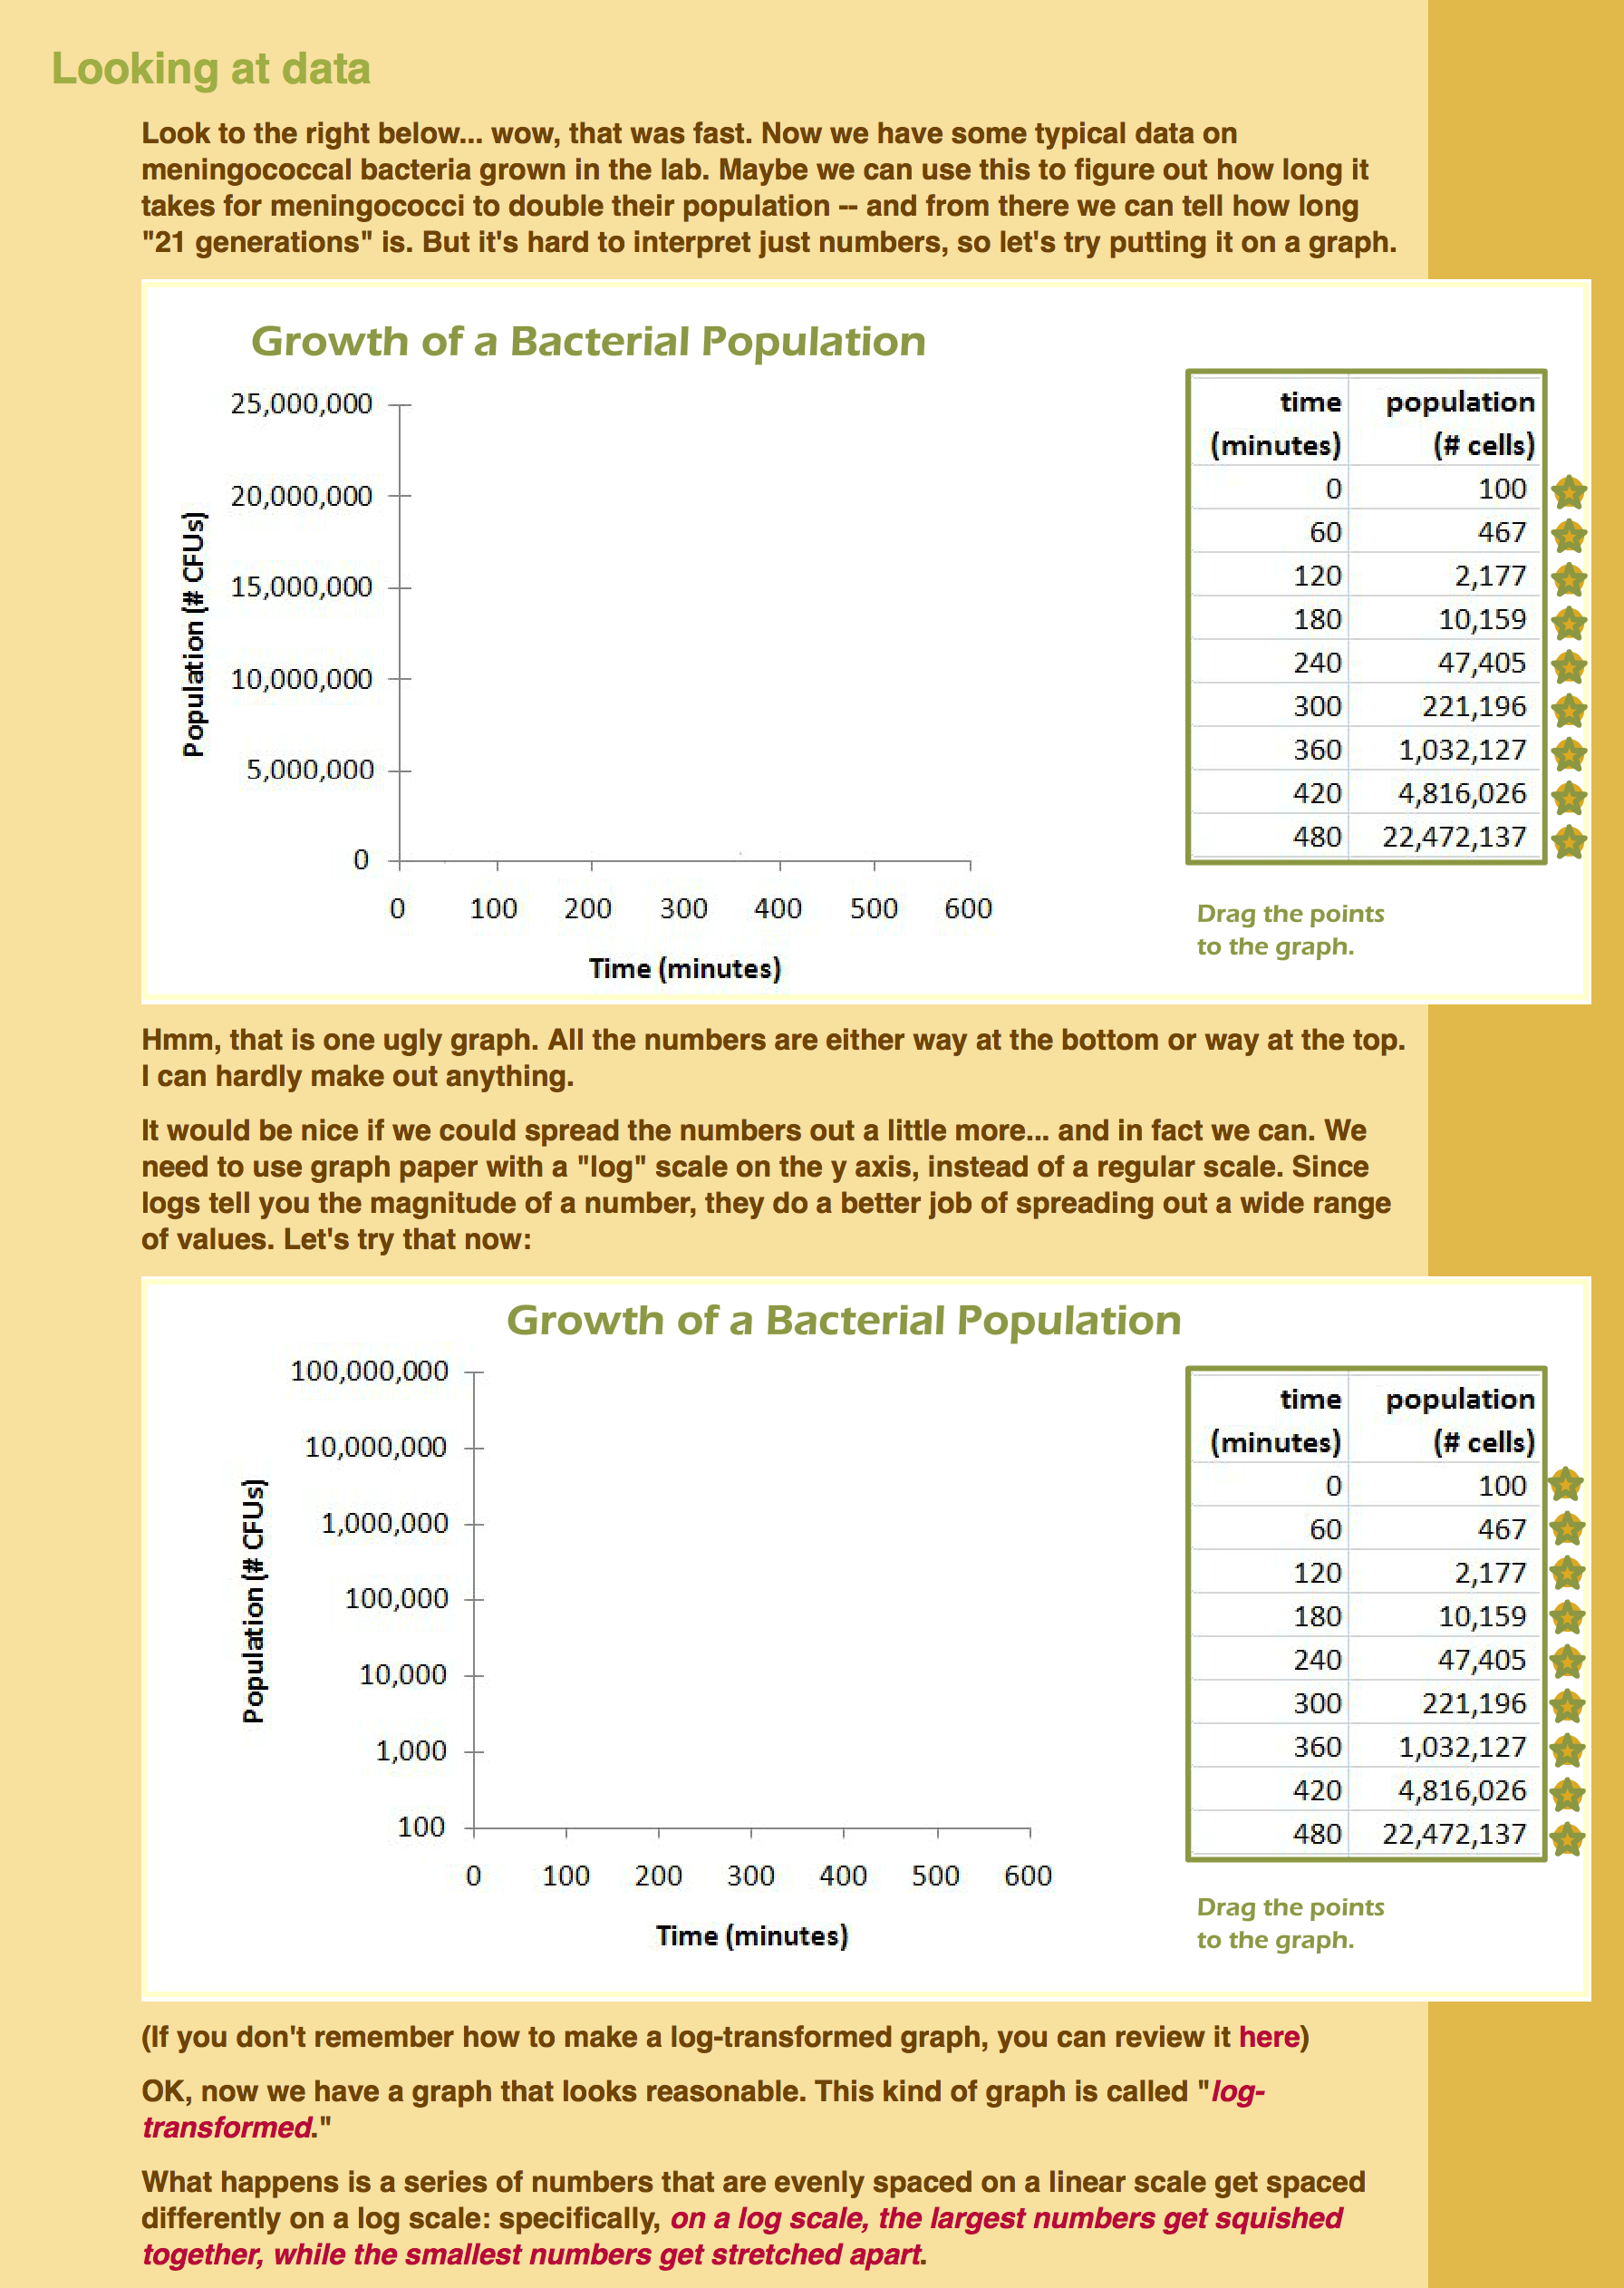
Ability to “play” with math
Intuitive, rather than formal, explanations
4
of 10

Slide 5
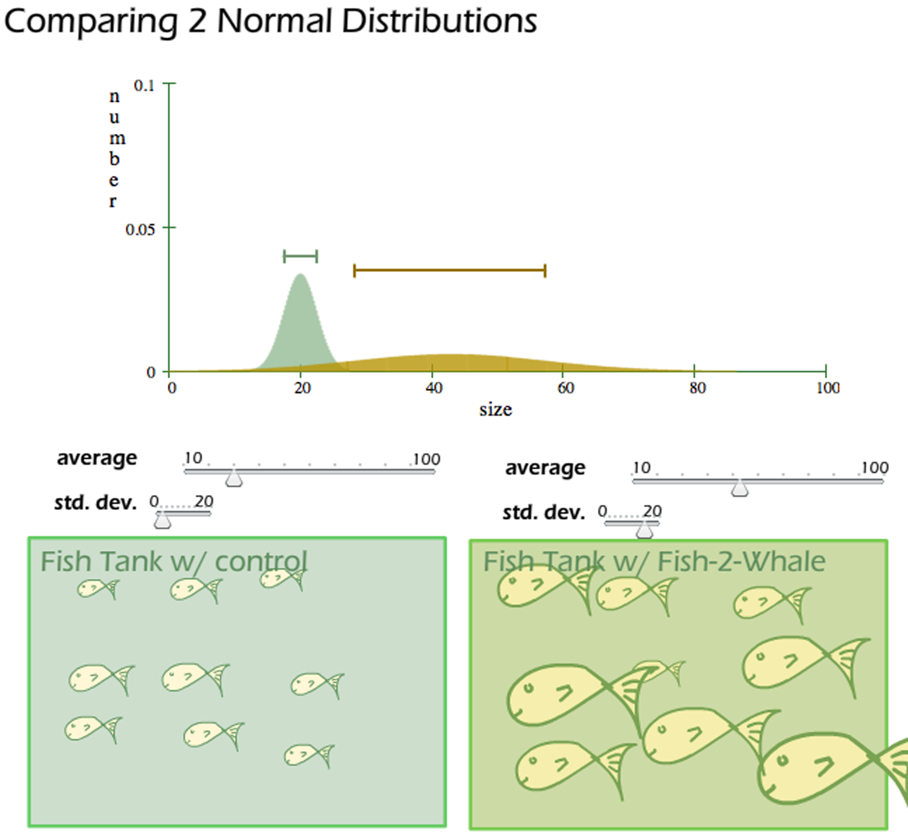
Participants in this FMN will
Adapt and implement two or more online modules in a course taught during the Fall 2018 semester
Introductory biology
Microbiology
Cell biology
Genetics
Environmental science
Mathematics
5
of 10

Slide 6
Participants in this FMN will
Adapt and implement two or more online modules in a course taught during the Fall 2018 semester
Collaborate with and learn from others in the network during online meetings (every two weeks)
6
of 10

Slide 7
Participants in this FMN will
Adapt and implement two or more online modules in a course taught during the Fall 2018 semester
Collaborate with and learn from others in the network during online meetings (every two weeks)
Create implementation guides and instructor resources that will be posted on QUBESHub
7
of 10

Slide 8
Participants in this FMN will
Adapt and implement two or more online modules in a course taught during the Fall 2018 semester
Collaborate with and learn from others in the network during online meetings (every two weeks)
Create implementation guides and instructor resources that will be posted on QUBESHub
8
of 10

Slide 9
FMN: Building mathematical intuition with online MathBench Biology Modules
For more information, contact Kaci Thompson (kaci@umd.edu)
9
of 10

Slide 10
FMN: Building mathematical intuition with online MathBench Biology Modules
For more information, contact Kaci Thompson (kaci@umd.edu)
10
of 10

