Slide 1
DIG into Data for the Biology Classroom 2018 Faculty Mentoring Network
Adaptations to Teaching Issues and Experiments in Ecology (TIEE) Modules
Julia Burrows, Chris Collins, John Doudna, Jill Hamilton, Sarah Neumann, Orissa Moulton, Kris Voss
FMN Facilitators
Kaitlin Bonner
Arietta Fleming-Davies
Raisa Hernandez-Pacheco
Kristine Grayson
1
of 10

Slide 2
DIG into Data for the Biology Classroom 2018 Faculty Mentoring Network
Adaptations to Teaching Issues and Experiments in Ecology (TIEE) Modules
Julia Burrows, Chris Collins, John Doudna, Jill Hamilton, Sarah Neumann, Orissa Moulton, Kris Voss
FMN Facilitators
Kaitlin Bonner
Arietta Fleming-Davies
Raisa Hernandez-Pacheco
Kristine Grayson
2
of 10

Slide 3
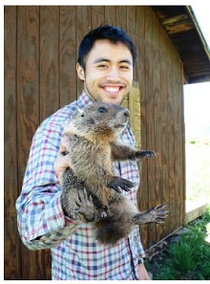
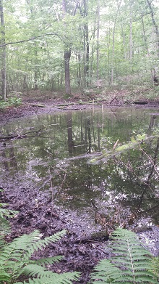
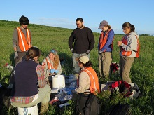
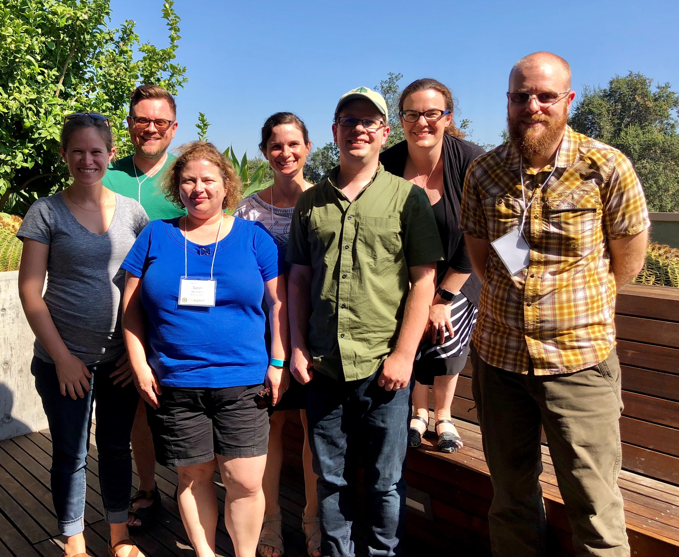
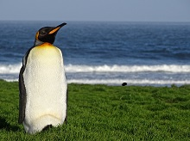
http://www.esa.org/tiee/vol/v13/toc.html
3
of 10

Slide 4
Time and Content
4
of 10

Slide 5
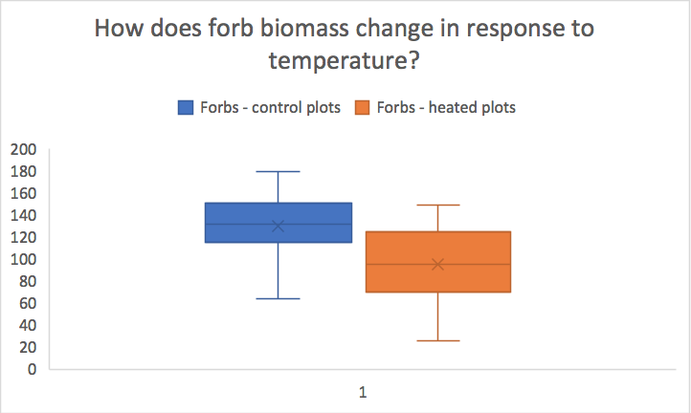
Hypothesis Generation & Hypothesis Testing
Investigating ecological processes using observations and experiments
5
of 10

Slide 6
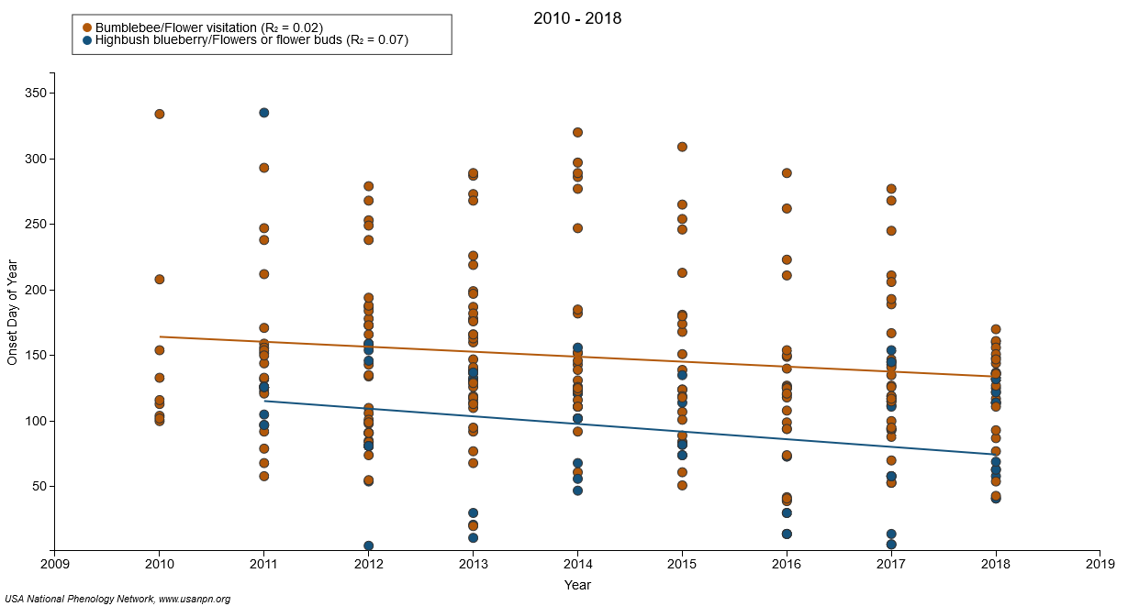
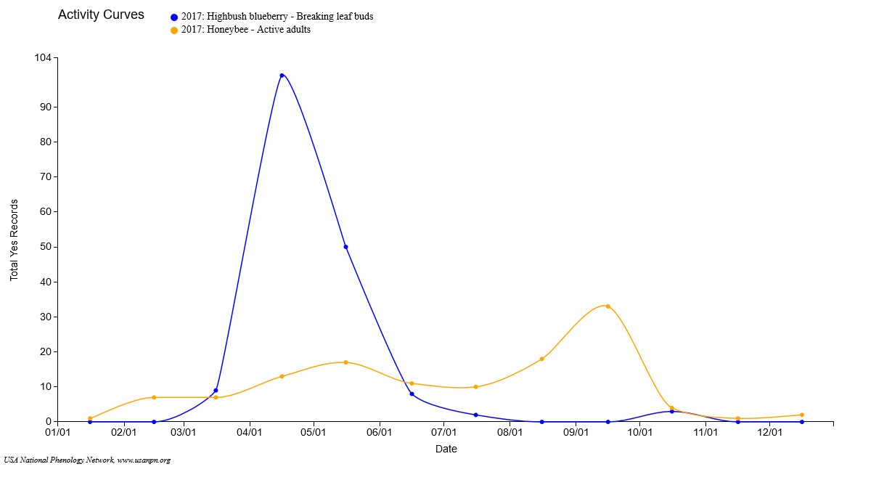
Data Management, Visualization, and Interpretation
6
of 10

Slide 7
Biology of Climate Change
(Wu & Ellwein 2017)
Bio for Non-majors
General Ecology
7
of 10

Slide 8
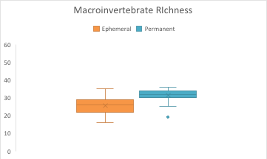
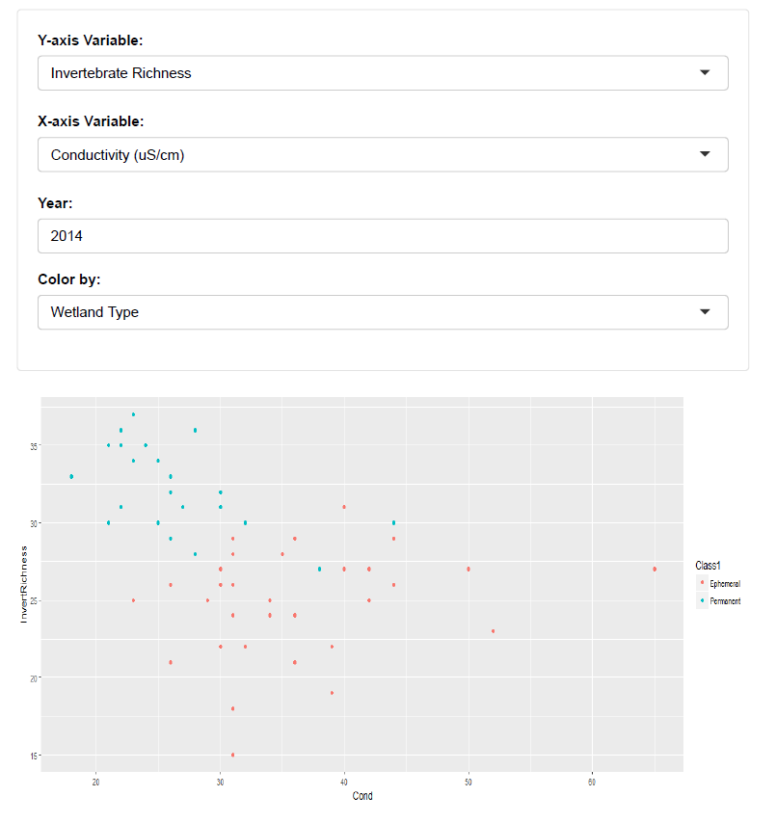
Drivers of diversity in wetland ecosystems
(Little 2018)
Intro Biology
Gen Ecology & Grad Biostatistics
8
of 10

Slide 9
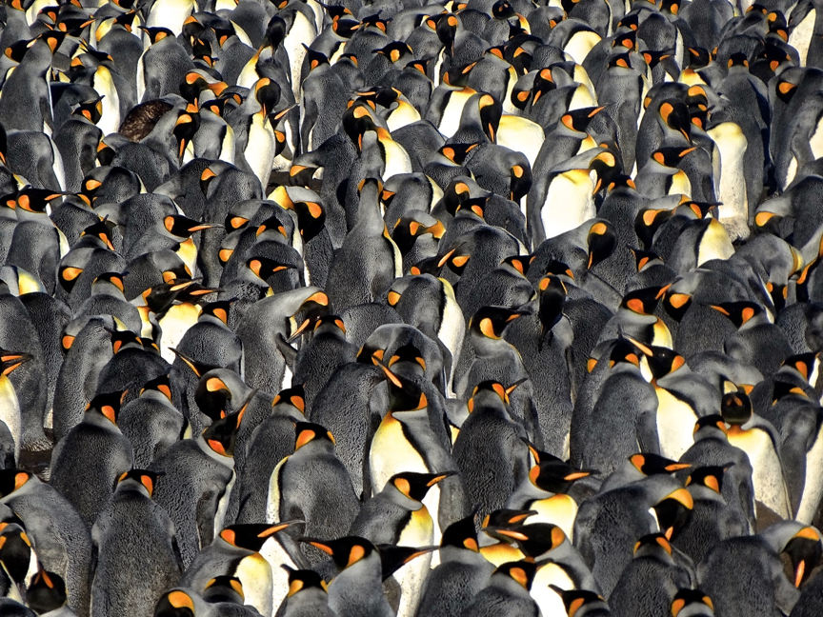
The nose knows: Penguin Foraging Behavior
(Bonner & Cunningham 2018)
Animal Behavior
9
of 10

Slide 10
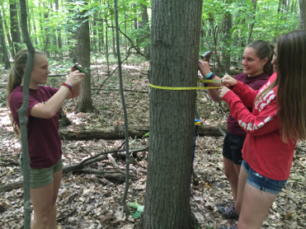
Managing big data
(McNeil & Jones 2018)
Zoology
Forest Ecology
10
of 10

