Slide 1
REDUCING BARRIERS TO TEACHING WITH R IN UNDERGRADUATE BIOLOGY
Fall 2018 QUBES Faculty Mentoring Network
Are you interested in using R to teach data visualization and/or data analysis in your undergraduate biology course? Are you looking for tools and modules to reduce barriers for students with little to no prior programming experience? Apply now to join us for a Faculty Mentoring Network featuring Swirl, an interactive program to facilitate and simplify teaching and learning R within the Rstudio console.
Contribute one new lesson and leave with >10 ready-to-use lessons!
Apply Here: qubeshub.org/groups/teaching_r_fmn
1
of 10

Slide 2
REDUCING BARRIERS TO TEACHING WITH R IN UNDERGRADUATE BIOLOGY
Fall 2018 QUBES Faculty Mentoring Network
Are you interested in using R to teach data visualization and/or data analysis in your undergraduate biology course? Are you looking for tools and modules to reduce barriers for students with little to no prior programming experience? Apply now to join us for a Faculty Mentoring Network featuring Swirl, an interactive program to facilitate and simplify teaching and learning R within the Rstudio console.
Contribute one new lesson and leave with >10 ready-to-use lessons!
Apply Here: qubeshub.org/groups/teaching_r_fmn
2
of 10

Slide 3
WHO IS THIS FOR?
Undergraduate biology instructors with prior R programming experience who are interested in ways to teach with R effectively to students with little to no programming experience
Participants should be comfortable performing basic data analysis operations in R.
3
of 10
Notes:
Participants should be comfortable reading in and manipulating data, performing t-tests and ANOVA, constructing linear regression etc.
If participants are not functional R users but are willing to work through tutorials prior to the workshop to get up to speed, they are also welcome to apply.
The FMN requires fall implementation; this requires a course, undergraduate mentorship, or guest lecturing. Folks with any of those opportunities are welcome to apply.

Slide 4
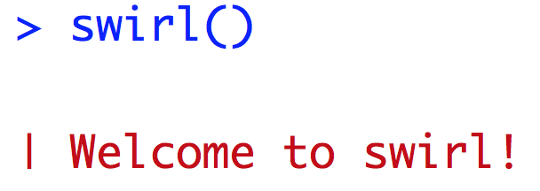
IN THIS FMN, PARTICIPANTS WILL…
Learn effective strategies and tools for teaching with R
Implement one existing Swirl lesson in a Fall 2018 course
Develop and implement one new Swirl lesson in a Fall 2018 course
Share lessons publicly on QUBESHub
4
of 10

Slide 5
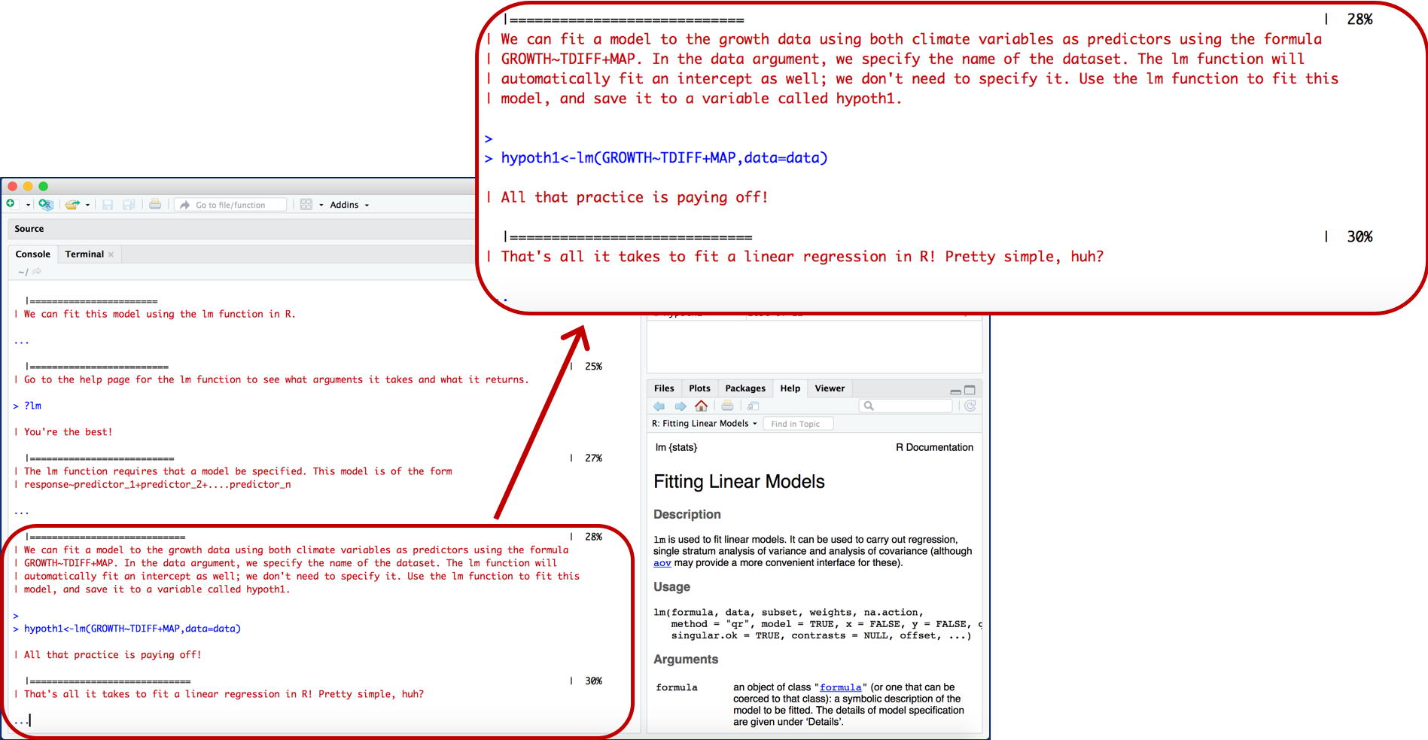
5
of 10

Slide 6
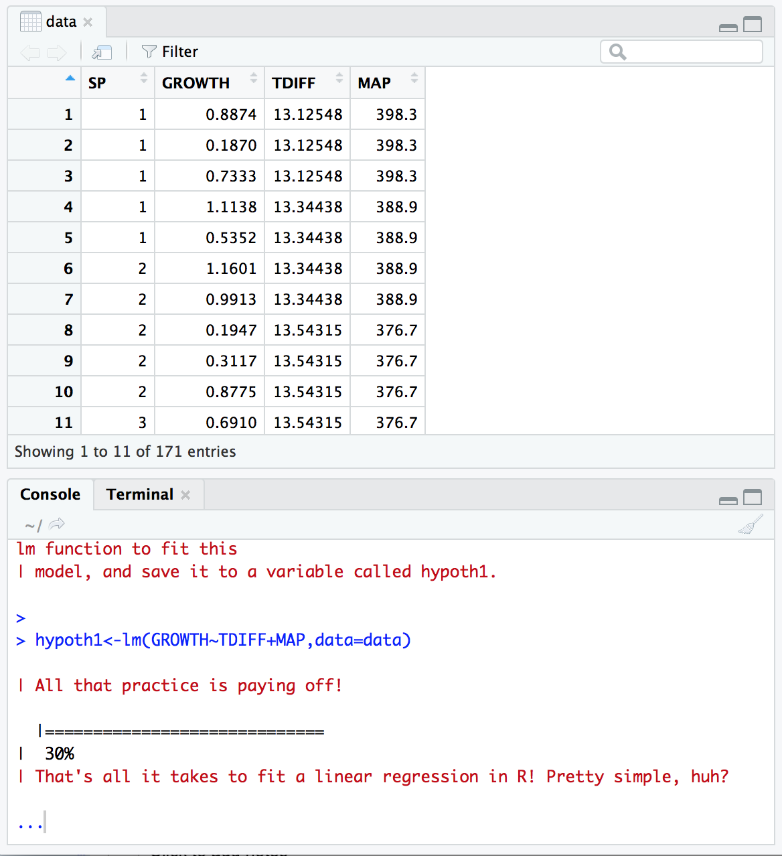
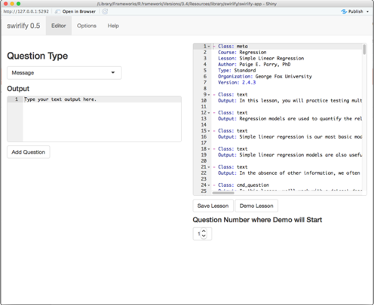
CREATE CUSTOM LESSONS IN A USER-FRIENDLY SHINY APP
SEAMLESSLY INTEGRATE BIOLOGICAL DATASETS
6
of 10

Slide 7
TIMELINE & COMMITMENT
6 weeks in Fall 2018 (starting in September)
Weekly one hour online meetings
Implement one existing Swirl lesson
Create, implement, and share one new Swirl lesson
7
of 10

Slide 8
BENEFITS OF PARTICIPATION
Access to a collection of ready-to-use Swirl lessons. Contribute one lesson, leave with over 10 lessons that are ready to implement in your course!
Online support throughout the process of implementing materials in your course.
Access to peer mentors on R, Swirl, and effective tips and teaching strategies.
8
of 10

Slide 9
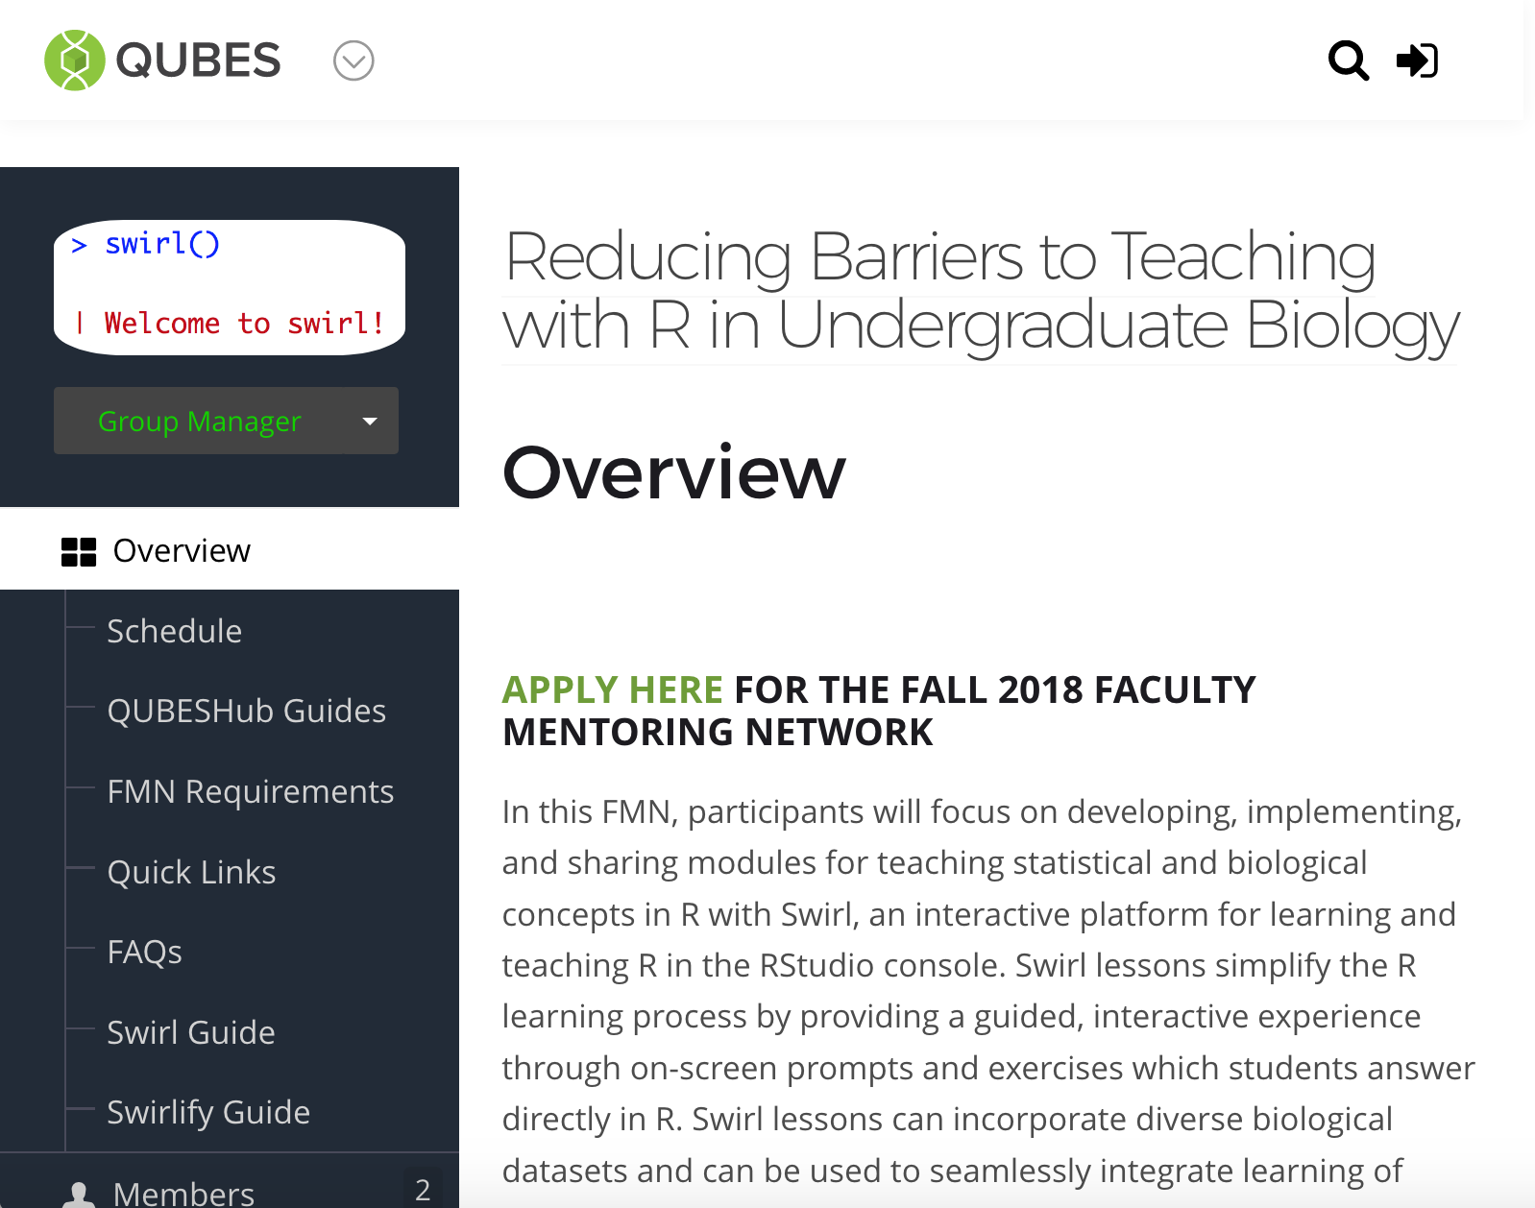
EXISTING SWIRL LESSONS
Basic R Programming
Handling and Visualizing Data
Central Tendency
Dispersion
Probability
Simple Linear Regression
GLMs
Hypothesis Testing
…and many more!
FREE ACCESS TO RESOURCES ON QUBESHUB PAGE
9
of 10

Slide 10
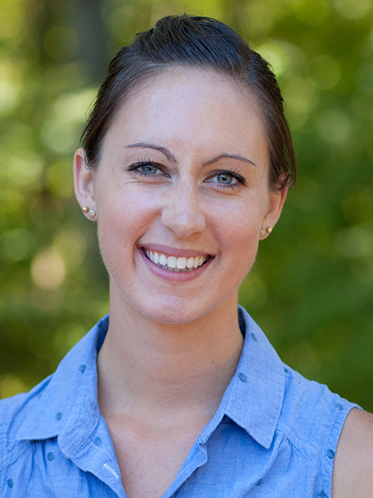
APPLY NOW!
Applications due by July 25, 2018
Selections made by August 1, 2018
For more information and to apply:
qubeshub.org/groups/teaching_r_fmn
Questions?
Contact Paige Parry:
pparry@georgefox.edu
10
of 10

