Slide 1
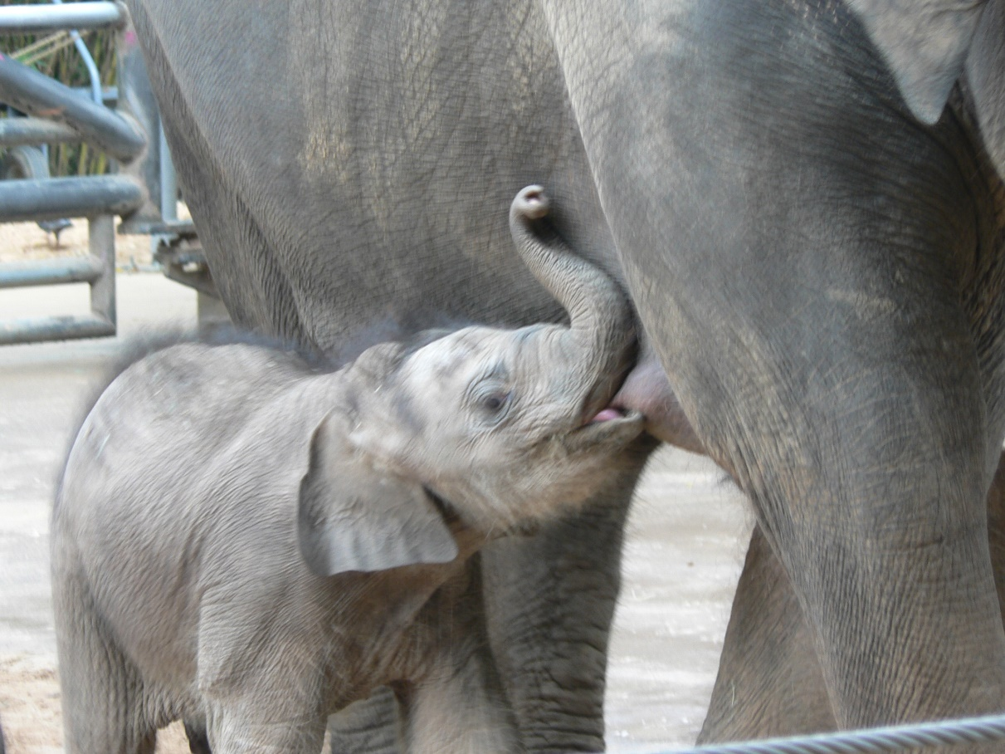
Lactase Persistence
Collaborators
Hilary Engebretson
Kam Dahlquist
Perse Lewis
Marcelle Darby
Shared starting point
The genetic story of the enzyme lactase
All mammals make lactase as infants so that they can digest the milk sugar lactose
Humans are the only mammals in which some adults still make lactase
Leads to three separate teaching resources…
Wikimedia commons; licensed under the Creative Commons Attribution-Share Alike 2.0 Generic license.
1
of 10

Slide 2
Teaching Resource 1
LEAD: Hilary Engebretson
COURSE: Human Anatomy & Physiology (200 level)
NEED: material to help students learn and practice…
Physiology of carbohydrate digestion
Scientific literacy
Quantitative literacy
Wikimedia commons; licensed under the Creative Commons Attribution-Share Alike 3.0 Unported license
2
of 10

Slide 3
Teaching Resource 1
RESOURCES
HHMI video – The making of the fittest: Got lactase?
https://www.hhmi.org/biointeractive/making-fittest-got-lactase-co-evolution-genes-and-culture
SNPedia page on Lactose Intolerance
https://www.snpedia.com/index.php/Lactose_intolerance
Primary research article – The European lactase persistence genotype…
http://bmjopen.bmj.com/content/bmjopen/1/1/e000125.full.pdf
HHMI activity – Got lactase? Blood-glucose data analysis
https://www.hhmi.org/biointeractive/got-lactase-blood-glucose-data-analysis
3
of 10

Slide 4
Teaching Resource 1
PRODUCT (in process!) is a 3-part activity
Part 1: COMPLETED BY STUDENTS BEFORE COMING TO CLASS (AS PREPARATION)
Students watch HHMI video
Students synthesize provided physiology & genetics background information
Students read primary literary article
Part 2: COMPLETED BY STUDENTS IN CLASS (AS GROUPS)
Students work through directed activities with research article
Students interpret tables in article
Students build a graph to represent data from article
Part 3: COMPLETED BY STUDENTS INDIVIDUALLY (AS CUMULATIVE ASSESSMENT)
Students graph new data set
Students interpret graph
Students make predictions from graph
4
of 10

Slide 5
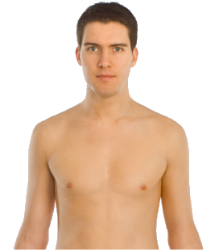
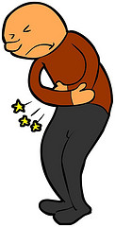
De-colonizing the Lactase Persistence Evo-Ed slide deck
All images of people in the slide deck are of men.
In the text, “humans” are conflated with “Europeans”.
Pastoralism and selection for the lactase persistence allele are presented as “advances.”
This implies that groups with the non-persistent allele are somehow deficient.
This could lead to misconceptions that dairying caused the mutation to occur.
We will remedy by showing a timeline of civilization for two lactase persistent groups and two lactase non-persistent groups in parallel.
The story of the lactase persistence allele arising independently in Africa is at the end of the presentation and reads like an afterthought.
All prehistoric artefacts need to be attributed to their group of origin.
http://www.evo-ed.org/Pages/Lactase/index.html
Leads: Kam Dahlquist, Perse Lewis, Marcelle Darby
5
of 10

Slide 6
These types of biases impact public health
According to Morales et al. (2011):
WHO recommends consumption of
240 liters of milk per person per year
or 3 servings of 8 ounces per day.
Effective consumption of dairy products and calcium in Chile remains below this recommendation at
~40 liters of milk per person per year
or ~4 ounces per day.
Hmmmm....
6
of 10

Slide 7
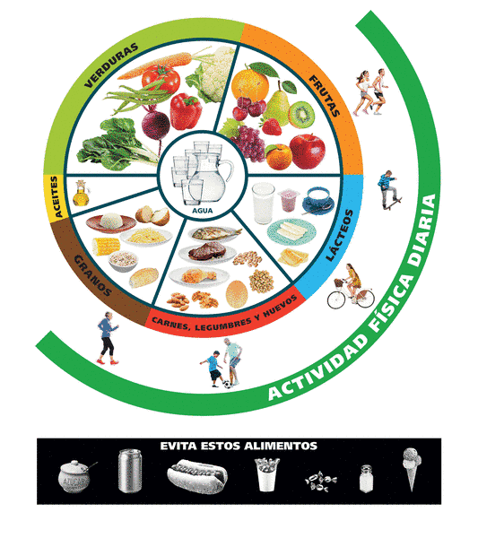
However, if a large proportion of the population is lactase nonpersistent, the recommendations are inappropriate
And, the World Health Organization actually does NOT have a milk consumption recommendation.
The Food and Health Organization of the United Nations states that National Food-Based Dietary Guidelines are best decided by each country.
Chile’s “food pyramid” includes dairy (although this image does not say how much).
Morales et al. (2011) state:
“The fact that the LNP state is an inherited condition should be considered when developing public programmes that encourage consumption of dairy products, and should be a stimulus for the food industry to develop new lactose-free dairy products.”
Or, public health guidelines could reflect native diets.
http://www.fao.org/nutrition/education/food-dietary-guidelines/regions/countries/chile/en/
7
of 10

Slide 8
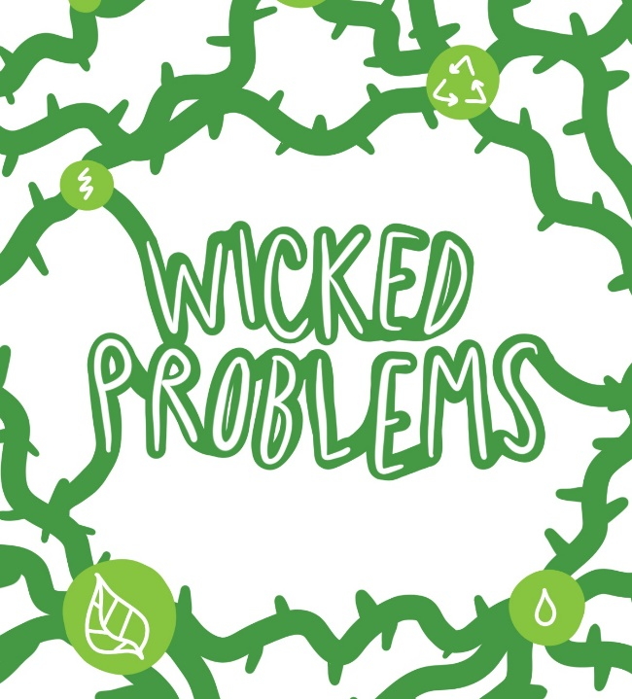
New course: Western Science Meets Indigenous Ways of Knowing
Leads: Perse Lewis and Marcelle Darby, University of San Diego
Course serves non-science majors, all levels freshman to senior, class size of up to 40
Associated labs has 20 students each
Nine learning outcomes that fall into three major categories:
Scientific and technological inquiry
Integration
Diversity, inclusion, and social justice
This course has to be approved by:
Two departments: Biology and Ethnic Studies
A committee for each core area (listed above)
The main core curriculum committee
Wicked problem: 9 diverse outcomes + 6 committees!
8
of 10

Slide 9
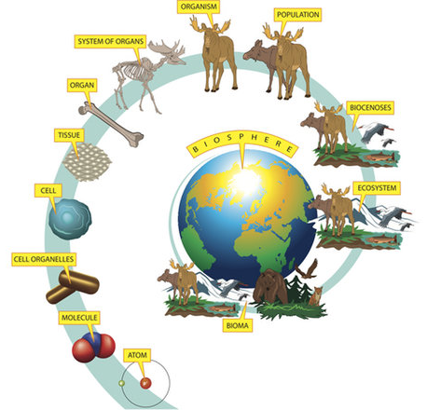
Tangibles from our work together
We will use the lactase persistence case throughout the course.
We found that this case aligns with every learning outcome.
How can we represent the hierarchy of biological organization from a de-colonized perspective?
How to use a less linear approach (spiral)
We needed a visual representation of the human organism and human populations from an unbiased perspective.
Custom artwork will be developed
We want to integrate Western science and research methods with indigenous ways of knowing to create a synergism.
https://www.livescience.com/44549-what-is-biology.html
9
of 10

Slide 10
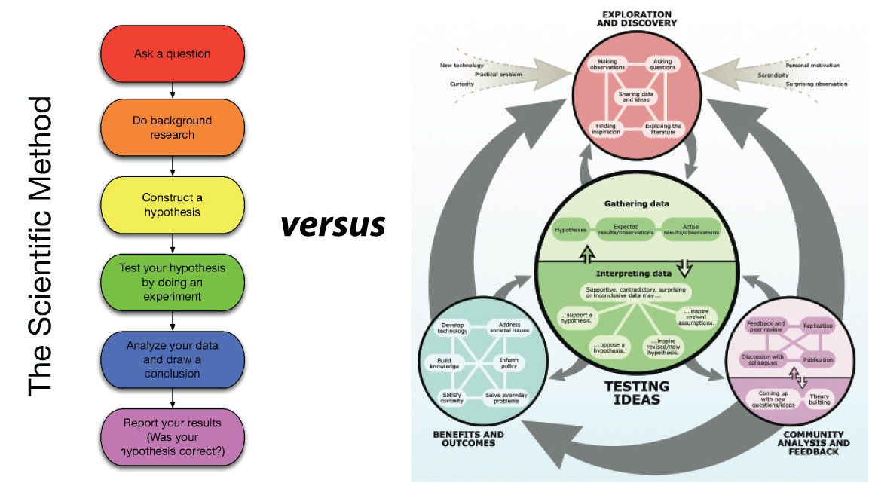
Integrating Western science and Indigenous ways of knowing
Guiding Principles of Indigenous Research
Reciprocity
Respect
Relevance
Responsibility
https://clasticdetritus.com/2012/04/02/all-i-have-to-do-is-write-it-up/
10
of 10

