Slide 1
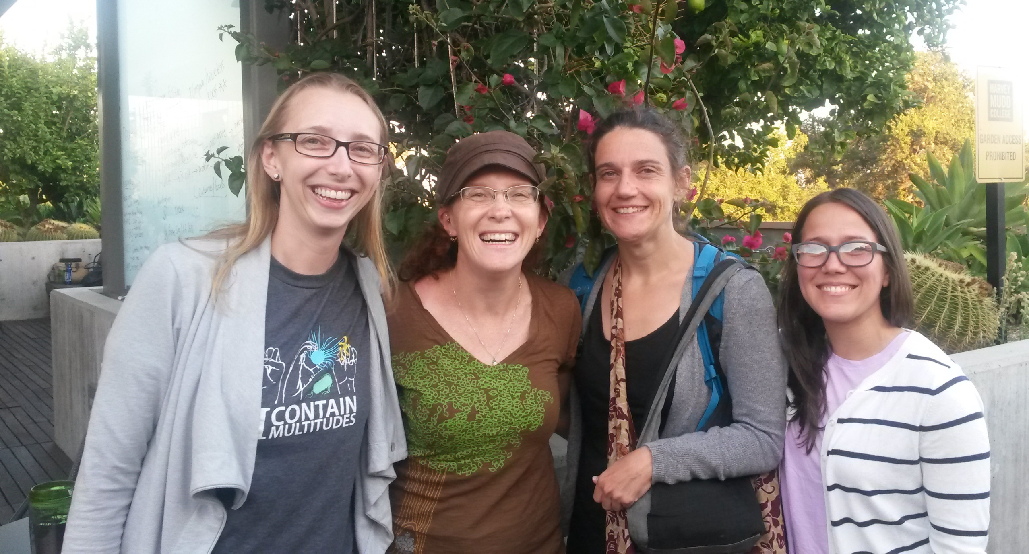
Kaitlin Bonner, Arietta Fleming-Davies,
Kristine Grayson, & Raisa Hernández Pechco
1
of 10

Slide 2
What is the OER data life cycle?
Our goal: closing the gap in the Open Educational Resources (OER) life cycle for biological data-centric teaching materials
2
of 10

Slide 3
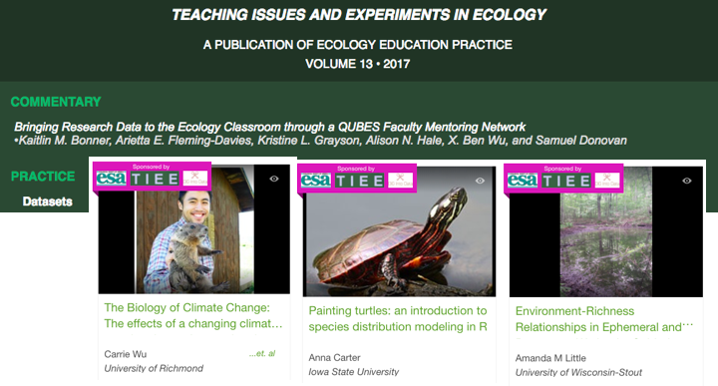
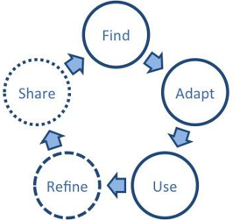
QUBES Faculty Mentoring Network in Spring 2017
Special issue with 9 published teaching modules using authentic research datasets
Creating materials to ‘Find’
3
of 10

Slide 4
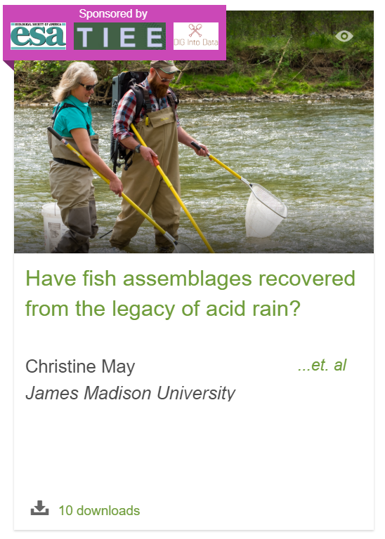
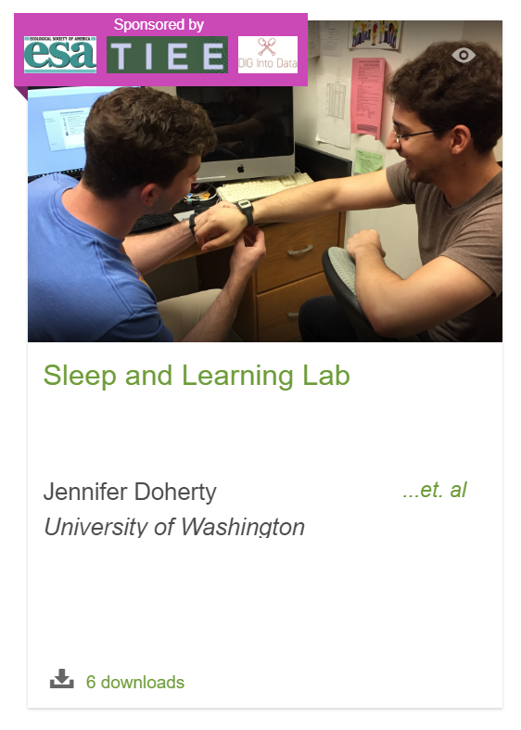
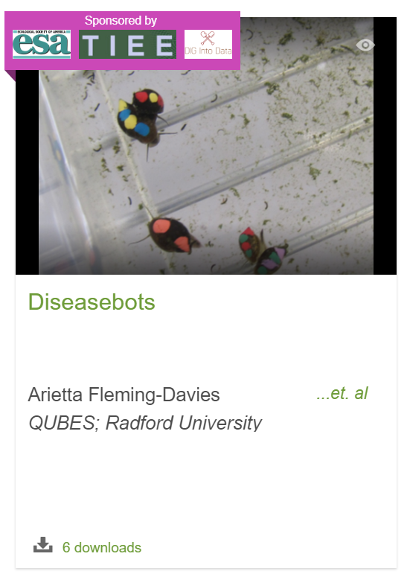
QUBES Faculty Mentoring Network in Spring 2017
3 modules in review and 6 modules in progress published on QUBES (versioning is awesome!)
4
of 10

Slide 5
“Bringing Research Data to the Ecology Classroom:
Opportunities, Barriers, and Next Steps”
Organized Oral Session
T
Thank you Hayley!!
5
of 10

Slide 6
Posting Workshop Materials
Upcoming: ESA and NABT – see you there????
6
of 10

Slide 7
NSF-funded RCN-UBE Incubator
Goal: Conceptualize and promote a community framework for the large-scale sharing and adaptation of data-centric educational resources
7
of 10

Slide 8
NSF-funded RCN-UBE Incubator
Discussed challenges and potential solutions, working on disseminating ideas through a white paper
Resource awareness
Lack of support and training
Academic culture and lack of incentives
Student attitudes and preparedness
Study persistent challenges to sharing materials through a faculty survey
8
of 10

Slide 9
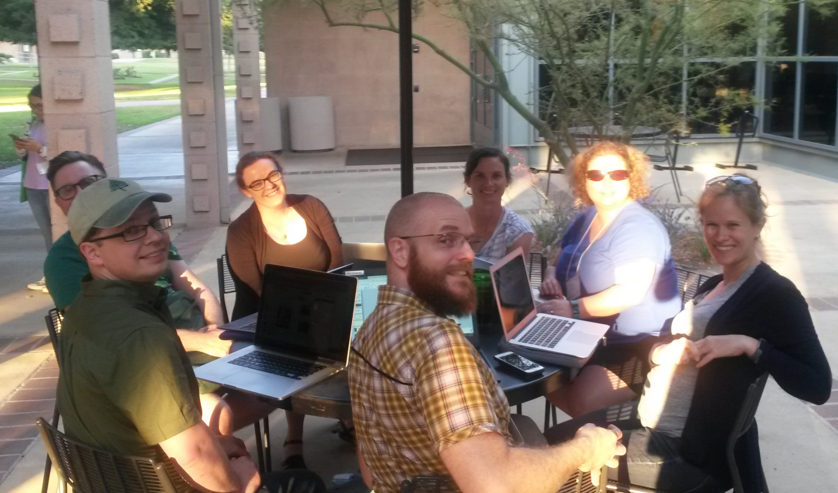
NSF-funded RCN-UBE Incubator
Promote QUBES system for publishing adaptations of resources
Apply the OER framework with a second DIG FMN to create and share adaptations of the resources produced by the first network
These wonderful folks up next!
9
of 10

Slide 10
How can you get involved?
Check out our ideas at qubeshub.org/groups/data_incubator
Survey about current use of and barriers to using data-centric resources
Looking for guidance on development and implementation – want to help us?!
Onward and upward!
10
of 10

