Slide 1
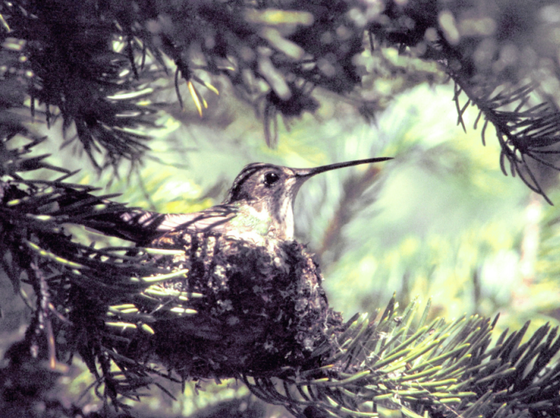
Phenology Mismatch: The Birds and the Flowers
Anne Walter (Biology), St. Olaf College
Becky Sanft (Mathematics), UNC Asheville
Learning Goals:
Link two or more phenomena by their probability distributions
Use models to make quantitative predictions of how these relationships will change as distributions become mismatched
Source: McKinney, et al. (2012)
1
of 10

Slide 2
Broad-tailed Hummingbirds
Arrive in mountains in northern Colorado prior to nesting
Have high fidelity to nesting site
Need glacier lilies
2
of 10

Slide 3
Broad-tailed Hummingbirds
Nesting is cued to first flowering of larkspur
3
of 10

Slide 4
Timeline
time
4
of 10

Slide 5
Timeline
time
5
of 10

Slide 6
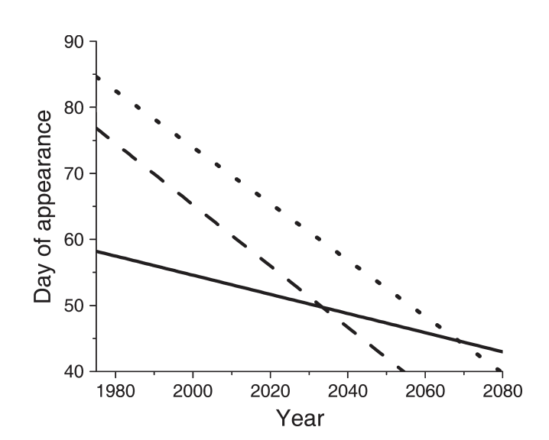
Source: McKinney, et al. (2012)
6
of 10

Slide 7
How do these changes affect the hummingbirds and flowers?
Source: McKinney, et al. (2012)
7
of 10

Slide 8
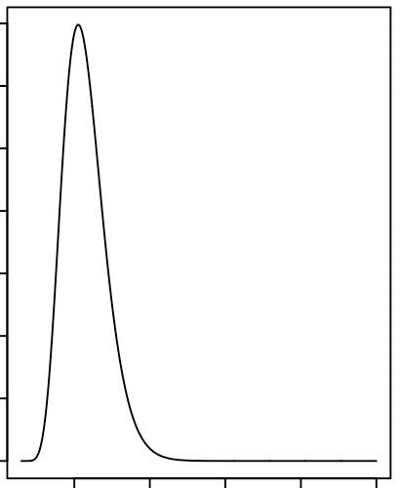
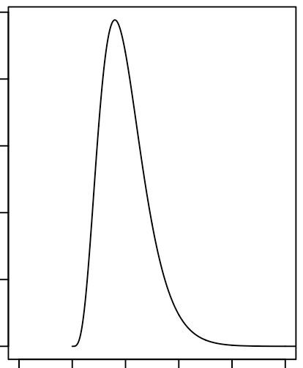
Qualitative Model
time
time
8
of 10

Slide 9
Qualitative Model
time
time
9
of 10

Slide 10
To Do List
Formulate the model
Get distribution data
Energetic limits
Other factors to consider?
Read the literature
10
of 10

