Slide 1

What’s the Beef* with Antibiotics in Agriculture?
Vedham Karpakakunjaram & Carolyn Wetzel
Off-shoot of Antibiotic Resistance working group “Vive la Résistance!”:
  Monica GuhaMajumdar, Carolyn Wetzel, Suann Yang, Chris “Pagz” Pagliarulo, Phil Gibson , Davida Smyth, Vedham Karpakakunjaram, Lillian Senn, Arietta Fleming-Davies
The Wicked Problem:
80% of antibiotic use in the US is in agriculture
Promotes faster growth in crowded conditions
Concern that over-use is leading to evolution of resistant bacteria
Movement to regulate and label
*Too idiomatic for UDL?
1
of 10
Notes:
Target courses: Intro Bio for majors or non-majors
Non-therapeutic use is problem, should still be able to use it to treat disease
http://www.claytonsorganicbeef.com/
https://www.dkmfarms.com/parker-family-farms-beef/
http://www.meatpoultry.com/articles/news_home/Food_Safety/2017/10/Passage_of_San_Francisco_meat.aspx?ID={22181EF5-C85E-4F3A-8BDB-2CF3DCED51E7}&cck=1

Slide 2



Three Learning Topics:
Evolution of antibiotic resistance by natural selection
Socio-economic factors in using antibiotics in production and of consumption of farm animals
Quantitative skills: Computer-based tests of evolution by natural selection, and basic arithmetic and graphing
Interrupted Case Format
2
of 10

Slide 3
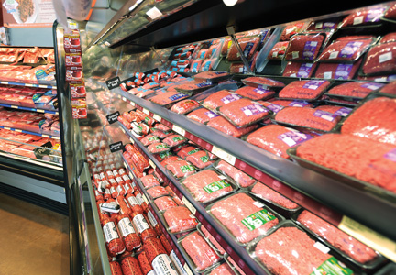
Part 1 – At the Grocery Store
  Two friends shopping for ground beef for a barbeque
  Comparing one labeled “raised without antibiotics” with less expensive unlabeled package
  Students learn about labeling standards (or lack thereof), why and how antibiotics are used on farms (slanted against use), possible problems with over-use
  Socio-economic: Can’t afford to buy antibiotic-free meat
  Quant: Simple calculations of price per pound, scaling up for number of servings
3
of 10

Slide 4
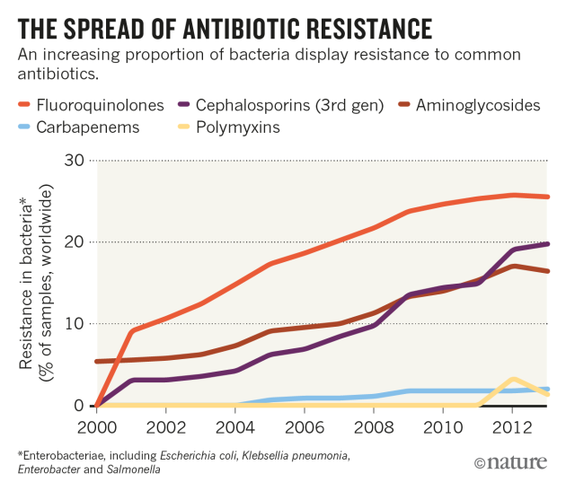
Example
Jesse says, “I don’t know about you, but my budget is pretty tight until I get paid next month. Do you think it’s really worth it to pay that much more for the meat from cows raised without antibiotics? We could use that extra money for chips and drinks.”
Sheldon gets excited and responds, “Antibiotic resistance is going to be a huge problem for humans! I just saw this scary YouTube video about how farmers are using too much antibiotics and now the bacteria don’t die when they use it, and when we eat the meat from those animals we can get sick because we’ll become resistant to the antibiotics, too.”
Task 3
Watch the video “The Trouble with Antibiotics” (Frontline 2014, 36:37, https://www.pbs.org/video/frontline-trouble-with-antibiotics/).
Identify where Sheldon’s description of antibiotic resistance is incorrect, and write out what his response would be if he really understood it.
4
of 10

Slide 5
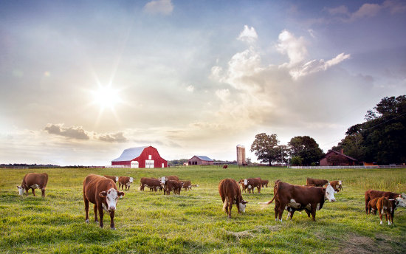
Part 2 – On the Farm
Alex graduates and returns to family farm
Wants to switch to antibiotic-free beef production
Needs to educate parents about evolution, figure out economics
Students learn to use Avida-ED to run experiment on bacterial evolution, advantages to farmer in using prophylactic antibiotics, current regulations on antibiotic use (regs vs guidelines), economic trade-offs made by farmers under different systems
Quant: Data analysis from Avida-ED output, cost-benefit calculations for farmers
5
of 10

Slide 6
Part 3: Avida-Ed Experiments
Preadaptation run with no antibiotics in the environment
Preadaptation run with antibiotics in the environment
Discuss the fitness costs of the phenotypes (antibiotic sensitive and resistant) in both environments: ratio between energy acquisition rates and offspring cost
Run an experiment with no antibiotics where two populations compete
Collect data on number of viable bacteria and those with higher fitness
6
of 10

Slide 7
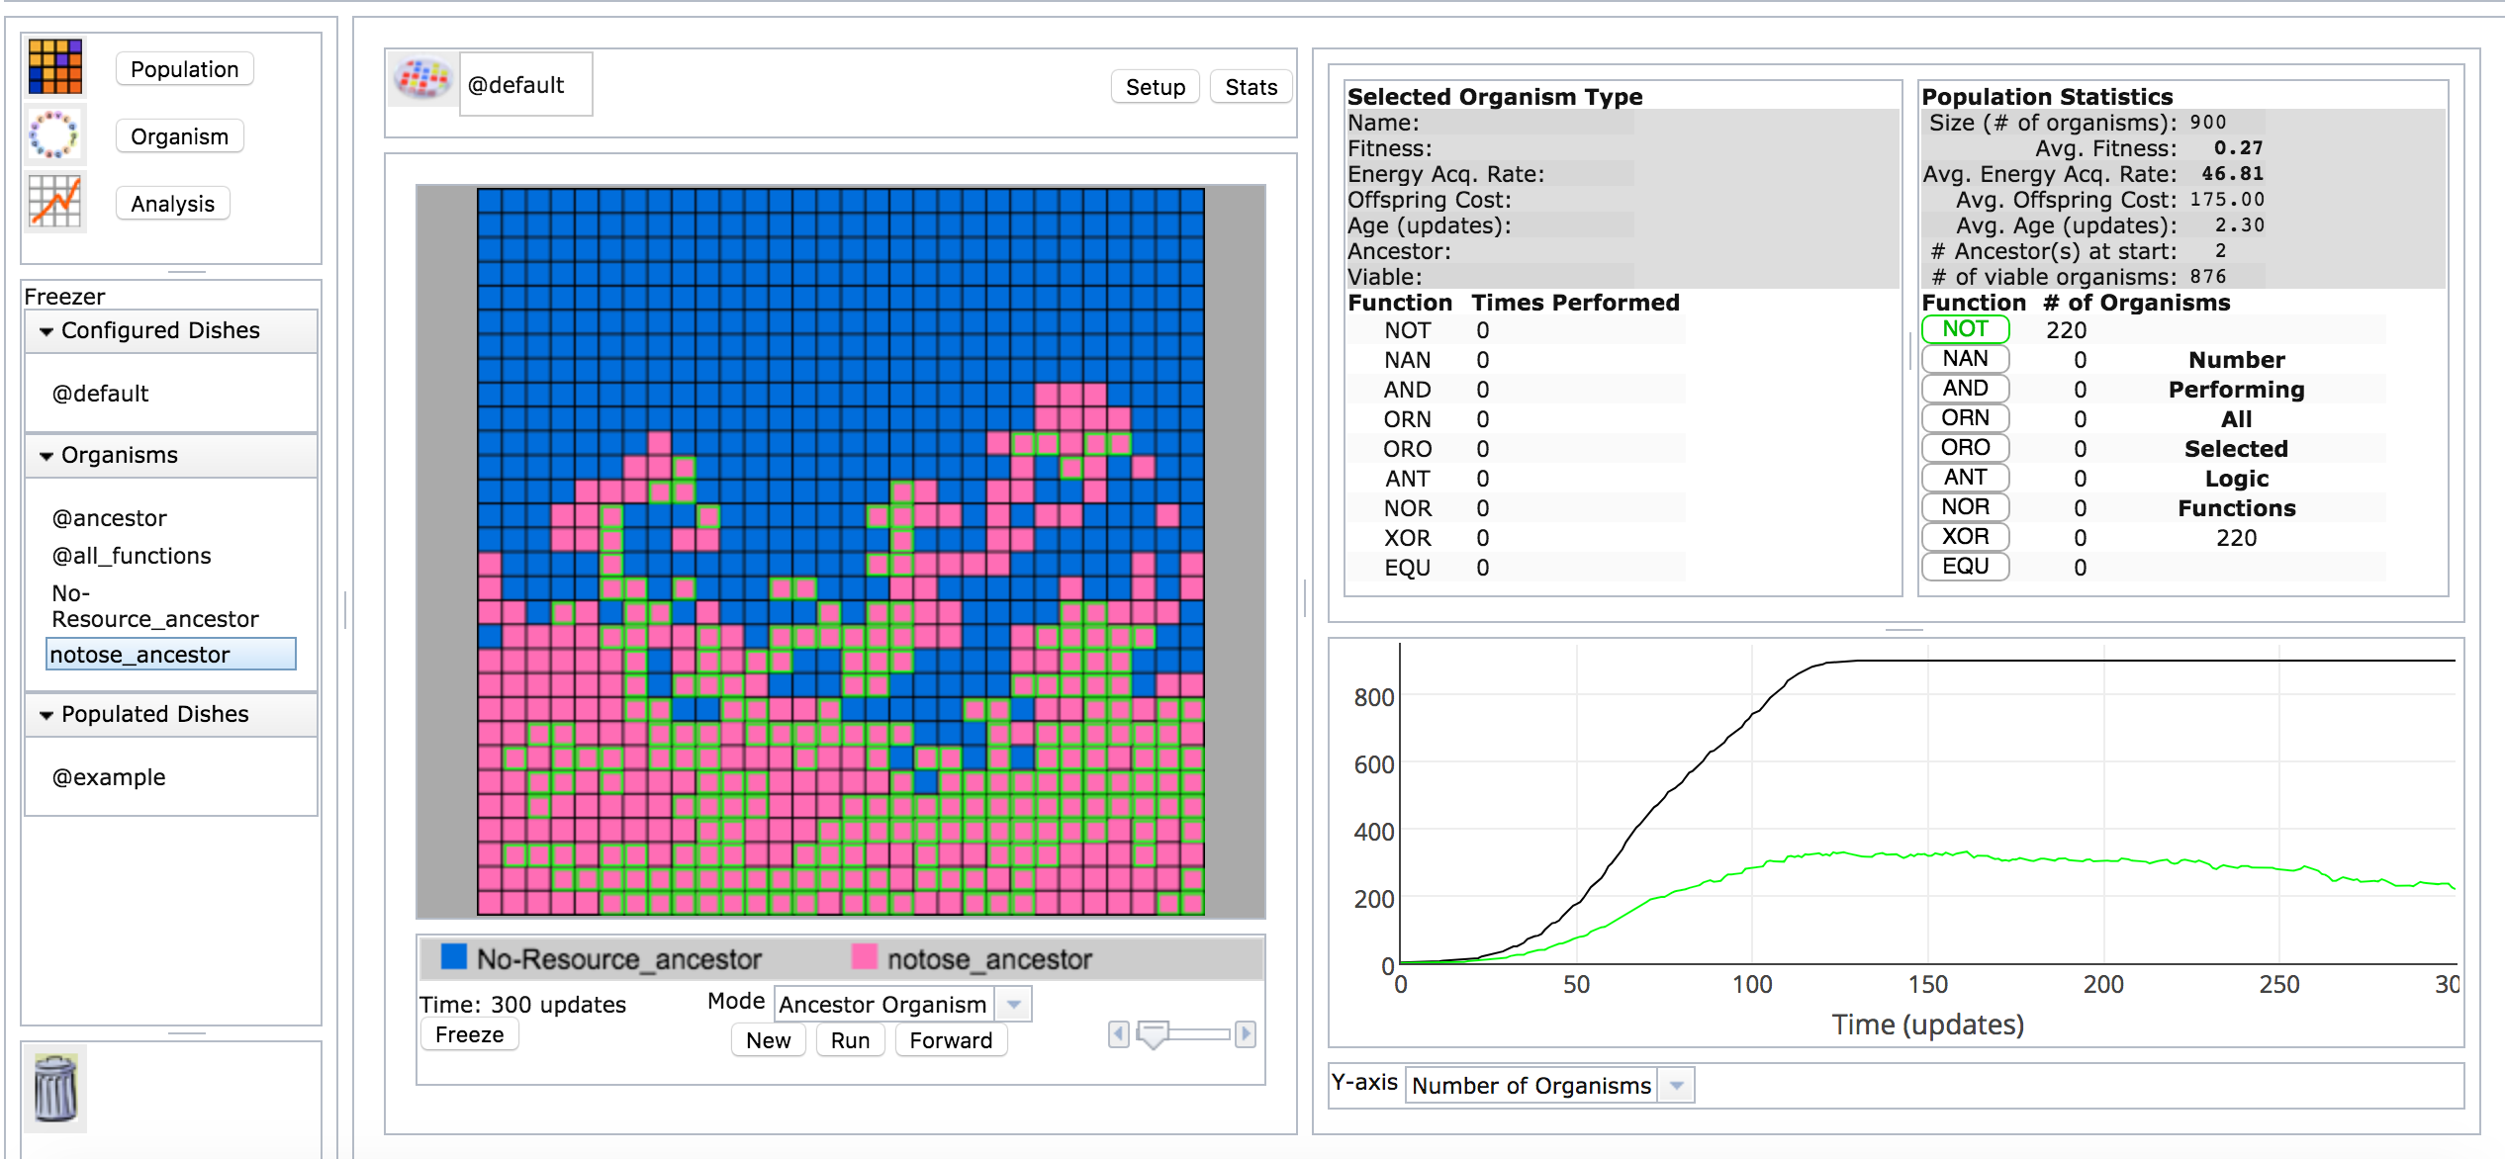
Environment without antibiotics
7
of 10

Slide 8
Environment with antibiotics: Frequency Change
Run an experiment with antibiotics in the environment, where two populations compete
Collect data on number of viable bacteria and those with higher fitness
8
of 10

Slide 9
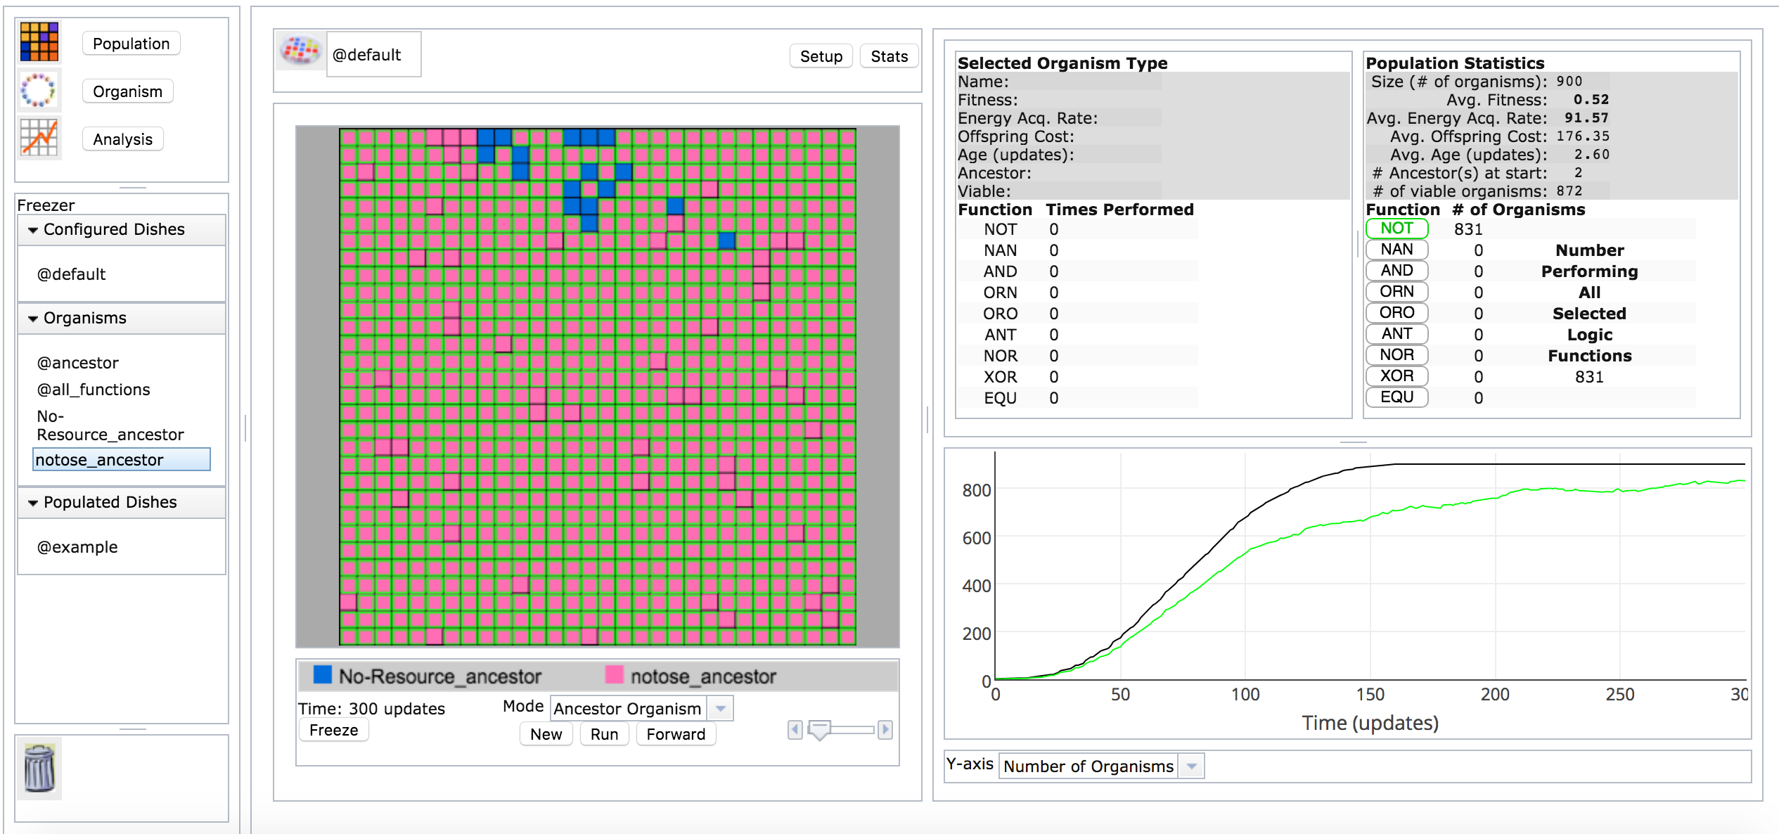
Environment with antibiotics: Frequency Change
9
of 10

Slide 10
Progress
Learning Objectives written
Part 1 narrative first draft written, activities figured out, video and reading identified
Part 2
  Avida-ED program mostly complete, instructions need to be written
  Resources for economic analysis need to be sourced and made into a quantitative activity
Discussion questions are written
Supporting materials need to be written (assessments, teaching guide, list of resources)
10
of 10

