Slide 1
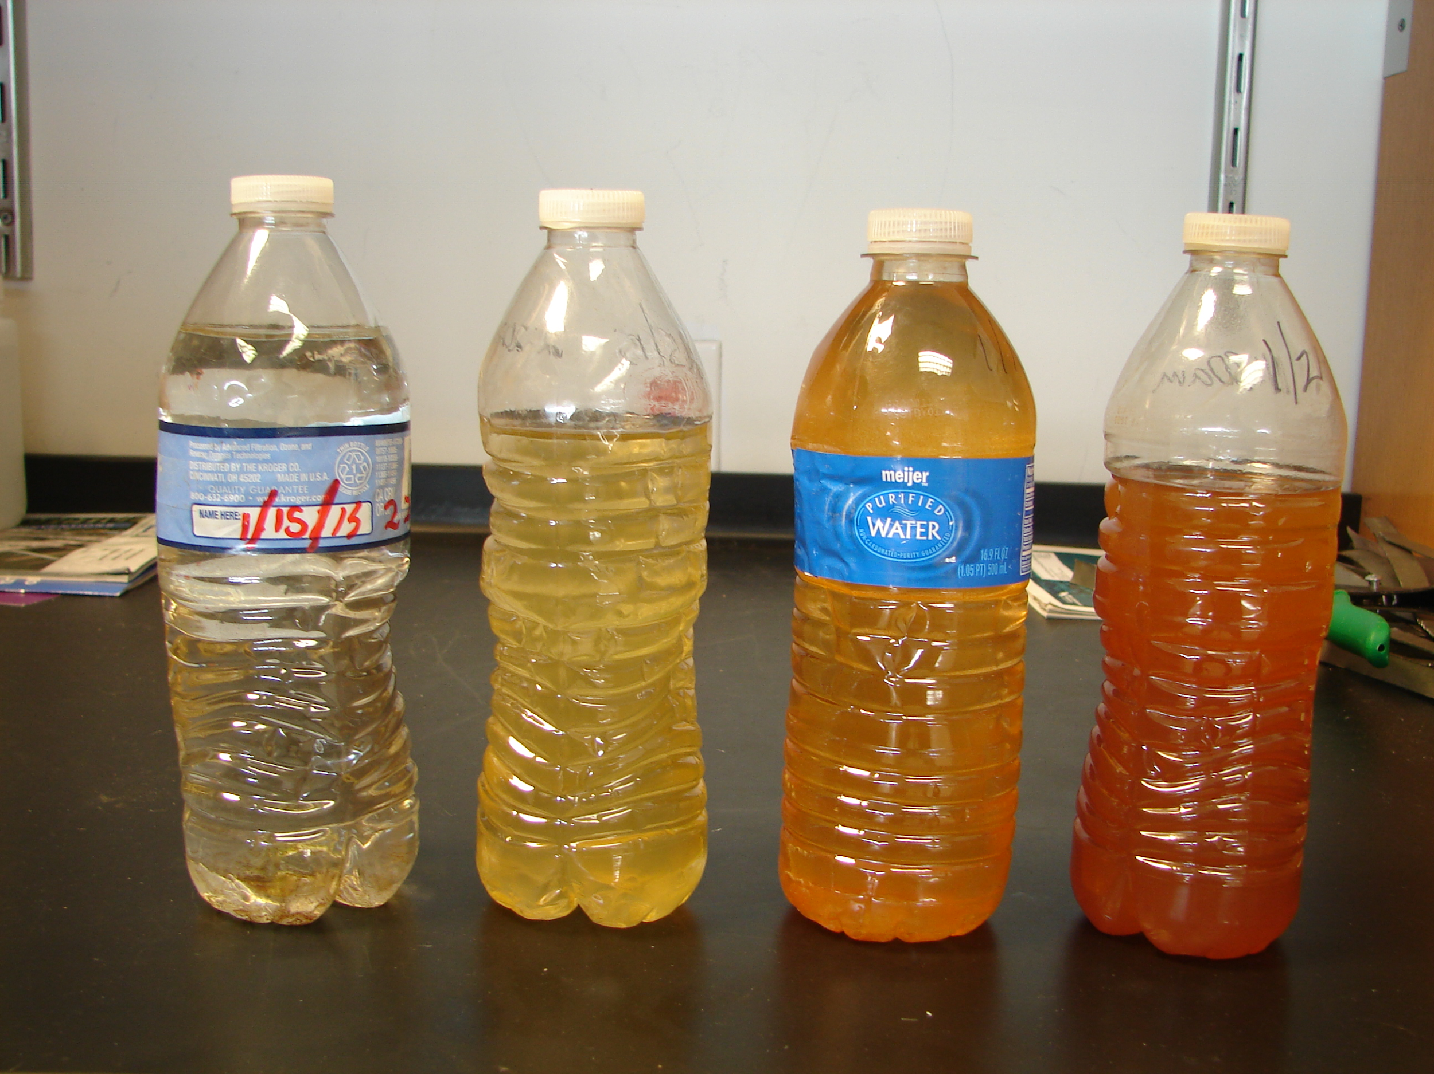
Flint Case Study- Learning Objectives
We are learning about...
The sociopolitical dimensions of an environmental
justice issue (the 2014 lead contamination of the
Flint water supply).
The water infrastructure in Flint.
Factors that influence water quality.
Lead properties/chemistry and impacts on health.
How to use scientific and political information to engage as agents of change.
1
of 10

Slide 2
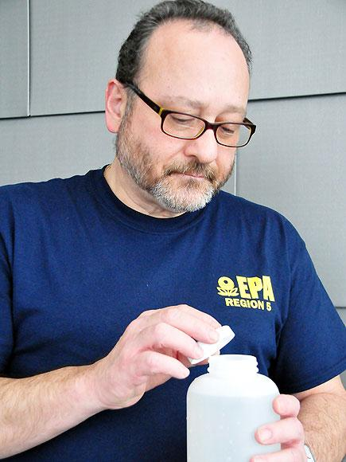
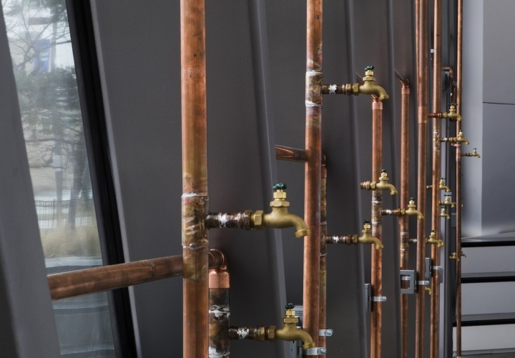
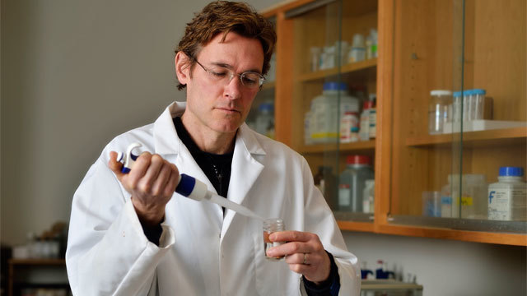
Narrative
Community Empowerment
Testimonies
Important Parties
Community- Moms and Little Miss Flint
Universities- Virginia Tech, Marc Edwards
Gov Orgs- EPA, Miguel del Toral
Students
2
of 10

Slide 3
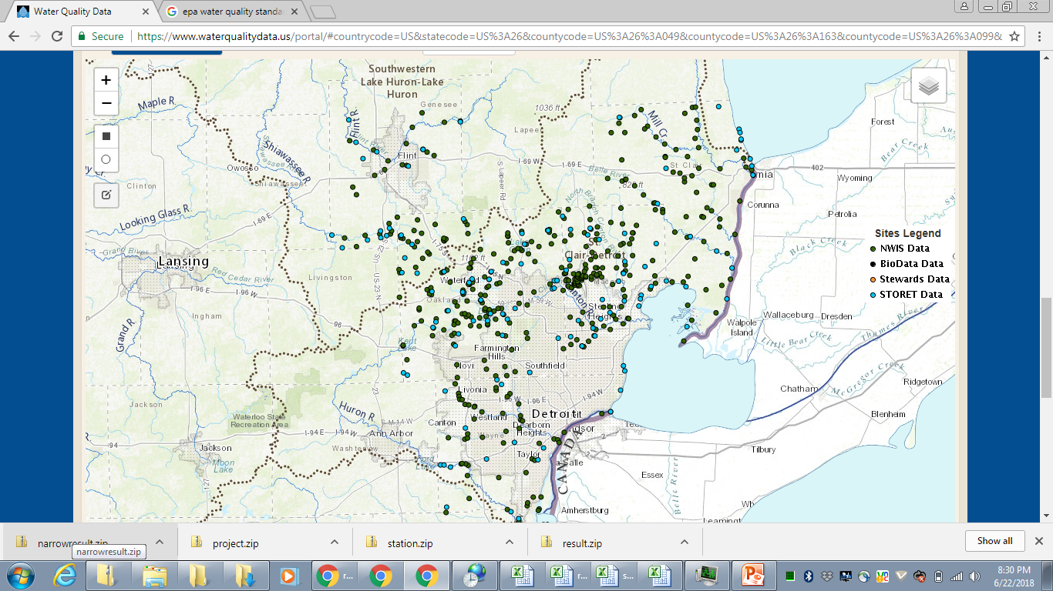
Part 1- Water Quality
Flint River
Flint
Water Quality
Storyline: LeAnne Walters
notices her tap water looks
different
Activity:
What is clean water?
Look at natural bodies of water and compare their nutrient concentrations to USEPA drinking water standards.
Identify the chemical composition of the Flint River and Detroit River
Identify the normal range for MI rivers
Compare to EPA standards
Detroit River
3
of 10

Slide 4
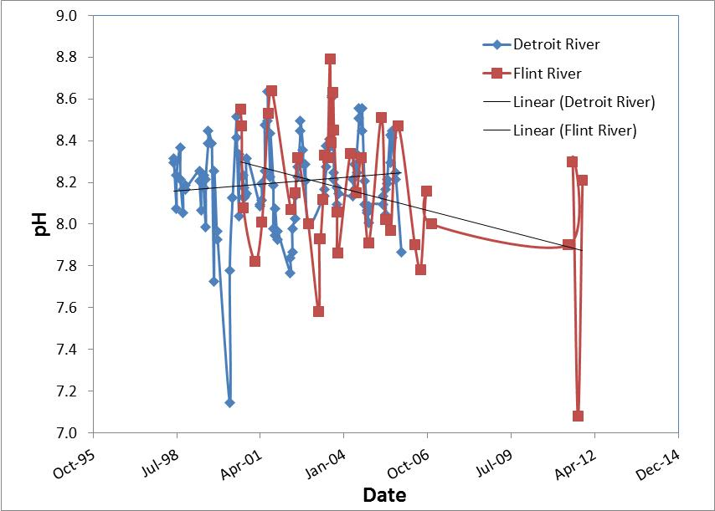
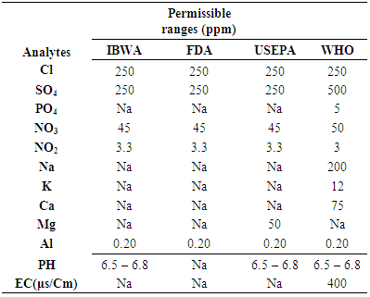
Part 1: Water quality
Detroit River
Date |  | Ammonia (mg/L) | Chloride (mg/L) | Lead (mg/L) | pH
06/16/98 |  | 0.012 | 6 | 0.09 | 8.3
06/17/98 |  | 0.125 | 8 | 0.174 | 8.32
07/21/98 |  | 0.042 | 6 | 0.294 | 8.08
07/21/98 |  | 0.021 | 6 | 0.189 | 8.24
09/02/98 |  | 0.01 | 6 | 0.166 | 8.37
09/03/98 |  | 0.084 | 8 | 0.12 | 8.22
10/07/98 |  | 0.06 | 7 | 0.326 | 8.06
10/07/98 |  | 0.032 | 6 | 0.395 | 8.17
11/03/98 |  | 0.022 | 7 | 0.144 | 8.19
Student Worksheet
Describe the water quality of Flint and Detroit Rivers
Download “Flint Water Quality Data”
Create a separate line graph comparing nutrient content of Flint and Detroit Rivers for each of the following parameters:
Nitrogen
Phosphorus
pH
Cl
Pb
What are the chemical differences in Flint and Detroit Rivers?
4
of 10

Slide 5
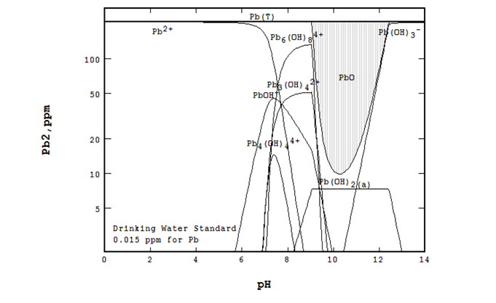
Part 2- Chemistry of Lead
Activity: Factors that influence movement of lead:
5
of 10

Slide 6
Part 2 - Chemistry of Lead
Activity: Model of lead in the body:
6
of 10

Slide 7
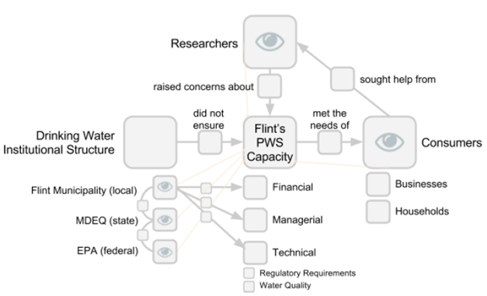
Part 3- Water Treatment Infrastructure
•Highlight the current state of American water treatment infrastructure
•Introduce different common water treatments relevant to the Flint case
•Provide timeline of major events relevant to government and policy infrastructure
7
of 10

Slide 8
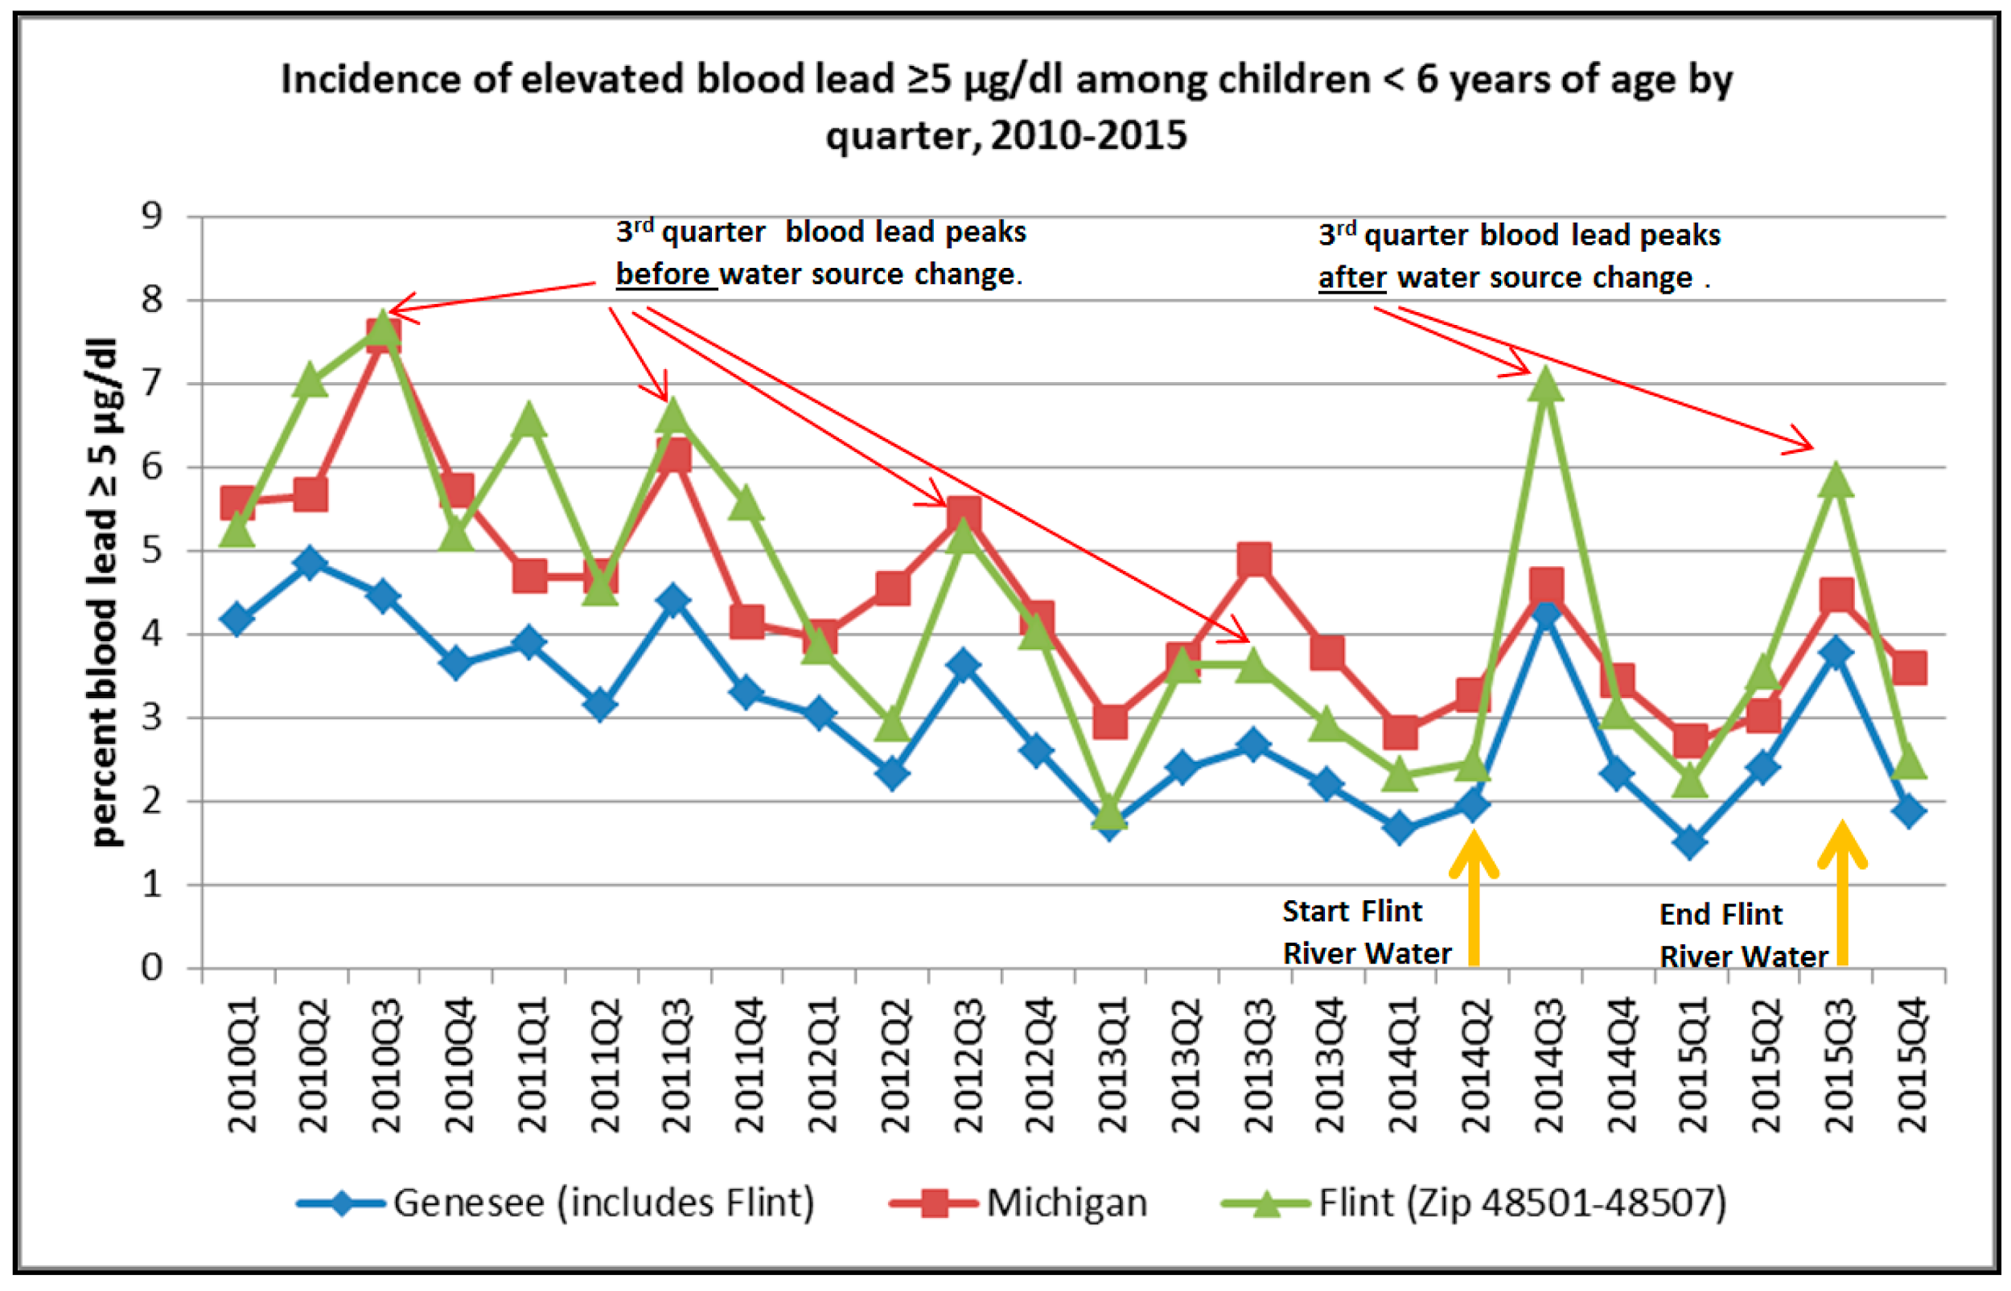
Part 4- Public Health
In process….
Identify agency’s protocols and procedure that were NOT followed in this event, that are supposed to be?
Bacterial infections caused?
Health impacts of Lead exposure?
8
of 10

Slide 9
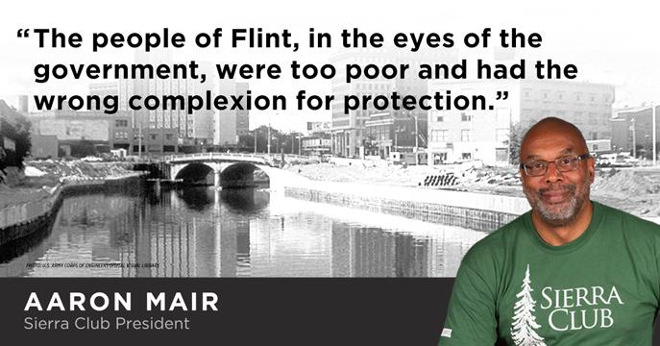
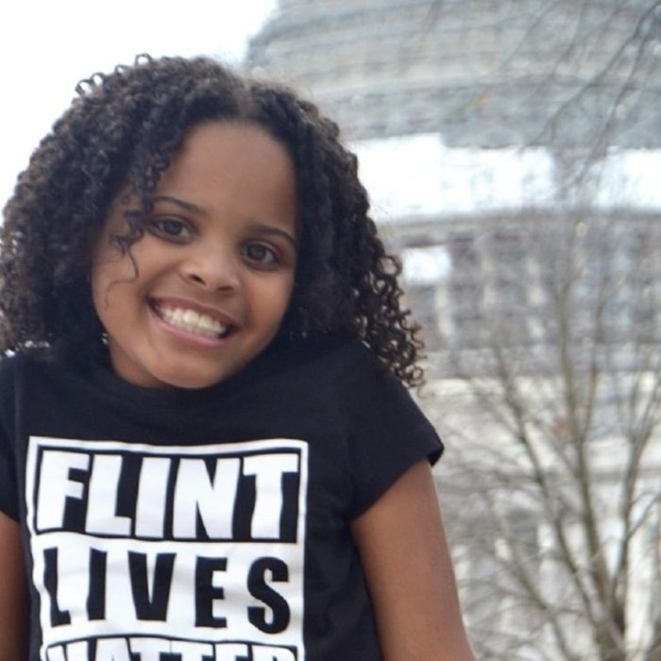
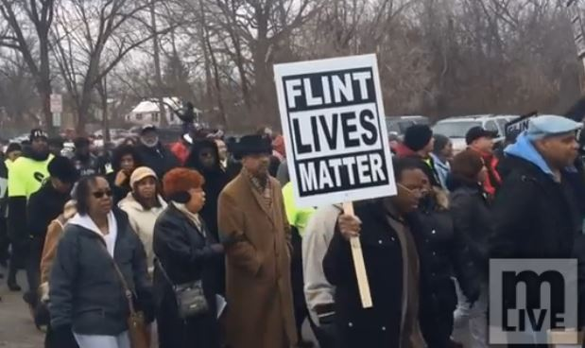
Part 5- Environmental Justice
Groupworthy Task: Is the Flint Water Crisis an Environmental Justice Issue? What evidence do you have to support your claim?
Synthesize, interpret, analyze, and model the demographics of Flint to determine who was most affected by the lead contamination
Describe environmental justice, including its origins (e.g., Robert Bullard) and growth as a movement and research how community members of Flint, MI engaged in activism. Include both successes and challenges.
9
of 10

Slide 10
Part 6- Final Project
Identify and gather local and national resources and organizations that could aid the environmental justice movement
Reflect on how the Water Crisis in Flint, MI is relevant to your own community and identify possible plans of actions that you could take within your own community to do so in the event that something similar might happen
Possible Final Project Options:
Write an EA/EIS
Write a letter to government official explaining issues using data & evidence
Design and implement a community-based final assessment
Create public service announcement about lead contamination
10
of 10

