Slide 1
Biological Networks
Soma Ghosh
Postdoctoral Research Fellow
Johns Hopkins University

Slide 2
Objectives
What is a network ?
Building Biological networks
Studying the Yeast Genetic Interaction network
Application of the Yeast Genetic Interaction network to the Yeast Genome Rearrangement project

Slide 3
What is a network ?
A network is a collection of objects
3
2
1
4
6
5

Slide 4
What is a network ?
A network is a collection of objects that are connected to each other.
3
2
1
4
6
5

Slide 5
What is a network ?
A network is a collection of objects that are connected to each other.
Terminology:
Objects → Nodes
Connections → Edges
Mathematical Representation:
Edges
Nodes
3
2
1
4
 | 1 | 2 | 3 | 4 | 5 | 6
1 | - | 1 | 0 | 0 | 1 | 0
2 |  | - | 1 | 4 | 0 | 0
3 |  |  | - | 1 | 0 | 0
4 |  |  |  | - | 0 | 1
5 |  |  |  |  | - | 0
6 |  |  |  |  |  | -
6
5
Adjacency Matrix

Slide 6
Adjacency Matrix
3
3
Degree(k) of a node = number of connections.
Hub node = node with the highest degree
2
2
1
1
4
4
6
6
5
5
 | 1 | 2 | 3 | 4 | 5 | 6 | k_{in} | k_{out}
1 | 0 | 1 | 0 |  | 1 | 0 | 1 | 2
2 |  | 0 | 1 | 1 | 0 | 0 | 2 | 2
3 |  | 1 | 0 | 0 | 0 | 0 | 2 | 1
4 |  |  | 1 | 0 | 0 | 1 | 1 | 2
5 | 1 |  |  |  | 0 | 0 | 1 | 1
6 |  |  |  |  |  | 0 | 1 | 0
Traffic pattern → Route options
Node 2 is the hub station → Eg. Penn station
How influential/connected a person is ?
Common food ingredient used in all types of cuisine
 | 1 | 2 | 3 | 4 | 5 | 6 | k
1 | 0 | 1 | 0 | 0 | 1 | 0 | 2
2 |  | 0 | 1 | 1 | 0 | 0 | 3
3 |  |  | 0 | 1 | 0 | 0 | 2
4 |  |  |  | 0 | 0 | 1 | 3
5 |  |  |  |  | 0 | 0 | 1
6 |  |  |  |  |  | 0 | 1
Undirected
Directed

Slide 7
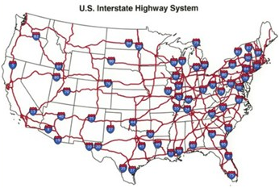
Common examples
Flavor network
Ahn, Y., Ahnert, S., Bagrow, J. et al. Flavor network and the principles of food pairing. Sci Rep 1, 196 (2011).

Slide 8
Fun projects to try
Use the Baltimore Link map to build a network of Baltimore city transit route and identify hub stops, densely used routes and all possible routes that you can take from your home to BUGGS.
Build you Facebook network using 20 facebook friends. Colour the connections based on the type of friends (school, neighbour, cousin). Weigh the nodes according to number of friends.

Slide 9
Biological networks – Basic components
Bing Zhang
Department of Biomedical Informatics
Vanderbilt University

Slide 10
Biological networks – Basic components
Nodes → Gene/ Protein/ Metabolite
Edges → interactions (direct/indirect)
regulators
co-expression
similarity
metabolic pathway
Edge weights → expression levels,
condition specific

Slide 11
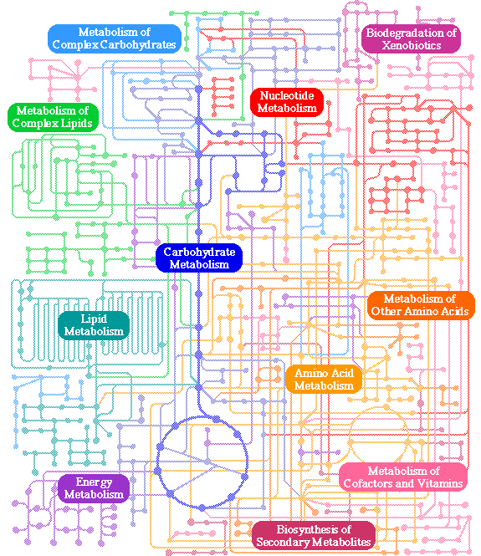
Biological networks – Examples
Metabolic networks:
Nodes → metabolites
Edges → metabolic reaction
KEGG database

Slide 12
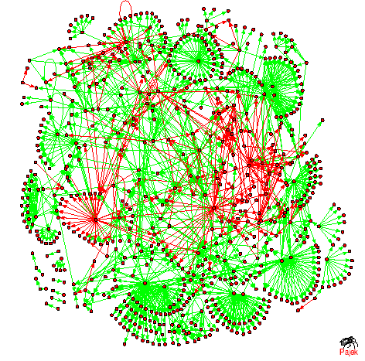
Biological networks – Examples
Transcription Regulatory networks:
Nodes → proteins
Edges → regulator
green → activation
red → inhibition

Slide 13
Network Analysis
1. Making sense out of biological networks

Slide 14
Network Analysis
Analysis involves:
Understanding the characteristics of the network
Modularity
Comparison with other networks (i.e., random networks)
Visualization involves:
Placing nodes in a meaningful way (layouts)
Mapping biologically relevant data to the network
Node size, node color, edge weights, etc
…which then allows for more analysis!

Slide 15
Network Analysis
1. Cytoscape (Shannon,P. et.al Genome Research 2003 Nov; 13(11):2498-504)
Cytoscape is an open source software platform for integrating, visualizing, and analyzing measurement data in the context of networks.

Slide 16
Network Analysis
2. CellNetVis (Heberle,H. et.al BMC Bioinformatics 2017; 18(395))
Constrained by sub-cellular space

Slide 17
Installing Cytoscape

