Slide 1
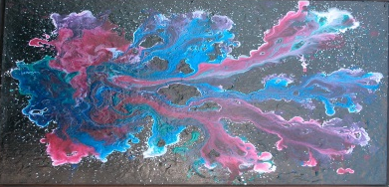
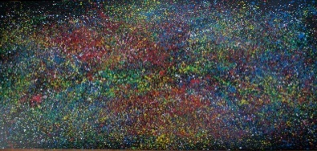
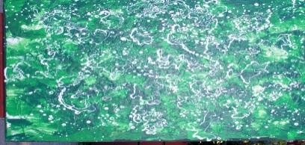
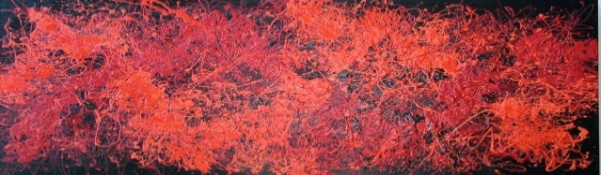


RCN-UBE Summit, January 14-16, 2016
A Brief History of RCN and RCN-UBE:
Transitioning from “Me” to “We”
and Harnessing the Power of the Network
Christopher R Meyer
Program Director, DBI
January 14-16, 2016
Embassy Suites Hotel DC Convention Center
Artwork by Robert Schimke

Slide 2
Who Am I?
Background, Education, Influences:
Native Californian: Student at Sierra College, Chico State University, University of California, Riverside
Michigan State University (Postdoctoral Scholar and Visiting Research Assistant Professor)
Chemistry and Biochemistry, CSUF: Assistant Professor to Chair
Program Director, NSF BIO MCB 2008- 09, DBI 2015 -
National ACS Committee on Professional Training
ASBMB Minority Affairs Committee (NEW 2015)
Commitment to teaching, research, service, and the best training for the next generation of scientists: Learning by Doing (early exposure to research), Integration of Teaching and Research, Collaborative and Interdisciplinary Training/Ideas Lab PI/Mentor

Slide 3
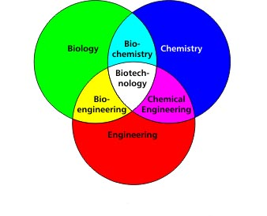
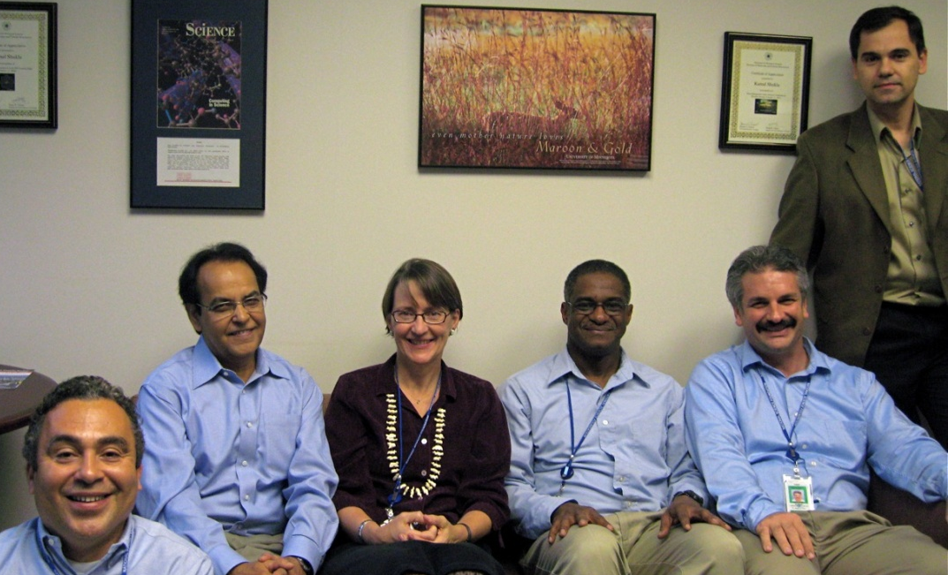
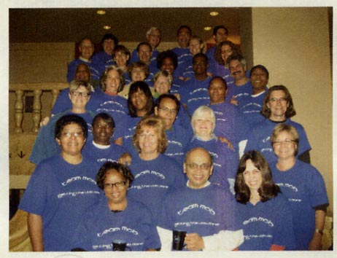
I had a very enriching year at NSF—Ideas, Inspiration, Innovation…
and it is great to be back and serving in DBI!
I enjoyed many conversations with colleagues from all over the country (and world) about their science, engagement with students, their optimism and aspirations for the future, and their concerns about issues and barriers at their institutions that held them back from executing both the simple and complex …We are all in the same “life boat”

Slide 4
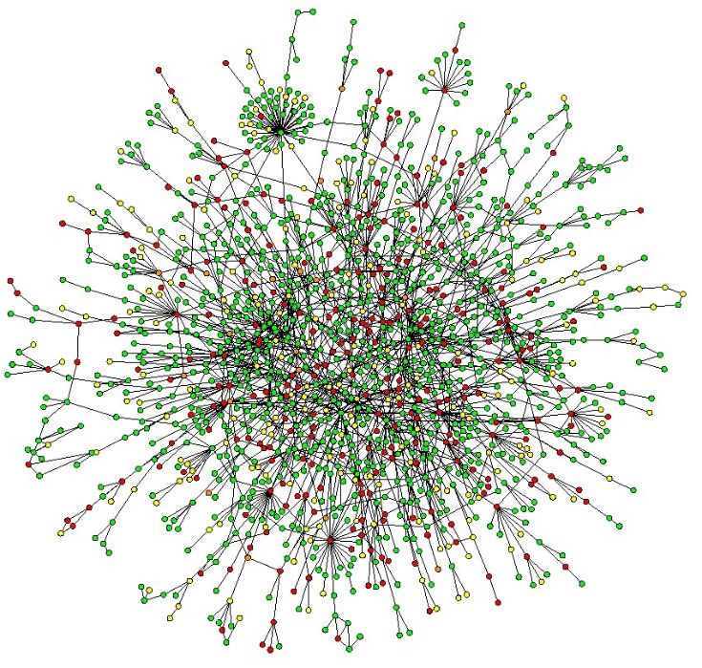


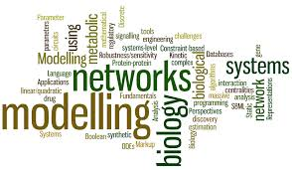
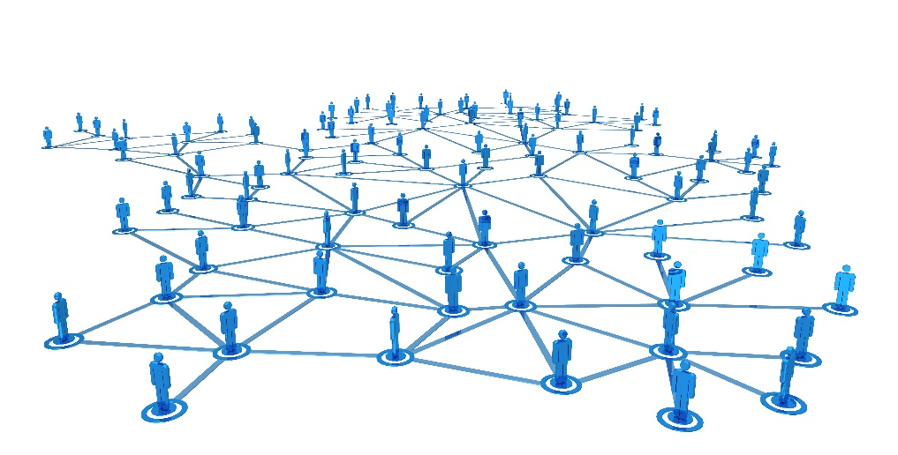



Popular Images of Networks….

Slide 5
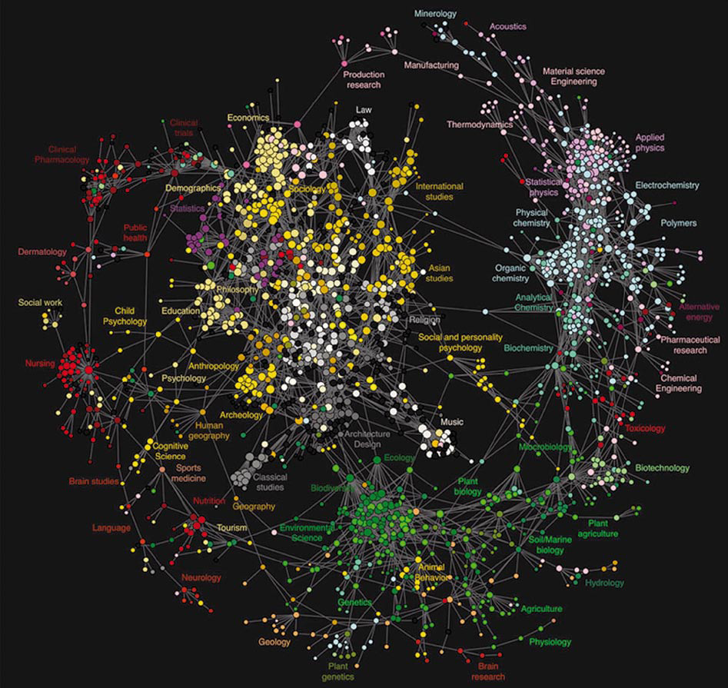
Map of Science (2009) in report by European Science Foundation – the “Future of Knowledge”- Mapping Interfaces: Highlights social sciences and also illustrates the few connections to the biophysical sciences and engineering fields…

Slide 6
Brief History* of the RCN Program… Motivation:
BioScience®
A Forum for Integrating the Life Sciences
American Institute of Biological Sciences
A Route to Boundary Crossing?
Many thoughtful observers of the scientific scene have stressed the need to encourage more research that crosses traditional disciplinary boundaries. Although few argue against that proposition in the abstract, turning the aspiration into reality has often seemed difficult, largely because the traditional reward systems of academia and grant giving have tended to favor work that, instead, fits into well-known categories and so can be more easily assessed. …
March 2012 / Vol. 62 No. 3 • BioScience 215
NSF BIO established the RCN Program in 2000 to “foster communication and promote collaboration among scientists with common interests from a broad background across disciplinary, geographical, and organizational boundaries”…
“…the RCN program appears to be changing the way bioscience is done—not in a paradigm breaking
way but by fostering new research networks…. RCN presents an exciting way to facilitate interdisciplinary research to address especially complex and challenging natural issues. Perhaps the notion of supporting research coordination networks could extend effectively to societal, technological, and other types of challenges as well.” -From Porter, A.L., Garner, J., and Crowl, T. March 2012 / Vol. 62 No. 3 • BioScience 215, 282 - 288
*Not meant to be comprehensive; the development of the RCN-UB E represents the dedicated work of many people..

Slide 7
NSF 09-057
Dear Colleague Letter: Incubator Proposal Opportunity for Research Coordination Networks - Undergraduate Biology Education
Dear Colleague:
We call your attention to an additional mechanism to support collaborations aimed at injecting new ideas and approaches into undergraduate biology curricula. As part of our effort to stimulate positive changes in biology education, we will accept proposals that request support for the initial development of networks that will catalyze positive changes in biology undergraduate education.
The Undergraduate Biology Education track in the Research Coordination Network program (RCN-UBE) considers proposals that will enhance communication and coordination among scientists and educators who are exploring new approaches to enhance undergraduate biology education. The proposed networking activities should have a theme as a focus of its collaboration. The focus could be on a broad research question, a specific group of organisms, or particular technologies or approaches…..
We look forward to receiving your proposals.
Sincerely,
James P. Collins Wanda E Ward
Assistant Director, National Science Foundation Acting Assistant Director, National Science Foundation
Biological Sciences Education and Human Resources

Slide 8
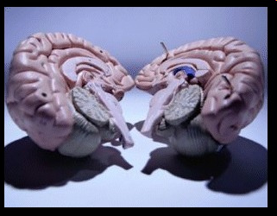
SOLVING THE SPLIT BRAIN PROBLEM
FOR UNDERGRADUATE FACULTY
TEACHING
RESEARCH
-from Brad Goodner, Hiram College

Slide 9

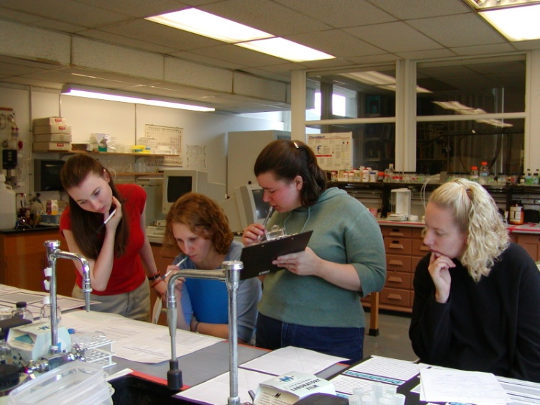
Introduce Students to Research Early & Often
--From Brad Goodner, Hiram College

Slide 10
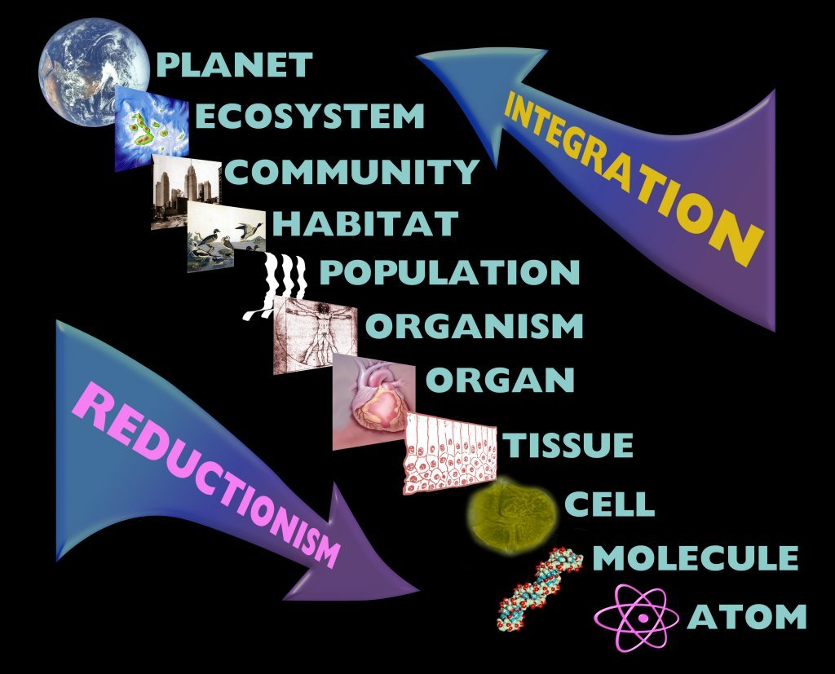
Brief History of RCNs
-From RCN 2nd Awardees Meeting Report
Arlington, VA
September 12-13, 2005
-Attended by 42 scientists
-Representing 37 of 38 active RCN projects
This is not much different in size and scope from this FIRST RCN-UBE Summit!

Slide 12
Five elements to bridge disciplines and foster collaboration
Face to face
Fostering personal contacts
Finding common ground and language
Defining shared interests
Focused questions
Establishing boundaries (geographic, conceptual)
Building bridges
Travel grants for extended inter-lab exchanges
Integrating activities at meetings
Creating focused task groups
Build a network of collaborations
Establishing trust
Encourage synthesis activities that accomplish more than any one person could have achieved.

Slide 13
Lessons From the Ecology PUI Community*:
Some Characteristics of Sustained Networks (no single framework!):
Frequent communication
Shared research focus and enthusiasm
Transparent structure for rewards and data access
Strong leadership and organization
FUNDING
Related to this:
Web networks that could serve as useful models, including for the artic hub for NSF to identify gaps in knowledge (https://www.arctichub.net/community ) and http://astrobiologyfuture.org/ with NASA to develop the next generation of the astrobiology roadmap.
*Bowne, D.R. et al (2011) Transforming Ecological Science at Primarily Undergraduate Institutions through Collaborative Networks. BioScience 61: 386-392.

Slide 14
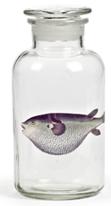
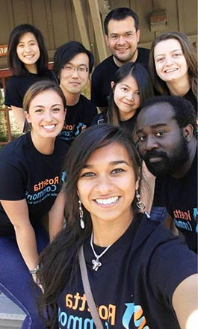
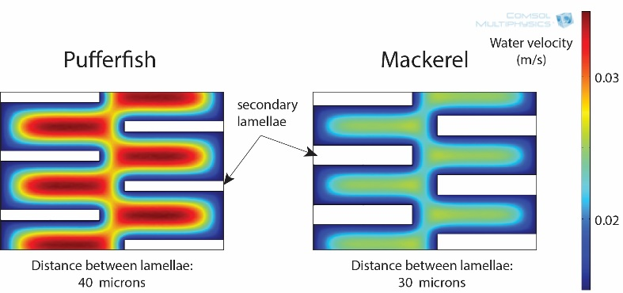
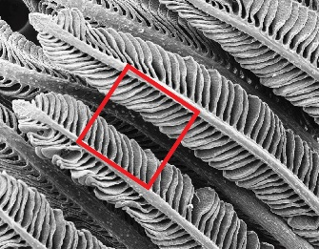
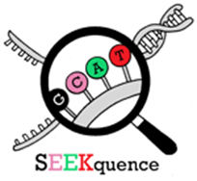
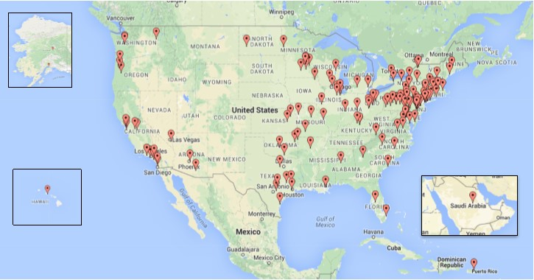
DBI-Human Resources: At the Leading Edge of Training the Biological Workforce
Postdoctoral Fellowship Program: Collections
REU:EAGER: A Virtual Community of Researchers in Computational Biomolecular Structure & Design
Using museum collections to model interspecific variation in hydrodynamics and oxygen uptake over gills
Week 10: Rosetta Conference to present a poster and connect with Rosetta developers from around the world
Week 1: Boot Camp to learn Rosetta coding
Students disperse to conduct research at 10 sites (8 have other REUs)
RCN-UBE Program: GCAT-SEEK: Genome Consortium for active undergraduate research and teaching using NGS
Stacy Farina
Workshops for development and to generate educational modules
Network with over 200 members (PUI and MSI institutions)
Over 1000 students
Products include 9 papers (6 with student co-authors)

Slide 15
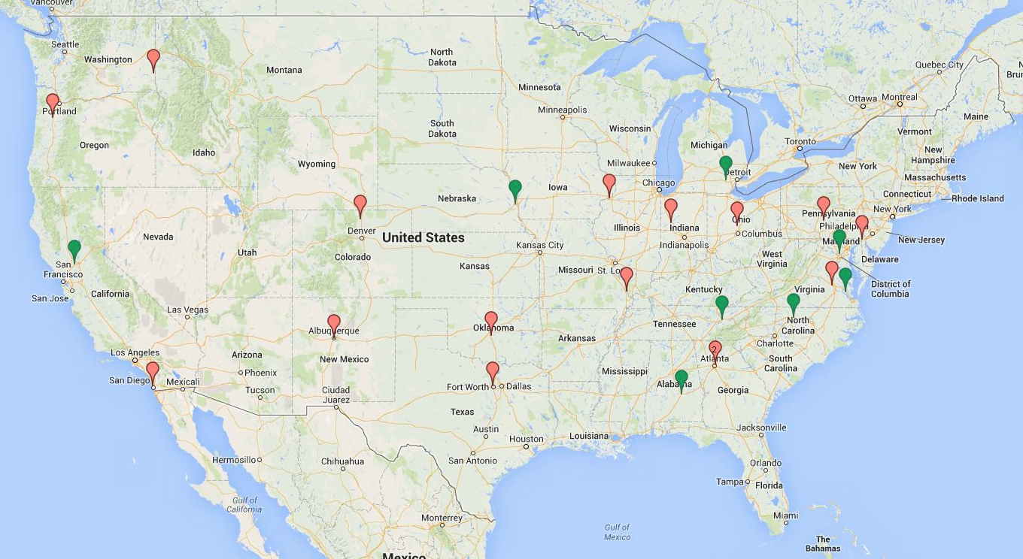
RCN-UBE Active Site Map of Full (16) and
Incubator (7) Awards (2015)*
*As of May 2015

Slide 16
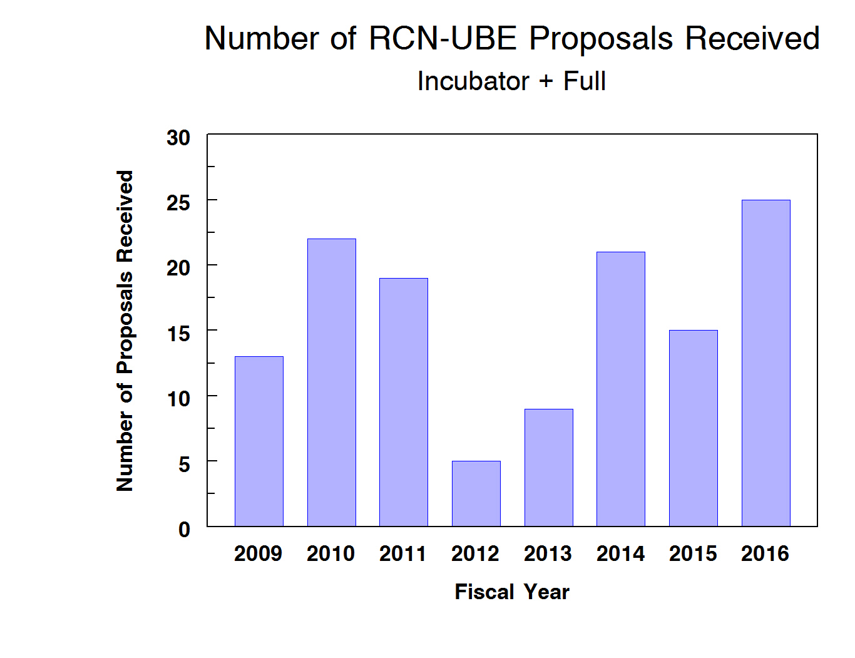
2013: 9, 3 Full
6 Incubator
2014: 21, 9 Full
12 Incubator
2015: 15, 7 Full 8 Incubator
2016: 25, 13 Full
12 Incubator
It should be noted that a few awards were also made in 2008

Slide 17
RCN-UBE
Summary of Funded Areas
 | 23 Active Awards | 15 Panel Reviewed | 5 Potential Awards
Faculty Professional development | 4.5 | 6 | 3
Emerging fields into Bio Curriculum | 5 | 3 | 1
Active Learning | 4.5 | 2 | 1
Improved Assessment | 2.5 | 1
Improve Transition from 2-4 yr institutions | 2 | 0
Authentic Research Experiences | 5 | 2
Emerging Technologies in Classroom | 1 | 1
-Example of preliminary binning of proposals based on area

Slide 18
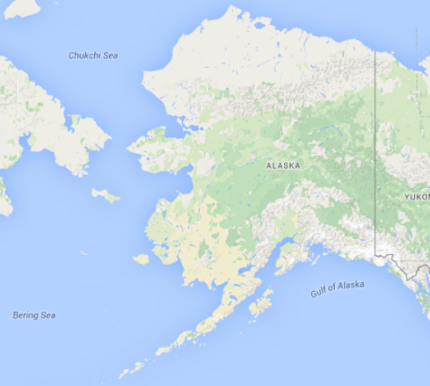
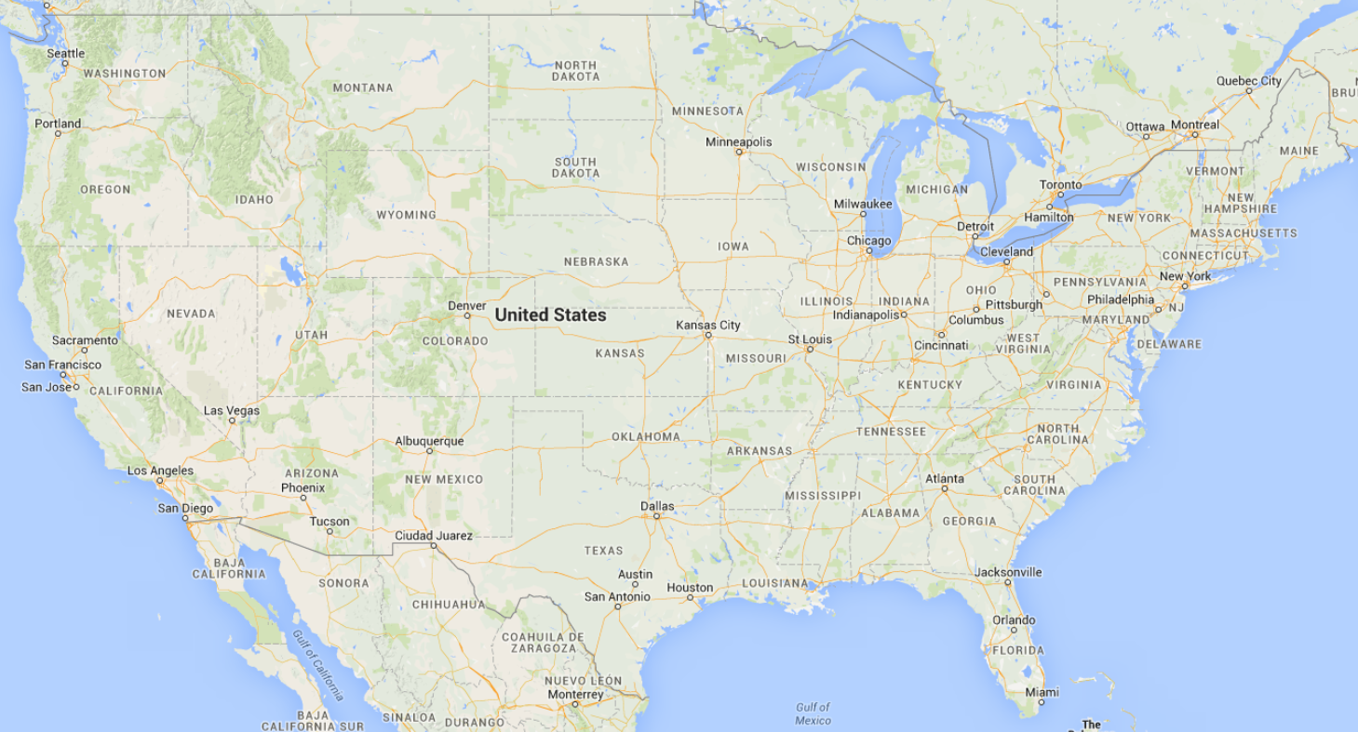
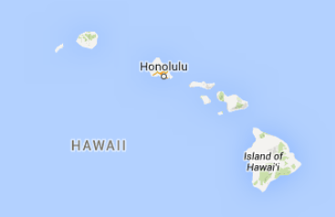
RCN-UBE - GCAT-SEEK: The Genome Consortium for Active Undergraduate Research and Teaching Using Next-Generation Sequencing
Proposal: 1248096
PI: Vincent Buonaccorsi
Start

Slide 19
RCN-UBE - GCAT-SEEK: The Genome Consortium for Active Undergraduate Research and Teaching Using Next-Generation Sequencing
Proposal: 1248096
PI: Vincent Buonaccorsi
Current

Slide 20
RCN-UBE: Advancing Integration of Museums into Undergraduate Programs (AIM-UP!)
Proposal: 0956129
PI: Joseph Cook
Start
Notes:
Question Chuck is not listed as PO Douglas Levy is?

Slide 21
RCN-UBE: Advancing Integration of Museums into Undergraduate Programs (AIM-UP!)
Proposal: 0956129
PI: Joseph Cook
Current
Notes:
Question Chuck is not listed as PO Douglas Levy is?

Slide 22
RCN-UBE Incubator: Biology Teaching Assistant Project (BioTAP)
Proposal: 1247938
PI: Elisabeth Schussler
Start

Slide 23
RCN-UBE Incubator: Biology Teaching Assistant Project (BioTAP)
Proposal: 1247938
PI: Elisabeth Schussler
Current

Slide 24

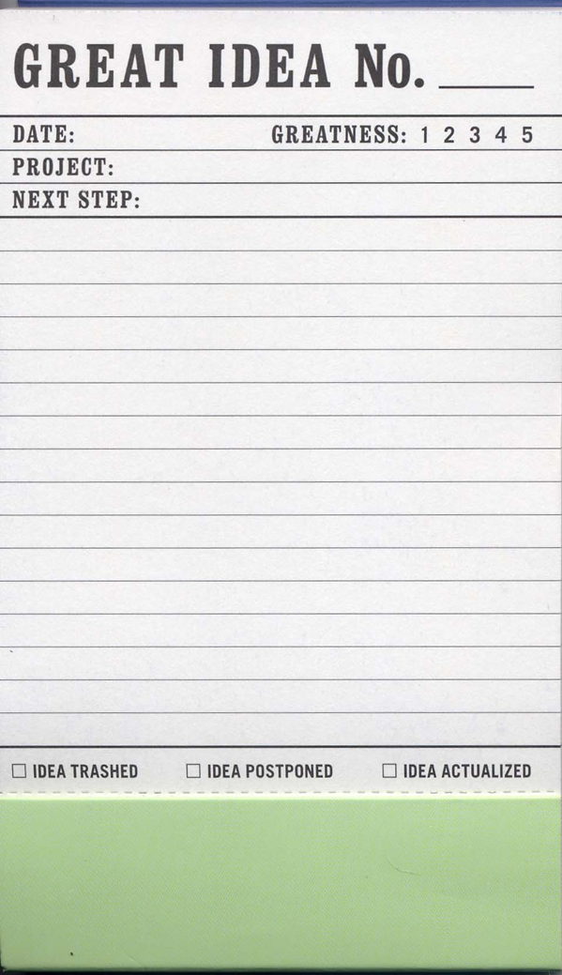
Notes:
Lots of great ideas out there in the community…I regularly brainstorm with Andy Burnett of Knowinnovations and I think his ongoing work with DEB on Broadening Particpation with the use ofr Appreciative Inquiry is terrific to identify best practices…just a few examples…

Slide 25
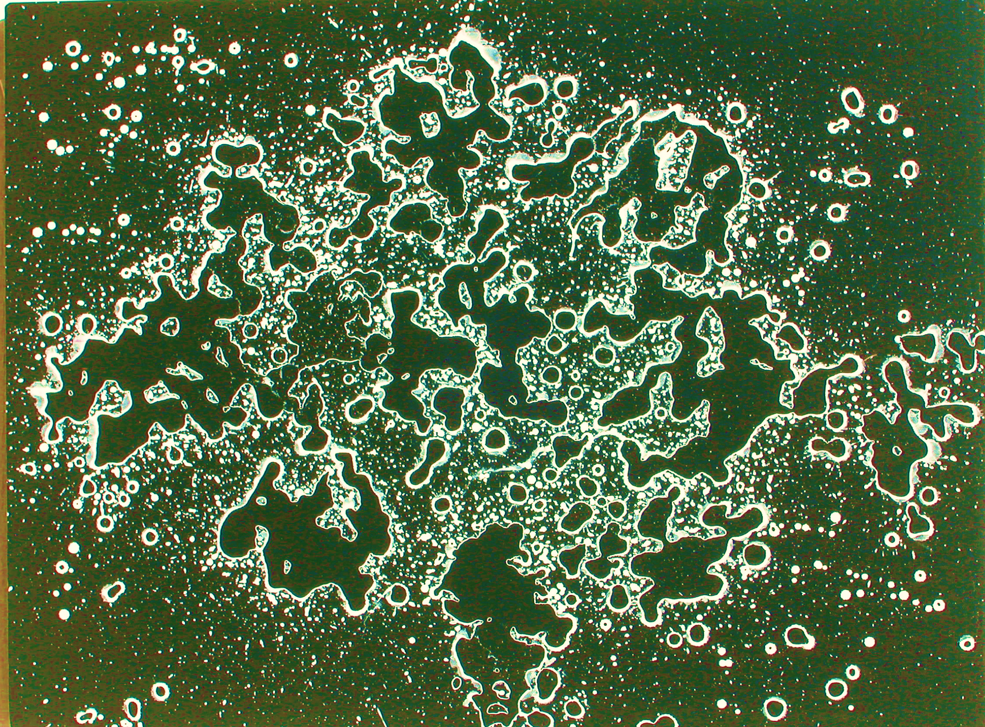
Some Goals…
A vision for the future
Recommendations for best practices—targeting all stakeholders!
Continuing networking and communication…
A report summarizing our conversations and ideas
We need all hands on deck!

Slide 26
Thank-you for your dedicated service to the community by your leadership roles in RCN-UBE projects—these interdisciplinary and collaborative efforts are essential to the progress of science and education!
It is a very altruistic endeavor to lead a network—emphasizing “we” over “me”. Often this critical work in underappreciated and does not receive the attention of single investigator driven awards.
The impact of networks go far beyond the counting of papers—the information and training that flows through a network can influence and benefit hundreds and thousands of individuals, having a transformative effect on research and education.

Slide 27
Keep Darwin’s Words in mind:
“ It is not the strongest of the species that survives, nor the most intelligent that survives;
it is the one that is the
MOST ADAPTABLE ! ”

