Slide 1
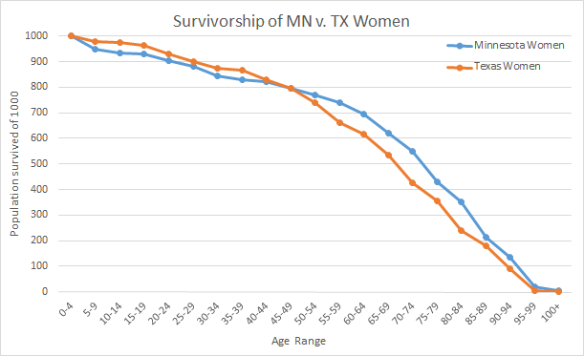
Survivorship of Women in Different Climates
Jessica Howell, Mikayla Bridgeman, Erin Seeman, Nadin Hamida
Introduction
The goal of this study was to find the effect of climate on the survivorship of women by creating and interpreting survivorship curves. Survivorship curves in this experiment are a visual tool used to display the relationship between two populations in the form of a graph. Survivorship curves are graphical representations of numbers or fractions of individuals all born at the same time (a cohort) that die at a given age (Genet 2016). Type one curves have a high rate of survivorship in early years and then survivorship drops rapidly because the organism has reached the end of its life span (Reece et al. 2014). Furthermore, humans tend to show the survivorship curve similar to the type one curves. This study compared the survival rates of women within two different climate ranges. While there are many studies comparing the survivorship of women to that of men or women of different races there was a surprising lack of studies done pertaining to climate. By comparing women in different climates within the same country we would be able to see if it had any profound effect. We hypothesized that climate would have an effect on the survivorship of women. Then, we predicted that women in warmer climates would have a lower rate of survival when compared to that of colder climate women. Warmer climates bring with it a series of health problems including dehydration and heat exhaustion to name a few. Using this study we were able to test this hypothesis and develop a reasonable answer to our question.
Discussion
The central question we asked was: what is the effect of climate on the survivorship of women? Furthermore, we hypothesized that there is a negative effect of a warm climate on women and predicted that urban women from a cool climate have a greater survivorship than women from a warm climate. By interpreting our data, we could conclude that our hypothesis was not strongly supported. From our results we could suggest that there might have been an increase in survivorship of Minnesota women after the age of 50. Texas women could have had a lower survivorship in the later years of their life because some of the cemetery data had veterans from the service. As they came back from combat, their health would have declined and led to less survivorship. Nevertheless, the graph shows that Minnesota women had less survivorship from the ages 0-50. Therefore our hypothesis can not be supported because we do not have enough evidence. Some errors in our experiment could have been choosing to big of a time frame in which people had died. Also, we did not look at the amount of individuals in each county so that could have an effect on our data. We used seven counties in Minnesota and only four in Texas which could have an effect of the survivorship in our study. If we were to do our experiment again, we would look at more specific death years rather than 150 years and look at climate regions that had the close to the same amount of individuals. Some further research would be specific types of women survivorship between states. For instance, women suffering from specific diseases or women in a certain type
of work field.
Abstract
In this experiment we came up with a central question: what is the effect of climate on the survivorship of women? Then, we hypothesized that there is a negative effect of a warm climate on women and predicted that urban women from a cool climate have a greater survivorship than women from a warm climate. Humans fall under the type one curve for survivorship because they take care of their young until adulthood. Furthermore, we looked at the difference of survivorship in women between the two states: Minnesota (cool) and Texas (warm). We used cemetery data to enter the age at death of 200 women from seven Minnesota counties and 200 women from four Texas counties. We used this information to get a standardized number of individuals and then interpreted our results to see if our hypothesis and prediction was correct. Nevertheless, the data suggested that our hypothesis was not strongly supported and needed revisions.
Figure 1: The population for survivorship of urban MN women and TX women between the ages of 0-100+
Methods
We looked at cemetery records to get the age at death of the urban women from both Minnesota and Texas. We obtained the cemetery records from http://interment.net/. We accumulated 200 subjects from each state whose deaths were between the years 1866 and 2016. When we collecting from both states we did not collect any records from calvary cemeteries in the thought of them dying from war rather than climate influences.
When getting subjects from the Minnesota cemetery records we used the information from the University of Minnesota Extension website that had a map of Minnesota's urban counties. We took cemetery records form the urban counties that had cemetery counties available. The counties that we used were Dakota, Scott, Stearns, Le Sueur, Wright, Isanti, and Ramsey.
We took 50 women from each of the counties of Dakota and Scott. We took 25 women from each of the counties of Wright, Isanti, and Ramsey. We took 19 women from Stearns County and 6 women from Le Sueur County.
For any county that we had multiple cemeteries available we proportioned the number of women taken from each cemetery based on how many records the cemeteries had.
We preformed the same procedures when looking for 200 subjects from urban Texas regions. But instead of a map of Texas split into urban areas and non-urban areas we used the Texas Department of Housing and Community Affairs Emergency Solutions Grant PDF. We cross referenced this with the cemetery records and used the counties that had available records.
All the data was entered into an excel spreadsheet including the number of individuals in each age class, the number and probability of individuals surviving to start, and a standardized number of individuals was calculated by multiplying by 1,000.
Results
There was a greater drop in MN than TX women during the ages of 5-49.
Once Texas women passed the age of fifty they declined at a greater rate than Minnesota women
Between the ages of 35 to 44 there was the same survivorship between the two states.
The results shows that the climate may have an effect on women survivorship in MN and TX.
Literature Cited
Genet (2016, p. 1) defines a survivorship curve as a "graphical
representation of the numbers or fractions of individuals in a cohort that die at a given age."
Reece et al. (2014, p. 1188) describes the different types of
survivorship curves. The one that was focused on was the type one curve.

