Slide 1
Color Vision (Deficiencies)
Shuchismita Dutta
Feb 17, 2023

Slide 2
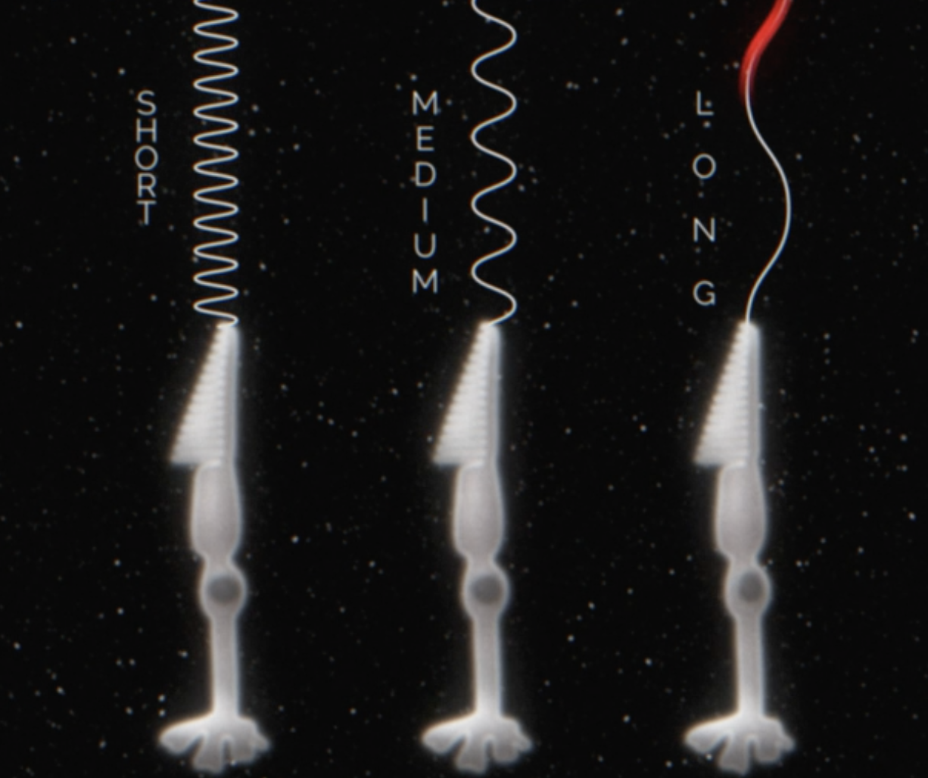
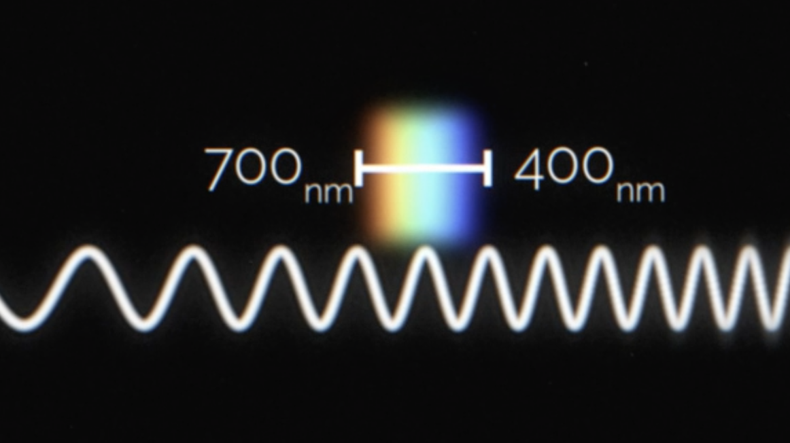
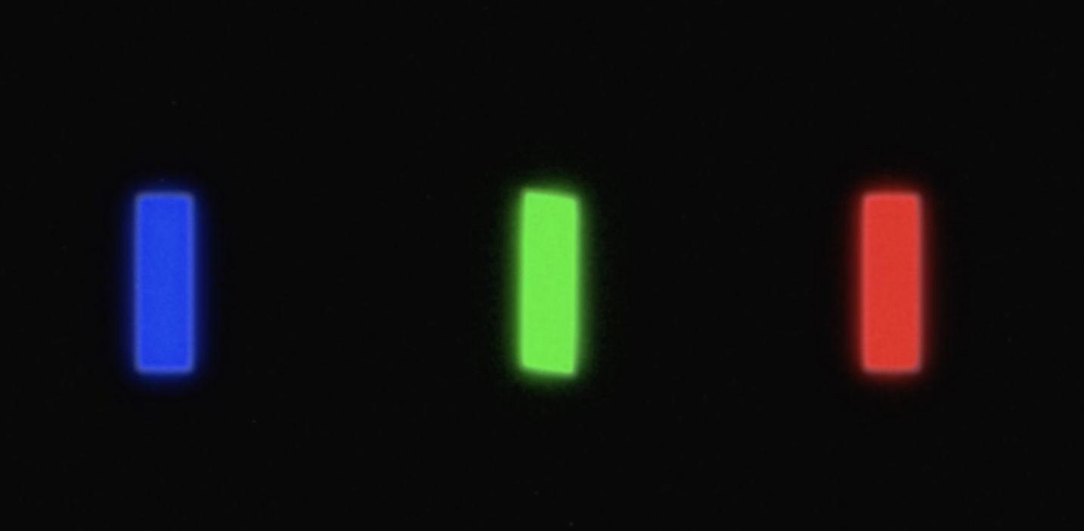
We see colors…
Cone pigments
S
M
L
Visible light - R→B
Rod cells for low light vision
Cone cells for bright light vision
3 classes of pigments (S, M, L) have different spectral sensitivities
B
G
R
Img Source: https://www.bbc.com/reel/video/p0f00wp9/magenta-the-colour-that-doesn-t-exist

Slide 3
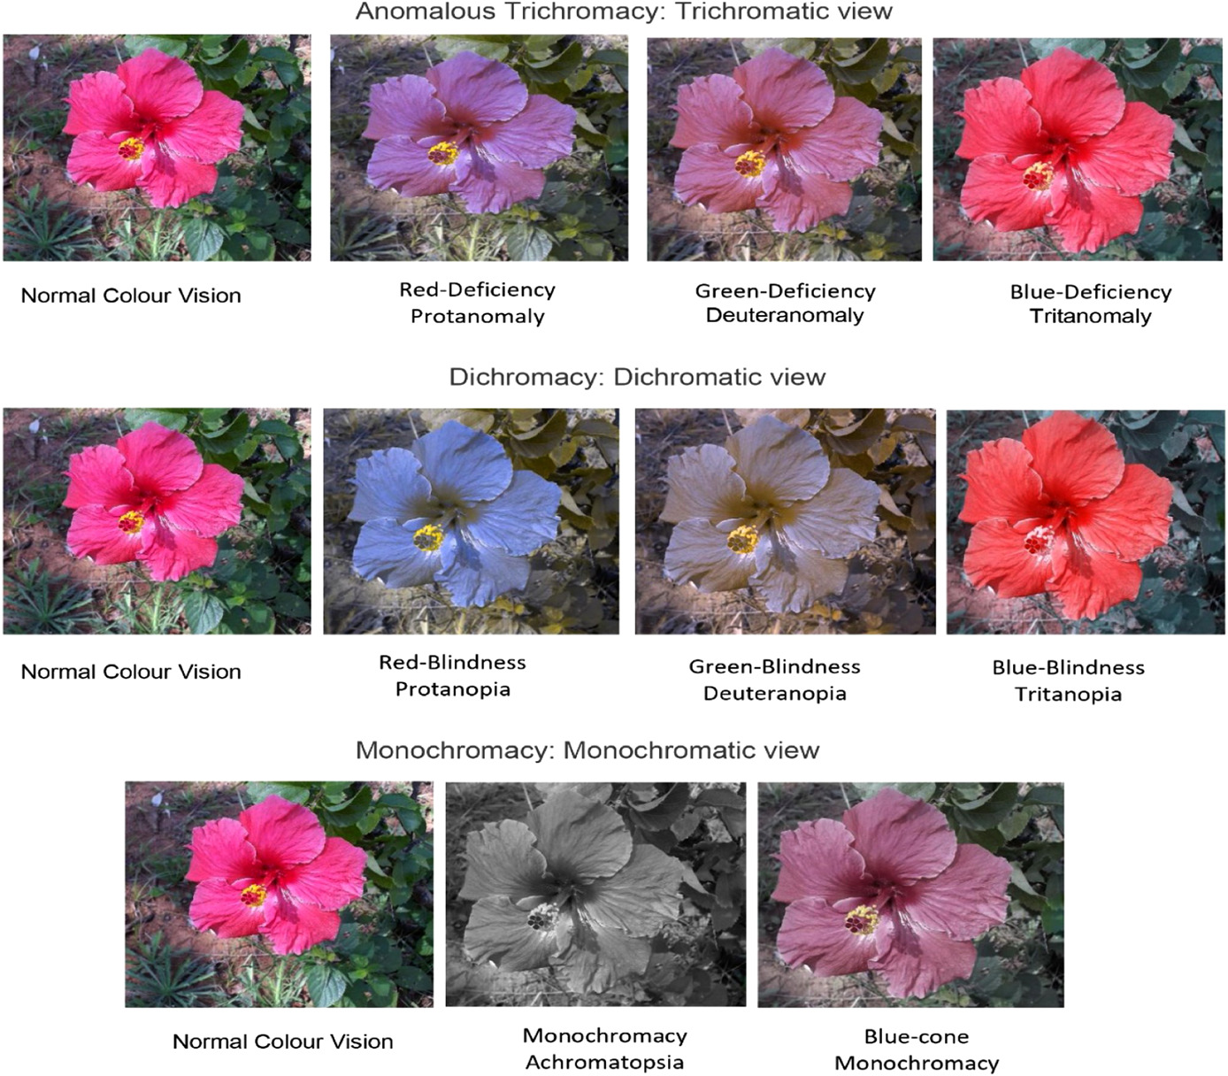
Color Vision Deficiencies (CVDs)
Normal (trichromats) vision needs at least 1 each of the S, M, and L pigments
prefix deutan: defects due to absence of M cones
prefix protan: defects due to absence of L cones
prefix tritan: defects due to absence of S cones
red-green color vision deficiencies: Inherited protan and deutan defects are common, affecting about 8% to 10% of men in the United States.
blue CVD or congenital tritan defects are rare, affecting < 1 in 10,000 people
Most common cause of red-green dichromacy - deletion of cone pigment genes (producing opsins)
doi:10.1001/archopht.118.5.691
https://doi.org/10.1002/hsr2.842

Slide 4
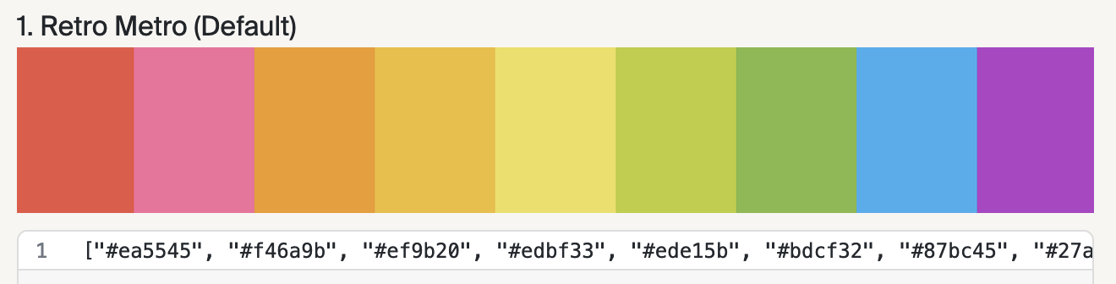
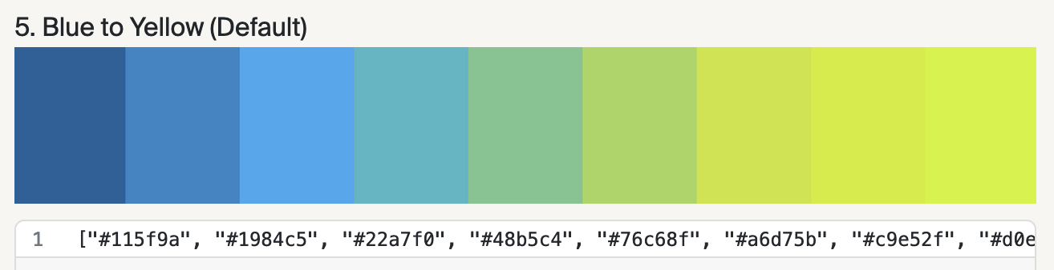
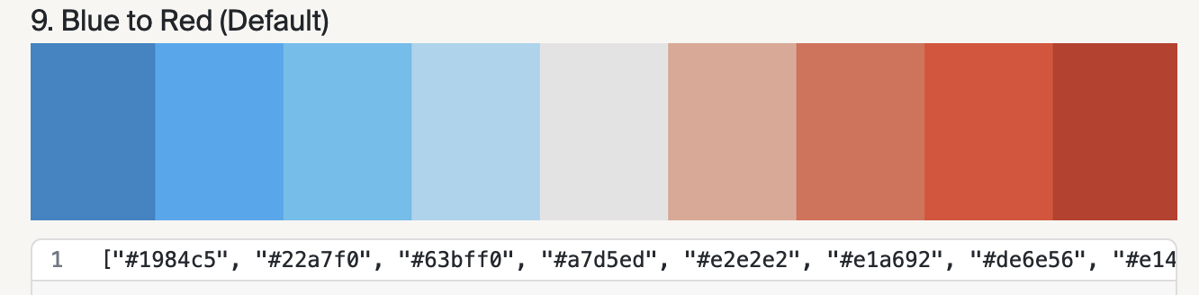
Color Palettes used in Data Visualization
Categorical - when the data variable has distinct labels and no natural order
Sequential - when the variable is numeric or possesses naturally ordered values
Diverging - when the variable is numeric and has a significant center value. This palettes is composed of two sequential palettes that share an endpoint and assigns easy to distinguish sequential colors to values that fall on either side of the center
Source: https://www.heavy.ai/blog/12-color-palettes-for-telling-better-stories-with-your-data
For more information - see also https://blog.datawrapper.de/diverging-vs-sequential-color-scales/

Slide 5
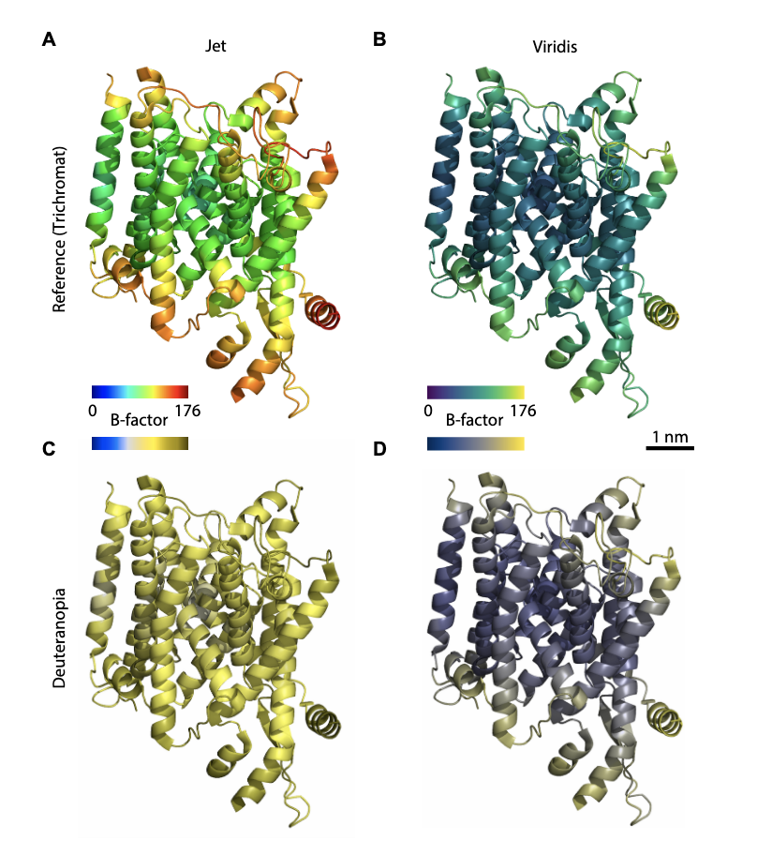
Using colors in biomolecular structure visualization
Structural biologists, let’s mind our colors, by Shyam M. Saladi, Ailiena O. Maggiolo, Kate Radford, William M. Clemons, Jr. 2020 (https://doi.org/10.1101/2020.09.22.308593)
Color blind-friendly palettes available at colorbrewer2.org, kuler.adobe.com, medialab.github.io/iwanthue, colorcyclesurvey.mpetroff.net etc.
check colormaps for perceptual uniformity or figures for color blindness-accessibility (e.g. colororacle.org, Colorblindly).
Patches to make Viridis and accompanying colormaps easily accessible in PyMOL, ChimeraX, and VMD can be found in github - see https://doi.org/10.1101/2020.09.22.308593

Slide 6
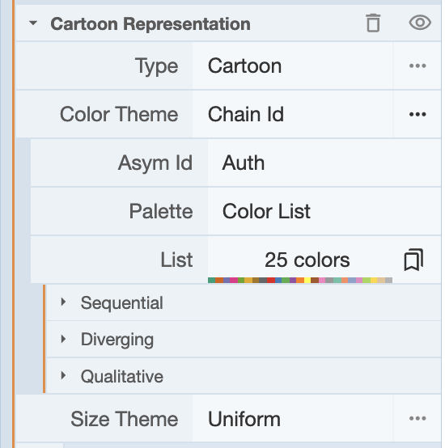
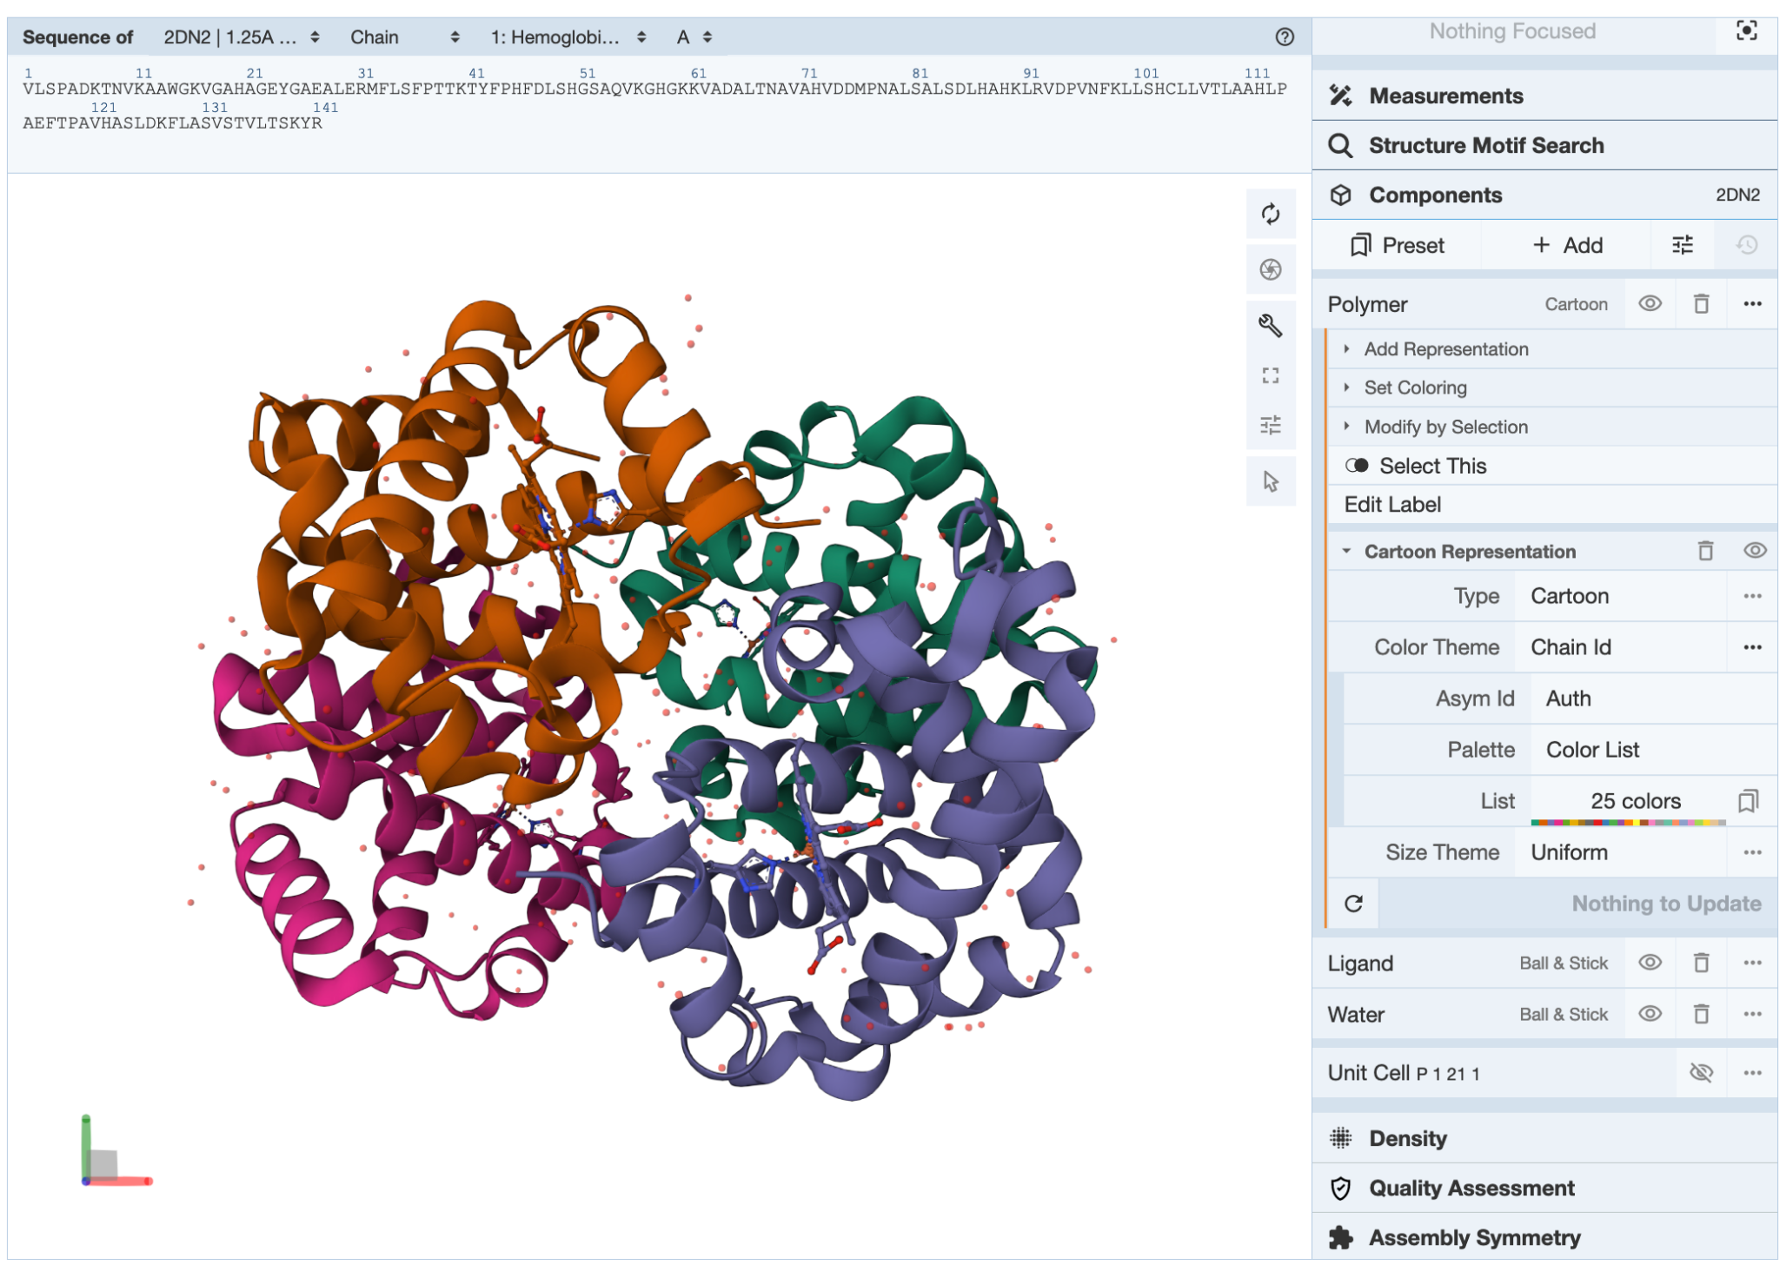
What happens in Mol*

Slide 7
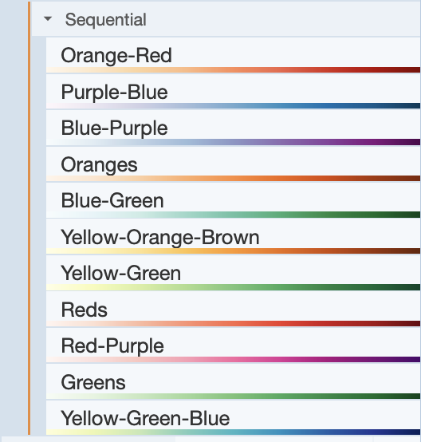
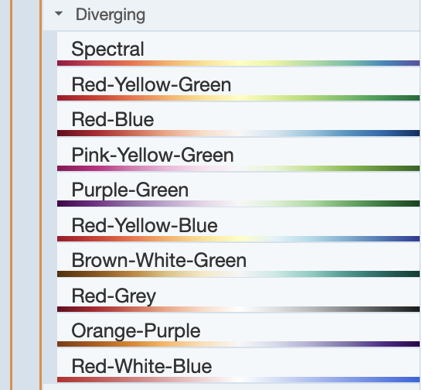
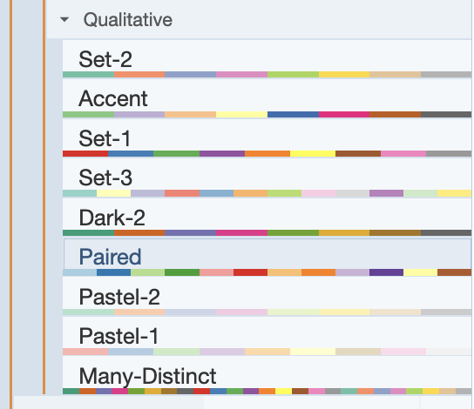
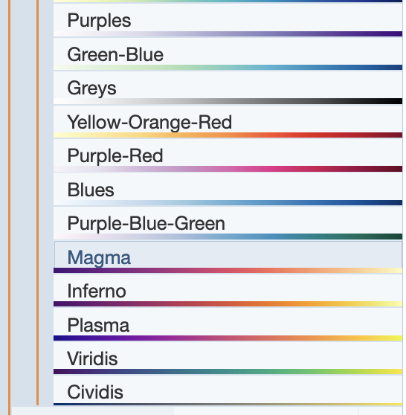
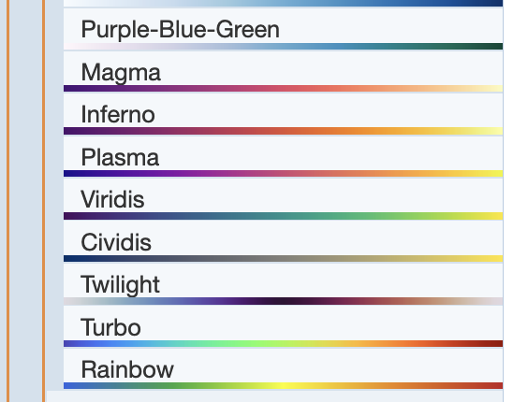
Options in Mol*
Which one of these color palettes work for individuals with CVDs?

Slide 8
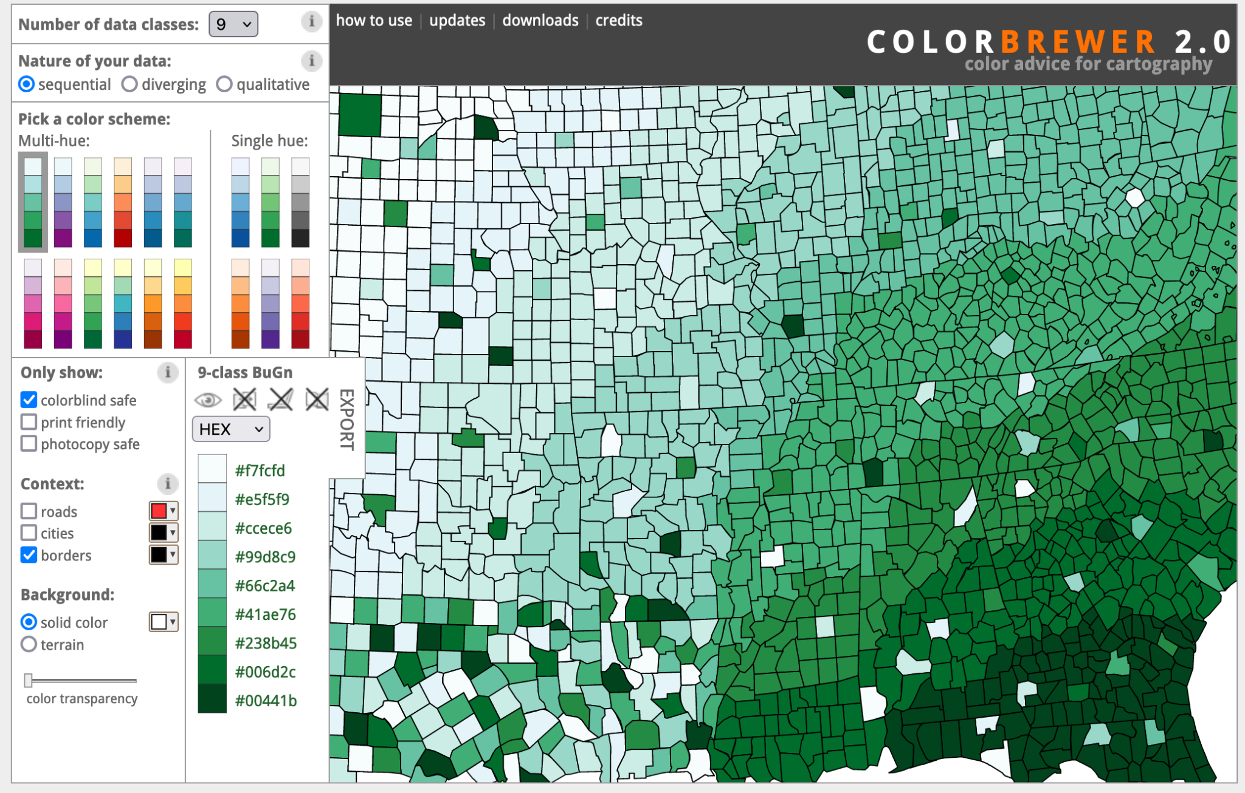
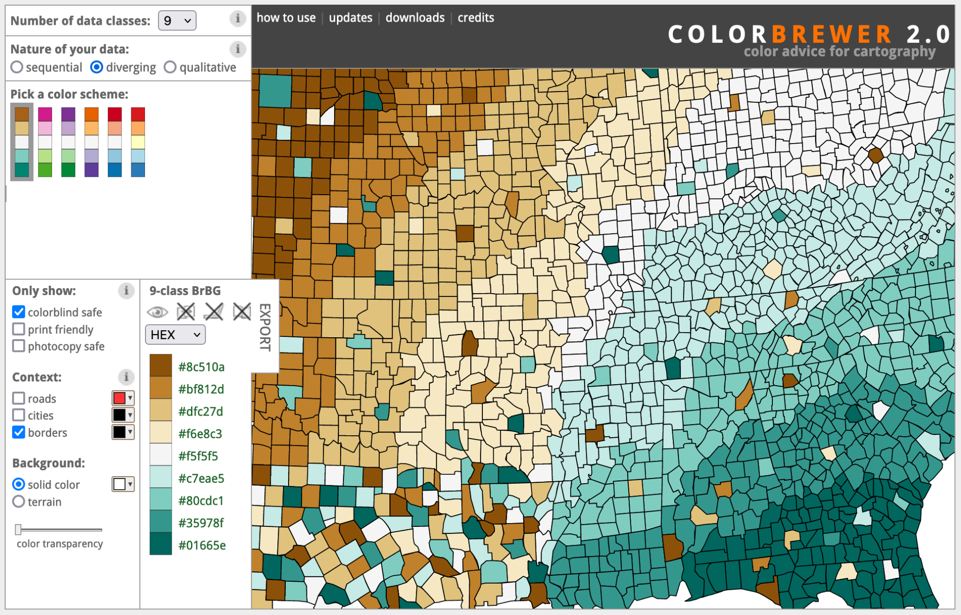
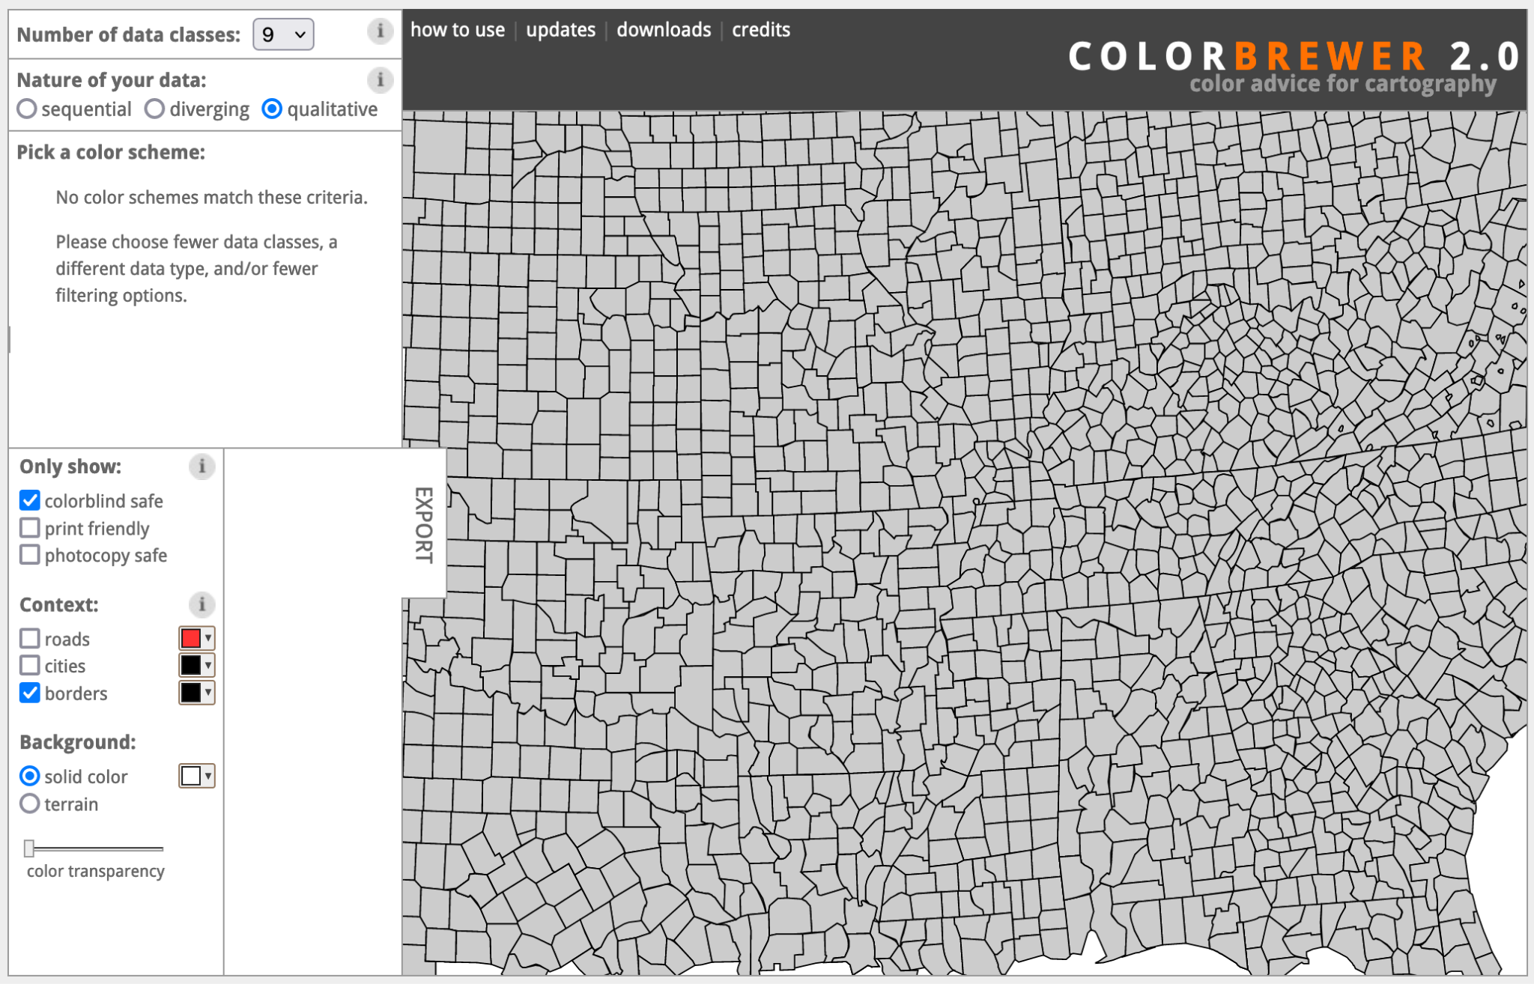
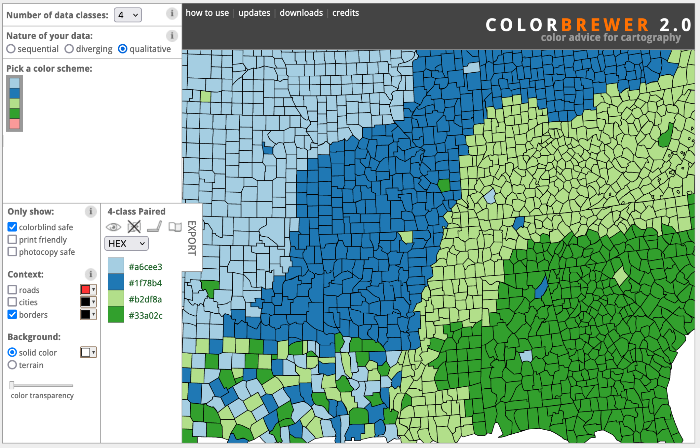
Which colors are colorblind safe (Colorbrewer 2.0)
Sequential
Diverging
Qualitative

Slide 9
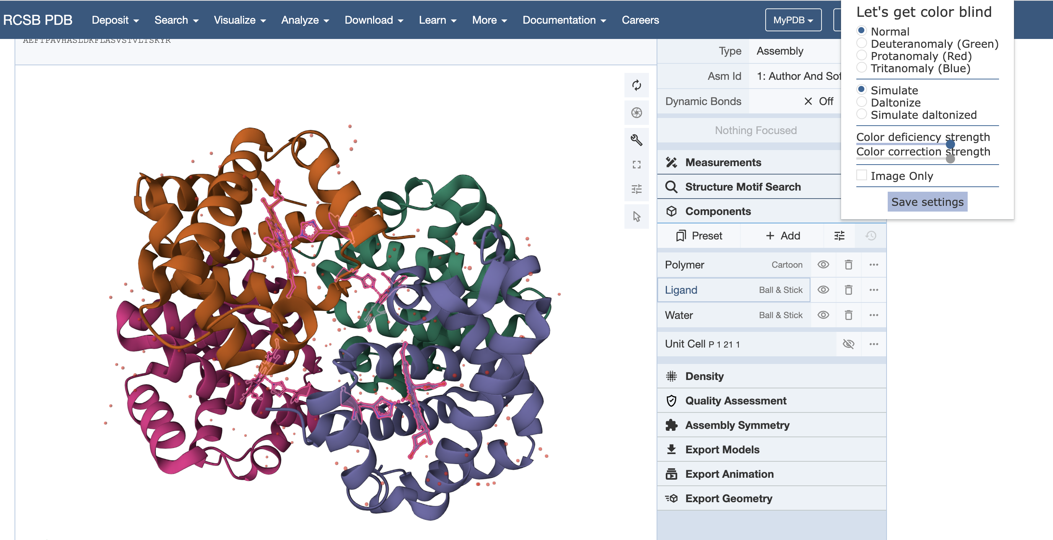
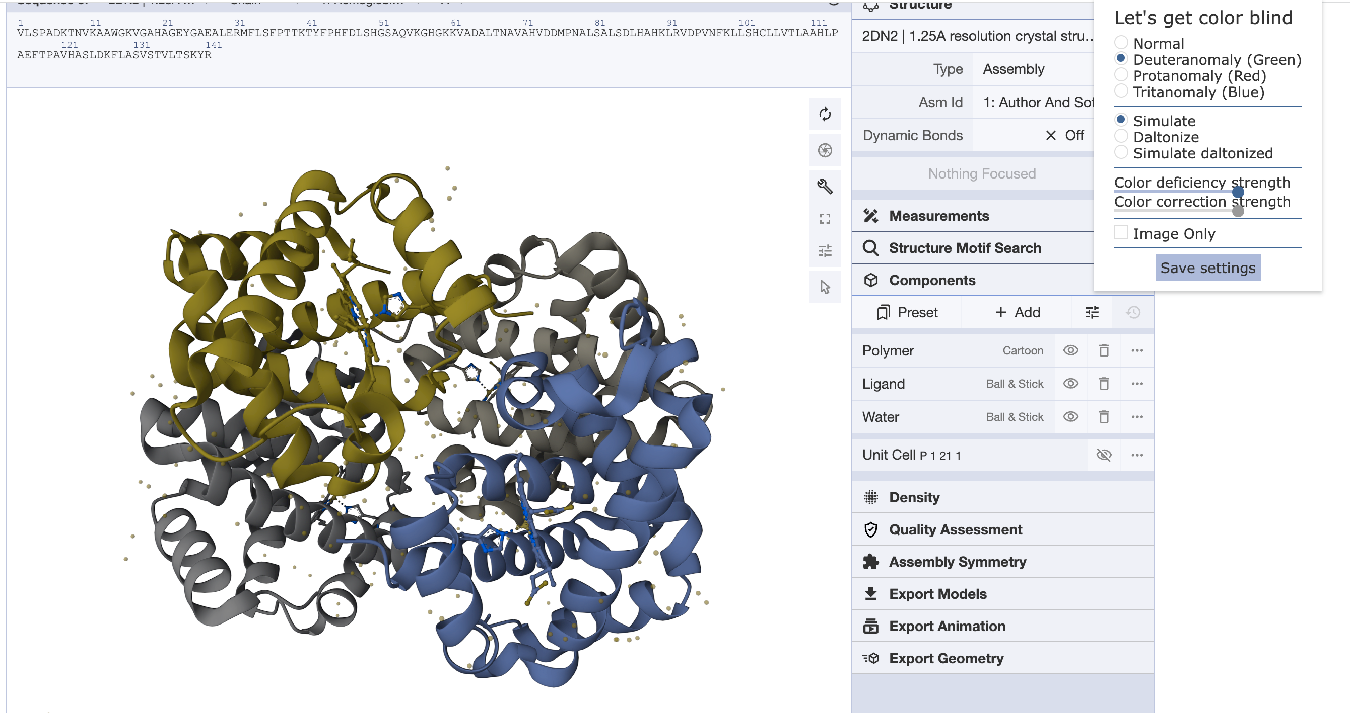
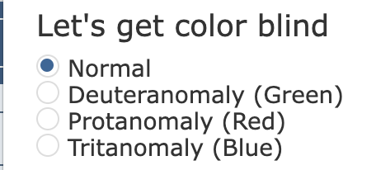
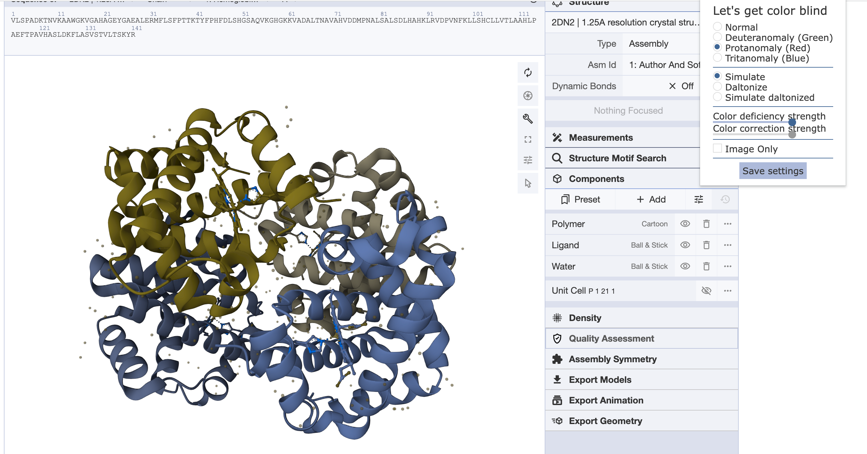
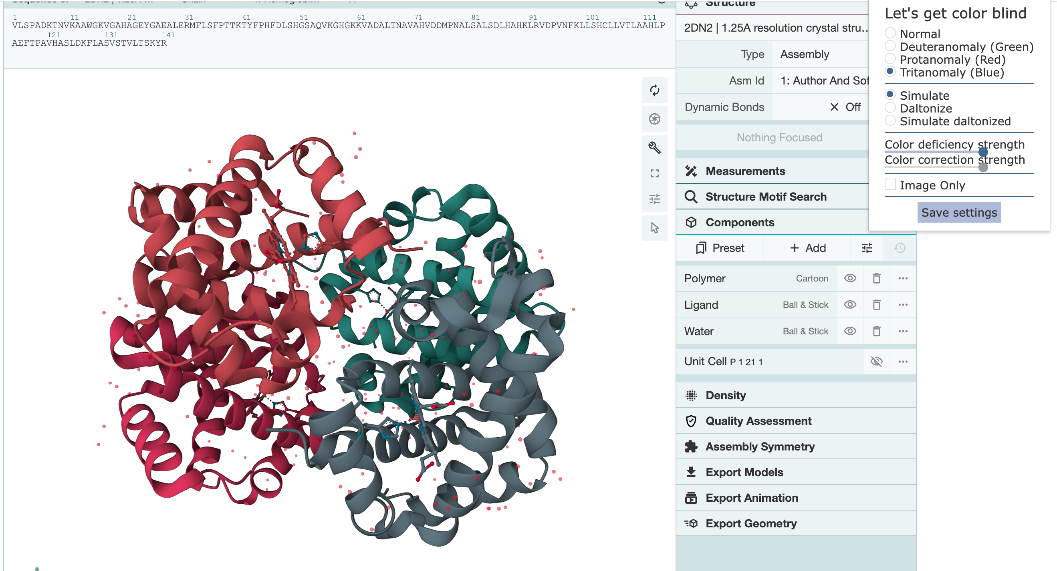
Options in Mol*

Slide 10
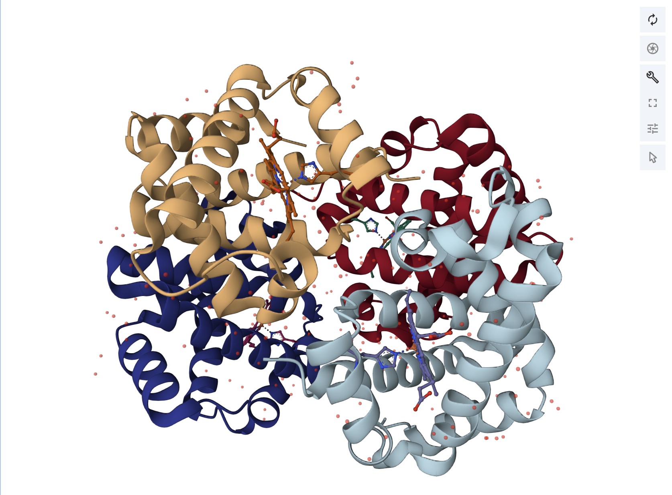
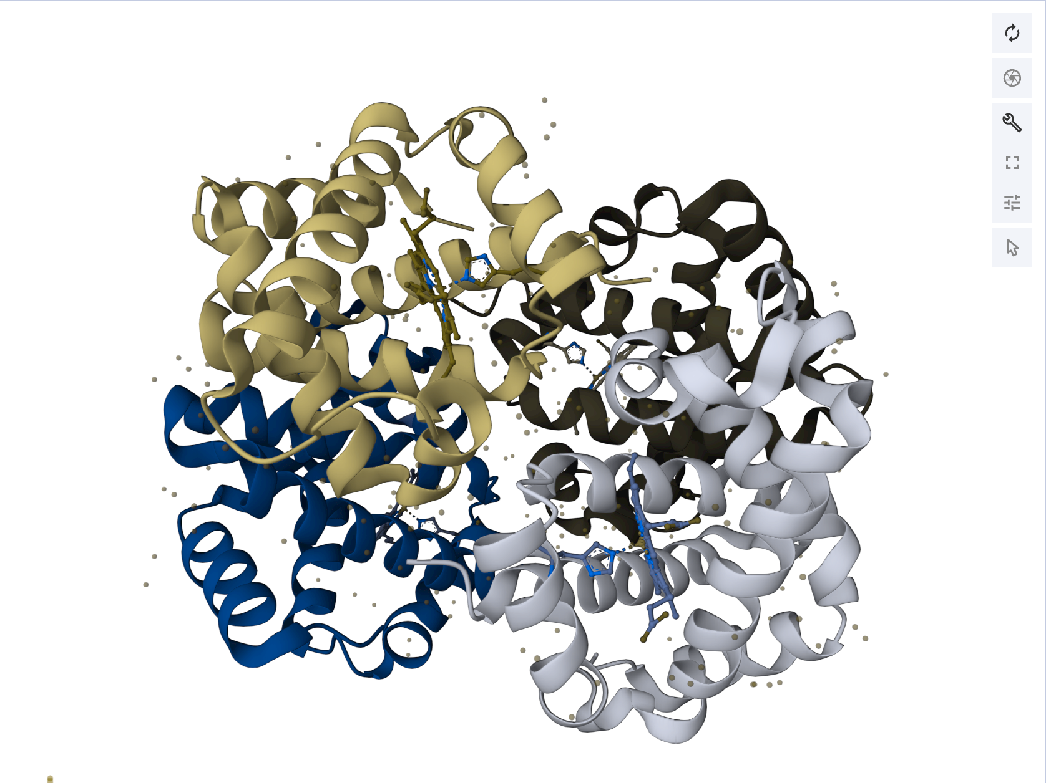
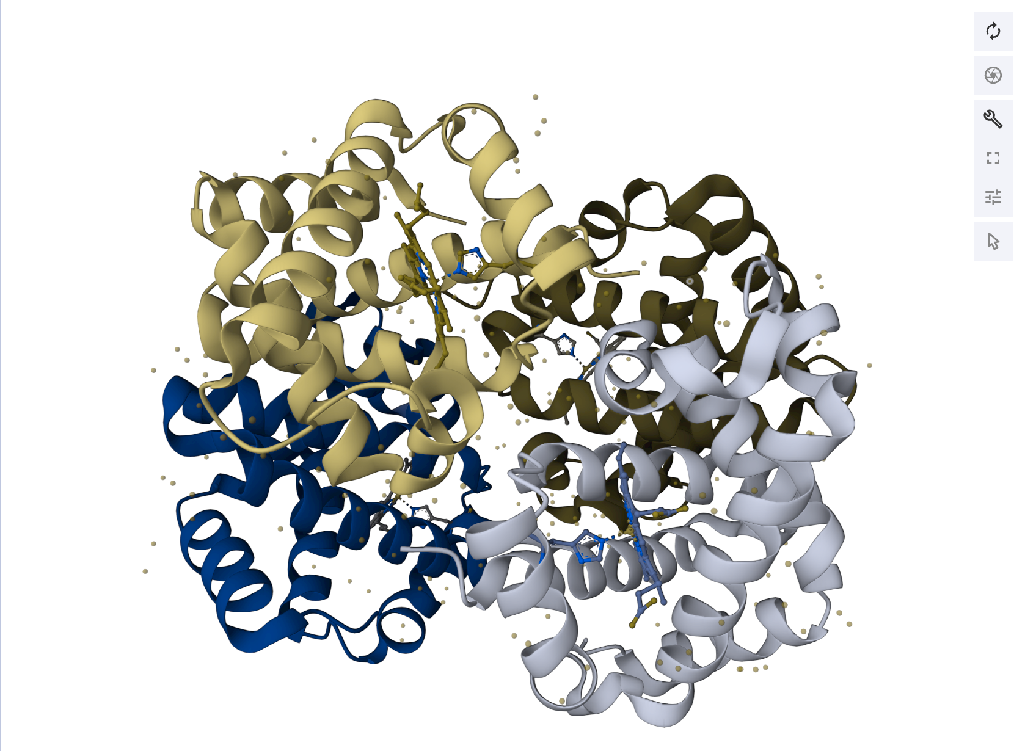
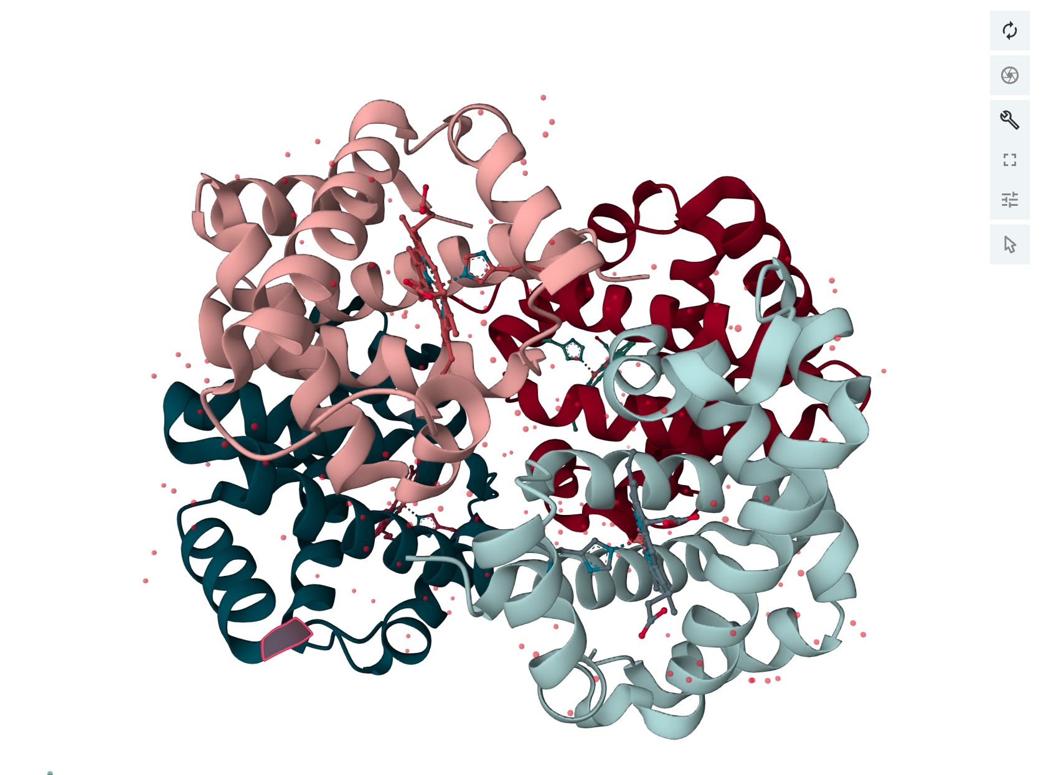
Options in Mol*

