Slide 1
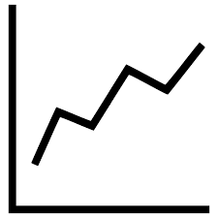
START
Type of independent variable?
Is there a natural order to the categories?
Categorical
NO
BAR GRAPH
Quantitative
YES
Are x-values independent of each other?
NO
LINE GRAPH
YES
SCATTERPLOT

