Slide 1
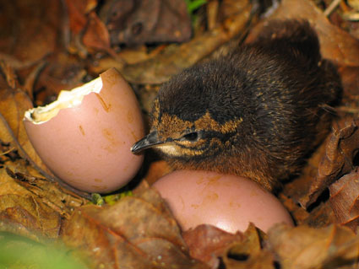
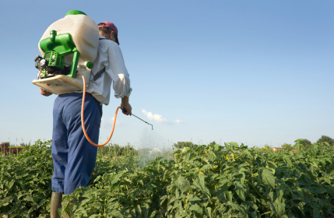
The Environment, Bird Eggshells, and Insectide Chemicals : A True Story

Slide 2
What are eggshells and why are they important?

Slide 3
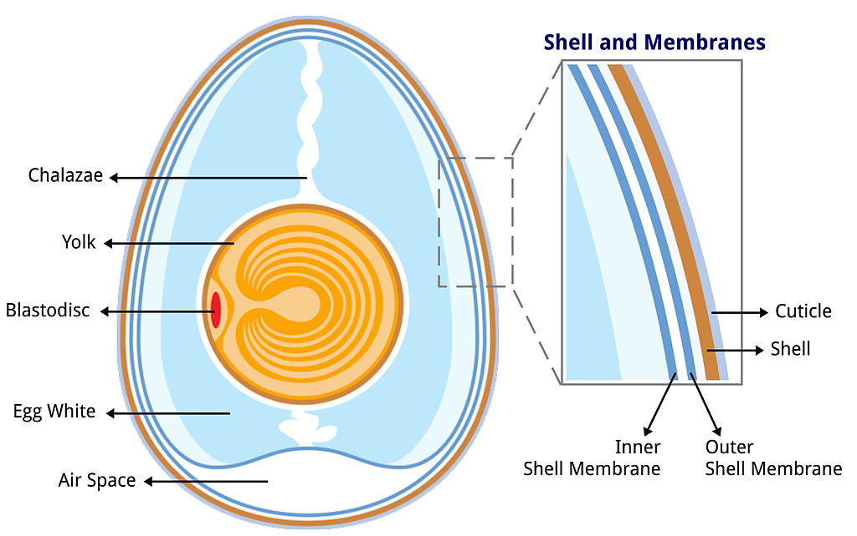
Eggshells -
the thin, hard outer layer of an egg made almost
entirely of calcium carbonate (CaCO3).

Slide 4
Eggshells
protect against damage and
microbial contamination
prevent dehydration
regulate gas and water
exchange for growing embryo
provide calcium for embryogenesis

Slide 5
How do chemicals affects eggshells?

Slide 6
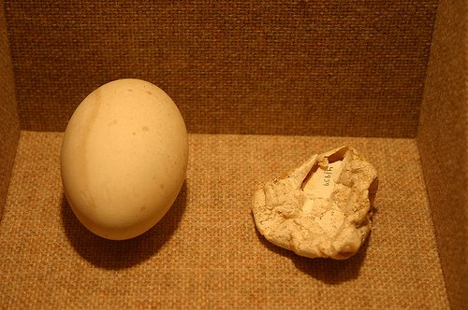
Insecticides and Eggshells
Bird eggs and Exposure to Environmental Chemicals

Slide 7
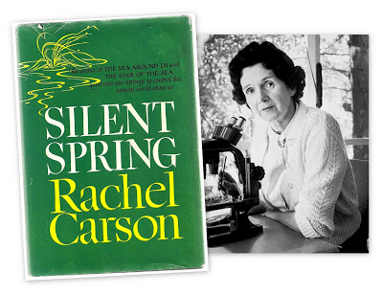
Rachel Carson
(1917-1964)
“Silent Spring”
A marine biologist who published “Silent Springs” in 1962. Starting in the mid-1940s, Carson became concerned about the use of synthetic pesticides, that involved aerial spraying of private land with
DDT. Simultaneously, she noticed their weren’t as many birds chirping. Why?

Slide 8
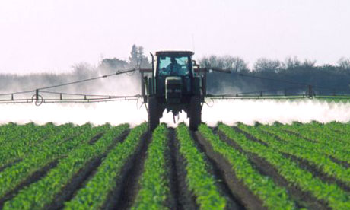
Insecticides and Eggshells
An insecticide is a chemical used for killing insects (e.g. DDT)
DDT * DDE
(dichlorodiphenyltrichloroethane) (dichlorodiphenyldichloroethylene)

Slide 9
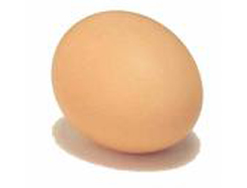
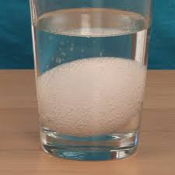
The “Naked Egg” Chemistry
CaCO₃ (s) + 2 HC₂H₃O₂ (aq) → Ca(C₂H₃O₂)₂ (aq) + H₂O (l) + CO₂ (g)
Calcium Acetic acid Calcium acetate water carbon
carbonate (vinegar) dioxide

Slide 10
What about other chemicals?

Slide 11
What are your thoughts?

