Slide 1








Resources for Collections-based
Undergraduate Education
Faculty Mentoring Network Kick-off Workshop
Gainesville, Florida
May 24th – 25th, 2017
Notes:
What is the point in thinking about education and NHC
Why collaborate?
Big initiatives and small scale examples directly relates to NHC
Lessons learned from these collaborations (based on several surveys)
New initiative and opportunities to be involved

Slide 2
Undergraduate Education is the logical step in training the future Workforce, engaging new End-Users, and sustaining and promoting Collections Science
Biodiversity Scientists
Undergraduates
K-12
Graduate Students
Notes:
To sustain our efforts in biodiversity science, broadly train the developing workforce, harness the energy and excitement in the next generation of scientists, explore novel uses and engage new audiences…in essence, to optimize the potential utility of biodiversity data in addressing issues of climate change, conservation of resources, biodiversity loss and invasive species we need to harness the energy of the next generation of scientists in concert with developing necessary data skills and the databases that can be used to solve big questions

Slide 3
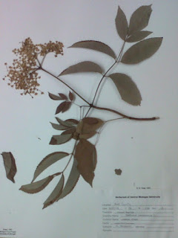
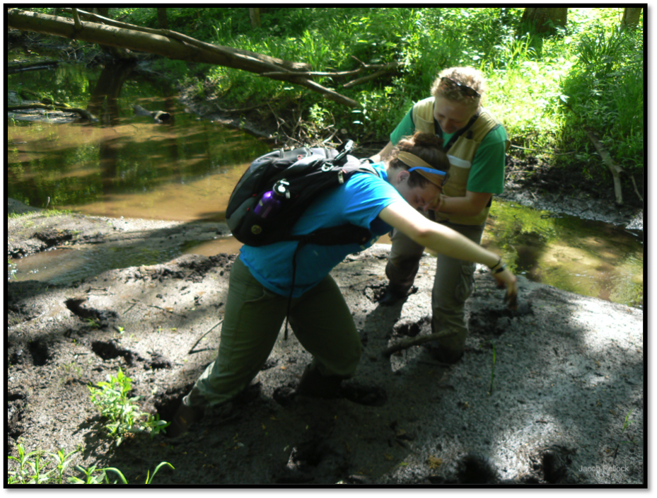
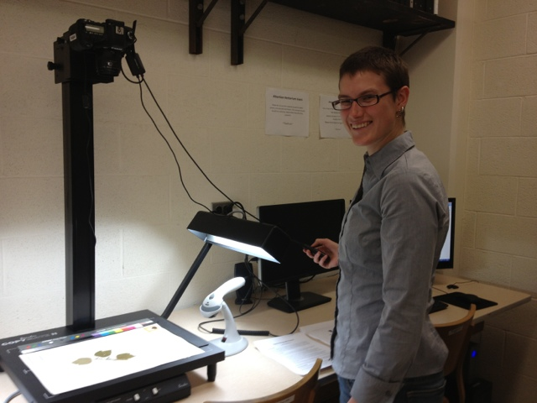
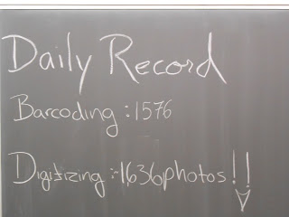
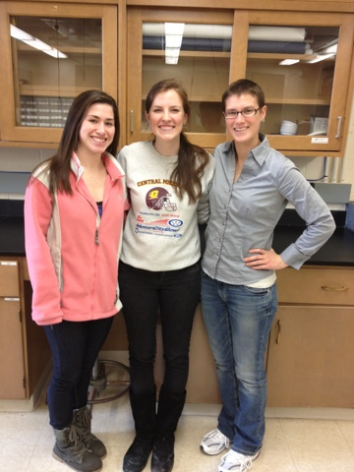
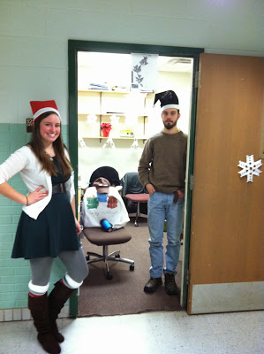
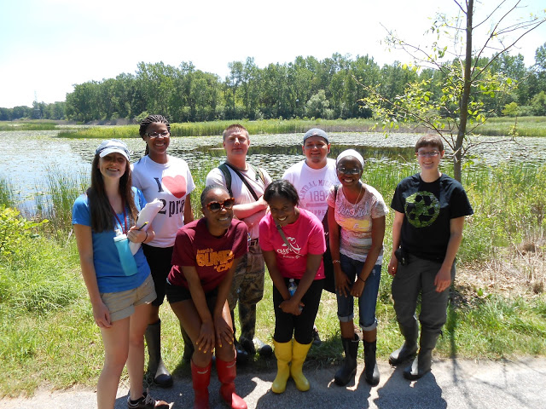

Collections are ideally and uniquely poised to address vision and Change* recommendations!
*Brewer, Carol A., and Diane Smith. "Vision and change in undergraduate biology education: a call to action." American Association for the Advancement of Science, Washington, DC (2011).

Slide 4
  CORE COMPETENCIES AND STUDENTS WORKING WITH COLLECTIONS AND COLLECTION BASED DATA*:
  AUTHENTICALLY ENGAGE IN INQUIRY-BASED LEARNING
      DATA IS EXPERIENTIAL, ITERATIVE AND VERIFIABLE
  EXPERIENCE THE DATA LIFECYCLE THROUGH THE CURATION CONTINUUM
  INVESTIGATE COMPLEX AND CHANGING SYSTEMS USING MODELING AND SIMULATION
  PRACTICE INTERDISCIPLINARY SCIENCE
  WORK COLLABORATIVELY WITH A NETWORK OF SCIENTISTS “MODELING” COMMUNICATION
WORK AT THE INTERFACE OF SCIENCE AND SOCIETY
    DATA IS PLACE-BASED AND CULTURALLY RELEVANT
*Brewer, Carol A., and Diane Smith. "Vision and change in undergraduate biology education: a call to action." American Association for the Advancement of Science, Washington, DC (2011).
Notes:
Add topical portion here as well

Slide 5
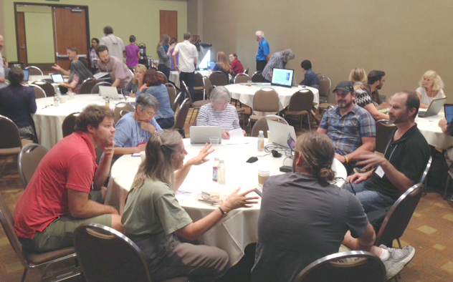
Vision and Change*
Strategies for Change Action Item
“ Faculty must engage in regular conversations and peer-to-peer mentoring about teaching and learning, and improve, test, and share their own understanding of how students learn. “
Small Collection Symposium, Boise, ID 2014
*Brewer, Carol A., and Diane Smith. "Vision and change in undergraduate biology education: a call to action." American Association for the Advancement of Science, Washington, DC (2011).

Slide 6
Educational Networks use a Community of practice model*
COMMUNITIES THROUGH WHICH INDIVIDUALS DEVELOP AND SHARE THE CAPACITY TO CREATE AND USE KNOWLEDGE
  SHARED DOMAIN OF INTEREST
    VALUE COLLECTIVE COMPETENCE AND LEARN FROM EACH OTHER
  THEY BUILD RELATIONSHIPS THAT ENABLE THEM TO LEARN FROM EACH OTHER.
    INTERACTIONS ARE ESSENTIAL!
  MEMBERS OF COMMUNITY OF PRACTICE ARE PRACTITIONERS.
    THEY DEVELOP A SHARED REPERTOIRE OF RESOURCES: EXPERIENCES, STORIES, TOOLS, WAYS OF ADDRESSING RECURRING PROBLEMS
*Wenger, E. (1998) Communities of practice: Learning, meaning, and identity.
Cambridge University Press, Cambridge, UK.

Slide 7
Why collaborate IN EDUCATIONAL NETWORKS*?
SHARED RESOURCES - AVOID REDUNDANCY AND INCREASE EFFICIENCY
BETTER INSTRUCTION
EXPANDED TOOLKIT
COMBINED EXPERTISE = CORE COMPETENCIES
MORE INCLUSIVE METHODS FOCUSED ON STUDENT LEARNING
INCREASED ACADEMIC RIGOR = INCREASED STUDENT EFFORT
FACILITATE LEARNING OF EDUCATOR
MORE ENGAGING STUDENT EXPERIENCE
BROAD DISSEMINATION/PROPOGATION OF MATERIALS
*Developed in part from: blog.brookespublishing.com/6-benefits-of-teacher-collaboration/
Notes:
Add PULSE Network and note the one in the southwest
Add paper from dude
QUBES
http://blog.brookespublishing.com/6-benefits-of-teacher-collaboration/

Slide 8
Sustained adoption of education innovations*
DISSEMINATION: GETTING THE WORD OUT TO POTENTIAL ADOPTERS ABOUT TRYING AN INNOVATION
PROPAGATION: A NEW TEACHING STRATEGY IS USED SUCCESSFULLY BY NON-DEVELOPING INSTRUCTORS.
  DEVELOPMENT
    INSTRUMENT CAN BE CONSISTENTLY INTERPRETED BY USERS OTHER THAN ITS DEVELOPERS.
    INSTRUMENT HAS CONSISTENT IMPACT ON STUDENT LEARNING REGARDLESS OF INSTRUCTOR
  DISSEMINATION
    PASSIVE (WEBSITES, PUBLICATIONS, PRESENTATIONS)
    ACTIVE (WORKSHOPS, WORKING GROUPS, NETWORKS, PERSONAL CONNECTIONS)
  SUPPORT
    DEVELOPING MATERIALS THAT AID ADOPTERS IN IMPLEMENTATION OR ARE MODULAR
    ENGAGING ADOPTERS IN DEVELOPMENT, LEVERAGING EXISTING COMMUNITIES, AND CREATING MECHANISMS FOR FOLLOW-UP
*Henderson, C., R. Cole, J. Froyd, D. Friedrichsen, R. Khatri, and C. Stanford (2015) Designing
educational innovations for sustained adoption: A how-to guide for education developers who
want to increase the impact of their work. Kalamazoo, MI: Increase the Impact.

Slide 9
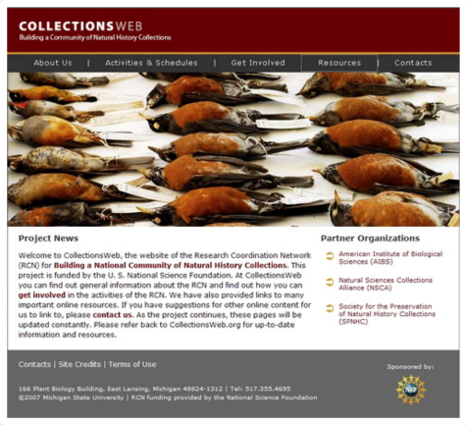
Building Educational Networks:
Collectionsweb* NSF RCN
*Powers, K.E., L.A. Prather, J.A. Cook, J. Woolley, H.I. Bart, Jr., A.K. Monfils, and P. Sierwald. 2014. Revolutionizing the use of natural history collections in education. The Science Education Review 13 (2): 24–33.
Notes:
GOAL: EXPLORE NEW OPPORTUNITIES AND NEW APPROACHES TO THE USE OF NATURAL HISTORY SPECIMENS AND SPECIMEN-BASED ELECTRONIC RESOURCES IN EDUCATIONAL PROGRAMS AT ALL LEVELS
RECOMMENDATIONS:
INVESTMENT IN DEVELOPING A NATIONAL DISTRIBUTED RESOURCE THAT PUTS SPECIMENS IN THE HANDS OF TEACHERS AND STUDENTS
INVESTMENT IN DEVELOPING EASY-TO-USE TOOLS TO ACCESS, ANALYZE, AND VISUALIZE SPECIMEN DATA IN A MEANINGFUL WAY .
INCORPORATE EDUCATIONAL EXPERTS, TEACHERS, MUSEUM SCIENTISTS, GRAPHIC DESIGNERS, COMPUTER SCIENTISTS, STATISTICIANS, GEOGRAPHERS, AND EXPERTS FROM MANY OTHER COMMUNITIES.
ENGAGE TEACHERS AND MUSEUM SCIENTISTS ACROSS THE COUNTRY

Slide 10

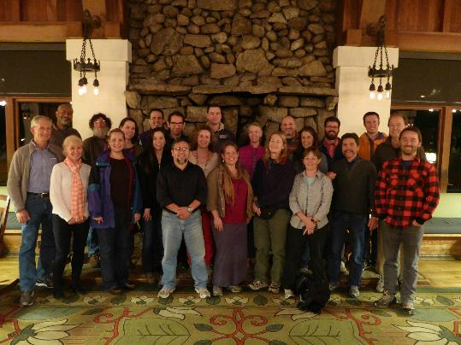
Building Educational Networks:
2010-2016 AIM-UP! NSF RCN-UBE*
*Cook, J. et al. 2014. Natural History Collections as Emerging Resources for Innovative Education. Bioscience 64:725-734
Notes:
Specimens and specimen data into undergraduate education
6 years – annual meetings and small gatherings

Slide 11

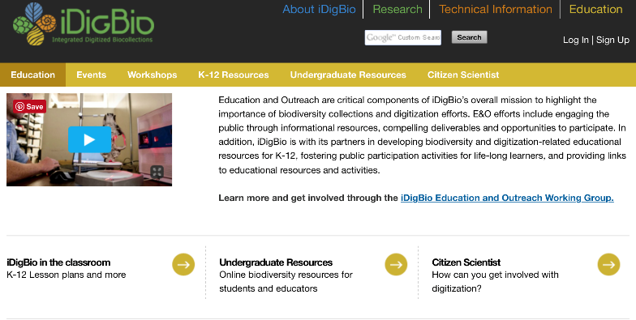
Building Educational Networks: iDigbio e&O working group
https://www.idigbio.org
Notes:
GOAL: DEVELOP, SHARE, AND COORDINATE EDUCATION AND OUTREACH ACTIVITIES AMONG IDIGBIO, TCNS, AND OTHER PARTNERING PROJECTS.
Quarterly virtual meetings
Two upcoming workshops
Incorporating K-12 Outreach into Digitized Collections Programs (Dec, 2016)
Building and Disseminating Resources for Collections-Based Undergraduate Education (May, 2017)
Webinar Series: the purpose is to share resources, tools, and expertise centered on E&O activities for ADBC partners and the collections community. Recordings of past webinars available.

Slide 12
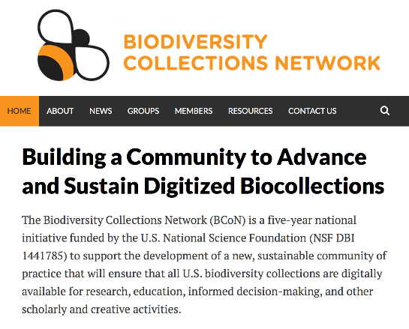
Building Educational Networks:
Biodiversity Collections network NSF RCN*
*American Institute of Biological Sciences. 2013. Implementation Plan for the Network Integrated Biocolllections Alliance. Reston, VA, USA.
https://bcon.aibs.org
Notes:
GOAL: BUILDING A COMMUNITY TO ADVANCE AND SUSTAIN DIGITIZED BIOCOLLECTIONS
ESTABLISH AN ORGANIZATIONAL AND GOVERNANCE STRUCTURE THAT WILL PROVIDE THE NATIONAL LEADERSHIP AND DECISION-MAKING MECHANISM REQUIRED TO IMPLEMENT THE NATIONAL STRATEGY.
ADVANCE ENGINEERING OF THE U.S. BIODIVERSITY COLLECTIONS CYBERINFRASTRUCTURE TO SUPPORT EFFICIENT WORKFLOWS, INNOVATIVE RESEARCH, EFFECTIVE POLICY, AND EDUCATIONAL ENGAGEMENT.
ENHANCE TRAINING OF EXISTING COLLECTIONS STAFF AND CREATE THE NEXT GENERATION OF BIODIVERSITY INFORMATION MANAGERS.
INCREASE BUY-IN AND PARTICIPATION FROM A BROADER RANGE OF STAKEHOLDERS.
ESTABLISH AN ENDURING AND SUSTAINABLE KNOWLEDGE BASE.
INFUSE SPECIMEN-BASED LEARNING AND EXPLORATION INTO FORMAL AND INFORMAL SCIENCE EDUCATION.

Slide 13
Lessons learned in Building EducationAl Networks*§:
IDENTIFY AND CLARIFY COMMON GOALS AND EXPECTATIONS - DEFINE SUCCESS FOR YOUR NETWORK
COLLABORATIVE, CONSTRUCTIVE , AND POSITIVE - PERSONAL RELATIONSHI[PS ARE IMPORTANT
DISAGREEMENT STRENGTHENS THE GROUP (FORMING, STORMING, NORMING, AND PERFORMING)
INCLUSIVITY – OPEN AND WELCOMING GROUP
SCIENCE EDUCATORS ARE A MUST!!!!
IDENTIFY AND EMPOWER THE “DOERS” = IDEAS TO PRACTICE
NEED A POINT PERSON TO MAINTAIN GROUP (CAN HAVE MORE THAN ONE)
REGULAR MEETINGS – FACE TO FACE IS IMPORTANT
COMMUNICATION, COMMUNICATION, COMMUNICATION
MECHANISM TO SHARE AND CENTRALIZE RESOURCES
BIG GROUPS ARE GREAT FOR GENERATING IDEAS AND CONSENSUS – SMALL GROUPS GET THINGS DONE!
HARD DEADLINES GENERATE RESULTS
MUST BE FLEXIBLE
*C. Eaton et.all. 2016. Summit of the Research Coordination Networks for Undergraduate Biology Education. CBE - Life Science Education. 15:4
§Monfils, A.K. 2016 . Advancing Integration of Museums into Undergraduate Education: AIM-UP! Program Evaluation. Summative evaluation of AIM-UP! RCN UBE Network for submission to the NSF

Slide 14

ASSESSMENT OF COMMUNITY NEEDS AND EXISTING RESOURCES IN NATURAL HISTORY COLLECTIONS BASED SCIENCE EDUCATION

Slide 15

UNDERGRADUATE EDUCATION:
MOVING FORWARD and addressing V&C
INTEGRATE VARIOUS EFFORTS AND CENTRALIZE RESOURCES TO EFFICIENTLY USE TIME AND EFFORT
INCORPORATE BIOLOGY EDUCATORS
DEVELOP MEANINGFUL UNDERGRADUATE RESEARCH EXPERIENCES INCORPORATING SPECIMEN CURATION CONTINUUM AND DATA LIFECYCLE
PROVIDE BEST PRACTICES FOR MENTORING STUDENT WORKERS IN NATURAL HISTORY COLLECTIONS
DEVELOP AND REFINE EDUCATIONAL MODULES INVOLVING NATURAL HISTORY COLLECTION DATA
DISSEMINATE/PROPOGATE MATERIALS
  INTRODUCE MODULES IN EDUCATIONAL VENUES (EDUCATION CONEFERENCES AND JOURNALS)
  INCORPORATE PARTNERS (ESRI, KURATOR, DATA CARPENTRY, WEDIGBIO, ETC.)
  TRAIN THE TEACHERS
  INCORPORATE IN TEXTBOOKS AND ON-LINE RESOURCES

Slide 16
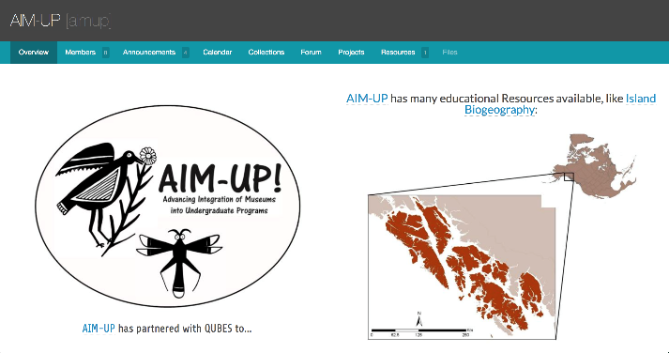
Building Educational Networks:
QUANTITATIVE UNDERGRADUATE BIOLOGY SYNTHESIS (QUBES)
https://qubeshub.org
Notes:
GOAL TO PROVIDE:
ACCESS TO HIGH QUALITY QUANTITATIVE AND INFORMATION LITERACY EDUCATIONAL MODULES AND RESOURCES
INSTRUCTOR TRAINING AND MENTORING

Slide 17

Biodiversityliteracy.org
BLUE-L@LISTS.UFL.EDU

Slide 18
Goals of Blue
CULTIVATE A DIVERSE AND INCLUSIVE NETWORK OF BIODIVERSITY RESEARCHERS AND BIOLOGY EDUCATORS FOCUSED ON UNDERGRADUATE DATA-CENTRIC BIODIVERSITY EDUCATION.
DEVELOP STRATEGIES AND EXEMPLAR MATERIALS TO GUIDE THE INTEGRATION OF BIODIVERSITY DATA INTO INTRODUCTORY UNDERGRADUATE BIOLOGY CURRICULA.
EXTEND THE NETWORK TO ENGAGE A BROADER COMMUNITY OF UNDERGRADUATE EDUCATORS IN BIODIVERSITY LITERACY EFFORTS.

Slide 19
Workshop and FMN Goals
REFINE ONE (OR MORE) AIM-UP! OR BLUE MODULES FOR BROAD SCALE IMPLEMENTATION
IDENTIFY AND ADDRESS BARRIERS TO USING COLLECTIONS DATA IN UNIVERSITY COURSES
INITIATE NEXT STEPS FOR INCREASING THE ADOPTION OF THE MODULE INTO UNDERGRADUATE COURSES
DEVELOP AND IMPLEMENT AN ASSESSMENT/EVALUATION PLAN FOR THE MODULE

Slide 20
Pre-meeting Survey results
THE GROUP (IN GENERAL):
GRASPS THE IMPORTANCE OF COLLECTIONS AND REGULARLY USES COLLECTIONS IN THE CLASSROOM.
HAS IDEAS FOR USING COLLECTION DATA IN THE CLASSROOM (LOGISTICS ARE AN ISSUE).
EXPRESSED CONCERN ABOUT USING PHYSICAL COLLECTIONS (E.G., DAMAGE, NO ACCESS, AND QUALITY).
WAS NOT OVERLY FAMILIAR WITH VISION AND CHANGE.
HAS COLLECTIONS BASED EXPERIENCE AND FEELS CONFIDENT USING COLLECTIONS IN THE CLASS ROOM.
LACKS FAMILIARITY WITH THE RESOURCES AND DATA AVAILABLE THROUGH DIGITIZED NATURAL HISTORY COLLECTIONS
JOINED THE WORKSHOP TO HAVE ACCESS TO NEW MATERIALS, GET MENTORING IN USING COLLECTIONS DATA IN EDUCATION, AND HAVE AN OPPORTUNITY TO COLLABORATE ON TEACHING PROJECTS

Slide 21
How to get involved in BLUE and other upcoming initiatives:
Email members of the BLUE steering committee and tell us your suggestion or how you would like to be involved:
  Deb Linton – linto1dl@cmich.edu
  Libby Ellwood – ellwoodlibby@gmail.com
  Anna Monfils – monfi1ak@cmich.edu
  Molly Phillips - mphillips@flmnh.ufl.edu
Join the iDIgBio E&O Working Group:
  Molly Phillips - mphillips@flmnh.ufl.edu
Share your materials/initiatives/successes! We want to share what the community is doing and we will post on the BiodiversityLiteracy.com website
Help us spread the word about collections in undergraduate education

Slide 22
Acknowledgements
AIM-UP! Network Participants
J. Cook, S .Edwards, S. Ickert-Bond, and E. Lacey (NSF #0956129 )
iDigBio Education and Outreach Working Group , Small Collections Network, and WeDigBio
L. Page, L. Fortés, B. McFadden, G. Riccardi, P. Soltis (NSF #EF-1115210)
QUBES
    NSF DBI #1346584, DUE# 1446269, DUE# 1446258, and DUE #1446284
Kurator
J. Hanken and B. Ludaescher (NSF DBI #1356438 and DBI #1356751)
CollectionsWeb
  L.A. Prather, H. Bart, M. Blackwell, and J. Woolley ( NSF #0639214)
Biodiversity Collections Network (BCoN)
      R. O’Grady and A. Bentley, NSF DBI #144178

