Slide 1
Getting to know the data,
Getting to know all about the data

Slide 2
Examples of data
Observational
  Recording that you saw a species
    Can be crowdsourced, provides data over time
    Assumes that you accurately ID the species and that you record it correctly

Slide 3
Examples of data
Observational
  Recording that you saw a species
    Can be crowdsourced, provides data over time
    Assumes that you accurately ID the species and that you record it correctly
Environmental
  Recording an abiotic variable
    Can be automated, done with a tool
    Depends on accuracy and precision of tool

Slide 4
Examples of data
Observational
  Recording that you saw a species
    Can be crowdsourced, provides data over time
    Assumes that you accurately ID the species and that you record it correctly
Environmental
  Recording an abiotic variable
    Can be automated, done with a tool
Modeled
  Input large quantities of data
    Useful for prediction
    Robustness dependent on the input data

Slide 5
Examples of data
Observational
  Recording that you saw a species
    Can be crowdsourced, provides data over time
    Assumes that you accurately ID the species and that you record it correctly
Environmental
  Recording an abiotic variable
    Can be automated, done with a tool
Modeled
  Input large quantities of data
    Useful for prediction
    Robustness dependent on the input data
Other? What kinds of data do you use in research?

Slide 6
Collections data*
Pros
Verifiable
Old
  Baseline data
  Data for research on topics not yet known
  Comparison over time
DNA → Individual → Species
Often have associated text in field books
Not just full specimens (e.g., sounds, genetic info, fossils)
Standards-based databases
*including characteristics that are not necessarily unique to collections

Slide 7
Collections data*
Pros
Verifiable
Old
  Baseline data
  Data for research on topics not yet known
  Comparison over time
DNA → Individual → Species
Often have associated text in field books
Not just full specimens (e.g., sounds, genetic info, fossils)
Standards-based databases
Cons
Biases
  Geographic
  Temporal (years and seasonal)
  Research-based
  Taxonomic
  Phenological
  Duplication
Post-collection errors
  Illegible handwriting
  Incomplete label data
  Poor preservation
*including characteristics that are not necessarily unique to collections

Slide 8
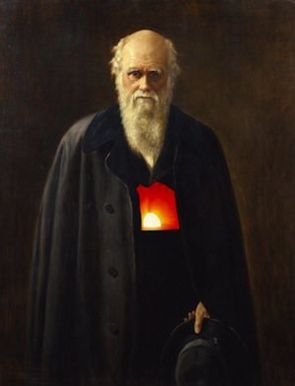
Darwin Core
The Darwin Core is a body of standards. It includes a glossary of terms (in other contexts these might be called properties, elements, fields, columns, attributes, or concepts) intended to facilitate the sharing of information about biological diversity by providing reference definitions, examples, and commentaries.
(https://en.wikipedia.org/wiki/Darwin_Core)
http://www.canadensys.net/publication/darwin-core

Slide 9
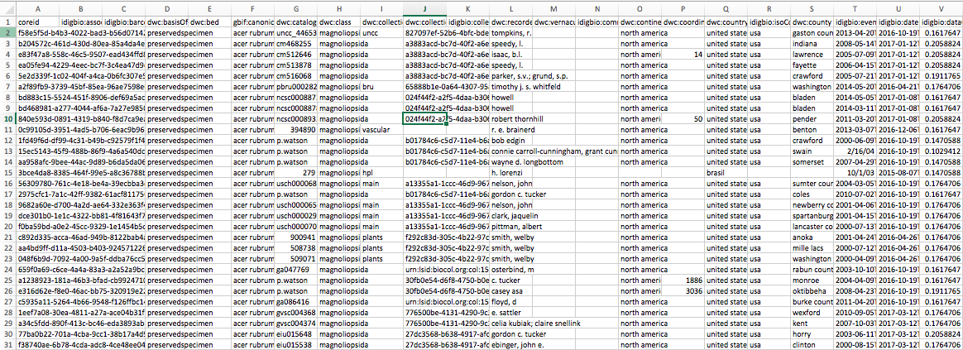
iDigBio portal search results
Each row represents a specimen housed in a collection

Slide 10
iDigBio portal search results
Same Darwin Core format for all species, localities, types of specimen, etc.

Slide 11
As with applications of other data sources, it’s all about appropriately accounting for the characteristics of the data

Slide 12
As with other data sources, it’s all about appropriately accounting for the characteristics of the data
As with applications of other data sources, it’s all about appropriately accounting for the characteristics of the data
These are critical aspects of data literacy for undergrads in all data-heavy STEM fields!

Slide 13
As with other data sources, it’s all about appropriately accounting for the characteristics of the data
As with applications of other data sources, it’s all about appropriately accounting for the characteristics of the data
Get to know the data and the applications are limitless!
These are critical aspects of data literacy for undergrads in all data-heavy STEM fields!

