Slide 1


Using Kurator Tools for Data Quality and Cleaning Biodiversity Data
Tracy Barbaro
tbarbaro@oeb.harvard.edu
Harvard Museum of Comparative Zoology
Kurator/Encyclopedia of Life
HTTP://BIODIVERSITYLITERACY.COM

Slide 2

Purpose
Kurator tools and validators can help you check biodiversity data, clean data and standardize data before doing statistical analysis.
Kurator operates in Darwin Core terms, the standards used for sharing and reusing Natural History Collections data and other biodiversity data such as observations.

Slide 3

How Kurator Works
Checks data sets for internal consistency and validation
Checks data sets against external authority resources (e.g. Global Biodiversity Information Facility or GBIF)
Identifies potential problems and proposes corrections that you may apply to your data

Slide 4

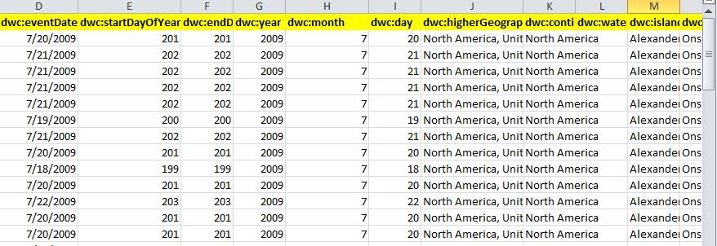
What is Darwin Core?
Darwin Core is a set of data standards and terms that allow for easier sharing, publication and use of occurrence data and specimen data.
Used in a spreadsheet format Darwin Core (also called “Darwin Core Archives, or DwC-A), includes “fields” that help identify data:
Examples of Darwin Core Standard Data fields:
scientificName
basisofRecord
stateProvince
islandGroup
Locality
eventDate
year
day
month
decimalLatitude
decimalLongitude

Slide 5
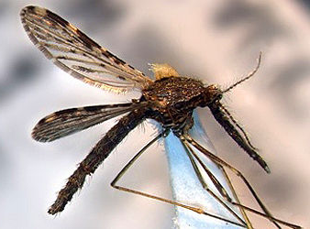
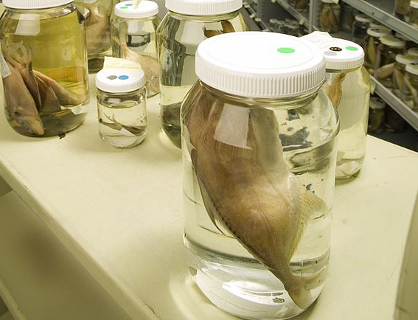
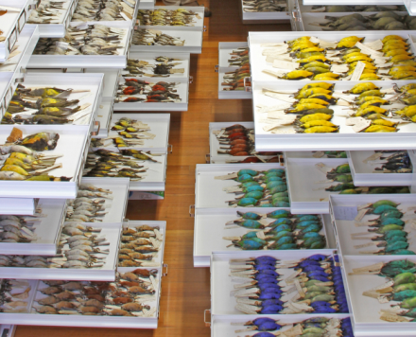
Uses of Collections Data - Examples
Examine trends in infectious diseases such as West Nile Virus and Malaria using mosquitos specimens
Measure mercury levels in fish specimens to determine ecosystem health
Examine bird specimens for clues about evolution, food webs and ecosystem health for conservation purposes
Notes:
Peterson, A. Townsend, ADOLFO G. NAVARRO‐SIGÜENZA, and H. E. S. I. Q. U. I. O. BENÍTEZ‐DÍAZ. "The need for continued scientific collecting; a geographic analysis of Mexican bird specimens." Ibis 140.2 (1998): 288-294
Suarez, Andrew V., and Neil D. Tsutsui. "The value of museum collections for research and society." BioScience 54.1 (2004): 66-74.
Image credits: Bird collections: By Peter J. Park - Losos JB, Arnold SJ, Bejerano G, Brodie ED III, Hibbett D, et al. (2013) Evolutionary Biology for the 21st Century. PLoS Biol 11(1): e1001466. doi:10.1371/journal.pbio.1001466, CC BY 2.5, https://commons.wikimedia.org/w/index.php?curid=23745509
Mosquito: Natural History Museum London http://eol.org/data_objects/12486754
Fishes: CC BY https://commons.wikimedia.org/wiki/File:CSIRO_ScienceImage_6049_Alastair_Graham_Fish_Collection_Manager_Australian_National_Fish_Collection_examining_a_specimen_in_one_of_the_15000_or_so_jars_that_are_stored_in_the_collection.jpg

Slide 6
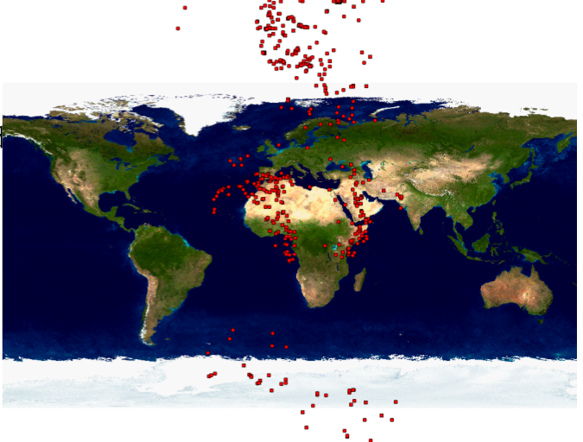
Common Errors in Data
Collections data can be “all over the map”
misspelled names
inconsistent dates
incorrect or transposed geographic information
duplicate records
matching names of unrelated geographic locations
Notes:
Image Source: Kurator: Towards Data Curation Workflows for Mere Mortals
B.Ludäscher,J. Hanken, D. Lowery,J.A. Macklin, T. McPhillips,P.J. Morris, R.A. Morris, T. Song

Slide 7
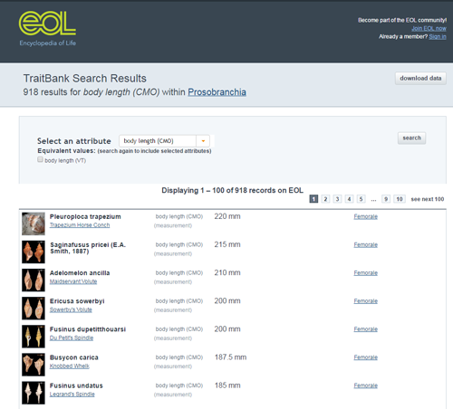
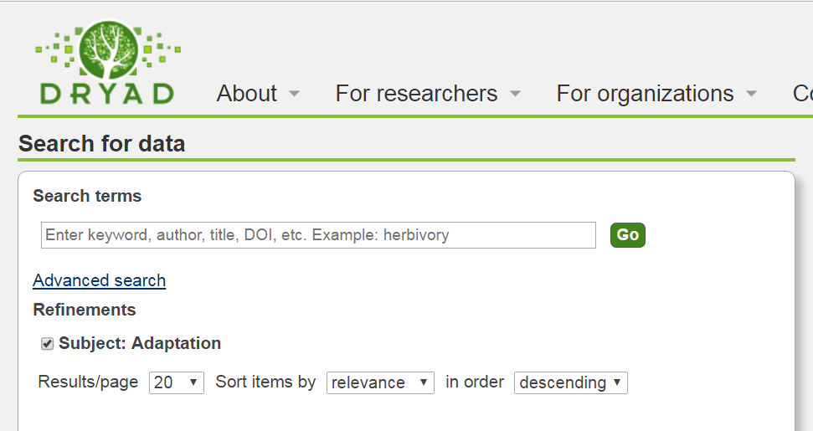
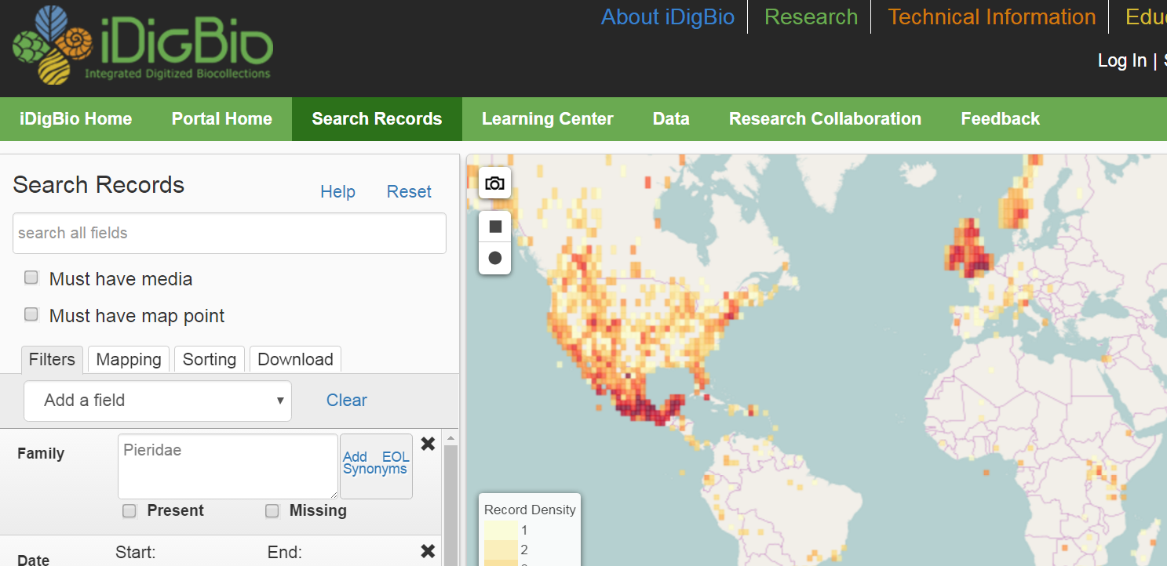
Finding Collections and Biodiversity Data
You can access Natural History Collections and biodiversity data through iDigBio, Dryad, Vertnet, Global Biodiversity Information Facility (GBIF), Encyclopedia of Life’s (EOL) TraitBank and other open source portals.
These data include specimens, human observations, machine observations, and others.

Slide 8
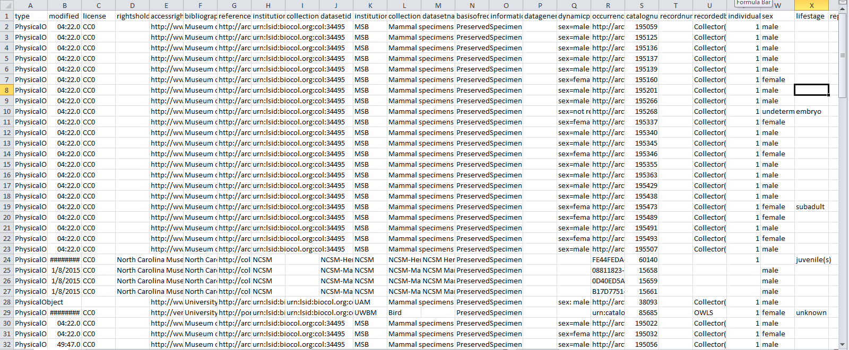
LOTS of data to sort through

Slide 9
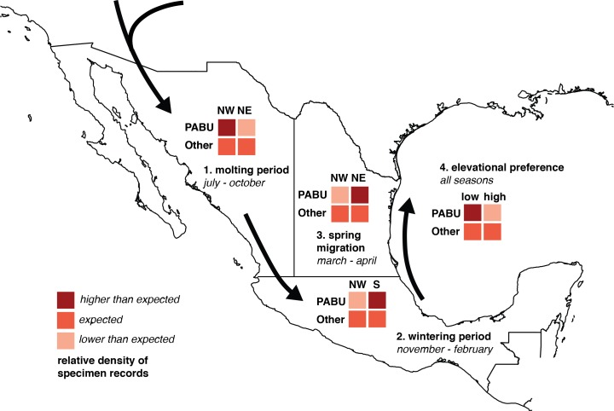
Data Fit for (re)Use
Our Task: Assess the quality of specimen data in datasets and “clean” the data before analyzing it.
How?
Data Standards
Data Quality + Cleaning
Diagram of chi-square test predictions of seasonal changes in Painted Bunting specimen record densities.
(Source: Linck, E., Bridge, E. S., Duckles, J. M., Navarro-Sigüenza, A. G., & Rohwer, S. (2016). Assessing migration patterns in Passerina ciris using the world’s bird collections as an aggregated resource. PeerJ, 4, e1871. CC BY 10.7717/peerj.1871

Slide 10

Kurator Data Quality Tools
Standardization (Darwinizer Tool)
Georeference Validator
Date Validator
Field Value Counter
Data File Aggregator

Slide 11
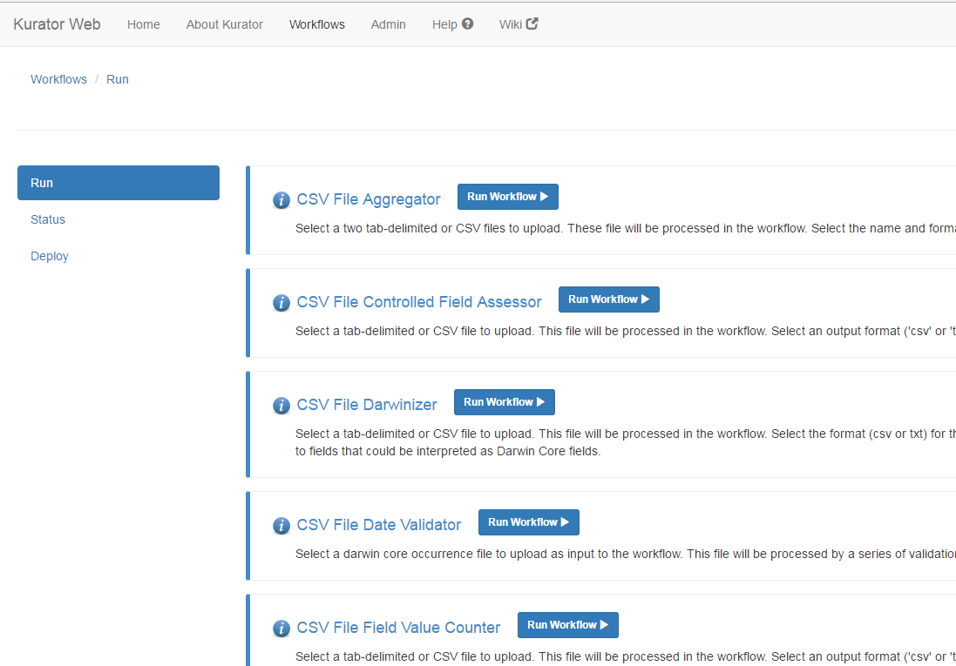
Kurator Tools or “Workflows” http://kurator.acis.ufl.edu/kurator-web/

Slide 12
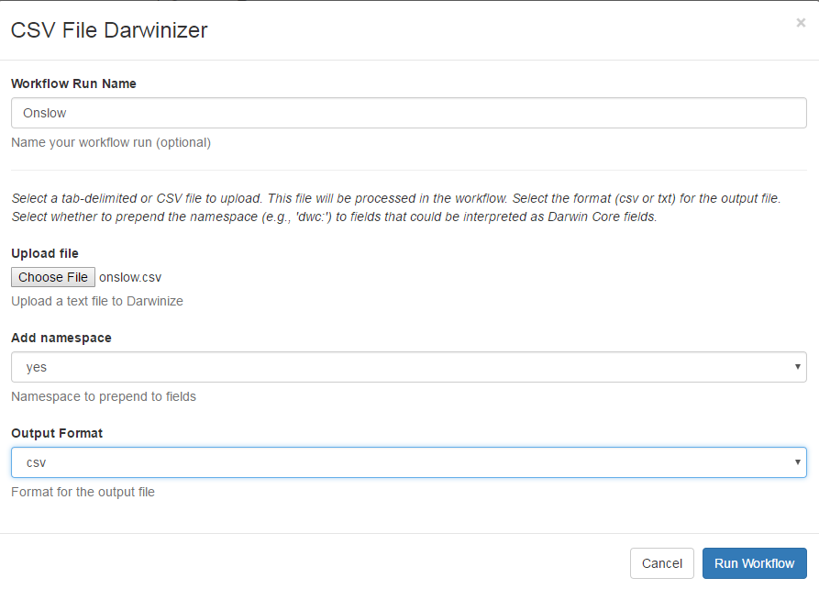
Standardization -- Darwinizer Tool
This tool will check your dataset for and replace them with Darwin Core terms.
All of your data files (.csv) should run through the Darwinizer Tool first to standardize data fields before using the other Kurator tools. Save the new file as “filename_darwinized”.

Slide 13
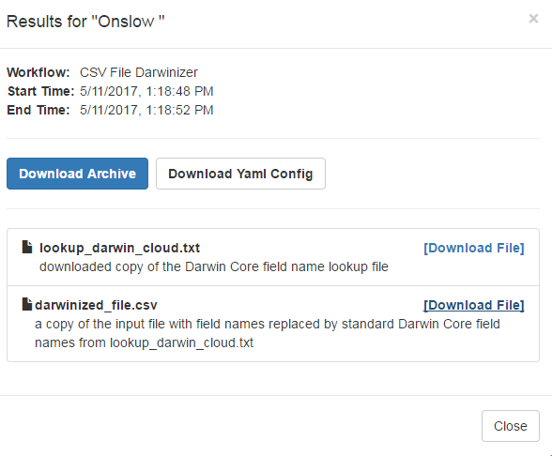
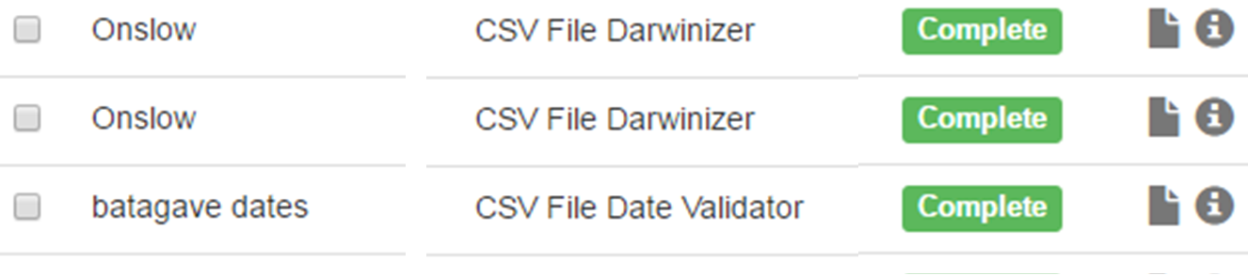
Download Results

Slide 14
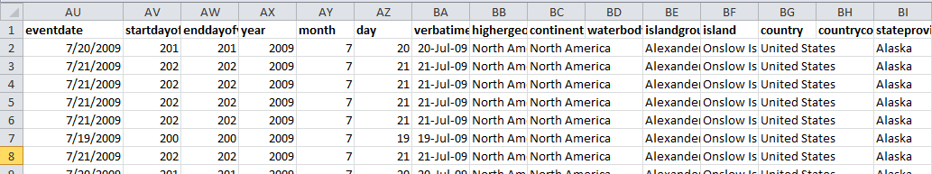
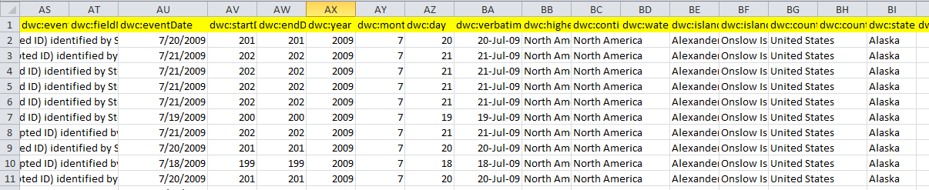
Data before “Darwinizing”
Data after“Darwinizing” headings replaced with Darwin Core terms (e.g. “dwc:day”)
Now your file is ready to be used in any of the Kurator Tools

Slide 15
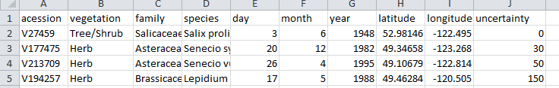
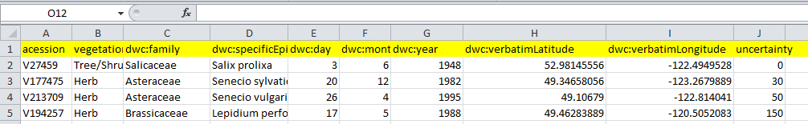
Can you Darwinize your own data? And then run Data Quality tests with Kurator? YES
Example: Plant data from Dryad - Before
Example: Plant data from Dryad – After being Darwinized, ready for the Kurator tools

Slide 16
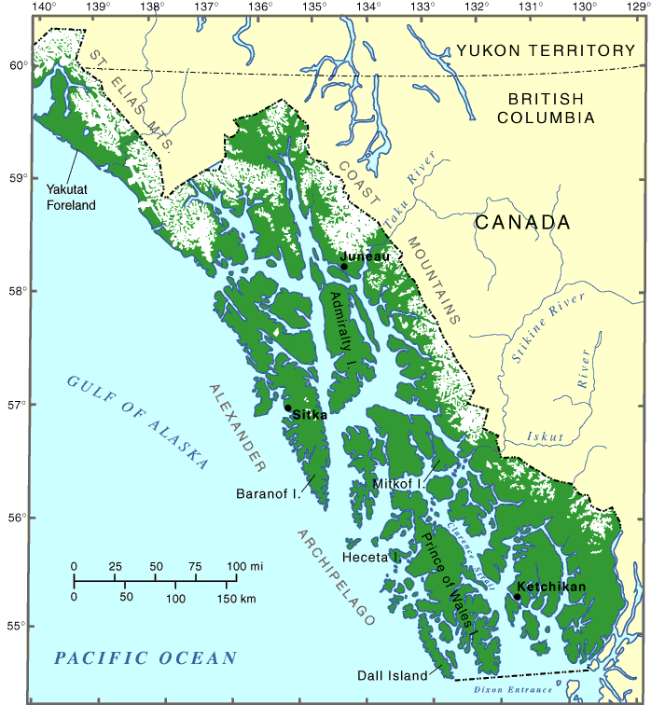
Example: Island Biogeography Module
Determine the number of mammal species collected on each of the selected islands in the Alexander Archipelago in Alaska to examine species richness
Data Quality and Cleaning
Use the Kurator “Darwinizer “to standardize data
fields to Darwin Core terms
Use the Kurator Georeference Validator to validate
Georeferenced data
Use Kurator Field Value Counter to weed out any
records that are not mammals
Image Credit:
USGS Geosciences and Environmental Change Science Center,
https://gec.cr.usgs.gov/archive/alaska/alexArchipelago.html
Notes:
Image Credit: USGS Geosciences and Environmental Change Science Center, https://gec.cr.usgs.gov/archive/alaska/alexArchipelago.html

Slide 17
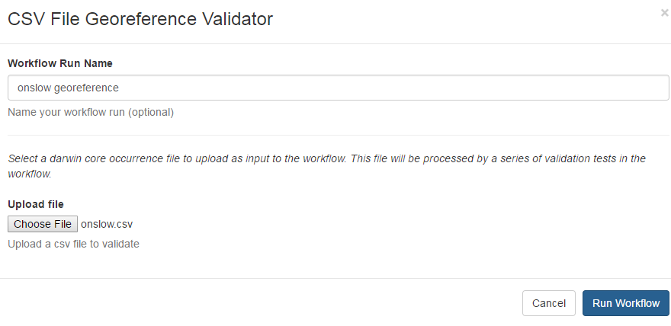
Georeference Validation
The Georeference Validator checks georeferenced data to confirm:
Latitude and longitude coordinates are in the country
Coordinates are within range
State or Province is consistent with coordinates
Water body is valid
This validator creates a data quality report with errors found amendments made.

Slide 18
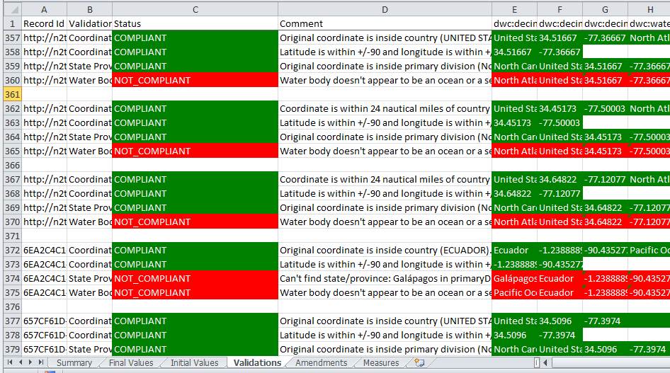
Georeference Validator Results Example

Slide 19
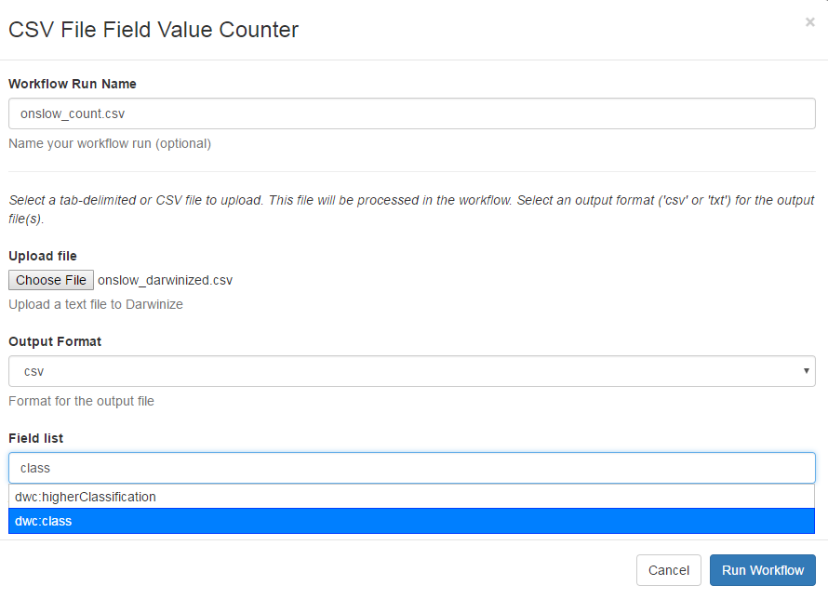
Field Value Counter Tool
The Field Counter creates a report of counts for each field in a list of Darwin Core values. For example you can search for counts of locations or taxonomic ranks in your data set to find data records that are not relevant to your research.
Enter in Darwin Core terms in the Field List. The auto search will provide suggested terms.

Slide 20
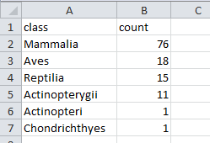
Field Counter: Review Results
Review count report and then go make manual changes in our data.
You can do this sorting in Excel instead, but benefits of using Field Counter is that you can automate “error finding” and get accurate counts of records.
Taxon|class count

Slide 21
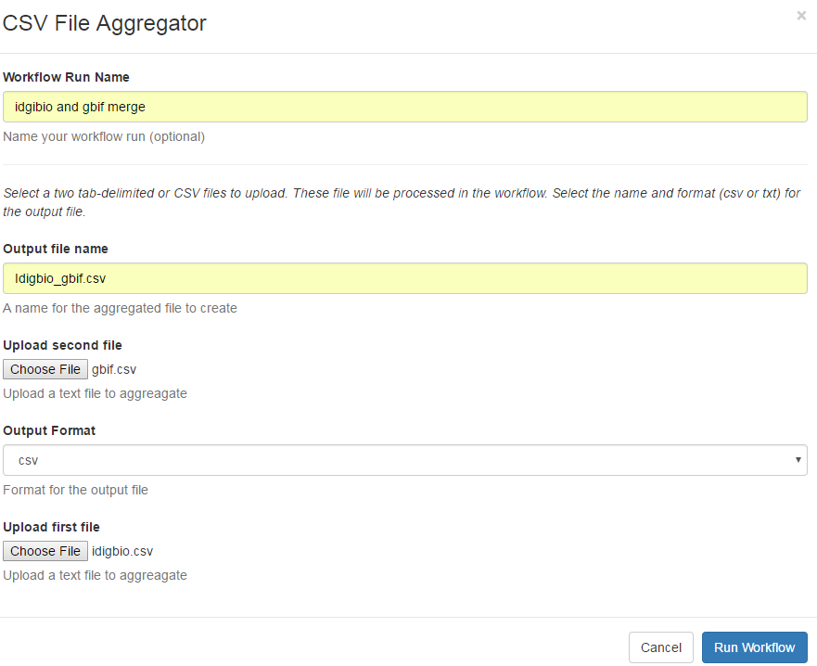
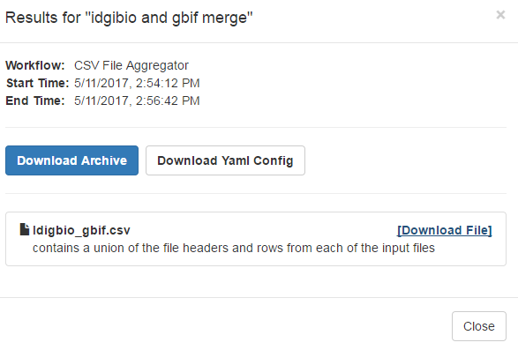
Data File Aggregator
The Aggregator tool will combine two data sets files into one file, with Darwin Core headings.
Example: Specimen data from iDigBio and observation data from the Global Biodiversity Information Facility (GBIF) data files.

Slide 22
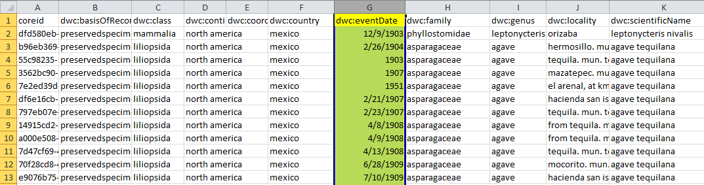
One aggregated you can sort by type of record, date, family, geographic fields, etc., and can input the .csv file into other Kurator Tools (i.e. Date Validator)

Slide 23
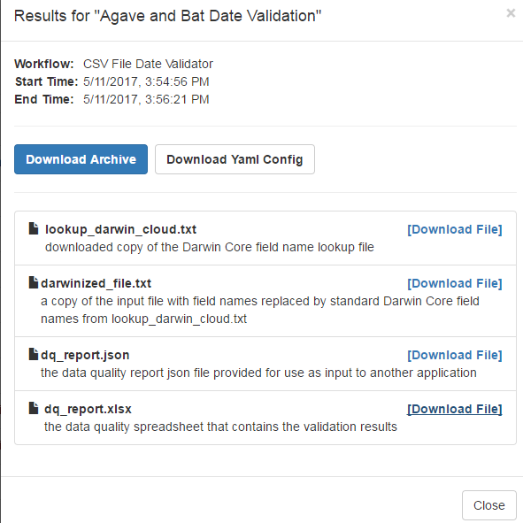
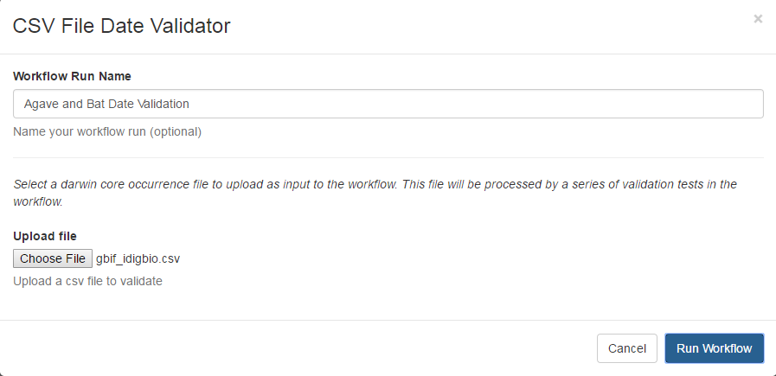
Date Validator
Tests to see if collecting event date is a valid date, test to see if it matches start + end dates, day of year, etc. and will produce a data quality report.

Slide 24
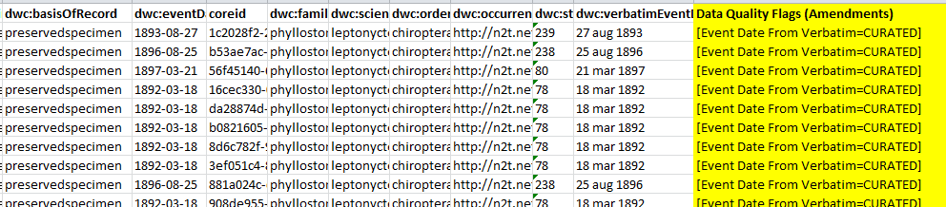
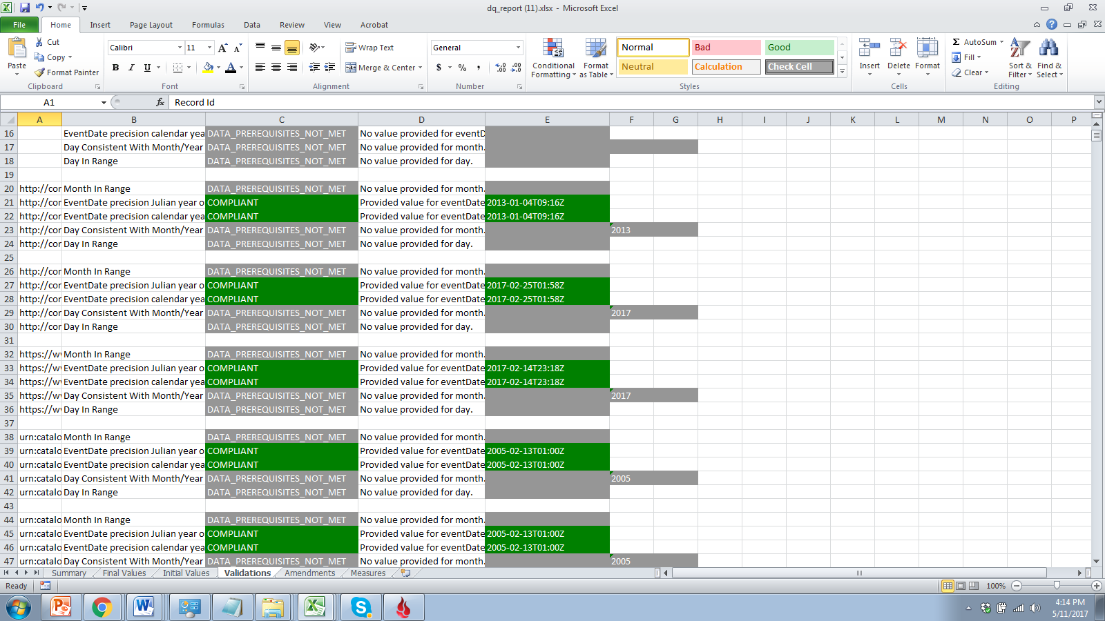
The Date Validator will test the following internally and make changes, or point out missing values:
EventDate precision Julian year or better.
EventDate precision calendar year or better.
Day Consistent With Month/Year
Day In Range

Slide 25
Questions?

