Slide 1

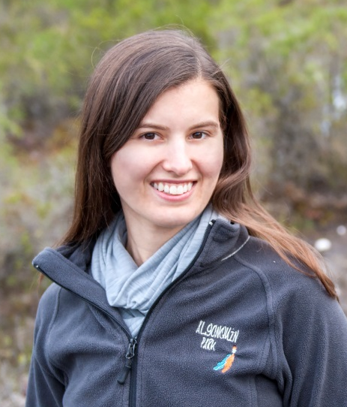

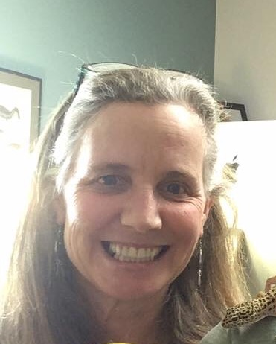

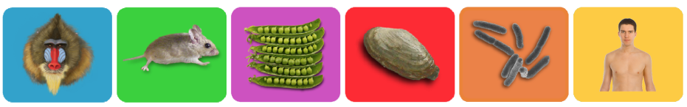
Evo-ED Cases - A Case-based
Integrative Approach to Teaching Evolution
Peter White
pjtwhite.org
@DrPeteWhite
Alexa Warwick
arwarwick.weebly.com/
@ARWarwick
Jim Smith
msu.edu/~jimsmith/
Louise Mead
beacon-center.org/
@louisesmead

Slide 2
Introductions
A
Name
Where you’re from
What your teaching (level/content area)
What session(s) you attended earlier

Slide 3
Outcomes for Today’s Session
Participants will:
Explore and articulate the challenges of teaching evolution.
Explore the Evo-Ed Cases and investigate how they may be used in the teaching and learning of biology
Discuss the utility of using a common biological system to teach multiple sub-disciplinary concepts.
Brainstorm and develop implementation strategies.
  In-class activities
  Case studies
  Lesson plans
  Etc.
www.evo-ed.org

Slide 4
Outline of Today’s Session
www.evo-ed.org

Slide 5
Outline of Today’s Session
PART I:
How do you teach evolution?
Why adopt a new approach to evolution education?
PART II:
Introduction to Evo-Ed Cases.
Explore: How can Evo-Ed Cases be integrated into your teaching?
PART III:
Looking ahead!
Lesson plans, Activities, Innovative Implementation
www.evo-ed.org

Slide 6
Outline of Today’s Session
PART I:
How do you teach evolution?
Why adopt a new approach to evolution education?
PART II:
Introduction to Evo-Ed Cases.
Explore: How can Evo-Ed Cases be integrated into your teaching?
PART III:
Looking ahead!
Lesson plans, Activities, Innovative Implementation
www.evo-ed.org

Slide 7
How do you teach evolution?
Two minutes: Share some examples with your neighbor.
  Specific activities?
  Overall structure?
Debrief.

Slide 8
P
How might a biology/science student explain the theory of evolution?
Notes:
Rhetorical?

Slide 9
EVOLUTION = NATURAL SELECTION

Slide 10
EVOLUTION = NATURAL SELECTION

Slide 11
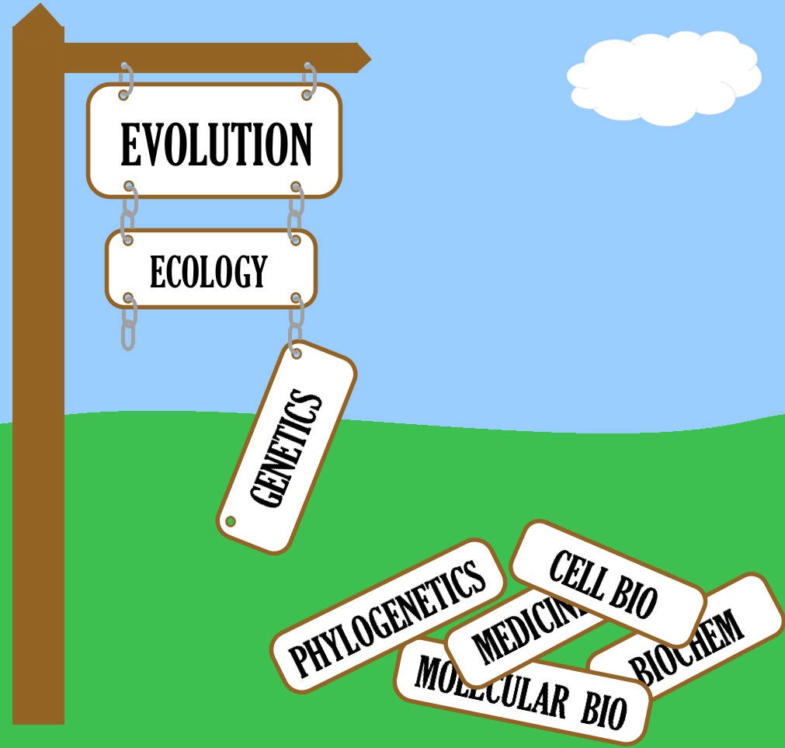

Slide 12
How would we like biology/science students to explain the theory of evolution?
Notes:
Rhetorical

Slide 13
Ecology
Molecular Genetics
Population Biology
Cell Biology
Virology
Phylogenetics
Medicine
Biogeography
Developmental Biology
evolution

Slide 14
The Two-Track Problem
From: White et al. 2013. Integrative Cases for Teaching Evolution, Evolution: Education and Outreach 6:17

Slide 15

Trait Evolution
Genetic Mutation
Protein Function
Sub-Cellular Biological Processes
EVOLUTION
Novel Phenotype
Selection!
Population/ Community Consequences

Slide 16
Trait Evolution
Genetic Mutation
Protein Function
Sub-Cellular Biological Processes
EVOLUTION
Novel Phenotype
Selection!
Population/ Community Consequences

Slide 17
What is a protein?
Draw a picture.
What does this protein do?

Slide 18
What is a protein?
Draw a picture. What does this protein do?
Student “A”
“A protein is a substance that is made up of amino acids. DNA is a protein. Proteins are containers for genetic information to be stored in. This protein houses material that determines hair color.”
Student “B”
“A protein is a very important concept in cellular growth. I couldn’t, for the life of me, draw you one right now but hopefully I will be able to soon because I honestly have no idea where to even begin. (Added later) A protein is a chain of amino acids.”

Slide 19
What is a protein?
Draw a picture. What does this protein do?
Students have very crude mental models of proteins

Slide 20
Trait Evolution
Genetic Mutation
Protein Function
Sub-Cellular Biological Processes
EVOLUTION
Novel Phenotype
Selection!
Population/ Community Consequences

Slide 21
Outline of Today’s Session
PART I:
What is evolution?
Why adopt a new approach to evolution education?
PART II:
Introduction to Evo-Ed Cases.
Explore: How can Evo-Ed Cases be integrated into your teaching?
PART III:
What’s missing?
Lesson plans, Activities, Innovative Implementation
www.evo-ed.org

Slide 22
  TWO GOALS:
  Develop cases that promote the learning of evolution as an integrative biological theory.
  Provide teaching resources for science instructors so they can teach evolution as an integrative biological theory.

Slide 23
  TWO GOALS:
  Develop cases that promote the learning of evolution as an integrative biological theory.
  Provide teaching resources for science instructors so they can teach evolution as an integrative biological theory.

Slide 24
Trichromatic Vision Evolution in Primates
Fur Color Evolution in Beach Mice
Seed Taste Evolution in Field Peas
Toxin Resistance Evolution in Clams
Evolution of Citrate Utilization in E. coli
Evolution of Lactase Persistence in Humans
www.evo-ed.org

Slide 25
What is a CASE?

Slide 26
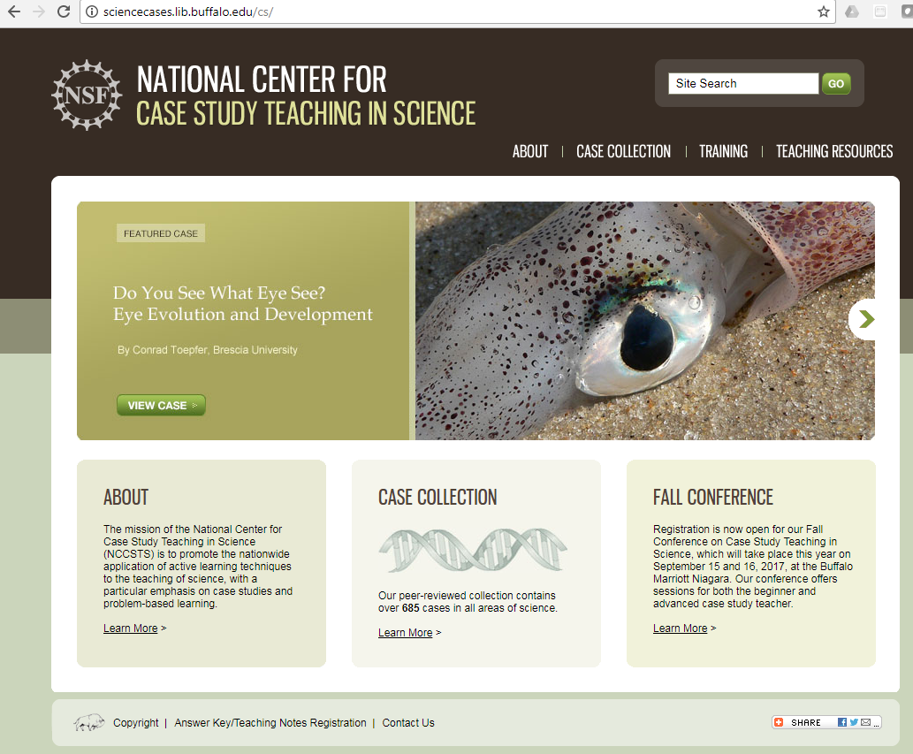
Case ≠ Case Study

Slide 27
Case ≠ Case Study
Case = Scenario
Case = Exemplar
Case = Example

Slide 28
www.evo-ed.org

Slide 29
Toxin Resistance Evolution in Clams
www.evo-ed.org

Slide 30
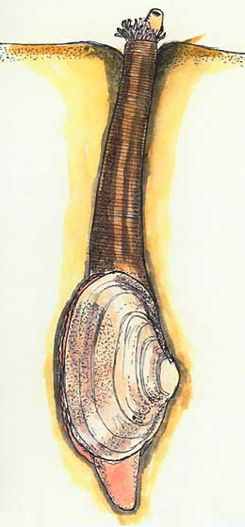
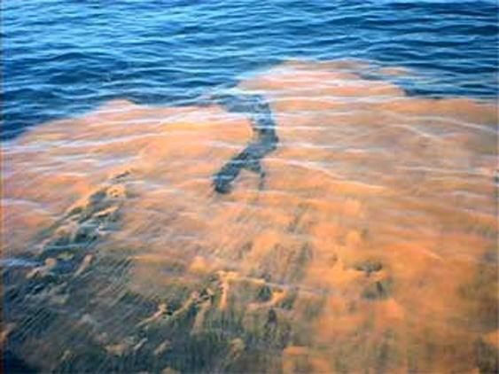
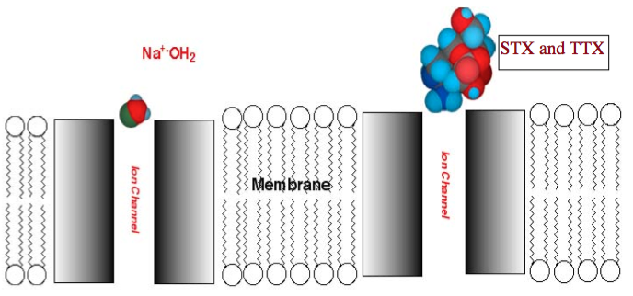

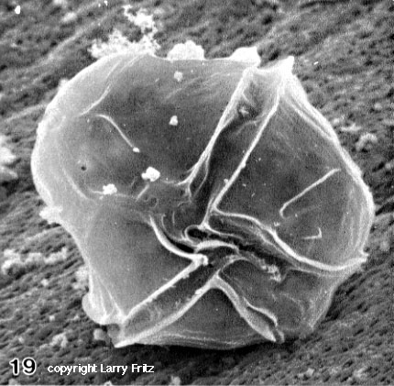
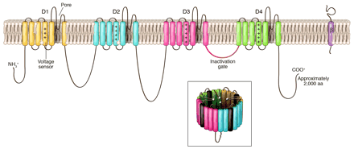
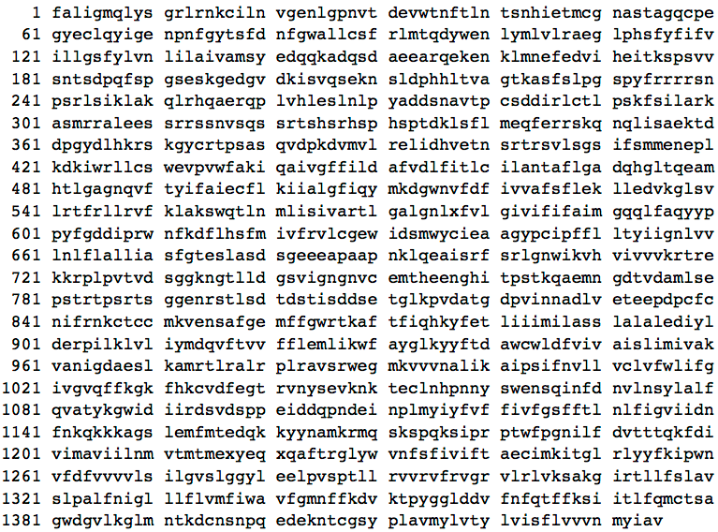
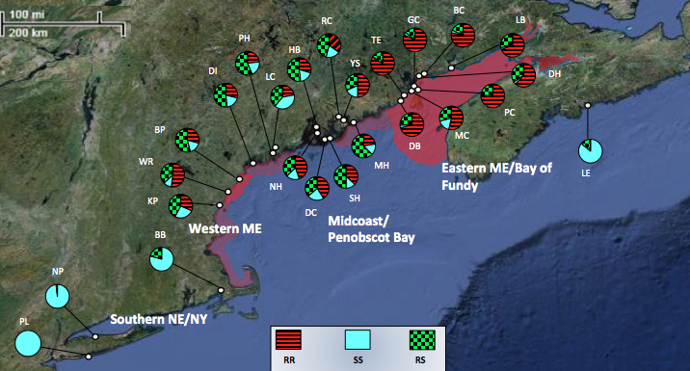
Evolution of Toxin Resistance in Clams

Slide 31
Evolution of Toxin Resistance in Clams
Algal blooms affecting marine ecosystems.
Food webs and biomagnification of toxins.
Human interaction with ecosystem.
Different allele frequencies in geographically isolated populations due to different environmental conditions.
Mendelian genetics, inheritance and dominant-recessive relationships.
Single nucleotide substitution mutation that changes the structure and function of a protein.
Action potential transmission through a neuron.

Slide 32
  GOALS:
  Develop cases that promote the learning of evolution as an integrative biological theory.
  Provide teaching resources for science instructors so they can teach evolution as an integrative biological theory.

Slide 33
  GOALS:
  Develop cases that promote the learning of evolution as an integrative biological theory.
  Provide teaching resources for science instructors so they can teach evolution as an integrative biological theory.

Slide 34
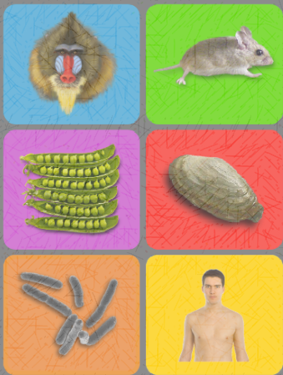
  GOALS:
  Develop cases that promote the learning of evolution as an integrative biological theory.
  Provide teaching resources for science instructors so they can teach evolution as an integrative biological theory.

Slide 35
  Each case features:
  A comprehensive overview of the system.
  A set of teaching and learning resources.

Slide 36
A Case Overview

Slide 37
www.evo-ed.org

Slide 38
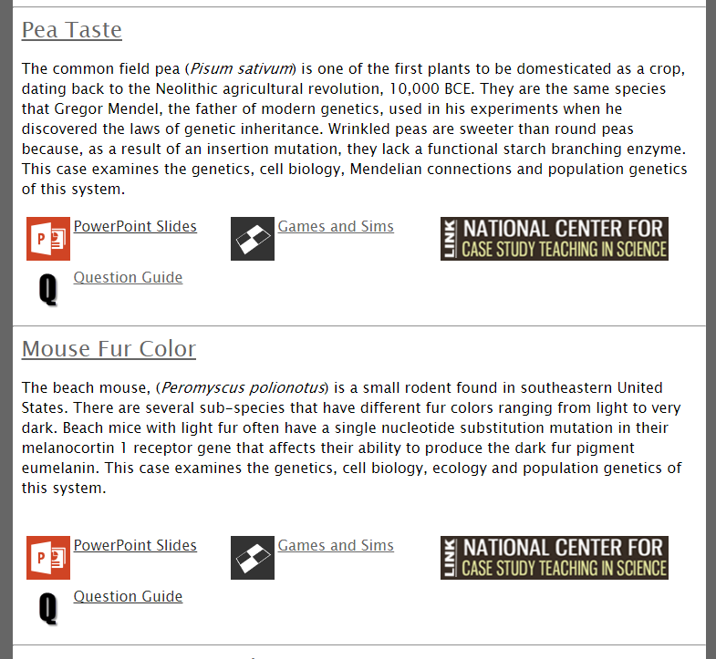
Splash Page has brief descriptions of cases and links to resources

Slide 39
www.evo-ed.org

Slide 40
Case Splash Page has links to different aspects of the biology

Slide 41
www.evo-ed.org

Slide 42
Teaching and
Learning Resources

Slide 43
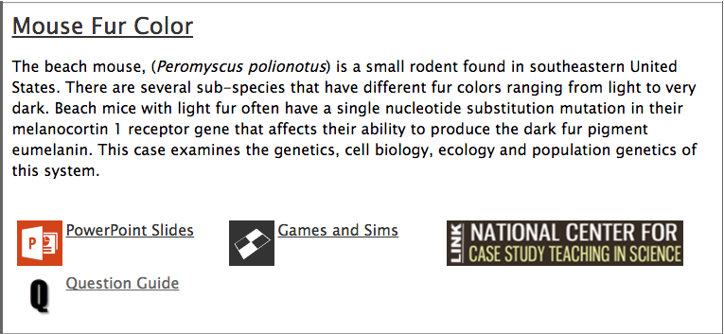

Slide 44
Set of Mouse Case PowerPoint Slides

Slide 45
Games and Sims – Colonize the Beach

Slide 46
NCCSTS – Case Study

Slide 47
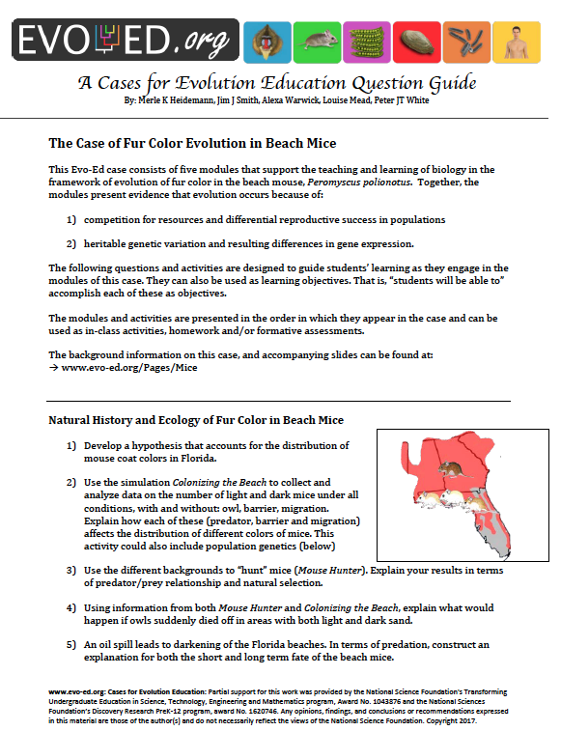
Question Guide

Slide 48
Outline of Today’s Session
PART I:
What is evolution?
Why adopt a new approach to evolution education?
PART II:
Introduction to Evo-Ed Cases.
Explore: How can Evo-Ed Cases be integrated into your teaching?
PART III:
Looking ahead!
Lesson plans, Activities, Innovative Implementation
www.evo-ed.org

Slide 49
Outline of Today’s Session
PART I:
What is evolution?
Why adopt a new approach to evolution education?
PART II:
Introduction to Evo-Ed Cases.
Explore: How can Evo-Ed Cases be integrated into your teaching?
PART III:
Looking ahead!
Lesson plans, Activities, Innovative Implementation
www.evo-ed.org

Slide 50
A
Explore the cases
and make a
“process figure”
Notes:
Activity to get to know the cases and present a method for structuring lessons/activities

Slide 51
Worksheet = “Process Figure”
What is the driving question for the entire case?
Think about: intended student level / course
For one phenomenon in a case, come up with:
  Question
  Student Explanation – how might a student respond to that question (varies by level)
  Investigation – what will students do to work towards answering the question
  Data & Finding – answers the posed question and typically leads to another question (next row!)
Notes:
Investigation - what will students DO to work towards answering the question
Data/finding – answers posed quesiton, leads to another question

Slide 52


What phenomena?
Phenomena:
Events in nature that scientists and students investigate and then try to explain.
(Slide adapted from Joe Krajick)
Notes:
Ask: what is a phenomena?
https://www.youtube.com/watch?v=8N_tupPBtWQ
Thanks to Ted Willard from NSTA
Download and store

Slide 53


“Three dimensional” learning
Three components of exploring phenomena
  Disciplinary core ideas
  Scientific practices
  Cross cutting concepts
Students learn content through
engagement in scientific practices,
using science ideas to explain how and why phenomena occur.
(Slide adapted from Joe Krajick)

Slide 54
Phenomena:
Can be explored with a scientific question.
Scientific practices
Core ideas of the discipline
Cross cutting concepts that span disciplines
Integrating phenomena into your teaching
(Slide adapted from Joe Krajick)
Notes:
The working together of the three dimensions (core ideas, crosscutting concepts and scientific and engineering practices) to focus classroom assessment and instruction on explaining phenomena or designing solutions to problems

Slide 55
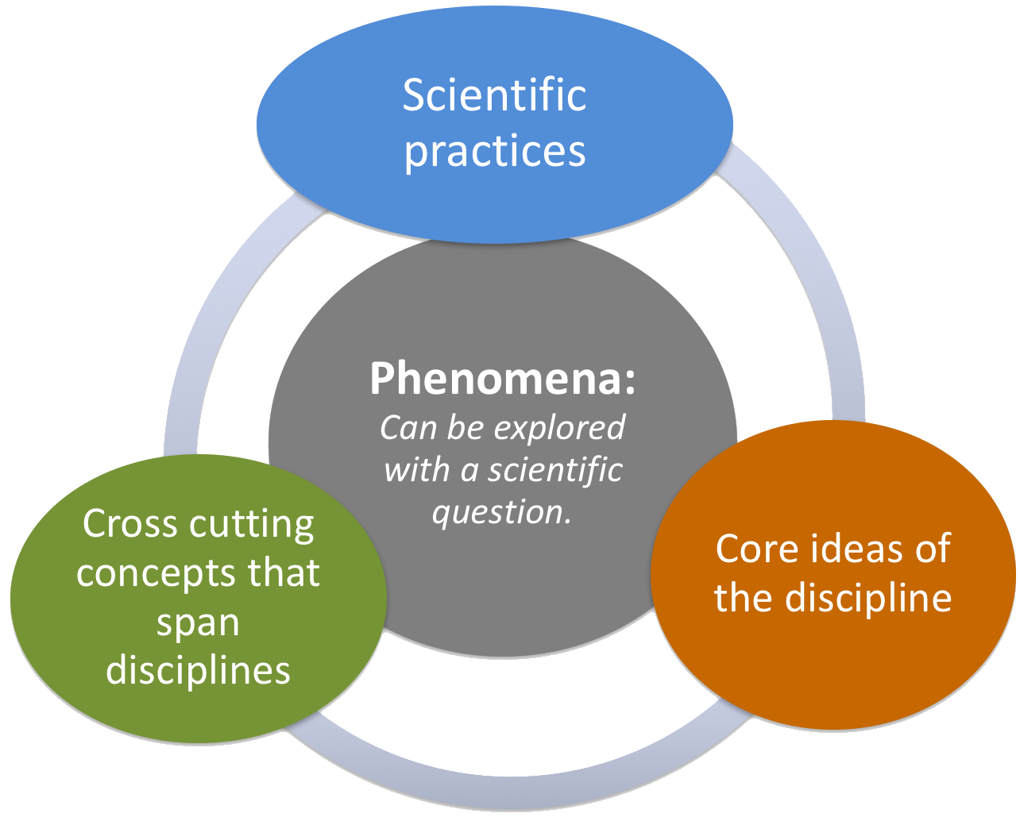
“Three dimensional” learning
  Disciplinary core ideas
    evolution
  Scientific practices
    developing & using models
    analyzing & interpreting data
    constructing explanations & designing solutions engaging in argument from evidence
    obtaining, evaluating & communicating information.
  Cross cutting concepts
    cause & effect
    scale
    systems, energy & matter
    structure & function

Slide 56
“Process Figure”
Frames the Evo-Ed cases in a 3D learning framework.
Worksheet handed out.

Slide 57
“Process Figure”
Start by defining a driving question
Example:
How and why do mice in the old field habitat have dark fur and mice in the beach habitat have light fur?

Slide 58
“Process Figure”
Start by defining a driving question
Next, choose a phenomenon within the case, and given your teaching context…
Work through the process figure:
Phenomenon | Question | Student Explanation | Investigation | Data & Finding

Slide 59
Example:
Process Figure for Beach Mice
Phenomenon | Question | Student Explanation | Investigation | Data & Finding
Field mice have varying coat coloration which varies across regions that are dramatically different in soil color and brightness. | Where do field mice live and are they distributed in any particular manner? | Different kinds of mice have different colors, like cats and dogs. | Students graph data (Belk & Smith 1996) on a map. The data includes the location of the populations, brightness of the habitat at each locality, and coat color of the mice found in each population. | Students identify the pattern or association between the coat color of the mice and the brightness of the habitat, nothing that there is variation over the distribution of the species, but that the variation appears to correlate with habitat.

Slide 60
Example:
Process Figure for Beach Mice
Phenomenon | Question | Student Explanation | Investigation | Data & Finding
Field mice have varying coat coloration which varies across regions that are dramatically different in soil color and brightness. | Where do field mice live and are they distributed in any particular manner? | Different kinds of mice have different colors, like cats and dogs. | Students graph data (Belk & Smith 1996) on a map. The data includes the location of the populations, brightness of the habitat at each locality, and coat color of the mice found in each population. | Students identify the pattern or association between the coat color of the mice and the brightness of the habitat, nothing that there is variation over the distribution of the species, but that the variation appears to correlate with habitat.

Slide 61
Example:
Process Figure for Beach Mice
Phenomenon | Question | Student Explanation | Investigation | Data & Finding
Field mice have varying coat coloration which varies across regions that are dramatically different in soil color and brightness. | Where do field mice live and are they distributed in any particular manner? | Different kinds of mice have different colors, like cats and dogs. | Students graph data (Belk & Smith 1996) on a map. The data includes the location of the populations, brightness of the habitat at each locality, and coat color of the mice found in each population. | Students identify the pattern or association between the coat color of the mice and the brightness of the habitat, nothing that there is variation over the distribution of the species, but that the variation appears to correlate with habitat.

Slide 62
Example:
Process Figure for Beach Mice
Phenomenon | Question | Student Explanation | Investigation | Data & Finding
Field mice have varying coat coloration which varies across regions that are dramatically different in soil color and brightness. | Where do field mice live and are they distributed in any particular manner? | Different kinds of mice have different colors, like cats and dogs. | Students graph data (Belk & Smith 1996) on a map. The data includes the location of the populations, brightness of the habitat at each locality, and coat color of the mice found in each population. | Students identify the pattern or association between the coat color of the mice and the brightness of the habitat, nothing that there is variation over the distribution of the species, but that the variation appears to correlate with habitat.

Slide 63
Example:
Process Figure for Beach Mice
Phenomenon | Question | Student Explanation | Investigation | Data & Finding
Field mice have varying coat coloration which varies across regions that are dramatically different in soil color and brightness. | Where do field mice live and are they distributed in any particular manner? | Different kinds of mice have different colors, like cats and dogs. | Students graph data (Belk & Smith 1996) on a map. The data includes the location of the populations, brightness of the habitat at each locality, and coat color of the mice found in each population. | Students identify the pattern or association between the coat color of the mice and the brightness of the habitat, nothing that there is variation over the distribution of the species, but that the variation appears to correlate with habitat.

Slide 64
Example:
Process Figure for Beach Mice
Phenomenon | Question | Student Explanation | Investigation | Data & Finding
Field mice have varying coat coloration which varies across regions that are dramatically different in soil color and brightness. | Where do field mice live and are they distributed in any particular manner? | Different kinds of mice have different colors, like cats and dogs. | Students graph data (Belk & Smith 1996) on a map. The data includes the location of the populations, brightness of the habitat at each locality, and coat color of the mice found in each population. | Students identify the pattern or association between the coat color of the mice and the brightness of the habitat, nothing that there is variation over the distribution of the species, but that the variation appears to correlate with habitat.

Slide 65
Blank Process Figure Worksheet
What is the case driving question?
Choose a phenomenon within the case.
Think about how this could be used in your teaching context.
Phenomenon | Question | Student Explanation | Investigation | Data & Finding

Slide 66
go to www.evo-ed.org
choose a case to explore
fill out a process figure

Slide 67
debrief…
Which case did you explore?
Share your process figure!

Slide 68
Outline of Today’s Session
PART I:
What is evolution?
Why adopt a new approach to evolution education?
PART II:
Introduction to Evo-Ed Cases.
Explore: How can Evo-Ed Cases be integrated into your teaching?
PART III:
Looking ahead!
Lesson plans, Activities, Innovative Implementation
www.evo-ed.org

Slide 69
P
Trichromatic Vision Evolution in Primates
Fur Color Evolution in Beach Mice
Seed Taste Evolution in Field Peas
Toxin Resistance Evolution in Clams
Evolution of Citrate Utilization in E. coli
Evolution of Lactase Persistence in Humans
CASE TOPICS

Slide 70
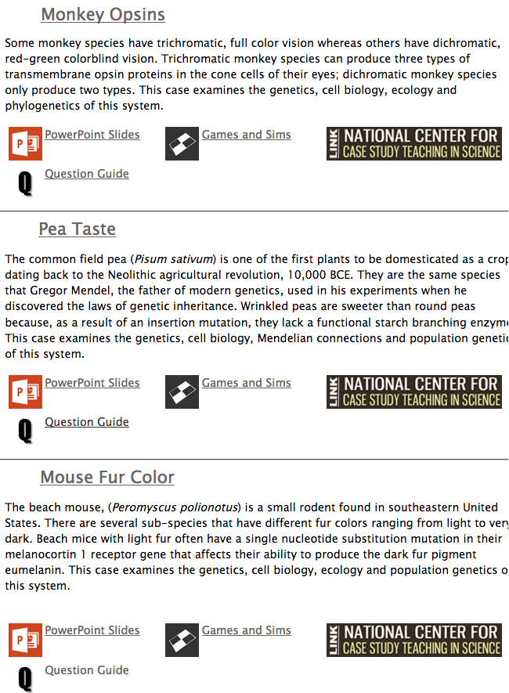
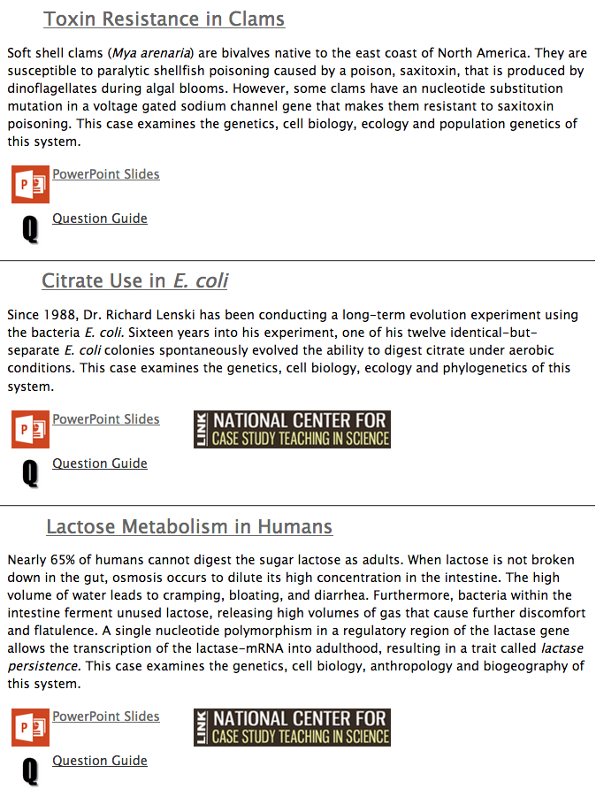

Slide 78
What’s Next?

Slide 79
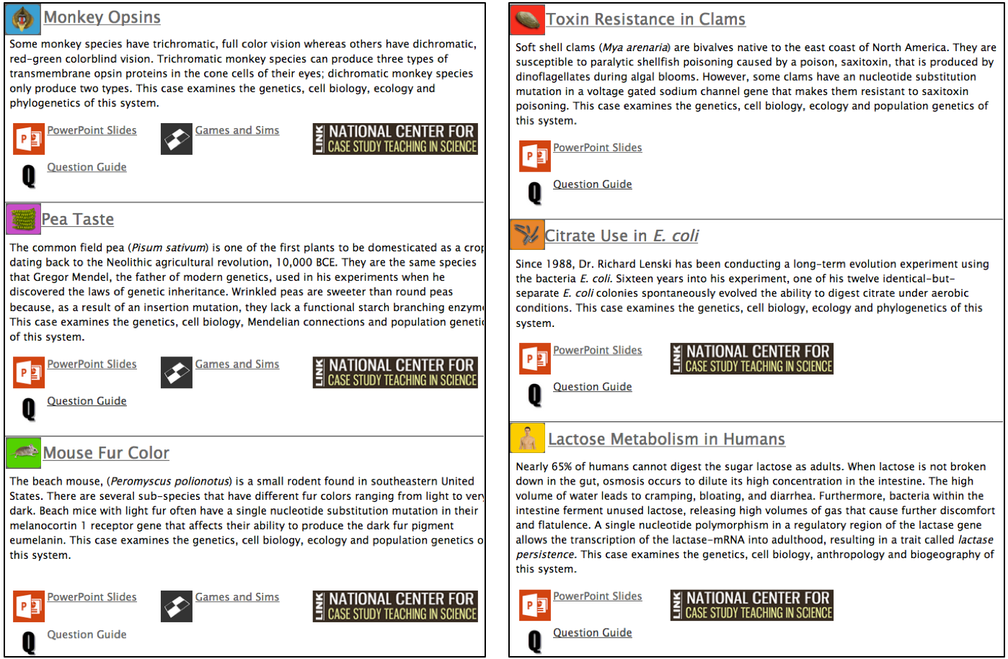


Slide 81
Beach Mice Data Nugget

Slide 82


Slide 83
Classroom Activity

Slide 84
Classroom Activity

Slide 85
Classroom Activity

Slide 86
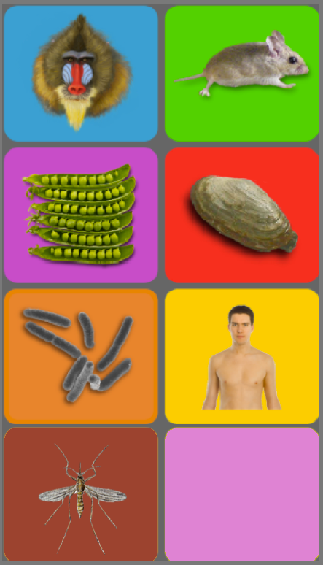
Additional Cases?
Mosquito insecticide resistance?
?

Slide 88
Summary of Potential Projects
Create a classroom activity using the cases.
Storyboard an idea for a new game or sim.
Create a homework activity that guides
students through one of the cases.
Write a new NCCSTS Case Study.
Assemble a new Data Nugget activity.
Design a lesson plan.
Use the process figure to map out a pathway through one of the cases.
Synthesize existing research to describe a new case of trait evolution.
Publish your resources!

Slide 89
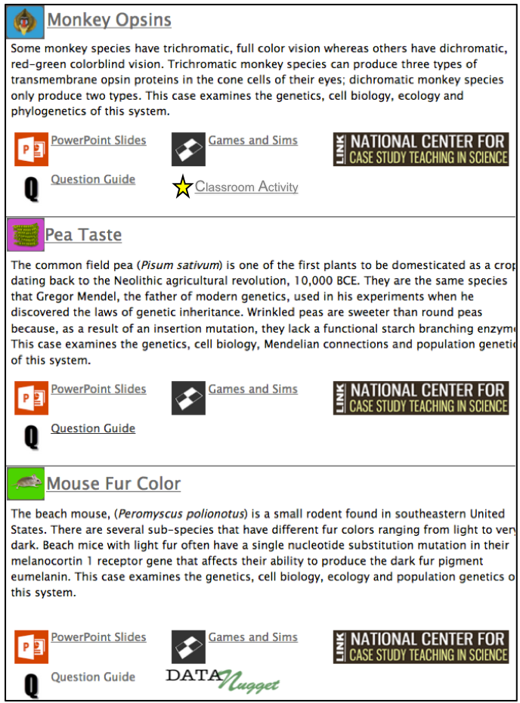
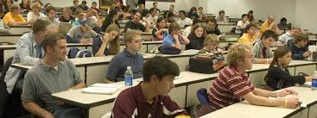
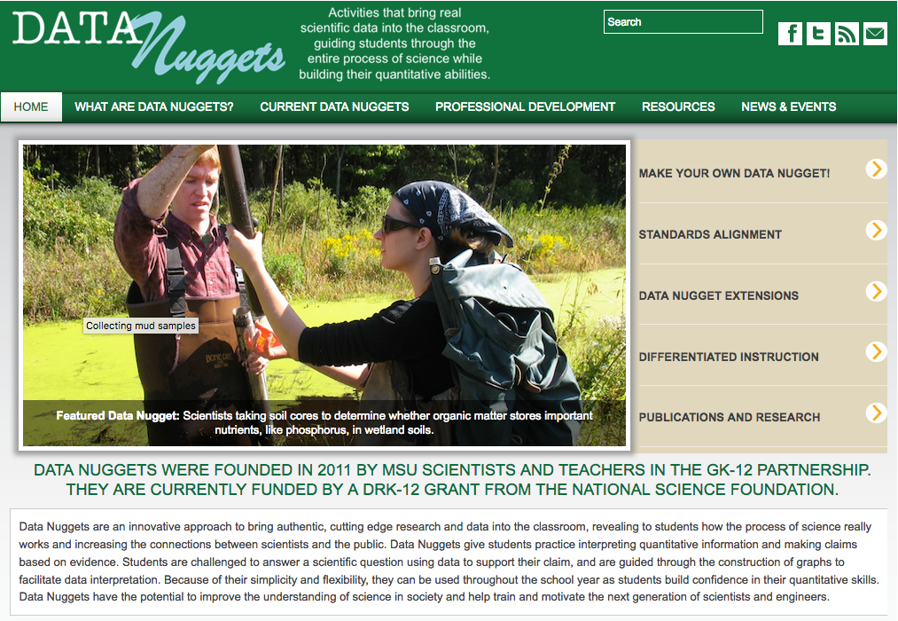
Become an Education Resource Developer
Create something you can use in class to help teach evolution.
Publish your resource!
  Evo-Ed.org
  Data Nuggets
  NCCSTS
Classroom Activity

Slide 90
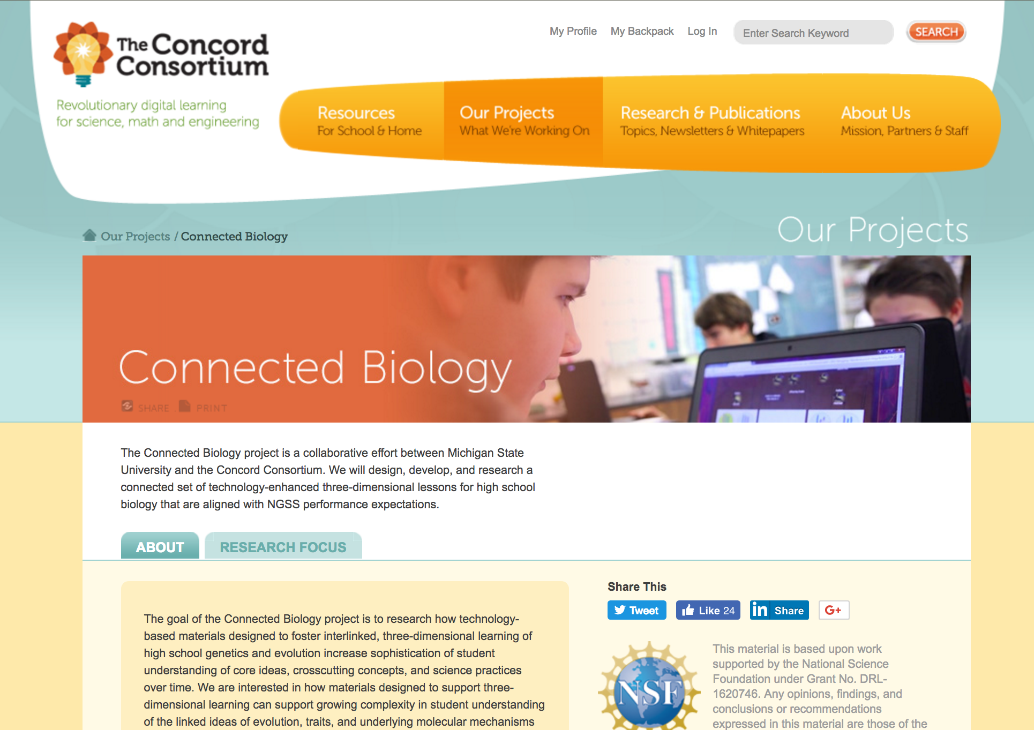
Become an Education Resource Developer
K-12 Opportunity
ConnectedBio – collaborative effort between MSU and the Concord Consortium (NSF DRK-12)
Classroom Activity

Slide 91
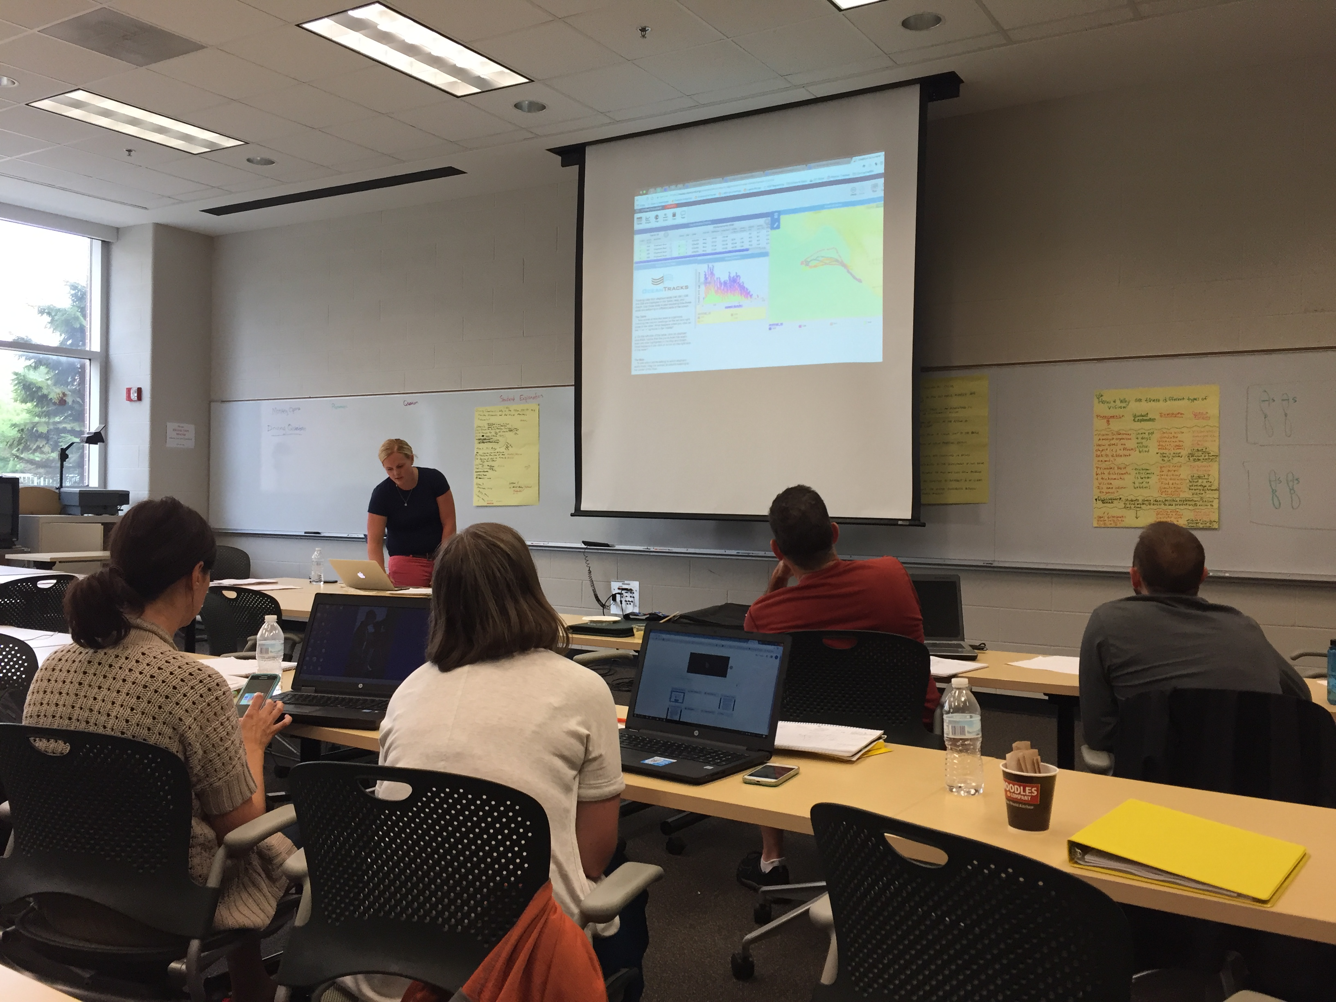
Next Steps
What do you see yourself developing?
Notes:
Engage with high school teachers = grant funding!

