Slide 1
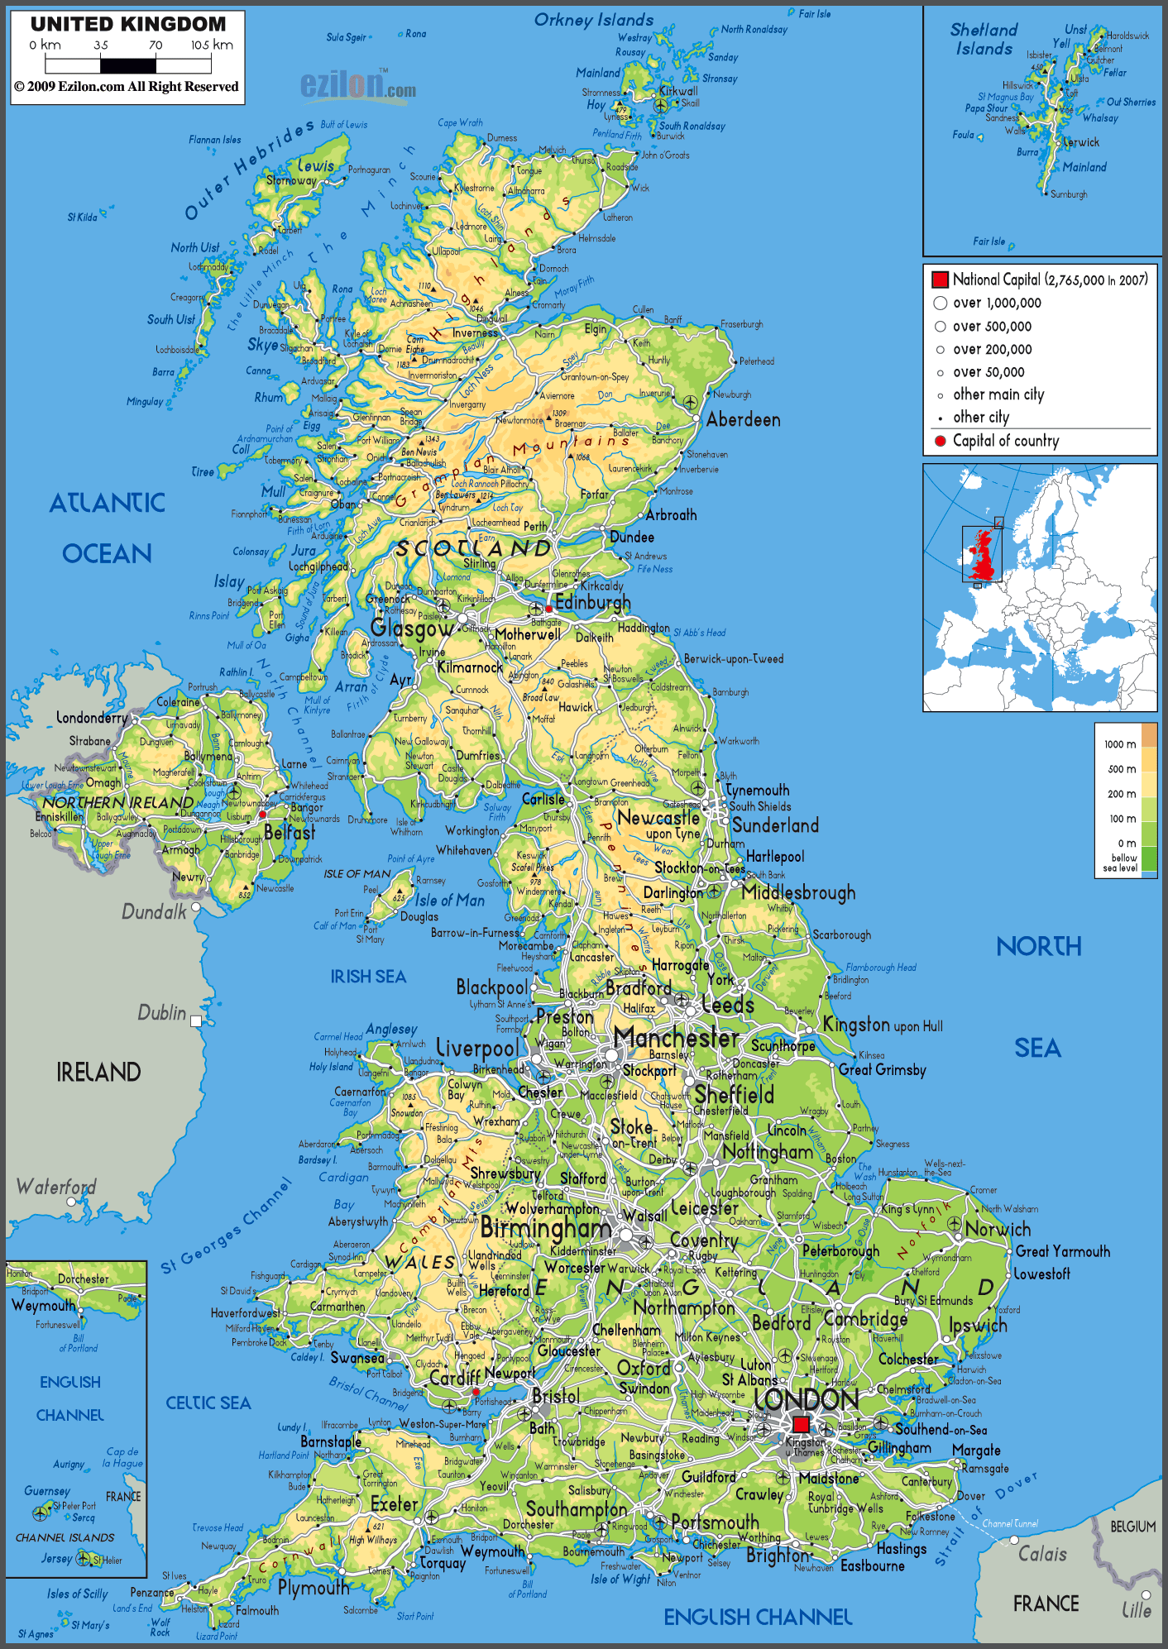
(Orkney)
Bressay
(Shetland)
Muck
Iona
May
Ailsa

