Slide 1
Inviting Students to Engage in the Modeling Process Through a New Framework for Models and Modeling
and researchers
Hannah Callender Highlander
University of Portland

Slide 2
goals
Spark your interest in a new way of thinking about and talking about models and modeling
  Language is important
Encourage dialogue on challenges and solutions to incorporating models and modeling
  We’re in this together. You’re not alone!
Provide take-home tools/ideas you WANT to use.
Share resources for further modeling activities.

Slide 3
Modeling challenges
“Incorporating modeling in the classroom can be challenging.”
What are yours?
Mine:
  Incorporating new material means something else must go.
  Creating my own modeling projects takes time.
  Do I understand the biology well enough to guide students?
  How to make this a meaningful experience?

Slide 4
How to approach the challenges?
Problem:
How to incorporate more models and modeling into the classroom?
What we know
  Models and modeling are all around us
  Everyone is telling us we should be using them and teaching our students how to work with models.
What we may not know
  Do we all think of the same thing when we think of a “model”?
  What about modeling?
  If you’re not doing much now, how can you ease into it?
Our proposed solution
  Develop an inclusive framework for models and modeling that encourages collaboration among disciplines

Slide 5
Definition of a model
Model: a simplified, abstract or concrete representation of relationships and/or processes in the real world, constructed for some purpose.
  Simplified: caricature of the real world
  Purpose: enhance our understanding of the process or relationship being modeled
Models have multiple representations
Parable of the blind men and the elephant (poem by John Godfrey Saxe)
  Different perspectives lead to different information.
  The use of multiple representations provides a deeper understanding of the problem.

Slide 6
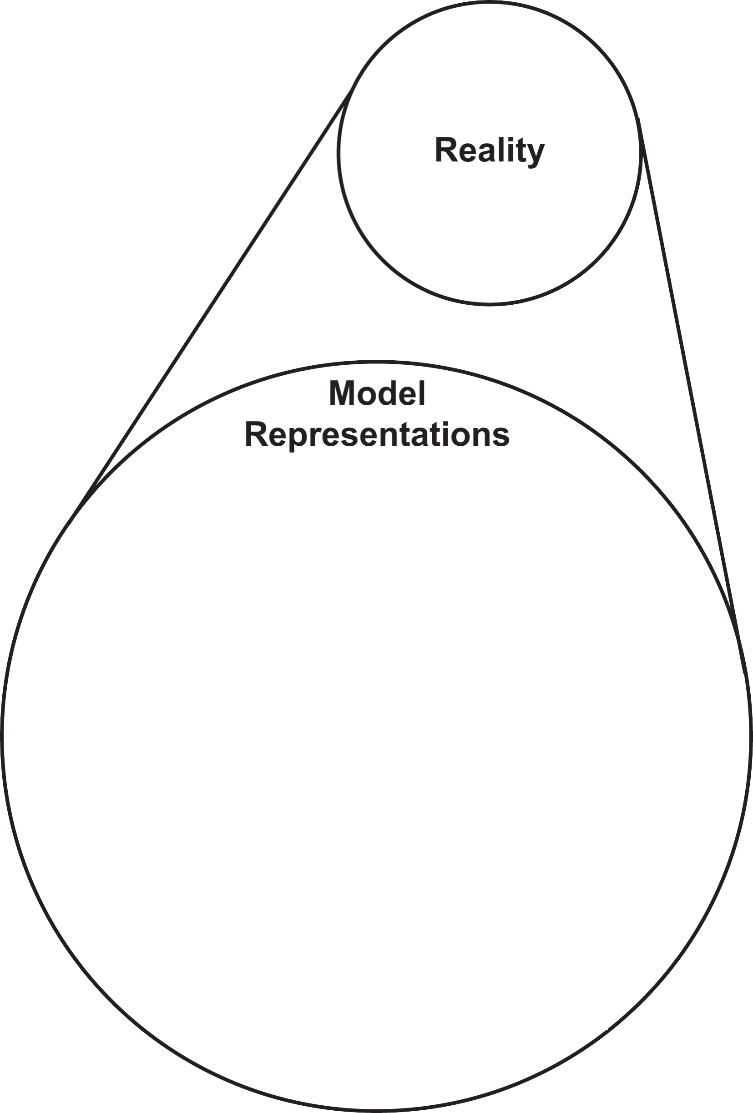
“Rule of five”
What’s the big deal?
Models are not only formulas
Mathematical understanding is strengthened when students can make connections between different representations.
Students may prefer working with certain representations, but benefit most from seeing and using multiple representations and from moving between them.
Experiential
Verbal
Numerical
Symbolic
Visual

Slide 7
Verbal representation
Hypothesis: A mutation in a particular gene will reduce the rate of bacterial growth because the mutation impairs DNA replication.
Prediction: On average global temperature will increase.
Assumption: We assume that the population is well mixed.
Simple descriptions of observations: The rate of increase is decreasing; we observe far more of the blue flower type than the purple flower type.
Qualitative data: Spiciness ratings by tasters of chili peppers.
Experiential
Animations & simulations
Physical models
Experiments & observations
Verbal
Hypotheses
Predictions
Qualitative experimental data
Numerical
Simulated data
Derived data
Quantitative experimental data
Symbolic
Equations
Parameters & state variables
Visual
Graphs
Schematics
Data visualizations

Slide 8
Symbolic representation
Equations: Discrete difference equation for geometric growth x_{n+1} = λx_{n} and continuous differential equation for exponential growth dP/dt = rP
Parameters: If in HWE, p = frequency of one allele, p² = frequency of homozygotes for that allele
State variable: P(t) = population at time t (in years)
Equation (stats): linear regression
Equation (stats): probability distribution
Experiential
Animations & simulations
Physical models
Experiments & observations
Verbal
Hypotheses
Predictions
Qualitative experimental data
Numerical
Simulated data
Derived data
Quantitative experimental data
Symbolic
Equations
Parameters & state variables
Visual
Graphs
Schematics
Data visualizations

Slide 9
Numerical representation
Simulated data: Numbers of infected individuals calculated from a Symbolic epidemic model
Derived data: low density growth rate and carrying capacity calculated from plotting relative growth rate versus population for logistic growth
Quant. Exp. Data: Measured population counts from experiments
Experiential
Animations & simulations
Physical models
Experiments & observations
Verbal
Hypotheses
Predictions
Qualitative experimental data
Numerical
Simulated data
Derived data
Quantitative experimental data
Symbolic
Equations
Parameters & state variables
Visual
Graphs
Schematics
Data visualizations

Slide 10
Visual representation
Graph: relative growth rate versus population
Schematic: SIR epidemic model; stock-and-flow diagrams
Data visualizations: histograms, scatter plots, infographics, etc.
Experiential
Animations & simulations
Physical models
Experiments & observations
Verbal
Hypotheses
Predictions
Qualitative experimental data
Numerical
Simulated data
Derived data
Quantitative experimental data
Symbolic
Equations
Parameters & state variables
Visual
Graphs
Schematics
Data visualizations

Slide 11
Experiential representation
Animations & simulations: A video of bacterial growth; beanbag biology; virtual laboratories (e.g, SimBio, the BUGBOX-predator virtual laboratory)
Experiential
Animations & simulations
Physical models
Experiments & observations
Verbal
Hypotheses
Predictions
Qualitative experimental data
Numerical
Simulated data
Derived data
Quantitative experimental data
Symbolic
Equations
Parameters & state variables
Visual
Graphs
Schematics
Data visualizations
Notes:
I had an extra slide for this one in case this hyperlink didn’t work or if we didn’t have internet.

Slide 12
Experiential representation
Animations & simulations: A video of bacterial growth; beanbag biology; virtual laboratories (e.g, SimBio, the BUGBOX-predator virtual laboratory)
Experiential
Animations & simulations
Physical models
Experiments & observations
Verbal
Hypotheses
Predictions
Qualitative experimental data
Numerical
Simulated data
Derived data
Quantitative experimental data
Symbolic
Equations
Parameters & state variables
Visual
Graphs
Schematics
Data visualizations
Notes:
I had a movie of this netlogo model in another slide.

Slide 13
Experiential representation
Physical model: structure of DNA
Experiential
Animations & simulations
Physical models
Experiments & observations
Verbal
Hypotheses
Predictions
Qualitative experimental data
Numerical
Simulated data
Derived data
Quantitative experimental data
Symbolic
Equations
Parameters & state variables
Visual
Graphs
Schematics
Data visualizations

Slide 14
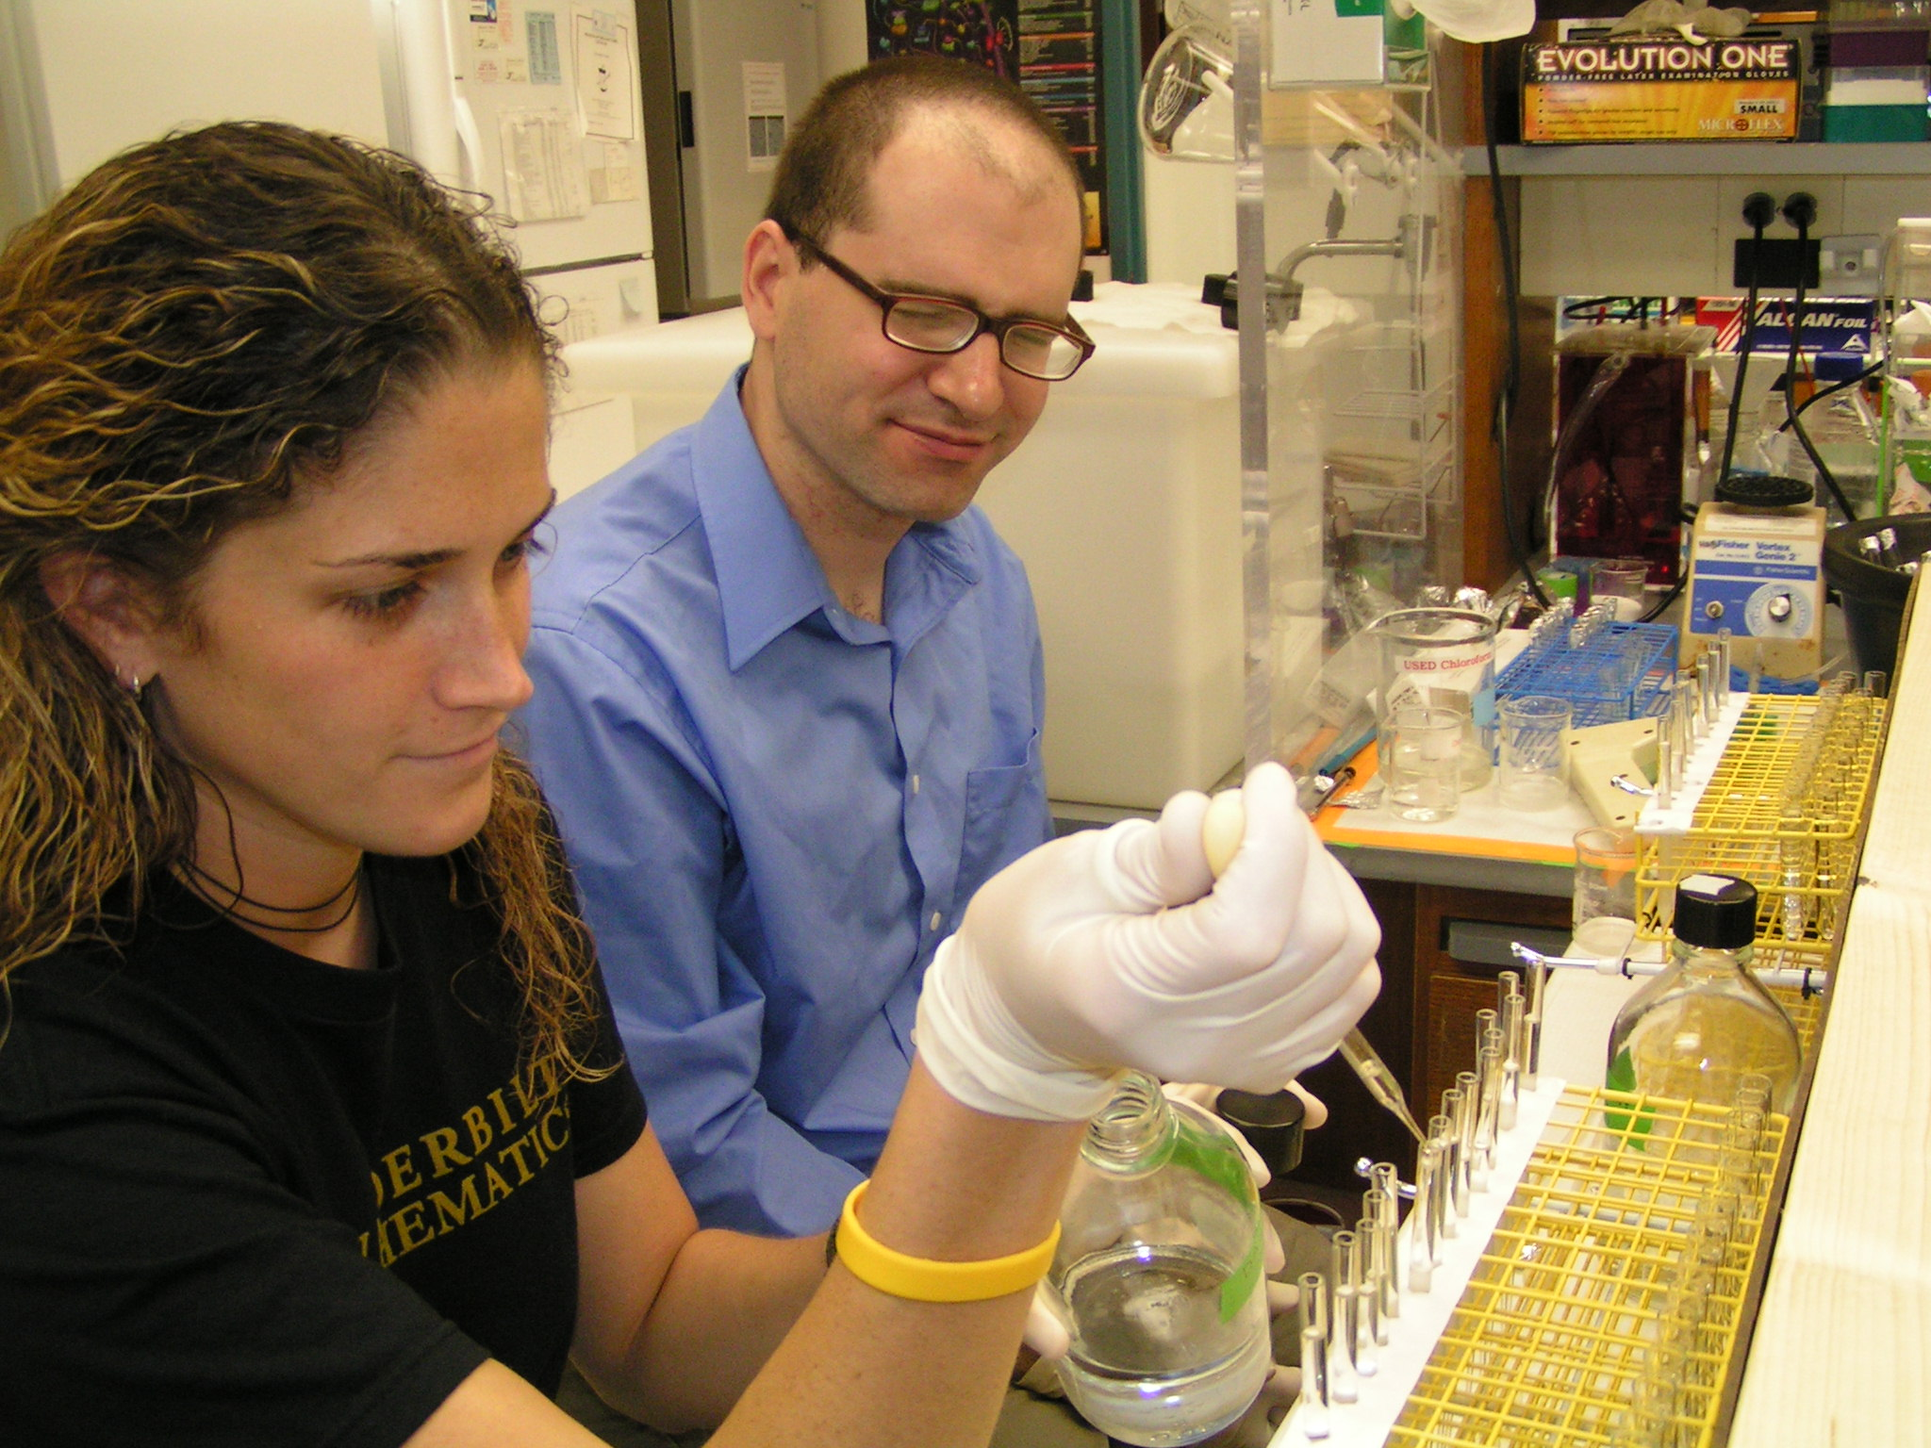
Experiential representation
Experiments & observations: measure bacterial growth in the laboratory
Experiential
Animations & simulations
Physical models
Experiments & observations
Verbal
Hypotheses
Predictions
Qualitative experimental data
Numerical
Simulated data
Derived data
Quantitative experimental data
Symbolic
Equations
Parameters & state variables
Visual
Graphs
Schematics
Data visualizations

Slide 15
Benefits of Experiential representation
Separate from Visual: direct sensory experience plays a distinct and independent role
More easily connected with the original phenomena than any of the other representations
Provide an entryway for understanding models that do not require
  abstraction of Symbolic or Visual representations
  integration of detail needed to understand a Numerical representation
  conceptual knowledge and reading comprehension needed to understand a Verbal representation.
Experiential
Animations & simulations
Physical models
Experiments & observations
Verbal
Hypotheses
Predictions
Qualitative experimental data
Numerical
Simulated data
Derived data
Quantitative experimental data
Symbolic
Equations
Parameters & state variables
Visual
Graphs
Schematics
Data visualizations

Slide 16
Multiple representations Predator-prey example
Problem: Model of prey deaths by a single predator as a function of prey density
Verbal: assumptions of Holling type 2 functional response
  Number of prey attacked increases with the time available for searching, the prey density, and with the searching efficiency or attack rate of the predator.
  Search time decreases as prey numbers increase.
Symbolic: resulting equation

Slide 17
Multiple representations Predator-prey example
Problem: Model of prey deaths by a single predator as a function of prey density
Numerical: data
Visual: graph Holling Type II functional response curve

Slide 18
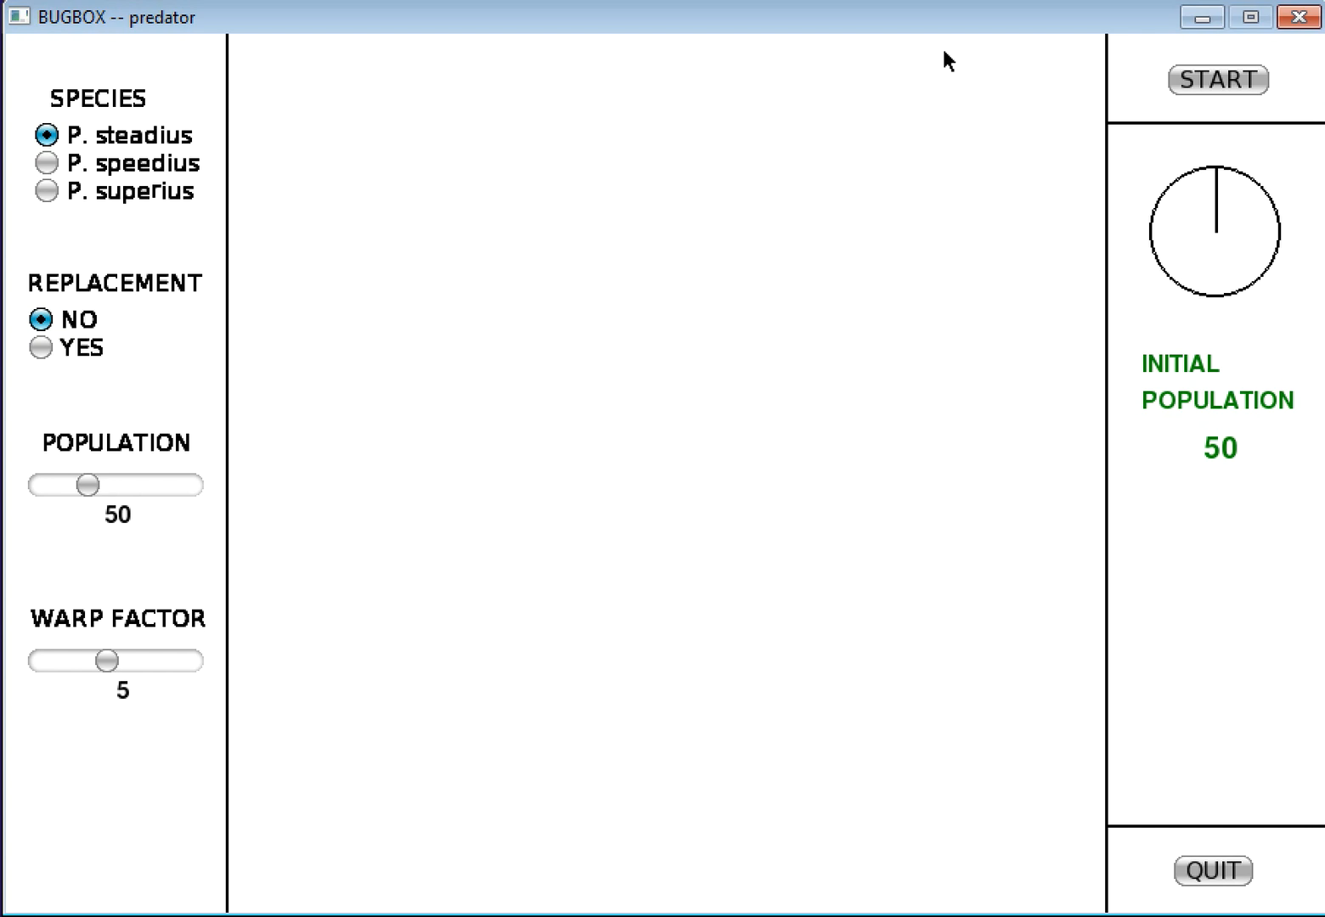
Multiple representations Predator-prey example
Problem: Model of prey deaths by a single predator as a function of prey density
Experiential: animation
  BUGBOX virtual laboratory (Ledder G. 2007. BUGBOX-predator. https://www.math.unl.edu/ ~gledder1/BUGBOX/)
  Agent-based model of an experiment
    One predator is given fixed amount of time to find and consume stationary prey
  Observe predator dividing time between searching and handling
  BONUS: no prior knowledge needed
Notes:
This is the only movie I kept in this version. I talked about how Glenn’s model works for two different population sizes.

Slide 19
Multiple representations Logistic growth example
Verbal:
  Statements about growth rate: “relative growth rate is a decreasing linear function of population”
  Statements linking math model to biological concepts: “absolute growth rate is proportional to population and the remaining capacity for population growth”
Symbolic: logistic growth equation
Numerical:
  population data
  Absolute and relative growth rates (derived data)
Visual:
  Graph of population size vs time
  Graph of per capita population rate of change vs population size
Experiential: Experiments measuring growth of bacteria
  Actual lab experiment
  Manipulating a simulation
  Viewing results of a time-lapse or animation
  BONUS: no prior knowledge needed

Slide 20
Recall:
Definition of a model
Model: a simplified, abstract or concrete representation of relationships and/or processes in the real world, constructed for some purpose.
Experiential
Animations & simulations
Physical models
Experiments & observations
Verbal
Hypotheses
Predictions
Qualitative experimental data
Numerical
Simulated data
Derived data
Quantitative experimental data
What is “modeling”?
Symbolic
Equations
Parameters & state variables
Visual
Graphs
Schematics
Data visualizations

Slide 21
Definition of modeling
Modeling: a process composed of the various sets of activities involved in a larger modeling enterprise.
Modeling enterprise: traditional iterative process
  Example: state the problem, make simplifying assumptions, mathematize, analyze the model, refine or extend the model
Individual modeling activities:
  moving from observations of reality to an abstracted model, either as an initial step in developing a model or as part of a model revision
  moving from one model representation to another representation of the same model
  comparing models to each other (e.g., model selection) or to reality (model validation).

Slide 22
Rule of 5 framework
5 model representations
  Boxes
Experiential
Animations & simulations
Physical models
Experiments & observations
Verbal
Hypotheses
Predictions
Qualitative experimental data
Numerical
Simulated data
Derived data
Quantitative experimental data
Symbolic
Equations
Parameters & state variables
Visual
Graphs
Schematics
Data visualizations

Slide 23
Rule of 5 framework
5 model representations
  Boxes
Modeling activities
  Arrows: moving from one representation (box) to another
  Moving from reality to an abstracted model
  Comparing models to one another or to reality
Experiential
Animations & simulations
Physical models
Experiments & observations
Verbal
Hypotheses
Predictions
Qualitative experimental data
Numerical
Simulated data
Derived data
Quantitative experimental data
Symbolic
Equations
Parameters & state variables
Visual
Graphs
Schematics
Data visualizations

Slide 24
Rule of 5 framework
Caution: Context is important!
  Example: finding an equilibrium solution
  Thinking about modeling is critical
Advantages of this framework:
  We can practice modeling activities and a modeling process (a pathway that connects activities) without engaging in full modeling enterprise
  Enhance collaboration and scaffolding
Experiential
Animations & simulations
Physical models
Experiments & observations
Verbal
Hypotheses
Predictions
Qualitative experimental data
Numerical
Simulated data
Derived data
Quantitative experimental data
Symbolic
Equations
Parameters & state variables
Visual
Graphs
Schematics
Data visualizations

Slide 25
Modeling Process: logistic growth
Example of a “mathematical” modeling process (any pathway that traverses through the symbolic box)
Experiential → Numerical
  perform an experiment to measure the growth of a bacterial culture over time (or watch a time-lapse video of the phenomenon or manipulate a simulation)
  use raw population data to calculate absolute and relative growth rates
Numerical → Visual
  Given the growth rates, plot the data in different ways
Visual → Verbal
  From the resulting plot, construct a verbal model consisting of the assumption that the growth rate is proportional to population
Verbal → Symbolic
  From the verbal model, write down the resulting differential or difference equation for logistic growth
Experiential
Animations & simulations
Physical models
Experiments & observations
Verbal
Hypotheses
Predictions
Qualitative experimental data
Numerical
Simulated data
Derived data
Quantitative experimental data
Symbolic
Equations
Parameters & state variables
Visual
Graphs
Schematics
Data visualizations

Slide 26
Important notes
Multiple pathways exist (may be discipline specific)
A box (representation) may be traversed multiple times
Previous pathway could be extended (Our work is never done!)
The longer the pathway, the richer the experience
As the students engage in each of these activities, they should be thinking about what they are doing and the connections they are making.

Slide 27
Modeling Process: structure of Dna
Example of a biological modeling pathway (took by Watson and Crick)
Numerical and Verbal → Experiential
  Quantitative and qualitative data led to the physical model
Experiential → Verbal
  Physical model led to a hypothesis about mechanism: “It has not escaped our notice that the specific pairing we have postulated immediately suggests a possible copying mechanism for the genetic material.”
    Watson J.D. and Crick F.H. 1953. Molecular structure of nucleic acids. Nature. 171(4356): 737-738.
Experiential
Animations & simulations
Physical models
Experiments & observations
Verbal
Hypotheses
Predictions
Qualitative experimental data
Numerical
Simulated data
Derived data
Quantitative experimental data
Symbolic
Equations
Parameters & state variables
Visual
Graphs
Schematics
Data visualizations
Notes:
Can you think of a pathway on your own?

Slide 28
Modeling Process:
Hardy-weinberg Equil.
Example of a statistical modeling pathway
Experiential → Verbal
  Upon conducting an experiment, students make a hypothesis based on their observations that allele frequencies remain the same from one generation to the next
Verbal → Symbolic
  From the verbal model, the Symbolic probability model representation is derived (HWE) stating that allele and genotype frequencies do not change in subsequent generations
Symbolic → Experiential
  HWE symbolic model prompts us to measure genotype frequencies in a population of interest to test for presence of HWE
Experiential → Numerical
  From our experiment we collect and record our data
Numerical → Symbolic
  From the data we perform a chi-squared test to the null probability model of HWE
Symbolic → Verbal
  Results of the test are used as evidence for the presence or absence of evolutionary forces
Experiential
Animations & simulations
Physical models
Experiments & observations
Verbal
Hypotheses
Predictions
Qualitative experimental data
Numerical
Simulated data
Derived data
Quantitative experimental data
Symbolic
Equations
Parameters & state variables
Visual
Graphs
Schematics
Data visualizations

Slide 29
Benefits to new framework
In agreement with other frameworks for teaching modeling, but:
Encourages deliberate and thoughtful development of individual modeling activities and skills in not only mathematics, but in other disciplines
Inclusive of disciplinary-specific research approaches taken by mathematicians, statisticians, and biologists
Emphasizes that the Experiential representation is crucial for student learning, particularly in partner disciplines.
Any pathway through the boxes “counts” as modeling.

Slide 30
Modeling Pathways and the Modeling Enterprise
Important aspects of modeling not embedded in framework as arrows
  Model abstraction and revision
    Incorporation of more biological detail
  Model validation
    Test model against data (original or new)
  Model selection
    Test model against other models
    Instructor’s role:
      Remind students to pause, validate the model, and if needed, reexamine the model assumptions or mathematization to refine it.
      Remind them that they are working in a conceptualized model of reality, and the assumptions and results should be critically analyzed in that light.

Slide 31
Improving student learning
The ability to move between representations enhances learning, but students have difficulty with this.
One study showed that simply telling students the purpose of the multiple representations can have a positive impact on learning.
How can we help? (Understanding Science website)
  Make it explicit
  Help students reflect and connect
  Provide context , again and again

Slide 32
Be explicit
Tell your students what you are doing, and why, in the context of modeling.
Teach students the modeling framework.
  definitions of models and modeling
  the model representations (boxes)
  the many modeling activities (arrows, model refinement, selection, validation)
Be clear that biologists are already engaged in modeling but may not use the same language or approach as mathematicians or statisticians.
Tell them there are many entry points, and any arrow is a valid modeling activity, as long as the student is connecting what they’re doing to the modeling process.

Slide 33
Help students reflect and connect
Have students reflect upon the modeling process by assigning metacognitive exercises
  a one-minute paper
  Journals
Work with instructors from different disciplines to help students make connections between classes to solidify their understanding of modeling.
Using a common framework can help us engage in conversations with colleagues from other disciplines, and thus bring the connections to our students.

Slide 34
Give it context, again and again
Ground the modeling investigation in the biological problem, using the Experiential representation as much as possible.
Use the framework to acknowledge and clarify the various approaches that each discipline takes to solving the same scientific problem.
  Different practitioners have different paths through the boxes that are equally valid.
Give examples of different paths in the same context.

Slide 35
Modeling Density Dependent population growth
Experiential: Physical simulation with checkerboard and dice
Numerical: Record data in a table
Visual: Plot population versus time and change in population versus population by hand
Verbal: Statements about population growth, assumptions we have made about growth
Symbolic: derive formulas for growth, using verbal and visual results
Experiential: extend physical simulation to computer simulation for further investigation

Slide 36
Modeling Density Dependent population growth
Notes:
I had a video of this in case Netlogo didn’t work.

Slide 37
Agent-based modeling in netlogo
Free download
  https://ccl.northwestern.edu/netlogo/
Models library
  Evolution models
Railsback and Grimm text
  Agent-based and Individual-based Modeling: A Practical Introduction
  http://www.railsback-grimm-abm-book.com/
  Excellent introduction to NetLogo and to scientific modeling

Slide 38
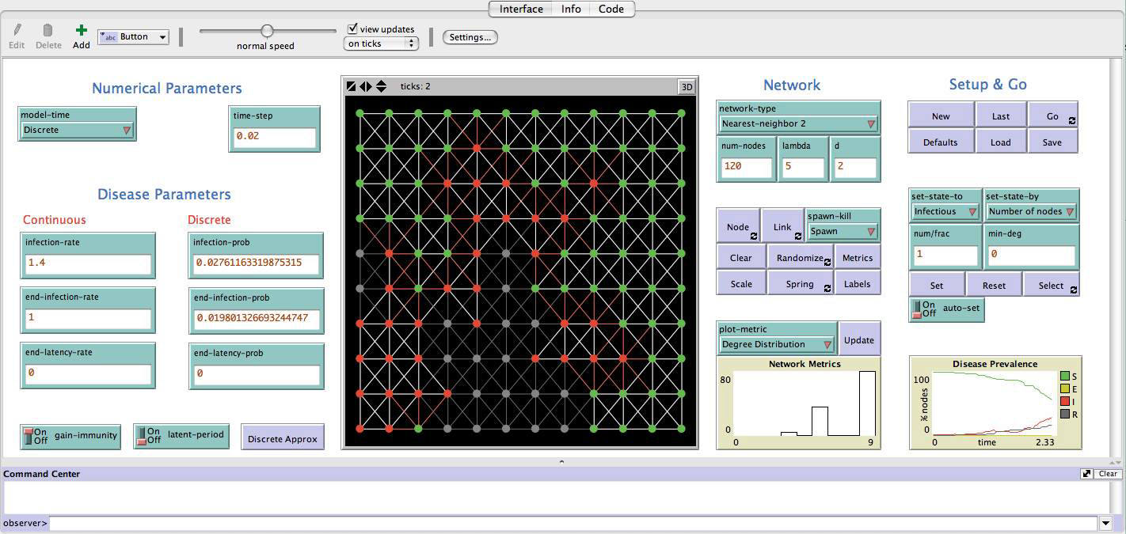
Infectious diseases on networks (IONTW)
  http://www.qubeshub.org/IONTW
  In: Raina Robeva (ed.), Algebraic and Discrete Mathematical Methods for Modern Biology, Academic Press, 2015.
Notes:
Shameless plug
Book chapters and online modules

Slide 39
conclusions
Many calls to incorporate more modeling
A common framework can help make teaching modeling more accessible and bring partner disciplines together.
Five model representations
  Experiential
  Verbal
  Numerical
  Visual
  Symbolic
Modeling activities, part of the larger modeling enterprise, involve moving between representations.

Slide 40
Final recommendations
Have a shared goal
  Improve student learning
  Answer a research question
Start small, but have a concrete deliverable
  Modify a single lesson plan: Ideas?
  Co-advising a thesis
  Internal grant
Be willing to be both a student and a teacher
Be explicit about language: language varies among disciplines
Be in it for the long term

Slide 41
Acknowledgements
Melissa Aikens, University of New Hampshire
Kam Dahlquist, Loyola Marymount University
Joe Dauer, University of Nebraska-Lincoln
Sam Donovan, University of Pittsburgh
Carrie Eaton, Unity College
Greg Goins, North Carolina A&T State University
Kristin Jenkins, BioQUEST
John Jungck, University of Delaware
Drew Lamar, College of William and Mary
Glenn Ledder, University of Nebraska-Lincoln
Robert Mayes, Georgia Southern University
Joe Redish, University of Maryland
Richard Schugart, Western Kentucky University

Slide 42
More information
Information and ideas around using our framework for teaching
  https://qubeshub.org/primus-ruleoffive
Eaton, C. D., Highlander, H. C., Dahlquist, K. D., LaMar, M. D., Ledder, G., Schugart, R. C. A “Rule of Five” Framework for Models and Modeling to Unify Mathematicians and Biologists and Improve Student Learning.
  https://arxiv.org/abs/1607.02165
Log Growth Netlogo download
  https://qubeshub.org/groups/nimbios_wg_teachingquantbio/File:/uploads/LOGROWTH_HC.html
Coming soon: Modeling investigation lesson plan for HWE

