Slide 1
  Sewage will Save the World:
  Bacteriophage as a Cure for Superbugs
Bri’Anna Horne
Clinical Coordinator and Microbiologist
Adaptive Phage Therapeutics.

Slide 2
Pre-Antibiotic Era
Chemical
  Mercury, bromine, and iodine
Amputation
Bloodletting

Slide 3
1896 Ernst Hankin
Observed Ganges filled with Vibrio cholera

Slide 4

1896 Ernst Hankin
Observed Ganges filled with Vibrio cholera…. but
Notes:
In 1896 Ernest Hankin observed that the Ganges and Jumna rivers in India seemed to possess antibacterial properties, and he surmised that this might in some way be responsible for the reduced number of cases of gastrointestinal infection, particularly cholera, in those villages close to the river.

Slide 5
Antibiotics didn’t exist before 1941
Notes:
Antibiotics were not used as a form of treatment until 1941, Flemming discovered the mold penicillin by chance in 1926. In circumstance that some might call poor laboratory technique. An petri dish left open over the weekend introduced a growth on the plate unlike the bacterial lawn present and displayed a distinct clearing where bacterial growth was expected.

Slide 6
1928
“ The time may come when penicillin can be bought by anyone in the shops. There is the danger that the ignorant man may easily underdose himself and by exposing his microbes to non-lethal quantities of the drug make them resistant. ”
Sir Alexander Fleming, the discoverer of penicillin, at his 1945 Nobel Prize lecture

Slide 7
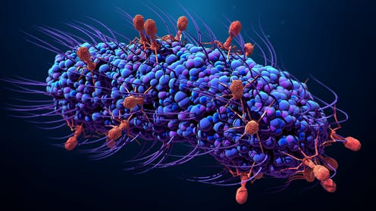
Like all viruses…
Intra-cellular obligate parasites
  Bacteria
Highly specific and targeted host range
  Very few bacteriophage have coverage over different orders
  Some phage are known to infect a single bacterial species or more
Nucleic Acid Genome
  ssDNA, dsDNA, dsRNA, and ssRNA

Slide 8
The World Of Bacteriophage
Vast
  Estimated 10^31 phage particles on the planet
  For every single bacteria, there are 10 bacteriophage
Highly Dynamic
  ~40% of the bacterial population is killed every day by phage
Highly Diverse
  Darwinian Evolution right before our eyes

Slide 9
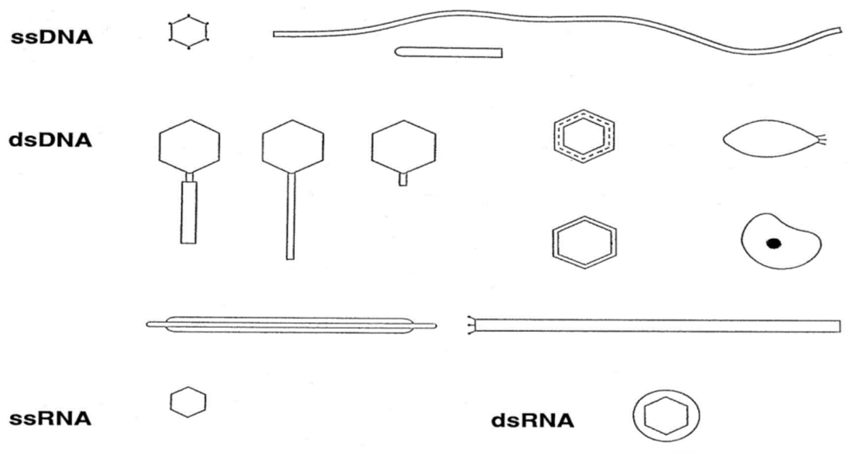

Slide 10
Bacteriophage Genomes
  Individual Isolation- this is a successful method for most bacteria species we are able to propagate in the lab with current methods
    ~ # of Isolated <5000, in 2012 only 750 had been completely sequenced
  Viral Metagenomics- harvesting DNA from environmental sewer samples
    We may never be able to cultivate these organisms for further study
  Mining Prophage from bacterial genomes
    20% of sequenced bacterial chromosomes contain prophage
  Horizontal genetic exchange plays a dominant role in shaping these genome architectures.

Slide 11
Simplistic Structure
  Simple structure composed of a protein capsid ( head) - housing the genome
  Sheath
  Tail
  Tail Fibers

Slide 12
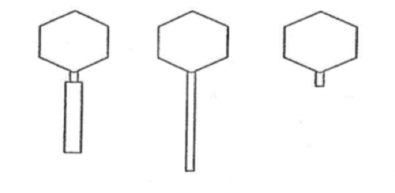
dsDNA Tailed Phage
Siphoviridae
  Sipho in relation to a tube; tube like
  Characterized for long flexible tails
Myoviridae
  Myo- in relation to muscle
  Known for their contractile tails
Podoviridae
  Podo- in relation to foot
  Characterized for their stubby tail

Slide 14
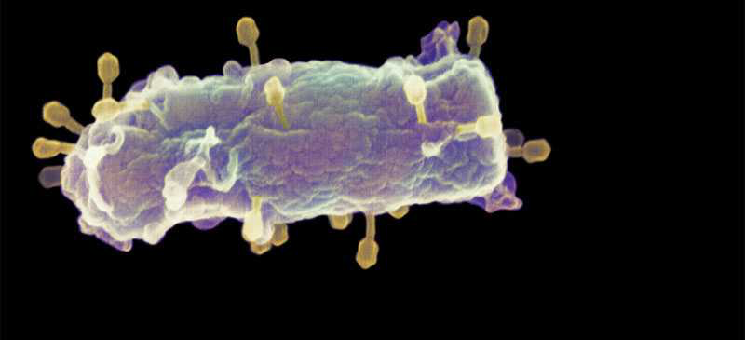
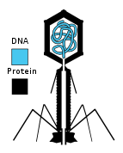
Bacteriophage: The dominant bacteria killers on earth
Bacteriophage (“phage”) are viruses that host on bacteria
~50% of bacteria are killed by phage every day
Generally safe to humans & for non-targeted bacteria

Slide 15
1928
“ The time may come when penicillin can be bought by anyone in the shops. There is the danger that the ignorant man may easily underdose himself and by exposing his microbes to non-lethal quantities of the drug make them resistant. ”
Sir Alexander Fleming, the discoverer of penicillin, at his 1945 Nobel Prize lecture

Slide 16
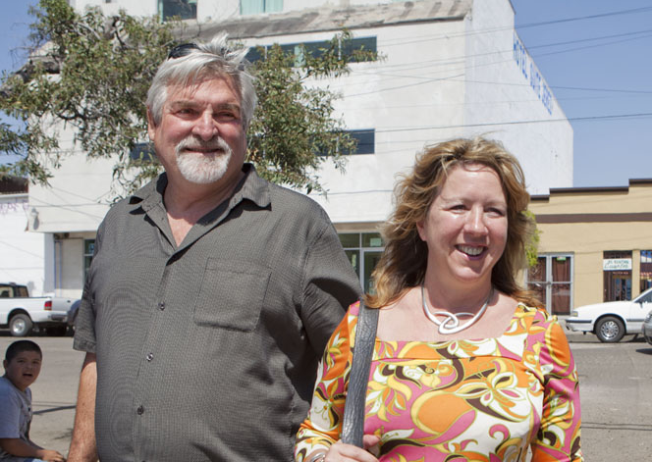




Tom Patterson
November 2015

Slide 17
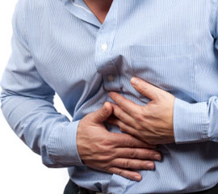
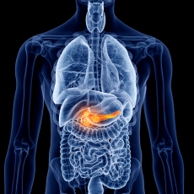
Case Study
Tom Patterson
Acute abdominal pain
Nausea

Slide 18
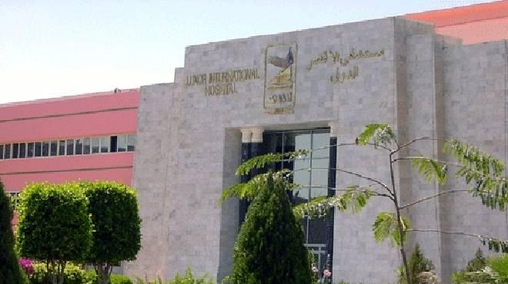
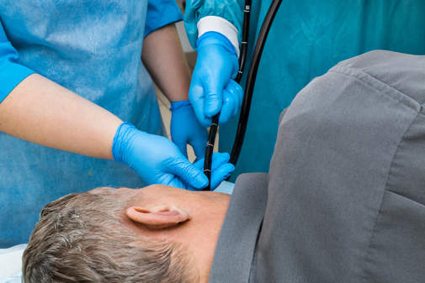
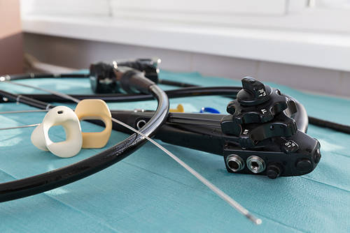
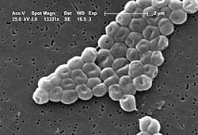

Case Study
Tom Patterson

Slide 19
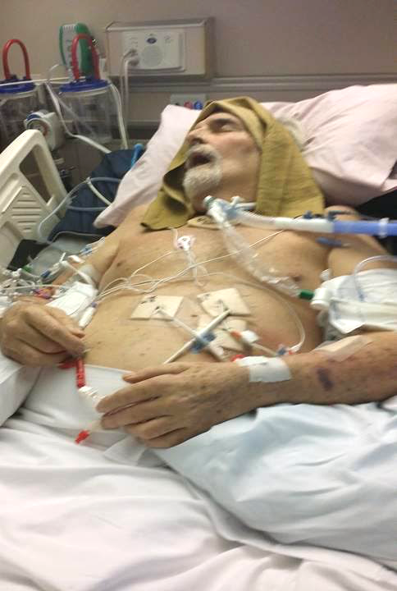
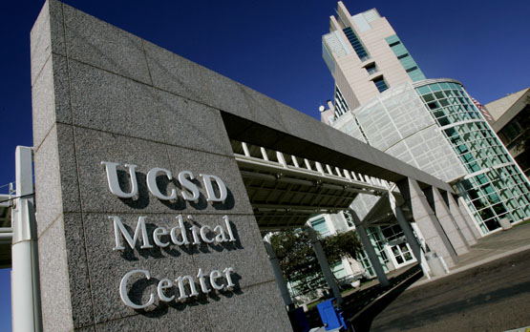

Slide 20

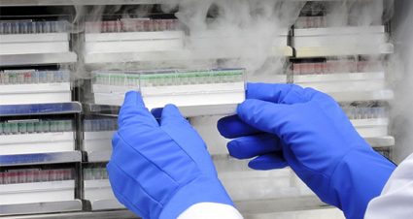
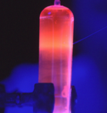
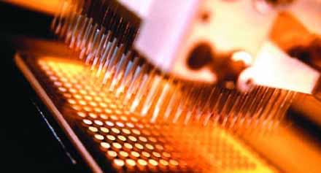
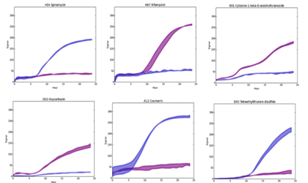
Case Study
Tom Patterson
March 11, 2016: UCSD sent a culture to Dr. Biswas at NMRC
March 17, 2016: iv infusion of 5 precision-matched and purified phage
Dr. Biswas, utilized innovative rapid phage/pathogen matching system (HRQT™) -- testing 100 phage (PhageBank™)vs isolate

Slide 21
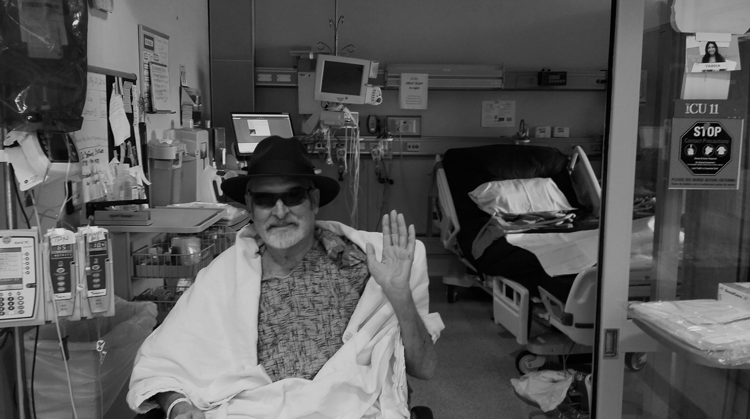
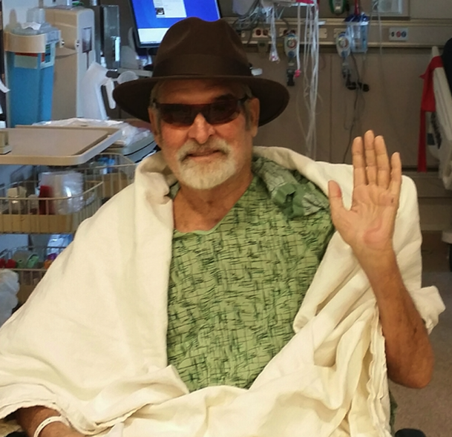
Case Study
April 2016: Tom is ready to go home

Slide 22
Tom Patterson
Patient #1
A. baumannii survivor

Slide 23
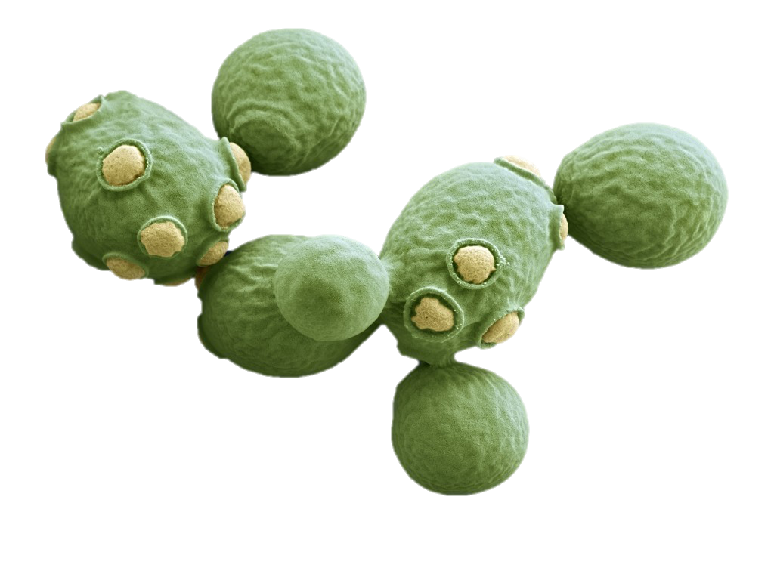
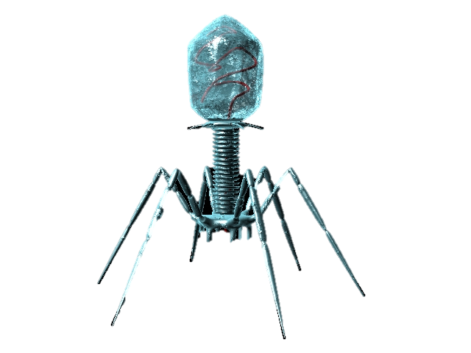


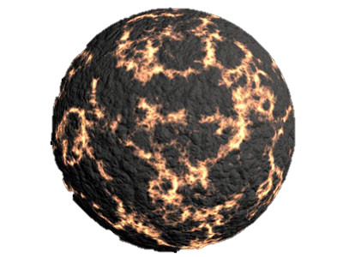
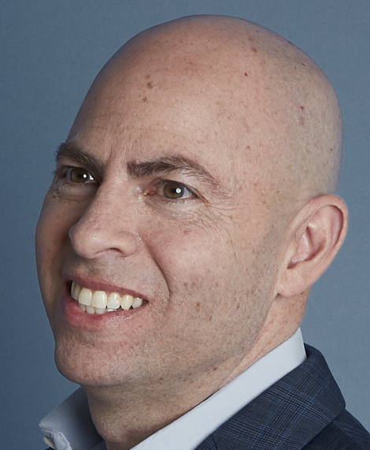

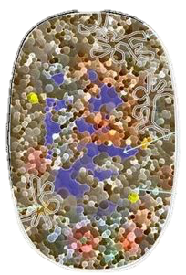
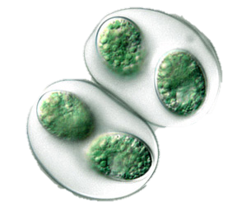
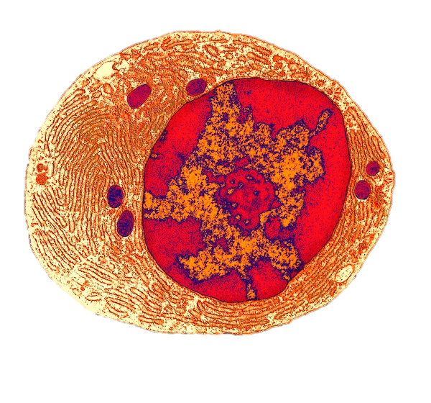
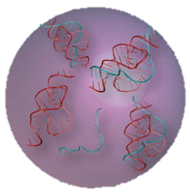
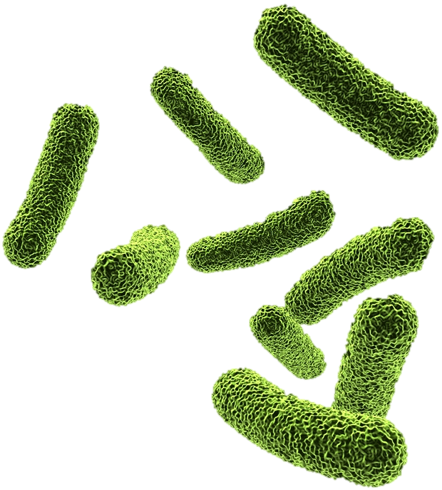
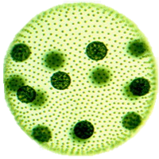
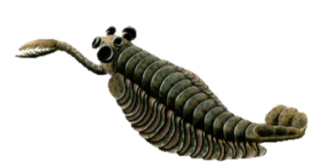
Brief History of Life on Earth (Scale = Billions of Year)
4.6: Earth
0.6: Fungi & antibiotics
4.5: Moon
4.4: Oceans
5
4
3
2
1
Today
4.2: First life
1.8: Eukaryotes
0.5: Cambrian explosion
3.9: Prokaryotes
3.0: Cyanobacteria & oxygen catastrophe
3.9: Phages
3.5: Luca
1.8: Multicellular

Slide 24
The Diminishing Effectiveness of Antibiotics
Data: CDC 2013 Report on Drug Resistance

Slide 26
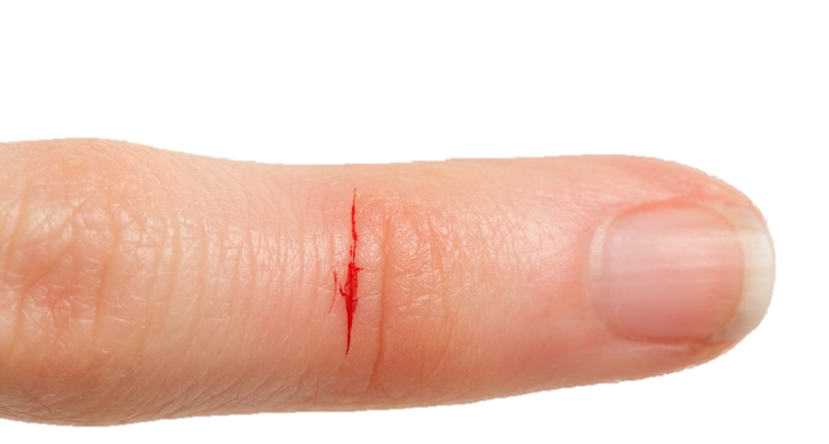
“We are heading for a post-antibiotic era, in which common infections and minor injuries can once again kill.”

Slide 27
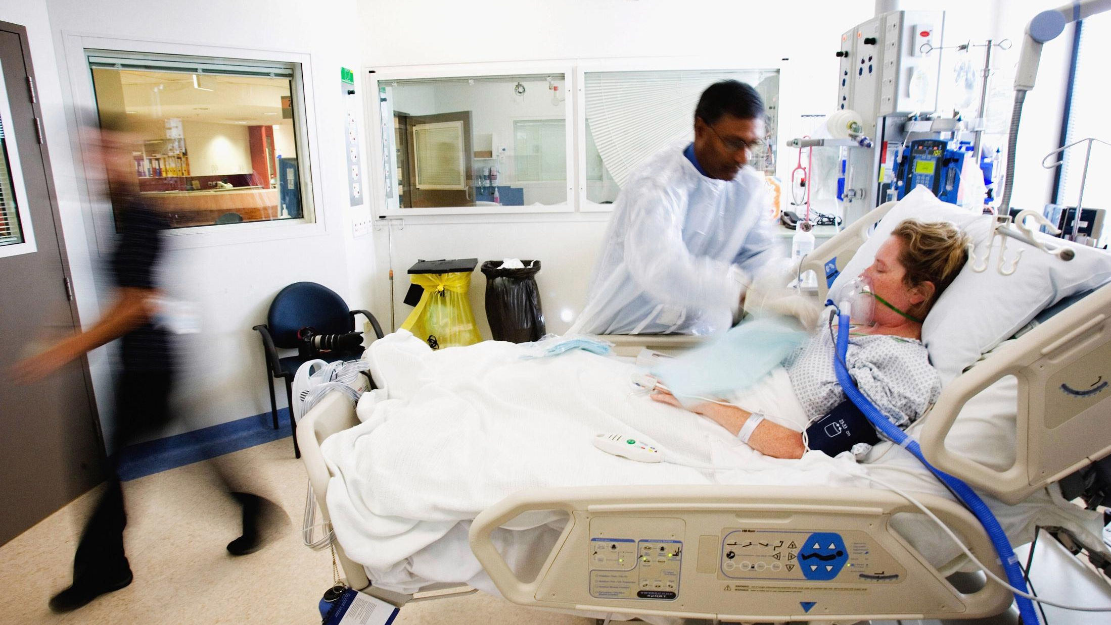
Problem:
Antibiotics are failing

Slide 28
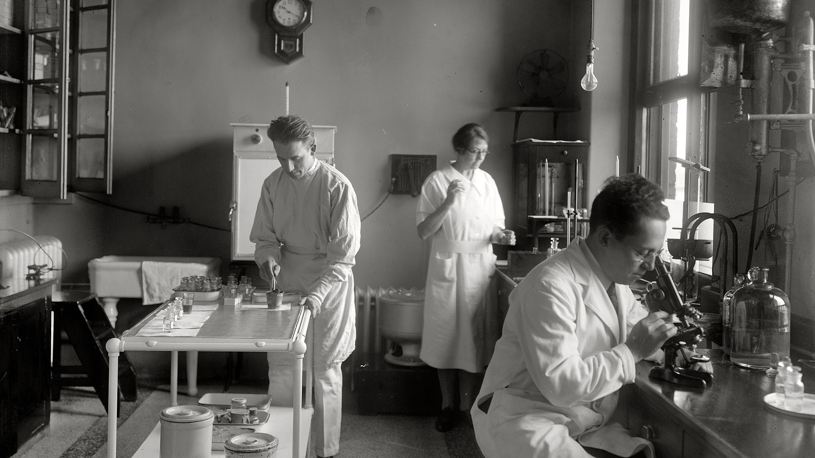
Historical Challenges of Phage Therapy
Phage have narrow host range = hit or miss
Toxins produced in manufacturing limited safe dose
Phage can contain and transmit undesired genes

Slide 29


BIOLOGICAL DEFENSE RESEARCH DIRECTORATE
2010: Environmental sampling & development of PHAGEBANK™
2012: HRQT Companion D_{x}
2016: Initial Clinical Success
2017: APT acquired rights

Slide 30








eIND Personalized Phage Treatment – SLOW & EXPENSIVE
10 days
Hospital Ships Bacterial Culture to APT
HRQT
Companion Diagnostic
Phage Grown
Phage Purified
QC:
24 hr Sterility Testing
APT Ships
PhageBank to Hospital
Therapy is Administered to Patient
Setting
Hospital
APT

Slide 31
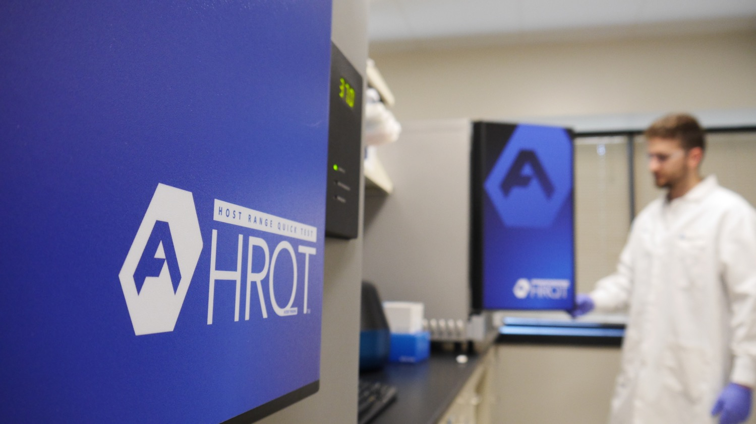
Therapeutic Overview
1
2
HRQT
Broad spectrum coverage
Companion Diagnostic

Slide 32
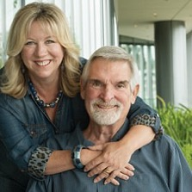

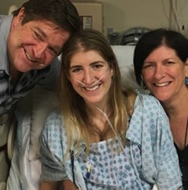
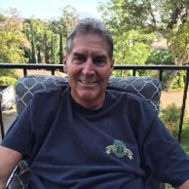
Personalized PT: Victim of eIND Efforts
Patient #2:
2 y.o. Male
P. aeruginosa
Patient #8:
60 y.o. Male
P. aeruginosa
Tarek Kashan
A. baumannii
Klebsiella
Tom Patterson
A. baumannii
Patient #11:
23 y.o. Male
B. gladioli
John Willson
P. aeruginosa
Mallory Smith
B. cenocepacia
eIND cases:
Get a lot of attention
Take a lot of effort
Cost a lot of money
Patient #3:
77 y.o. Male
A. baumannii

Slide 33
Perception of Personalized Phage Therapy
“… phage therapy has been tried, mostly unsuccessfully, in the past.”
“several day turnaround time is too slow for adequate treatment of severe, acute infections.”
“There are also cumbersome supply chain issues that make feasibility an issue.”
CARB-X Review Committee (April 2017)
I want to see the clinical trials so we have more than theory + anecdote.
Kevin Outterson, Executive Director at CARB-X via Twitter (Dec 2018) in response to TIME coverage of phage
“Tom Patterson’s case is great for Tom, but patient-specific phage is not commercially viable”
Anonymous (2018)

Slide 34
Perception of Personalized Phage Therapy
“Personalized” requires on-demand manufacturing – WRONG
Expensive – WRONG
QC on each product, not large lots – WRONG
Requires multiple sites across the world – WRONG
Time consuming - WRONG
A large pharma’s view of personalized phage therapy (January 2019)

Slide 35
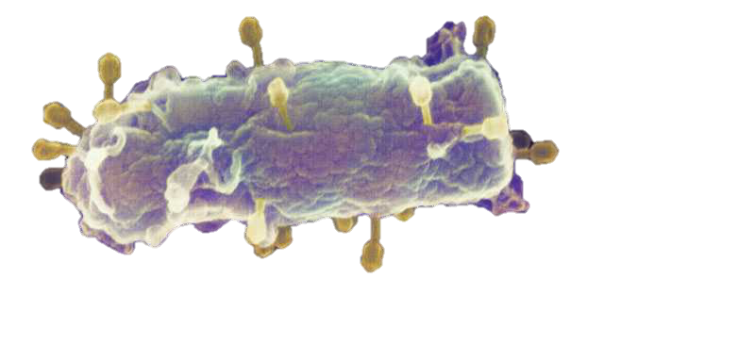
Problems with Antimicrobial Pipeline
Antibiotics
Phage
Nearly every antibiotic compromised by resistance
150,000 MDR deaths/yr in US
(2018 data = 7x prior estimates)
MDR on track to pass cancer as leading killer
Safety – significant issue
All emerging antibiotics likely to lose efficacy
FDA Commissioner Gottlieb - 14 SEP 2018:
Phage first among promising alternative approaches
Committed to regulatory path for phage
Phage’s positive safety profile is well understood by FDA

Slide 36
Problems with Antimicrobial Pipeline
Antibiotics
Phage Cocktail
Personalized Phage
Challenges:
Phage hit or miss
Narrow host ranges leads to “resistance” within a patient
Phage can compete with each other and decrease effectiveness
Resistance will develop, just like with antibiotics
In vitro lysis established for each patient
Can adapt to infection
Match synergy w/ other phage and antibiotics
Historically challenged:
  Time for match effort
  Time due to logistics
  Regulatory challenges re: personalized medicine
Nearly every antibiotic compromised by resistance
150,000 MDR deaths/yr in US
(2018 data = 7x prior estimates)
MDR on track to pass cancer as leading killer
Safety – significant issue
All emerging antibiotics likely to lose efficacy

Slide 37
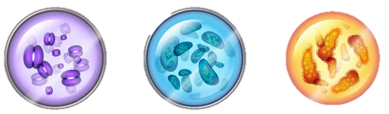

Problems with Narrow Spectrum Rx
Year 1
Year 2
Year 3
Year 4
Year 5
Year 6
Future
Pathogens collected from clinical sites
Drug/phage candidate ID
Pre-clinical R&D
(incl cocktail development)
Clinical Study 1
Clinical Study 2
FDA BLA
Market Adoption
Product targets these
Not these
MDR Microbiome at Hospital X
Not those

Slide 38

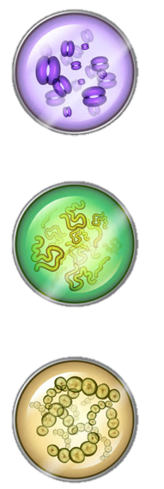
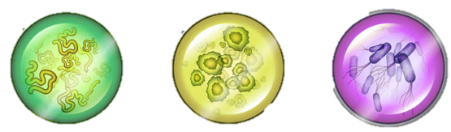
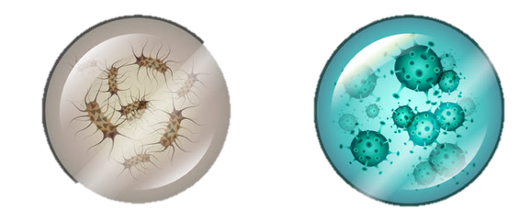
Year 1
Year 2
Year 3
Year 4
Year 5
Year 6
Future
Clinical Study 1
Clinical Study 2
FDA BLA
Market Adoption
Ongoing phage discovery
Ongoing collection from patients
MDR Microbiome at Hospital X

Slide 39
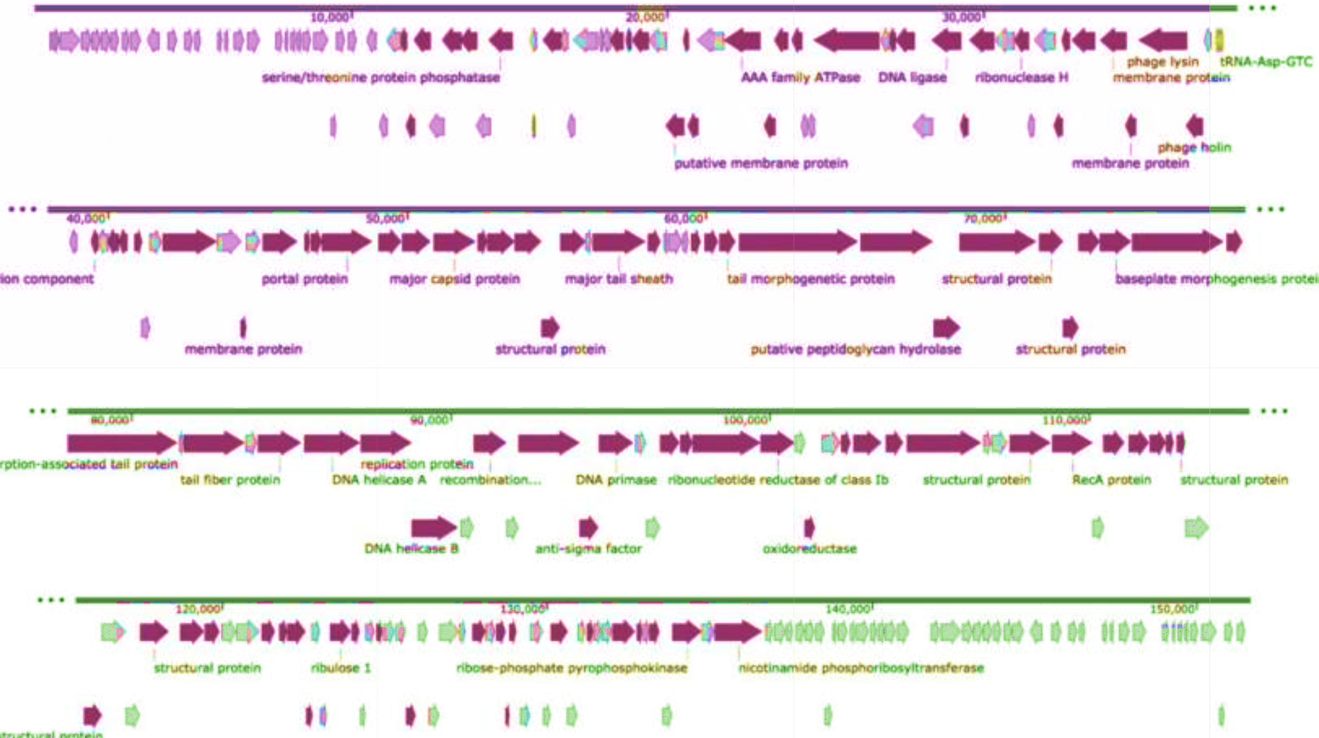
Phage Discovery: On-Going Coverage Extension
  BDRD Environmental Collection
Phage Plaques
Screening
Un-covered Pathogen
Coverage get’s better with time
DMF Review

Slide 40
Resistance
100%
Pathogen Coverage
50%
Antibiotics
& fixed cocktails
0%
YEARS

Slide 41
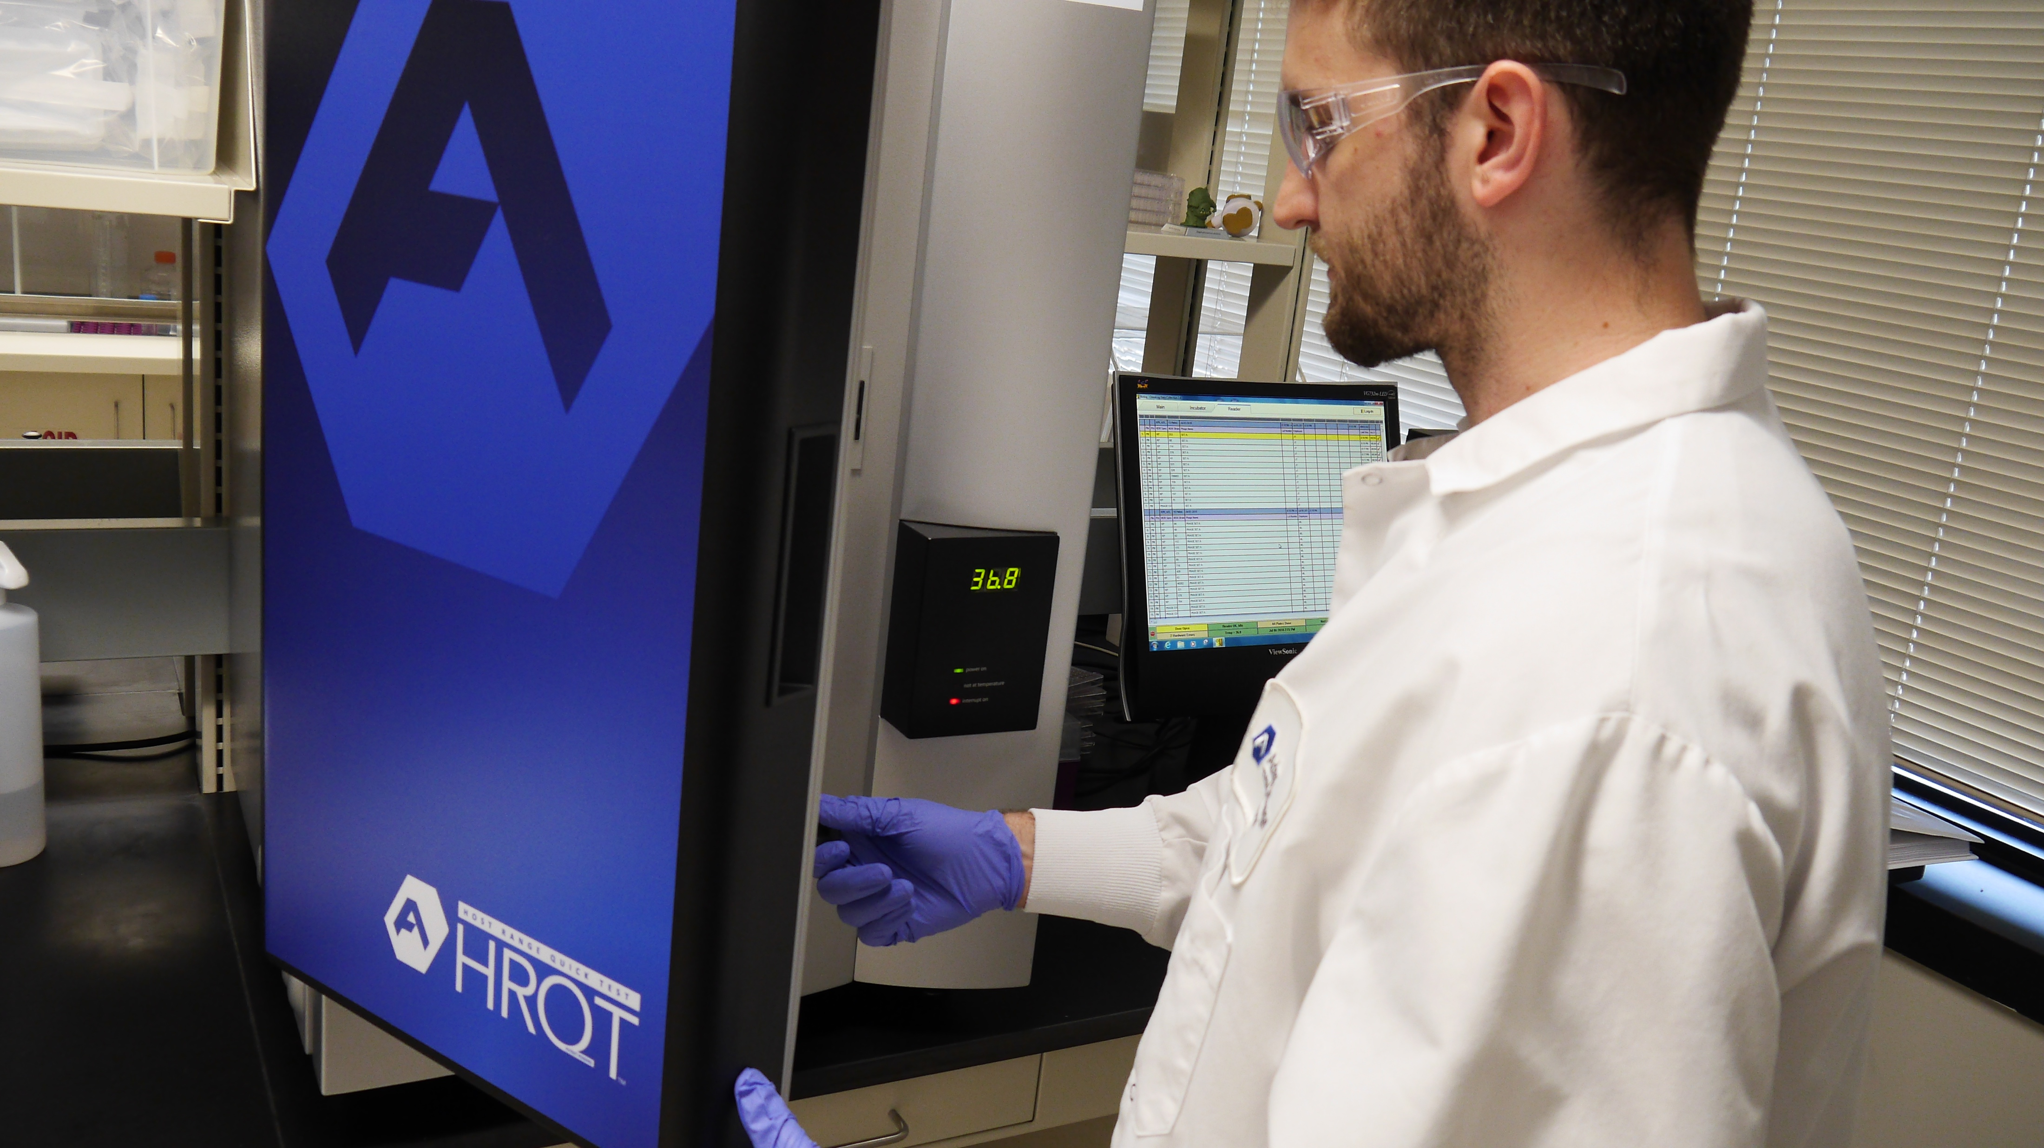





PhageBank Personalized Approach
Companion Diagnostic
1. Large phage collection
2. Companion diagnostic
Patient A
MDR A. baumannii
Patient B
MDR E. coli & Kleb
S. aureus
A. baumannii
P. aeruginosa
E. coli
K. pneumoniae
E. faecium

Slide 42
OK… looks good. But how does it scale?
  Manufacturing:
    Just In Time (JIT)… not gonna be “in time”
    Needs to allow for bulk QC – including stability data
    Need to be sensitive to COGs
  Matching:
    Has to be same-day FAST – to treat acute infections
    Has to be scalable with logistics
  Distribution:
    Has to be same-day FAST – to treat acute infections
    Has to be scalable with logistics
  Regulatory – has to be acceptable to the FDA

Slide 43
Manufacturing: J.I.T. – not an option
Prior attempts at personalized phage based on JIT
  Phage growth and purification takes a few days – and sometimes fails
  Aseptic fill and sterility testing takes time – and sometimes fails
  Genomic sequencing and screening for potential deleterious genes takes time
  FDA review of this data takes time
Acutely sick patients don’t have time… 7.6% decrease in survival with every hour delay in receiving antibiotics for sepsis patients admitted to ICU. (Kumar et al)

Slide 44
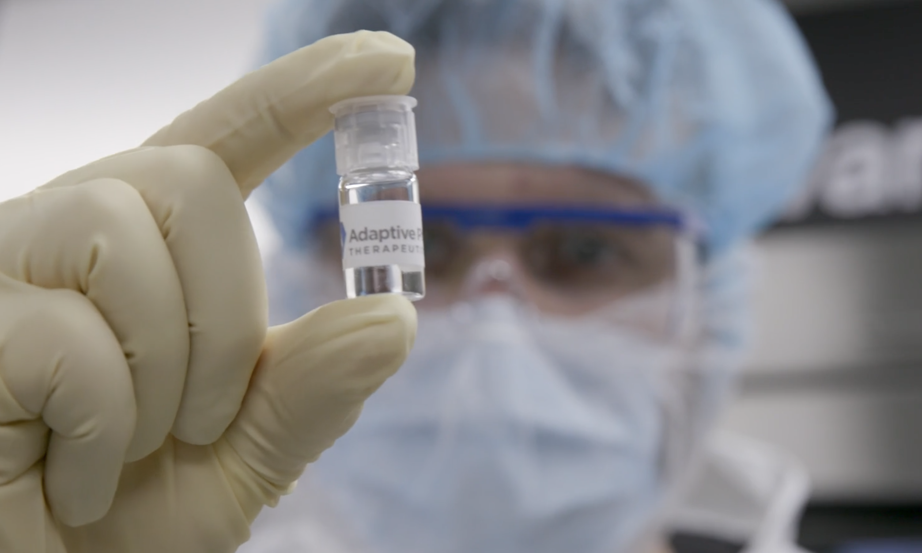
Pre-manufacturing highly purified doses is part of the answer
  Large batch economics
  Allows time for QC
  Immediate availability (after match)

Slide 45

GMP Manufacturing Facility
Automated high-throughput HRQT™ assay
Simultaneously tests 100s of phage vs patent’s bacteria
Identifies precision PhageBank therapy in 8 hours

Slide 46
Pre-manufacturing has it’s own challenges
Fill: Typical 3 days/batch
A library of 1,000 phage: ~10 years
Photo: Typical Fill Suite

Slide 47
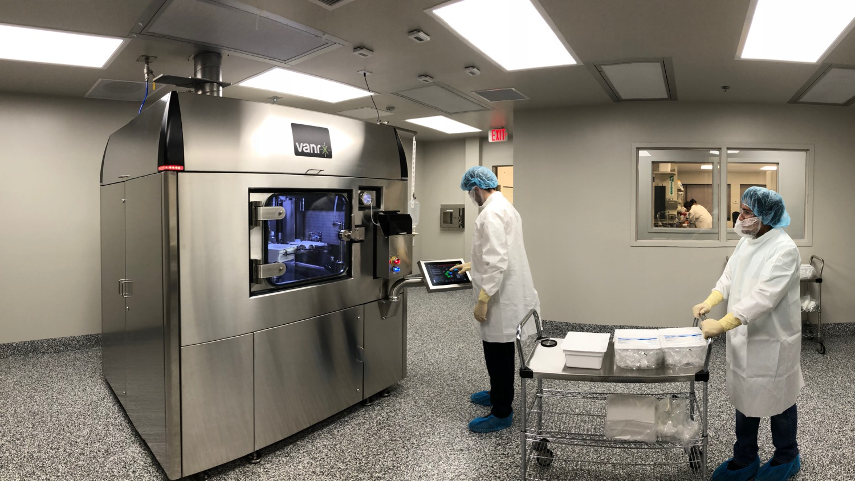
Innovative Fill Tech: 10x Improvement in Throughput
Photo: APT Fill Suite

Slide 48
Easily Scalable Rapid Companion Diagnostic
Iterative Path to Ideal:
  Centralize (24hr TOT)
  CLIA diagnostic labs (18hr TOT)
  AI software (sub-minute?)

Slide 49
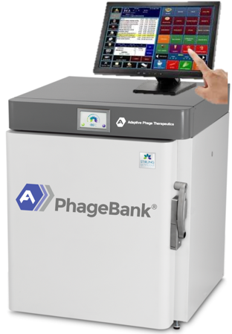
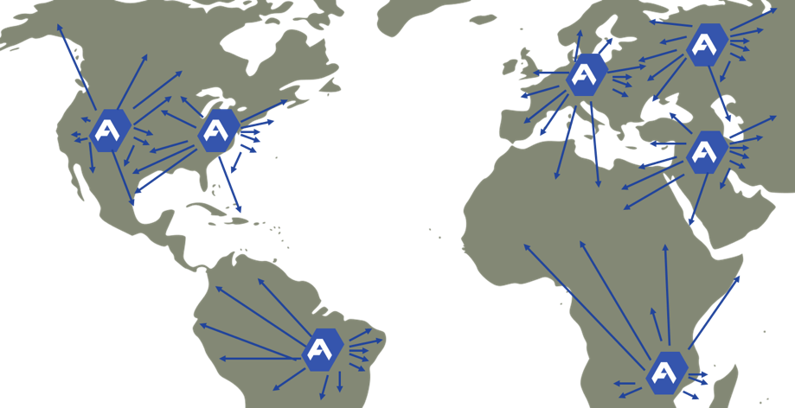

Personalized Approach Adapts Phage Mix to Rapidly Treat Each Patient Until the Infection Resolves.
PhageBank ATMs: Hospital-based inventory enable treatment within one day
HRQT in Regional CLIA Labs
Hospital-based PhageBank ATMs
HRQT in regional CLIA labs and major medical centers

Slide 50


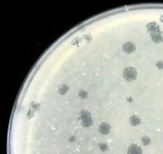



1
2
3
4
Collected
Environmental samples and clinical isolates
Isolated
Phage that target ESKAPE are isolated
Safety Screen
Screened for deleterious genes
Banked
Cleared phage added PhageBank™
Envisioned by NIH researcher Carl Merril, MD in 2003
Navy initiated phage hunt in 2010

Slide 51


HRQT™
The Host Range Quick Test
1
2
3
4
Pathogen Loading
Cultured bacteria from patient is grown and robotically distributed into multiwell plates
PhageBank™
Hundreds of potential matching phage strains are pulled from PhageBank
Assay
Robots load hundreds of strains of phage into individual wells containing the patient’s bacterial culture
Kill Curves
Machine vision system plots bacteria death and optimizes selection of phage and phage combinations
2012: Navy developed assay

Slide 52
Here’s where APT comes in…
2016:
World-wide exclusive license to PhageBank™ and HRQT™
CRADA:
NMRC is expanding PhageBank®,
NMRC sequencing and screening phage
APT to commercialize
APT to lead treatment efforts for eIND patients

