Slide 1
Introduction to dna sequencing
Vince Buonaccorsi
Juniata College

Slide 2
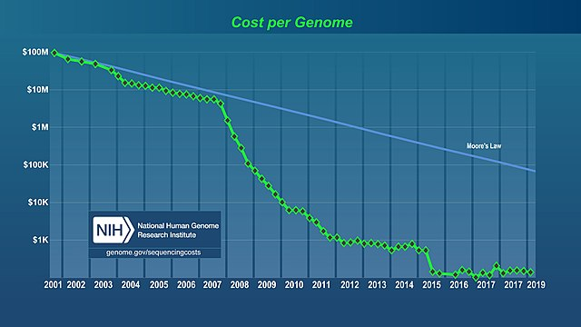
Cost of sequencing
https://www.genome.gov/about-genomics/fact-sheets/Sequencing-Human-Genome-cost
Notes:
Moore's law is the observation that the number of transistors in a dense integrated circuit (microchip) doubles about every two years
NHGRI has carefully tracked costs per human genome at its funded 'genome sequencing centers' for many year. In short, nearly all human genome sequencing in 2015 yields high-quality 'draft' (but unfinished) sequence.
Dip in 2007 due to devp of massively parallel seq

Slide 3
Next (2nd) Generation Sequencing
How does Illumina sequencing work?
Illumina bridge pcr Sequencing
Notes:
https://www.youtube.com/watch?time_continue=298&v=fCd6B5HRaZ8

Slide 4
Some sequencing terminology
Paired End Sequencing
Mate Pair Sequencing
Notes:
In order to sequence large genomes using short reads, PE and MP reads sequenced in about even amounts

Slide 5
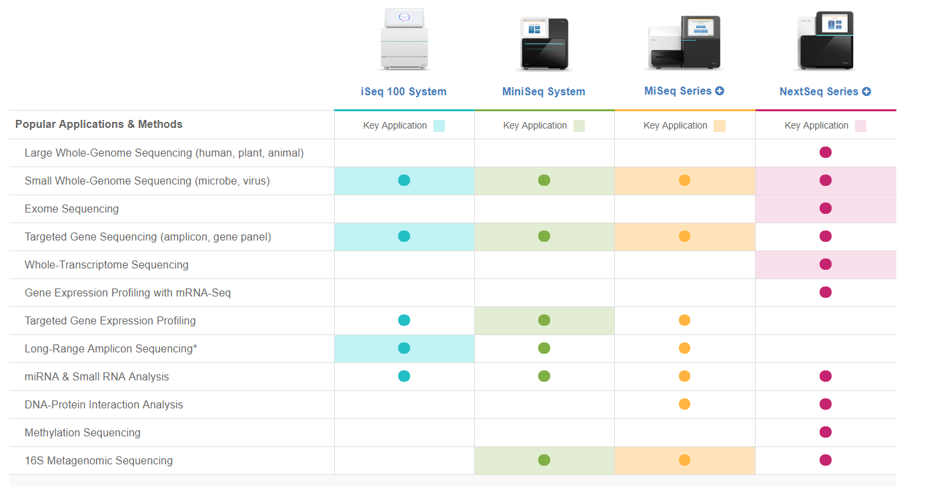
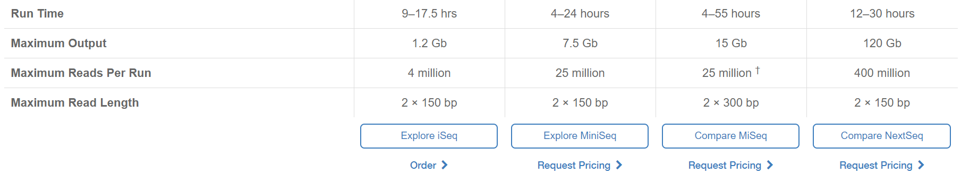
Next (2nd) Generation Sequencing
https://www.illumina.com/systems/sequencing-platforms.html
Notes:
Iseq $20k, MiniSeq $50K, MiSeq $100K
“Iseq price per sample $25 to $115”
4M reads, 36SE to 2X150PE. 144MB to 1.2GB

Slide 6
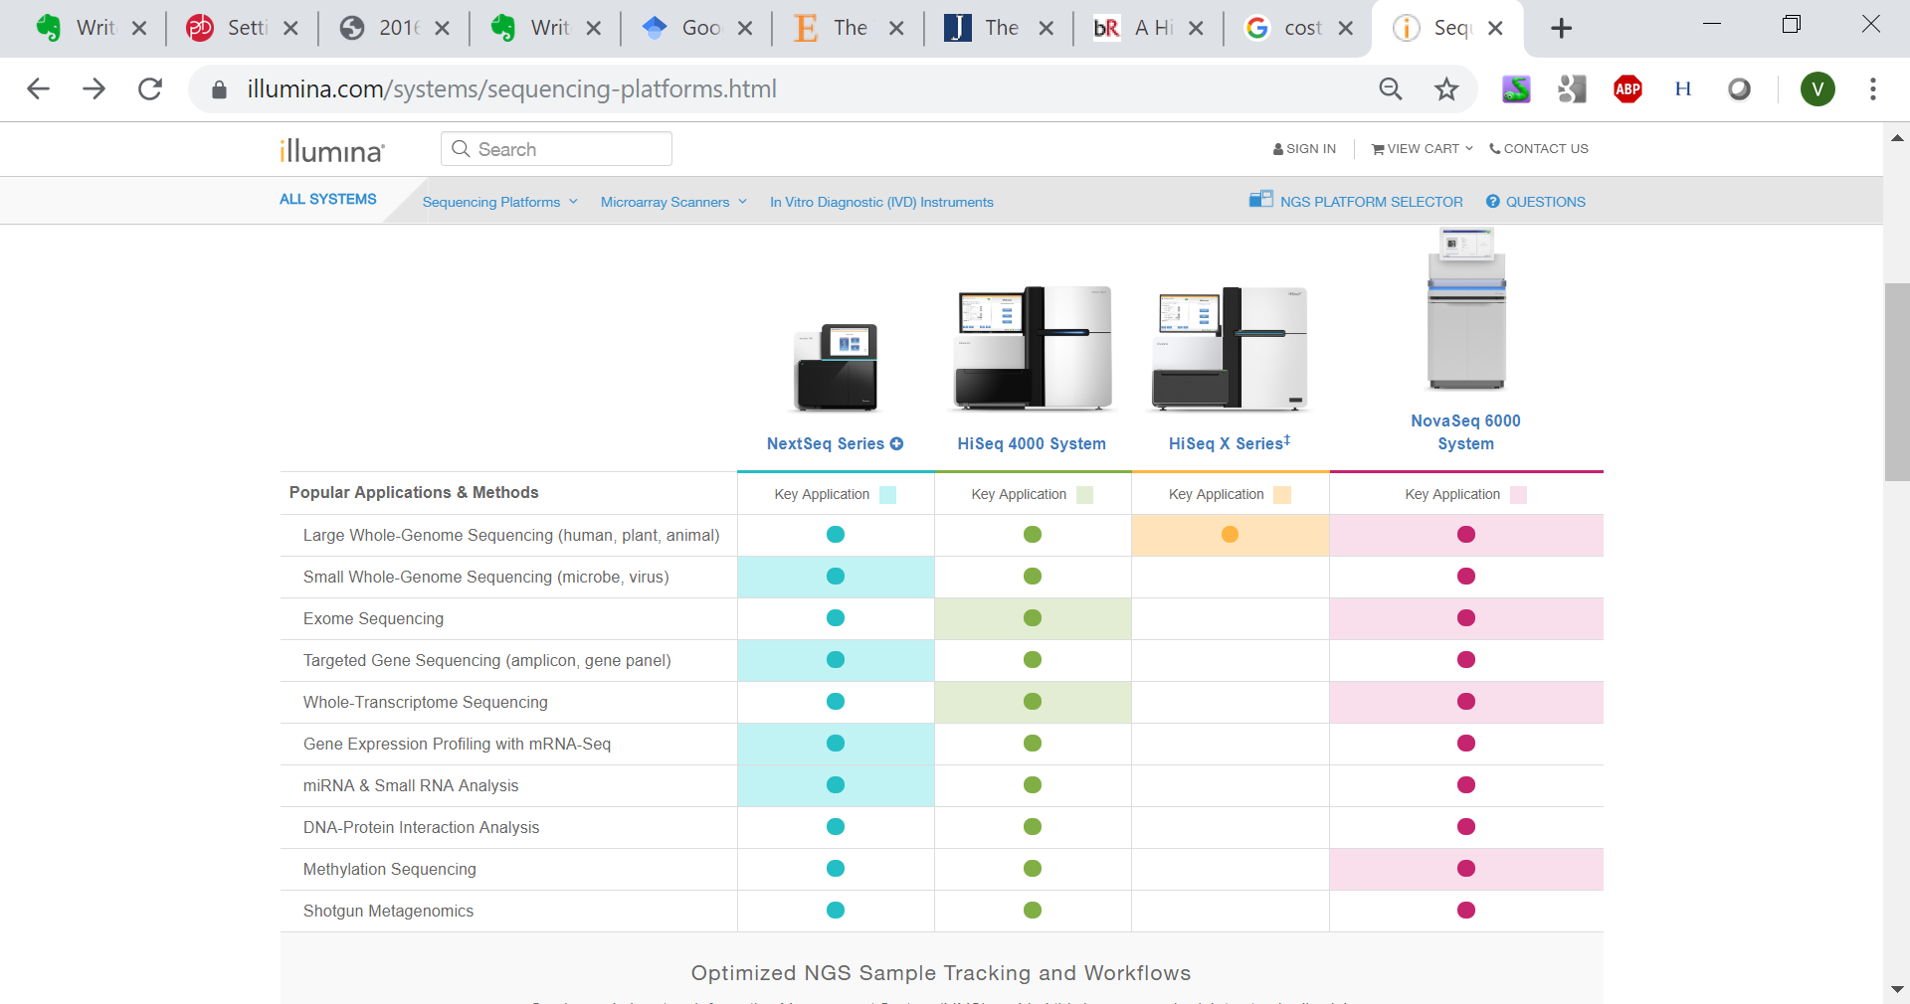
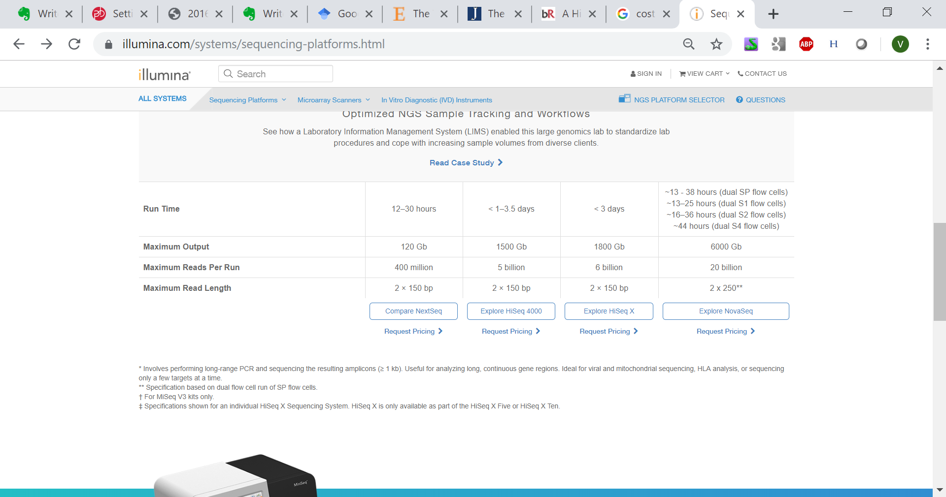
Cont.

Slide 7
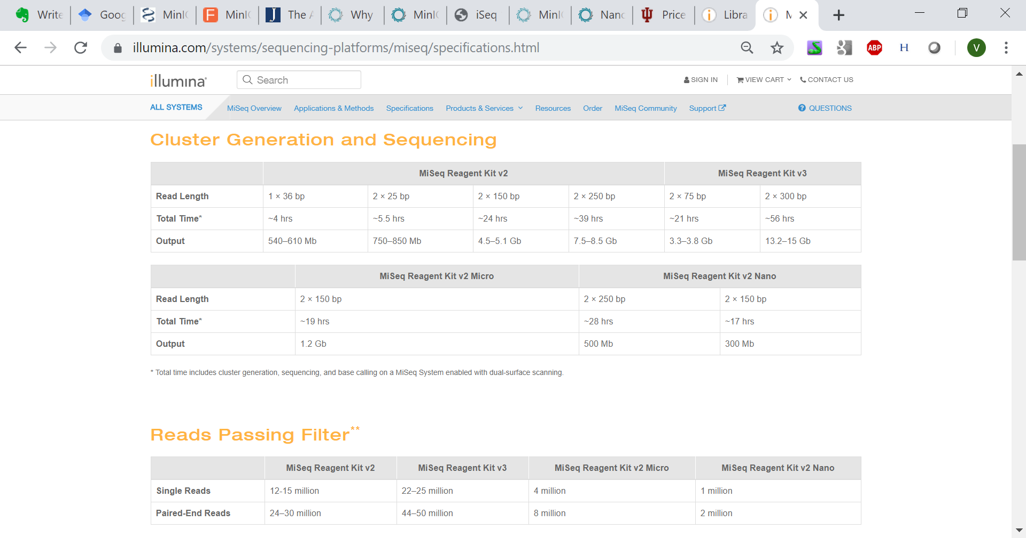

Slide 8
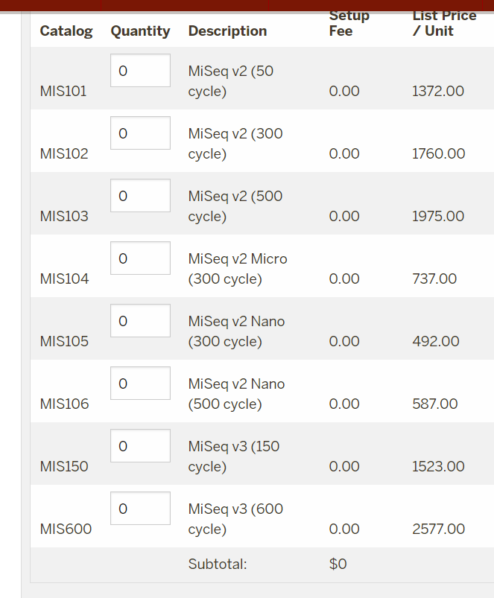
Commercial ProvidER
0.850 Gb (50-cycle MiSeq v2)
5.1 Gb (300-cycle MiSeq v2)
8.5 Gb (500-cycle MiSeq v2)
1.2 Gb (300-cycle MiSeq Micro v2)
0.3 Gb (300-cycle MiSeq Nano v2)
0.5 Gb (500-cycle MiSeq Nano v2)
https://www.illumina.com/products/by-type/sequencing-kits/cluster-gen-sequencing-reagents/miseq-reagent-kit-v2.html
https://cgb.indiana.edu/about/price-list.html
Notes:
For “500 cycle” 2x250PE (300 single)
DNA to library prep (nextera XT, flex) 12-24 samples 1 hr
IU: 30 SAMPLES, ($2900 +587) = 3504 /30 = $116)
Post library prep spri-bead purification (20 min) or gel (1.5hrs+1hr quiaquick column)
Bioanalyzer QC 1hr
Loading onto sequencer (20 min flush, prep PhiX and formamide for denature library), loading 30 min

Slide 9
MiSeq nano v2
Output
  Read type 2X250PE (or 2X150PE)
  1m READS
  total output: 500bp per read * 1M reads =500MB
  500mb/30 genomes = 16 MB of sequence per sample
  For SNPs, 30X coverage of a 200kb genome = 6MB
Fees and times
  IU library prep for Nextera ($967 setup + $27 per sample)
  IU for library prep and seq: 30 SAMPLES, ($1777 +587) = 3504 /30 = $80 ea ($545 ea for 3)
  Own library prep: cheaper but may need to buy agilent bioanalyzer and/or qubit fluorometer
Notes:
11 samples per chip for HS dna analysis
Spri beads ($100 for 5ml)
Library prep: tagmentation, PCR, cleanup, normalization
~$40/SAMPLE lib prep Nextera kit + ~$15 misc +$587 seq at IU
Genomic DNA to library prep 12-24 samples 90min
Post library prep spri-bead purification (20 min) or gel (1.5hrs+1hr need quiaquick column)
Bioanalyzer (new with agilent software $30-40K, used $6-10K) QC 1hr
$50-150 per chip if seq company does it as service
Qubit Fluorometer ($3.5)
Library prep involves tagmentation (shearing and adding adapters), PCR amp (increase quantity and add sequencing indexes), normalization (bead normalization option in some cases instead of BA/gel)

Slide 10
Third generation sequencing (TGS)
Real time
Single molecule (no amplification)
Long read
Pac Bio & Oxford Nanopore

Slide 11
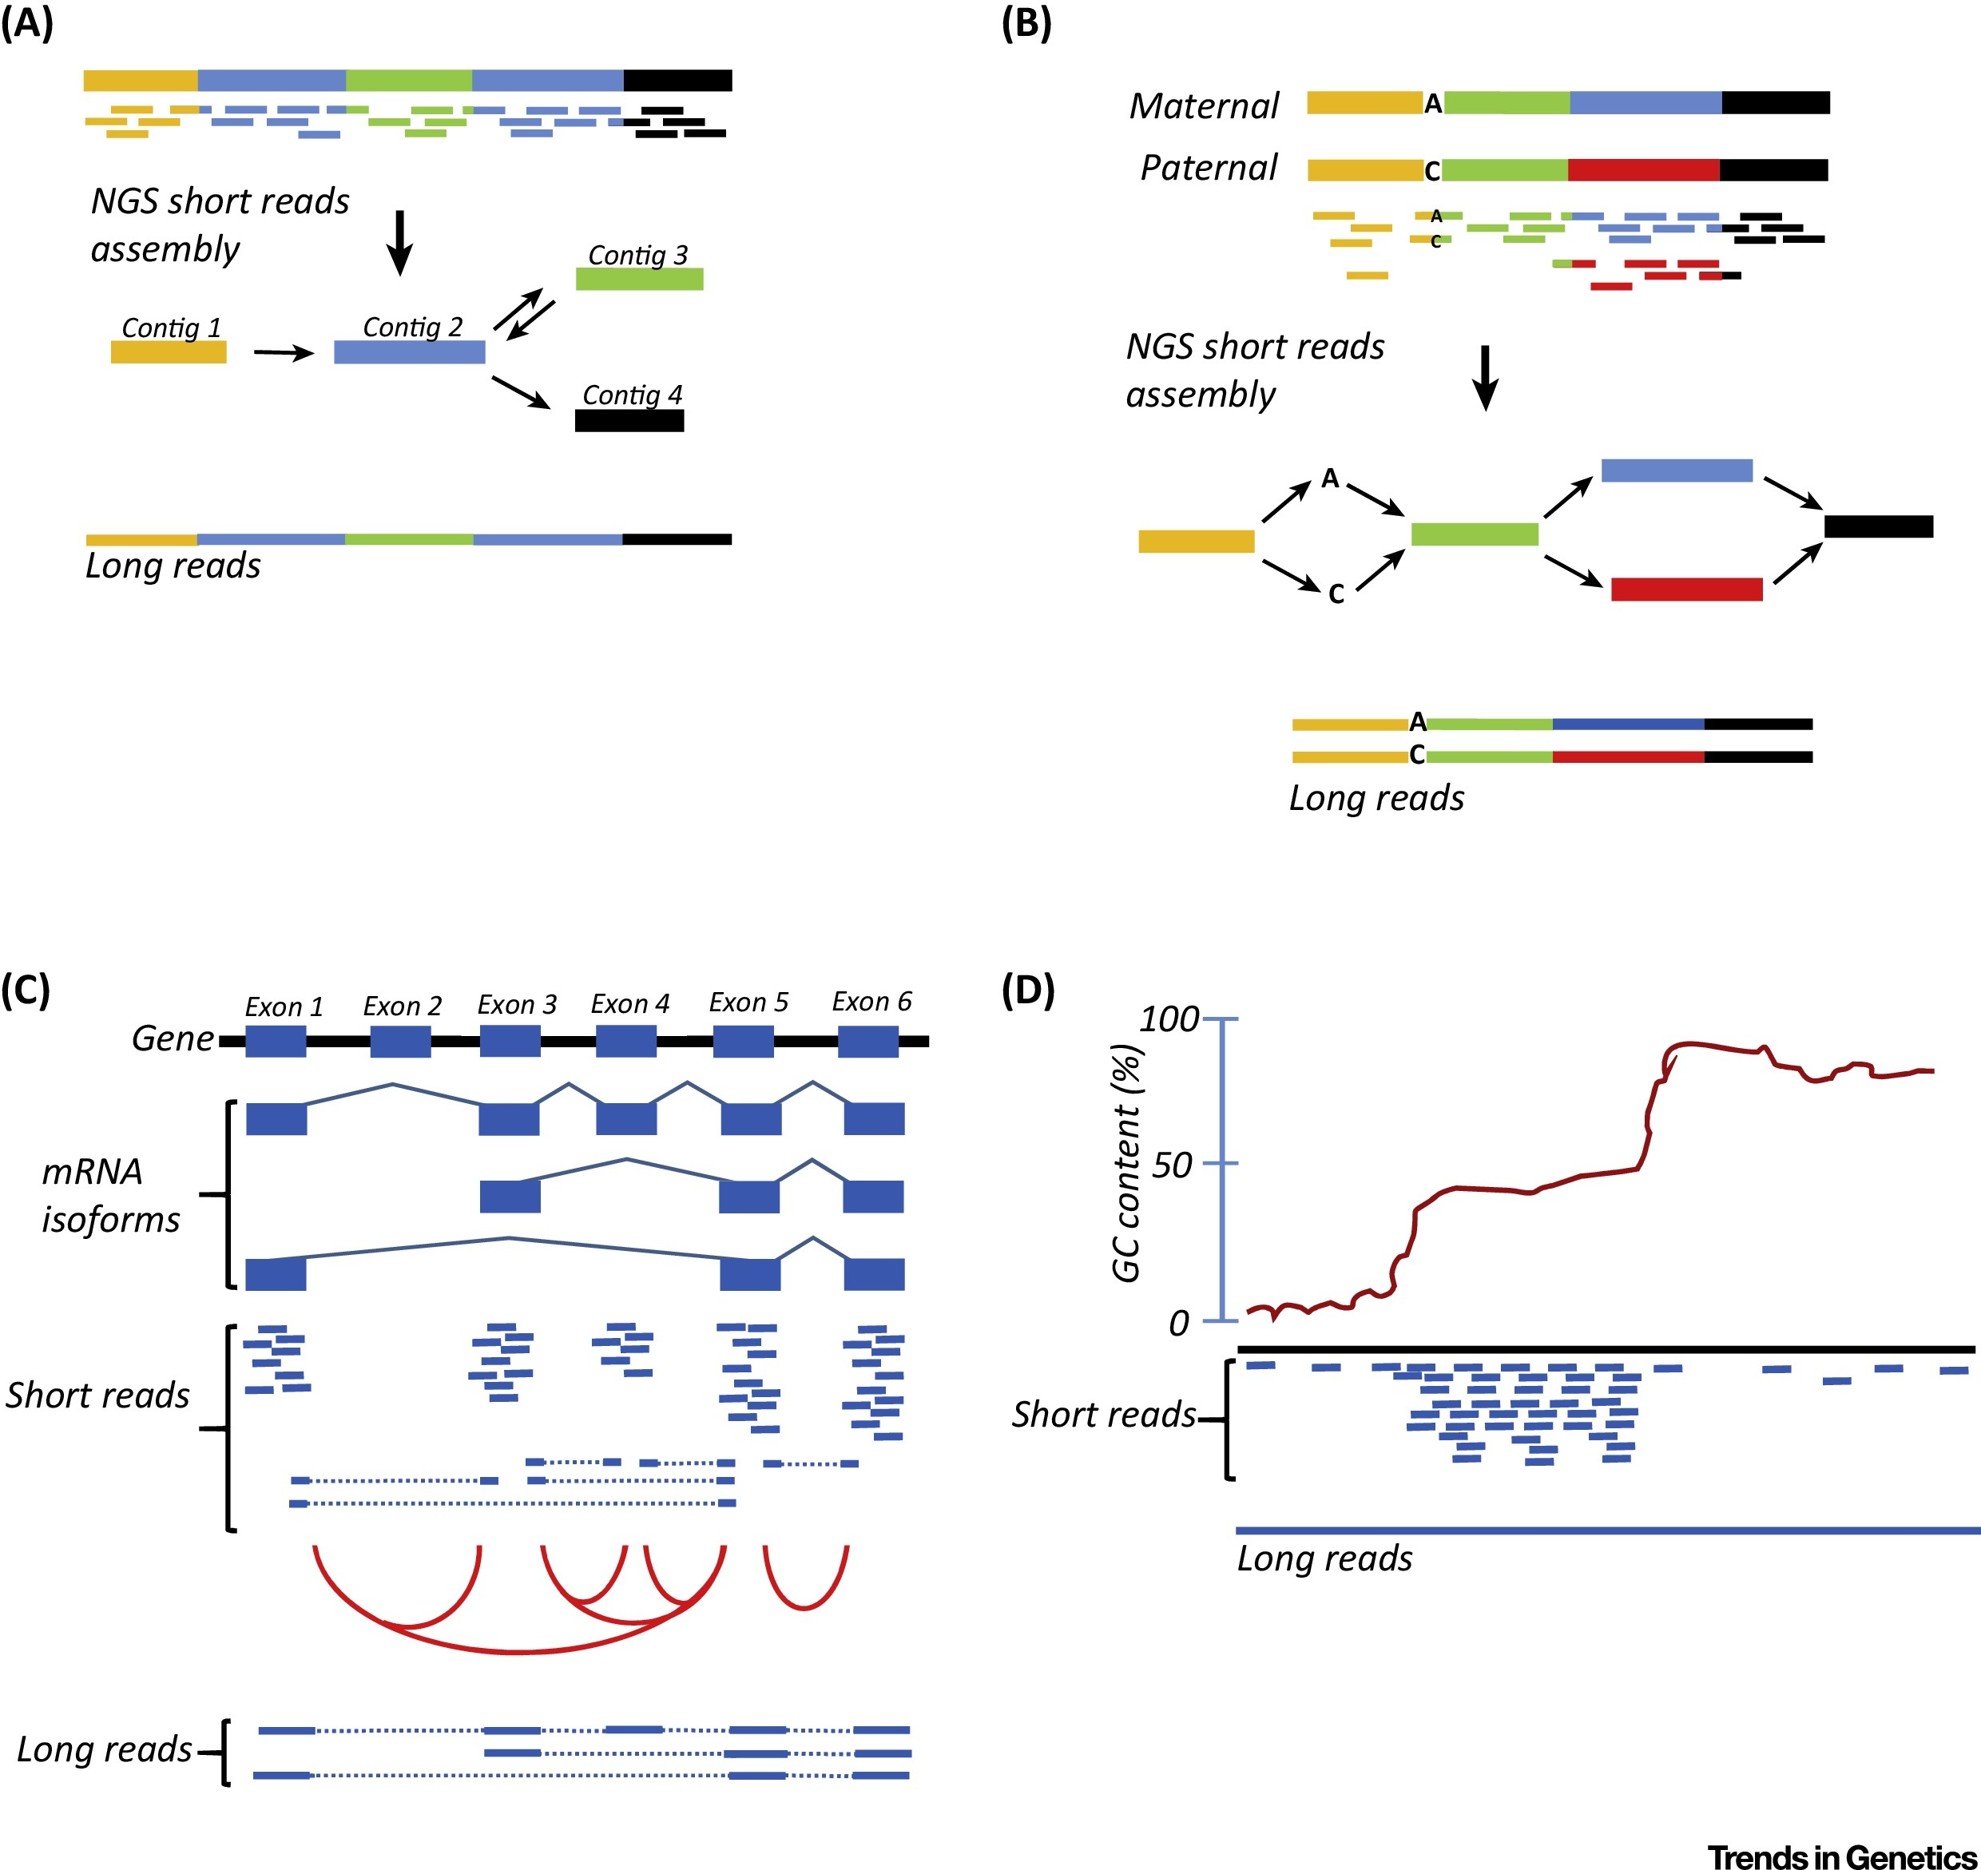
Short vs Long reads
Positives with long reads
Resolves Repeats
Provides Phasing
Resolves structural variants
Resolves Alt Splicing
Not sensitive to PCR Bias due to GC content
Traditional problems with long reads
High error rates
low throughput
Van Dijk et al. 2018

Slide 12
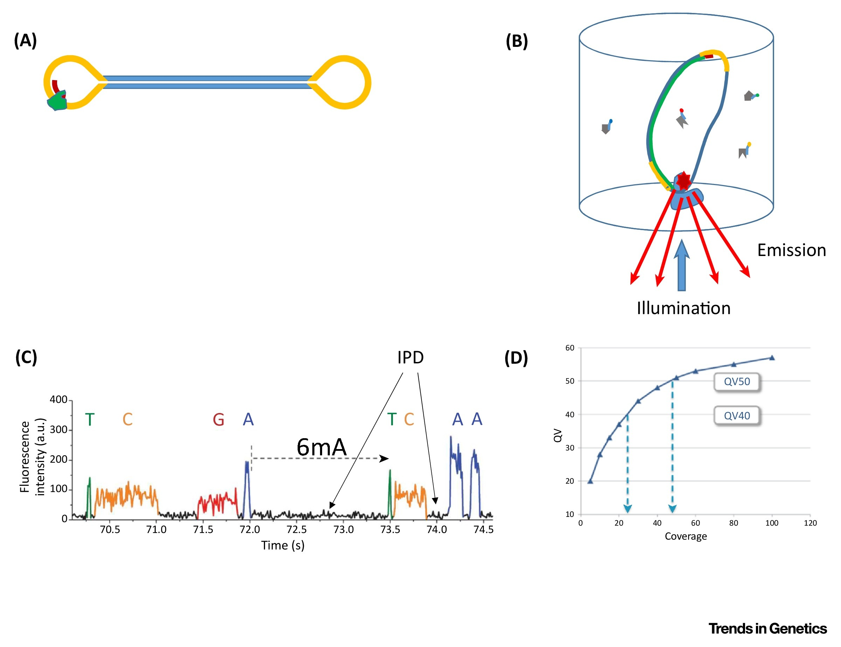
Pac Bio
single-molecule real-time’ (SMRT) sequencing
How it works
Van Dijk et al. 2018
Notes:
Circular consensus sequencing (CCS) [also continuous long read sequencing CLR; median frag size 50kb]
Interpulse duration
Each run 13% error rate, but multiple passes of circle through ZMW(zero mode waveguides)
CCS: Both strands sequenced multiple times
QV40: 99.999%accurate. , QV50:99.9999% accurate
Coverage=number of passes for a single molecule
Interpulse duration between nucleotides, affected by base modifications.
Variant detection just 10x coverage needed acc to video

Slide 13
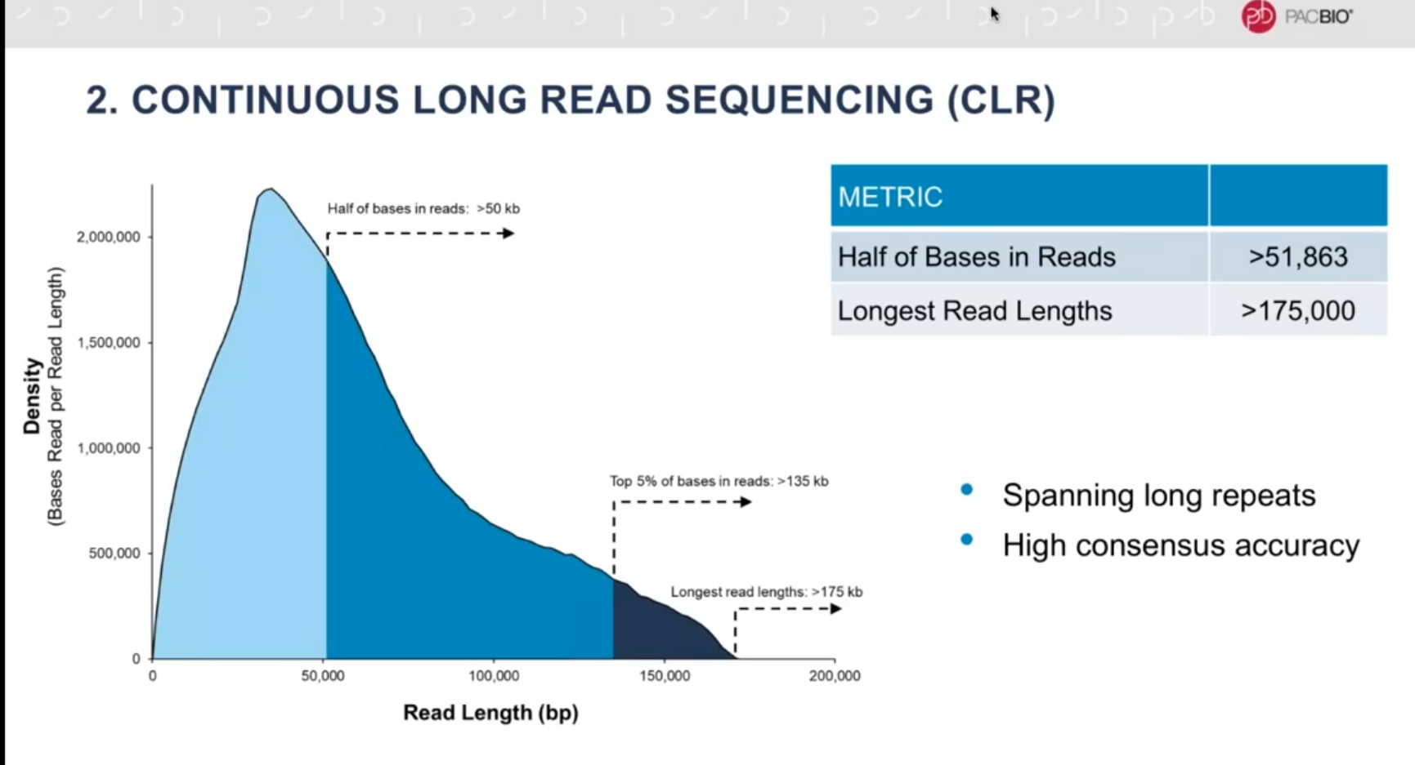
Pac Bio Sequel 2
https://www.pacb.com/blog/setting-a-new-gold-standard-in-strain-sequencing-webinar-describes-cannabis-pan-genome-project/
Notes:
Goal is to sequence long fragments: best for scaffolding large genomes, but fewer passes per molecule

Slide 14
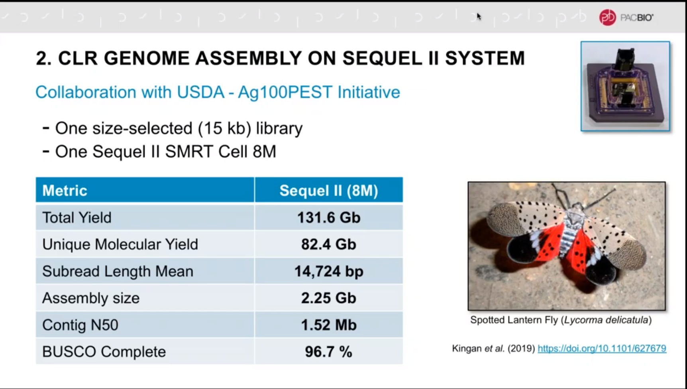
Pac Bio Sequel 2
https://www.pacb.com/blog/setting-a-new-gold-standard-in-strain-sequencing-webinar-describes-cannabis-pan-genome-project/

Slide 15
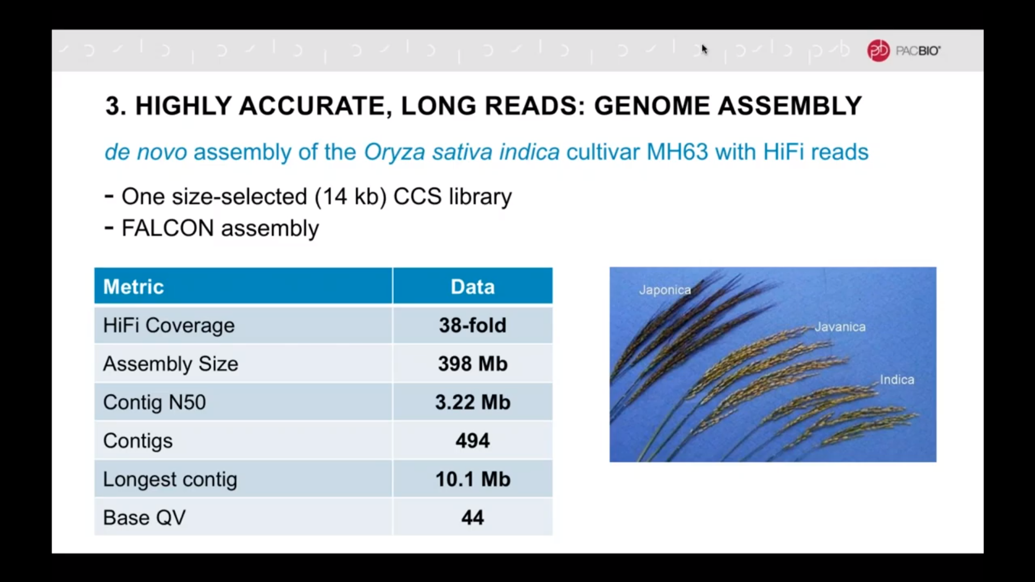
Pac Bio Sequel 2
https://www.pacb.com/blog/setting-a-new-gold-standard-in-strain-sequencing-webinar-describes-cannabis-pan-genome-project/

Slide 16
Costs of pacbio runs per platform
PacBio Sequel SMRTbell Template Preparation /prep | $620
PacBio Sequel SMRTbell Template Sequencing /SMRT Cell | $1,509
Pulse Field Gel Electrophoresis /gel | $233
PacBio Barcoded Adapters | $56
  Throughput for sequel i
    1M wells; 10GB per chip
  Error rates
    CCS: <0.1%
    CLR: 10% for single pass
  Oregon state pricing for sequel I
  For small genomes, ~$700 ea pooling 16.
https://cgrb.oregonstate.edu/core/pacbio/pacbio-service-fees

Slide 17
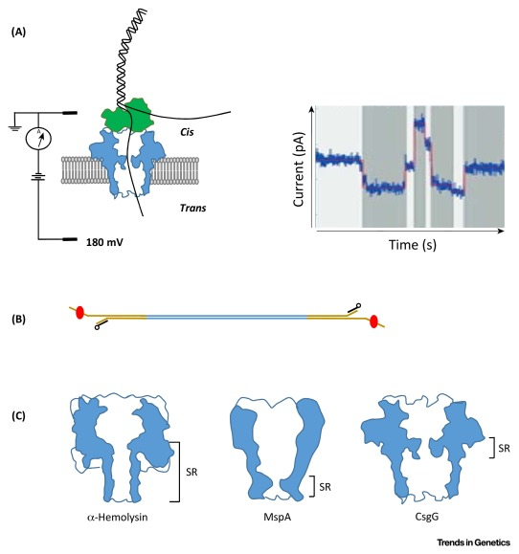
Oxford Nanopore
nanopore sequencing
Unlimited DNA fragment size (>1Mbp)
15%error rate single pass (1D), 3% 2D
Wells reused many X
video
Van Dijk et al. 2018
Notes:
https://nanoporetech.com/products/minion
Black nucleic acid
Blue is nanopore (SR sensing region. Smaller SR, fewer nt contribute to signal, more accurate.
Red circle for binding motor protein
Black thing: cholesterol group that helps DNA locate to membrane
Both strands sequenced, with error rates down to 3%
Wells reused up to 150X to increase throughput
Extra video https://vimeo.com/337258910

Slide 18
A minion run
Lu et a. 2016
Notes:
Library prep involves adding adapters to ends of DS fragments, a hairpin on one side, and a Y adapter that binds to motor protein. A tether brings molecule in close association with surface of membrane
Red produced up to 126 reads, black zero
C)Squiggle plot of raw current measurements over time
D)Kmers of 4 to 6 read (shifting 1 base at time) and most likely sequence deduced by cloud-based software

Slide 19
platforms
https://nanoporetech.com/sites/default/files/s3/literature/MinION-Brochure-14Mar2019.pdf

Slide 20
Lu et al. 2016. Genomics, Proteomics & Bioinformatics 14, 265-279

Slide 21
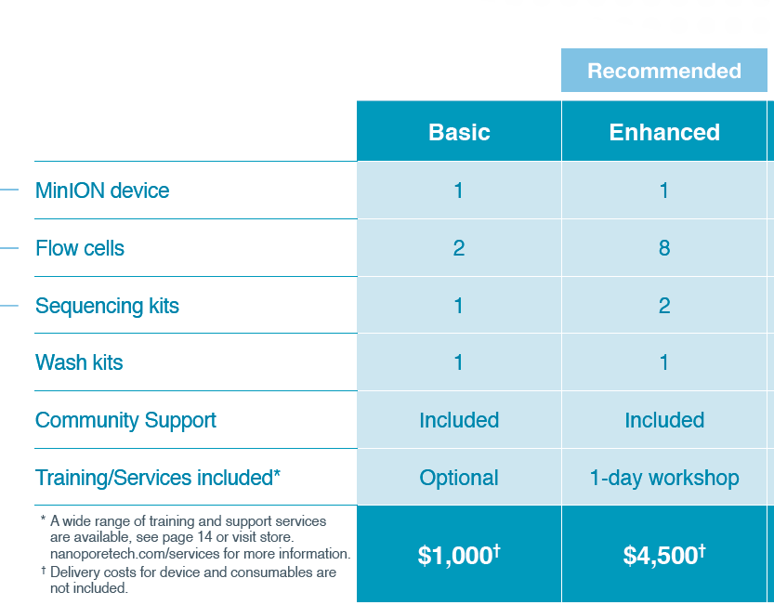
$1000 minion starter kit
Minion 512 channels, up to 30GB
Individual flow cells $900 ea (bulk pricing available)
Additional $650 for kit barcoding up to 12 samples
Library prep tricky relative to illumina, esp. barcoding
  Could stop, flush and reload instead of multiplexing
  High quality DNA and a good amount of DNA a must
Flowcell quality variable, but can return if really bad
https://nanoporetech.com/sites/default/files/s3/literature/MinION-Brochure-14Mar2019.pdf
Notes:
Minion 1 million reads.
Turn on, run, turn off, flush restart with new sample, OR multiplex.
Flowcells 3/10 bad, tricky library for barcoding. High Qual and a good amount DNA a must
Shotgun. Similar prep time. Harder to multiplex (2 or 3).
Other equipment needed
beads and magnet

Slide 22
Flongle adapter
Flongle adapter (126 channels, ~$90 per adapter, up to 1.8GB)
https://nanoporetech.com/products/flongle
  Requires minion device
  Requires kits
  Shelf life 3 weeks
  Qubit to assess sample Quantity
Kits
  $650 for 6 rapid (10 min) sample barcoding kit
    ($90 +$650)/6 = $123 per sample
  Individual rxn kit and run about $200 ea
  1D only
  400 ng of high molecular weight gDNA (>30 kb)
Notes:
$600 for 6 reactions for single ligation 1D kit
$100+$90 flongle = $190 per sample
Flongle 35s to 1:10

Slide 23
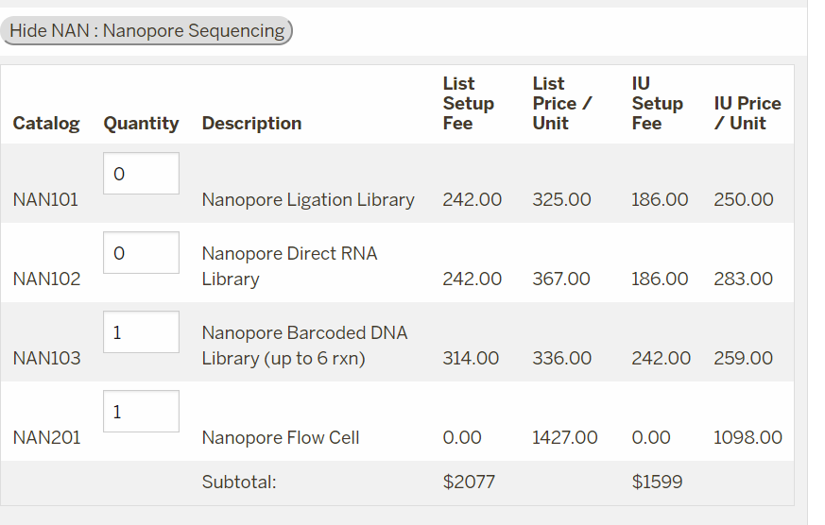
IU Pricing
$(1427+314 + (336*6) /6 =$626 per sample if 6 samples multiplexed
Up to 30GB data
5GB per sample if 6
Notes:
Flowcell + kit ((1427+(242+(336*6)))=2258) /6

Slide 24
Downstream methods
  Platform-specific software to process raw data into higher quality reads
  Bacterial Genome analysis: https://gcat-seek.weebly.com/
  Genome Assembly
    Miniasm available on Patric webserver for ONT & PACBIO (patricbrc.org)
  Genome Comparison
    Patric Comprehensive Genome Analysis Service: Assembly, annotation, comparison
    Emboss alignment dotplots
    http://emboss.sourceforge.net/apps/cvs/emboss/apps/alignment_dot_plots_group.html
  Variant comparison
    Nanopipe webserver: ONT alignment statistics, consensus sequence, polymorphism data, and visualization of the alignment
Notes:
Patric Web based server for SPAdes
Patric Comprehensive Genome Analysis Service
assembly, annotation, identification of nearest neighbors, a basic comparative analysis that includes a subsystem summary, phylogenetic tree, and the features that distinguish the genome from its nearest neighbors

Slide 25
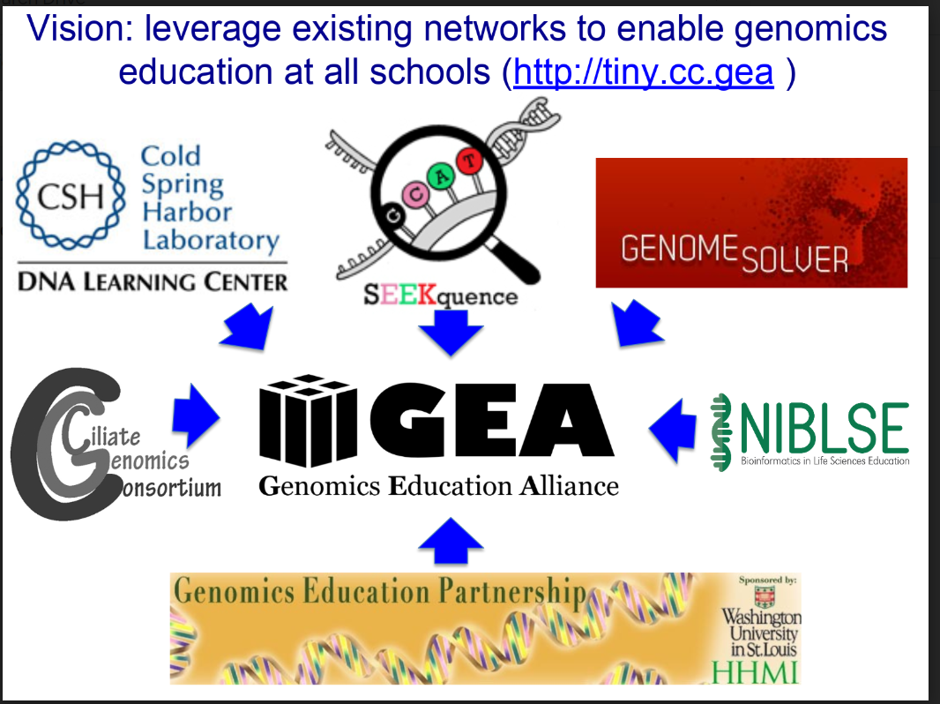

Slide 26
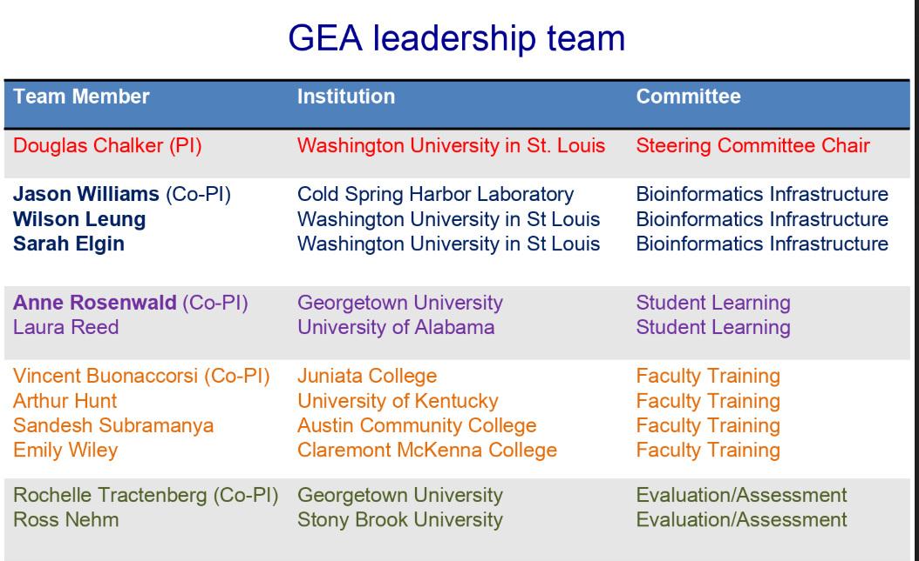

Slide 27
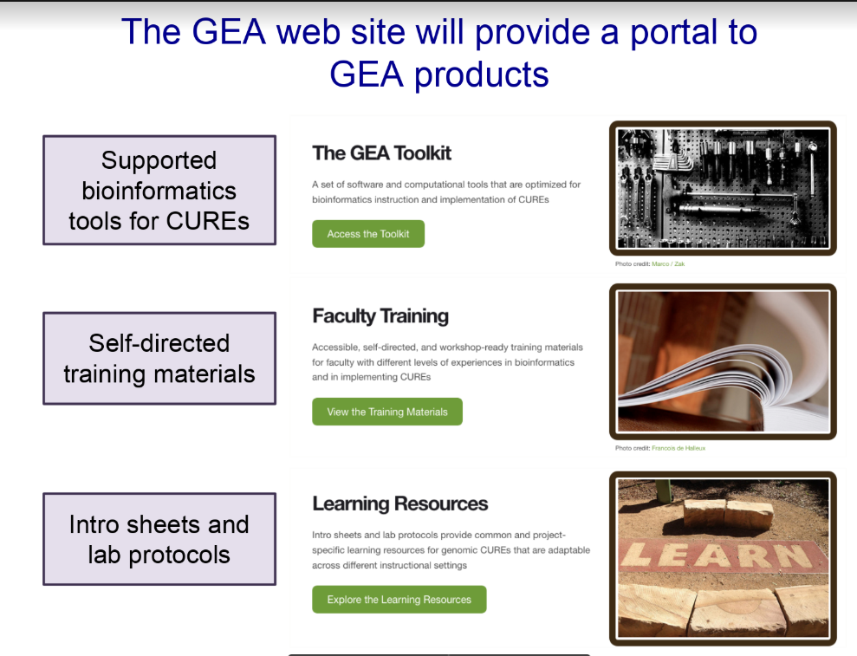

Slide 28

Start with small bites, then a full CURE,then develop your own CURE

Slide 29
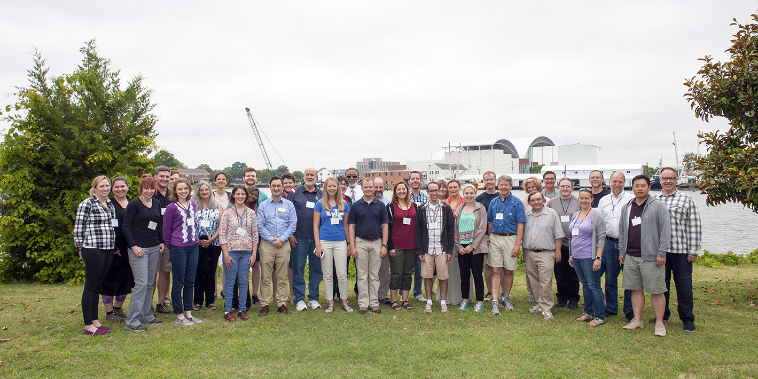
Genome consortium for active teaching using nextgen sequencing
Eight summer workshops were organized and run over a six-year period
  Three at MSIs
200 faculty and student participants
Wet lab and computer lab
Topics
  Bacterial genome sequencing
  Eukaryotic genomics (genome seq, Radseq, variants)
  Microbial community sequencing
  RNAseq
5000 students taught using GCAT SEEK resources (600 in independent research)
60K jobs submitted to JC-HHMI HPC
38 disciplinary or educational pubs, 29 with student authors, 60 different student authors
GCAT-TGS?
Notes:
Eight summer workshops were organized and run over a six-year period. Three genomics workshops were performed at Minority Serving Institutions including Morgan State University, California State University at Los Angeles, and Hampton University. Approximately 200 different faculty and students completed at least one summer workshop. The workshop included wet-lab sessions for preparing samples for sequencing, training for genomics data analysis including high performance computing, training for assessing student learning, sessions devoted to educational planning, and a session on how to teach the ethical, legal, and societal implications of genomics to biology students. Research projects included RNAseq, prokaryotic genomics, eukaryotic genomics, and microbial community sequencing approaches.
Over the six year period the network grew from 100 to 300 faculty distributed around the country. Faculty reported use of network protocols, data, or computational resources to help teach approximately 5000 students genomic data analysis, 600 of which were mentored in an independent research setting. Over 60,000 jobs were submitted to the Juniata HHMI high performance computing cluster by network faculty and students since 2013. To date, the network has supported 38 educational or disciplinary manuscripts, 29 of which included student authors, with over 60 different student authors in total. Educational modules were developed by workshop participants and are available on the network webpage (https://gcat-seek.weebly.com/).

Slide 30
BI380-Biological Science Research Methods: Eukaryotic Genomics
Semester long CURE, 2X3hr of lecture/lab, 4 credits, Writing, Nine UL Biologists and Biochemists
Goals and Assignments
Read review articles and primary research articles to understand the background of the specific area to be studied.
Collaboratively derive research objectives and design experiments
Collaboratively problem-solve issues arising with experimental design and technique
Communicate research through writing a primary research manuscript describing the project background and methods and discussing the significance of the results
Semester Workflow
Weeks 1 to 5
  Bioinformatics/genomics training and problems
  Literature review and annotation
  Proposal : Genome annotation and evolutionary comparisons
Weeks 6 to 11 Analysis/training
Weeks 11 to 14 Analysis/writing

Slide 31
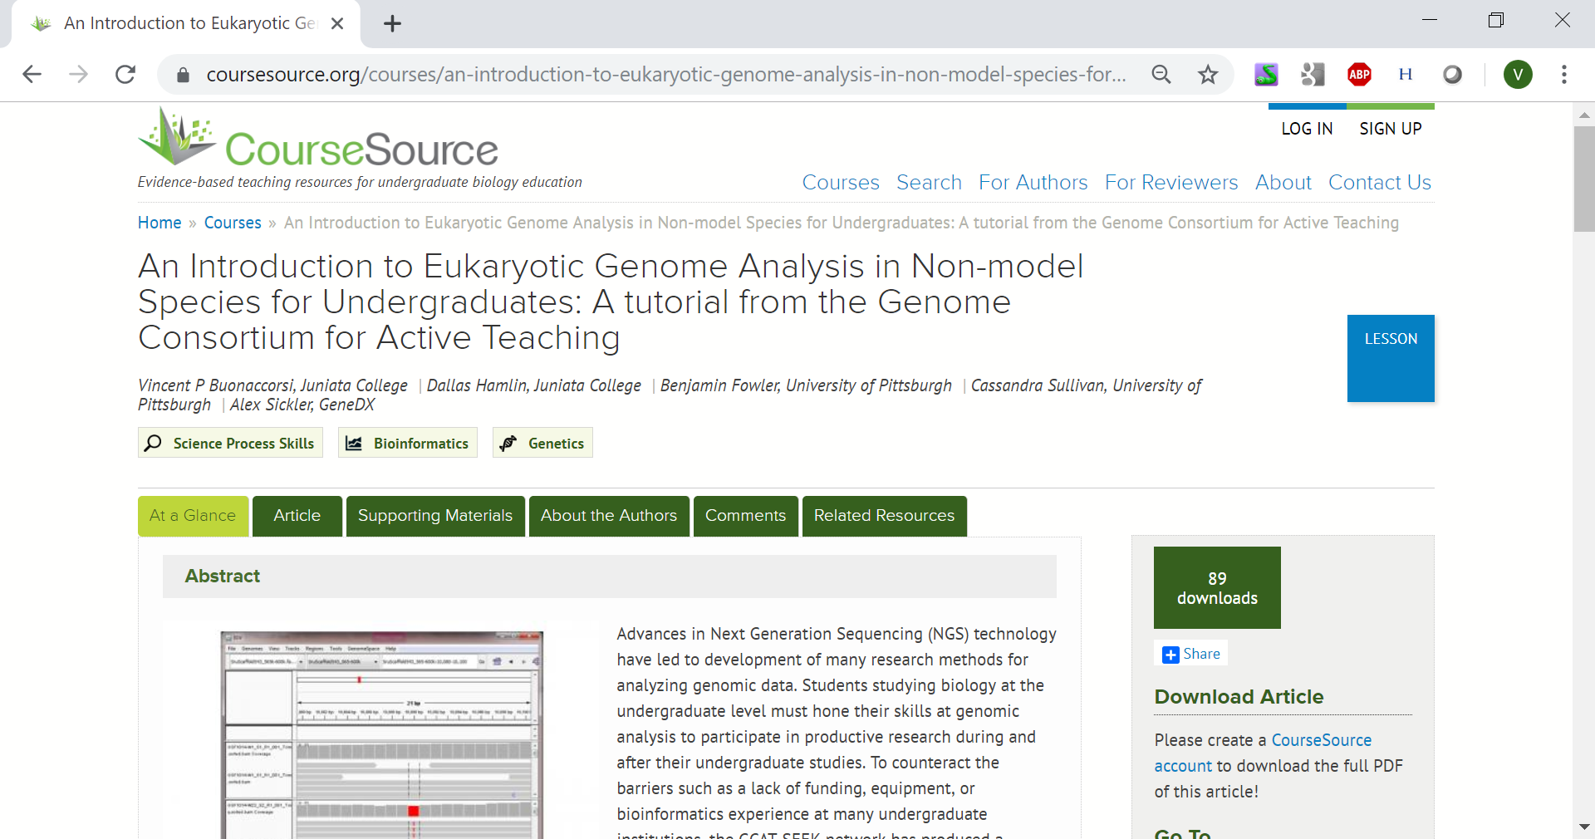

Slide 32
Genomics/Bioinformatics
Training
CourseSource Tutorial II
CourseSource Tutorial I
Chapter 1. Linux tutorial: Some basics
Chapter 2. Genome Assembly: Overview & experimental design
Chapter 3. Genome annotation: Overview and manual annotation of a eukaryotic gene
Key tech references
Practical Computing for Biologists, Haddock & Dunn
Bioinformatics Data Skills, Buffalo

Slide 33


Slide 35
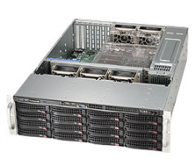
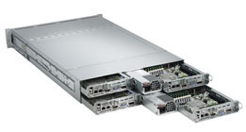
Juniata-HHMI Shared HPC resources
One Master Node
  Processors AMD Opteron Eight-Core 16 Cores per Master Node 2
  16Gb RAM per Master Node
  Hard Drive RAID Edition 3TB 6Gb/s Hard Drive, 7200RPM
  Operating System CenTOS 1
  130TB storage
Six Compute Nodes
  Processors AMD Opteron 32 Cores per Compute Node
  RAM 8GB 128Gb Ram per Compute Node
  Hard Drive RAID Edition 500GB 6Gb/s Hard Drive
~100 programs/pipelines installed
Tech support
Notes:
Thanks to Vince, Anne wood, dave fusco, Loren Rhodes, Technology Soultion Center
Remote Monitor the Health of the Cluster Hardware 1
Period One Month of Biweekly Remote Access and Log Reviewing 1
Includes Scheduled Remote System Reviewing and Error Log Checking 1
Includes Email Event Monitoring 1
Includes Ambeint Room Temperature Monitoring

Slide 36
Lessons learned: The Bad
Frustration, delays, time limitations to learn all methods in depth
Things break, programs don’t work
Some students persistently timid or underperforming, leading to dominant/recessive actors within groups or knowledge/data gaps
Drowning in sea of methodology, terminology
“3 hours per week per credit” = “a lot”
Some students miss point of doing a research project

Slide 37
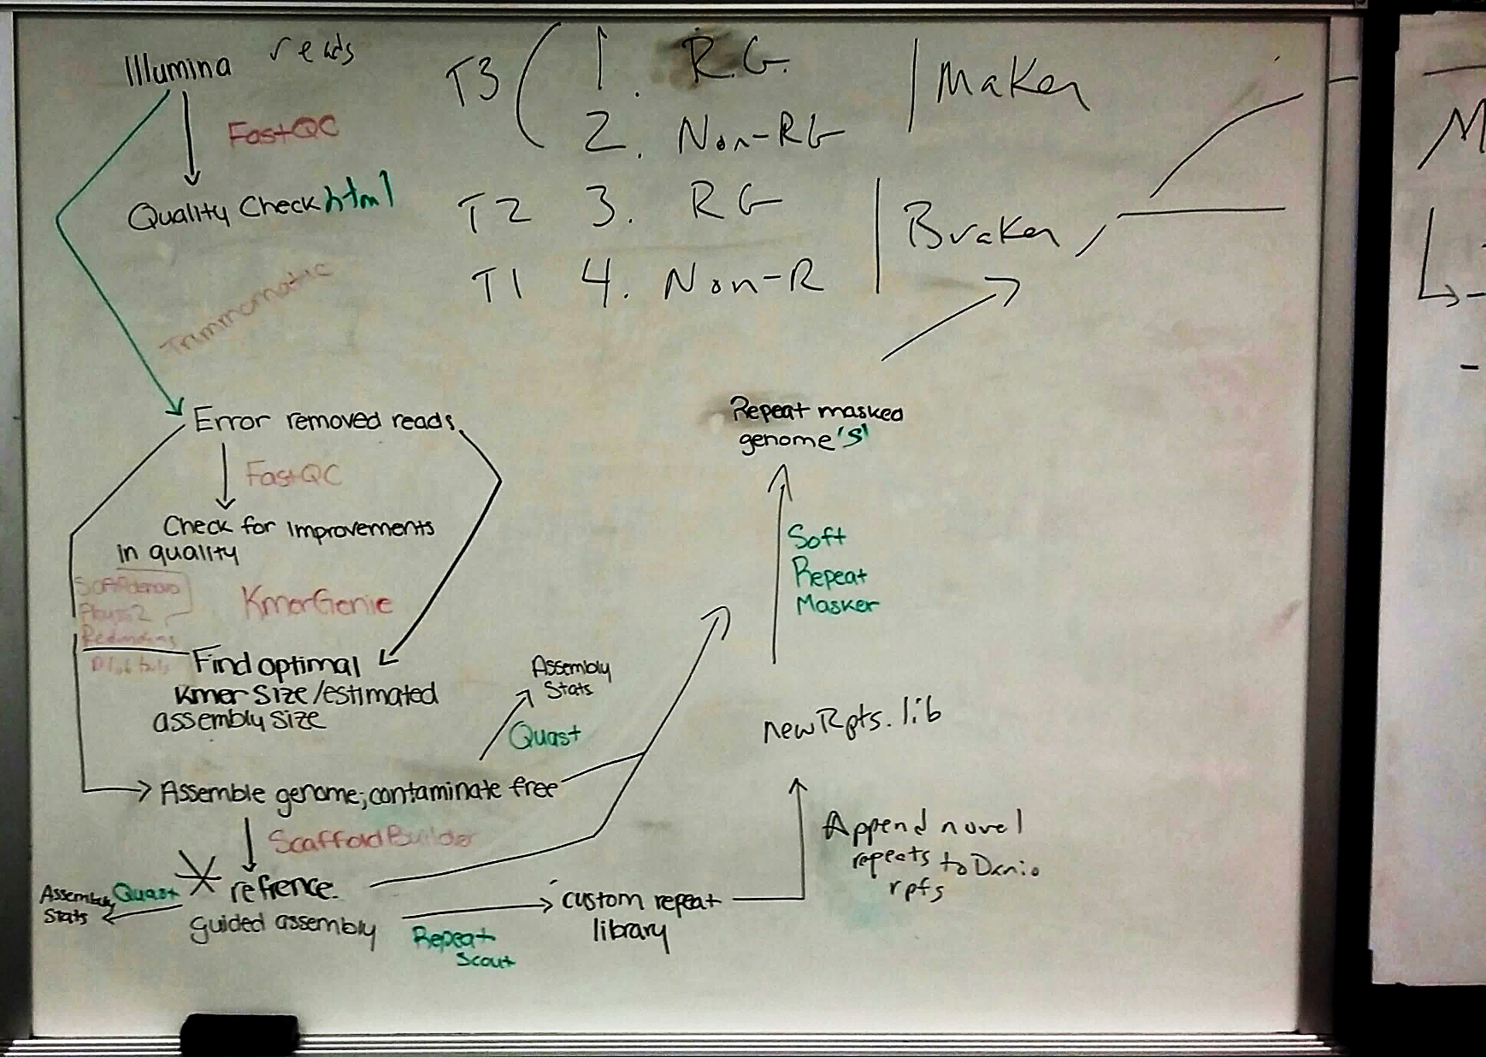
Lessons learned: The Good
Visual Workflows
Access to cluster, vetted training manuals
Freedom to choose analysis path
Alignment of literature, skills, and project
Flexible scheduling, backup plans
Instructor experience
Adaptable schedule, workflow, due dates
Prepare for rubber-hits-road moment
Staff, teacher support
Team work & problem solving builds comraderie to combat tech troubles
Online shared supplements…

Slide 38
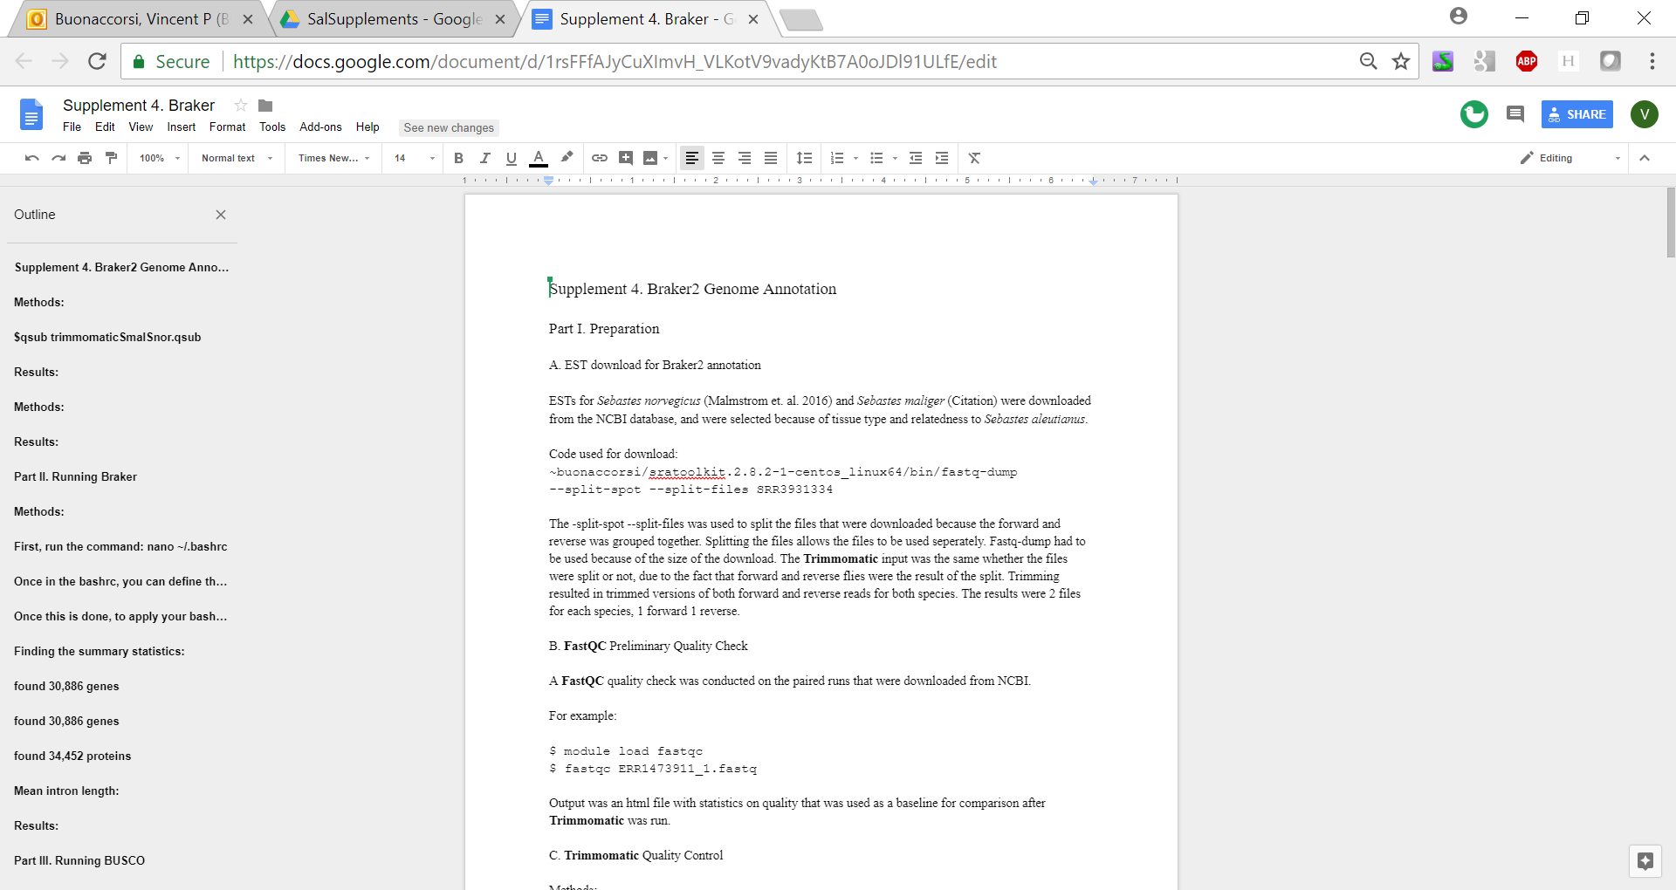

Slide 39
Overall Mentality
High expectations, high support, stay in trenches with students to read class
Fail quickly to learn quickly
Come equipped for psychological battle
... Dr. Buonaccorsi has high expectations, and there was a lot of work involved, but I learned more than I imagined possible in a semester about bioinformatics.

Slide 40
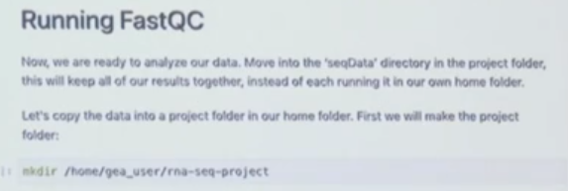
Notes:
https://drive.google.com/drive/folders/1lbNqrH26mkQ1nVSCuPzKd4EyQ3XDXldy
49 minutes in

