Slide 1
The Story of the Data
(thinking of data as evidence)

Slide 2
The Story of the Data
Process of Inquiry

Slide 3
The Story of the Data
Process of Inquiry
Bottlenecks & Barriers

Slide 4
Levels of Evidence about Student Learning
&
Information about Student Experiences

Slide 5
National studies of student experiences and learning based on Large-Scale Assessments (e.g., overall “effective practices” from the Wabash National Study).

Slide 6
National studies of student experiences and learning based on Large-Scale Assessments (e.g., overall “effective practices” from the Wabash National Study).
Your own institution’s results from those national assessment instruments.

Slide 7
National studies of student experiences and learning based on Large-Scale Assessments (e.g., overall “effective practices” from the Wabash National Study).
Your own institution’s results from those national assessment instruments.
Your own institution’s further analysis of the above (bringing in specific comparison groups—by year, major, student’s identity or background, etc.).

Slide 8
National studies of student experiences and learning based on Large-Scale Assessments (e.g., overall “effective practices” from the Wabash National Study).
Your own institution’s results from those national assessment instruments.
Your own institution’s further analysis of the above (bringing in specific comparison groups—by year, major, student’s identity or background, etc…).
Your institution’s own data (retention data, GPA, information about majors, and student participation, etc.).

Slide 9
National studies of student experiences and learning based on Large-Scale Assessments (e.g., overall “effective practices” from the Wabash National Study).
Your own institution’s results from those national assessment instruments.
Your own institution’s further analysis of the above (bringing in specific comparison groups—by year, major, student’s identity or background, etc…).
Your institution’s own data (retention data, GPA, information about majors, and student participation, etc.).
Course/Faculty/Student Level Information (student feedback/evaluation forms, peer reviews of teaching, information about DFWs, syllabi, etc.).

Slide 10
Using Data to Help Students
1. What kind of information do you have about your students that gives you insights about their experiences and learning?

Slide 11
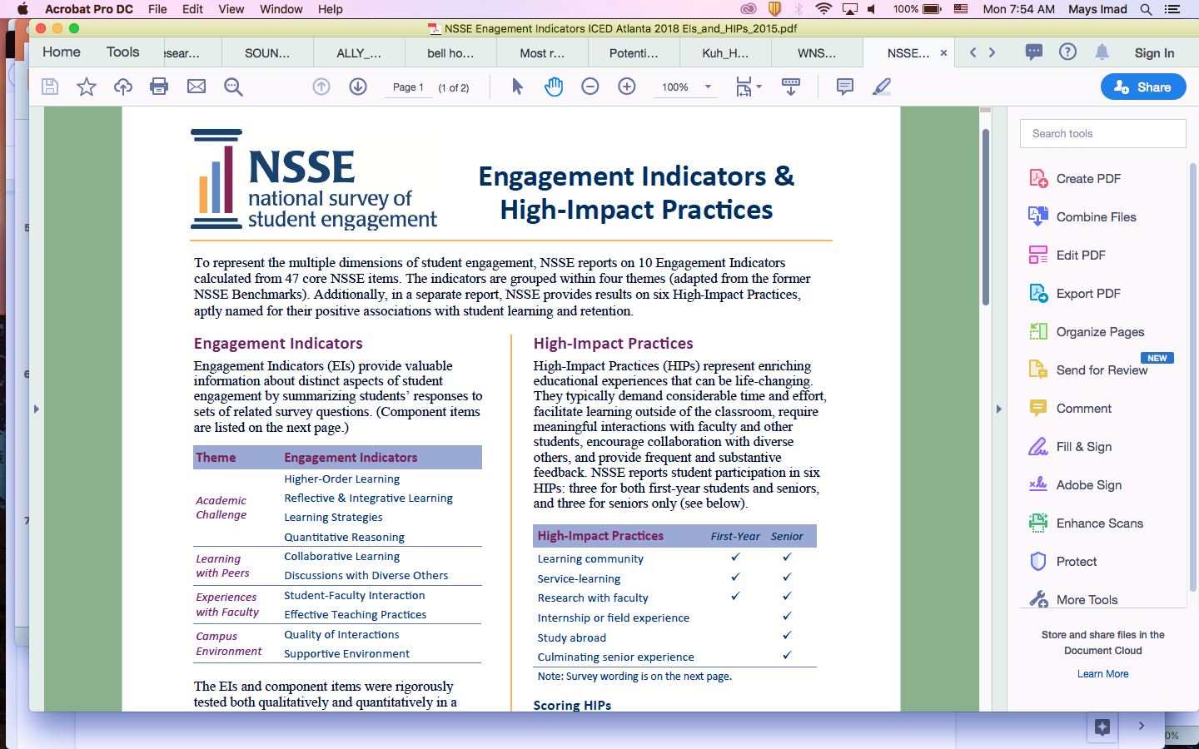
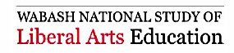
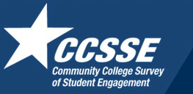
Example from National Evidence

Slide 14
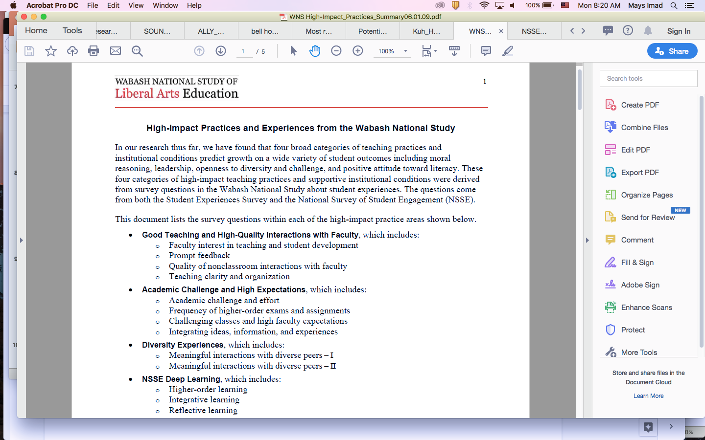

Slide 15
What happens to this type of data on your campus? (Who sees it? What actions are taken as a result of that information?)

Slide 16
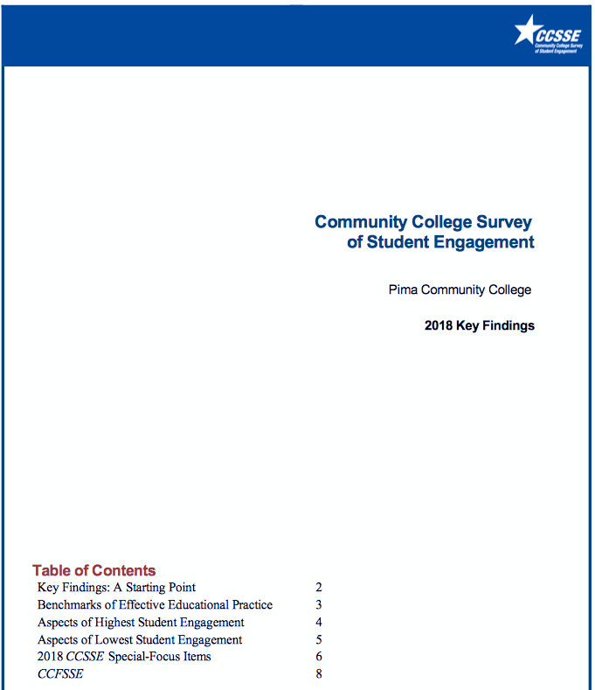

Slide 17
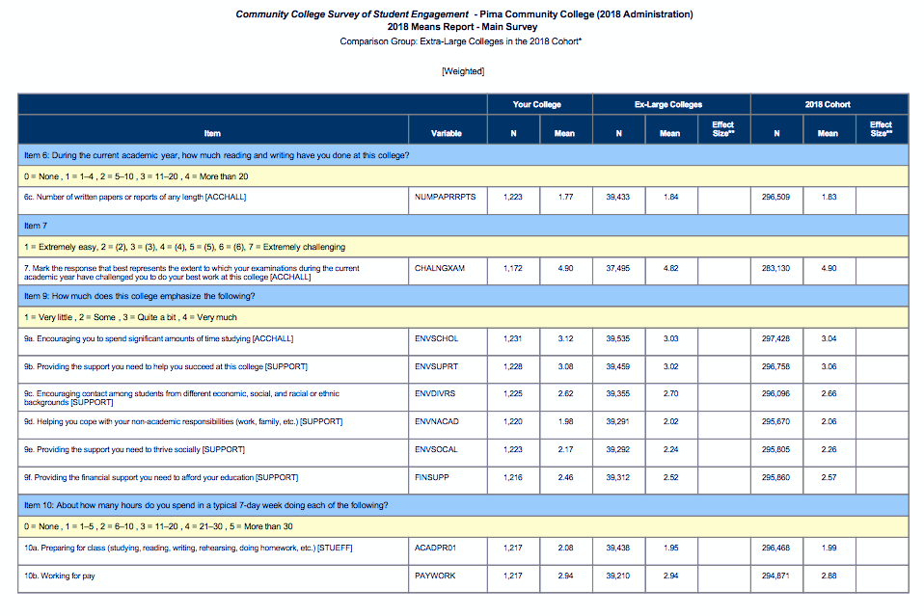

Slide 18
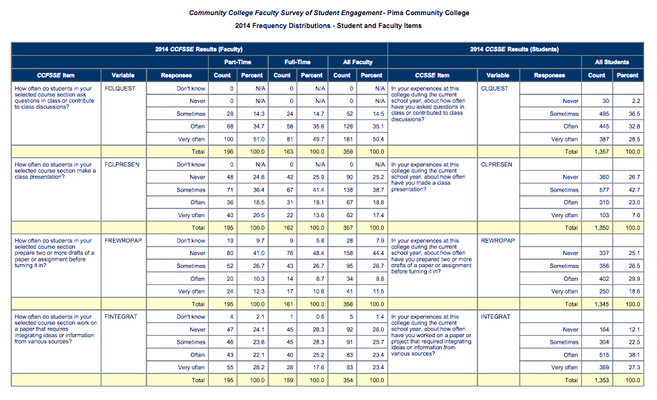

Slide 19
Ideally, what would happen with this data?

Slide 20
Ask Questions to Improve Learning

Slide 21
Where do I think an area of improvement is needed?
Notes:
In your majors, in your classes, in your department?

Slide 22
2018

Slide 23
Students
During the current academic year, how much has your coursework at this college emphasized making judgements about the value or soundness of information, arguments, or methods?
2018

Slide 24
Students
During the current academic year, how much has your coursework at this college emphasized making judgements about the value or soundness of information, arguments, or methods?
2018
Never Sometimes Often Very often

Slide 25
Students
During the current academic year, how much has your coursework at this college emphasized making judgements about the value or soundness of information, arguments, or methods?
n=98,635
56.3%
2018
Never Sometimes Often Very often

Slide 26
Students
During the current academic year, how much has your coursework at this college emphasized making judgements about the value or soundness of information, arguments, or methods?
n=98,635
56.3%
Faculty
How much does the coursework in your selected course section emphasize making judgements about the value or soundness of information, arguments, or methods?
2018
Never Sometimes Often Very often

Slide 27
Students
During the current academic year, how much has your coursework at this college emphasized making judgements about the value or soundness of information, arguments, or methods?
n=98,635
56.3%
Faculty
How much does the coursework in your selected course section emphasize making judgements about the value or soundness of information, arguments, or methods?
n=15,701
68.2%
2018
Never Sometimes Often Very often

Slide 28
“In my introductory science courses, the concept of critical thinking was given a cursory five minutes, and then we dove right into concepts of biology. I think this is an oversight.”

Slide 29
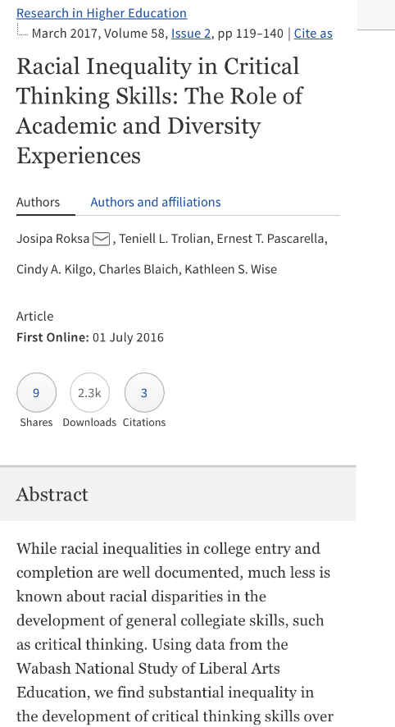

Slide 30


Slide 31
Using Data to Help Students
2. How might you use national or institutional data to help your students?

Slide 32
What helps or gets in the way of that data being utilized to improve student learning?

Slide 33
Don’t Make Assumptions
Not One Size Fits All

Slide 34
Describe your optimal learning environment:

Slide 35
“I think it makes it better for the class if the teacher talks about their personal life and listens [to] other students lives and stories because it really brings the class together and it’s more of a relaxed environment. When the students have a better relationships with each other in class, then more people will be involved with activities and again feel more comfortable in class.”

Slide 36
“[One] factor that I would find helpful in creating an optimal learning environment would be helping the students get to know each other for a few minutes when class starts for the semester.”

Slide 37
“[Professors] can create an optimal learning environment by building relationships with students and making themselves available to those who need help.”

Slide 38
Where in your syllabus or your class do you offer an opportunity for your students to get to know you and each other?

Slide 39
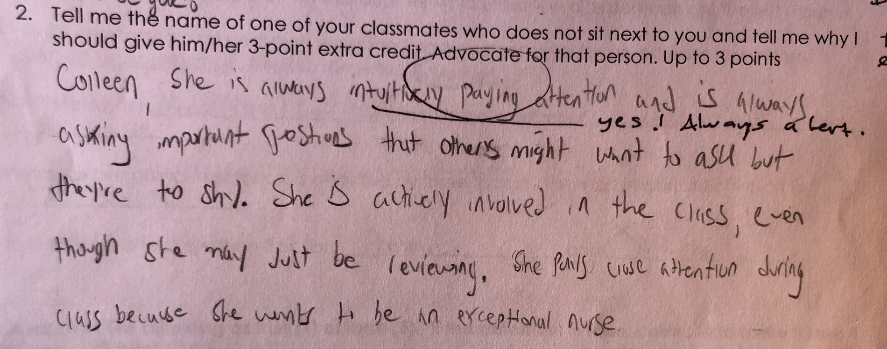

Slide 40
Individual Evidence

Slide 42
Using Data to Help Students
3. What do you use your course evaluations for?

Slide 43
Preparing Students to Take Course Evaluations

Slide 44
Why?
Improve response rates and improve the value of results
Improve student engagement
Improve students learning

Slide 45
I reassure students that the online course evaluation system is designed to protect confidentiality.

Slide 46
I reassure students that the online course evaluation system is designed to protect confidentiality.
I tell students that their feedback will help me improve my teaching.

Slide 47
I reassure students that the online course evaluation system is designed to protect confidentiality.
I tell students that their feedback will help me improve my teaching.
I help students learn to recognize and give constructive criticism.

Slide 48
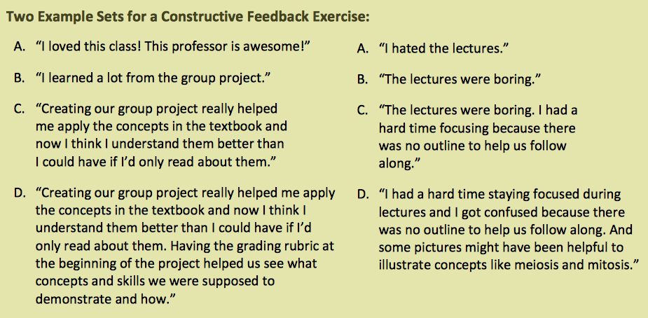
https://atl.wsu.edu/documents/2015/02/course-evaluations-and-constructive-criticism-talking-with-students.pdf/

Slide 49
Using Data to Help Students
4. How do you deal with harsh or vague comments?

Slide 50
I reassure students that the online course evaluation system is designed to protect confidentiality.
I tell students that their feedback will help me improve my teaching.
I help students learn to recognize and give constructive criticism.
I share with students data about biases against women and racialized faculty.

Slide 51
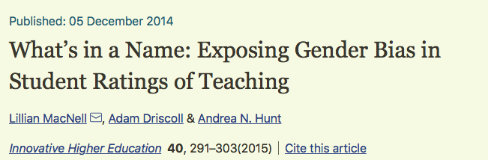
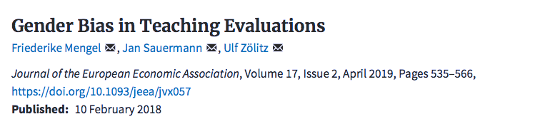
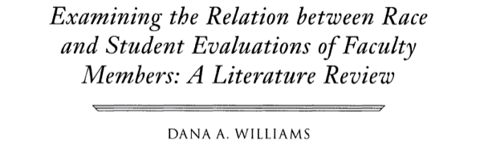

Slide 52
I reassure students that the online course evaluation system is designed to protect confidentiality.
I tell students that their feedback will help me improve my teaching.
I help students learn to recognize and give constructive criticism.
I share with students data about biases against women and minoritized faculty.
We practice throughout the semester.

Slide 54
Using Data to Help Students
5. Where do you think an area of improvement is needed? In your majors, in your classes, in your department? What data do you need and how will you obtain that data?

Slide 55
Student Records
Pre-college characteristics (HS rank, SAT/ACT, etc.)
Admissions scores/tests
Financial need, aid awarded, etc.
Course enrollment, credit completion, grades, course patterns
Employment data
Placement tests
Participation in programs (pre-college or other)
Institutional Assessment Data
New student surveys (CIRP, CSI, BCSSE)
NSSE, CCSSE
Placement information
Student surveys
Learning outcomes tests (CLA, CAAP, Prof Profile)
Co-curricular transcripts

Slide 56
Department/Program Assessment Data
Program-level assessment data
Placement information
Senior exit surveys
Capstone projects/honors theses
Portfolios
Alumni and employer data
Program participation (e.g., specialized clubs, UG research, etc.)
Classroom experiences, course evaluations, learning assessments
Transactional Data
Use of services (e.g., tutoring, advising, writing center, etc.)
Course-level data
Co-curricular participation

