Slide 1
MATH BOWL
∑
±
∂
∫
÷
∞
At SIMIODE EXPO
2023 edition designed by Paul Fonstad, Franklin College

Slide 2
Rounds for Today’s Competition
Déjà Vu
Think Twice
Wordle Math Art
Punny Math
MARVELous Math
Sing a Song of π

Slide 3
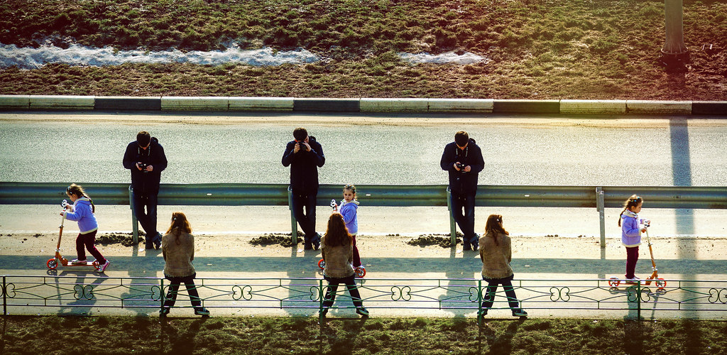
Round 1: Déjà Vu
Each question will have a repeated answer, where the repeat could be the same written term or the same sounding term.

Slide 4
SAMPLE QUESTION: An otherwise uninteresting flat two dimensional surface
ANSWER: Plain Plane

Slide 5
Round 1, Question 1
Within this water-holding kitchen basin, you can use differential equations to find this stable node.

Slide 6
Round 1, Question 1
Within this water holding kitchen basin, you can use differential equations to find this stable node.
Ready?

Slide 7
Round 1, Question 1
Within this water holding kitchen basin, you can use differential equations to find this stable node.
A Sink Sink

Slide 8
Round 1, Question 2
An exemplary example of a system of differential equations designed to mimic a real world situation could be considered this.

Slide 9
Round 1, Question 2
An exemplary example of a system of differential equations designed to mimic a real world situation could be considered this.
Ready?

Slide 10
Round 1, Question 2
An exemplary example of a system of differential equations designed to mimic a real world situation could be considered this.
A Model Model

Slide 11
Round 1, Question 3
If you are adding together an arbitrary collection of numbers, you are finding this.

Slide 12
Round 1, Question 3
If you are adding together an arbitrary collection of numbers, you are finding this.
Ready?

Slide 13
Round 1, Question 3
If you are adding together an arbitrary collection of numbers, you are finding this.
Some Sum

Slide 14
Round 1, Question 4
When the professor didn’t know the true answer to a student’s question about continuous transformations groups, he made up this instead.

Slide 15
Round 1, Question 4
When the professor didn’t know the true answer to a student’s question about continuous transformations groups, he made up this instead.
Ready?

Slide 16
Round 1, Question 4
When the professor didn’t know the true answer to a student’s question about continuous transformations groups, he made up this instead.
A Lie Lie

Slide 17
Round 2: Déjà Vu
Each question will have a repeated answer, where the repeat could be the same written term or the same sounding term.

Slide 18
Round 2: Think Twice
Each question is simple, but think twice before answering!

Slide 19
SAMPLE QUESTION: How many cubic feet are in a cubic yard?
ANSWER: 27

Slide 20
Round 2, Question 1
What number do you get when you take the product of all the digits on a phone key pad?

Slide 21
Round 2, Question 1
What number do you get when you take the product of all the digits on a phone key pad?
Ready?

Slide 22
Round 2, Question 1
What number do you get when you take the product of all the digits on a phone key pad?
ANSWER: 0

Slide 23
Round 2, Question 2
If a bat and a ball cost $5, and the bat costs $4 more than the ball, how much does the ball cost?

Slide 24
Round 2, Question 2
If a bat and a ball cost $5, and the bat costs $4 more than the ball, how much does the ball cost?
Ready?

Slide 25
Round 2, Question 2
If a bat and a ball cost $5, and the bat costs $4 more than the ball, how much does the ball cost?
ANSWER: $0.50

Slide 26
Round 2, Question 3
Evaluate the following Integral:
$$\int_{−π}^{π}{2x^{2023}−11}xcos\left(x\right) dx$$

Slide 27
Round 2, Question 3
Evaluate the following Integral:
$$\int_{−π}^{π}{2x^{2023}−11}xcos\left(x\right) dx$$
Ready?

Slide 28
Round 2, Question 3
Evaluate the following Integral:
$$\int_{−π}^{π}{2x^{2023}−11}xcos\left(x\right) dx$$
ANSWER: 0

Slide 29
Round 2, Question 4
If Haseeb biked to school from home at 6 miles per hour and biked back home at 12 miles per hour, what was his average speed for the round trip?

Slide 30
Round 2, Question 4
If Haseeb biked to school from home at 6 miles per hour and biked back home at 12 miles per hour, what was his average speed for the round trip?
Ready?

Slide 31
Round 2, Question 4
If Haseeb biked to school from home at 6 miles per hour and biked back home at 12 miles per hour, what was his average speed for the round trip?
ANSWER: 8 mph

Slide 32
Round 3: Wordle Math Art
The game Wordle is played like the logic game Mastermind with a dictionary. A correct letter in the correct spot appears green, a correct letter in an incorrect spot appears yellow, and an incorrect (or overused) letter appears grey. For each question, 5 guesses have been made, and the coloring of guesses draws a picture of the solution. The correct answer is the solution to the Wordle.

Slide 33
SAMPLE QUESTION:
Q | U | A | D | S
S | L | O | E | S
S | N | E | A | K
S | P | A | R | K
P | A | I | N | T
S | L | O | P | E
ANSWER: SLOPE

Slide 34
Round 3, Question 1
F | O | L | D | S
F | O | U | R | S
C | O | Y | E | R
V | O | T | E | R
S | K | I | F | F
F | O | R | T | Y

Slide 35
Round 3, Question 1
F | O | L | D | S
F | O | U | R | S
C | O | Y | E | R
V | O | T | E | R
S | K | I | F | F
F | O | R | T | Y
READY?

Slide 36
Round 3, Question 1
F | O | L | D | S
F | O | U | R | S
C | O | Y | E | R
V | O | T | E | R
S | K | I | F | F
F | O | R | T | Y

Slide 37
Round 3, Question 2
I | C | I | E | R
O | T | T | E | R
I | S | L | E | T
A | L | T | E | R
T | E | S | L | A
R | A | T | I | O

Slide 38
Round 3, Question 2
I | C | I | E | R
O | T | T | E | R
I | S | L | E | T
A | L | T | E | R
T | E | S | L | A
R | A | T | I | O
READY?

Slide 39
Round 3, Question 2
I | C | I | E | R
O | T | T | E | R
I | S | L | E | T
A | L | T | E | R
T | E | S | L | A
R | A | T | I | O

Slide 40
Round 3, Question 3
A | F | T | E | R
V | I | R | U | S
T | O | P | I | C
F | U | N | N | Y
M | E | A | T | S
U | N | I | O | N

Slide 41
Round 3, Question 3
A | F | T | E | R
V | I | R | U | S
T | O | P | I | C
F | U | N | N | Y
M | E | A | T | S
U | N | I | O | N
READY?

Slide 42
Round 3, Question 3
A | F | T | E | R
V | I | R | U | S
T | O | P | I | C
F | U | N | N | Y
M | E | A | T | S
U | N | I | O | N

Slide 43
Round 3, Question 4
B | A | S | I | C
F | O | U | N | D
G | R | O | W | S
J | U | N | K | S
L | I | V | I | D
E | M | P | T | Y

Slide 44
Round 3, Question 4
B | A | S | I | C
F | O | U | N | D
G | R | O | W | S
J | U | N | K | S
L | I | V | I | D
E | M | P | T | Y
READY?

Slide 45
Round 3, Question 4
B | A | S | I | C
F | O | U | N | D
G | R | O | W | S
J | U | N | K | S
L | I | V | I | D
E | M | P | T | Y

Slide 46
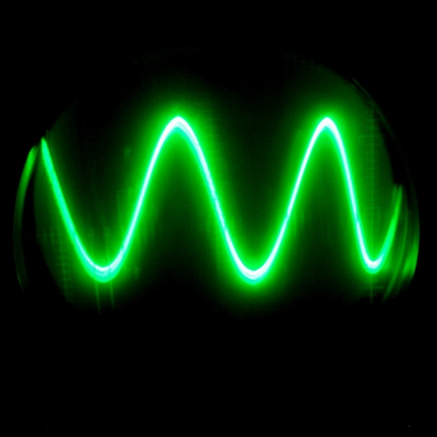
Round 4: Punny Math
Math Puns are the first sine of madness
The correct answer to each question is a punny one!

Slide 47
SAMPLE QUESTION: The ratio of the circumference of a honey crisp or golden delicious to its diameter could best be described as this.
Math Puns are the first sine of madness
ANSWER: Apple Pi

Slide 48
Round 4, Question 1
When asked why computers use only the digits 0 and 1, while we use the digits 0 through 9, the Mayans had different digits up to twenty, and the Babylonians had symbols up to sixty, singer Megan Trainer responded thusly.
Math Puns are the first sine of madness

Slide 49
Round 4, Question 1
When asked why computers use only the digits 0 and 1, while we use the digits 0 through 9, the Mayans had different digits up to twenty, and the Babylonians had symbols up to sixty, singer Megan Trainer responded thusly.
Ready?
Math Puns are the first sine of madness

Slide 50
Round 4, Question 1
When asked why computers use only the digits 0 and 1, while we use the digits 0 through 9, the Mayans had different digits up to twenty, and the Babylonians had symbols up to sixty, singer Megan Trainer responded thusly.
Because it’s all about that base
Math Puns are the first sine of madness

Slide 51
Round 4, Question 2
When asked why we have to pay taxes on every penny, the accountant responded that taxes were calculated this way.
Math Puns are the first sine of madness

Slide 52
Round 4, Question 2
When asked why we have to pay taxes on every penny, the accountant responded that taxes were calculated this way.
Ready?
Math Puns are the first sine of madness

Slide 53
Round 4, Question 2
When asked why we have to pay taxes on every penny, the accountant responded that taxes were calculated this way.
Per Cent
Math Puns are the first sine of madness

Slide 54
Round 4, Question 3
If Russia introduced a new form of currency that is worth four times as much as its current one, it could be called this.
Math Puns are the first sine of madness

Slide 55
Round 4, Question 3
If Russia introduced a new form of currency that is worth four times as much as its current one, it could be called this.
Ready?
Math Puns are the first sine of madness

Slide 56
Round 4, Question 3
If Russia introduced a new form of currency that is worth four times as much as its current one, it could be called this.
Quadruple
Math Puns are the first sine of madness

Slide 57
Round 4, Question 4
If you want to kiss your crush online, you could use this oval-like shape.
Math Puns are the first sine of madness

Slide 58
Round 4, Question 4
If you want to kiss your crush online, you could use this oval-like shape.
Ready?
Math Puns are the first sine of madness

Slide 59
Round 4, Question 4
If you want to kiss your crush online, you could use this oval-like shape.
ellipse
Math Puns are the first sine of madness

Slide 60
Round 5: MARVELous Math!
Determine what math concept was being referenced in the Marvel Cinematic Universe.

Slide 61
SAMPLE QUESTION: The stones Thanos is after are named after this mathematical concept, since when they are combined their power is limitless.
ANSWER: Infinity Stones

Slide 62
Round 5, Question 1
Containing the space stone, this McGuffin in both Captain America: The First Avenger and The Avengers is actually the name given to the 4-dimensional analog of the cube.

Slide 63
Round 5, Question 1
Containing the space stone, this McGuffin in both Captain America: The First Avenger and The Avengers is actually the name given to the 4-dimensional analog of the cube.
Ready?

Slide 64
Round 5, Question 1
Containing the space stone, this McGuffin in both Captain America: The First Avenger and The Avengers is actually the name given to the 4-dimensional analog of the cube.
ANSWER: Tesseract

Slide 65
Round 5, Question 2
In Avengers: Endgame, Tony Stark discovers time travel is possible by considering this one-sided object that you can make at home by taking a thin strip of paper and taping it to itself with a twist added.

Slide 66
Round 5, Question 2
In Avengers: Endgame, Tony Stark discovers time travel is possible by considering this one-sided object that you can make at home by taking a thin strip of paper and taping it to itself with a twist added.
Ready?

Slide 67
Round 5, Question 2
In Avengers: Endgame, Tony Stark discovers time travel is possible by considering this one-sided object that you can make at home by taking a thin strip of paper and taping it to itself with a twist added.
ANSWER: Mobius Strip

Slide 68
Round 5, Question 3
“Do you know what’s cooler than magic? Math.” This quip comes during a battle with Dr. Strange, where this friendly neighborhood super hero uses his knowledge of geometry to overcome the former master of the mystical arts.

Slide 69
Round 5, Question 3
“Do you know what’s cooler than magic? Math.” This quip comes during a battle with Dr. Strange, where this friendly neighborhood super hero uses his knowledge of geometry to overcome the former master of the mystical arts.
Ready?

Slide 70
Round 5, Question 3
“Do you know what’s cooler than magic? Math.” This quip comes during a battle with Dr. Strange, where this friendly neighborhood super hero uses his knowledge of geometry to overcome the former master of the mystical arts.
ANSWER: Spiderman

Slide 71
Round 5, Question 4
In the most recent film Wakanda Forever, Riri Williams has a note on her dorm room whiteboard about a mathematical conjecture which states that if you start with a positive integer, divide by 2 if even, multiply by 3 and add 1 if odd, and repeat this process long enough, eventually you will always get to one. What is this conjecture named?

Slide 72
Round 5, Question 4
In the most recent film “Wakanda Forever,” Riri Williams has a note on her dorm room whiteboard about a mathematical conjecture which states that if you start with a positive integer, divide by 2 if even, multiply by 3 and add 1 if odd, and repeat this process long enough, eventually you will always get to one. What is this conjecture named?
Ready?

Slide 73
Round 5, Question 4
In the most recent film “Wakanda Forever,” Riri Williams has a note on her dorm room whiteboard about a mathematical conjecture which states that if you start with a positive integer, divide by 2 if even, multiply by 3 and add 1 if odd, and repeat this process long enough, eventually you will always get to one. What is this conjecture named?
ANSWER: Collatz Conjecture

Slide 74
FINAL Round: Sing a Song of π
For each question, I will ask for some information about a song about π, then play a clip of the song, then give a hint. Find the correct answer to the original question.

Slide 75
SAMPLE QUESTION: Name the Band being Parodied

Slide 76
SAMPLE QUESTION: Name the Band being Parodied The 2000’s boy band being parodied had such hits as “Bye Bye Bye”, “It’s Gonna be Me,” and “Music of My Heart.” More recently, their former member Justin Timberlake has continued his success with the Trolls movies.
ANSWER: NSYNC

Slide 77
Round 6, Question 1
Name the TV Show:

Slide 78
Round 6, Question 1
Name the TV Show:
In this episode, Linda is so tired from baking pies that not only does she see the pies singing, she also finally sees what the boys are building in the backyard. Too bad for Candace that Linda doesn’t believe her own eyes.

Slide 79
Round 6, Question 1
Name the TV Show:
In this episode, Linda is so tired from baking pies that not only does she see the pies singing, she also finally sees what the boys are building in the backyard. Too bad for Candace that Linda doesn’t believe her own eyes.
Phineas and Ferb

Slide 80
Round 6, Question 2
Name the Singer:

Slide 81
Round 6, Question 2
Name the Singer:
Scoring her first hit in the UK in 1978, this singer released her song “Pi” in 2005, but it took until 2022 before she cracked the top 10 of the US charts, making it all the way to number 3 with her 1985 song “Running Up That Hill.”

Slide 82
Round 6, Question 2
Name the Singer:
Scoring her first hit in the UK in 1978, this singer released her song “Pi” in 2005, but it took until 2022 before she cracked the top 10 of the US charts, making it all the way to number 3 with her 1985 song “Running Up That Hill.”
Kate Bush

Slide 83
Round 6, Question 3
Name the Movie:

Slide 84
Round 6, Question 3
Name the Movie:
In this movie, June sings this song on her way to Math Camp, but when she misinterprets a note from her father, it leads her away from the bus and into a run-down theme park from her wonderful childhood imagination.

Slide 85
Round 6, Question 3
Name the Movie:
In this movie, June sings this song on her way to Math Camp, but when she misinterprets a note from her father, it leads her away from the bus and into a run-down theme park from her wonderful childhood imagination.
Wonder Park

Slide 86
Round 6, Question 4
Name the Singer:

Slide 87
Round 6, Question 4
Name the Singer:
Beginning her career as a child actress on The Wonder Years, she earned her BS in Mathematics from UCLA, has an Erdös number of 4, and has written several books encouraging adolescents to study math, including Math Doesn’t Suck, Kiss My Math, and Hot X.

Slide 88
Round 6, Question 4
Name the Singer:
Beginning her career as a child actress on The Wonder Years, she earned her BS in Mathematics from UCLA, has an Erdös number of 4, and has written several books encouraging adolescents to study math, including Math Doesn’t Suck, Kiss My Math, and Hot X.
Danica McKellar

Slide 89
Thanks For Playing!!!
±
∑
∂
∞
∫
÷
MATH BOWL
At SIMIODE EXPO
Math Puns are the first sine of madness

Slide 90
Pictures All Used Under Creative Commons License
"Spring deja vu" by Valeri Pizhanski is licensed under CC BY-SA 2.0.
PI Music by https://www.craiyon.com/ with the prompt “the math symbol pi standing tall in the center surrounded by musical notes implying that a fanciful song dedicated to pi is being played as background music in appreciation of the mathematical concept”
""green sine" by bdu is licensed under CC BY-NC-SA 2.0
Photo by Erik Mclean: https://www.pexels.com/photo/comic-books-on-the-table-7809122/
Man Looking through documents at a workplace by Michael Burrows https://www.pexels.com/photo/man-looking-through-documents-at-workplace-7129713/
Dreamy ethnic businessman thinking about project by Michael Burows https://www.pexels.com/photo/dreamy-ethnic-businessman-thinking-about-project-7129700/

