Slide 1
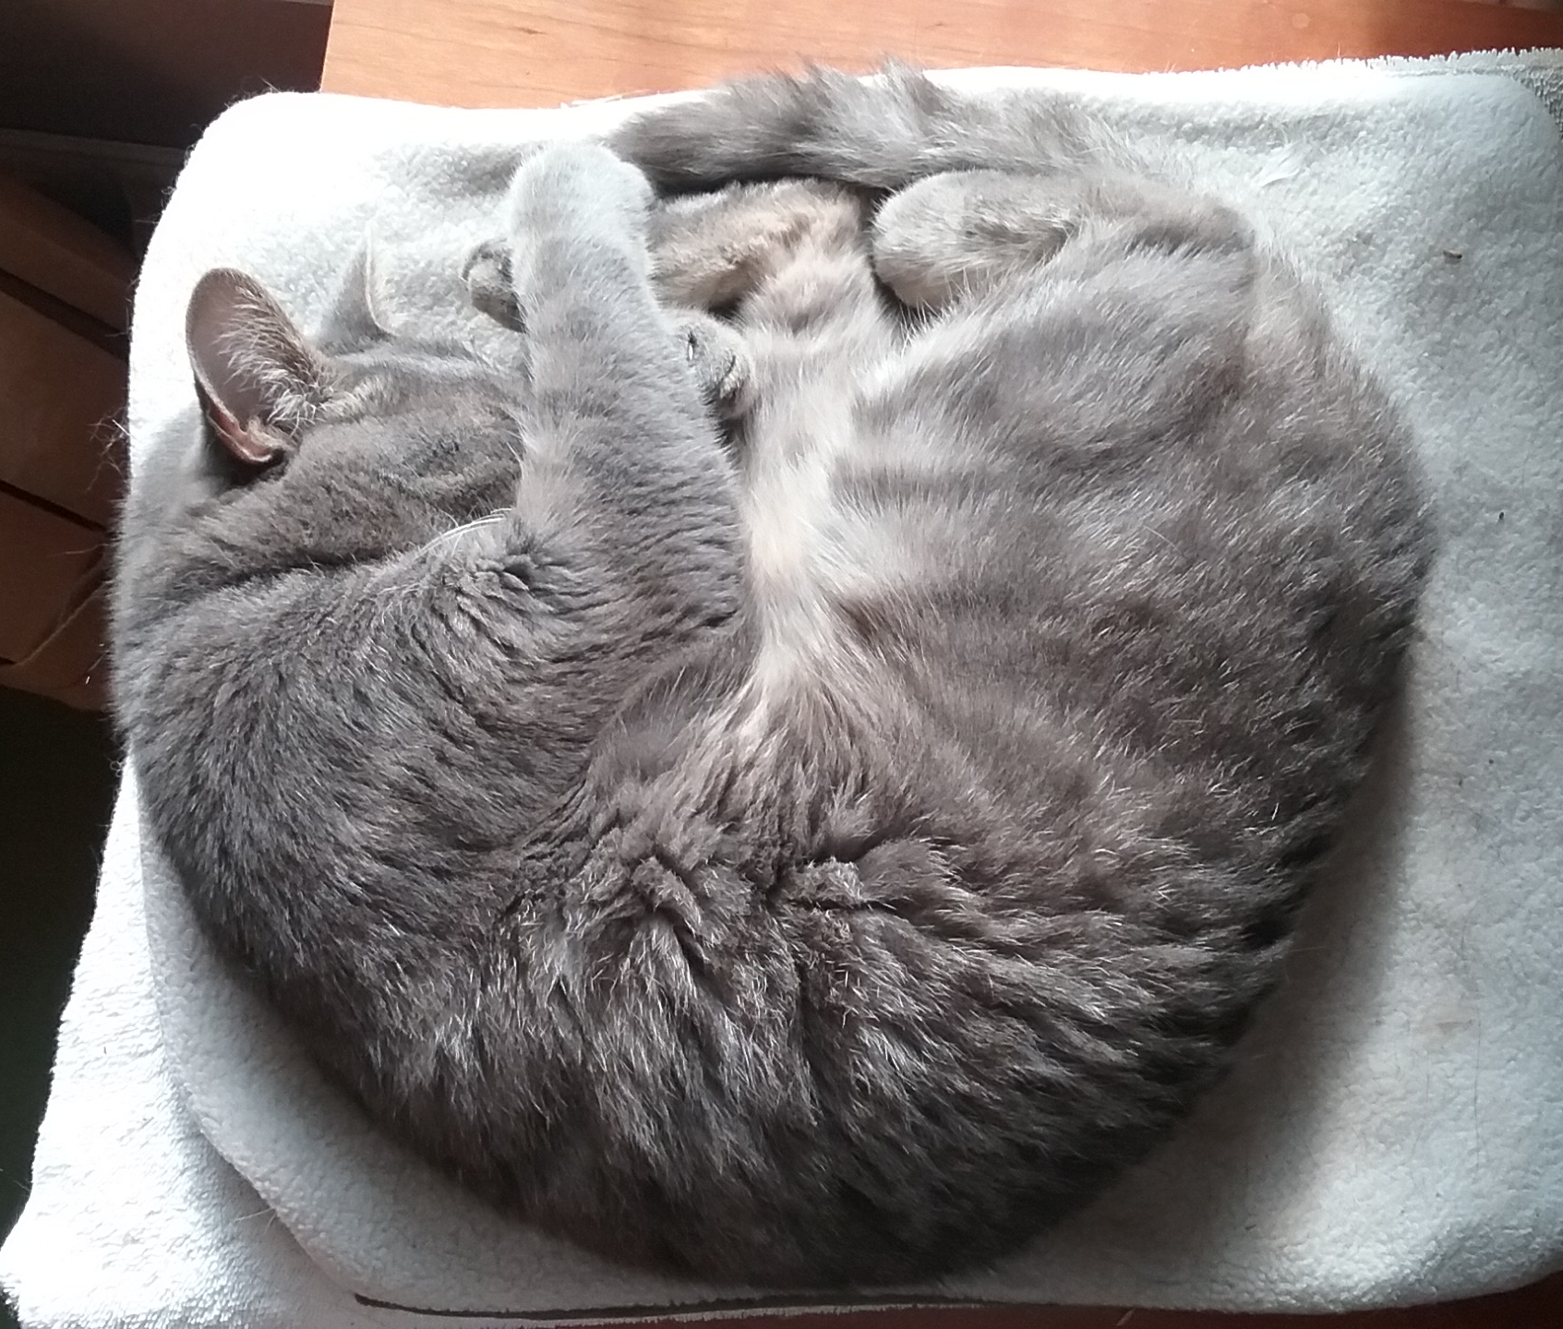
Cats teach stats:
I came for the cat, I stayed for the stats
Suann Yang
Jenny Hazlehurst
Darcy Taniguchi
William Plumer Jacobs
Intended learning outcomes:
Reduce anxiety around stats
Collect data
Calculating derived variables
Draw/interpret graphs
Test an adorable hypothesis using stats
Interpret results of stats
1
of 10

Slide 2
Module using 5E format
Observe video
Engage
Explore
Explain
Elaborate
Evaluate
Ask questions about video
Collect data
Graph with Shiny app
Interpret results
2
of 10

Slide 3
Count how many times WPJ boops the ball with his right vs his left paw
UDL version: work in pairs, add sound effects
Our question:
Is WPJ right or left pawed?
3
of 10

Slide 4
Count how many times WPJ boops the ball with his right vs his left paw
UDL version: work in pairs, add sound effects
Our question:
Is WPJ right or left pawed?
4
of 10

Slide 5
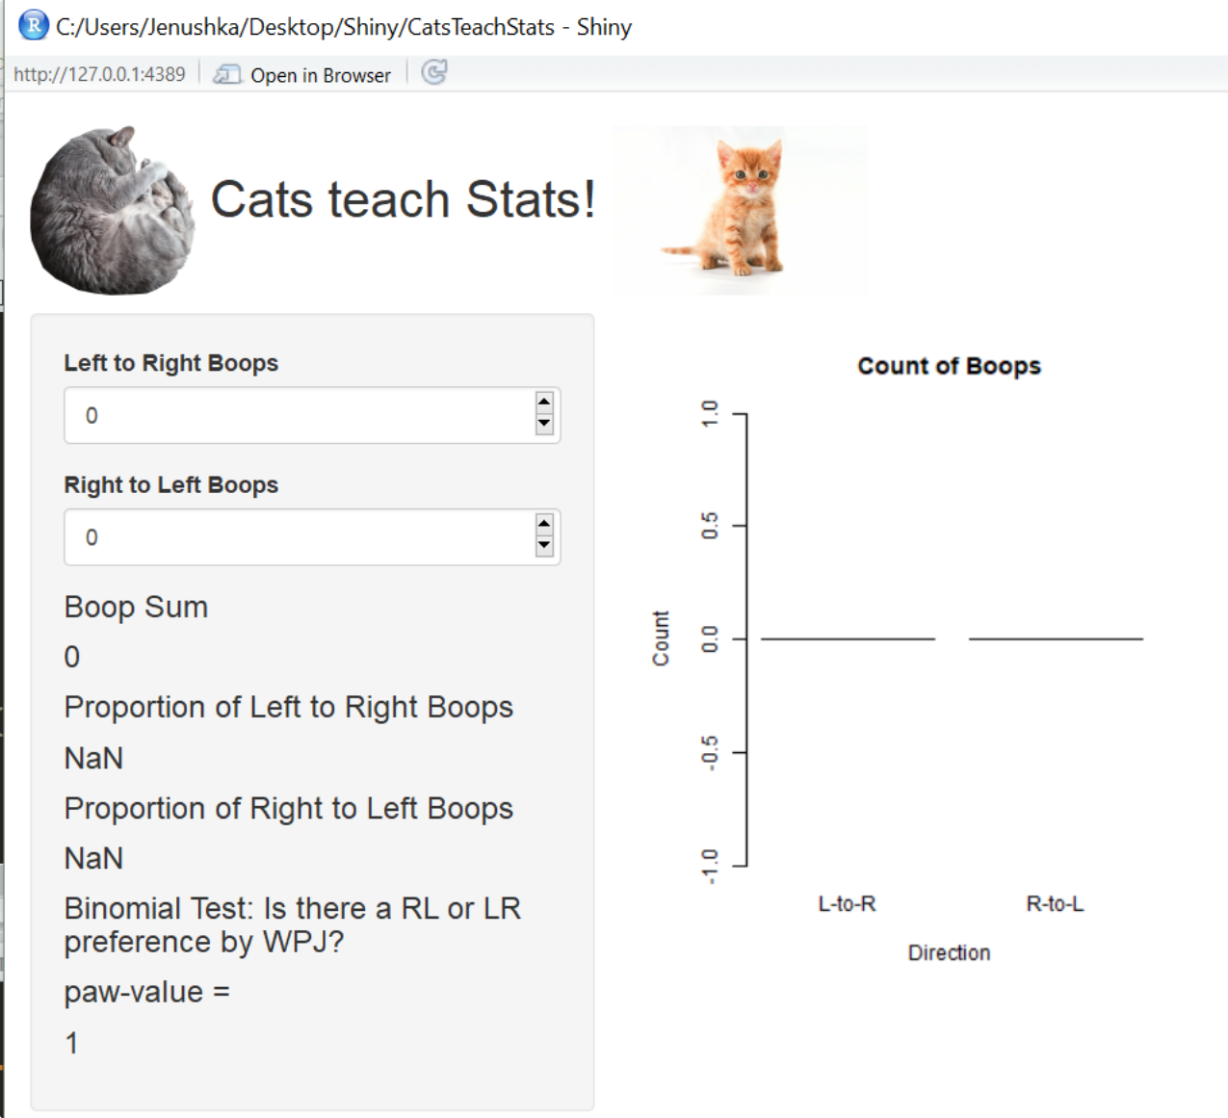
Our question:
Is WPJ right or left pawed?
5
of 10

Slide 6
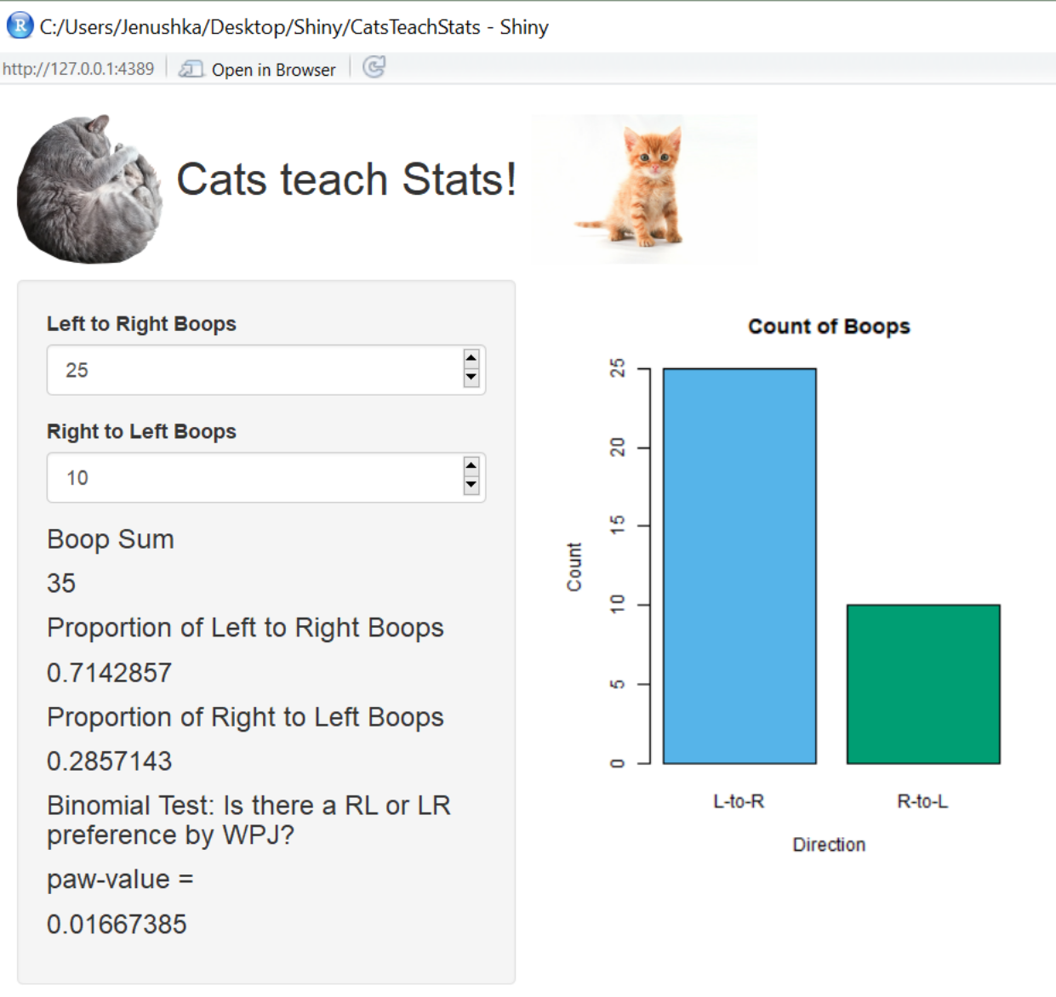
Our question:
Is WPJ right or left pawed?
6
of 10

Slide 7
Create Swirl lessons
Calculate derived variables (e.g., boops per minute)
Drawing a graph in R
Analyze/interpret graphs
Test hypotheses using quantitative stats
7
of 10

Slide 8
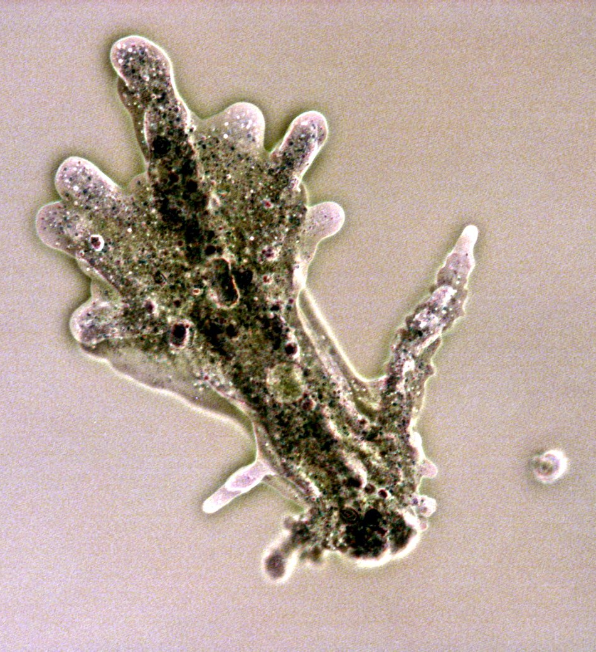
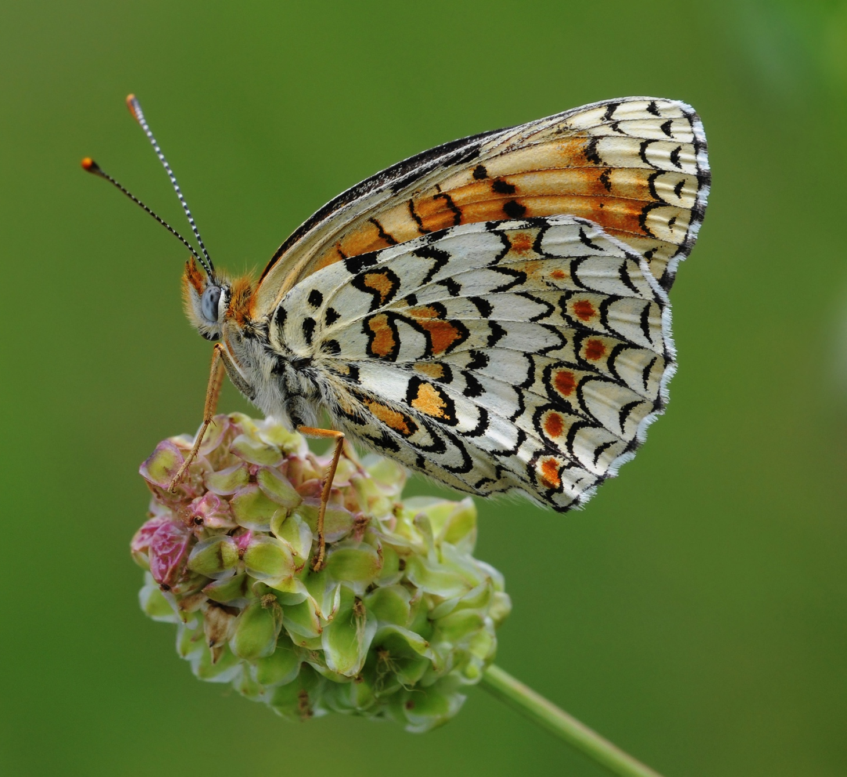
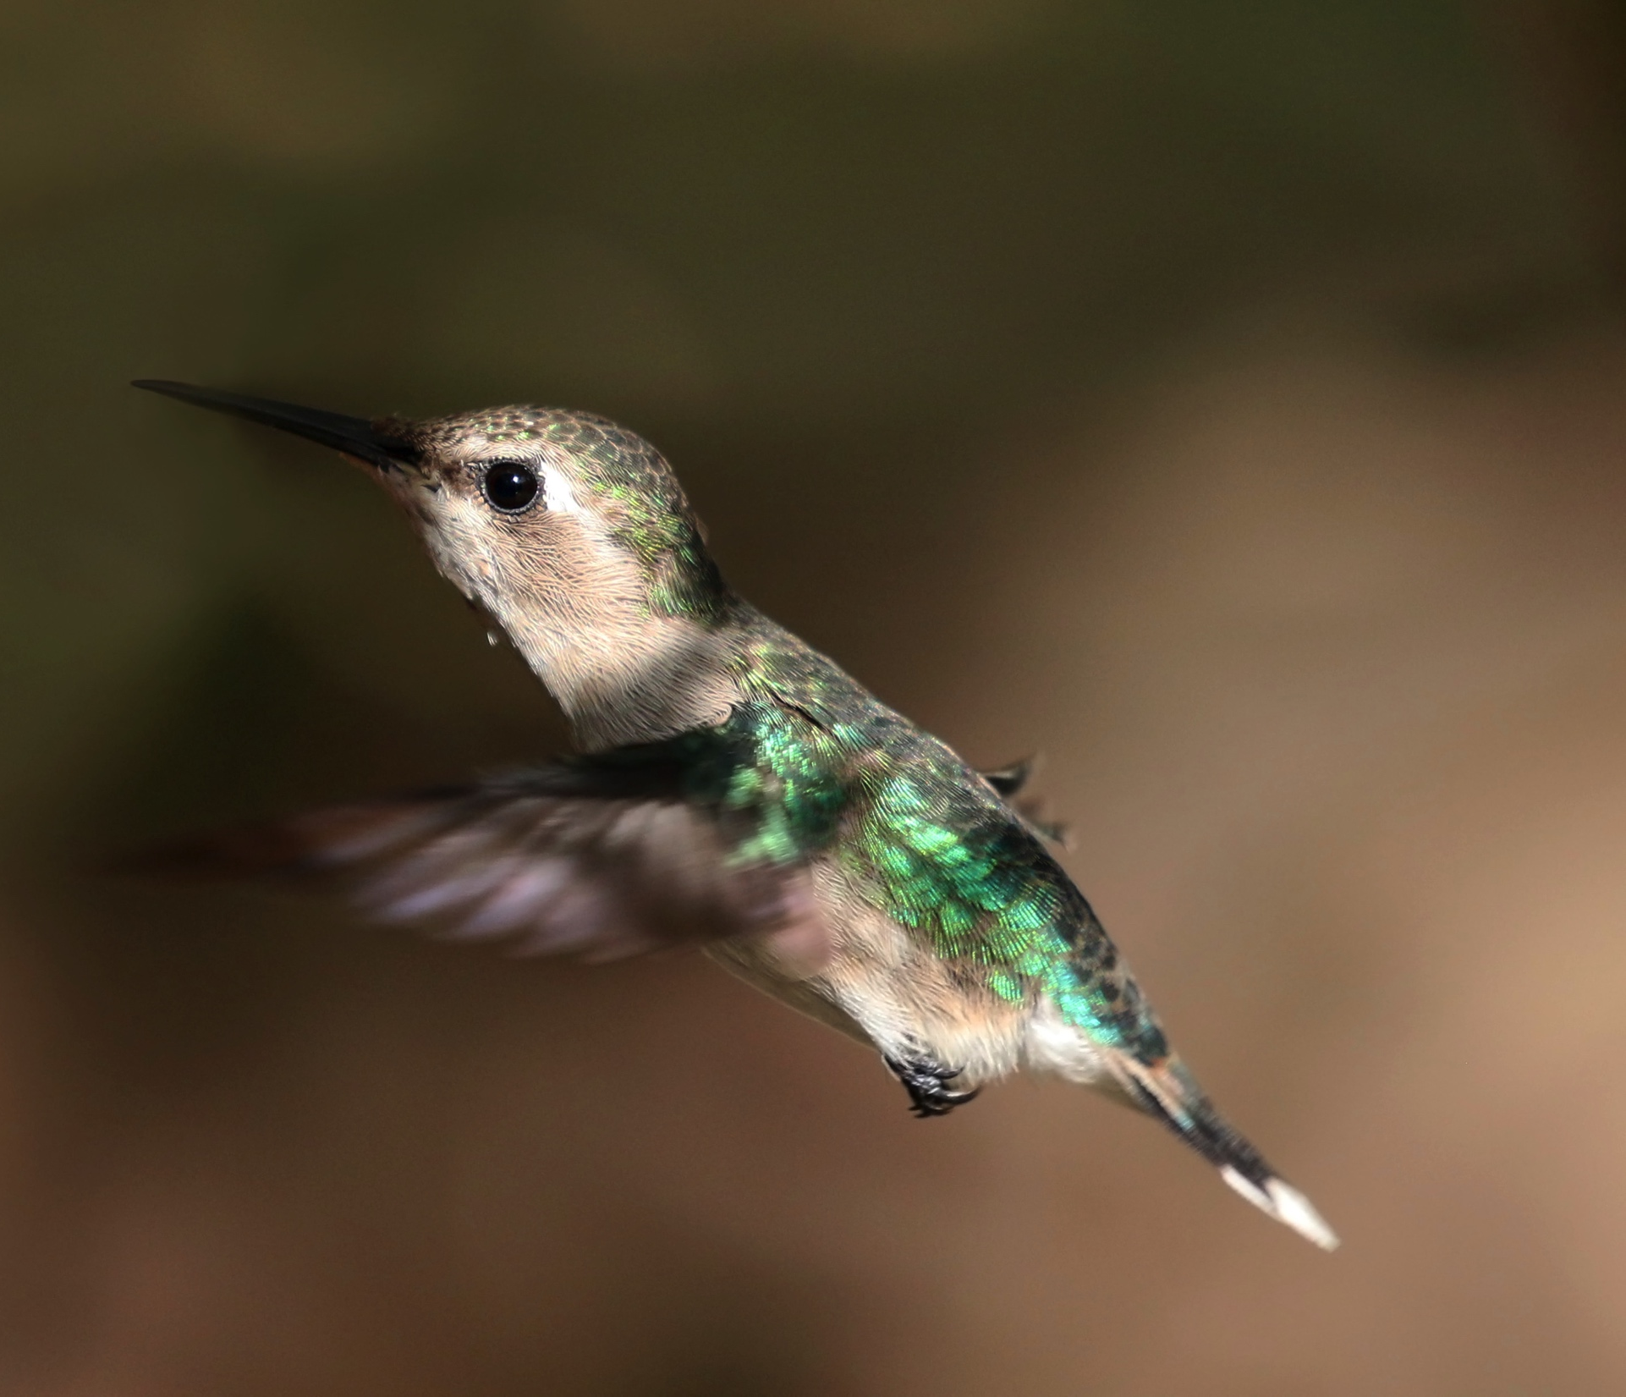
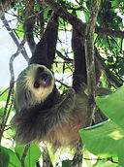
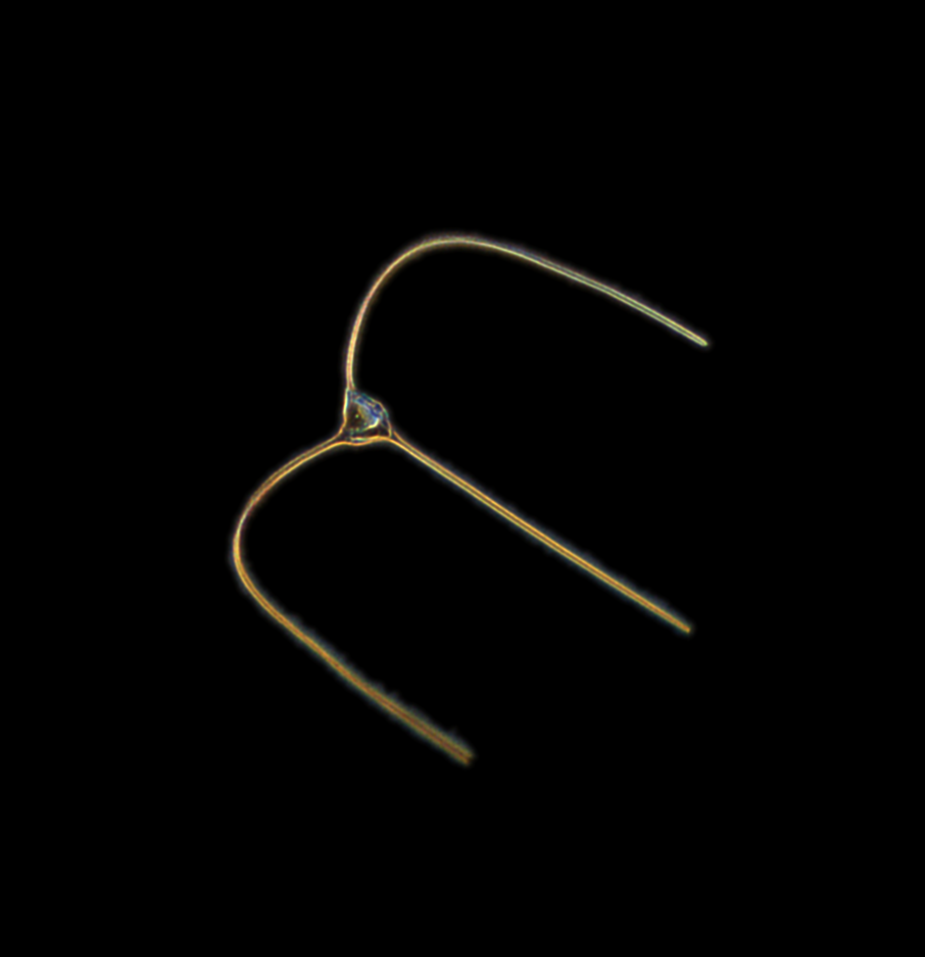
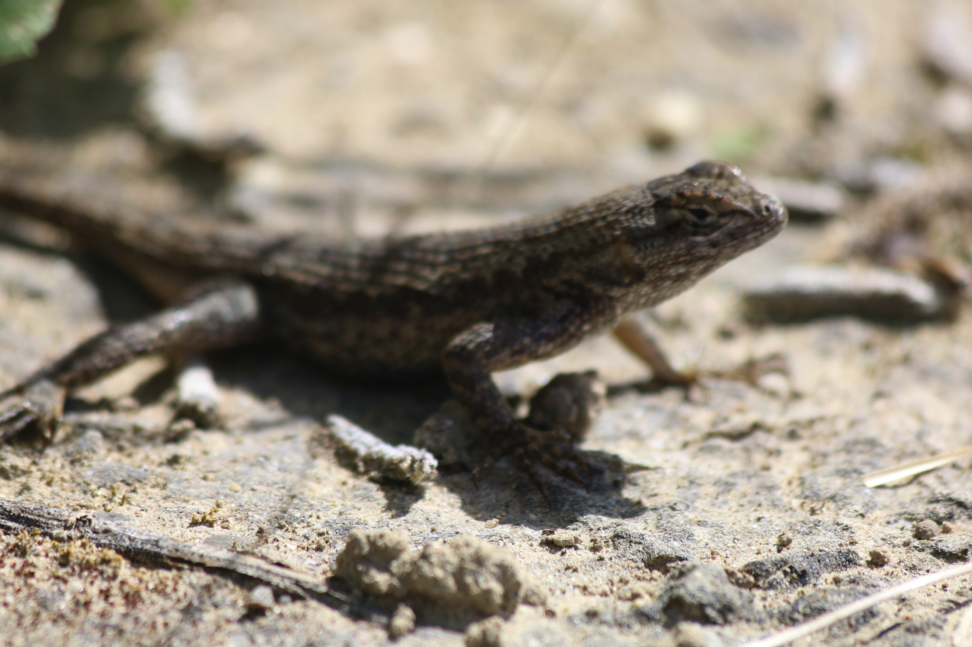
Allow students to use any appropriate cute organismal video
By Charles J Sharp - Own work, from Sharp Photography, sharpphotography, CC BY-SA 4.0,
By Zeynel Cebeci - Own work, CC BY-SA 4.0,
By Cymothoa exigua - Own work, CC BY-SA 3.0,
By Pacific Southwest Region USFWS from Sacramento, US - Western fence lizard, Public
By derivative work: Stevenj (talk)Original photo by Leyo. (Two-toed sloth Costa Rica.jpg) [CC BY 2.5 (https://creativecommons.org/licenses/by/2.5) or GFDL
spc.ucsd.edu
8
of 10

Slide 9
Wicked problems
Reduce math anxiety
Repurpose open source data
Translate math and science with the new language of gifs
Create for universal engagement
9
of 10

Slide 10
Thanks!
10
of 10

Slide 11
Thanks!
11
of 10

