Slide 1



Big Picture: Problem-Based Overhaul
OPPORTUNITY
LIFESTYLE
PEOPLE
who are
VALUABLE
to other
PEOPLE
question
design
solve
influence
create
lead
heal
YeaH PBL!!!!!
WHY?
1
of 10
Notes:
Background
We are doing a complete PBL Overhaul
WHY?
(Why do students come?)
Opportunity
People (who are) Valuable (to other) people
(Valuable People can do these things)
question, design, solve, influence, create, lead, heal
Deliberate Practice & Feedback
Years
No shortcuts
PBL

Slide 2
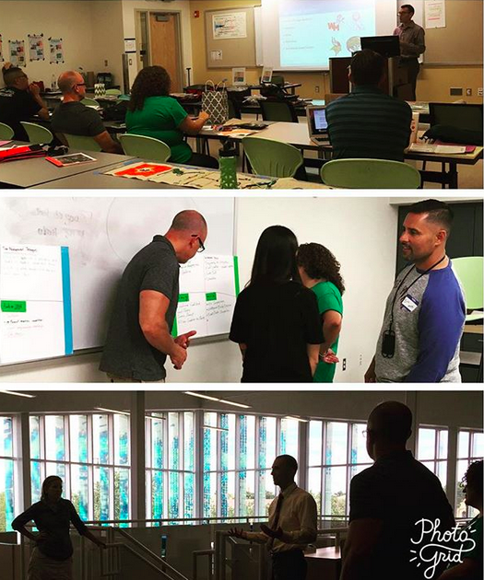


2
of 10
Notes:
In PBL students engage real ill defined Population
First year students, biology majors
~ 750 - 800 students across 2 sections
Course Structure
2 courses in sequence
Lecture hall 2/week for 75 minutes (~400 students / section)
Recitation 1/week for 50 minutes (upto 96 students per section
Pedagogy
Problem-based learning
Assessment plan
Cases throughout the semester
Application of core models
Group work
Formative and summative

Slide 3

Wk | Core Models
1 | Homeostasis (organismal level)
 | Mass & Energy balance
 | Evolution → Natural selection
 | Niche
 | Population growth
 | Interspecies interactions
 | Food webs & trophic levels
15 | Nutrient cycles
Final | End case
Core Skills
Quantitative reasoning
Experimental design
Data analysis & evaluation
Models/Modeling
Critical thinking & problem solving
Information literacy
Self-directed learning & Self-management
Teamwork & communication
Cultural intelligence & sensitivity
Comprehension of core models
Application, analysis, & synthesis of core models
3
of 10
Notes:
Learning goals
Conceptual
Apply knowledge of food webs, trophic levels, & bioaccumulation to critically think through a case study to solve a novel problem (near transfer)
Experimental design and quantitative skills
Analyze and interpret data
Construct and test hypotheses
Construct visual representations of data
Synthesize evidence to draw conclusions and refine hypotheses as needed
Interpersonal skills
Work in teams to solve a problem
Review the work of peers and provide meaningful feedback
Communicate information to a variety of audiences
Information literacy
Define a problem and identify what one knows and needs to know
Search for and evaluate scientific literature
Synthesize literature to construct an argument
Assessment product
Produce a technical report to the Arizona Department of Health detailing the initial observation and findings regarding the source and mechanism behind a recent cluster of cases where patients are presenting with acute CNS pathology due to aldrin poisoning.
Produce a 300 word speech to a local town hall meeting (with greeting and closing) detailing the source and mechanism behind a recent cluster of cases where patients are presenting with acute CNS pathology due to aldrin poisoning.
Assessment product
Produce a technical report to the Arizona Department of Health detailing the initial observation and findings regarding the source and mechanism behind a recent cluster of cases where patients are presenting with acute CNS pathology due to aldrin poisoning.
Produce a 300 word speech to a local town hall meeting (with greeting and closing) detailing the source and mechanism behind a recent cluster of cases where patients are presenting with acute CNS pathology due to aldrin poisoning.

Slide 4
End Case LEARNING GOALS
Conceptual
Experimental Design & Interpretation
Information Literacy
Interpersonal Skills
4
of 10
Notes:
Learning goals
Conceptual
Apply knowledge of food webs, trophic levels, & bioaccumulation to critically think through a case study to solve a novel problem (near transfer)
Experimental design and quantitative skills
Analyze and interpret data
Construct and test hypotheses
Construct visual representations of data
Synthesize evidence to draw conclusions and refine hypotheses as needed
Interpersonal skills
Work in teams to solve a problem
Review the work of peers and provide meaningful feedback
Communicate information to a variety of audiences
Information literacy
Define a problem and identify what one knows and needs to know
Search for and evaluate scientific literature
Synthesize literature to construct an argument
Assessment product
Produce a technical report to the Arizona Department of Health detailing the initial observation and findings regarding the source and mechanism behind a recent cluster of cases where patients are presenting with acute CNS pathology due to aldrin poisoning.
Produce a 300 word speech to a local town hall meeting (with greeting and closing) detailing the source and mechanism behind a recent cluster of cases where patients are presenting with acute CNS pathology due to aldrin poisoning.
Assessment product
Produce a technical report to the Arizona Department of Health detailing the initial observation and findings regarding the source and mechanism behind a recent cluster of cases where patients are presenting with acute CNS pathology due to aldrin poisoning.
Produce a 300 word speech to a local town hall meeting (with greeting and closing) detailing the source and mechanism behind a recent cluster of cases where patients are presenting with acute CNS pathology due to aldrin poisoning.

Slide 5
SCENARIO: Potential CNS Disorder Cluster
linked to Aldrin insecticide
5
of 10
Notes:
A doctor working at a local clinic in downtown Phoenix, Arizona, reached out to you after noticing an unusually high number of patients, often multiple members of the same family, showing up with symptoms associated with acute central nervous system pathologies (including seizures, headaches, dizziness, uncontrolled muscle movements, etc.). Ultimately, they concluded that these patients had been exposed to a pesticide called Dieldrin. They thought this was unusual since the compound has been banned for agricultural use since the 1970s and stopped being used to treat termite infestations in 1987.
Given the unusual nature of the case and cluster of cases showing up in such a short period of time, your friend was obligated to submit a report to the Arizona Department of Health Services. The report required additional information about how these patients potentially got exposed to this compound. Being an epidemiologist whose primary job it was to determine the distribution of outbreaks such as this and investigate the cause of those outbreaks, you took up the case.

Slide 6
SCENARIO:
Potential case cluster or hotspot(s) of acute CNS symptoms connected with Aldrin exposure.
Students take on role of epidemiologists.
Step | Problem | Resources Supplied | Products
1 | What is the epidemiology of CNS disorder hotspot? Determine: -Distribution of cases -Site of contamination -Vector -Mechanism | De-identified: -Case histories -Incidence data from other regional clinics -Incidence maps | Teams will write: - Hypothesis - Justification - Alt hypotheses - Explanation of mechanisms with citations - e.g. bioaccumulation
6
of 10
Notes:
FOR JB: Given this situation, students will work to understand the how this situation occurred. To get them started, they will be given de-identified case histories, incidence data and maps. Each group will be required to come up with a hypothesis and justification for it, and using what they have learned during the semester, possible mechanisms.

Slide 7
SCENARIO:
Potential case cluster or hotspot(s) of acute CNS symptoms connected with Aldrin exposure.
Students take on role of epidemiologists.
Step | Problem | Resources Supplied | Products
2 | Design Experiment to Test Hypothesis - ID Source, vector - Eliminate Alt hypotheses | Information & Limitations: -tests that can be run -equipment and personnel available -budget and time constraints | Teams will produce: - Experimental design - Graphs of data that would indicate support, refute or be inconclusive towards the hypothesis
7
of 10

Slide 8
SCENARIO:
Potential case cluster or hotspot(s) of acute CNS symptoms connected with Aldrin exposure.
Students take on role of epidemiologists.
Step | Problem | Resources Supplied | Products
3 | Results Interpretation & Conclusion -Which hypotheses are supported/not and why? -Alternative hypotheses as needed Dissemination of findings -Communicate findings in summary reports to 2 audiences | Data regarding: -Water quality analysis -Soil quality analysis -Food sources -Household interviews Formatting: Appropriate format for submitting technical report | Teams will write: -Conclusion indicating which hypotheses are supported or not, justifying with data -Alternative hypotheses as needed Teams will produce summary of findings for: -Tech Report for Az Dpt. of Health Services -200-300 word statement for local town hall meeting
8
of 10
Notes:
The final part of this PBL will involve reaching conclusions about the case. With information concerning water and soil analysis, and household activities including food consumed provided, students will identify the vector and source of the contamination. Does the evidence agree or disagree with their hypothesis? Finally, groups will prepare two reports about this incident. One will be a technical report for the AZ Department of Health. The second will be a two minute oral statement of the incident suitable for a town hall or city council meeting.

Slide 9
SCENARIO:
Potential case cluster or hotspot(s) of acute CNS symptoms connected with Aldrin exposure.
Students take on role of epidemiologists.
Step | Problem | Products
1 | What is the epidemiology of CNS disorder hotspot? | Teams will write: - Hypothesis - Justification - Alt hypotheses - Explanation of mechanisms with citations - e.g. bioaccumulation
2 | Design Experiment to Test Hypothesis | Teams will produce: - Experimental design Graphs of data that would indicate support, refute or be inconclusive towards the hypothesis
3 | Results Interpretation & Conclusion Dissemination of findings | Teams will write: -Conclusion indicating which hypotheses are supported or not, justifying with data -Alternative hypotheses as needed Teams will produce summary of findings for: -Tech Report for Az Dpt. of Health Services -200-300 word statement for local town hall meeting
Conceptual
Experimental
Design & Interpretation
Information Literacy
Interpersonal Skills
9
of 10

Slide 10
OPPORTUNITY
question design solve influence create lead heal
10
of 10
Notes:
To ensure that this day means we have delivered on our promise, and that our students can look forward to great opportunity
We must ensure the world

Slide 11
OPPORTUNITY
YeaH PBL!!!!!

