Slide 1
Science Case Network presents
Writing Cases for Problem Based Learning
Kate O’Toole and Patricia Marsteller
RCN-UBE Project #1062049

Slide 2
This too can be YOUR class

Slide 3
Where to Start: Writing New Cases
Know your audience
What do students know?
What Interests them?
Know your curriculum
What concepts are hard to teach?
What concepts can you connect to real world issues?
Define your objectives
What do you want them to know and be able to do?
What “Learning Issues” do you want students to investigate?

Slide 4
What concept might work well with PBL or Cases?
Think about the syllabus for one of the courses you will be teaching (or have taught).
Pay particular attention to the course and unit objectives. Discuss with your partner which concepts are easy to teach (and how you know students learned them). Discuss which are hard and why? List at least two easy and two hard ones below.
Take 5-10 minutes for this exercise. We will share observations from each group..
Report

Slide 5
Which concepts?
“We can’t make the whole course PBL. My department chair would have heart failure. I wonder what kinds of topics and concepts we should use it for? ”, Graham stated.
“Let’s start with something easy that we already have a lab for so it can be investigative”, said Danielle.
Ah, come on. We probably should pick one of the hardest things for students to learn. What we really want to do is incorporate more Quantitative methods, stats, equations…Or something where they have lots of misconceptions. That’s the stuff where they really get turned off and disengaged, countered Christine. Let’s all brainstorm a list of hard concepts.”

Slide 6
TPS – Part 1
THINK and record: Two topics/concepts/standards to teach using PBL
Consider:
What is boring?
What is difficult to teach?
What are students failing to understand?
PAIR: Share your topics and justification for selecting them

Slide 7
Topic choice
Choose one topic
Write down one big take home message

Slide 8
TPS – Part 2
THINK and record: real-world connections for each topic
Consider:
Examples of this topic in action
Household items, famous people/places, health concerns, food/cooking, natural disasters,
What is in the news?
PAIR: Share, discuss other ideas, give feedback

Slide 9
Write Objectives
Pick 1 of your topics
Write 2 behavioral learning objectives (consider how students will demonstrate their understanding)
Swap with a partner
Partner edits/clarifies the first 2 objectives
Partner adds 2 more objectives

Slide 10
Know your audienceting Cases
Knowledge/Abilities
Limits
Interests/Disinterests
Places, People, Activities, Names, Music, Fashion, TV/movies/magazines/websites
Mindset: https://www.beloit.edu/mindset/2019/

Slide 11
Choose scenario
Write one-two realistic settings, stories or scenarios
Alternatively, find a news story or a scientific article that can be the case focus
Now get into pairs….
Convince your partner that your scenarios are a good way to teach this

Slide 12
Drafting
Individually, or in a small group…
Draft a paragraph or two
Then first case review…
Find a new partner who hasn’t heard your idea
Read it aloud to them
They guess your primary objective…

Slide 13
Design Products
List characteristics of your students—developmental, preferred learning styles, interests, group dynamics, prior knowledge on problem topic, etc.
List specific curriculum outcomes your students will achieve through the Case or problem-based learning unit

Slide 14
What Will Students Do
Resolution of problem;
(How did we do?)
Presentation or formulation
of problem
Next stage of
the problem
Integrate new
Information;
Refine questions
Organize ideas and
prior knowledge
(What do we know?)
Reconvene, report
on research;
Pose questions (What do
we need to know?)
Research questions;
summarize;
analyze findings
Assign responsibility
for questions; discuss
resources

Slide 15
Pat’s Design Product 3
Provide copies of the documents or materials that will “hook” students into the relevance of the problem and introduce them to their role and situation. If your “hook” will include a person, video, role-play, etc., describe it clearly here.
Find a case, a PBL or a “clicker case that might work. See the handout for starting points.
Or Use a news story, an article, a picture an artifact
Describe how the hook will interest your students?

Slide 16
Sage Design Product 3
Construct the anticipated problem map/web, which represents the complexity of the problem your students will meet. (Note: You may use Inspiration® software if you wish, another program, or draw by hand)
Adapted from Sara Sage workshop

Slide 17
Assessment – Students
You can use these criteria to assess their products
their participation and contribution to
work in groups,
the kinds of issues they identify,
the questions they develop,
the investigations they propose,
where and how they locate resources,
how they conduct investigations, and
the presentations they make.

Slide 18
Assessment – Students
While students are working, consider these criteria:
· actively acquiring information about a
science topic within this problem space?
· re-organizing this information?
· using strategies to select resources beyond
text materials?
· using a problem-oriented approach? (Is there
a question for investigation?)
· collaborating with other individuals in
problem posing or problem solving?

Slide 19
Assessment – Students
While students are working, consider these criteria:
· choosing among alternative approaches to
solve problems?
· negotiating, arguing, or attempting to
convince others?
· generating graphs, tables, charts, or other
graphics?
· presenting conclusions?
· presenting evidence to support their conclusions?
· generating further questions as a result of this
activity?

Slide 20
Assessment products
Along the way assessments
Final authentic assessment
Rubrics
What criteria state your expectations for a successful performance? What evidence will demonstrate that students have learned? BE SURE the rubric aligns with your curriculum outcomes.

Slide 21
PBL Process
Facts What do you know from the case? | Questions What would you like to ask the characters to help you?
Hypotheses What’s the case about? | Learning Issues What do you need to look up or find out about?

Slide 22
Alternate boxchart
Facts/Data | Learning Issues | Strategies

Slide 23
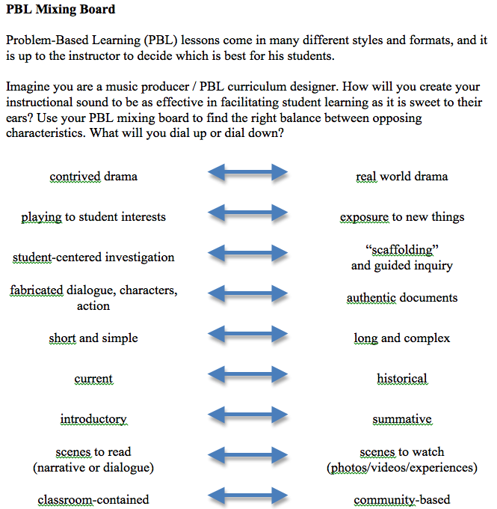

Slide 24
What are we waiting for?

