Slide 1
A visual guide to accessing NEON data
Please view included slide notes throughout the presentation for additional details
Updated 1 January 2019
Notes:
This guide walks viewers through how to access data through the NEON data portal and a few related resources for working with NEON data. The NEON data portal remains in dynamic development. This photographic guide will be regularly updated. If the data portal you are viewing does not match this guide, please check for an updated version.
The guide is laid out to be followed sequentially from starting on the NEONScience.org website to downloading data to your computer. After this sequence additional slides are provided that details on other pages or topics of interest to data users.

Slide 2
Discovering NEON Data
NEONScience.org
Data.NEONScience.org
Notes:
This section highlights key resources provided on neonscience.org and data.neonscience.org. You will want to familiarize yourself with both sites to better understand how NEON collects and provides data.

Slide 3
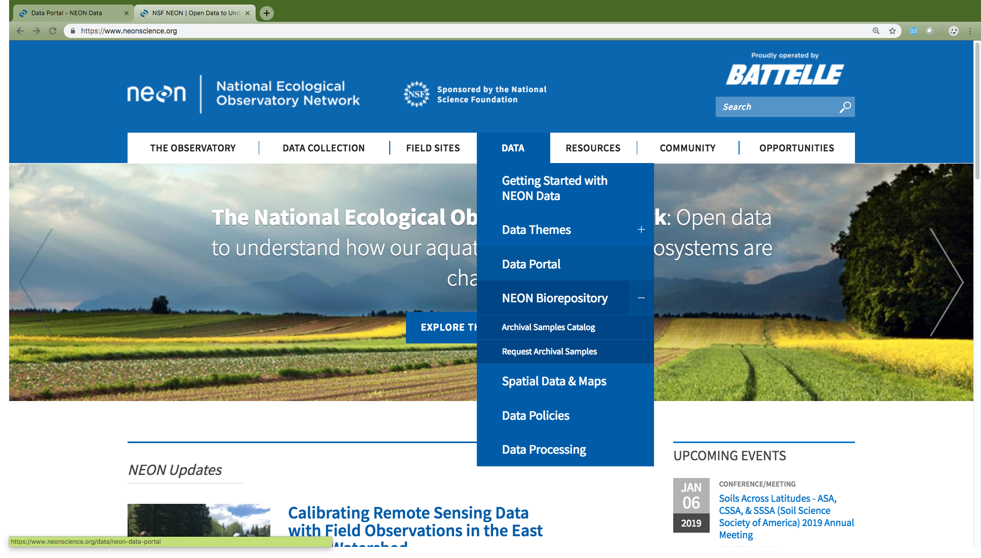
NEONScience.org
Overview of data collection
Field site maps
Information for researchers
Using NEON Infrastructure
Access to the NEON Data Portal
Notes:
We start the journey to downloading NEON data from the NEONScience.org homepage. The main NEON website, NEONScience.org, provides many resources for researchers and educators interested in NEON including direct access to the data portal.
Data Collection – introductory information to how NEON collects data. A good place to start to understand what types of data NEON collects or determine if the data NEON collects is what you want for your research or teaching.
Field Sites – The field site maps and list will help you gain familiarity with the sites. If you are interested in data from particular locations, identify the four letter codes for each site of interest, you will need these when selecting the data for these sites.
Data – Information on NEON data, samples & specimens, data policy, and more. Includes of the the other links to get to the data portal.

Slide 4
Data.neonscience.org
Explore and download data
Information on programmatic access to NEON data
API
Code packages
Access data product user guides, detailed protocols, and other important documents
News on product updates and versions
Notes:
The NEON data portal, at data.neonscience.org, is the place to explore and download NEON data products as well as find the detailed information about all NEON data products. We will go through many of these pages in more detail.

Slide 5
Explore & Download Data From Portal
Data Browser
Data Product Detail Pages
Notes:
In this section, we will go through steps to access and download NEON data.

Slide 6
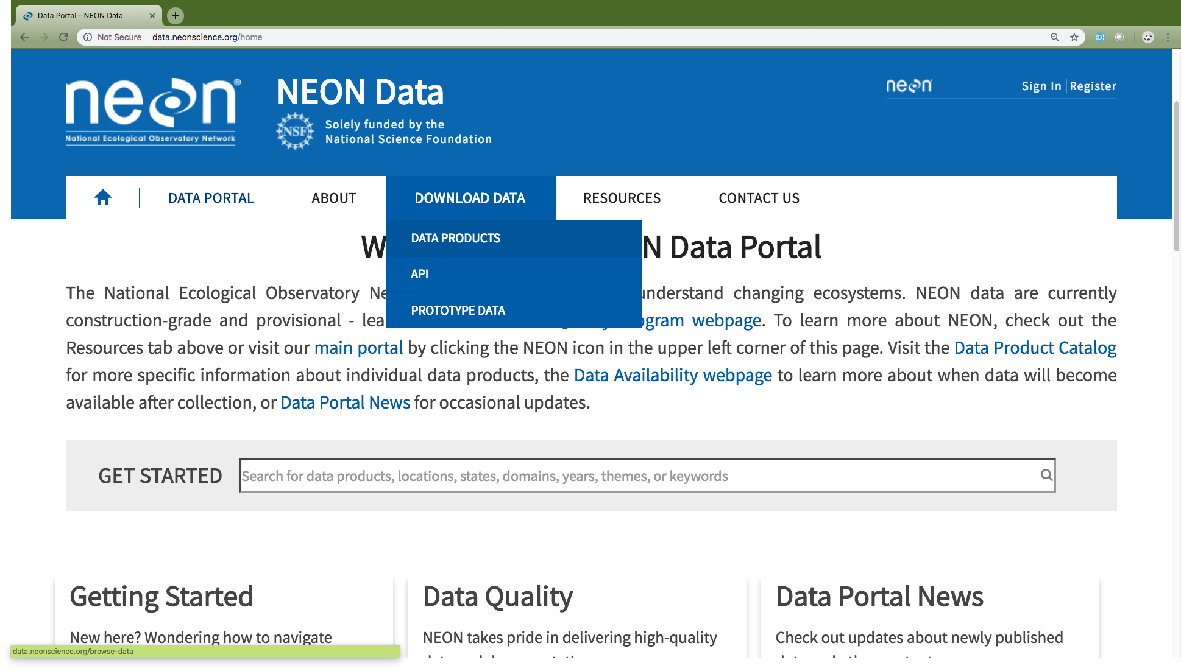
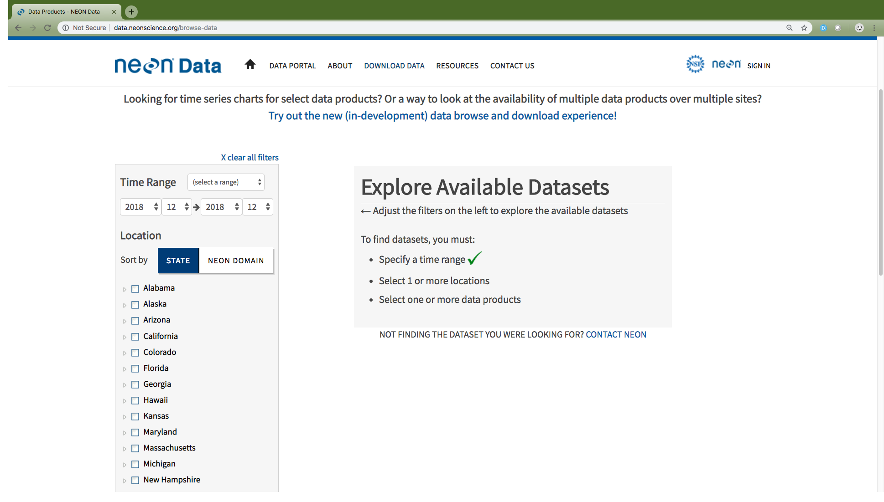
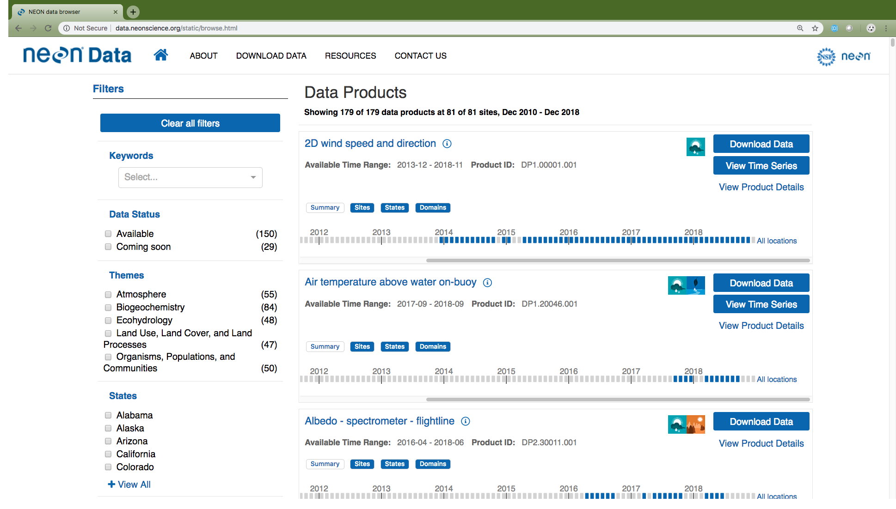
Browse data
Step 1
Step 2
Step 3
Notes:
We recommend that you use the “beta” data browser as shown in Step 3. This browser has improved functionality over the previous data browser (step 2 in the images above) and will become the sole browser in the near future. The direct URL for the Browse Data page is http://data.neonscience.org/static/browse.html.
(This slide contains animations to fully view each step)
Step 1: Start by selecting “Data Products” from the Download Data main navigation menu.
Step 2: Click the link in the middle of the page to get to the Data Browser.
Step 3: You are now on the data browser. Proceed to next slide.

Slide 7
Browse data: Filter to find data products of interest
Results of filtering on “carbon”
Remove all filters
Filter by keyword
Filter by category
Data status
Themes
States
Domains
Sites
Data teams
Notes:
To begin, choose keyword(s) or select from the available categories to filter to NEON data products of interest to you. Alternatively, you can scroll down through data products when there are no filters selected to view all of NEON’s data products.
When using the keyword search, if you don’t get the result you are interested in try a related word or shorter phrase. For example, if you are interested in small mammal data from live trapping, you’ll find that “trapping data” returns zero data products, while “small mammals” returns two data products (“Small mammal box trapping” and “Small mammal sequences DNA barcode”) and simply “mammals” returns three data products (the two previous plus “Rodent-borne pathogen status”).

Slide 8
Browse data: Key information
Associated data themes
Summary information
Move to next step to download data
Data product name
Data range for which data is currently available to download
Data product number
Data availability by month
Blue: currently available for download
Grey: not available for download
Go to data product page to get details & associated documents
Notes:
Each data product window provides a variety of useful information and links to other useful information.
Key among these are the data product name and data product number. Both are important for referring to your data and looking up the data in the future.
The information icon next to the data product name will display a short description of the data product. Alternatively, clicking on the data product name will give you the same information. If this is insufficient for your needs, you’ll want to select “View Product Details”.
View Product Details is a link that takes the user to the Product Detail Page (see page specific slide for details).
The Available Time Range and Availability bar icons are both related to what is available for download from the data portal at the current time. All data are distributed in per month packages therefore, each bar represents one calendar month. Blue month boxes mean that data are currently available for use. The grey boxes could mean that data were never collected and will never be available, data were collected but have not been processed but will be availability in the future, or that the specific months occur in the future (a full year shows up at a time).

Slide 9
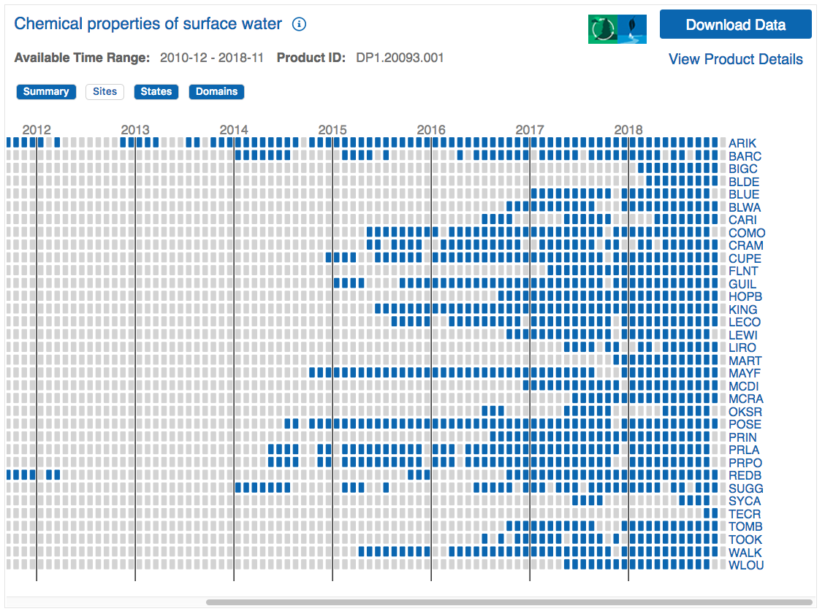
Browse data: View data availability
Notes:
You can view the availability of NEON data as an overall summary or by site, state, or domain. A given site, state, or domain will only appear if it is available for at least one month for that data product. If you are only interested in data from select locations, you can click on those locations here to select them for download or you can do that in the next step.
If you are interested in only specific locations, you will need to know the four letter code for these sites. These can easily be looked up on the field site map (https://www.neonscience.org/field-sites/field-sites-map) or list (https://www.neonscience.org/field-sites/field-sites-map/list).

Slide 10
Configure data download Step 1
Select Download Data when you are ready to configure a data download
Notes:
Select Download Data when ready to configure your data set to download. You can only configure and download one data product at a time on the data portal.
There are a few data products, primarily remote sensing, phenocam and genomics data, that cannot currently be downloaded from the beta browse data page. When you select “Download Data” for these data products, you will be reverted to the previous browse data page. For details on how to configure this data for download, see the slide “Configure AOP data for Download” or “Configure Data Hosted by Partner”.

Slide 11
Configure data download Step 2
1a. Select date range of interest
1b. Select area(s) of interest by clicking on appropriate line(s)
2. Select inclusion of documents
3. Select data type
4. Check file size
5. Click Download Data
Notes:
When you select “Download Data” on the data browser, a pop up window will appear where you will configure your data set. After selection your desired data range and locations you’ll have to make two choices, inclusion of documents and data type.
Include documents? This will provide PDFs of related documents (User Guides, Protocols, Algorithm Theoretical Basis Documents, etc) in the folder that you are downloading. We recommend you do this on the initial download of a data product so that you readily have this important information for use while using NEON data. All related documents can also be found on the Documents tab of each Data Product Details page (see slide for more details).
Basic vs Expanded Data Type? Basic data include an overall data flag for the overall quality of the data. The expanded data types have additional data flags regarding specific processing steps or data control analyses. For research purposes, you will likely want the expanded package. For educational or initial data exploratory, the basic package is likely sufficient.
Given the timeframe and types of data collected, NEON data product packages can quickly become very, very large. We recommend always checking the estimated download size BEFORE starting any download.

Slide 12
Use downloaded data: Structure
Uncompressed
Most NEON data products are delivered as compressed (zipped) .csv files.
Other formats include .hdf5 and .tif
Uncompress to view the contents
Data in compressed site by month files
For each site by month, there may be multiple related data tables per data product.
Uncompressed
Notes:
The data will download to your default download location (likely your Downloads folder).
Most NEON data products are delivered as compressed (zipped) .csv files. Other formats include .hdf5, .tif, and .kmz. These next few slides only pertain to the data products delivered compressed with data in .csv files. For all compressed files, view them by uncompressing.

Slide 13
Use downloaded data: Key files
Uncompressed
Included documentation (if selected)
User Guide, Protocol, etc.
Validation file
Contains the data processing rules
EML (.xml) file
Machine readable metadata file
Readme file
Important information on the download
Data table(s)
One or more related .csv files
Variables file
Lists which variables are found in which data table
Uncompressed
Notes:
Included documentation (if selected)
The User Guide, Protocol, etc. – Exact files vary by data product. All files can also be found on the Data Product Details page.
Information in the User Guide is specifically designed to help users work with NEON data.
Validation file
Contains the machine readable data processing rules –
EML (.xml) file
Machine readable metadata file. More about EML at NEON (http://data.neonscience.org/faq) and KNB (http://ecogrid.ecoinformatics.org/external//emlparser/docs/index.html).
Readme file
Important information on the data product and includes information on the specific download.
Data table(s)
One or more related .csv files
Variables file
Lists which variables are found in which data table. This can be very useful for figuring out how to link the related data tables.

Slide 14
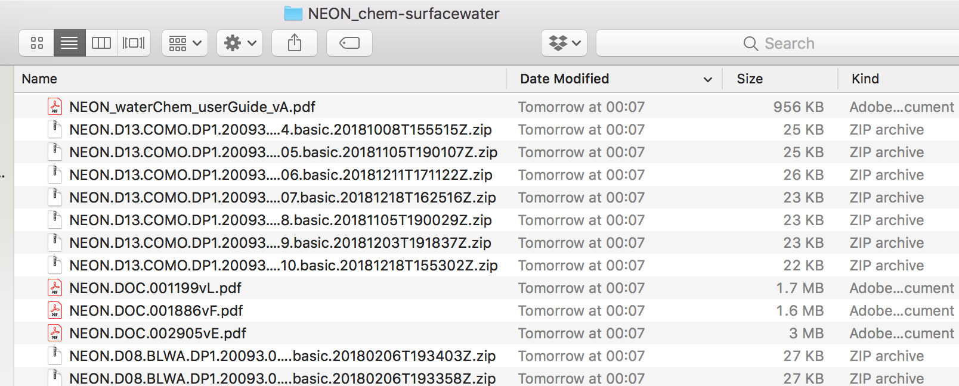
Use downloaded data: Stack data
Use neonUtilities R package to combine all site by month files.
Tools to help (see notes)
Super simple script for beginners
Using neonUtilites with Python
Data tutorial on neonUtilites
neonUtilities::stackByTable()
Notes:
When downloaded from the portal, data come in month by site files. It is nearly impossible to work with all these separate files. NEON provides the neonUtilities R package which contains the stackByTable function to combine the files so that you only have one of each type for all dates and sites.
Tools to help you use this tool:
Not an R user? No worries, we have a super simple script for beginners: https://www.neonscience.org/resources/code-resources (scroll down to Super Easy R Script to download)
Prefer to use Python and not R? Not a problem, follow these directions to use the R package functionality within Python: https://www.neonscience.org/neon-utilities-python.
Want to learn about the many tools that neonUtililities has to offer for working with NEON data? This data tutorial is for you:https://www.neonscience.org/neonDataStackR.
This concludes the sequential series of slides to explore, download and access NEON data.

Slide 15
Legacy browse data
Step 1
Step 2
Step 3
Select criteria
Notes:
(This slide contains animations to view each step)
The legacy browse data page is another method of searching for data. It is also the page that you currently need to use to access much of the Airborne Observation Platform data and data hosted by partner organizations (phenocam & genomic sequence data). Details on these are provided on the next few slides.
The direct URL for the legacy browse data page is http://data.neonscience.org/browse-data

Slide 16
Legacy browse data: Filter to find data products of interest
Remove all filters
Select date range
Filter by category
States
Domains
Sites (a subcategory of
state or domain)
Themes
Data product name (a
subcategory of theme)
Data product name
Data availability
Move to next step
Notes:
In order to browse data and configure your data set, you must first select your date range of interest (default is only the current month) and data product(s) or site(s). Individual data products are listed under the respective data themes on the left side bar. While you can view multiple data products in the search window, you can only configure and download them one at a time. The Configure Data Slide is similar to that for the Browse Data page. We show the details for AOP and partner hosted data on the next two slides.

Slide 17
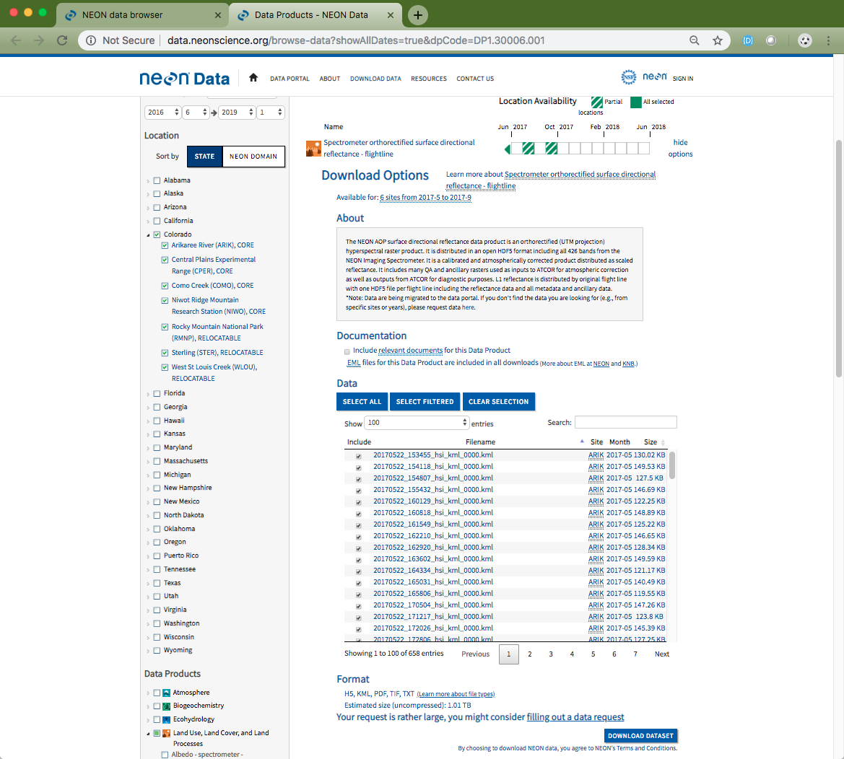
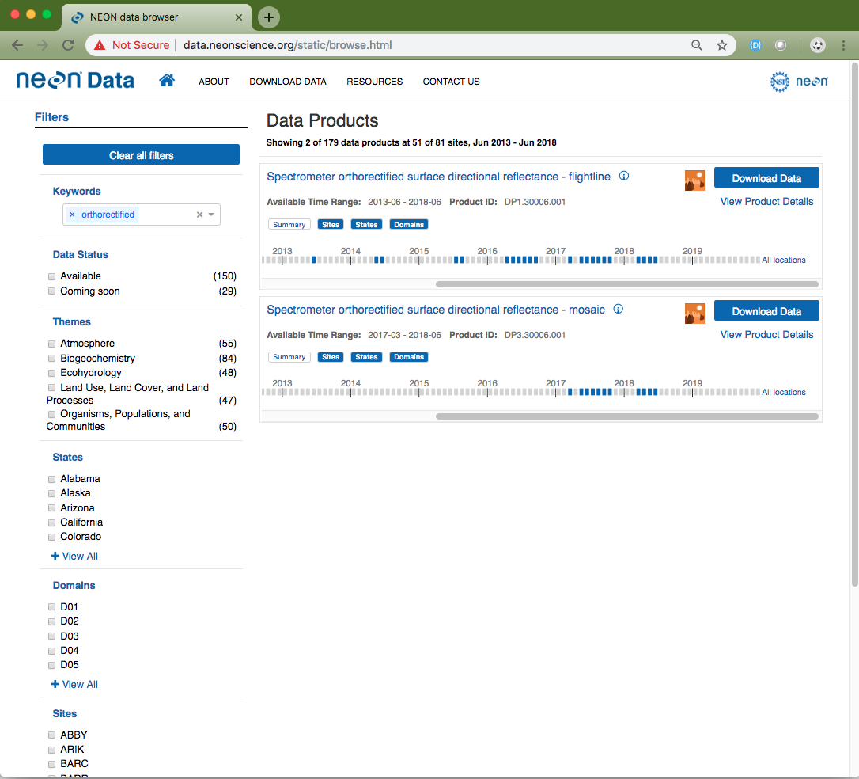
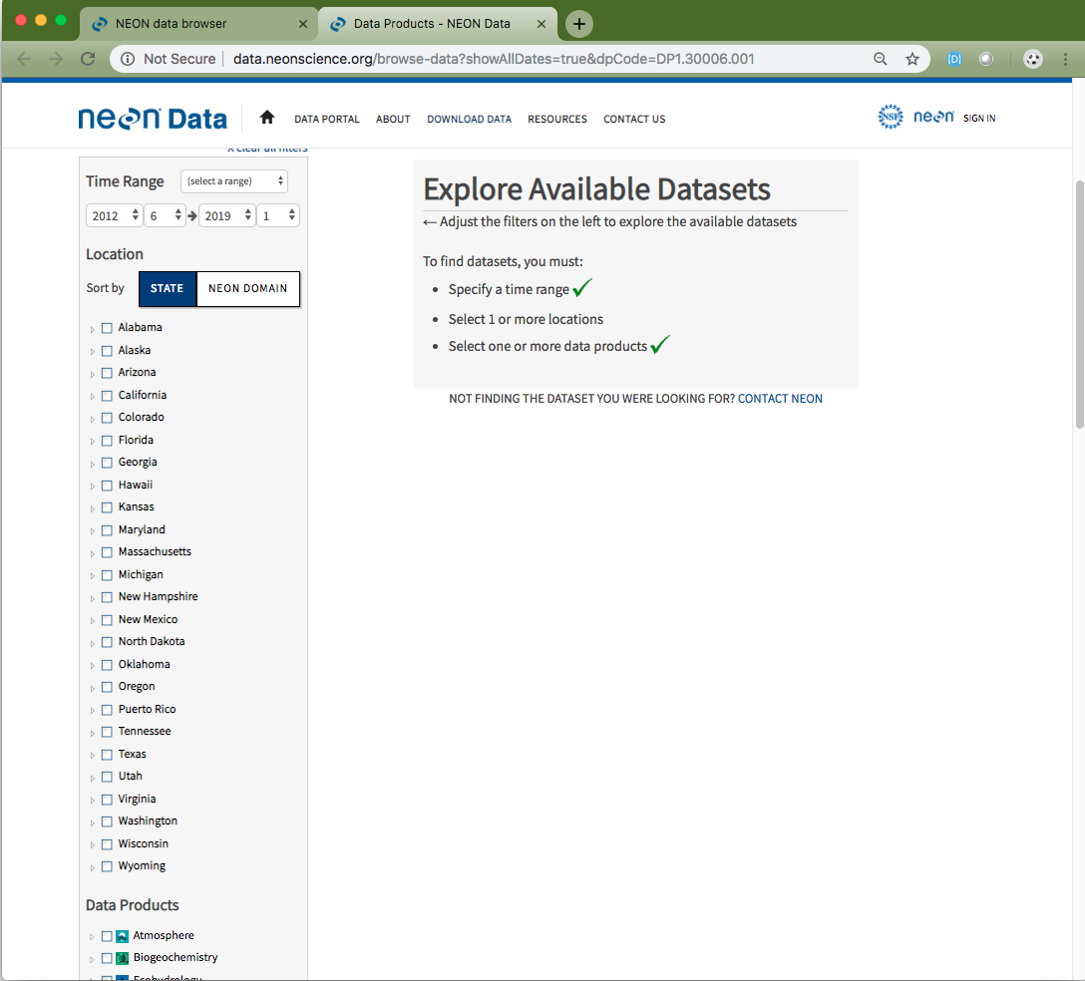
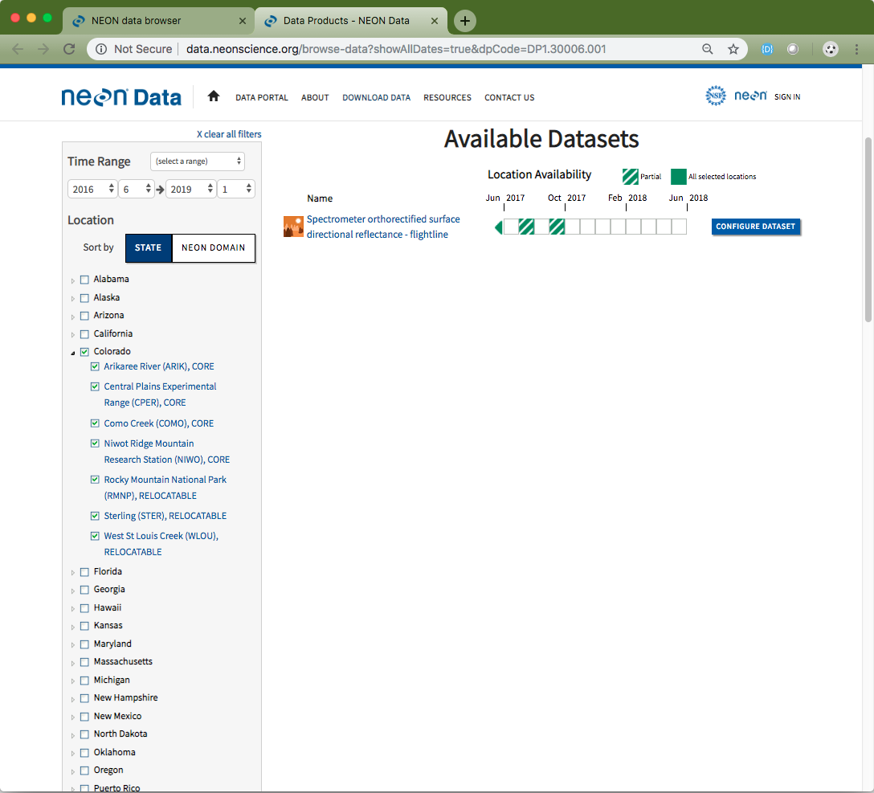
Configure AOP data
Step 4
Step 1
Step 2
Step 3
Include documents
Filter & search options
Select specific files
Check download size
Data product automatically selected
Notes:
(This slide contains animations to view each step)
To download AOP data from the portal you can start of the data browser (Step 1) or legacy data browser (Step 2).
Find the data product of interest and then select “Download Data”.
You will automatically be redirected to the Legacy Data page. Here the Data Product you previously selected will be automatically selected. (If you choose to start on the legacy browser, you will have to select the correct data product).
Select your desired criteria. See the “Legacy browse data: Filter to find data products of interest” slide for specifics. Then select “Configure Dataset”.
Configure your data set.
Choose if you want to include relevant documents.
Given the size of many AOP files, you have the option of downloading specific sections of data from a site. Use the filter selection to download your desired data.
Check the file size. VERY important for the AOP files as they can be very large.
Download Data.

Slide 18
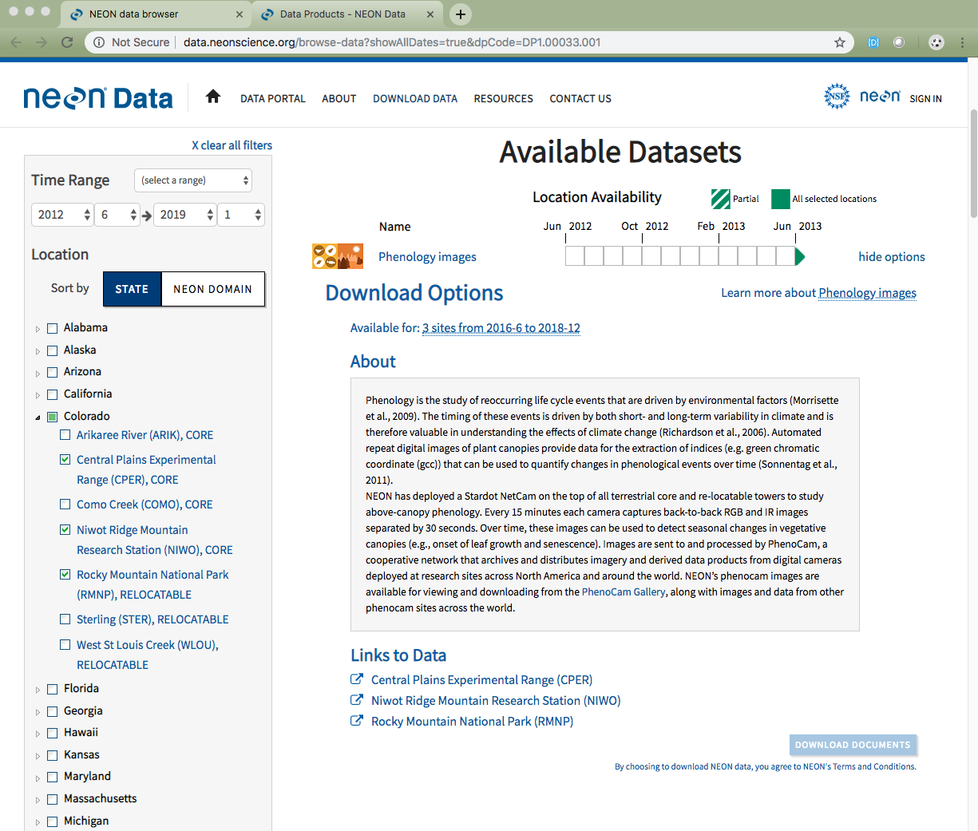
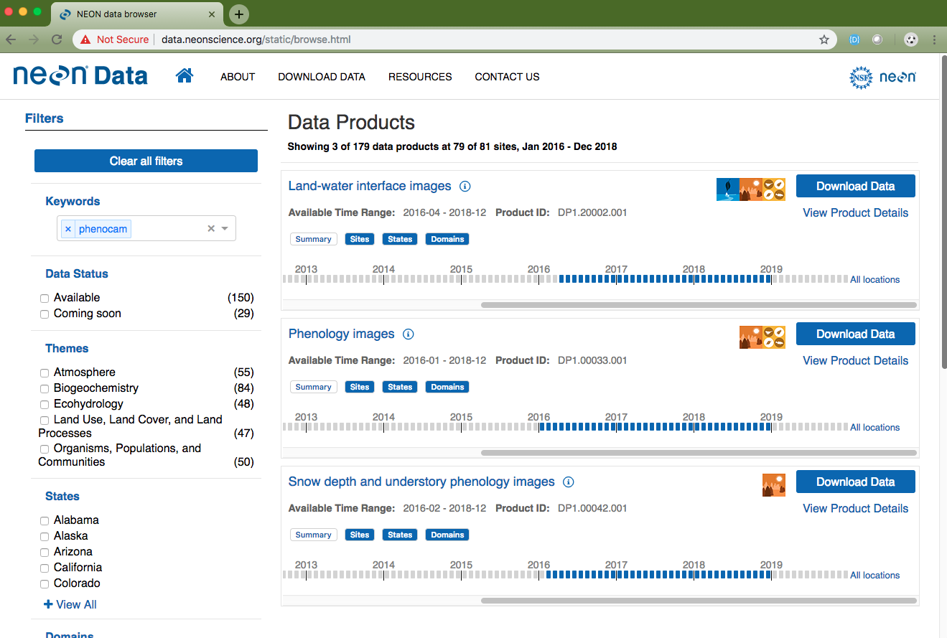
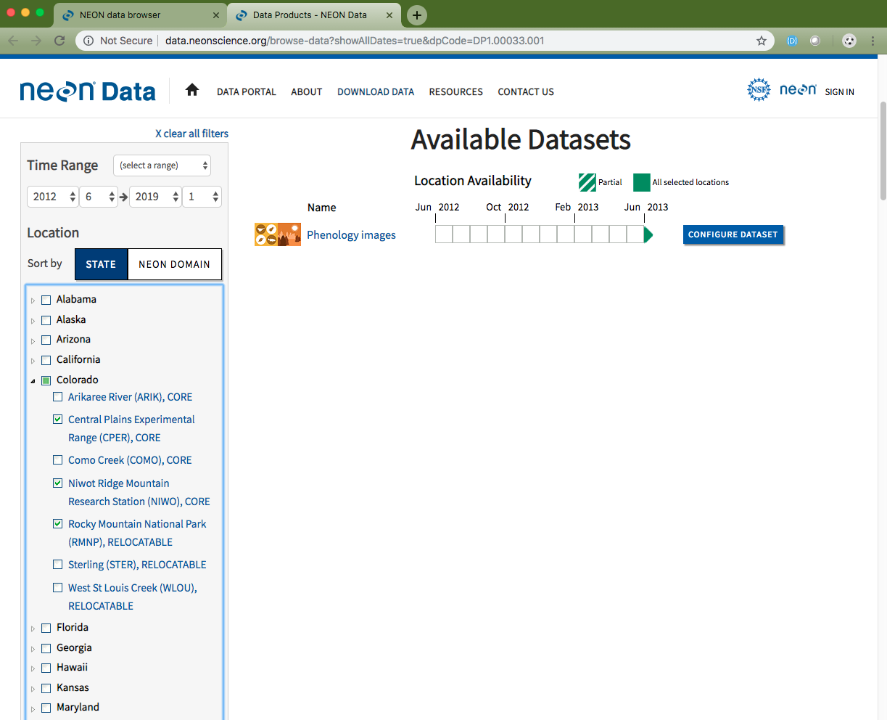
Configure data hosted by a partner organization
Step 4
Step 1
Step 2
Step 3
Data product automatically selected
Notes:
(This slide contains animations to view each step)
NEON partners with some organizations to host data. This includes our phenocam, hosted by the PhenoCam Network and genome sequence data, hosted by MG-RAST. You can search these data on the NEON data portal and then access the data through the partner organization’s website.
To download data hosted by other organizations from the NEON data portal you can start of the data browser (Step 1) or legacy data browser (Step 2).
Find the data product of interest and then select “Download Data”.
You will automatically be redirected to the Legacy Data page. Here the Data Product you previously selected will be automatically selected. (If you choose to start on the legacy browser, you will have to select the correct data product).
Select your desired criteria. See the “Legacy browse data: Filter to find data products of interest” slide for specifics. Then select “Configure Dataset”.
Access your data set by clicking on the appropriate link. You will be redirected to the partner’s website where you can access the data. You can access the associated documents for these data products on the respective Data Product Detail page (see Browse Data or Data Product Detail Page slide for details).

Slide 19
Additional Important Pages
Data Product Detail Pages
File Name Conventions Page
Data Quality Pages
Notes:
In this section, we will go through steps to access and download NEON data.

Slide 20
Data product details
These pages provide you with all the information regarding any NEON data product.
Four tabs:
Details: information on the data product
Documents: links to related documents (PDFs)
Closely Related Data: other NEON data products you may be interested in.
Release History: updates on any substantial changes that have happened to the data product over the years.
Notes:
Data product detail pages can be accessed from the Browse Data page by clicking on the View Product Details text or through the main navigation menu (Resources -> Data Product Catalog; then search for the data product of interest).

Slide 21
File name conventions
Provides details on standardized names of the data files.
data.neonscience.org/file-naming-conventions
Notes:
All NEON data file names contain specific information. This page provides the information needed to decipher the file names.

Slide 22
Data quality
Learn how NEON ensures quality, reliable data.
data.neonscience.org/data-quality
Notes:
In addition to the information on this page regarding data quality, we have three videos that explain the data processing steps:
Observational Sampling: https://youtu.be/82-scTZsyeY
Instrumented Systems: https://youtu.be/0crRkvQWu3E
Airborne Observation Platform: https://youtu.be/f5e-X9dMnXs

Slide 23
Programmatic access to NEON data
Use the NEON API
Learn More: data.neonscience.org/data-api
Use the neonUtilities R package
Functions to directly access NEON data (not just stack downloaded files)
Available on CRAN
Data tutorial: www.neonscience.org/neonDataStackR
Additional tools
github.com/NEONScience
Code Resources
Notes:
This guide primarily discusses how to access NEON data from the data portal. However, data can also be accessed programmatically using several tools. For more question, please use our Contact Us form:
General NEON questions: https://www.neonscience.org/observatory/contact-us
Data portal/API specific questions: http://data.neonscience.org/feedback

