Slide 1
A Brief Introduction to Synthetic Biology
Robert H. Newman
Assistant Professor of Biology
North Carolina A&T State University

Slide 2
What is…
Synthetic Biology

Slide 3
Synthetic Biology
The use of molecular biology tools and techniques to “forward-engineer” cellular behavior

Slide 4
Synthetic Biology
Complex Circuit Design
Metabolic Engineering
Cell-based Therapeutics
Genome Synthesis

Slide 5
Synthetic Biology
Complex Circuit Design
Metabolic Engineering
Cell-based Therapeutics
Genome Synthesis

Slide 6
Foundations of Circuit Design:
Regulated Gene Expression
LacI
lacI
P
lacO
P_{Lac}
lacZ
lacY
lacA
IPTG
LacZ
LacY
LacA
LacI
lacI
P
lacO
P_{Lac}
lacZ
lacY
lacA

Slide 7
Simple Circuit Design: Bi-Stable Toggle Switch
IPTG
LacI
lacI
P
lacO
P_{Lac}
lacZ
lacY
lacA

Slide 8
Simple Circuit Design: Bi-Stable Toggle Switch
IPTG
LacI
lacI
P
lacO
P_{Lac}
GFP

Slide 9
Simple Circuit Design: Bi-Stable Toggle Switch
IPTG
LacI
lacI
OR3
lacO
P_{Lac}
GFP
cI
P
heat

Slide 10
Simple Circuit Design: Bi-Stable Toggle Switch
LacI
lacI
OR3
lacO
P_{Lac}
GFP
cI
P
GFP Fluorescence
Time

Slide 11
Simple Circuit Design: Bi-Stable Toggle Switch
IPTG
LacI
lacI
OR3
lacO
P_{Lac}
GFP
cI
P
IPTG
GFP Fluorescence
Time

Slide 12
Simple Circuit Design: Bi-Stable Toggle Switch
IPTG
LacI
lacI
OR3
lacO
P_{Lac}
GFP
cI
P
IPTG
GFP Fluorescence
Time

Slide 13
Simple Circuit Design: Bi-Stable Toggle Switch
IPTG
LacI
lacI
OR3
lacO
P_{Lac}
GFP
cI
P
heat
IPTG
heat
GFP Fluorescence
Time

Slide 14
Complex Circuit Design: Oscillatory Circuit
LacI
lacI
P
P_{Lac}
GFP
AraC
P
AraC
GFP Fluorescence
Time

Slide 15
Complex Circuit Design: Oscillatory Circuit
LacI
lacI
P
P_{Lac}
GFP
AraC
P
AraC
GFP Fluorescence
Time

Slide 16
Complex Circuit Design: Oscillatory Circuit
LacI
lacI
P
P_{Lac}
GFP
AraC
P
AraC
GFP Fluorescence
Time

Slide 17
Complex Circuit Design: Oscillatory Circuit
LacI
lacI
P
P_{Lac}
GFP
AraC
P
AraC
GFP Fluorescence
Time

Slide 18
Complex Circuit Design: Oscillatory Circuit
LacI
lacI
P
P_{Lac}
GFP
AraC
P
AraC
GFP Fluorescence
Time

Slide 19
Synthetic Biology
Complex Circuit Design
Metabolic Engineering
Cell-based Therapeutics
Genome Synthesis

Slide 20
Synthetic Biology
Complex Circuit Design
Metabolic Engineering
Cell-based Therapeutics
Genome Synthesis

Slide 21
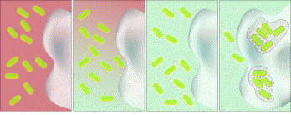
Cell-based Therapeutics:
Bacterial Invasion of Cancer Cells
Aerobic Conditions/
Low Cell Density
OFF
Hypoxia/
High Cell Density
ON
inv
Induction
Invasion
Anderson, JC et al. JMB 2006

Slide 22
Synthetic Biology
Complex Circuit Design
Metabolic Engineering
Cell-based Therapeutics
Genome Synthesis

Slide 23
Synthetic Biology
Complex Circuit Design
Metabolic Engineering
Cell-based Therapeutics
Genome Synthesis

Slide 24
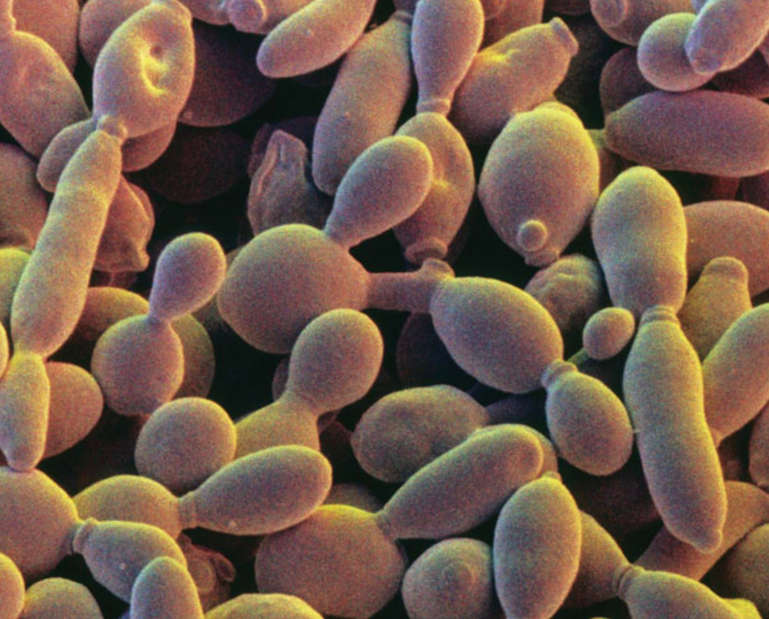
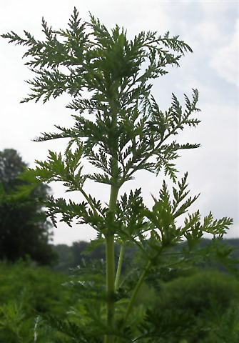
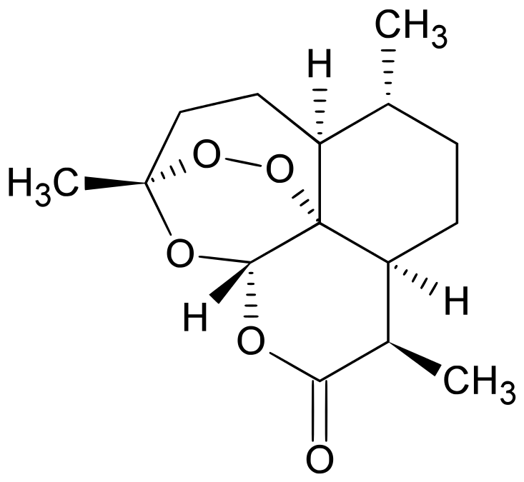
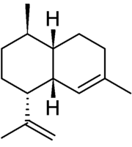
Metabolic Engineering: Artemisinin Semi-Synthesis
Mevalonate Biosynthetic Pathway
MevA
MevB
MevC
MevD
ADS
CYP71
JD Boeke and S Richardson
Amorpha-4,11-diene precursor
Artemisia annua
Artemisinin

Slide 25
Metabolic Engineering: Artemisinin Semi-Synthesis
Mevalonate Biosynthetic Pathway
MevA
MevB
MevC
MevD
ADS
CYP71
JD Boeke and S Richardson
<$0.25/dose
Amorpha-4,11-diene precursor
Artemisia annua
Artemisinin

Slide 26
Synthetic Biology
Complex Circuit Design
Metabolic Engineering
Cell-based Therapeutics
Genome Synthesis

Slide 27
Synthetic Biology
Complex Circuit Design
Metabolic Engineering
Cell-based Therapeutics
Genome Synthesis

Slide 28
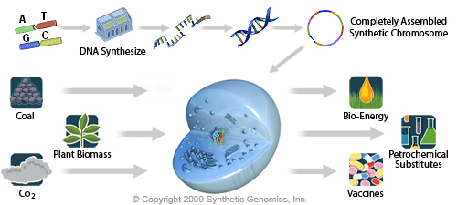
Genome Synthesis: Synthetic Cells

Slide 29
Genome Synthesis: Synthetic Cells

Slide 30
On the Precipice of the Future…
Let me now comment on the question "what next". Up to now we are working on the descriptive phase of molecular biology. ... But the real challenge will start when we enter the synthetic phase of research in our field. We will then devise new control elements and add these new modules to the existing genomes or build up wholly new genomes. This would be a field with an unlimited expansion potential and hardly any limitations to building "new better control circuits" or ..... finally other "synthetic" organisms, like a "new better mouse". ... I am not concerned that we will run out of exciting and novel ideas, ... in the synthetic biology, in general.
-Geneticist Waclaw Szybalski, 1974

Slide 32
Synthetic Biology
Metabolic Engineering
Complex Circuit Design
Genome Synthesis
Cell-based Therapeutics

