Slide 1

1
of 10

Slide 2
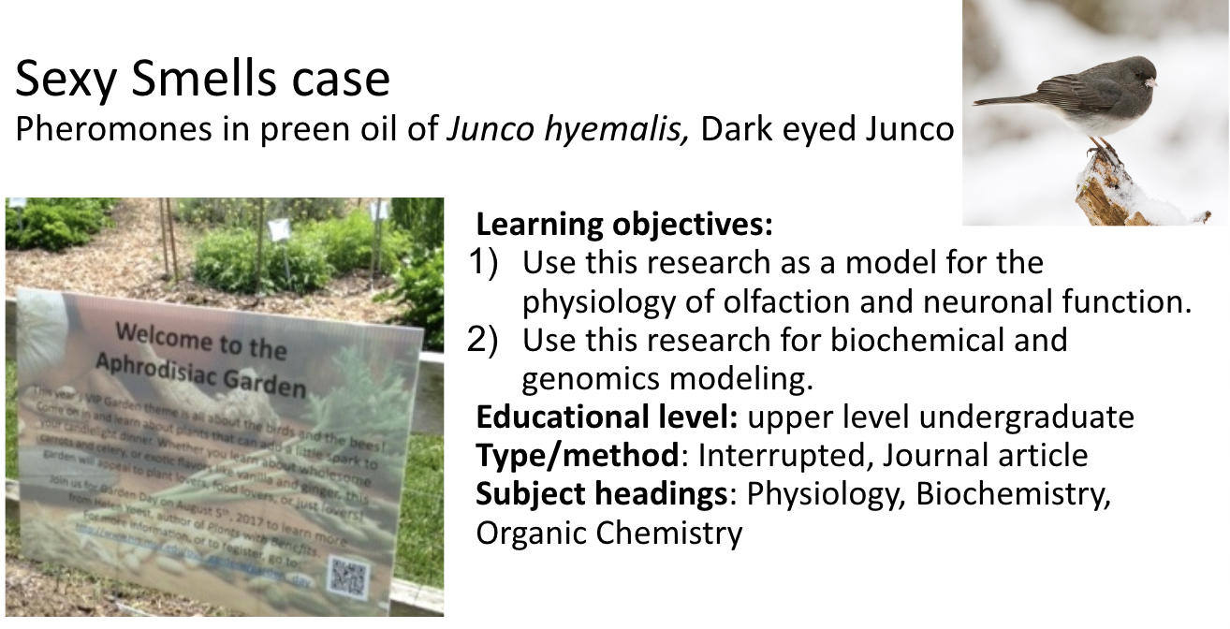
2
of 10

Slide 3
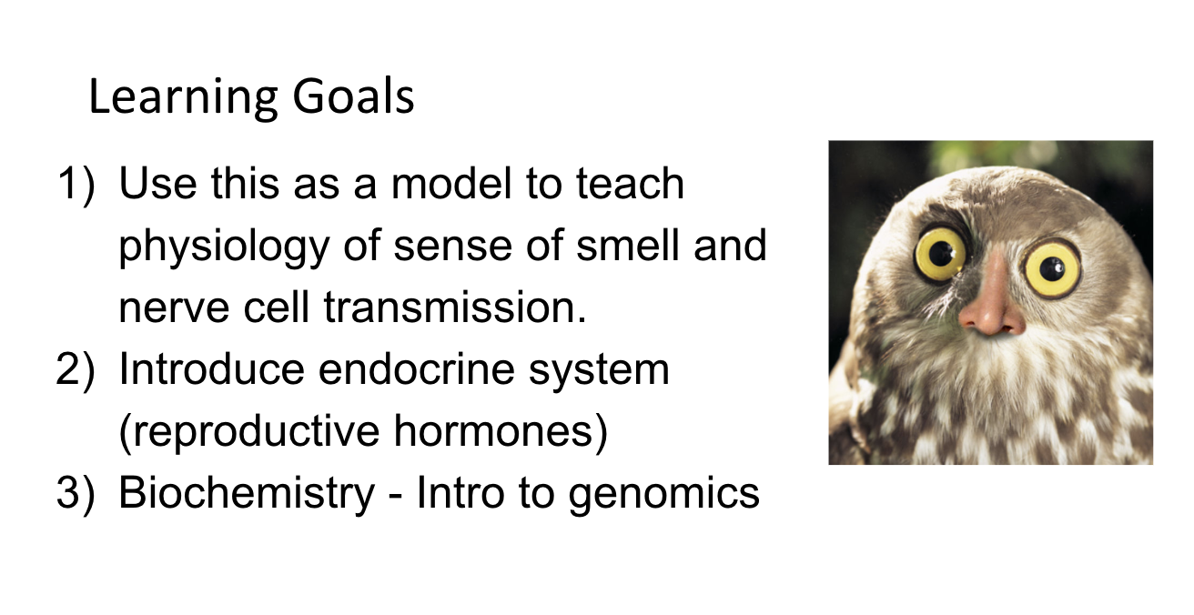
3
of 10

Slide 4
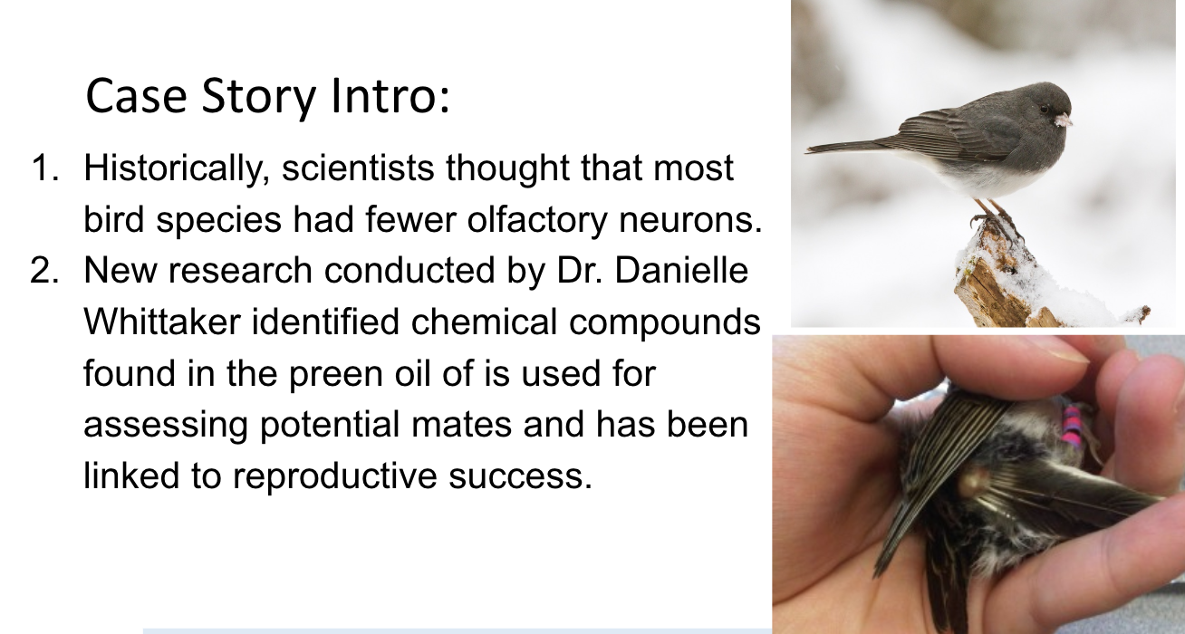
4
of 10

Slide 5
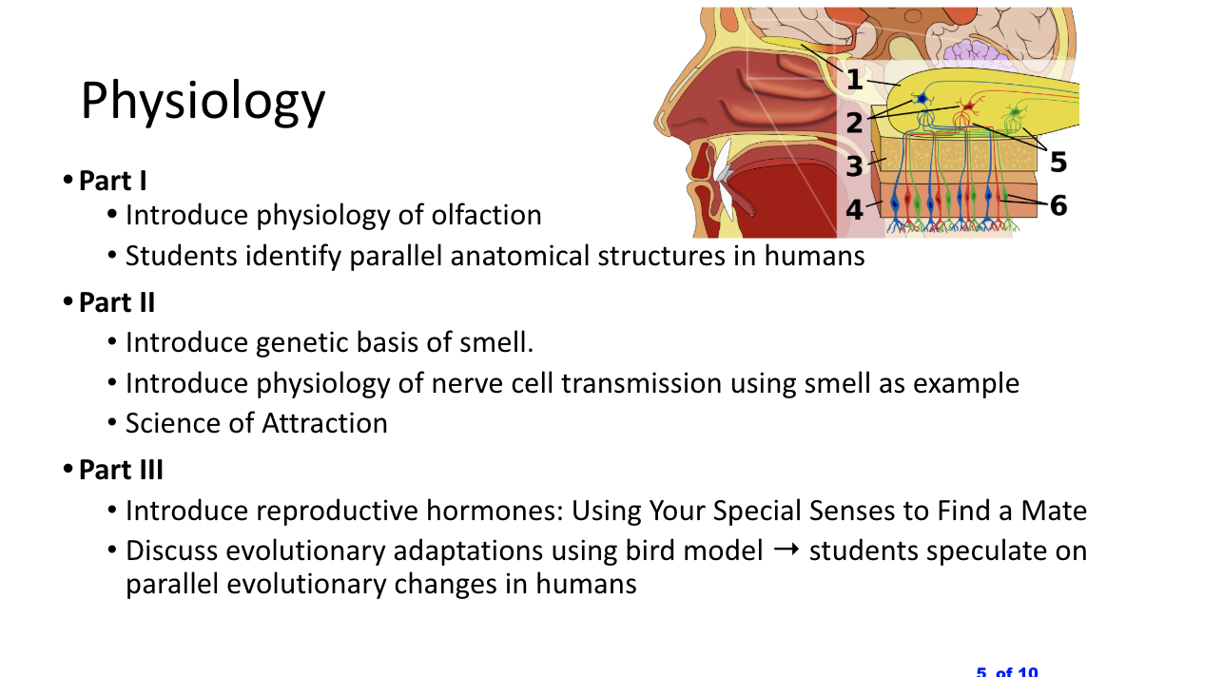
5
of 10

Slide 6
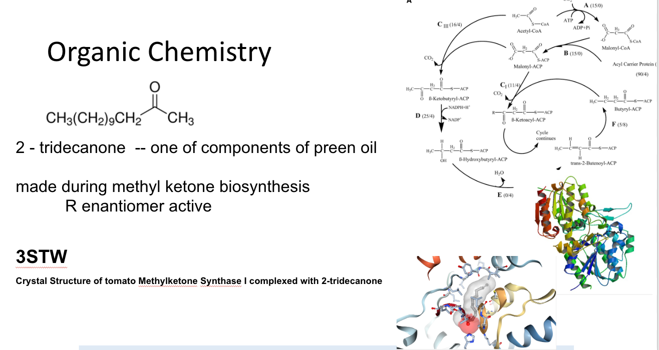
6
of 10

Slide 7
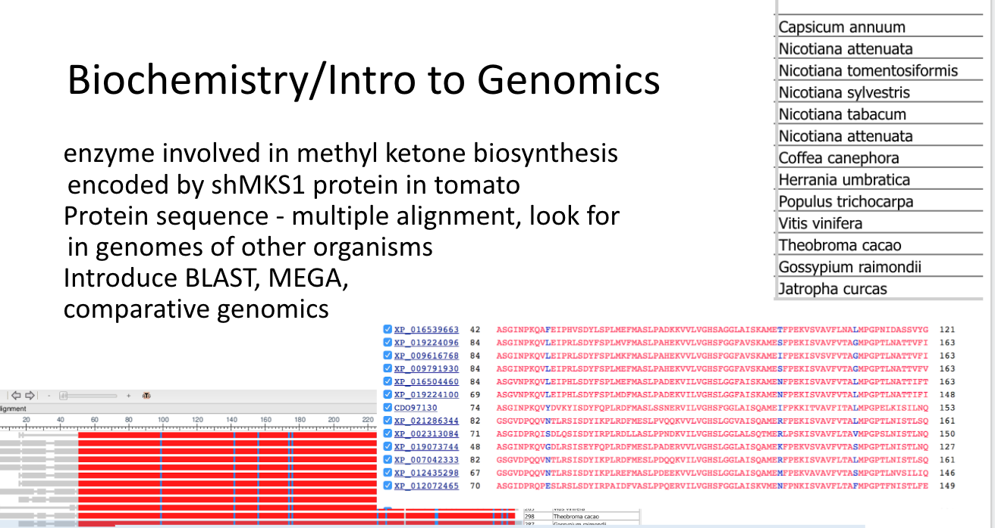
7
of 10

Slide 8
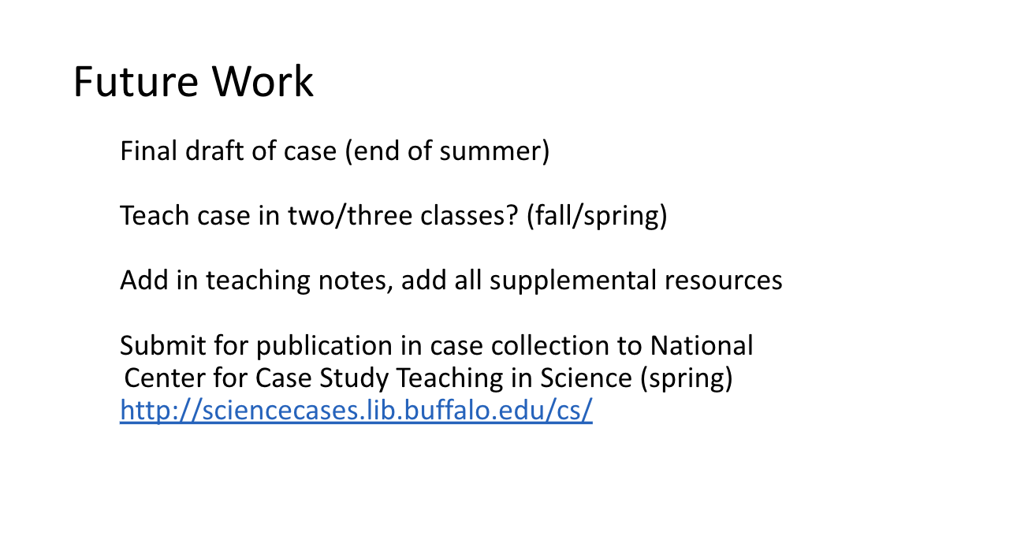
8
of 10

Slide 9
Update!
Case finalized and piloted in
General Biochemistry – Spring 2018, Spring 2019
Genomics and Bioinformatics – Fall 2018
Anatomy and Physiology I – Winter 2019
Teaching notes compiled
Case survey data collected
For Genomics part - Spring 2018 (Gen Biochem), informed edits on Genomics part, revised version used in Fall 2018 and Spring 2019 (survey data still to be analyzed from spring)
For Physiology part – Winter 2019
Working on finalizing all edits using survey feedback, and preparing for submission to Case Study Collection while here!

