Slide 1
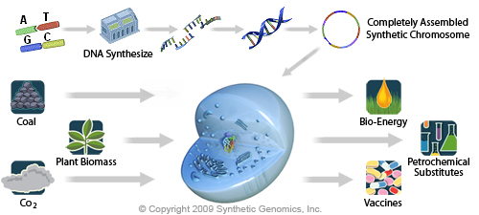
Genome Synthesis: Synthetic Cells
DNA Synthesis

Slide 2
Genome Synthesis: Synthetic Cells
DNA Synthesis

Slide 3
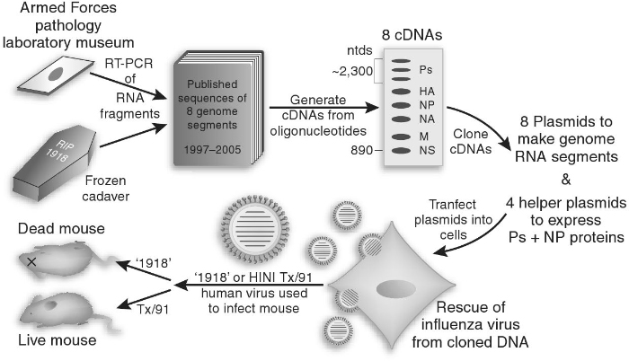
Synthetic viruses
Resurrected viruses (1918 flu)

Slide 4
Human herpesviruses
Common name | Scientific name | Disease | Prevalence
Herpes simplex virus 1 | Human herpesvirus 1 | Facial, labial and ocular lesions | 67% global prevalence, 0-49 year olds
Herpes simplex virus 2 | Human herpesvirus 2 | Genital lesions | 11% global prevalence, 15-49 year olds
Varicella-zoster virus | Human herpesvirus 3 | Chickenpox and shingles | >99% in the US, 40+ year olds (before vaccine introduction)
Human cytomegalovirus | Human herpesvirus 5 | Infectious mononucleosis | 45 – 100% depending on population
 | Human herpesvirus 6 and 7 | Childhood roseola | HHV-6: 72 – 100% of healthy adults globally
Epstein-Barr virus | Human herpesvirus 4 | Cofactor in human cancers | >80% in the US, 18-19 year olds
Kaposi’s sarcoma-associated herpesvirus | Human herpesvirus 8 | Cofactor in Kaposi’s sarcoma | 0 – 15% in the US, much higher in particular geographic locations
Alpha
Beta
Gamma
Notes:
I’m already throwing around a lot of herpes acronyms so here is a table with all 8 of the human HVs. We used HSV-1 in the project I’m going to tell you about, but we’re interested in understanding more about other members of the group as well. HSV-1 and 2 and VZV are alpha herpesviruses
Ref: HSV-1 Looker et al 2015, HSV-2 Looker et al 2015, VZV Kilgore et al 2003, HCMV Cannon et al 2010, HHV6+7 , EBV Dowd et al 2013, KSHV Zuckerman et al 2004 (book: Principles and Practice of Clinical Virology)

Slide 5
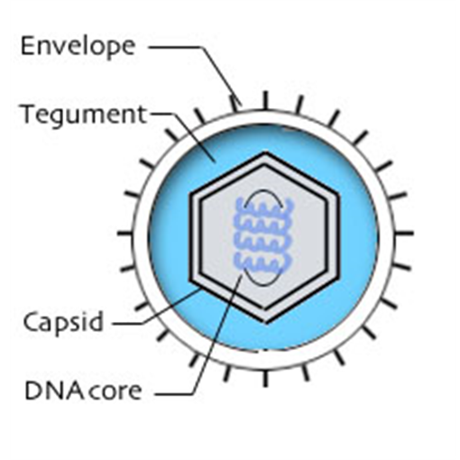
Human herpesviruses
TR_{L}
IR_{L}
IR_{S}
TR_{S}
Herpesviruses are large dsDNA viruses.
  120 – 230 kbp, up to 75% GC content
Important global pathogens
  HSV-2 infection predisposes a person to HIV infection
  EBV and KSHV are oncogenic
HVs used as delivery vectors
  Gene therapy, oncolytic viruses, and vaccine vectors
After primary infection, HV persist in their host as latent episomes for life.
Notes:
HV are large dsDNA viruses and their size is one of the reasons we chose to work on them. The genomes are tricky to manipulate and synthesis of large genomes is difficult and we decided this was a project we could develop tools for. HV genomes are 120-230 thousand bp and be up to 75% GC and much higher in smaller regions of the genome. HV are also important pathogens. We work with HSV-1 which typically causes cold sores, but other viruses in this family can have more serious outcomes. HSV-2 infection…. EBV and KSHV can cause or contribute to carcinogenesis. HCMV is associated with many types of cancer but doesn’t appear to be causative. HV are highly prevalent across the globe because they persist as lifelong infections. Cartoon of the structure of HSV-1 where the DNA is surrounded by a caspid and an envelope---between is an unstructured tegument.

Slide 6
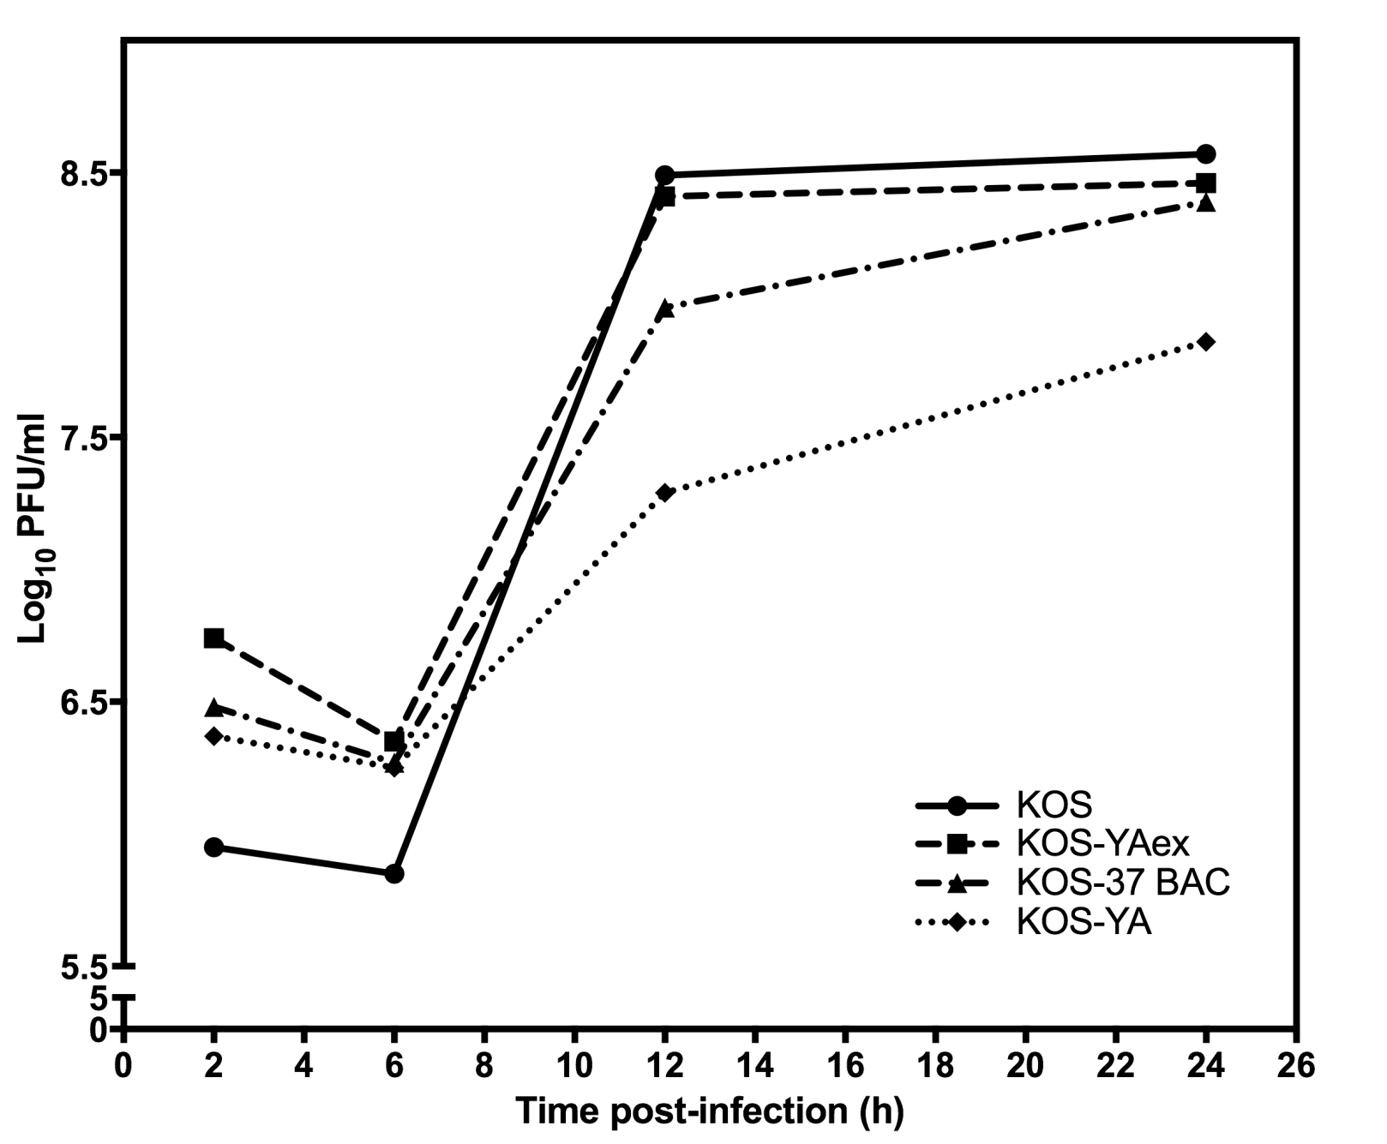
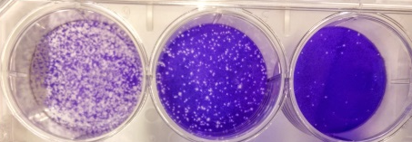

Replication kinetics confirm that KOS^{YA} is similar to WT KOS
Plaque Formation by KOS^{YA}
Amount HSV-1 genome transfected
Oldfield et al. 2017 PNAS
Notes:
So the next step after generating the wild-type virus was to make edits to the genome!

Slide 7
Double deletion of UL16+UL21 prevents nuclear egress and primary envelopment of HSV-1
KOS^{YA}
KOS^{YA}∆UL16∆UL21
Unpublished data, Prashant Desai
Notes:
One interesting mutant we are following up on, UL16+21 double deletion→ In this Transmission EM of WT KOS-YA you can see capsids in the nucleus and enveloped virus budding from the cell surface, Virus with the Double deletion forms capsids but they do no leave the nucleus and none are seen on the cell surface.

Slide 8
BENEFITS
Expand and improve genetic tools for viruses that impact human and animal health
Basic biology
Therapeutics
  Vectors for gene therapy and heterologous vaccine
  Oncolytic viruses
Diagnostic tools
Rationally attenuated vaccines

Slide 9
Synthetic viruses
Deoptimized viruses

Slide 10
Synthetic Bacteria

Slide 11
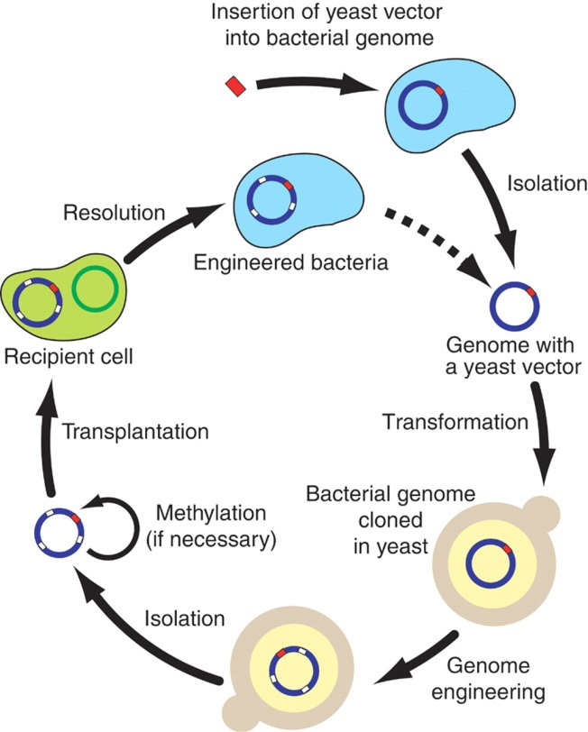
Steps toward the creation of a hypothetical minimal genome
1995: Sequencing of M. genitalium genome
1999: Nonessential genes in M. genitalium
2003: Assembled genome of PhiX174
2007: Genome transplantation
2008: Synthesis of bacterial genome
2009: Assemble large pieces of genome in yeast
2010: First synthetic cell, JCVI-syn1.0

Slide 12
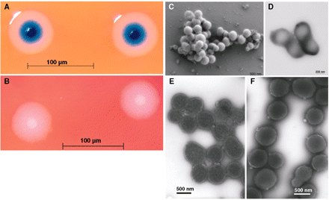
First synthetic cell, JCVI-syn1.0, created in 2010

Slide 13
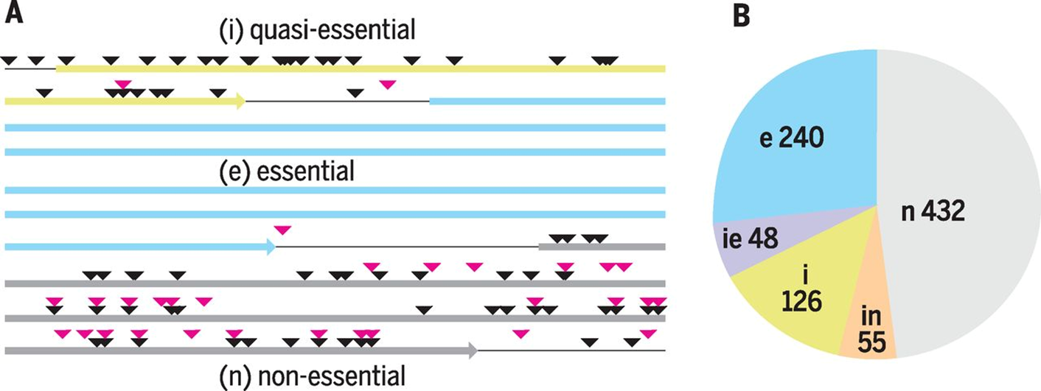
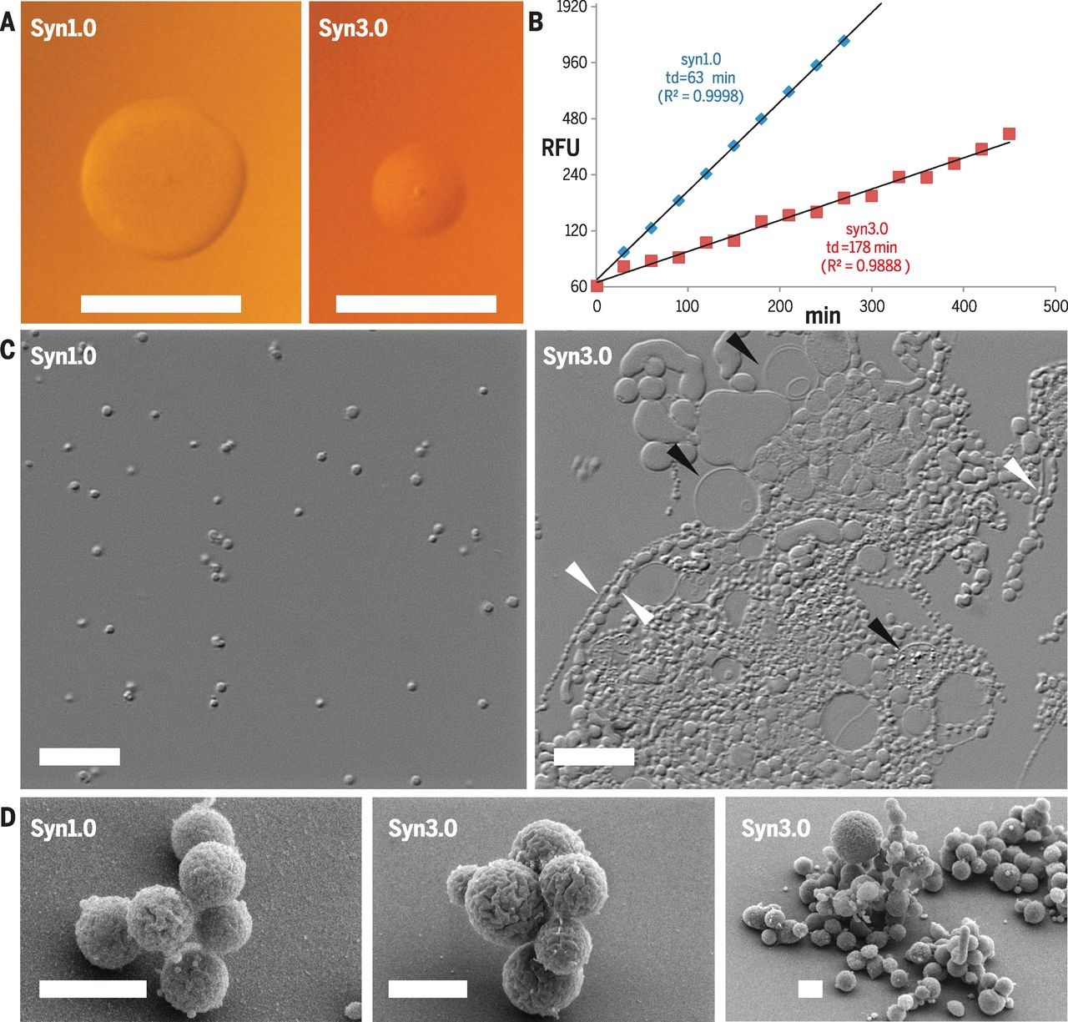
Synthetic bacteria
Minimized genome
Clyde A. Hutchison III et al. Science 2016;351:aad6253

Slide 14

The minimal cells are much more heterogeneous heterogeneous
Clyde A. Hutchison III et al. Science 2016;351:aad6253
Published by AAAS
Notes:
Comparison of syn1.0 and syn3.0 growth features. (A) Cells derived from 0.2 μm–filtered liquid cultures were diluted and plated on agar medium to compare colony size and morphology after 96 hours (scale bars, 1.0 mm). (B) Growth rates in liquid static culture were determined using a fluorescent measure (relative fluorescent units, RFU) of double-stranded DNA accumulation over time (minutes) to calculate doubling times (td). Coefficients of determination (R²) are shown. (C) Native cell morphology in liquid culture was imaged in wet mount preparations by means of differential interference contrast microscopy (scale bars, 10 μm). Arrowheads indicate assorted forms of segmented filaments (white) or large vesicles (black). (D) Scanning electron microscopy of syn1.0 and syn3.0 (scale bars, 1 μm). The picture on the right shows a variety of the structures observed in syn3.0 cultures.

Slide 15
Synthetic bacteria
Recoded genome

Slide 16
Synthetic Eukaryotes

Slide 17
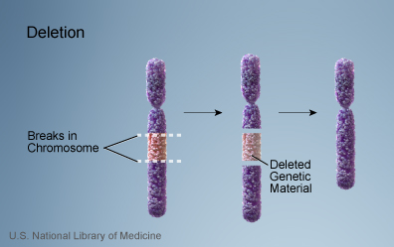
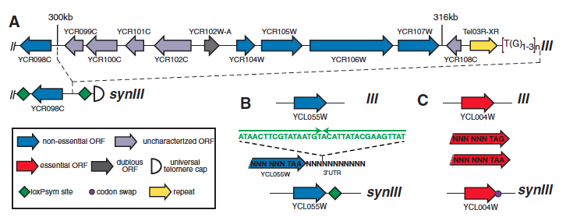
Synthetic Yeast (Sc2.0)
The World’s First Synthetic Eukaryotic Genome
Above: a chromosome as it is seen in the cell; Below: a zoom in of a certain region.
Annaluru (2014)
Notes:
If we were to zoom in a region of a gene/chromosome the above is an imaged representation of what we would find: 123-Synthetic chromosomes and cells can be manipulated and altered to better suit *** Representative synIII design segments for loxPsym site insertion (A & B) and stop codonTAG to TAA editing (C) are shown. Green diamonds represent loxPsym sites embedded inthe 3′ UTR of non-essential genes and at several other landmarks. Fuchsia circles indicatesynthetic stop codons (TAG recoded to TAA).

Slide 18




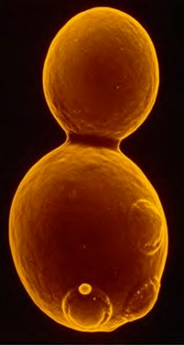
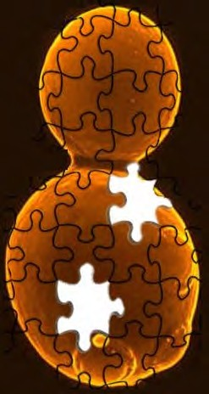








Sc2.0 designer genome sequence
‘Sc1.0’
‘Sc2.0’
Richardson et al. 2017

Slide 19
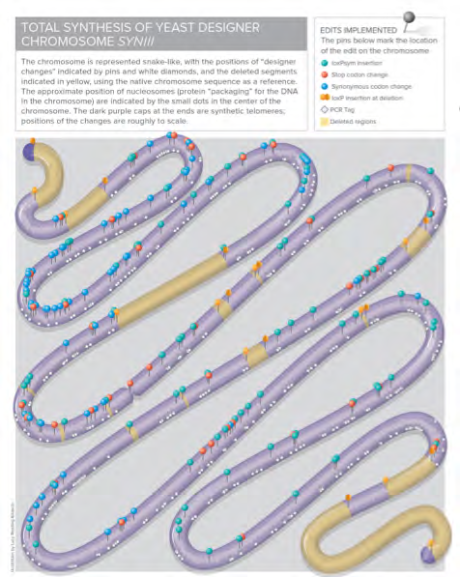
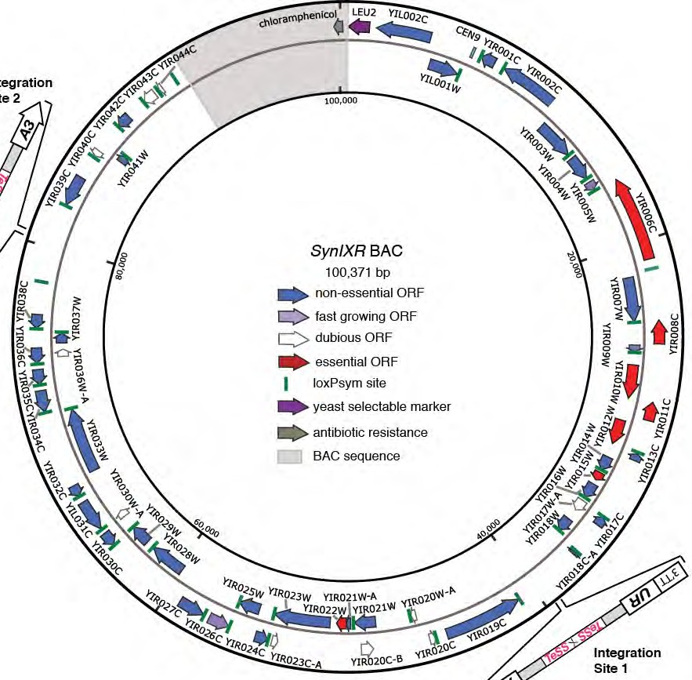


synIXR and synIII – functional, designer eukaryotic chromosomes
SYNTHETIC CHROMOSOME ARMS FUNCTION IN YEAST & GENERATE PHENOTYPIC DIVERSITY
TOTAL SYNTHESIS OF YEAST DESIGNER CHROMOSOME SYNIII
March, 2014

Slide 20
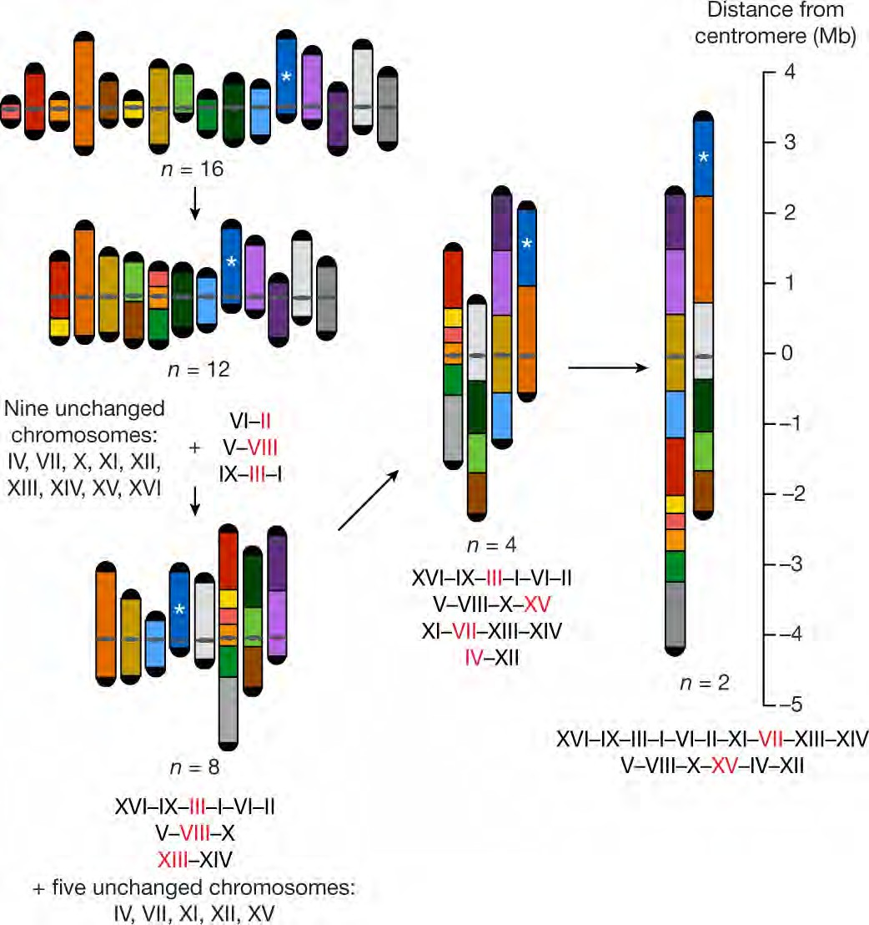
Karyotype engineering by chromosome fusion leads to reproductive isolation in yeast
Luo et al. 2018 Nature

Slide 21
Lessons from synVI (and Sc2.0) to be applied to genome writing in general
Large-scale DNA design requires software
  Sequence completeness and annotation of genome are critical considerations
Eﬃcient assembly strategy is critical
  Commercial synthesis delivers only 3-5 kb typically
Eﬃcient delivery strategy is critical
  Destination cell transformability & strategy to maintain new DNA in cell
De-bugging strategies will be required
  Bugs uncover new biological information

Slide 22
Where to next?

Slide 23
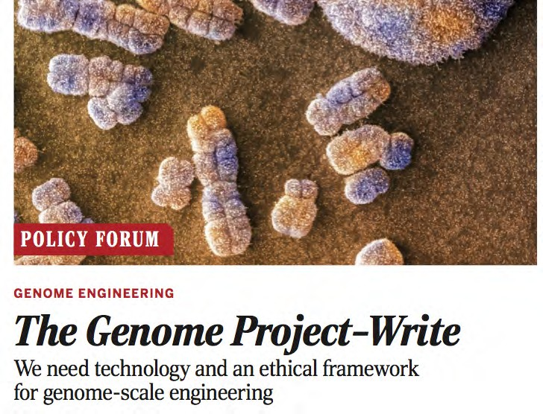
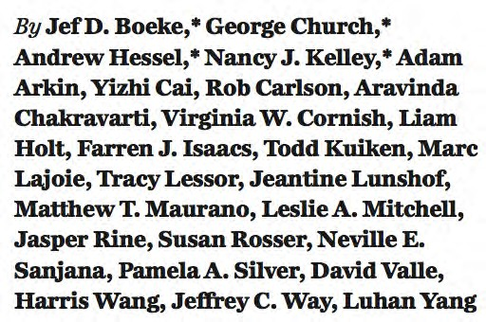
Genome Project (GP) Write: the next step, writing mammalian genomes
EngineeringBiologyCenter.org

Slide 24
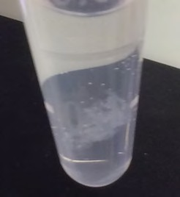










Challenges for building mammalian synthetic chromosomes
2. Intact
transfer
3. Nuclear delivery
1. Handling DNA in vitro
4. Site-speciﬁc Integration
5. Fitness/function

Slide 25
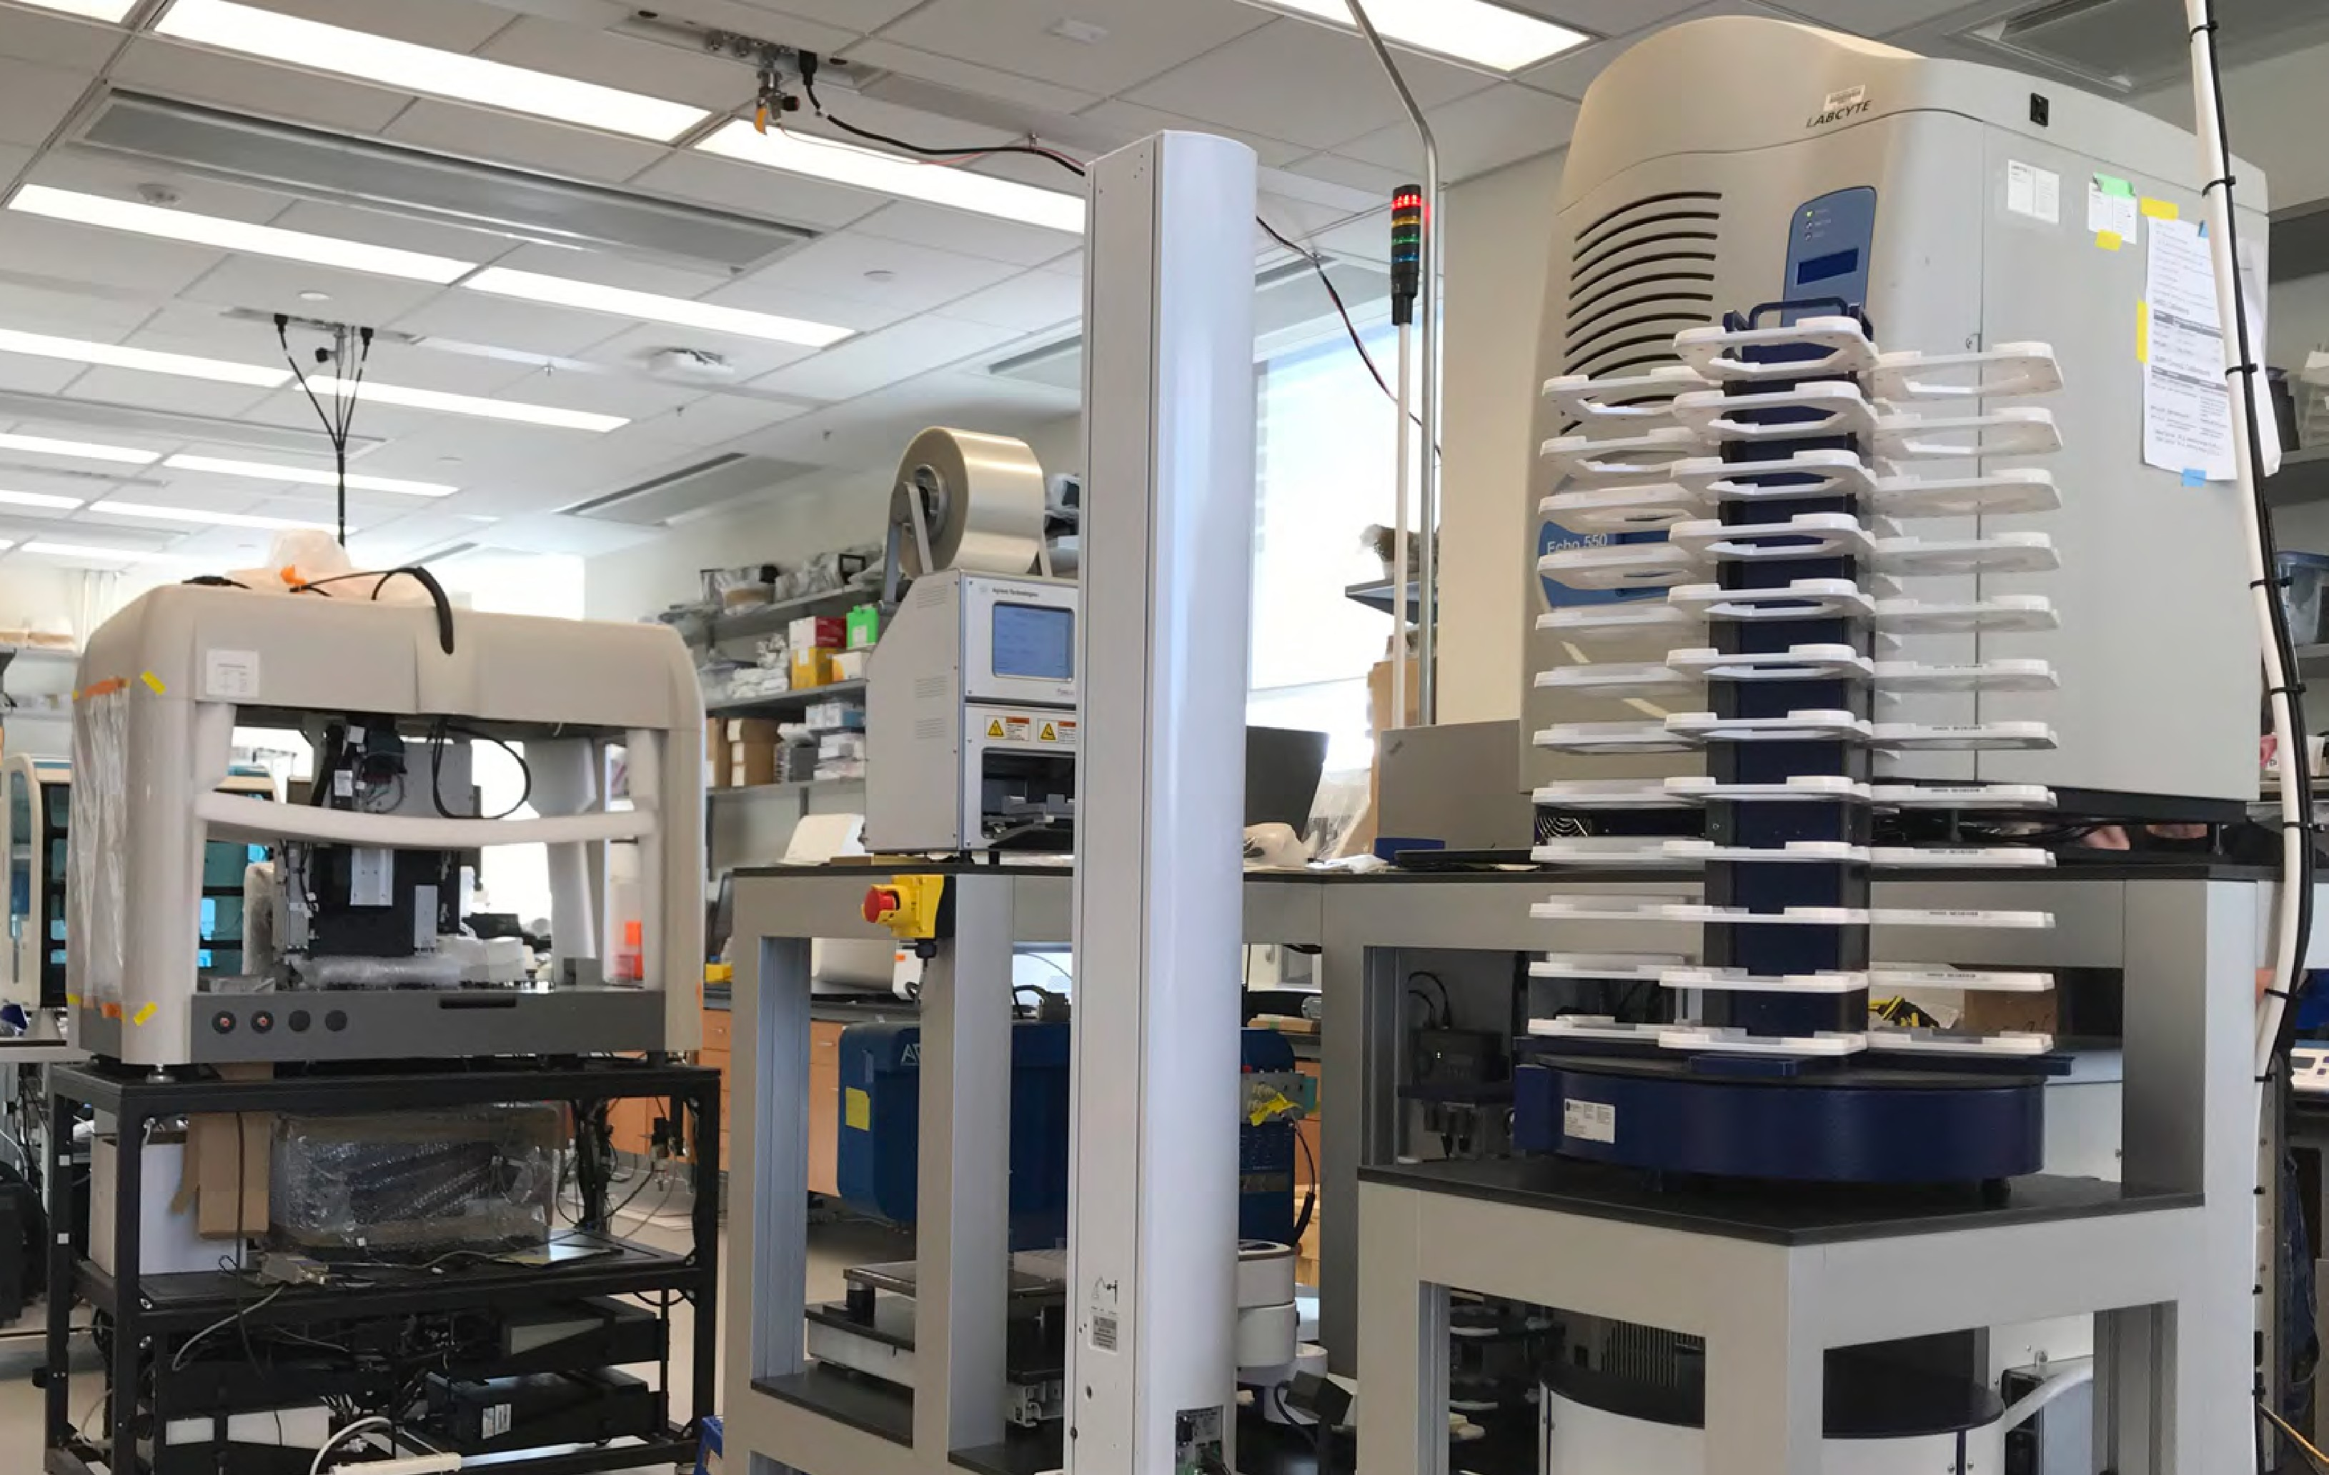
GenomeFoundry@ISG

Slide 26
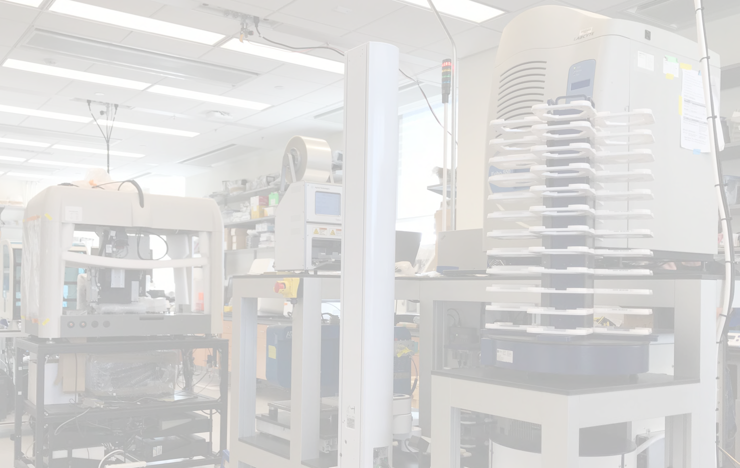
GenomeFoundry@ISG (NYU)
Automated Work Cell
nano- and micro-scale liquid dispensers
robotic arms
plate stacks
automated centrifuge
plate peeler
plate heat sealer
1536 (or 384) qPCR
High throughput gene expression analysis
Genotyping
Sc2.0
qPCRTag analysis
Junction PCR
analysis
genome editing

Slide 27








Genome writing pipeline
Source DNA
Measure & Debug
Idea
Design
Build
Deliver
What are you going to build…and WHY?
A grand challenge…or a grant challenge?
It’s going to be a big job, who will participate?
What is the deﬁnition of success?

Slide 28
Ethical conundrums……

Slide 29
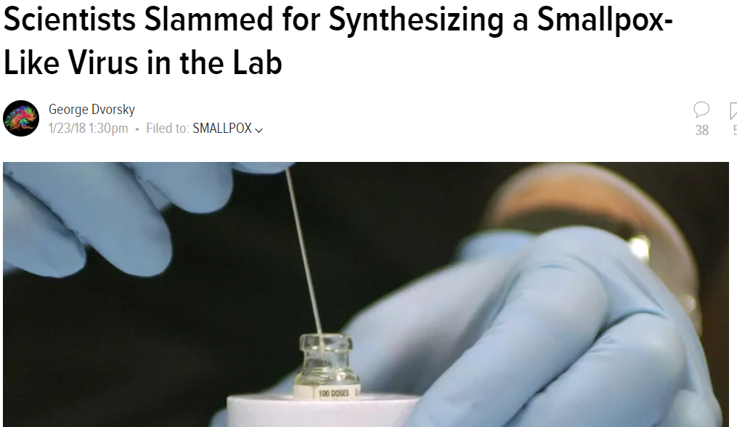
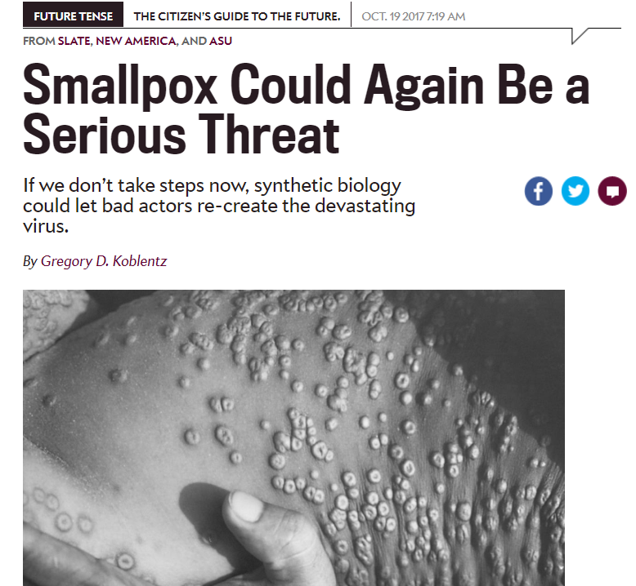
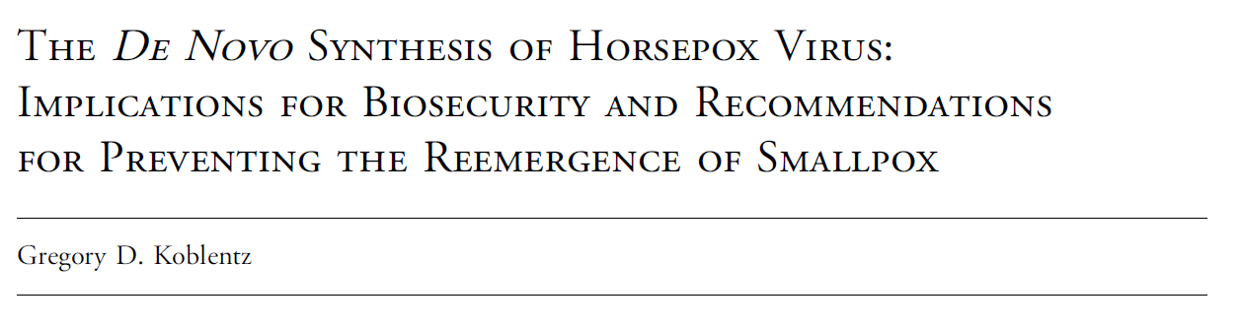

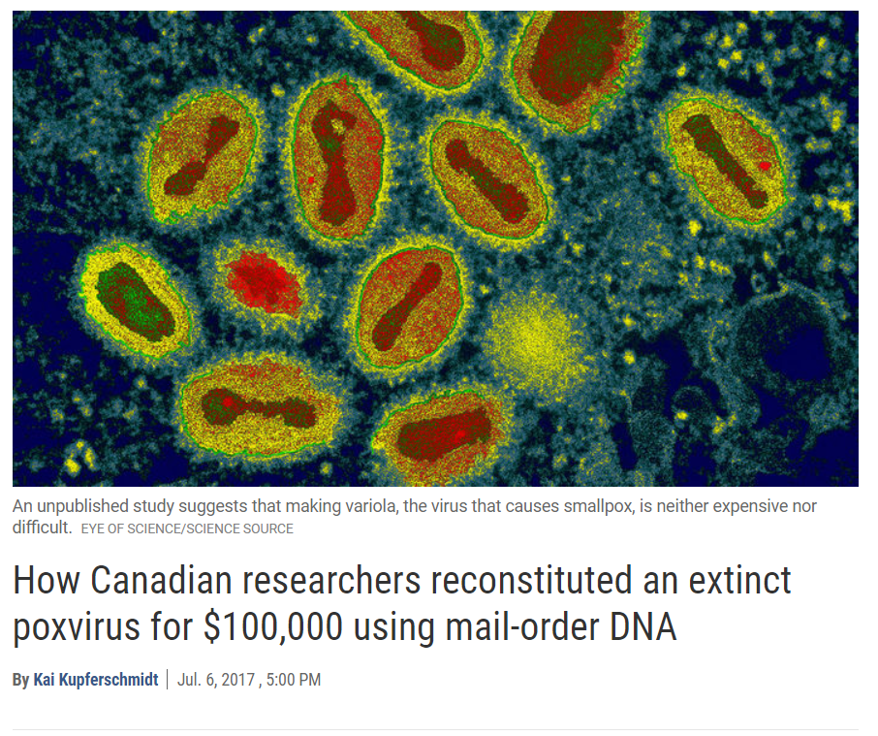
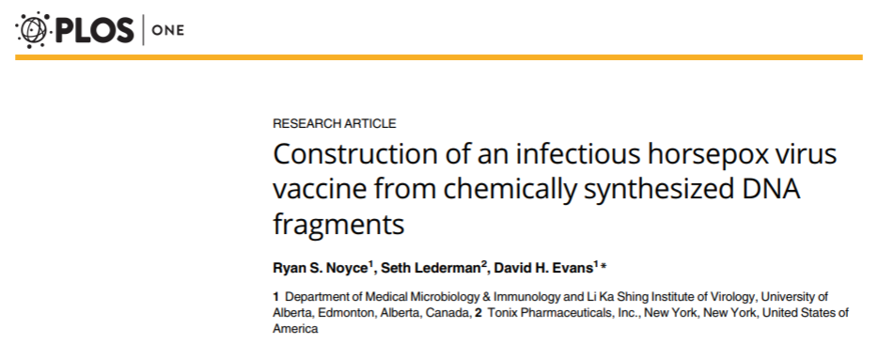
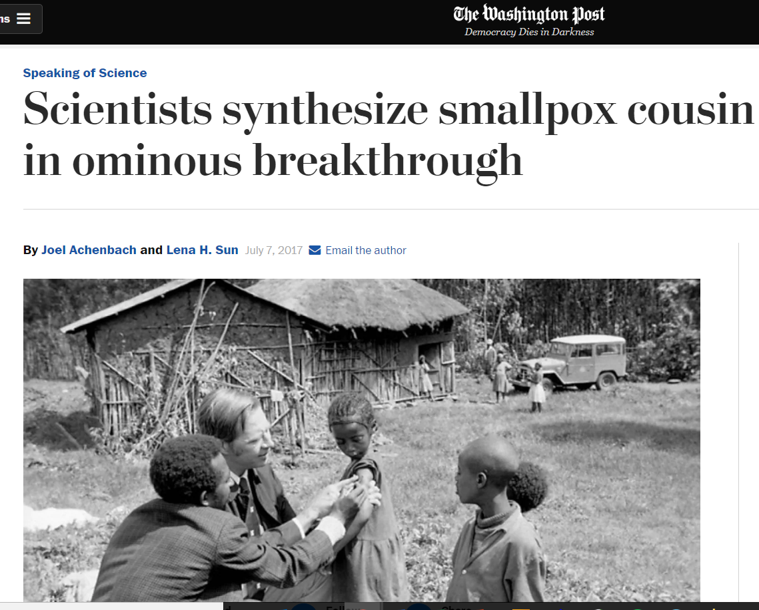
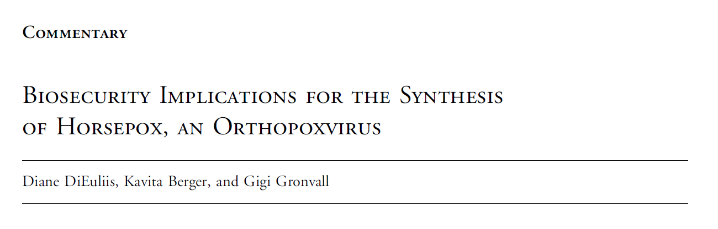

Science News article

Slide 30
Synthetic viral genomics biosecurity issues
International Gene Synthesis Consortium
  If you can’t rely on screening >100mer DNA sequences alone to prevent bad actors or misguided scientists from using synthetic genomics to build dangerous viruses, how do you regulate synthetic viral genomics?
    IBCs, Journals, norms
Where do you draw the line with expanding these tools?
  Select agents need genetic tools too! (i.e. to develop improved vaccines)
Open data and reproducibility versus information hazards

