Slide 1
Ethics of Synthetic Genetics in Conservation
Dr. Fran Sandmeier
Colorado State University - Pueblo
franziska.sandmeier@csupueblo.edu
Research Coordination Network in Undergraduate Biology Education: Build a Genome Network

Slide 2
An Ethical Dilemma
Many conservation biologists agree that we live in the Anthropocene, an new era marked by a human-caused 6th mass extinction, unprecedented human population growth & land conversion, and a changing climate. Synthetic genetics is forcing us to answer:
Is it ethical to alter the genome of a species for conservation of biodiversity?
Is it ethical to have the technology to keep a species from going extinct, and not use it?

Slide 3
Recent Changes in Synthetic Genetics
GMOs (genetically modified organisms): common and currently regulated by national & international laws/agreements
Agriculture: enhanced nutrition/resistance to herbicides/etc.
Synthesis of natural products
New technology (e.g., CRISPR/CAS9) has greatly accelerated the ability to genetically engineer organisms
Target specific genes and induce change
De novo create new sequences (e.g., synthetic yeast genome)
Gene drives that perpetuate changes by also altering sequence of sperm/eggs – and patterns of inheritance

Slide 4
CRISPR/CAS9
Derived from immune responses of bacteria, to infecting viruses
A system that cleaves DNA at a specific location
In synthetic biology, we can
Cause a loss of function in a gene
Add a new sequence in the cleaved location
Homologous repair mechanisms then change both strands of DNA
Cribbs and Parrera, 2017

Slide 5
Examples
Inserting genes for resistance to disease from preserved DNA of dead individuals into the genome of endangered ferrets
Similar resistance to disease by adding specific genes from European chestnuts into seedlings of the functionally-extinct American chestnut

Slide 6
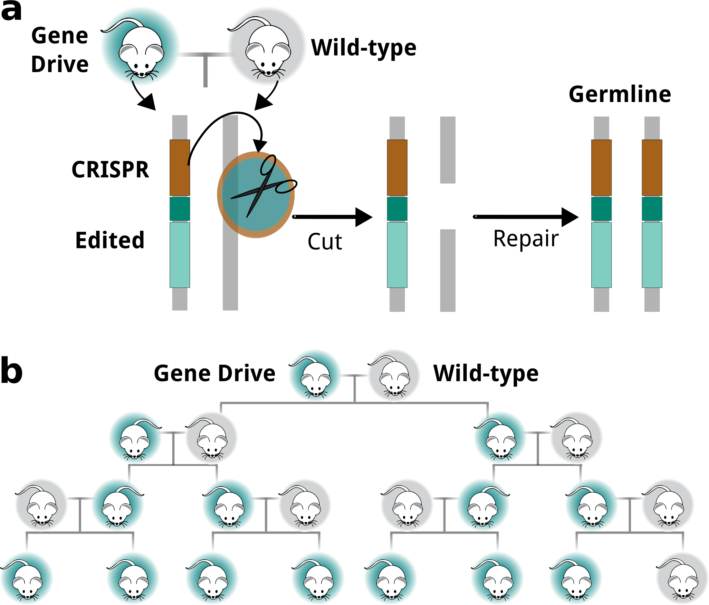
Gene Drives
Gene drives use CRISPR/CAS and cause animals to pass this gene on to every one of its offspring (or nearly every offspring) (germline alteration refers to alteration in gametes/sex cells)
Mechanism:
Esvelt and Gemmell, 2017

Slide 7
Gene Drives in Action
Green individuals could have disease resistance (endangered animals) or become all female/have reduced fertility (invasive animals that are the cause for the endangerment of other species)
Outcome: non-Mendelian inheritance
Esvelt and Gemmell, 2017

Slide 8
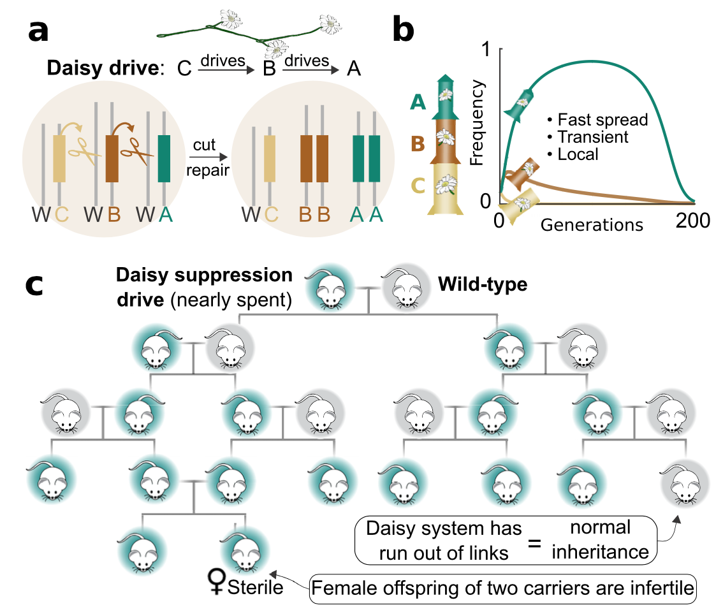
Daisy Chain Gene Drives
Spread rapidly at first, but are self-limiting.
Because C is a drive for B, it is lost first, and B increases rapidly but is lost as C decreases. Once B is lost, A acts like a normal Mendelian gene and is lost in ½ of the offspring, on average.
This example explains how an invasive animal population could be controlled if all female offspring of two A carriers would be infertile.
Esvelt and Gemmell, 2017

Slide 9
Conservation Applications? (Option 1)
Synthetic genetics have only been PROPOSED as conservation strategies
We will work our way through some proposals, that were reviewed by the International Union for the Conservation of Nature in 2019
You will act as a board of scientists, policy makers, and community members to review these project proposals
Working in small groups, give a project a “Yes”, a “Yes, with certain precautions”, or a “No”.
Go in order through your cards/slides. You may need to adjust your answers as you receive additional data.
We will reconvene as a class to discuss these proposals and your decisions!

Slide 10
Conservation Applications? (Option 2)
Synthetic genetics, with gene drives have only been PROPOSED as a conservation strategies
We will work through one of the proposals with a lot of support from scientists, government, and portions of the public
Eradicating European rats from New Zealand via gene drives.
How is this done (theoretically?):
Engineer rats to only produce females – eventually the population will shrink to such a small size that it will crash
Engineer rats with low fertility/sterility – similar result, but works best with several gene drives (daisy chain)

Slide 11
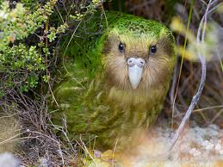
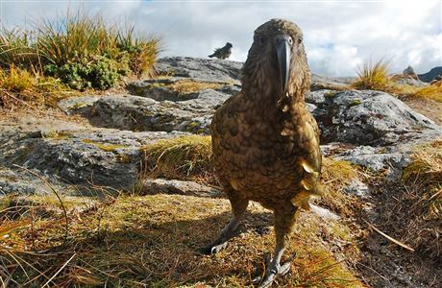
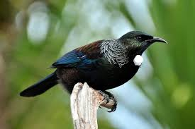
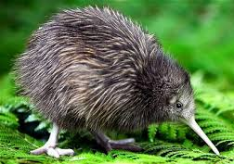
Why are Rats a Problem?
New Zealand is unique in having endemic species, found nowhere else, that evolved without mammalian predators (the only native mammals are bats)
Bird species, in particular, are very diverse, spectacular, and many have gone extinct, or declined to the brink of extinction due to mammalian predators

Slide 12
Current Conservation Efforts
Currently, large-scale, expensive measures are being employed to rid offshore islands of mammals and re-introduce native species that are part of captive breeding programs (ex. Kakapo captive breeding has produced an increasing population – currently at > 200 birds)
Captive breeding programs have a common problem of running out of suitable habitat (e.g., predator-free)

Slide 13
Proposal
Rats engineered with gene drives could humanely, and without polluting chemicals, reduce rat populations and drive them to extinction
Predator Free 2050 is a movement that has garnered support from conservationists, the government, and local communities (including some Maori communities) – but not without legitimate concerns that more harm than good may result from a failure of containment of engineered rats, loss of funds/effort in other conservation-measures, unknown ecological ramifications, etc.
Follow through the case study to evaluate both the scientific and ethical arguments for and against the use of gene drives

