Slide 1
Biological Networks
Soma Ghosh
Postdoctoral Research Fellow
Johns Hopkins University

Slide 2
Network topologies

Slide 3
Properties of Biological Networks
1. Scale free networks
Degree distribution follows power law

Slide 4
Properties of Biological Networks
1. Scale free networks
“Preferential attachment“
Albert-László Barabási, Science 325 (5939) 2009

Slide 5
Properties of Biological Networks
2. Robust
“Preferential attachment“
Ensures protection from random attacks, but still vulnerable to targeted attacks

Slide 6
Properties of Biological Networks
3. Dynamic
Networks capture the response of the system to environmental stimuli, genetic perturbations or drug treatment.
Understanding network dynamics provide the means of perturbing the network to achieve desired (or suppress undesired) phenotypes.
Goode, D.K et. al., Dev. Cell 36 (5), 2016

Slide 7
Properties of Biological Networks
Modular
4. Modular
Ensures robustness/ evolvability
Functional redundancy
Can be used to predict functions of unannotated proteins based on “guilt by association”
Random
Wang Z, Zhang J, PLOS Computational Biology 3(6): 2007

Slide 8
Properties of Biological Networks
5. Exhibit emergent properties
Muhammad, D et. al., Biochimica et Biophysica Acta (BBA) - Gene Regulatory Mechanisms,1860(1) 2017
Faingold, C.L, Neuronal Networks in Brain Function, CNS Disorders, and Therapeutics, Page: 419-428
Networks can be used to generate mathematical models that enable the prediction of complex behaviors.
Modeling methods: Differential equations, Boolean networks, Agent based modeling

Slide 9
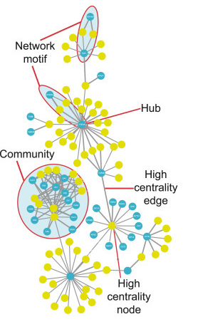

Slide 10
Yeast Genetic Interaction Network

Slide 11
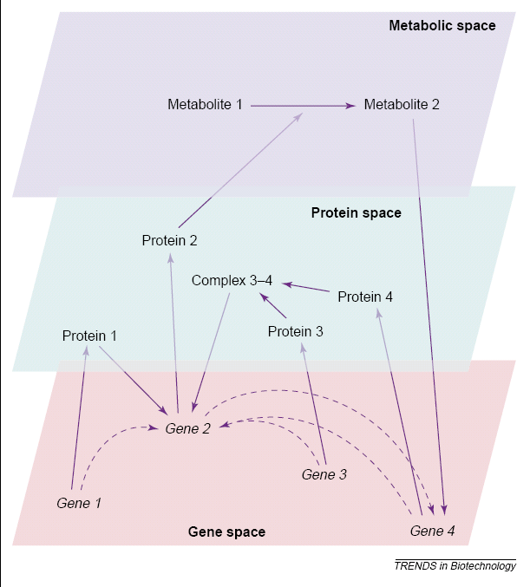
Genomics
Genomics – “The large scale study of genomes and their functions”
Why protein network?
Assemblies represent more than the sum of their parts.
`complexity' may partly rely on the contextual combination of the gene products.

Slide 12
Methodologies for high throughput research
Pairwise test for protein interactions
(Yeast 2 hybrid)
Purify protein complexes and identify binding partners
Screen for genetic interactions between proteins
(synthetic lethality)
Large scale tests for protein interactions
(protein chips)
Image courtesy: BUGGS

Slide 13
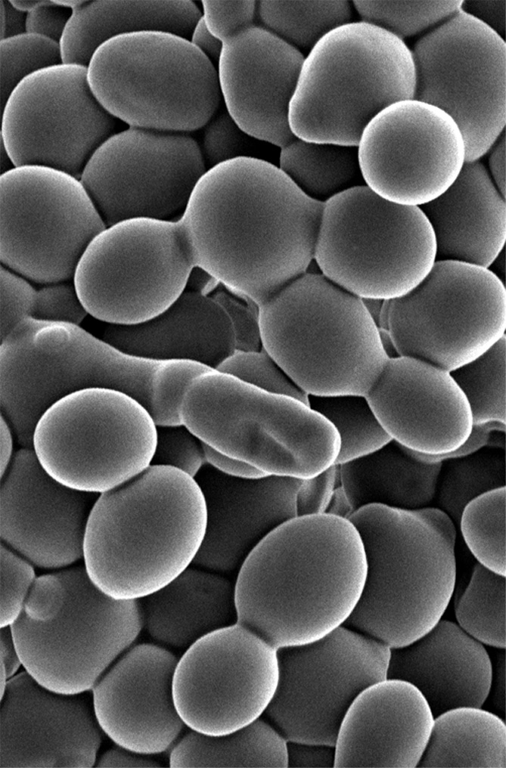
Yeast as a model
Smaller genome
All the essential functions are conserved from yeast to humans.
Why yeast genomics?
A model eukaryote organism …
Saccharomyces cerevisiae

Slide 14
Yeast Genetic Interaction Network
“A comprehensive analysis of protein-protein interactions in Saccharomyces cerevisiae”P.Utez et al, Nature 2000
“Functional organisation of the yeast proteome by systematic analysis of protein complexes” G. Gavin et al, Nature 2002
“Global Mapping of the Yeast Genetic Interaction Network” Tong et al, Science 2004
“Conserved patterns of protein interaction in multiple species” R. Sharan et al, PNAS 2005

Slide 15
Pairwise testing of protein interactions in yeast reveals several important yeast hubs
Notes:
a, Autophagy pathway illustrating potential novel interactions that place functionally unclassified proteins in a biological context. b, Potential interactions identified by screens of the Sm motif-containing proteins Lsm2, Lsm4 and Lsm8. c, The Clb/Cdc28/Cks1 complex shows novel interactions between proteins involved in the same biological function. d, The Msh5 pathway illustrates novel interactions that link biological functions together into greater cellular processes.

Slide 16
Functional organization of the yeast proteome by systematic analysis of protein complexes
Notes:
Higher order organisation of the proteome. Each node is a complex of proteins and connections are made if they share common proteins. Another way to see how connected everything is. Therefore regulation of one might inadvertently lead to regulation of another.

Slide 17
Functional organization of the yeast proteome by systematic analysis of protein complexes
Focus was on physical interactions.
However, true genetic interactions are not always a result of physical interactions.
So, two genes might be far apart in the genome, might not physically interact and still influence the activity of each other
Notes:
Higher order organisation of the proteome. Each node is a complex of proteins and connections are made if they share common proteins. Another way to see how connected everything is. Therefore regulation of one might inadvertently lead to regulation of another.

Slide 18
Synthetic lethality
High genetic redundancy hardens the discovery of many gene functions (30%).
Only the double mutation is lethal, either of the single mutations is viable.
Why?
  Single biochemical pathway.
  Two distinct pathways for one process.
  Transcriptional regulation
  Feed-forward/ feedback loops

Slide 19
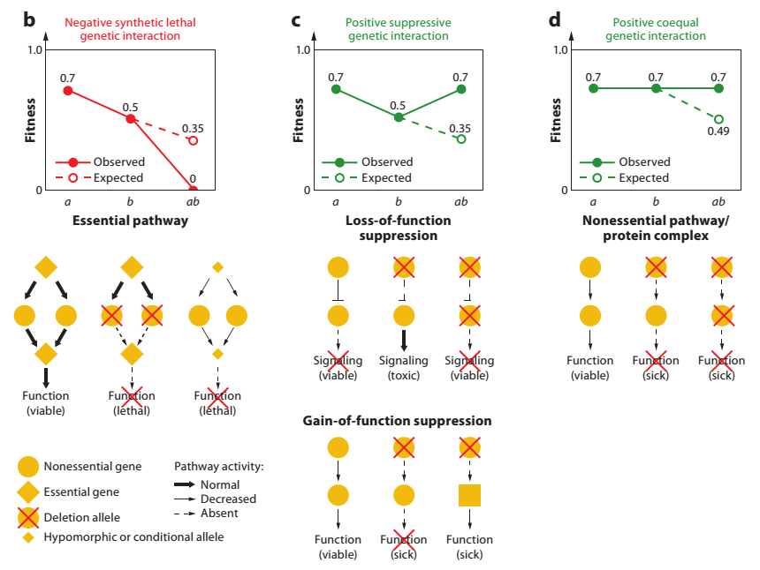
Help identify genes whose products buffer one another and impinge on the same essential biological process

Slide 20
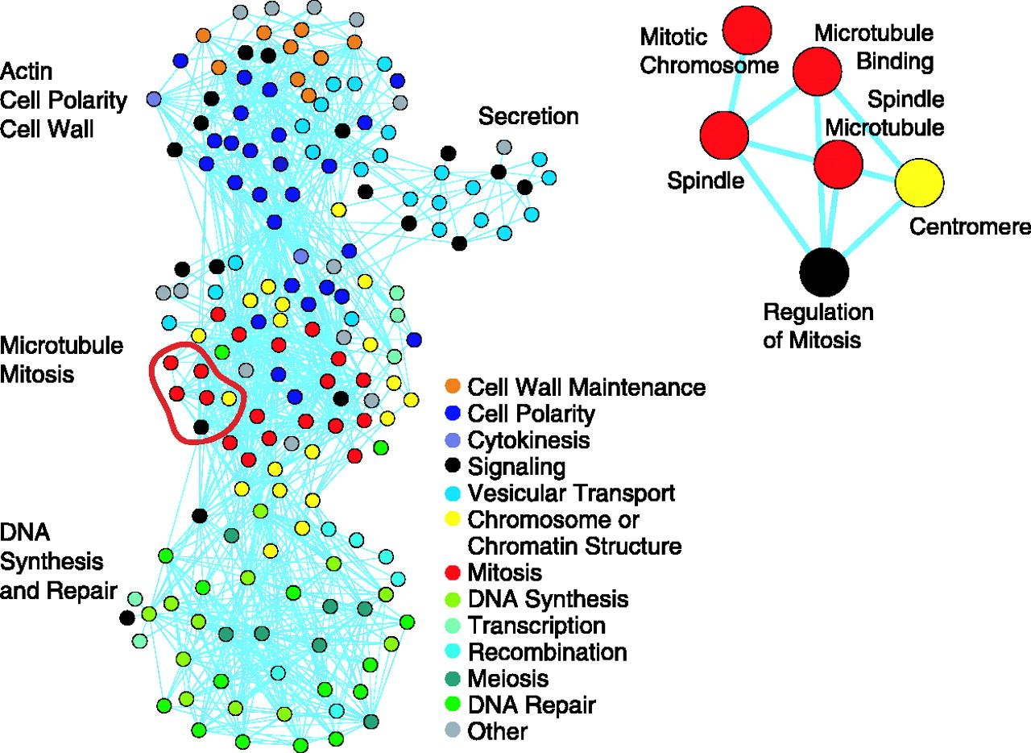

Fig. 1. A network of genetically connected gene functions.
Amy Hin Yan Tong et al. Science 2004;303:808-813
American Association for the Advancement of Science
Notes:
A network of genetically connected gene functions. GO attribute names are colored according to the legend. Pairs of different GO attributes are linked if they are connected by genetic interactions significantly, more often than would be expected by chance (P < 0.002) (table S7). The subsets of GO attributes were clustered using a network layout algorithm (5). Because the P values have been corrected for multiple hypothesis testing by resampling (5), it would be unlikely (P < 0.002) to find any lines in this network if synthetic interaction and GO annotation were unrelated. A section of the complete map on the left (outlined in red) is shown in greater detail on the right. Additional views of this map may be found in figs. S9 and S10. Significance is based on the Fisher's exact test of association, and the P value is corrected for multiple hypothesis testing by resampling (29).

Slide 21
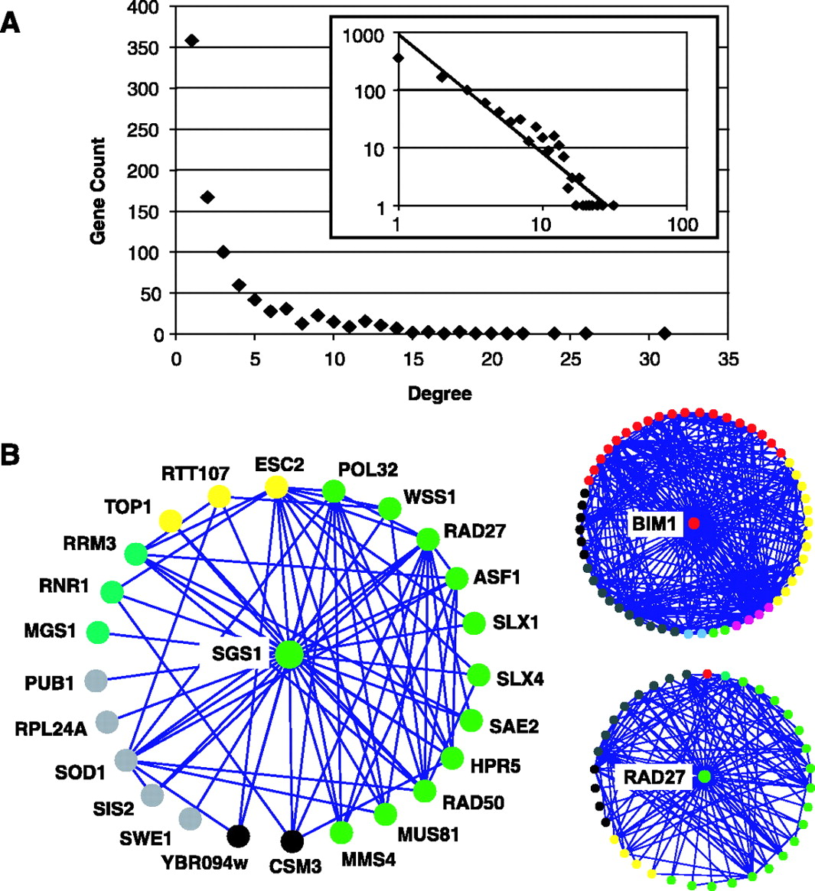
Fig. 4. (A) The degree distribution of SGA array genes not also used as query genes.
Example of preferential attachments
Amy Hin Yan Tong et al. Science 2004;303:808-813
American Association for the Advancement of Science
Notes:
(A) The degree distribution of SGA array genes not also used as query genes. The number of genes with each degree (number of interaction partners) is shown on linear and log-log (inset) scales. The fit to a straight line in the log-log plot indicates a power-law degree distribution, a characteristic of a “scale-free” network. An analysis of the degree distribution of the query genes is included in the supplementary material (5) (fig. S11). (B) The topology of the genetic network of neighborhood of three query genes (SGS1, RAD27, and BIM1). Genes are represented as nodes and synthetic genetic interactions are represented as edges connecting the nodes. The nodes are colored according to a defined subset of GO functional annotations (table S8). 95% of the nodes were tested for synthetic genetic interactions against each other.

Slide 22
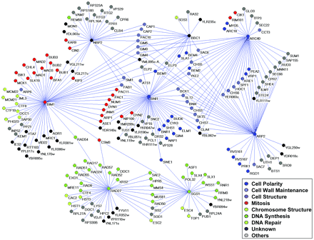
Synthetic lethality map
synthetic lethality analysis
8 genes against all produced a network of synthetic lethal pairs.
Systematic Genetic Analysis with Ordered Arrays of Yeast Deletion Mutants

Slide 23
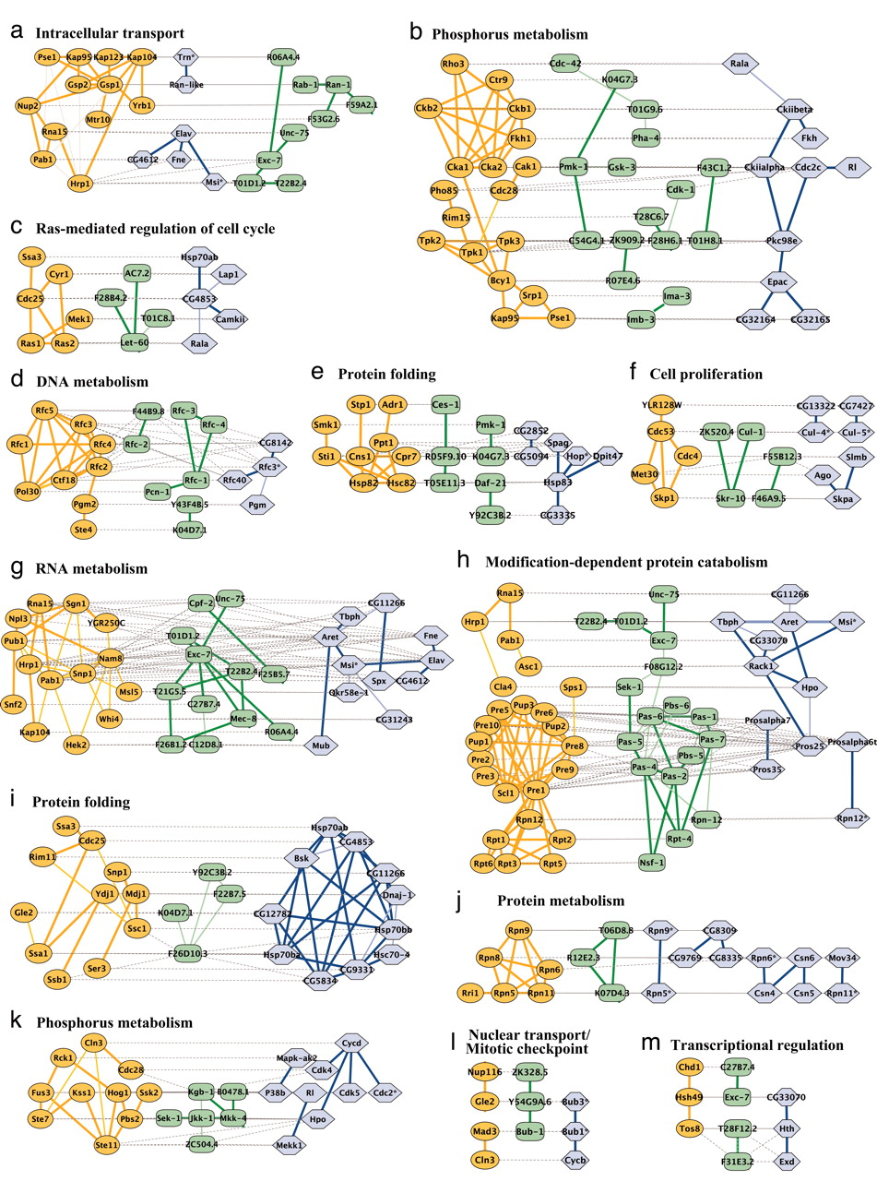

Conserved patterns of protein interaction in multiple species
Roded Sharan et al. PNAS 2005;102:6:1974-1979
©2005 by National Academy of Sciences
Notes:
Representative conserved network regions. Shown are conserved clusters (a–k) and paths (l and m) identified within the networks of yeast, worm, and fly. Each region contains one or more overlapping clusters or paths (see Fig. 3). Proteins from yeast (orange ovals), worm (green rectangles), or fly (blue hexagons) are connected by direct (thick line) or indirect (connection via a common network neighbor; thin line) protein interactions. Horizontal dotted gray links indicate cross-species sequence similarity between proteins (similar proteins are typically placed on the same row of the alignment). Automated layout of network alignments was performed by using a specialized plug-in to the cytoscape software (34) as described in Supporting Text.

Slide 24
Notes:
Until now, no genetic interaction studies have been performed on yeast variants obtained from SCRaMBLE. I think we are still at a stage where we are sequencing and identifying genes that result in a particular mutation. The next step obviously, will be to identify interactions. For example, can we make the tiny colonies that grew on 7% ethanol, grow better. These are called rescue mutations, where you are selecting for mutations that rescues the fitness defect.

Slide 27
Mechanism of ethanol tolerance

Slide 28
Protein protein interaction network of Yeast

Slide 29
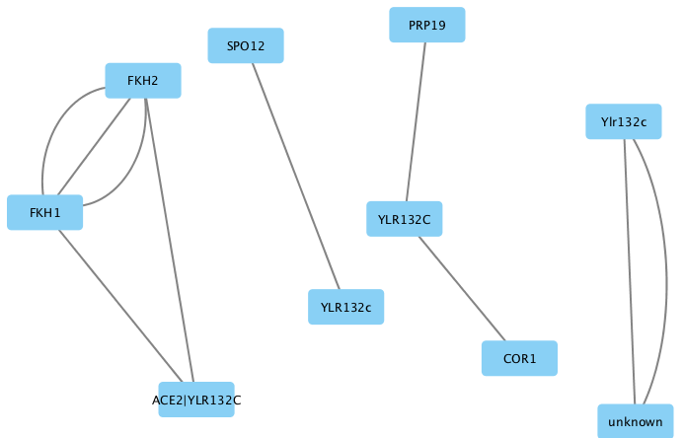
Protein protein interaction network of Yeast
Identify connections specific to Ace2

Slide 30
Sec24
Fps1
Ace2
Psd1
Mgs1

Slide 31
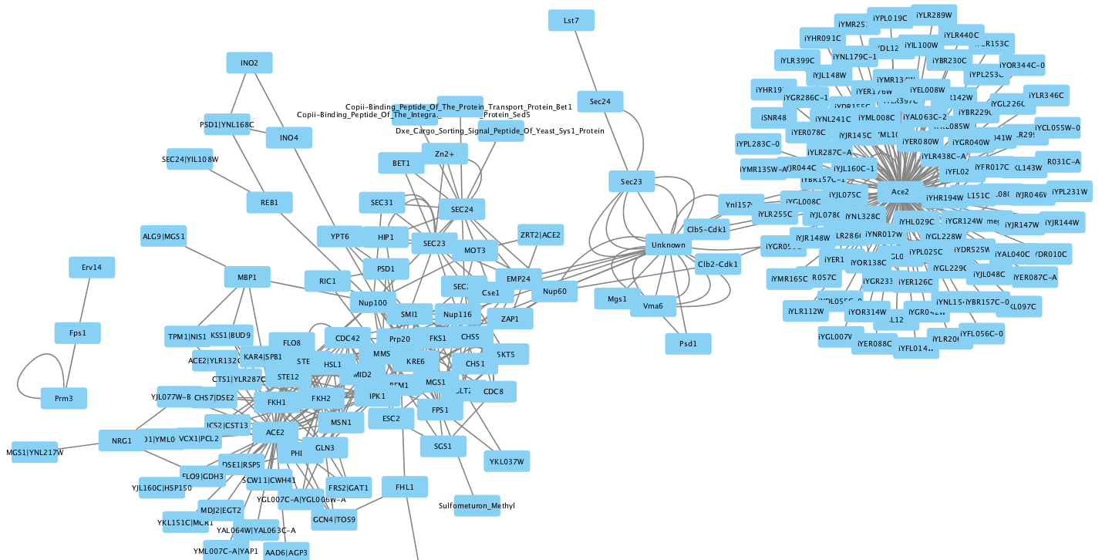
Protein protein interaction network of Yeast
Genes involved in ethanol resistance
Sec24
Fps1
Ace2
Psd1
Mgs1

