Slide 1
Variables, Graphs, Rates of Change, and regression lines
Example in Excel

Slide 2
Variables
x variable and y variable: represent values that change or vary.
x is called the independent variable
y is called the dependent variable because it depends upon x
Function: y = f(x)
y = 2x + 4, y = x² - 2x + 5
Graph of functions: x on horizontal axis, y on vertical axis.
y
x

Slide 3
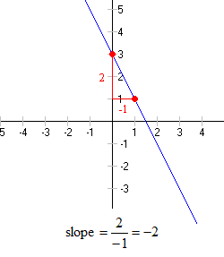
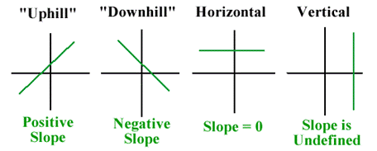
Linear Functions
y = mx + b
m = slope = rise/run = change in y/change in x = rate of change
b = y-intercept

Slide 4
Graphing
Age (Years) | Height (Inches)
0 | 20
1 | 23
2 | 26
3 | 29
4 | 32
5 | 35
6 | 38
7 | 41
8 | 44
9 | 47
10 | 50
My height from birth to age 10
height is dependent variable, time is independent variable
height = 3(age) + 20 or y = mx + b
slope = 3 = rate of change
total change in height = 3(10) = 30 inches.
Line graph b/c variable vs time

Slide 5
Graphing
Age (Years) | Actual Height (Inches)
0 | 17.2
1 | 18.9
2 | 24.3
3 | 28.4
4 | 29.1
5 | 36.1
6 | 39.1
7 | 40.6
8 | 41.2
9 | 45.9
10 | 49.1
More realistic data
Line graph b/c variable vs time
Trendline = regression line = best fitting line
Form of a regression line: y = mx + b
Slope = rate of change = 3.21 which means that my height increases 3.21 inches per year
Total change in height = 3.21(10) = 32.1 inches
R² = 0.98 means that 98% of the variation in my height is explained by the linear model which means the model is a good fit

Slide 6
Graphing
Height (Inches) | Weight (lbs)
17.2 | 7.1
18.9 | 31.2
24.3 | 39.6
28.4 | 43.2
29.1 | 45.1
36.1 | 60.2
39.1 | 63.1
40.6 | 65.8
41.2 | 69.1
45.9 | 71.2
49.1 | 71.9
My weight vs my height
Scatter plot since two continuous variables
weight = 1.81(height) – 9.25
Positive relationship: slope = 1.81 so my weight increases by 1.81 lbs for every 1 inch increase in height = rate of change in weight
91% of variation in weight explained by variation in height

Slide 7
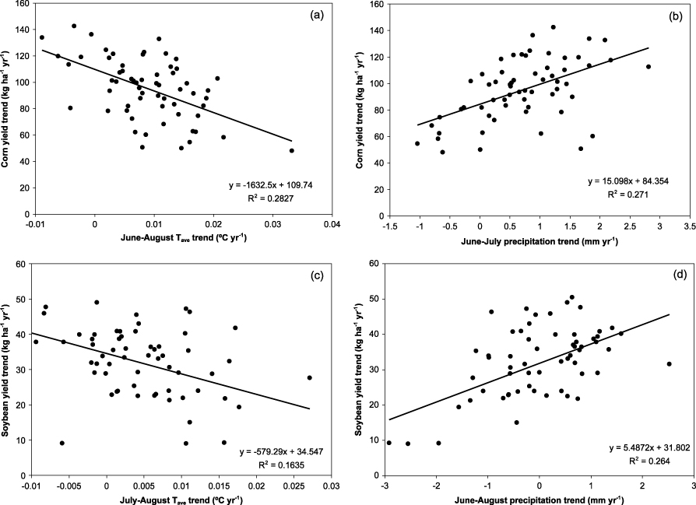
Graphing
Generally have lots of measurements

Slide 8
In Excel
Insert $→$ Line Chart or Scatter
Chart Tools $→$ Design $→$ Select Data
Right Click $→$ Add Trendline $→$ Check to show equation and R-squared value

