Slide 1
Exploring the population dynamics of wintering bald eagles through long-term data
TIEE Module implemented by:

Slide 2
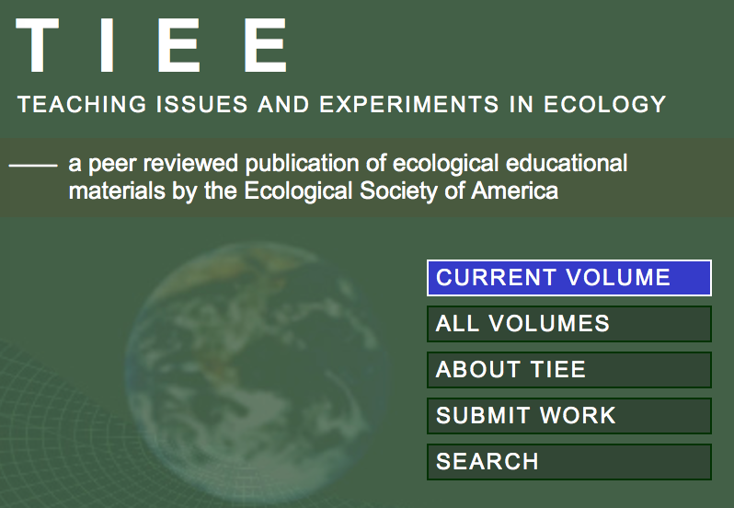
TIEE
ESA
QUBES

Slide 4
Bald Eagle (Haliaeetus leucocephalus)
Bald and Golden Eagle Protection Act (Eagle Act) and the Migratory Bird Treaty Act (MBTA)
Protect bald eagles from a variety of harmful actions and impacts
http://www.fws.gov/alaska/eaglepermit/pdf/national_guidelines.pdf

Slide 5
Bald Eagle (Haliaeetus leucocephalus)
Capable of breeding at 4-5 years of age
In healthy populations, may not start breeding until much older
Bald eagles may live 15-25 years in the wild
Adults weigh 8-14 pounds (occasionally reaching 16 pounds in Alaska)
Wingspans of 5-8 feet
http://www.fws.gov/alaska/eaglepermit/pdf/national_guidelines.pdf

Slide 6
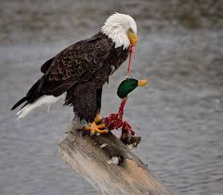
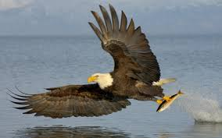
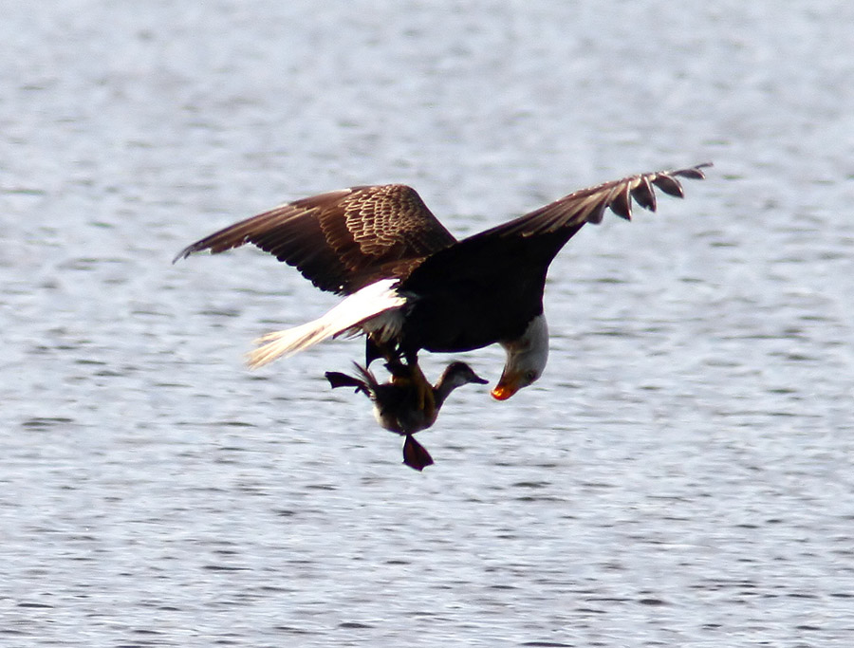
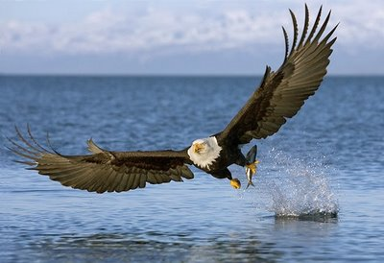
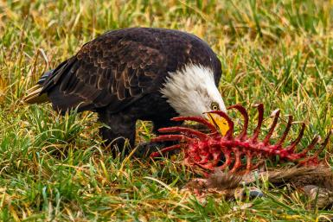
Eating Habits (opportunistic carnivores)
Fish
Water fowl
Slide courtesy of D. Wilgers, McPherson College
Carion

Slide 7
Natural History
Historically occurred throughout the contiguous United States and Alaska
Declining in lower 48 States between 1870-1970, have rebounded and re-established breeding territories in each of the lower 48 states
Largest North American breeding populations are in Alaska and Canada
Also: Florida, Pacific Northwest, Greater Yellowstone area, the Great Lakes states, Chesapeake Bay region
http://www.fws.gov/alaska/eaglepermit/pdf/national_guidelines.pdf

Slide 8
Natural History: distribution varies seasonally
Bald eagles that nest in southern latitudes frequently move northward in late spring and early summer, often summering as far north as Canada
Most eagles that breed at northern latitudes migrate southward during winter, or to coastal areas where waters remain unfrozen
http://www.fws.gov/alaska/eaglepermit/pdf/national_guidelines.pdf

Slide 9
Natural History: distribution varies seasonally
Migrants frequently concentrate in large numbers at sites where food is abundant and they often roost together communally
In some cases, concentration areas are used year-round: in summer by southern eagles and in winter by northern eagles
http://www.fws.gov/alaska/eaglepermit/pdf/national_guidelines.pdf

Slide 10
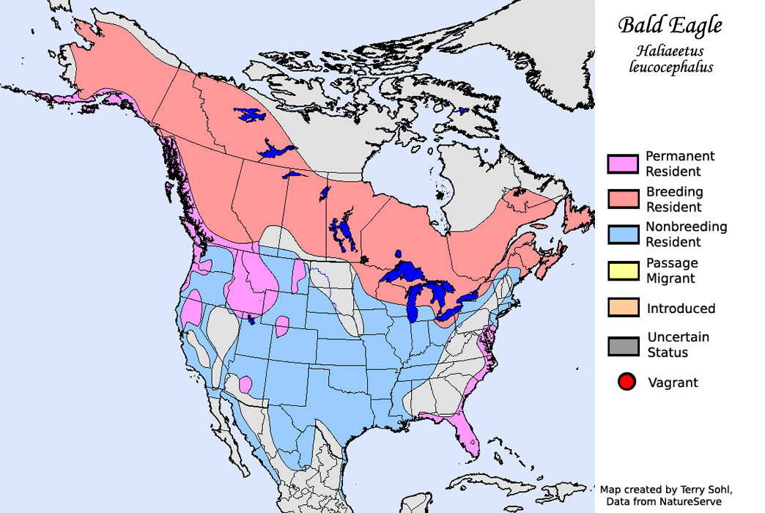
Slide courtesy of D. Wilgers, McPherson College

Slide 11
http://www.fws.gov/home/feature/2007/bald_eagle_pop_map_final.pdf

Slide 12
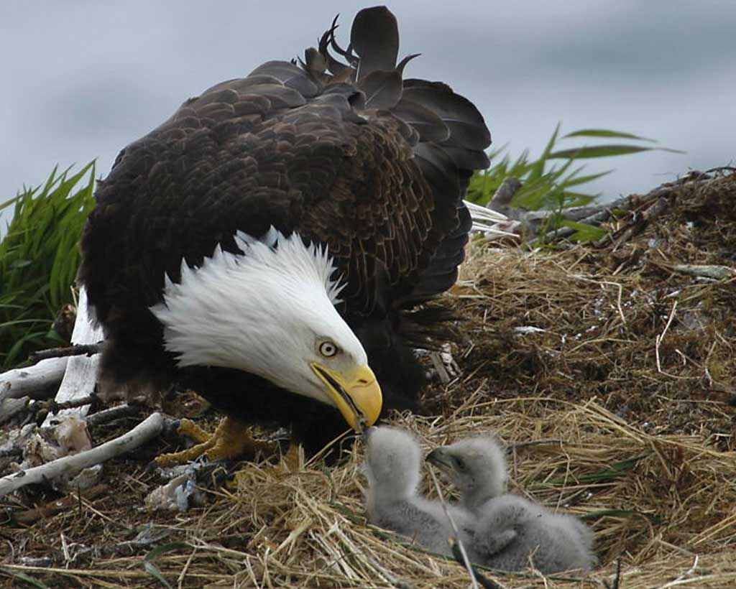
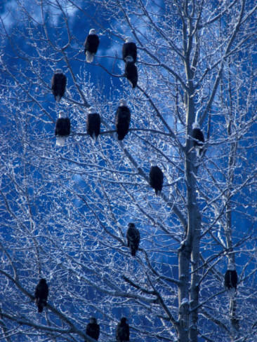
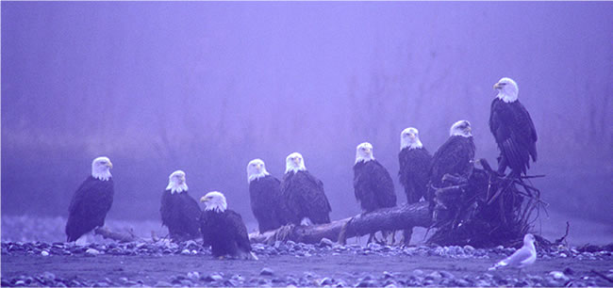
Sensitive to human activity
-Nests built ~ 1.2 km from low density human
disturbance
-1.8 km from medium/high density human
disturbance
Predominantly solitary animals
-migrate individually, but will roost together at stopover points
Slide courtesy of D. Wilgers, McPherson College

Slide 13
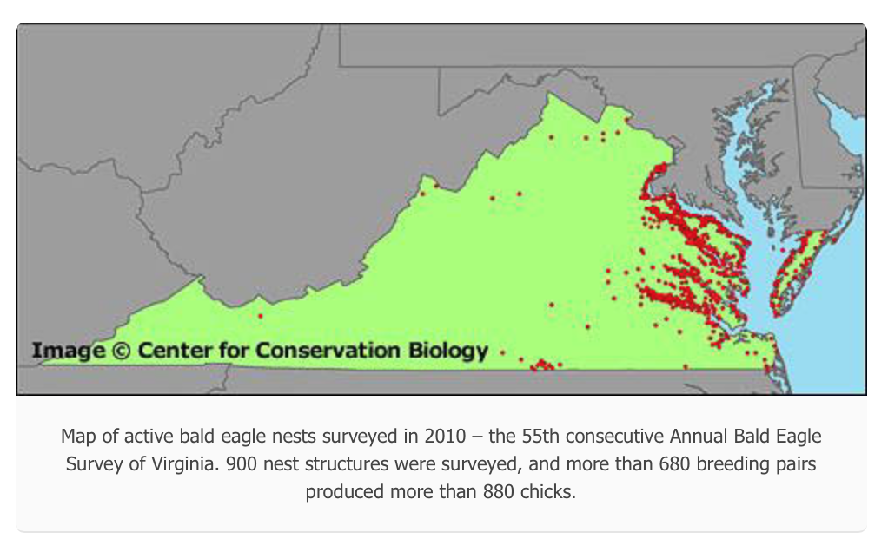
http://www.ccbbirds.org/what-we-do/research/species-of-concern/virginia-eagles/status-in-virginia/

Slide 14
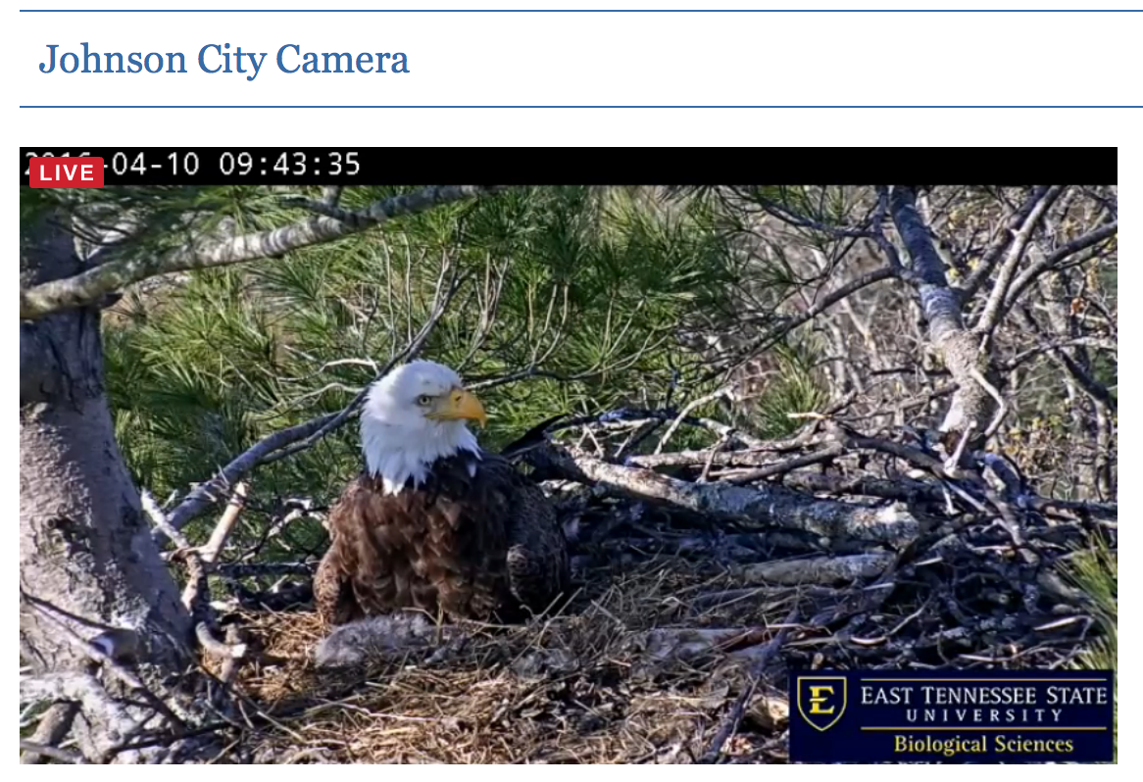
http://www.etsu.edu/cas/biology/eagle-cam/cameras.php

Slide 15
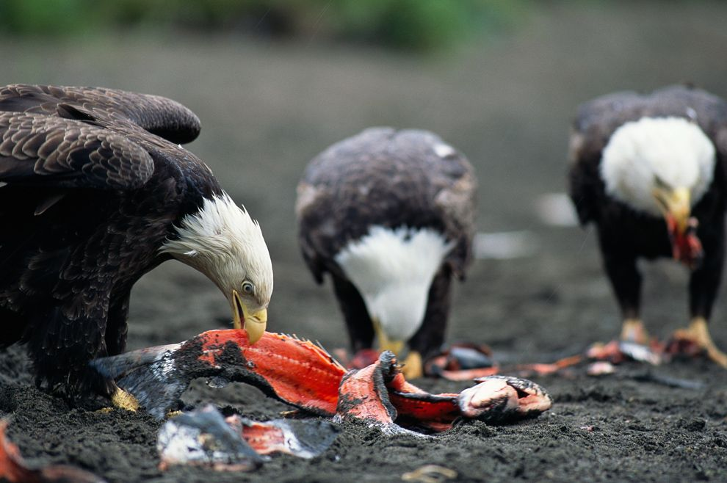
Part I: How does the bald eagle population at a winter stopover change over three decades?
Part II: How do salmon abundance and December temperatures influence bald eagle numbers?
Slide courtesy of D. Wilgers, McPherson College

Slide 16
Long-term data on bald eagles
Bureau of Land Management in Northern Idaho
Since 1974, counted migrating bald eagles every midwinter at Lake Coeur d’Alene
Eagle counts taken on a weekly basis at several sites on the northeast end of the lake
Additional data on:
Kokanee salmon (Onorhynchus nerka) abundance
Weather

Slide 18
Part I: How does the bald eagle population at a winter stopover change over three decades?

Slide 19
Part II: How do salmon abundance and December temperatures influence bald eagle numbers?

Slide 20
1-page proposal (30-points) Due next week
Question related to phenology or eagles
Hypothesis (If):
Prediction (then):
Experimental design
Independent variable(s):
Dependent variable(s):
Type of graph
Type of statistical analysis
Typed, group assignment, 11 font, 1 inch margins
Introduction, background, “build up” to question
Experimental design
References

