Slide 1
Investigating the footprint of climate change on phenology and ecological interactions in north-central North America
TIEE Module implemented by:
Notes:
Completed in a 4 hour lab period (with introductory lectures, it took about 3.5 hours)

Slide 2
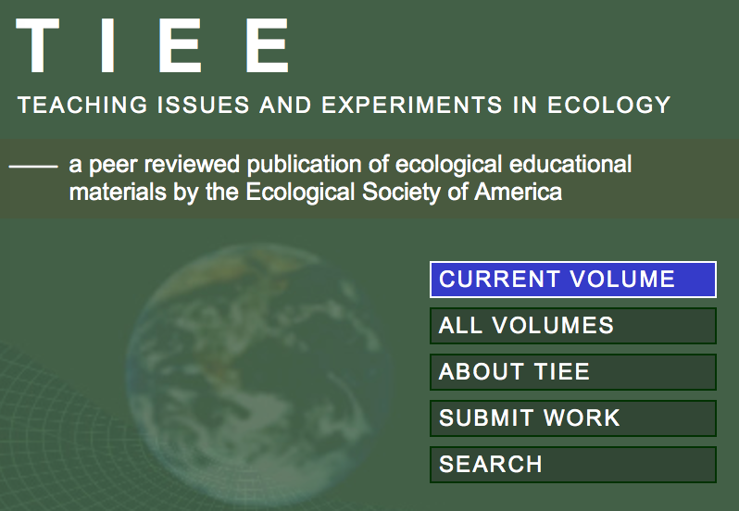
TIEE
ESA
QUBES

Slide 4
Investigating the footprint of climate change on phenology and ecological interactions in north-central North America
Use data set from Ohio: have long-term temperatures changed?
How will these temperature changes impact plant and animal phenology, ecological interactions, and, as a result, species diversity?
Phenology: study of the timing of recurring seasonal biological events (Forrest and Miller-Rushing, 2010)
Exercise designed to give students experience working with large datasets
Use real ecological data to evaluate long-term temperature change and its impacts on flowering phenology, pollinator emergence and arrival phenology, and emergent trophic mismatches

Slide 5
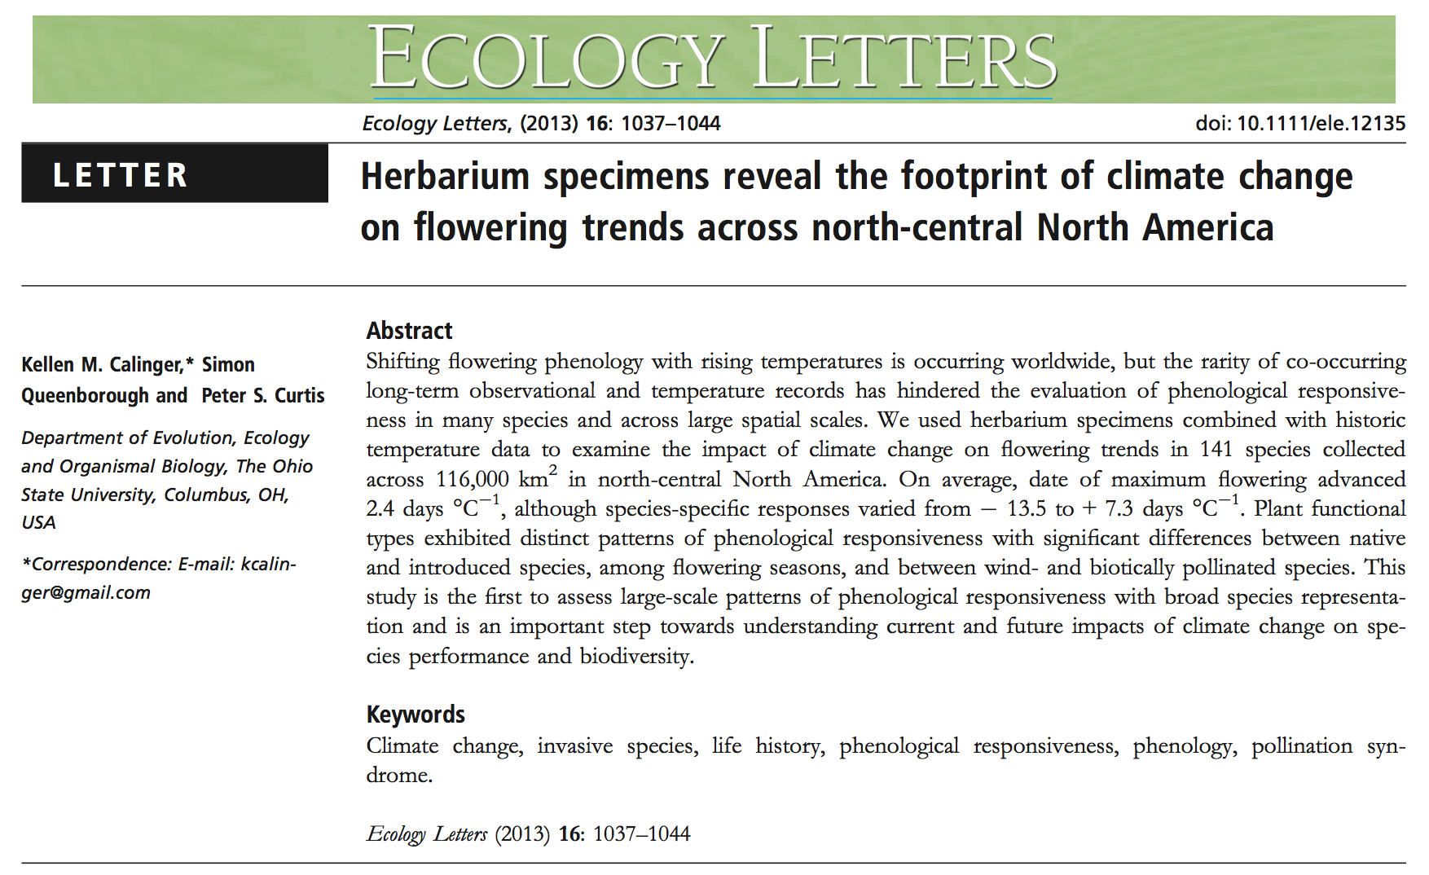

Slide 6
Introduction to Phenology
Study of the timing of recurring seasonal biological events (Forrest and Miller-Rushing, 2010)
“…temporal dimension of natural history”
Determines the stage of development reached by an organism or population at the time when it intersects with particular components of its environment
Forrest and Miller-Rushing, 2010

Slide 7
Introduction to Phenology
Ask questions such as:
How does a plant population’s timing of leaf unfolding vary with respect to temperature?
Has the date of the first frog call advanced over a period of decades?
Forrest and Miller-Rushing, 2010 (and references therein)

Slide 8
Introduction to Phenology
Growing concern with documenting and forecasting the impacts of climate change has driven increased interest in the role of phenology
Phenological shifts thoroughly documented biological responses to climate change for last 150 years
Forrest and Miller-Rushing, 2010 (and references therein)

Slide 9
“Climate change is causing mismatches in food supplies, snow cover and other factors that could severely impact successful migration and reproduction of avian populations unless they are able to adjust to new conditions.”

Slide 10
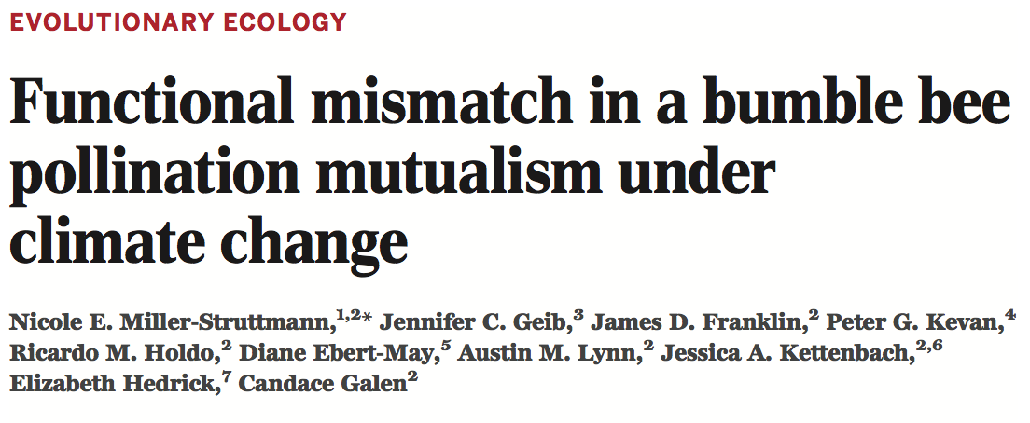
Warming summers → reduced numbers of flowers preferred by “long-tongued” bumble bee species preferred → forcing bees to be general foragers capable of feeding across remaining flowers, including many shallow flowers
N. E. Miller-Struttmann, et al.. Functional mismatch in a bumble bee pollination mutualism under climate change.
Science, 2015; 349 (6255): 1541 DOI: 10.1126/science.aab0868

Slide 11
Exercise you will do…
Get experience working with large datasets
Use real ecological data to evaluate:
long-term temperature change and its impacts on flowering phenology
pollinator emergence and arrival phenology
emergent trophic mismatches
Data sets:
U.S. Historical Climatology Network (USHCN, Menne et al. 2010)
Flowering phenology data Calinger et al. (2013)
Pollinator arrival and emergence time data from Ledneva et al. (2004)

Slide 12
Climate change
Climate change as a result of anthropogenic greenhouse gas (GHG) emissions is clear in both climatological and biological data
Global temperatures have increased by 0.74°C ± 0.18°C over the past 100 years (1906-2005)
Some regions experience locally greater warming (IPCC 2007)
Along with this average increase in temperature, extreme weather events including extreme heat have become more common
The ten hottest years on record have all occurred since 1998

Slide 13
Climate change
Scientists use long-term climate and biological datasets to assess past and current rates of warming and the impacts of this warming on key ecosystem functions
Analyses provide crucial information for prediction of future impacts of warming as massive quantities of GHGs are released into the atmosphere

Slide 14
Climate change
Phenological events include time of flowering, mating, hibernation and migration
Phenological events strongly driven by temperature
Warmer temperatures typically resulting in → earlier occurrence of springtime migration, insect emergence from dormancy, and reproductive events
Shifts in phenology, predicted by climate change have been observed worldwide
Climate change → broad impacts on ecology

Slide 15
In your groups…
Analyze long-term temperature data collected in Ohio by the U.S. Historical Climatology Network
Establish temperature trends in Ohio over the past 115 years
Investigate temperature effects on the:
Flowering of six plant species
Arrival and emergence times of two pollinator species

Slide 16
Look at the Excel file with data from Moodle
The temperature record for each climate division is given in separate worksheets
Each climate division worksheet includes two columns
“Year” provides the year in which the temperature data were collected
“Temp (deg C)” provides the spring time temperature for that year in degrees Celsius
These division temperatures were calculated by averaging the temperature records for every USHCN weather station in that division for the year of interest from February to May (spring temperatures)

Slide 24
Notes:
Ask James!

