Slide 1

WikiModel:
A Web-based Software Application that Enables Teachers, Students, Scientists and Engineers to Simulate, Fit and Share Mathematical Models
SIMIODE Expo 2023
Sami Kanderian
WikiModel LLC
sami@wikimodel.com
Immediate access to application (no download):
https://www.wikimodel.com
https://www.wikimodel.com/about/about-wikimodel
https://www.wikimodel.com/about/application-instructions
The above two links are clickable links on the top right of the WikiModel webpage
Notes:
I am not in academia. I left academia over 20 years ago, but I have a passion for mathematical modeling and mentoring. My educational background is in biomedical engineering and mechanical engineering which also describes my career path. To be honest, I didn’t really enjoy my differential equations class as an undergraduate. I didn’t see the point in solving for analytical solutions of differential equations. However, in my career, I’ve spent over a decade modeling insulin kinetics and glucose metabolism in type 1 diabetes and that’s how my interest in differential equations took off. That’s why I think SIMIODE a useful community to make student interested in mathematical modeling early on by demonstrating its applicability in solving real world problems. Enough about me and onto the WikiModel Software.

Slide 2
What is WikiModel?
A web based software tool for simulating and fitting models
No download or installation
Runs on the cloud via your web browser
  Device/OS agnostic (PC, Mac, tablet, smartphone)
No programming (enter equations as they appear in a text book)
Handles any number of differential and/or closed form equations
Handles discrete inputs (impulse, step, interpolation)
Simulated results are plotted on the screen
Fits model to data:
  Automatically figures out if linear or non-linear least squares is required
Simulation results can be downloaded
Workspaces are shareable to the public or private groups

Slide 3
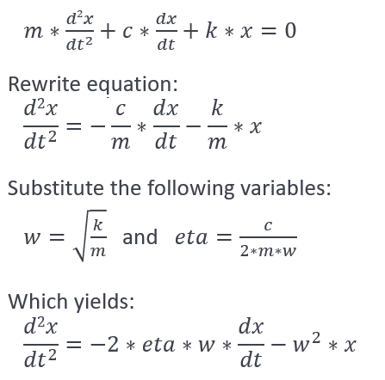
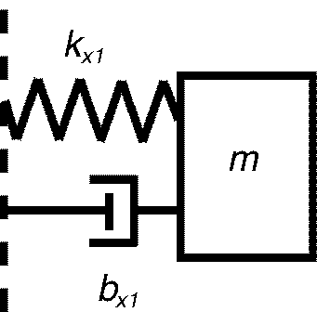
Example 1: A second order spring dashpot system:
Write second order equation as two first order ODEs:
dv/dt=-2*eta*w*v-w^2*x
dx/dt=v
Copy and paste model equations into WikiModel application:
  Simulate eta <1 (underdamped system)
  Simulate eta =1 (critically damped system)
  Simulate eta >1 (overdamped system)
Fit model to experimental data to identify eta, w, and x_ini
Direct link: http://www.wikimodel.com/workspace/5081879929683968/Second Order System

Slide 4
Other Modeling Examples:
Predator Prey Model:
  http://www.wikimodel.com/workspace/5081879929683968/Predator Prey
Model of Covid outbreak in Wuhan China:
Replication of Nature, Cell Discovery by Wang, H., Wang, Z., Dong, Y. et al. titled “Phase-adjusted estimation of the number of Coronavirus Disease 2019 cases in Wuhan, China” on 24th of February: https://www.nature.com/articles/s41421-020-0148-0
  http://www.wikimodel.com/workspace/5081879929683968/Coronavirus_Wuhan_A
Model of Covid cases in Hawaii taking into consideration vaccinations and incoming infected travelers:
  http://www.wikimodel.com/workspace/5081879929683968/Covid_Hawaii3
Hodgkin Huxley Current Clamp:
  http://www.wikimodel.com/workspace/5081879929683968/Hodgkin Huxley Current Clamp
Electrocardiogram:
Replication of McSharry PE, Clifford GD, Tarassenko L, Smith LA. A dynamical model for generating synthetic electrocardiogram signals. IEEE Trans Biomed Eng. 2003 Mar;50(3):289-94: https://ieeexplore.ieee.org/document/1186732
  http://www.wikimodel.com/workspace/5081879929683968/Electrocardiogram
Don’t worry about copying the links! You can search for the models using the Search Bar using any of the words in the saved workspace title (after the last / in the link)

Slide 5
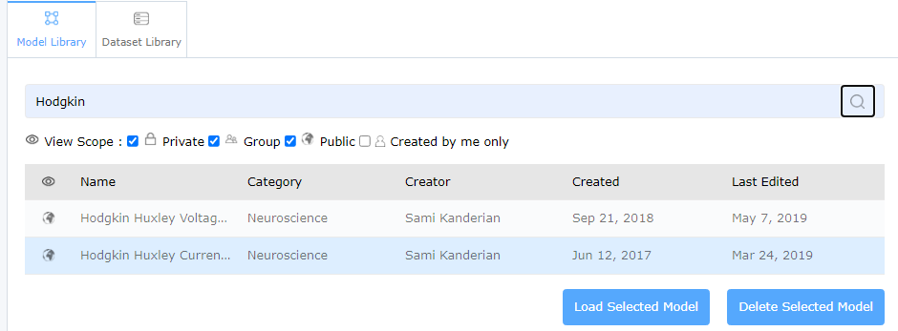
Searching for Models using the Search Bar
You can search for models by typing an words that are part of the saved workspace name

Slide 6
Examples in Day 2 session
Saturday, 11 February 2023 at 5:30pm Eastern
Main Room
Implementing a Multicompartment Pharmacokinetic Drug Delivery Model as a Systems of ODEs:
  http://www.wikimodel.com/workspace/5081879929683968/Three Compartment Bolus Response
A Virtual Patient with Type 1 Diabetes:
Replication of Kanderian SS, Weinzimer S, Voskanyan G, Steil GM. Identification of intraday metabolic profiles during closed-loop glucose control in individuals with type 1 diabetes. J Diabetes Sci Technol. 2009 Sep 1;3(5):1047-57.: https://www.ncbi.nlm.nih.gov/pmc/articles/PMC2769900/
  http://www.wikimodel.com/workspace/5081879929683968/Coronavirus_Wuhan_A
Don’t worry about copying the links! You can search for the models using the Search Bar using any of the words in the saved workspace title (after the last / in the link)

