Slide 2
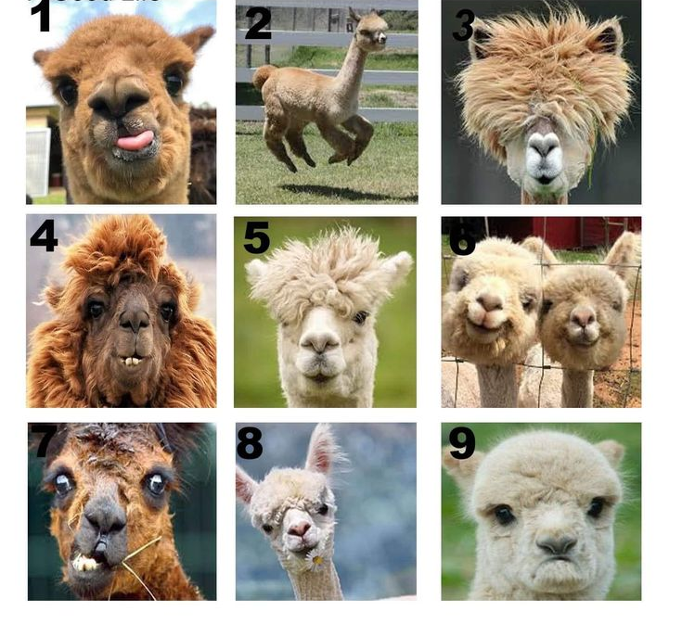

Slide 4
The Build a Genome course
(and a brief introduction to the synthetic yeast project)
Eric Cooper
Hartwick College
Oneonta, NY
August 4, 2023

Slide 5
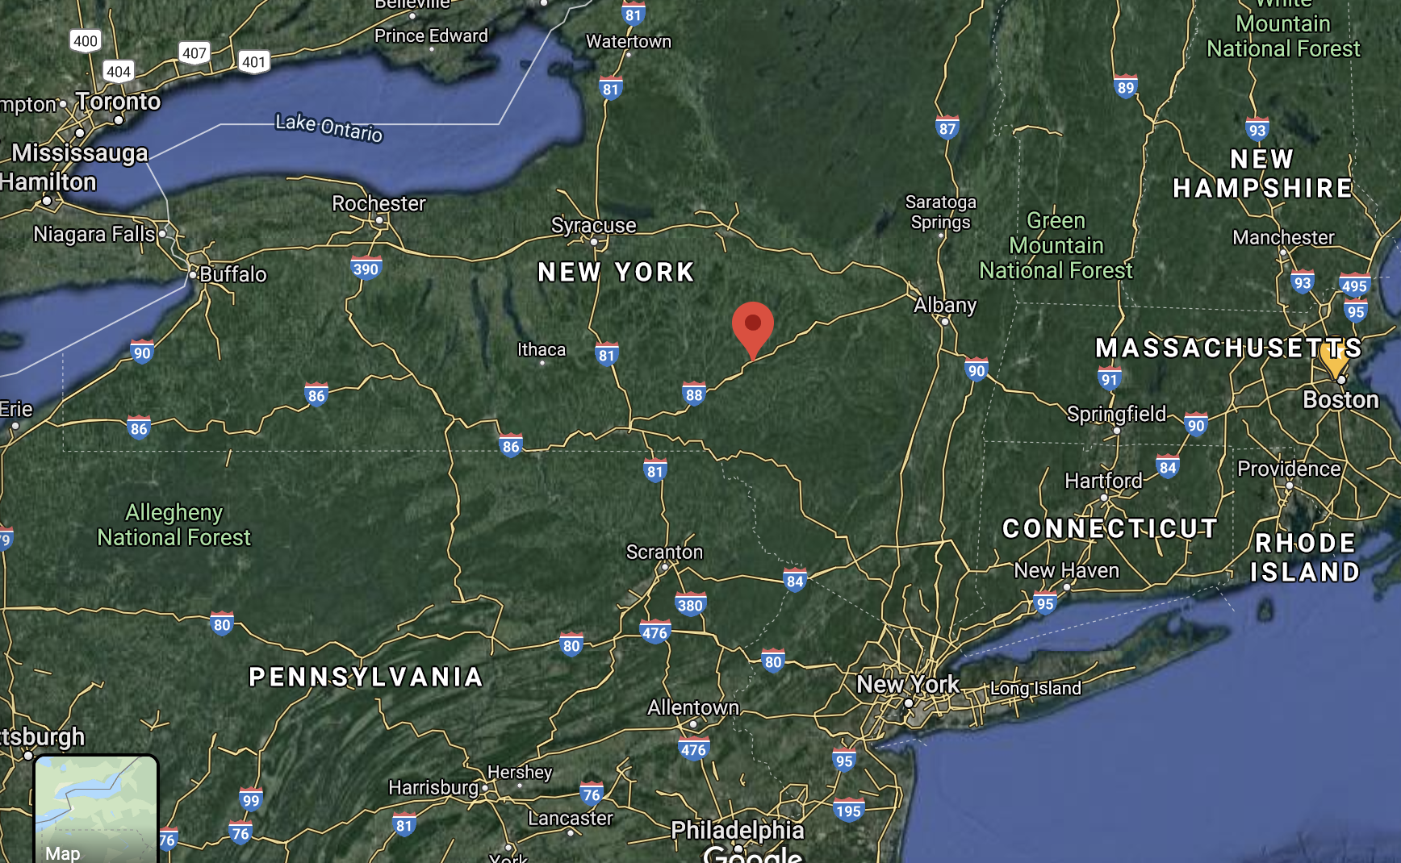

So glad you made it here!
Oneonta

Slide 6
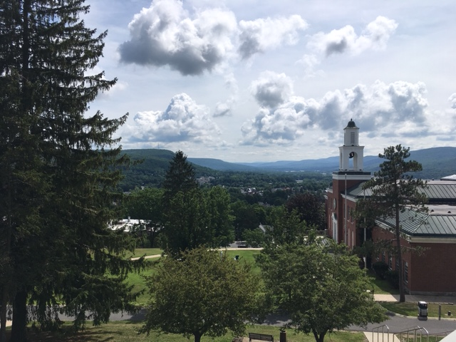
View from Hartwick’s main quad

Slide 7
View from Hartwick’s main quad

Slide 8
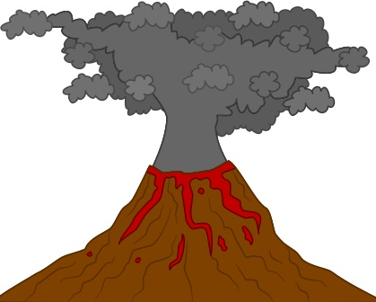
View from Hartwick’s main quad

Slide 9
Outline:
• Brief history of the synthetic yeast project
• How did the Build-a-Genome course start?
• What did the Build-a-Genome students actually do?
• Organization of the Build-a-Genome course
• What I loved about teaching Build-a-Genome, and what “elements”
have I tried to bring here?
Notes:
Grant grew out of our experiences teaching a unique course while postdocs called Build-a Genome. in which students participated in constrction of a fully synthetic yeast genome )first eukarytoi genome) whil elearning molec biol methods. Although synthetis of the DNA is now complete (and you will hear mpre about how the synthetic DNA is incoproated into the yeast genome later from Jeremy , the methods aer robust and can be utilized for other projects in undergrad labs. Also, I learned some valuble teaching lessons from this ocurse that I try to pply ot current courses…

Slide 10
Outline:
• Brief history of the synthetic yeast project
• How did the Build-a-Genome course start?
• What did the Build-a-Genome students actually do?
• Organization of the Build-a-Genome course
• What I loved about teaching Build-a-Genome, and what “elements”
have I tried to bring here?
Notes:
Grant grew out of our experiences teaching a unique course while postdocs called Build-a Genome. in which students participated in constrction of a fully synthetic yeast genome )first eukarytoi genome) whil elearning molec biol methods. Although synthetis of the DNA is now complete (and you will hear mpre about how the synthetic DNA is incoproated into the yeast genome later from Jeremy , the methods aer robust and can be utilized for other projects in undergrad labs.

Slide 11
Yeast is an excellent model organism for research
(and is important in the kitchen)
• ~6000 genes sprinkled along 16 chromosomes (12 Mb genome)
Saccharomyces cerevisiae
Saccharomyces cerevisiae
Notes:
Genome sequenced 1996
Many basic cellular processes deciphered in yeast – Nobel prizes for cell cycle controls, autophagy, protein traffickingin secretoty pathway,

Slide 12
Yeast is an excellent model organism for research
(and is important in the kitchen)
• ~6000 genes sprinkled along 16 chromosomes (12 Mb genome)
• Very few introns (< 5% of genes)
Saccharomyces cerevisiae
Saccharomyces cerevisiae
Notes:
Genome sequenced 1996
Many basic cellular processes deciphered in yeast – Nobel prizes for cell cycle controls, autophagy, protein traffickingin secretoty pathway,

Slide 13
Yeast is an excellent model organism for research
(and is important in the kitchen)
• ~6000 genes sprinkled along 16 chromosomes (12 Mb genome)
• Very few introns (< 5% of genes)
• Routine to knock out, replace and modify genes
Saccharomyces cerevisiae
Saccharomyces cerevisiae
Notes:
Genome sequenced 1996
Many basic cellular processes deciphered in yeast – Nobel prizes for cell cycle controls, autophagy, protein traffickingin secretoty pathway,

Slide 14
Yeast is an excellent model organism for research
(and is important in the kitchen)
• ~6000 genes sprinkled along 16 chromosomes (12 Mb genome)
• Very few introns (< 5% of genes)
• Routine to knock out, replace and modify genes
• Basic biochemistry and cell biology very similar to other eukaryotes
(including humans!)
Saccharomyces cerevisiae
Saccharomyces cerevisiae
Notes:
Genome sequenced 1996
Many basic cellular processes deciphered in yeast – Nobel prizes for cell cycle controls, autophagy, protein traffickingin secretoty pathway,

Slide 15
21st century Nobel Prizes for work with yeast!
2016
2013
2001
Yoshinori Ohsumi
Randy Shekman
Leland Hartwell
Paul Nurse
“for his discoveries
of mechanisms
for autophagy”
“for his discoveries
of machinery
regulating
vesicle traffic”
“for their discoveries of
key regulators of the
cell cycle”
Notes:
Genome sequenced 1996
Many basic cellular processes deciphered in yeast – Nobel prizes for cell cycle controls, autophagy, protein traffickingin secretoty pathway,

Slide 16
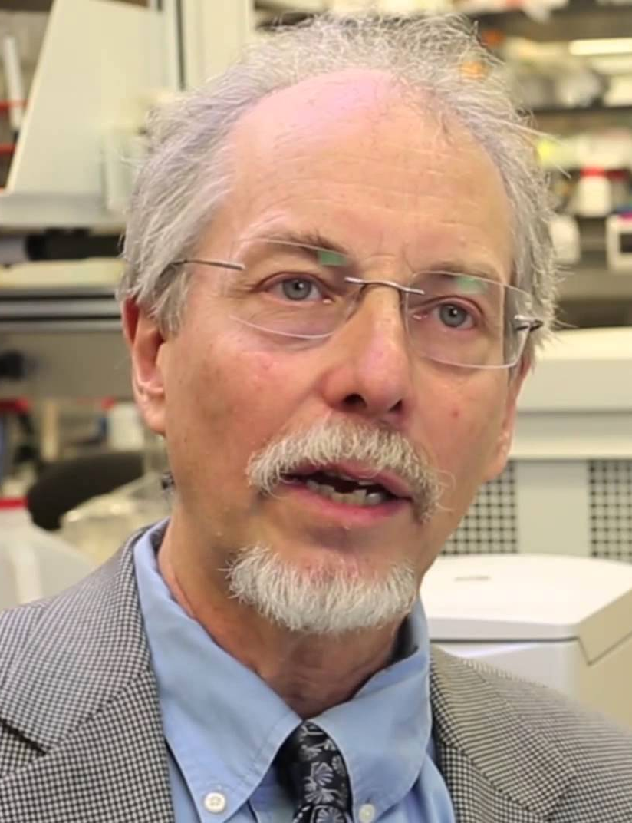
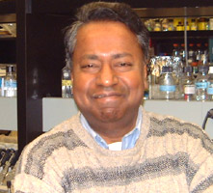
In ~2006,
two colleagues
at Johns Hopkins
were talking
about yeast…
Jef Boeke
Srinivasan Chandrasegaran
Notes:
What I cannot create, I do not understand.”
- Richard Feynman
What I cannot create, I do not understand.”- Richard Feynman

Slide 17
Can we understand more about “rules” of genome organization
by building a genome ourselves?
Jef Boeke
Srinivasan Chandrasegaran
Notes:
What I cannot create, I do not understand.”
- Richard Feynman
What I cannot create, I do not understand.”- Richard Feynman

Slide 18
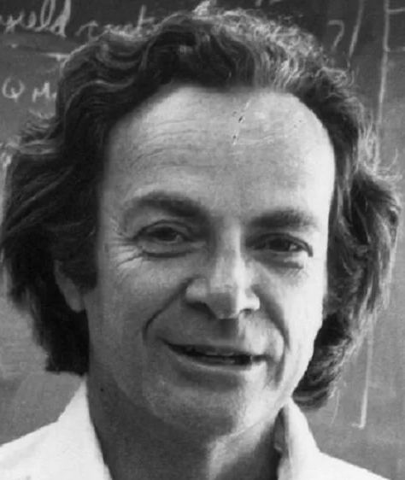
“What I cannot create,
I do not understand.
Richard Feynman
Jef Boeke
Srinivasan Chandrasegaran
Notes:
What I cannot create, I do not understand.”
- Richard Feynman
What I cannot create, I do not understand.”- Richard Feynman

Slide 19
If we were to design a genome, what changes would
we make?
Jef Boeke
Srinivasan Chandrasegaran
Notes:
What I cannot create, I do not understand.”
- Richard Feynman
What I cannot create, I do not understand.”- Richard Feynman

Slide 20
Overall, make conservative changes to avoid reduction in fitness…
Jef Boeke
Srinivasan Chandrasegaran
Notes:
What I cannot create, I do not understand.”
- Richard Feynman
What I cannot create, I do not understand.”- Richard Feynman

Slide 21
Overall, make conservative changes to avoid reduction in fitness…
…and maybe we could make the genome more “flexible” and “stable.”
Jef Boeke
Srinivasan Chandrasegaran
Notes:
What I cannot create, I do not understand.”
- Richard Feynman
What I cannot create, I do not understand.”- Richard Feynman

Slide 22
Changes being incorporated into the synthetic yeast genome:
Notes:
1. Unique PCR tags added to most open reading frames To discriminate the synthetic from wild type sequences

Slide 23
Changes being incorporated into the synthetic yeast genome:
Unique PCR tags added to most open reading frames
- Figure adapted from Annaluru et al.
Notes:
1. Unique PCR tags added to most open reading frames To discriminate the synthetic from wild type sequences

Slide 24
Changes being incorporated into the synthetic yeast genome:
Unique PCR tags added to most open reading frames
Remove all introns (from the ~5% of genes that have them)
- Figure adapted from Annaluru et al.
Notes:
2. Is splicing required for viability of a eukarytoic cell?

Slide 25
Changes being incorporated into the synthetic yeast genome:
Unique PCR tags added to most open reading frames
Remove all introns (from the ~5% of genes that have them)
Remove transposons and other highly repetitive regions
- Figure adapted from Annaluru et al.
Notes:
TO make a “stable” genome without transposons jumping into different sites or highly Repetitive regions that are “hotspots” for genetic instbility/recombinaiton

Slide 26
Changes being incorporated into the synthetic yeast genome:
Unique PCR tags added to most open reading frames
Remove all introns (from the ~5% of genes that have them)
Remove transposons and other highly repetitive regions
Move tRNA genes to own “mini-chromosome”
- Figure adapted from Annaluru et al.
Notes:
Re-location of tDNAs is important because they are hotspots for transposition and genome rearrangements. As such, the synthetic chromosomes may well be quite resistant to such recombinational events relative to normal chromosomes, and generally produce a more stable genome.

Slide 27
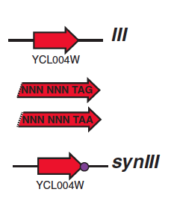
Changes being incorporated into the synthetic yeast genome:
Unique PCR tags added to most open reading frames
Remove all introns (from the ~5% of genes that have them)
Remove transposons and other highly repetitive regions
Move tRNA genes to own mini-chromosome
Change all TAG stop codons to TAA (to “free up” a codon)
- Slide adapted from Sarah Richardson

Slide 28
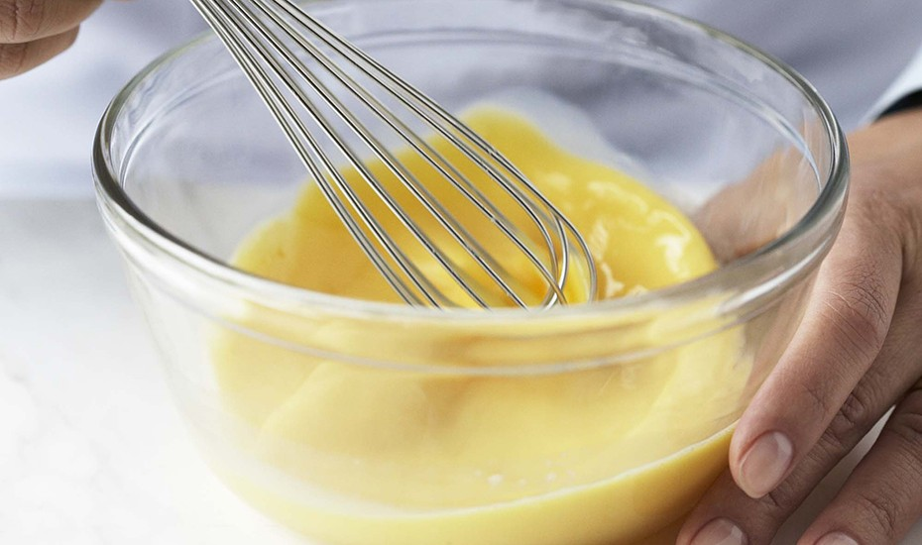
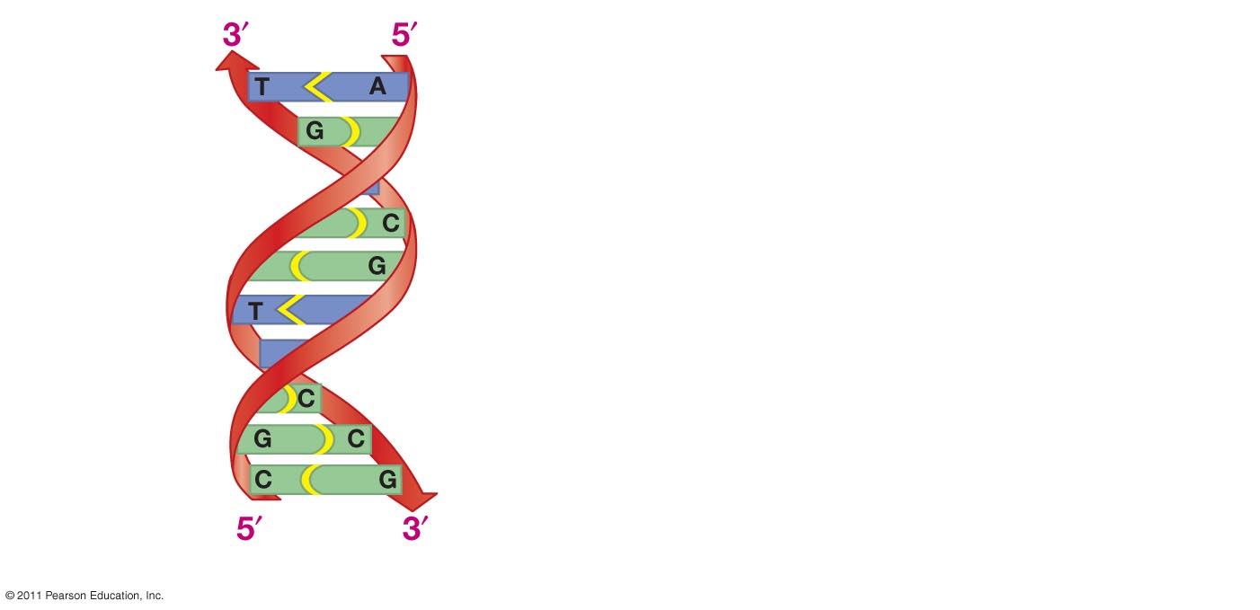
Generate a genome “shuffling” system called SCRaMbLE =
Synthetic Chromosome Rearrangement and Modification by
LoxP-mediated Evolution

Slide 29
Recombination sites placed in 3’UTRs of non-essential genes
Gene 1
Gene 2
Gene 3

Slide 30


Recombination sites placed in 3’UTRs of non-essential genes
and recombination can be activated on demand!
Gene 1
Gene 2
Gene 3

Slide 31
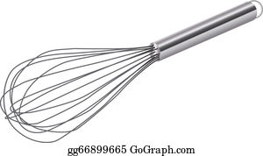
Scrambling the genome has different effects on genes
Gene 1
Gene 2
Gene 3

Slide 32
Scrambling the genome has different effects on genes
Gene 1
Gene 2
Gene 3
Gene 1
Remove a gene
Gene 2
Gene 3

Slide 33
Scrambling the genome has different effects on genes
Gene 1
Gene 2
Gene 3
Duplicate gene
Gene 1
Gene 1
Gene 2
Gene 3
Notes:
Deep sequencing of 64 synIXR SCRaMbLE strains revealed 156 deletions, 89 inversions, 94 duplications, and 55 additional complex rearrangements; several duplications are consistent with a double rolling circle mechanism.

Slide 34
Scrambling the genome has different effects on genes
Gene 1
Gene 2
Gene 3
Invert a gene
Gene 1
Gene 2
Gene 3
Notes:
Deep sequencing of 64 synIXR SCRaMbLE strains revealed 156 deletions, 89 inversions, 94 duplications, and 55 additional complex rearrangements; several duplications are consistent with a double rolling circle mechanism.

Slide 35
Let’s do it!
Jef Boeke
Srinivasan Chandrasegaran
Notes:
What I cannot create, I do not understand.”
- Richard Feynman
What I cannot create, I do not understand.”- Richard Feynman

Slide 36
Outline:
• Brief history of the synthetic yeast project
• How did the Build-a-Genome course start?
• What did the Build-a-Genome students actually do?
• Organization of the Build-a-Genome course
• What I loved about teaching Build-a-Genome, and what “elements”
have I tried to bring here?

Slide 37
Let’s do it!
Jef Boeke
Srinivasan Chandrasegaran
Notes:
What I cannot create, I do not understand.”
- Richard Feynman
What I cannot create, I do not understand.”- Richard Feynman

Slide 38
Let’s do it!
Jessica Dymond
(grad student)
Jef Boeke
Srinivasan Chandrasegaran
Notes:
What I cannot create, I do not understand.”
- Richard Feynman
What I cannot create, I do not understand.”- Richard Feynman

Slide 39

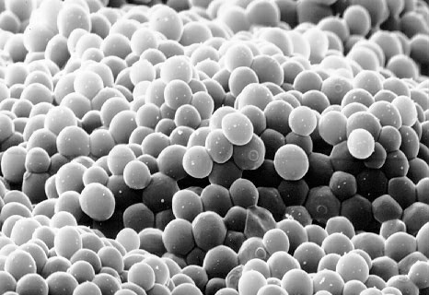

Slide 40
2007: Build-a-Genome course launched at Johns Hopkins
Notes:
BIG project to assemble a eukaryotic genome and a great ooprotunity for undergraduates to get incolved and learn molecualr biolpogy, be part of a real proeject. Also, didn’t hurt that undergrad labor was free as needed to reduce costs -

Slide 41
2007: Build-a-Genome course launched at Johns Hopkins
• Borrowed lab space
• Purchased PCR machines
from eBay
• Each student synthesized
~1500bp DNA

Slide 42
2007: Build-a-Genome course launched at Johns Hopkins
• Borrowed lab space
• Purchased PCR machines
from eBay
• Each student synthesized
~1500bp DNA
Workflow rapidly became more
robust and more students
wanted to be involved…

Slide 43
Build-a-Genome course offered every fall/spring through FA 2018
Permanent
X
• Borrowed lab space
• Purchased PCR machines
from eBay
• Each student synthesized
~1500bp DNA
more
X
10-15kb

Slide 44
Outline:
• Brief history of the synthetic yeast project
• How did the Build-a-Genome course start?
• What did the Build-a-Genome students actually do?
• Organization of the Build-a-Genome course
• What I loved about teaching Build-a-Genome, and what “elements”
have I tried to bring here?
Notes:
Here is the technical part!

Slide 45
First several years of course: Students were assigned a “chunk”
of yeast chromosome to synthesize (comprised of 10-15 “building blocks”)
Chromosome III
100
200
300
Chunk
# BB’s
A1
(12)
A2
(14)
B1
(14)
B2
(12)
B3
(9)
C1
(9)
C2
(9)
C3
(14)
D1
(11)
D2
(17)
D3
(12)
“Chunk”
Building Block
(~750 bp and is
smallest unit of
synthesized DNA)

Slide 46
First several years of course: Students synthesized ~750 bp “building
blocks” from partially overlapping oligos via 2 sequential PCR reactions
ONE building block (~750bp)
Computer software divides ~750 bp region
into ~18 partially overlapping ~60-mer oligonucleotides

Slide 47
First several years of course: Students synthesized ~750 bp “building
blocks” from partially overlapping oligos via 2 sequential PCR reactions
40nt
20nt
20nt
40nt

Slide 48
First several years of course: Students synthesized ~750 bp “building
blocks” from partially overlapping oligos via 2 sequential PCR reactions
How do the two sequential PCR reactions work?

Slide 49
First several years of course: Students synthesized ~750 bp “building
blocks” from partially overlapping oligos via 2 sequential PCR reactions
How do the two sequential PCR reactions work?
Jargon alert!

Slide 50
First several years of course: Students synthesized ~750 bp “building
blocks” from partially overlapping oligos via 2 sequential PCR reactions
How do the two sequential PCR reactions work?
First reaction: Templateless PCR

Slide 51
First several years of course: Students synthesized ~750 bp “building
blocks” from partially overlapping oligos via 2 sequential PCR reactions
How do the two sequential PCR reactions work?
First reaction: Templateless PCR
Second reaction: Finish PCR

Slide 52
Reaction 1: Templateless PCR (T-PCR)
40nt
20nt
20nt
40nt
Mix the ~18 partially
overlapping
oligos that comprise
a 750 bp fragment
Notes:
THIS IS A LENGTHENING MORE THAN AN AMPLIFICAIONT

Slide 53
Reaction 1: Templateless PCR (T-PCR)
Adjacent oligonucleotides anneal via complementary base pairing
between overlapping regions…

Slide 54
Reaction 1: Templateless PCR (T-PCR)
…polymerase extends the DNA…

Slide 55
Reaction 1: Templateless PCR (T-PCR)
…polymerase extends the DNA to generate longer fragments…

Slide 56
Reaction 1: Templateless PCR (T-PCR)
During additional cycles….

Slide 57
Reaction 1: Templateless PCR (T-PCR)
…even larger segments are are produced as the fragments
anneal to and prime synthesis of one another…

Slide 58
Reaction 1: Templateless PCR (T-PCR)
…over time, some full-length products are synthesized!

Slide 59
Reaction 1: Templateless PCR (T-PCR)
Sadly, the world is an imperfect place, and the full-length
products usually comprise just a fraction of the total.

Slide 60
Reaction 1: Templateless PCR (T-PCR)
T-PCR products are often heterogeneous
and may appear as a “smear” on a gel.

Slide 61
Reaction 1: Templateless PCR (T-PCR) produced
heterogeneous products
Full-length product

Slide 62
Reaction 1: Templateless PCR (T-PCR) produced
heterogeneous products
Full-length product
But, another round of PCR can amplify the full-length product from this complex mixture…

Slide 63
Reaction 2: Finish PCR (F-PCR)
Adding “outer primers” and performing
“Finish PCR” amplifies full-length
fragment from heterogeneous T-PCR product

Slide 64
~750bp building blocks synthesized via two sequential PCR reactions

Slide 65
~750bp building blocks synthesized via two sequential PCR reactions
• Reaction 1: Templateless PCR (T-PCR)
“Stitches” together individual oligonucleotides
Heterogeneous products

Slide 66
~750bp building blocks synthesized via two sequential PCR reactions
• Reaction 1: Templateless PCR (T-PCR)
“Stitches” together individual oligonucleotides
Heterogeneous products
• Reaction 2: Finish PCR (F-PCR) specifically amplifies
full-length products from the heterogeneous mixture

Slide 67

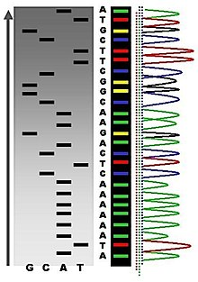
~750bp building blocks synthesized via two sequential PCR reactions
Students then ligated F-PCR products into plasmids, sent multiple
clones for sequencing, and identified “perfect” building blocks

Slide 68
2014: Article in Science reports first synthetic eukaryotic chromosome –most of the ~750bp building blocks assembled by BAG students!

Slide 69
2014: Article in Science reports first synthetic eukaryotic chromosome –most of the ~750bp building blocks assembled by BAG students!
synIII
WT
IX
III
VI, synIII
I
Notes:
Pulse-field gel

Slide 70
Synthetic yeast project went international -- teams around the world
assembled different chromosomes
Adapted from Richardson et al. Science Mar 10 2017

Slide 71
Outline:
• Brief history of the synthetic yeast project
• How did the Build-a-Genome course start?
• What did the Build-a-Genome students actually do?
• Organization of the Build-a-Genome course
• What I loved about teaching Build-a-Genome, and what “elements”
have I tried to bring here?

Slide 72
Organization of the Build-a-Genome course
• Molecular Biology Boot Camp for first couple of weeks = march
students stepwise through the workflow + “milestone” assignments
Notes:
Biologists, computer scientists,

Slide 73

Organization of the Build-a-Genome course
• Molecular Biology Boot Camp for first couple of weeks = march
students stepwise through the workflow + “milestone” assignments
When drawing up liquids into the
pipetman, only push the plunger
to the FIRST stop!! Am I clear!?
Notes:
Biologists, computer scientists,

Slide 74
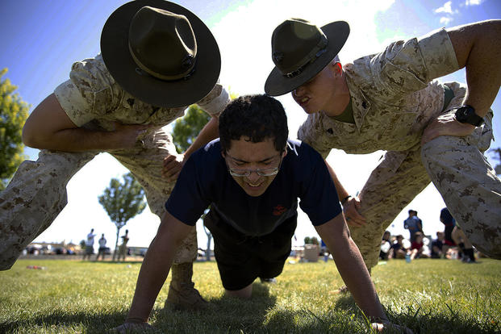
Organization of the Build-a-Genome course
• Molecular Biology Boot Camp for first couple of weeks = march
students stepwise through the workflow + “milestone” assignments
Now drop and give
me 20 microliters!
Notes:
Biologists, computer scientists,

Slide 75

Organization of the Build-a-Genome course
• Molecular Biology Boot Camp for first couple of weeks = march
students stepwise through the workflow + “milestone” assignments
• After “graduating” from boot camp, each student was presented with
lab key that provided 24/7 access to the lab
Notes:
Biologists, computer scientists,

Slide 76
Organization of the Build-a-Genome course
• Molecular Biology Boot Camp for first couple of weeks = march
students stepwise through the workflow + “milestone” assignments
• After “graduating” from boot camp, each student was presented with
lab key that provided 24/7 access to the lab
• Someone available 6 days/week to dispense reagents and to help
at “open lab” hours
Notes:
Biologists, computer scientists,

Slide 77
Organization of the Build-a-Genome course
• Molecular Biology Boot Camp for first couple of weeks = march
students stepwise through the workflow + “milestone” assignments
• After “graduating” from boot camp, each student was presented with
lab key that provided 24/7 access to the lab
• Someone available 6 days/week to dispense reagents and to help
at “open lab” hours
• Students presented at lab meetings every other week
Notes:
Biologists, computer scientists,

Slide 78
Outline:
• Brief history of the synthetic yeast project
• How did the Build-a-Genome course start?
• What did the Build-a-Genome students actually do?
• Organization of the Build-a-Genome course
• What I loved about teaching Build-a-Genome, and what “elements”
of it have tried to bring here?

Slide 79
What I loved about teaching Build-a-Genome, and what “elements”
of it have I been trying to bring to my current institution?
• Students participated in an authentic, ongoing research project!

Slide 80
What I loved about teaching Build-a-Genome, and what “elements”
of it have I been trying to bring to my current institution?
• Students participated in an authentic, ongoing research project!
• Students felt “ownership” of their own projects, yet had plenty of
structure and support (and the methods work really well!)

Slide 81
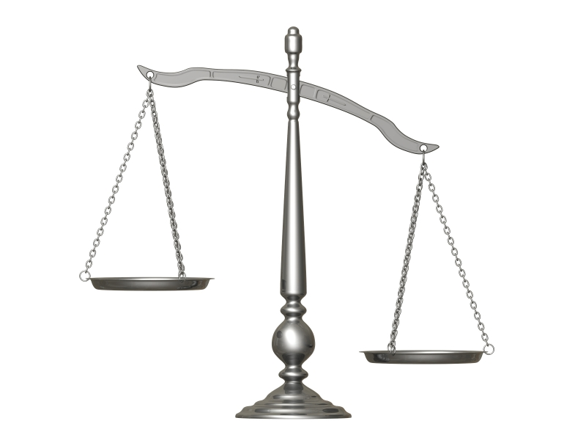
What I loved about teaching Build-a-Genome, and what “elements”
of it have I been trying to bring to my current institution?
• Students participated in an authentic, ongoing research project!
• Students felt “ownership” of their own projects, yet had plenty of
structure and support (and the methods work really well!)
• Less content but more skill development:
1) Technical
- PCR
Cloning
Sequencing and “bioinformatics”
Lots of repetition = they improve
2) “Professional”
- Presented frequently at lab meetings
- Organized their own time
- Had to troubleshoot their own experiments
Content vs. “Skills”
Content
Skills

Slide 82
What I loved about teaching Build-a-Genome, and what “elements”
of it have I been trying to bring to my current institution?
• Wasn’t “trapped” in traditional 1 x 3 hour lab per week
1) Not how real experiments work!
2) Students forget what they were doing by the next week
3) To cram the lab into this timeframe, I end up doing too
much of the work for them and they don’t learn as much.
Content vs. “Skills”
Content
Skills
Notes:
Independent projects = just learning the methods = apply these methods
1) Apply methods to synthesis of other
gene(s)
2) Improve workflow
Use the methods (pretty reliable) for a smaller project that could be divided up among the class → good because all students must do some kind of thesis and they could learn methods that they can use for thesis projects!
Get away from mindset that lab is just a 3-hour experience and that it doesn’t exist outside of that time period – they are going to have to come in to set up other things BUT they are going to need clear instructions on what to do. Office hours in the lab. Each group gets its own box, strict rules about labeling tubes.
Can graduates of the course and summer students serve as lab tutors?

Slide 83
What I loved about teaching Build-a-Genome, and what “elements”
of it have I been trying to bring to my current institution?
• Wasn’t “trapped” in traditional 1 x 3 hour lab per week
1) Not how real experiments work!
2) Students forget what they were doing by the next week
3) To cram the lab into this timeframe, I end up doing too
much of the work for them and they don’t learn as much.
• Opportunities for independent projects
Content vs. “Skills”
Content
Skills
Notes:
Independent projects = just learning the methods = apply these methods
1) Apply methods to synthesis of other
gene(s)
2) Improve workflow

Slide 84
What I loved about teaching Build-a-Genome, and what “elements”
of it have I been trying to bring to my current institution?
• Wasn’t “trapped” in traditional 1 x 3 hour lab per week
1) Not how real experiments work!
2) Students forget what they were doing by the next week
3) To cram the lab into this timeframe, I end up doing too
much of the work for them and they don’t learn as much.
• Opportunities for independent projects
• Mentors = BAG graduates train other students
Content vs. “Skills”
Content
Skills
Notes:
Independent projects = just learning the methods = apply these methods
1) Apply methods to synthesis of other
gene(s)
2) Improve workflow

Slide 85
How has this experience influenced my teaching at Hartwick?
• I always try to keep in mind what I learned at BAG – if students feel
invested in project, they will keep working at it and learn more!
Notes:
Courses and --

Slide 86
How has this experience influenced my teaching at Hartwick?
• I always try to keep in mind what I learned at BAG – if students feel
invested in project, they will keep working at it and learn more!
• Must have lots of structure (in the beginning)
• Lots of opportunities for individual “directed study” & senior projects –
methods are robust and applicable to synthesis of other genes
Notes:
Neochrom

Slide 87
THANKS!
Lisa Scheifele
Rob Newman
Fran Sandmeier
Leslie Mitchell
Jef Boeke
Dr. Chandra
Joel Bader
>200 Build a Genome students!

Slide 89
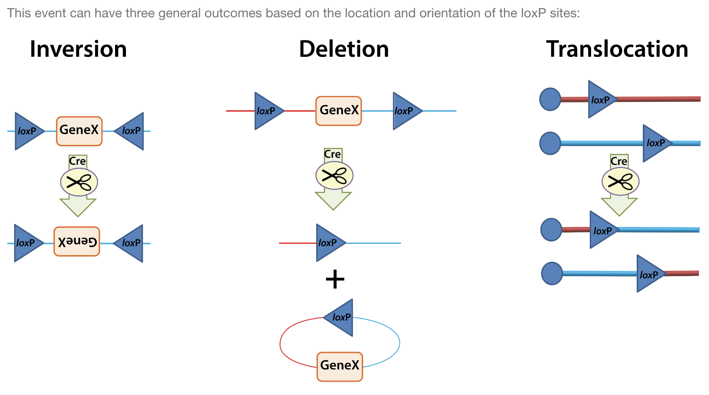
Notes:
Loxp site is 34bo sequence with two 13bp arms and an 8bp center region. The 8bp ecnter region is asymmetric, so provides a direction to the loxp site. This means that when sites come together, only a particular result will happen.

Slide 90
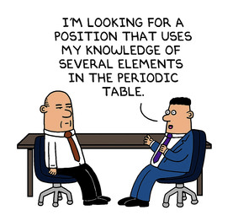
Scott Adams, creator of Dilbert
(most (in)famous Hartwick alumnus?)

