Slide 1
The 3+ BAG Workflows +(Synthesis of RFP) 1. Build-a-Phage 2. Neochromosomes 3. Scramble

Slide 2
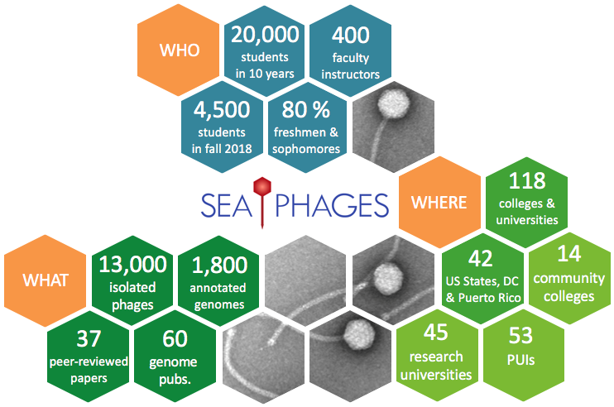
SEA-PHAGES

Slide 3
Next steps: Creation of a modular phage genome
Oldfield et. al, PNAS October 17, 2017
114 (42) E8885-E8894
Divide phage genome into 11 segments
Individually clone (and share!) each of the 11 segments

Slide 4
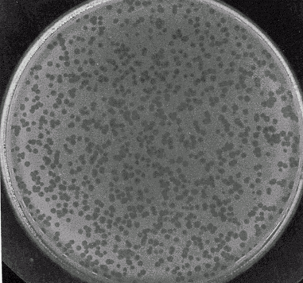
Next steps: Creation of a fully synthetic phage genome
Co-transform into yeast with vector to generate full-length genome
Test for infectivity, etc.
Digest each of the 11 fragments out of vector

Slide 5
Building Block Assembly

Slide 6
BRED

Slide 7
Working with phages: resources
The Actinobacteriophage Database | Procedures and Protocols (phagesdb.org)

Slide 8
Host strain and growth
Host strain: M. smegmatis mc²155
non-pathogenic, common soil organism that forms colonies on an agar plate in around 4 days.
smeg has a wide temperature range, but is typically grown in baffled flasks at 37°C on a shaker, which allows aeration of the culture.
Media: Middlebrook 7H9 is used as the base for the medium with carbenicillin and cycloheximide are added to inhibit molds, yeasts, and other bacteria.
In liquid culture, Tween®80 is added to the initial cultures to minimize clumps. It is excluded from subsequent subcultures, however, because it may inhibit phage infection.
Supplemented with ADC (albumin, dextrose, catalase)

Slide 9
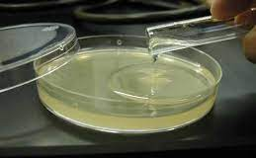
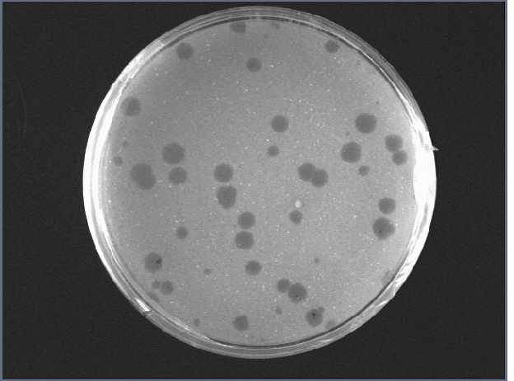
Phage
Phage: Mycobacteriophage Giles
Infection: Phage lysate is mixed with host cells and after 20 minutes is plated in top agar (0.7%)
Perform serial dilutions
Plaques appear after 2 days

Slide 10
Phage
DNA can be purified from phage plaques by simply flooding the plate with buffer
Can extract phage genomic DNA using the Promega DNA Clean-Up Kit.

Slide 11
BRED (Bacteriophage Recombination)
Marinelli et al. (2008)
Requires M. smeg mc²155 recombineering strain carrying plasmid pJV53 (we have it!)
Carries mycobacteriophage Che9c genes 60 and 61 (exonuclease and recombinase) under the control of the inducible acetamidase promoter.

