Slide 1



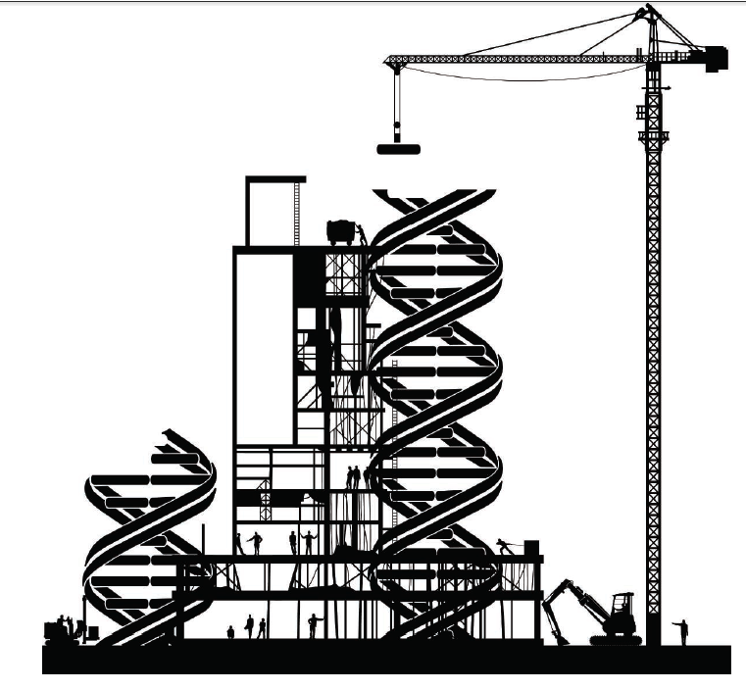
A Short Introduction to Synthetic Biology
Robert H. Newman
Nathan F. Simms Distinguished Professor of Biology
North Carolina A&T State University

Slide 2
What is
Synthetic Biology?

Slide 3
What is
Synthetic Biology?
The use of molecular biology tools and techniques to “forward-engineer” cellular behavior

Slide 4
What is
Synthetic Biology?
The use of molecular biology tools and techniques to “forward-engineer” cellular behavior
Synthetic biologists strive to optimize gene circuits for:

Slide 5
What is
Synthetic Biology?
The use of molecular biology tools and techniques to “forward-engineer” cellular behavior
Synthetic biologists strive to optimize gene circuits for:
Modularity: The ability to build complex circuits out of parts that retain predictable behavior regardless of context (e.g., DNA sequences & protein domains)

Slide 6
What is
Synthetic Biology?
The use of molecular biology tools and techniques to “forward-engineer” cellular behavior
Synthetic biologists strive to optimize gene circuits for:
Modularity: The ability to build complex circuits out of parts that retain predictable behavior regardless of context (e.g., DNA sequences & protein domains)
Orthoganality: Absence of unwanted crosstalk either between circuit parts or between circuit parts and the native signaling pathways of the host cell

Slide 7
What is
Synthetic Biology?
The use of molecular biology tools and techniques to “forward-engineer” cellular behavior
Synthetic biologists strive to optimize gene circuits for:
Modularity: The ability to build complex circuits out of parts that retain predictable behavior regardless of context (e.g., DNA sequences & protein domains)
Orthoganality: Absence of unwanted crosstalk either between circuit parts or between circuit parts and the native signaling pathways of the host cell
Tunability: The ability to tune the activity of circuit components up or down

Slide 8
What is
Synthetic Biology?
The use of molecular biology tools and techniques to “forward-engineer” cellular behavior
Synthetic biologists strive to optimize gene circuits for:
Modularity: The ability to build complex circuits out of parts that retain predictable behavior regardless of context (e.g., DNA sequences & protein domains)
Orthoganality: Absence of unwanted crosstalk either between circuit parts or between circuit parts and the native signaling pathways of the host cell
Tunability: The ability to tune the activity of circuit components up or down
Composability: The ability to connect simple building blocks into complex devices in which the output of one layer becomes the input for the next layer.

Slide 9
Synthetic Biology
Complex Circuit Design
Cell-based Therapeutics
Metabolic Engineering
Genome Synthesis

Slide 10
Synthetic Biology
Complex Circuit Design
Cell-based Therapeutics
Metabolic Engineering
Genome Synthesis

Slide 11
Foundations of Circuit Design:
Regulated Gene Expression
LacI
Term
RBS
lacI
P_{lacI}
lacO
P_{Lac}
lacZ
lacY
lacA
Lactose
LacZ
LacY
LacA
LacI
lacI
P_{lacI}
lacO
P_{Lac}
lacZ
lacY
lacA

Slide 12
Simple Circuit Design: Bi-Stable Toggle Switch
Lactose
LacI
lacI
P_{lacI}
lacO
P_{Lac}
lacZ
lacY
lacA

Slide 13
Simple Circuit Design: Bi-Stable Toggle Switch
IPTG
LacI
lacI
P_{lacI}
lacO
P_{Lac}
GFP

Slide 14
Simple Circuit Design: Bi-Stable Toggle Switch
IPTG
LacI
lacI
OR3
lacO
P_{Lac}
GFP
cI
P
heat

Slide 15
Simple Circuit Design: Bi-Stable Toggle Switch
lacI
OR3
lacO
P_{Lac}
GFP
cI
P
GFP Fluorescence
Time

Slide 16
Simple Circuit Design: Bi-Stable Toggle Switch
LacI
lacI
OR3
lacO
P_{Lac}
GFP
cI
P
GFP Fluorescence
Time

Slide 17
Simple Circuit Design: Bi-Stable Toggle Switch
IPTG
LacI
lacI
OR3
lacO
P_{Lac}
GFP
cI
P
IPTG
GFP Fluorescence
Time

Slide 18
Simple Circuit Design: Bi-Stable Toggle Switch
IPTG
LacI
lacI
OR3
lacO
P_{Lac}
GFP
cI
P
IPTG
GFP Fluorescence
Time

Slide 19
Simple Circuit Design: Bi-Stable Toggle Switch
LacI
lacI
OR3
lacO
P_{Lac}
GFP
cI
P
heat
IPTG
heat
GFP Fluorescence
Time

Slide 20
Complex Circuit Design: Oscillatory Circuit
LacI
lacI
P_{lacI}
P_{Lac}
GFP
LacO
P_{BAD}

Slide 21
Complex Circuit Design: Oscillatory Circuit
LacI
lacI
P_{lacI}
P_{Lac}
GFP
AraC
AraC
LacO
P_{BAD}

Slide 22
Complex Circuit Design: Oscillatory Circuit
LacI
lacI
P
P_{Lac}
GFP
AraC
P
AraC
GFP Fluorescence
LacO
P_{BAD}
Time

Slide 23
Complex Circuit Design: Oscillatory Circuit
LacI
lacI
P
P_{Lac}
GFP
AraC
P
AraC
GFP Fluorescence
LacO
P_{BAD}
Time

Slide 24
Complex Circuit Design: Oscillatory Circuit
LacI
lacI
P
P_{Lac}
GFP
AraC
P
AraC
GFP Fluorescence
LacO
P_{BAD}
Time

Slide 25
Complex Circuit Design: Oscillatory Circuit
LacI
lacI
P
P_{Lac}
GFP
AraC
P
AraC
GFP Fluorescence
LacO
P_{BAD}
Time

Slide 26
Complex Circuit Design: Oscillatory Circuit
LacI
lacI
P
P_{Lac}
GFP
AraC
P
AraC
GFP Fluorescence
LacO
P_{BAD}
Time

Slide 27
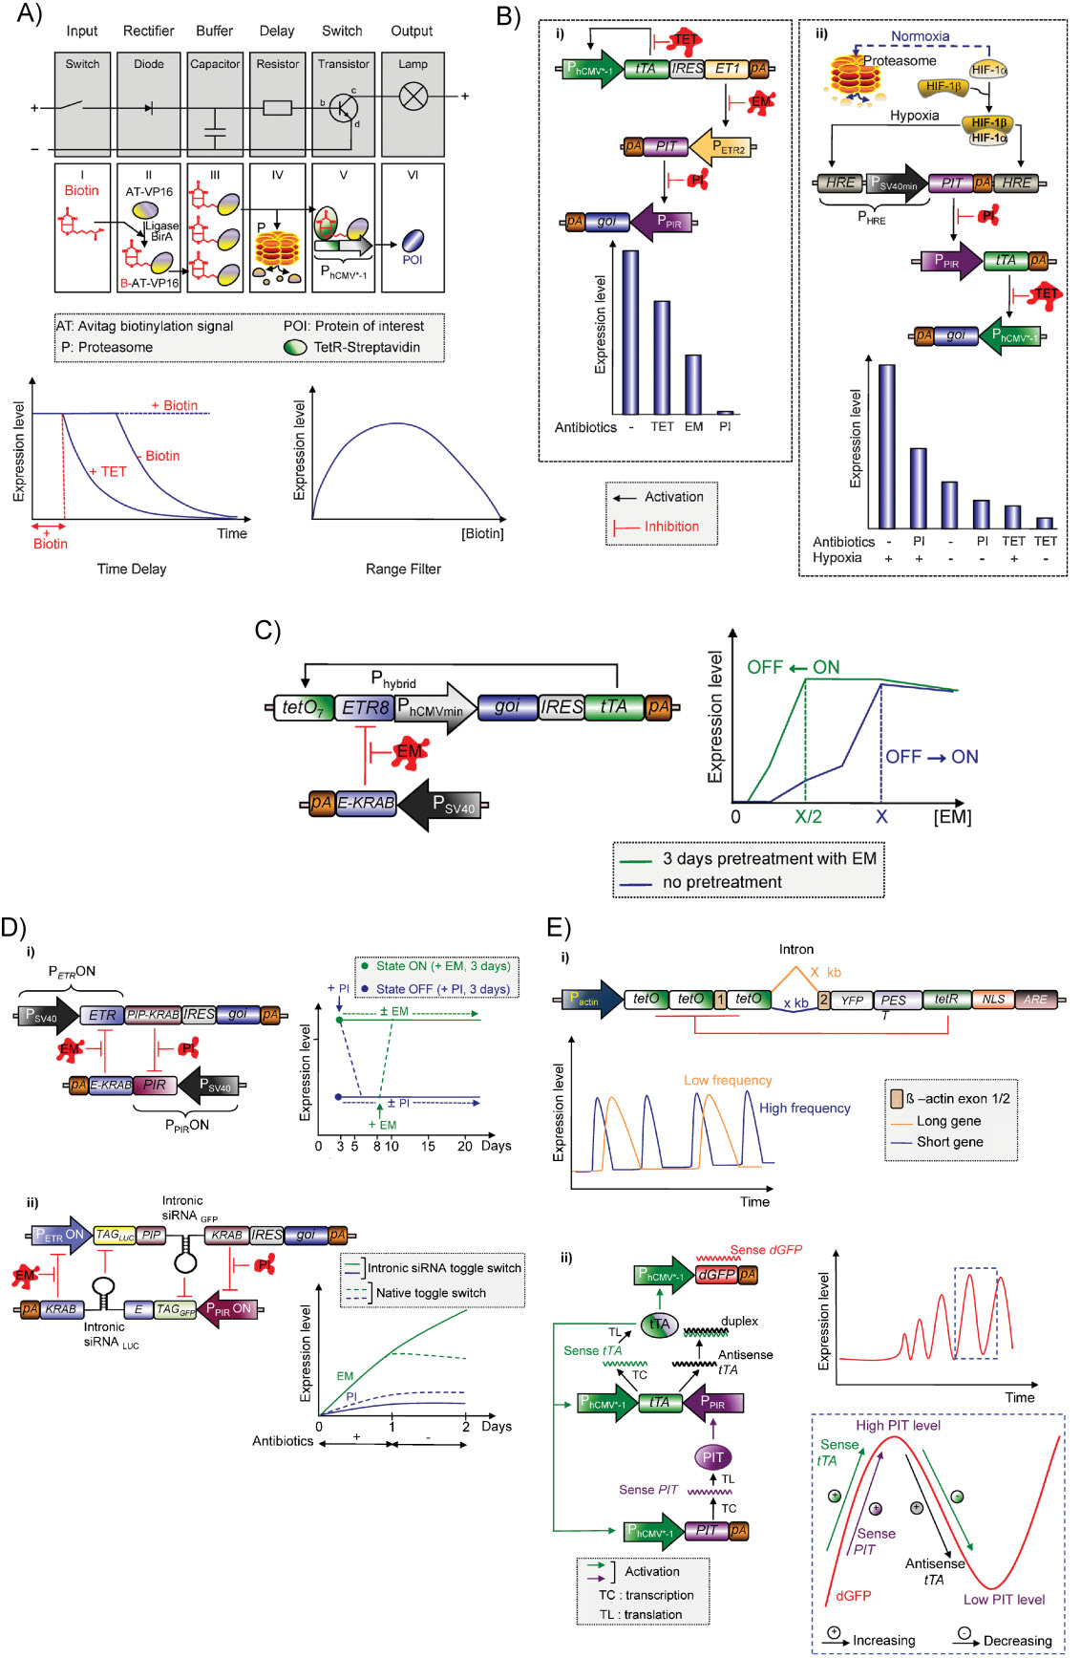
Advanced Control Strategies: Synthetic Gene Networks
Aubel and Fussenegger. BioEssays 2010
Notes:
A: Synthetic gene networks. Comparison of an electronic switchboard and the genetic implementation of a diode-capacitor-resistor-transistor circuit exhibiting time-delay and range filter characteristics. The input signal biotin (I, switch, input) is covalently linked to a synthetic avitag fused to the transactivation domain VP16 by the E. coli biotin ligase BirA (II, diode, rectifier). This creates an inducer depot inside the mammalian cell, which continues to trigger action even after the metabolic elimination of biotin (III, the capacitor, buffer). Biotinylated avitag-VP16 may either undergo proteasome (P)-based proteolysis following preprogrammed kinetics (IV, resistor, delay) or bind to TetR-streptavidin fusion proteins to create a transactivator (TetR-streptavidin-biotin-avitag-VP16) which controls PhcMCV-1 (V, transistor, switch) and fine-tunes the production of a protein of interest (POI) (VI, lamp, output). The time delay is manifested when biotin is withdrawn after a short pulse, because biotin linked to avitag-VP16 continues to sustain transgene expression. In addition to control via biotin, TetR-streptavidin-biotin-avitag-VP16 can be inactivated by tetracycline (TET). The range filter qualities of the circuit are visible when transgenic mammalian cells are exposed to increasing biotin levels. Between low and medium biotin levels, the system triggers a gradual increase in POI production as biotin heterodimerizes TetRstreptavidin and avitag-VP16. However, in the medium-to-high biotin concentration range, excess biotin binds directly to streptavidin and creates heterodimerization-incompetent transactivator monomers. This process gradually switches the system off.

Slide 28
Synthetic Biology
Complex Circuit Design
Cell-based Therapeutics
Metabolic Engineering
Genome Synthesis

Slide 29
Synthetic Biology
Complex Circuit Design
Cell-based Therapeutics
Metabolic Engineering
Genome Synthesis

Slide 30
Cell-based Therapeutics:
Bacterial Invasion of Cancer Cells
Aerobic Conditions/
Low Cell Density
OFF
Hypoxia/
High Cell Density
ON
inv
Induction
Invasion
Anderson, JC et al. JMB 2006

Slide 31
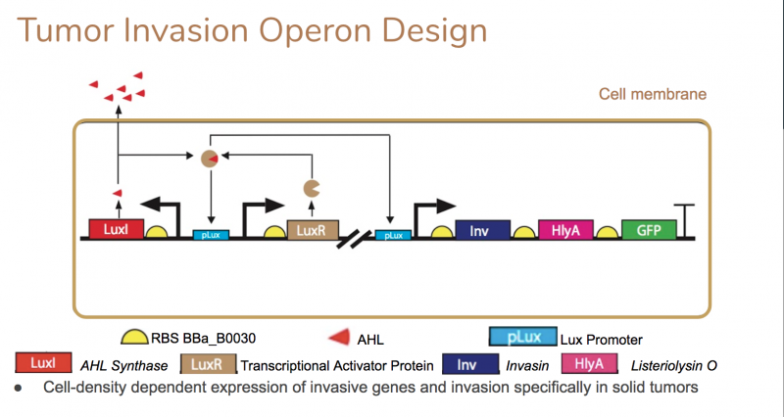
Cell-based Therapeutics:
Bacterial Invasion of Cancer Cells

Slide 32
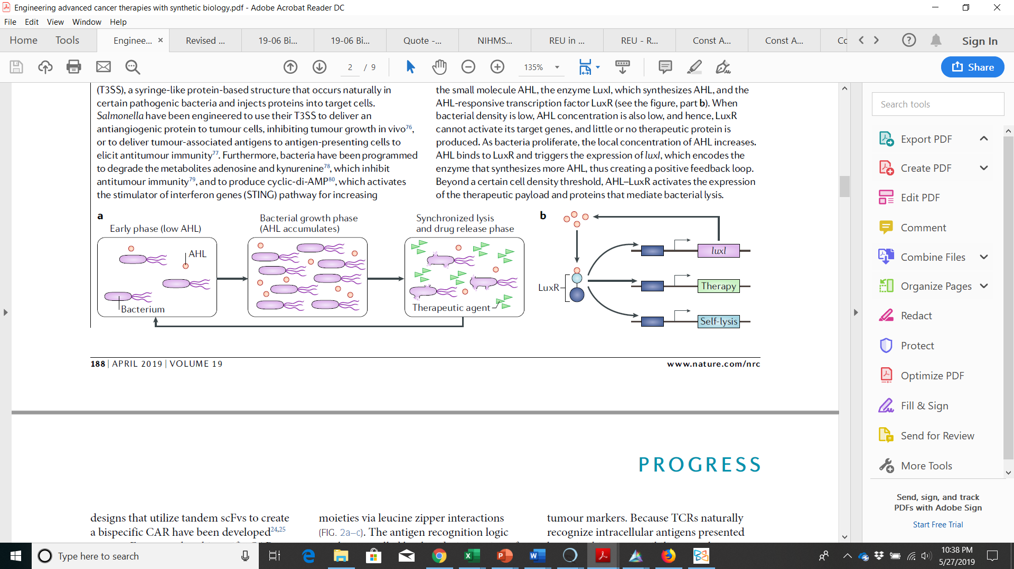
Cell-based Therapeutics
Wu et al. Nat. Rev. Canc. 2019

Slide 33
Synthetic Biology
Complex Circuit Design
Cell-based Therapeutics
Metabolic Engineering
Genome Synthesis

Slide 34
Synthetic Biology
Complex Circuit Design
Cell-based Therapeutics
Metabolic Engineering
Genome Synthesis

Slide 35
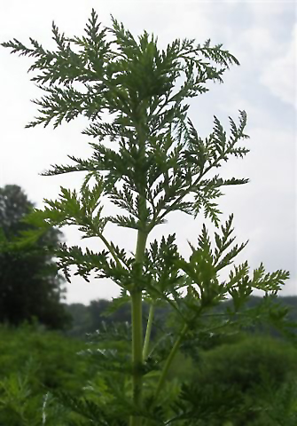
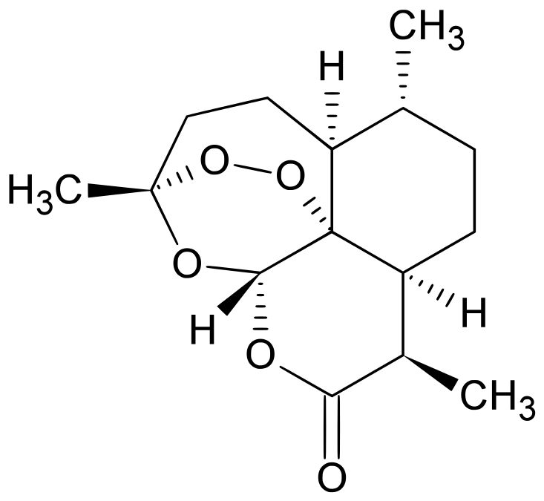
Metabolic Engineering: Artemisinin Semi-Synthesis
Standard extraction
Artemisia annua
Artemisinin

Slide 36
Metabolic Engineering: Artemisinin Semi-Synthesis
Cost/dose:
$$$ & Highly variable
Standard extraction
Artemisia annua
Artemisinin

Slide 37
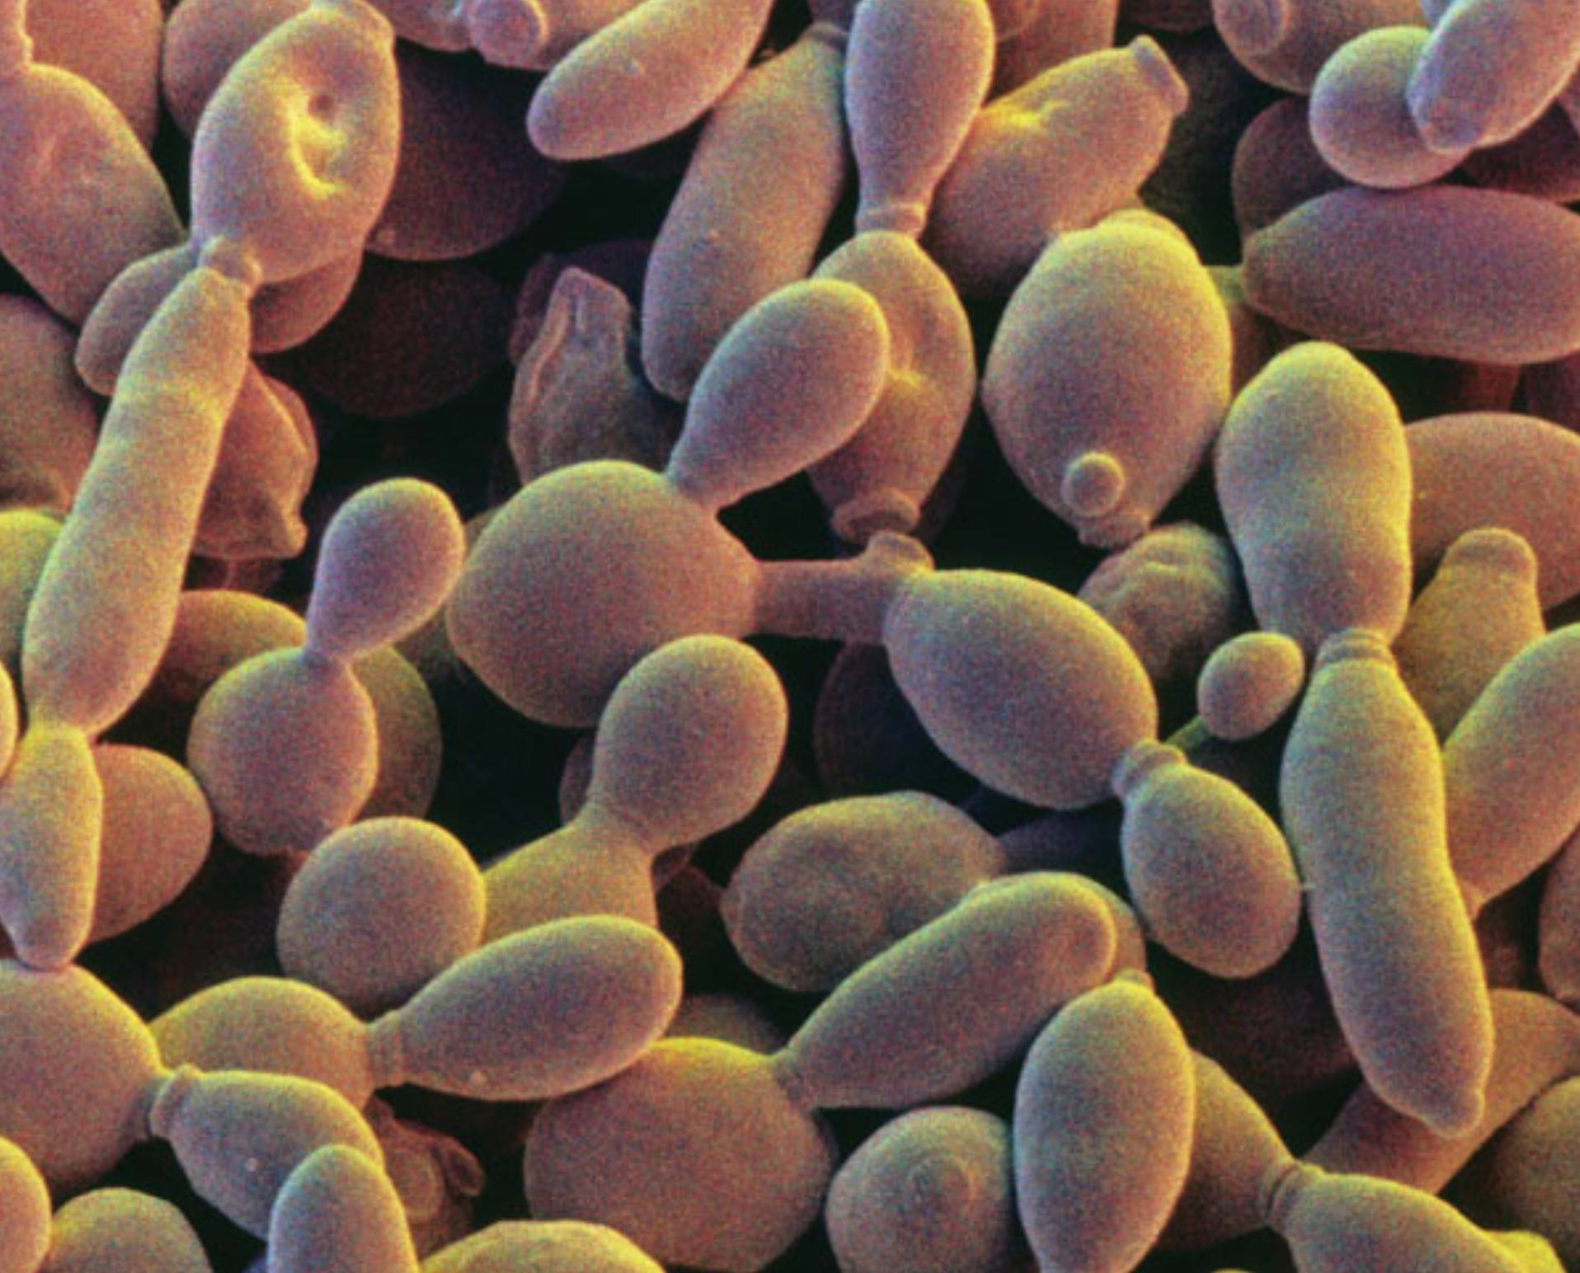
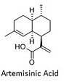
Metabolic Engineering: Artemisinin Semi-Synthesis
Mevalonate Biosynthetic Pathway
MevA
MevB
MevC
MevD
ADS
CYP71
ALDH1
JD Boeke and S Richardson
Artemisia annua
Artemisinin
Artemisinic Acid

Slide 38
Metabolic Engineering: Artemisinin Semi-Synthesis
Mevalonate Biosynthetic Pathway
MevA
MevB
MevC
MevD
ADS
CYP71
ALDH1
JD Boeke and S Richardson
<$0.10/dose
Artemisia annua
Artemisinin
Artemisinic Acid

Slide 39
Synthetic Biology
Complex Circuit Design
Cell-based Therapeutics
Metabolic Engineering
Genome Synthesis

Slide 40
Synthetic Biology
Complex Circuit Design
Cell-based Therapeutics
Metabolic Engineering
Genome Synthesis

Slide 41
Whole Genome Synthesis:
From Natural to Fully Synthetic Genomes
Ellis (2019)

Slide 42
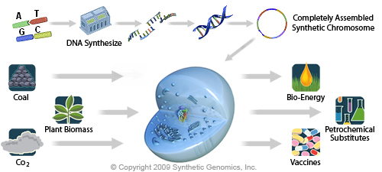
Genome Synthesis: Synthetic Cells
DNA Synthesis

Slide 43
Genome Synthesis: Synthetic Cells
DNA Synthesis

Slide 44
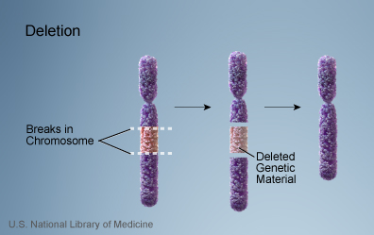
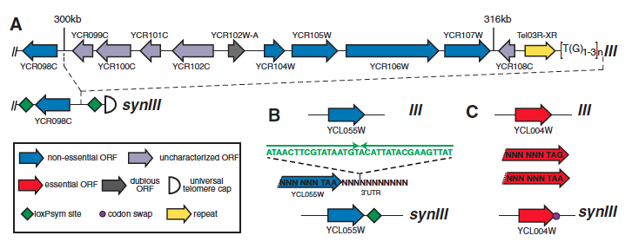
Synthetic Yeast (Sc2.0)
The World’s First Synthetic Eukaryotic Genome
Above: a chromosome as it is seen in the cell; Below: a zoomed in view of a certain region.
Annaluru (2014)
Notes:
If we were to zoom in a region of a gene/chromosome the above is an imaged representation of what we would find: 123-Synthetic chromosomes and cells can be manipulated and altered to better suit *** Representative synIII design segments for loxPsym site insertion (A & B) and stop codonTAG to TAA editing (C) are shown. Green diamonds represent loxPsym sites embedded in the 3′ UTR of non-essential genes and at several other landmarks. Fuchsia circles indicate synthetic stop codons (TAG recoded to TAA).

Slide 45
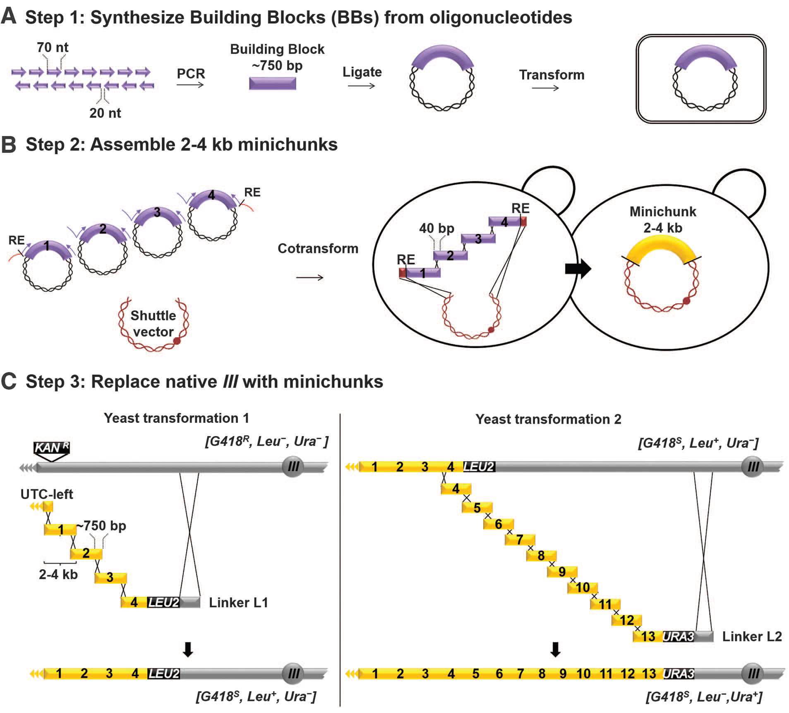
The BAG Workflow
Building Block and Minichunk Synthesis
Annaluru (2014)
Notes:
(A) Building block (BB) synthesis. 750 bp BBs (purple) were synthesized from oligonucleotides at Johns Hopkins University by students in the Build-A-Genome course. (B)Assembly of minichunks. 2–4 kb minichunks (yellow) were assembled by homologous recombination in S. cerevisiae Adjacent minichunks were designed to encode overlap of one BB to facilitate downstream assembly steps. Minichunks were flanked by a rare cutting restriction enzyme (RE) site, XmaI or NotI.

Slide 46
The BAG Workflow
Chunk Synthesis and Chromosome Assembly
Annaluru (2014)
Notes:
(C) Direct replacement of native yeast chromosome III with pools of synthetic minichunks. Eleven iterative one-step assemblies and replacements of native genomic segments of yeast chromosome III were carried out using pools of overlapping synthetic DNA minichunks (Table S2), encoding alternating genetic markers (LEU2 or URA3), which enabled complete replacement of nativeIII with synIII in yeast.

Slide 47
On the Precipice of the Future…
Let me now comment on the question "what next". Up to now we are working on the descriptive phase of molecular biology. ... But the real challenge will start when we enter the synthetic phase of research in our field. We will then devise new control elements and add these new modules to the existing genomes or build up wholly new genomes. This would be a field with an unlimited expansion potential and hardly any limitations to building "new better control circuits" or ..... finally other "synthetic" organisms, like a "new, better mouse". ... I am not concerned that we will run out of exciting and novel ideas, ... in the synthetic biology, in general.
-Geneticist Waclaw Szybalski, 1974

Slide 48
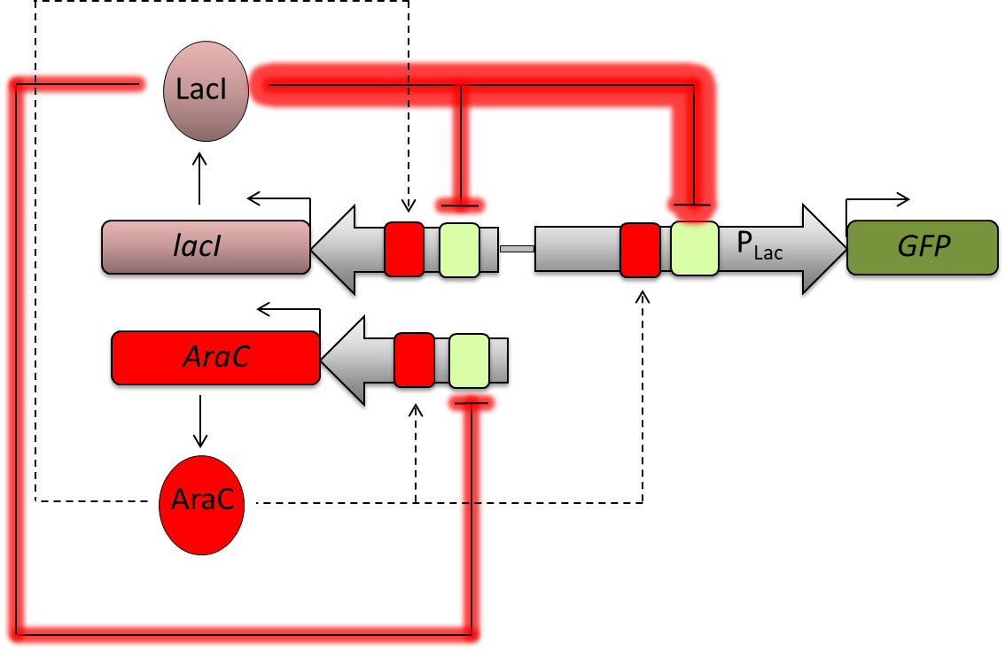
Questions

Slide 50
Advanced Control Strategies: “Titratable” Cascades
Aubel and Fussenegger. BioEssays 2010
Notes:
(Semi-)synthetic cascades. (i) A synthetic three-level regulatory cascade in which the first level is controlled by an autoregulated positive PhcMCV-1-driven feedback loop cocistronically expressing tTA and the macrolide-dependent transactivator (ET1). ET1 then binds PETR2 and activates the transcription of the streptogramin-dependent transactivator (PIT). Finally, PIT triggers PPIR-driven expression of the gene of interest (goi). The cascade can be interrupted at each level by the addition of a specific antibiotic (tetracycline, TET; erythromycin, EM; pristinamycin I, PI), each of which produces a discrete expression level. (ii) Semi-synthetic cascades process input from heterologous as well as endogenous signals. Under hypoxia, the hypoxia-inducible factor 1a (HIF-1a) heterodimerizes with HIF-1b and activates PHRE (PSV40 min linked to hypoxia-responsive elements, HRE), which drives PIT expression, and PIT triggers PPIR-driven tTA expression. This cascade produces up to six discrete goi expression levels, each of which is defined by a precise combination of a specific antibiotic and the oxygen status of the cell.

Slide 51
Advanced Control Strategies: “Titratable” Cascades
Aubel and Fussenegger. BioEssays 2010
Notes:
(Semi-)synthetic cascades. (i) A synthetic three-level regulatory cascade in which the first level is controlled by an autoregulated positive PhcMCV-1-driven feedback loop cocistronically expressing tTA and the macrolide-dependent transactivator (ET1). ET1 then binds pETR2 and activates the transcription of the streptogramin-dependent transactivator (PIT). Finally, PIT triggers PPIR-driven expression of the gene of interest (goi). The cascade can be interrupted at each level by the addition of a specific antibiotic (tetracycline, TET; erythromycin, EM; pristinamycin I, PI), each of which produces a discrete expression level. (ii) Semi-synthetic cascades process input from heterologous as well as endogenous signals. Under hypoxia, the hypoxia-inducible factor 1a (HIF-1a) heterodimerizes with HIF-1b and activates PHRE (PSV40 min linked to hypoxia-responsive elements, HRE), which drives PIT expression, and PIT triggers PPIR-driven tTA expression. This cascade produces up to six discrete goi expression levels, each of which is defined by a precise combination of a specific antibiotic and the oxygen status of the cell.

Slide 52
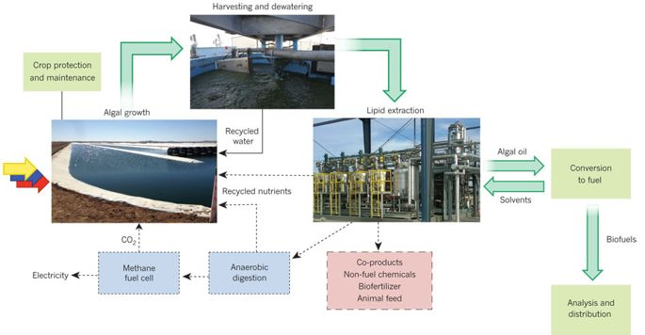
Re-engineering Microalgae for Biofuel Production
Georgianna and Mayfield (2012)

Slide 53
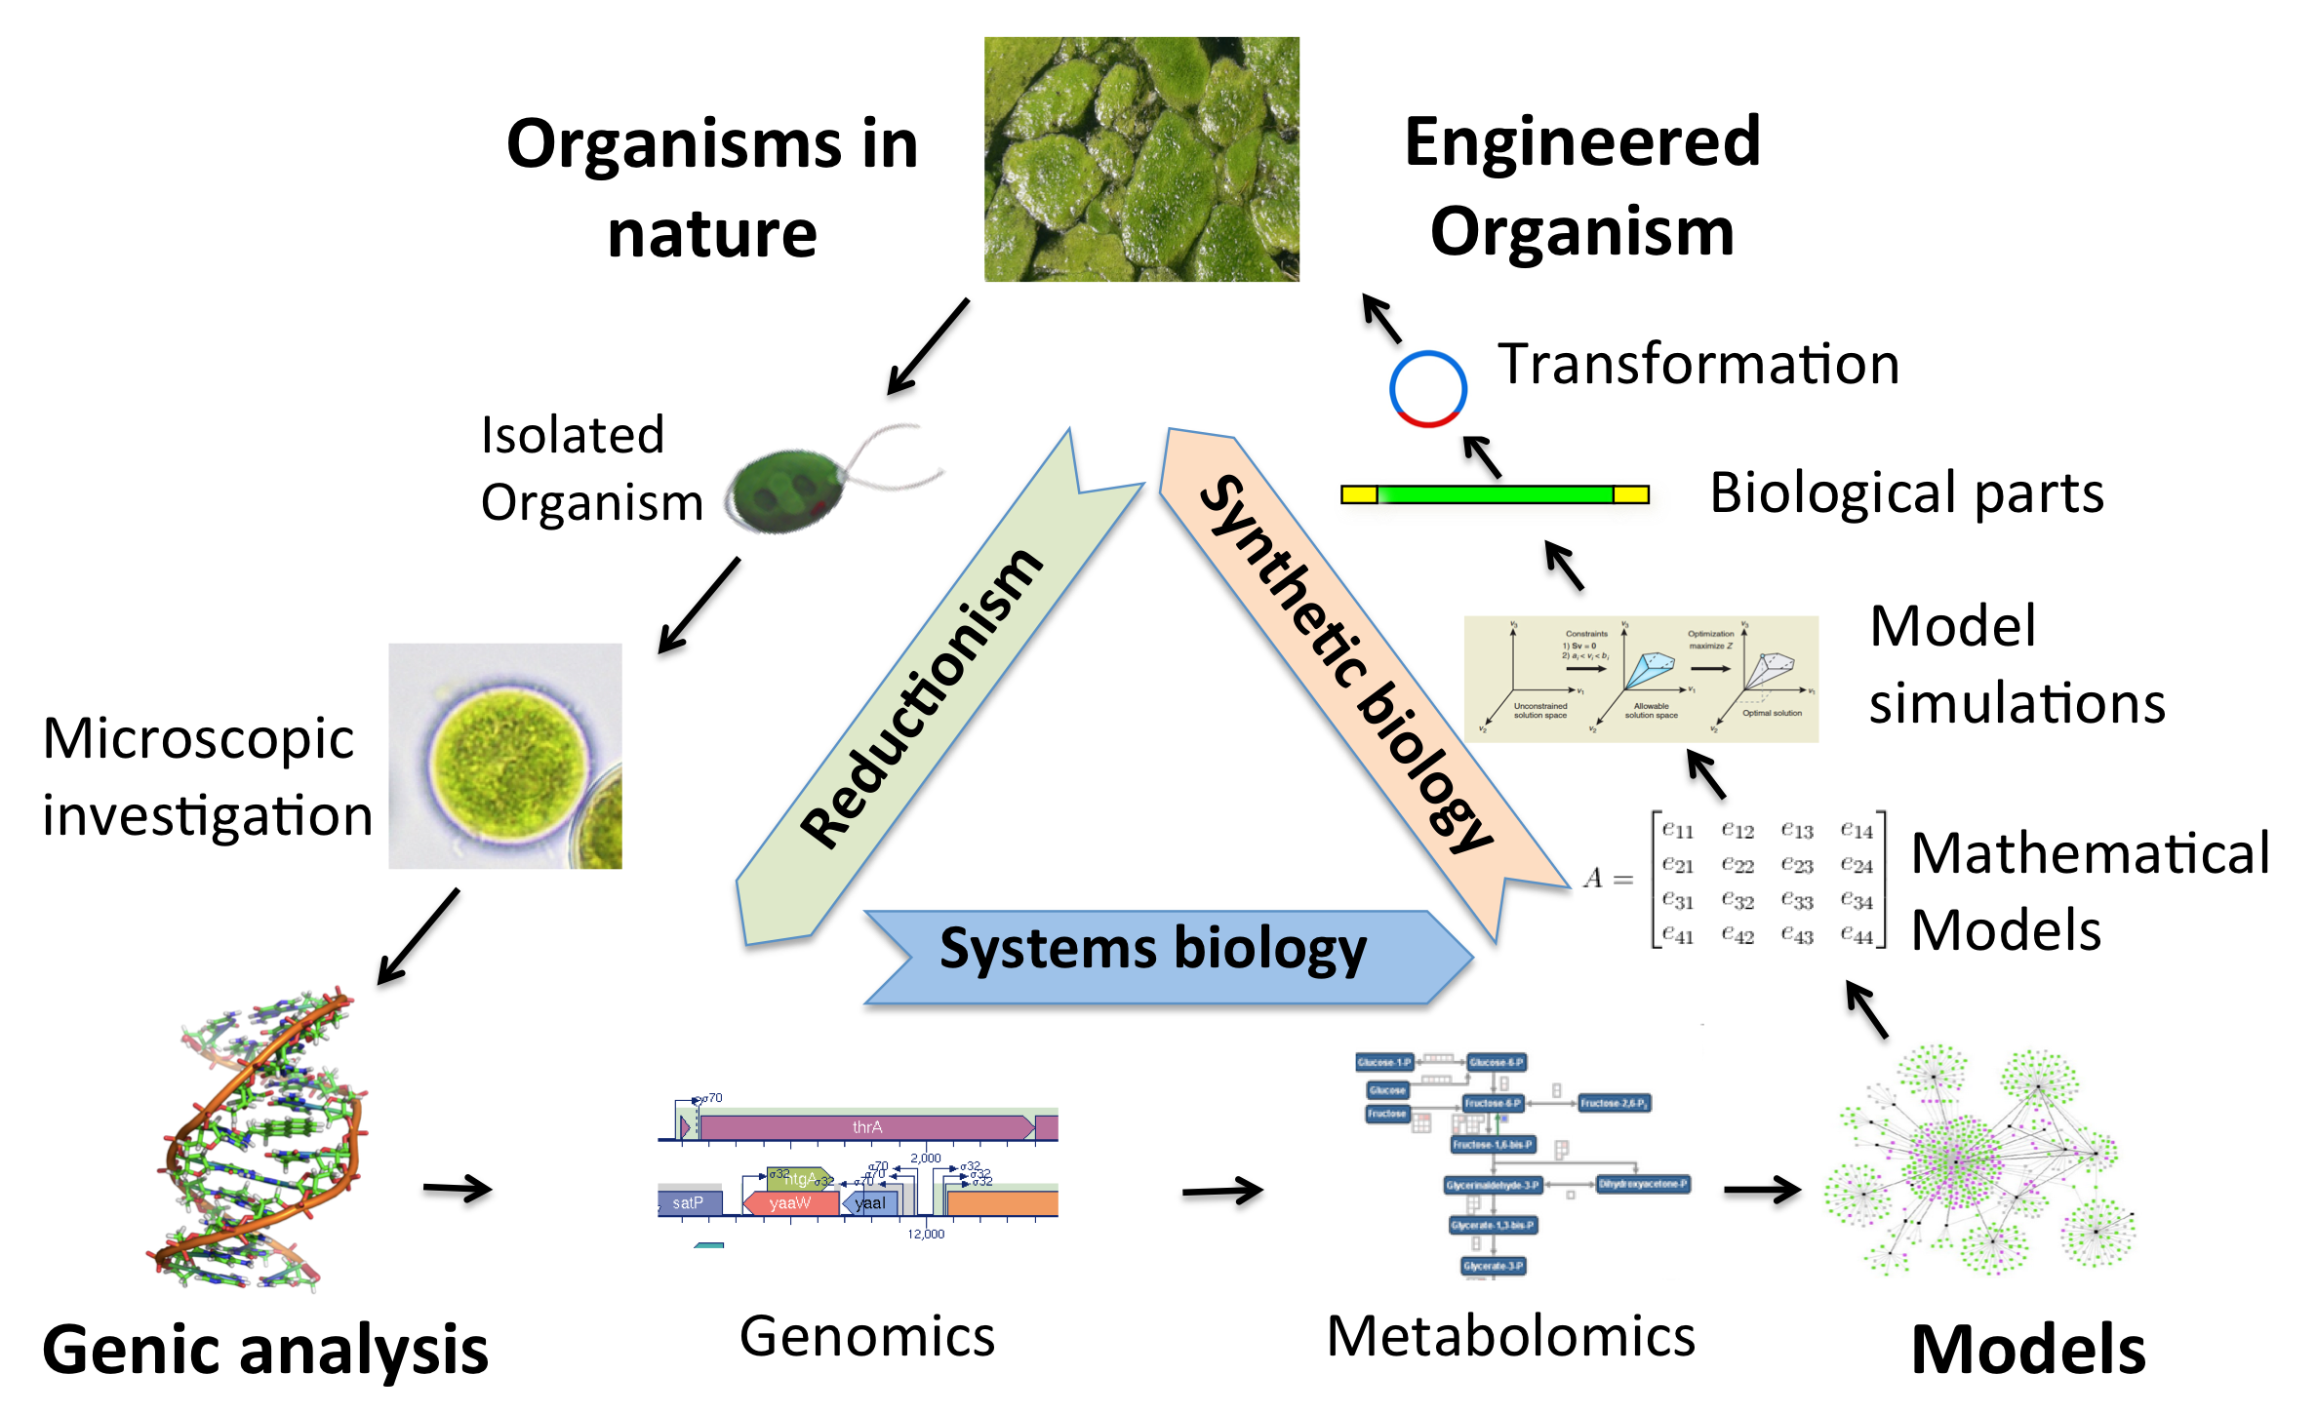
Re-engineering Microalgae for Biofuel Production
Genetic analysis

Slide 54
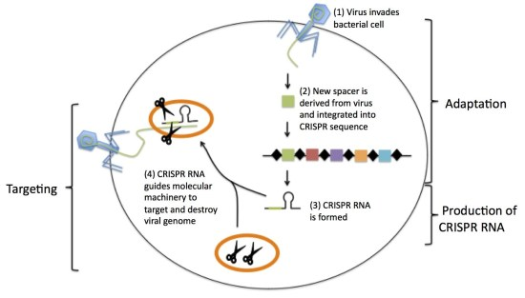
CRISPR/Cas9: A Powerful Tool for Genome Editing

Slide 55
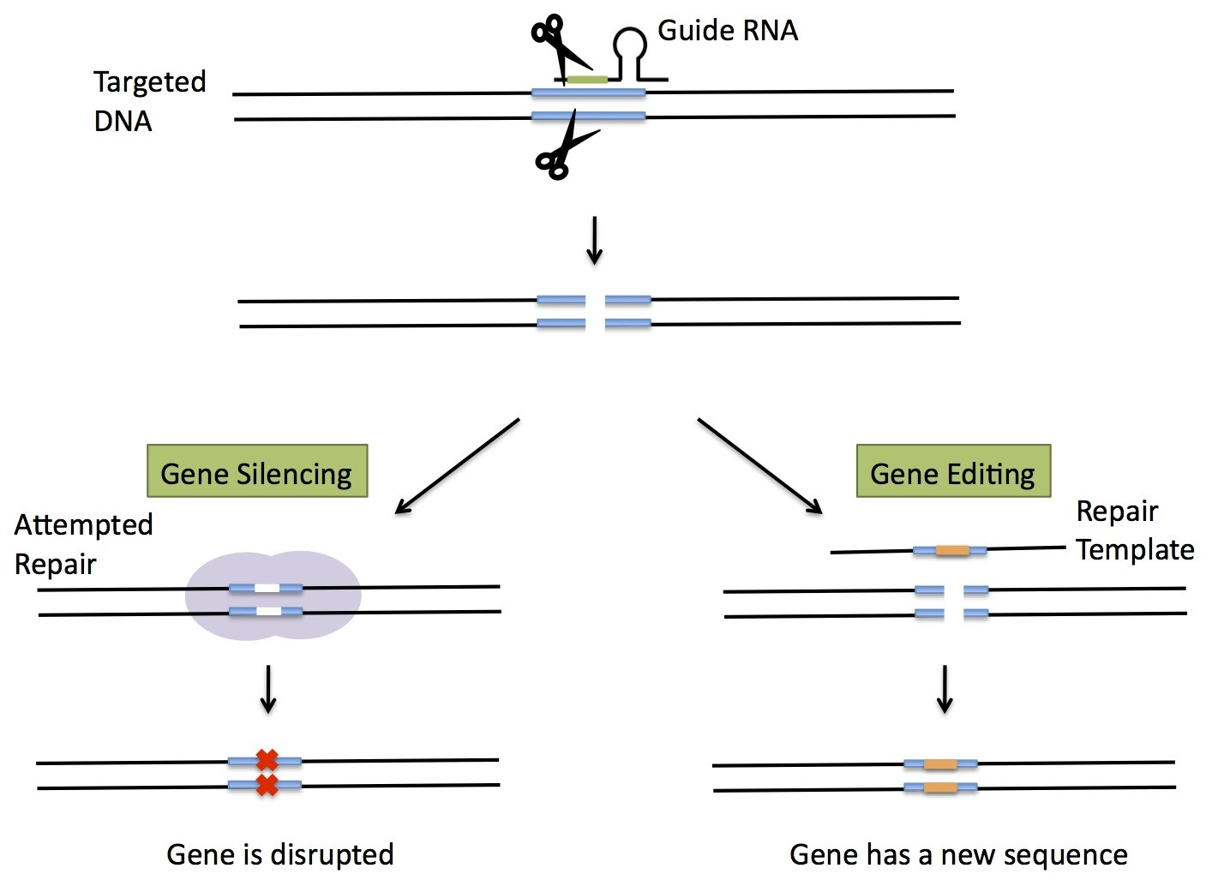
CRISPR/Cas9 System Can Be Adapted for Synthetic Biology Applications

Slide 56
Simple Circuit Design: Bi-Stable Toggle Switch
IPTG
LacI
lacI
OR3
lacO
P_{Lac}
GFP
cI
P
IPTG
GFP Fluorescence
Time

Slide 57
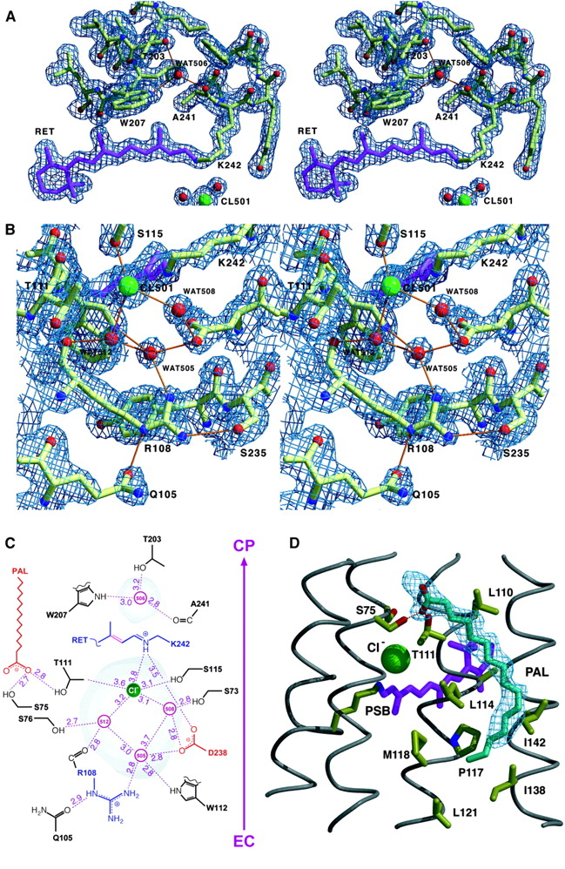
Coordinated Transport of Cl⁻ by Halorhodopsin
Cytoplasmic
Extracellular
Kolbe et al. Science 2000
Notes:
The retinal and chloride binding site. (C) Scheme depicting the hydrogen-bonding pattern between the transport site and the extracellular surface of HR. The volumes of internal cavities that hold CL501 and its associated water cluster or WAT506 (gray shading) are 67 Å3 and 21 Å3, respectively. The isomerizable 13-14 bond of the retinal is highlighted in purple; distances are given in angstroms. (D) Binding of palmitate close to the transport site. The 2F obs −F calc SA-OMIT electron density for palmitate is contoured at 0.8σ. The side-chain conformation of Thr111 that H bonds to the palmitate and thus faces CL501 by its methyl group is unambiguously defined by electron density. Palmitate is not synthesized by Haloarchaea but is ubiquitous in their natural habitat and growth media. Tritium-labeled palmitate added during the cultivation of H. salinarum strain D2 comigrates with HR during purification (37). Likewise, matrix-assisted laser desorption/ionization–mass spectrometry analysis indicates the presence of palmitate in HR samples used for crystallization (38).

Slide 58
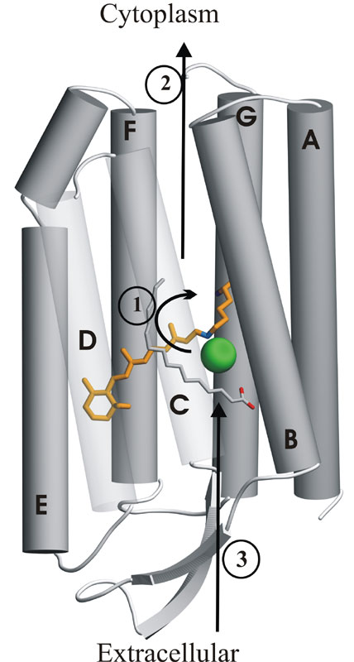
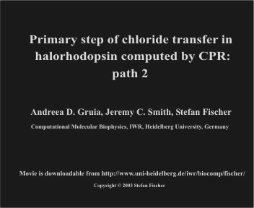
Coordinated Transport of Cl⁻ by Halorhodopsin
Notes:
Path 1 has the lowest energy barrier (~9.2 kcal/mol).
To be seen: Chloride passes on the Ser115 side of retinal, in front of the Ser115 side chain. Chloride transiently enlarges a lumen by pushing away helix C and the palmitate. H-bonds with water w24 and Ser115 are maintained until after the transition state is passed and the lumen starts reclosing. They are replaced by a salt-bridge with the Schiff base and water w79. Path 2 is very similar to path 1.

Slide 60
Synthetic Biology
Metabolic Engineering
Complex Circuit Design
Genome Synthesis
Cell-based Therapeutics

