Slide 1
Build-a-Genome
Options for Genomes and Workflows
Lisa Scheifele, Loyola University Maryland

Slide 2
Timeline of synthetic genes and genomes

Slide 3
What genome(s) next?

Slide 4
The 3+ BAG Workflows
+(Synthesis of RFP)
1. Build-a-Phage
2. Neochromosomes
3. Scramble

Slide 5
Synthesis of RFP

Slide 6
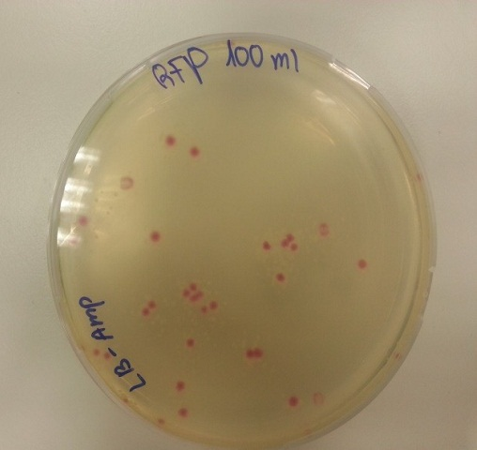
Synthesis and assembly of RFP
RFP
+
Linearized expression plasmid with homology to RFP

Slide 7
Build-a-Phage

Slide 8
Why synthesize phage?
Medical relevance is inherently interesting to students
  Mycobacteriophages are a diverse group of viruses that infect bacteria in the Mycobacteria genus.
  While we are working with Mycobacterium smegmatis, a harmless soil bacterium, the genus includes the human pathogen Mycobacterium tuberculosis.
  Genomes are relatively small (~50-70,000 bp)

Slide 9
Building Block Assembly

Slide 10
BRED

Slide 11
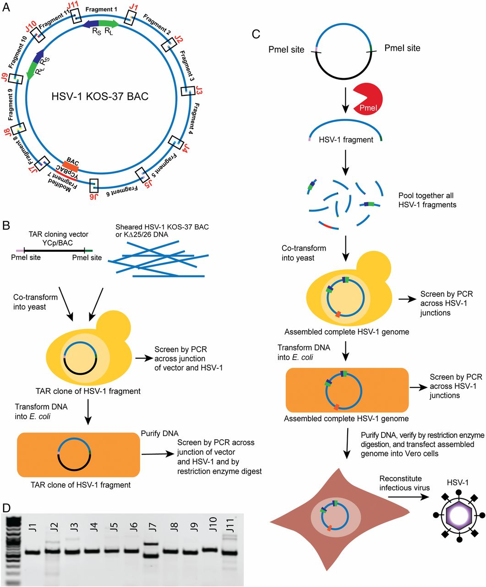
Next steps: Creation of a modular phage genome
Oldfield et. al, PNAS October 17, 2017
114 (42) E8885-E8894
Divide phage genome into 11 segments
Individually clone (and share!) each of the 11 segments

Slide 12
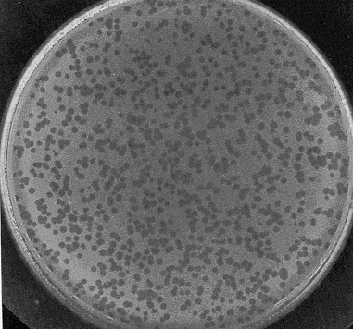
Next steps: Creation of a fully synthetic phage genome
Co-transform into yeast with vector to generate full-length genome
Test for infectivity, etc.
Digest each of the 11 fragments out of vector

Slide 13
What will this enable us to do?
Have students engage in all three phases of the engineering cycle

Slide 14
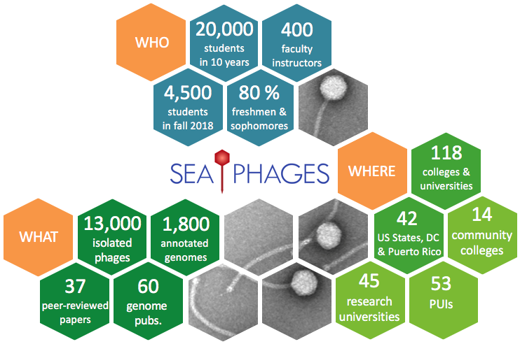
What will this enable us to do?
Capitalize on the many mycobacteriophage genomes that have been isolated and sequenced through the University of Pittsburgh’s PHIRE and HHMI’s SEA-Phages programs.

Slide 15
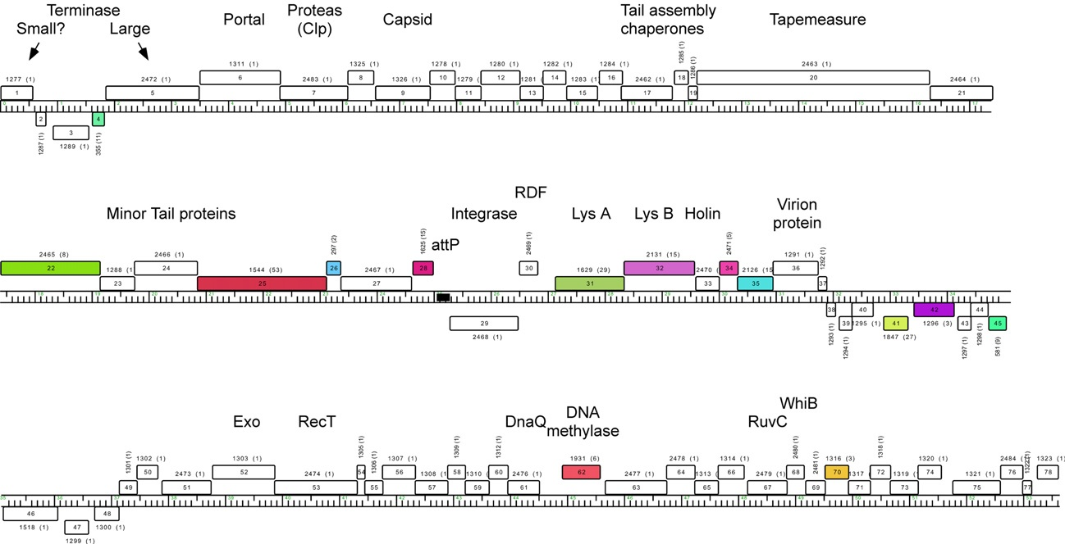
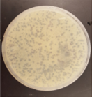
What will this enable us to do?
Begin to assign function to phage genes, about which little is known
Gene 68 deletion

Slide 16
What will this enable us to do?
Begin to assign function to phage genes, about which little is known
Begin to understand genome structure and arrangement

Slide 17
Neochromosomes
Extra, supernumerary chromosomes in yeast

Slide 18
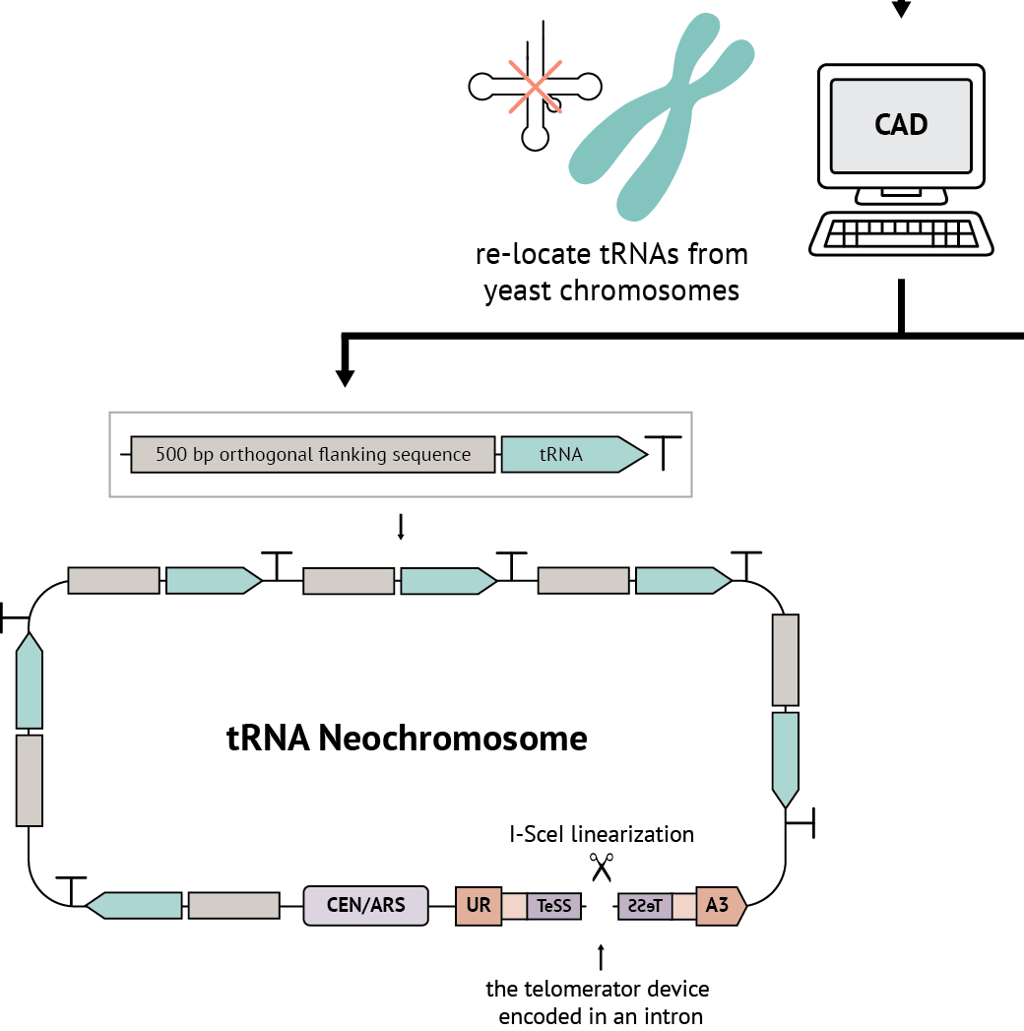
Why create neochromosomes?
Relocalize genes and DNA elements to affect genome stability (https://www.cailab.org/about)
Understand chromosome behavior
Transplant pathways into yeast cells to study them in isolation
Transplant pathways into yeast for biotechnology applications, drug screening

Slide 19
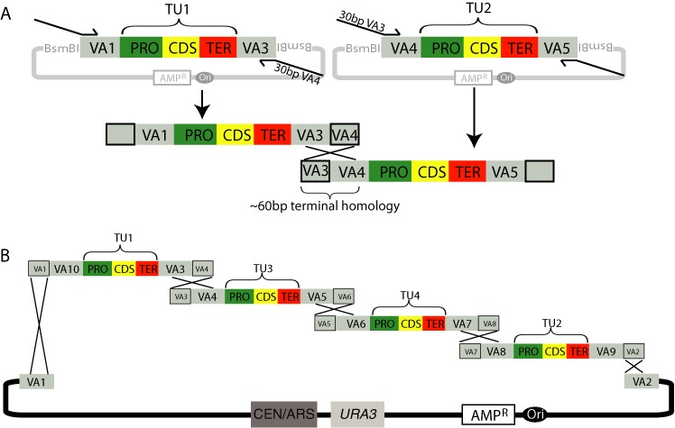
Methodology: Golden Gate assembly (based on restriction enzymes) or VEGAS (based on homologies)
Mitchell et al, Nucleic Acids Research 43(13) · May 2015

Slide 20
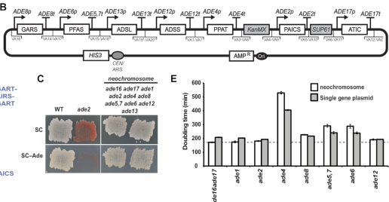
Transplantation of the human purine biosynthesis pathway
Nucleic Acids Res. 2020 Jan 10;
48(1):486-499.
Phylogenetic debugging of a complete human biosynthetic pathway transplanted into yeast
Neta Agmon et al

Slide 21
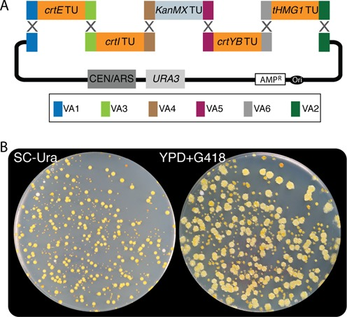
Neochromosome containing the beta-carotene pathway
Mitchell et al, Nucleic Acids Research 43(13) · May 2015

Slide 22
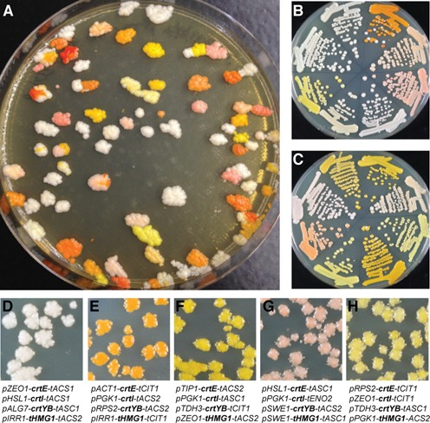
Combinatorial assembly with different promoters and terminators allows you to make many variants

Slide 23
Scramble
Synthetic Chromosome Rearrangement And Modification By LoxP-mediated Evolution

Slide 24
Why Scramble cells?
Learn about genome structure and evolution
Generate strains with beneficial properties

Slide 25
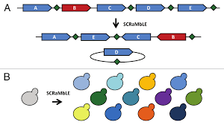
Methodology
LoxP sites at the 3’ end of every nonessential gene

Slide 26
Scramble allows rapid genome evolution and phenotype analysis
Induce Cre recombinase
Select for cells with
desired property
Generate pool of yeast
with various genome
rearrangements
Notes:
Have rearagnemnets occurred between separate chromosomes? oR more likely to occur intrachromosamally?

Slide 27
Three+ workflows
1. Bacteriophage synthesis
2. Neochromosomes
3. Synthetic yeast scramble
+ RFP synthesis

