Slide 1
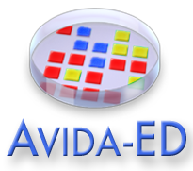
Avida-ED BIOME 2021 Workshop Pre-Workshop Assignment
(Good) Explore the Avida-ED website (https://avida-ed.msu.edu)
(Better) Do #1, and then Download the Avida-ED_Introduction.docx file associated with this workshop on the BIOME 2021 QUBES Website, launch Avida-ED, and go through the Introduction to familiarize yourself with Avida-ED
(Best) Do #’s 1 & 2, and then check out the article by Smith et al. (2016), entitled, “An Avida-ED digital evolution curriculum for undergraduate biology”, available at https://evolution-outreach.biomedcentral.com/articles/10.1186/s12052-016-0060-0

