Slide 1
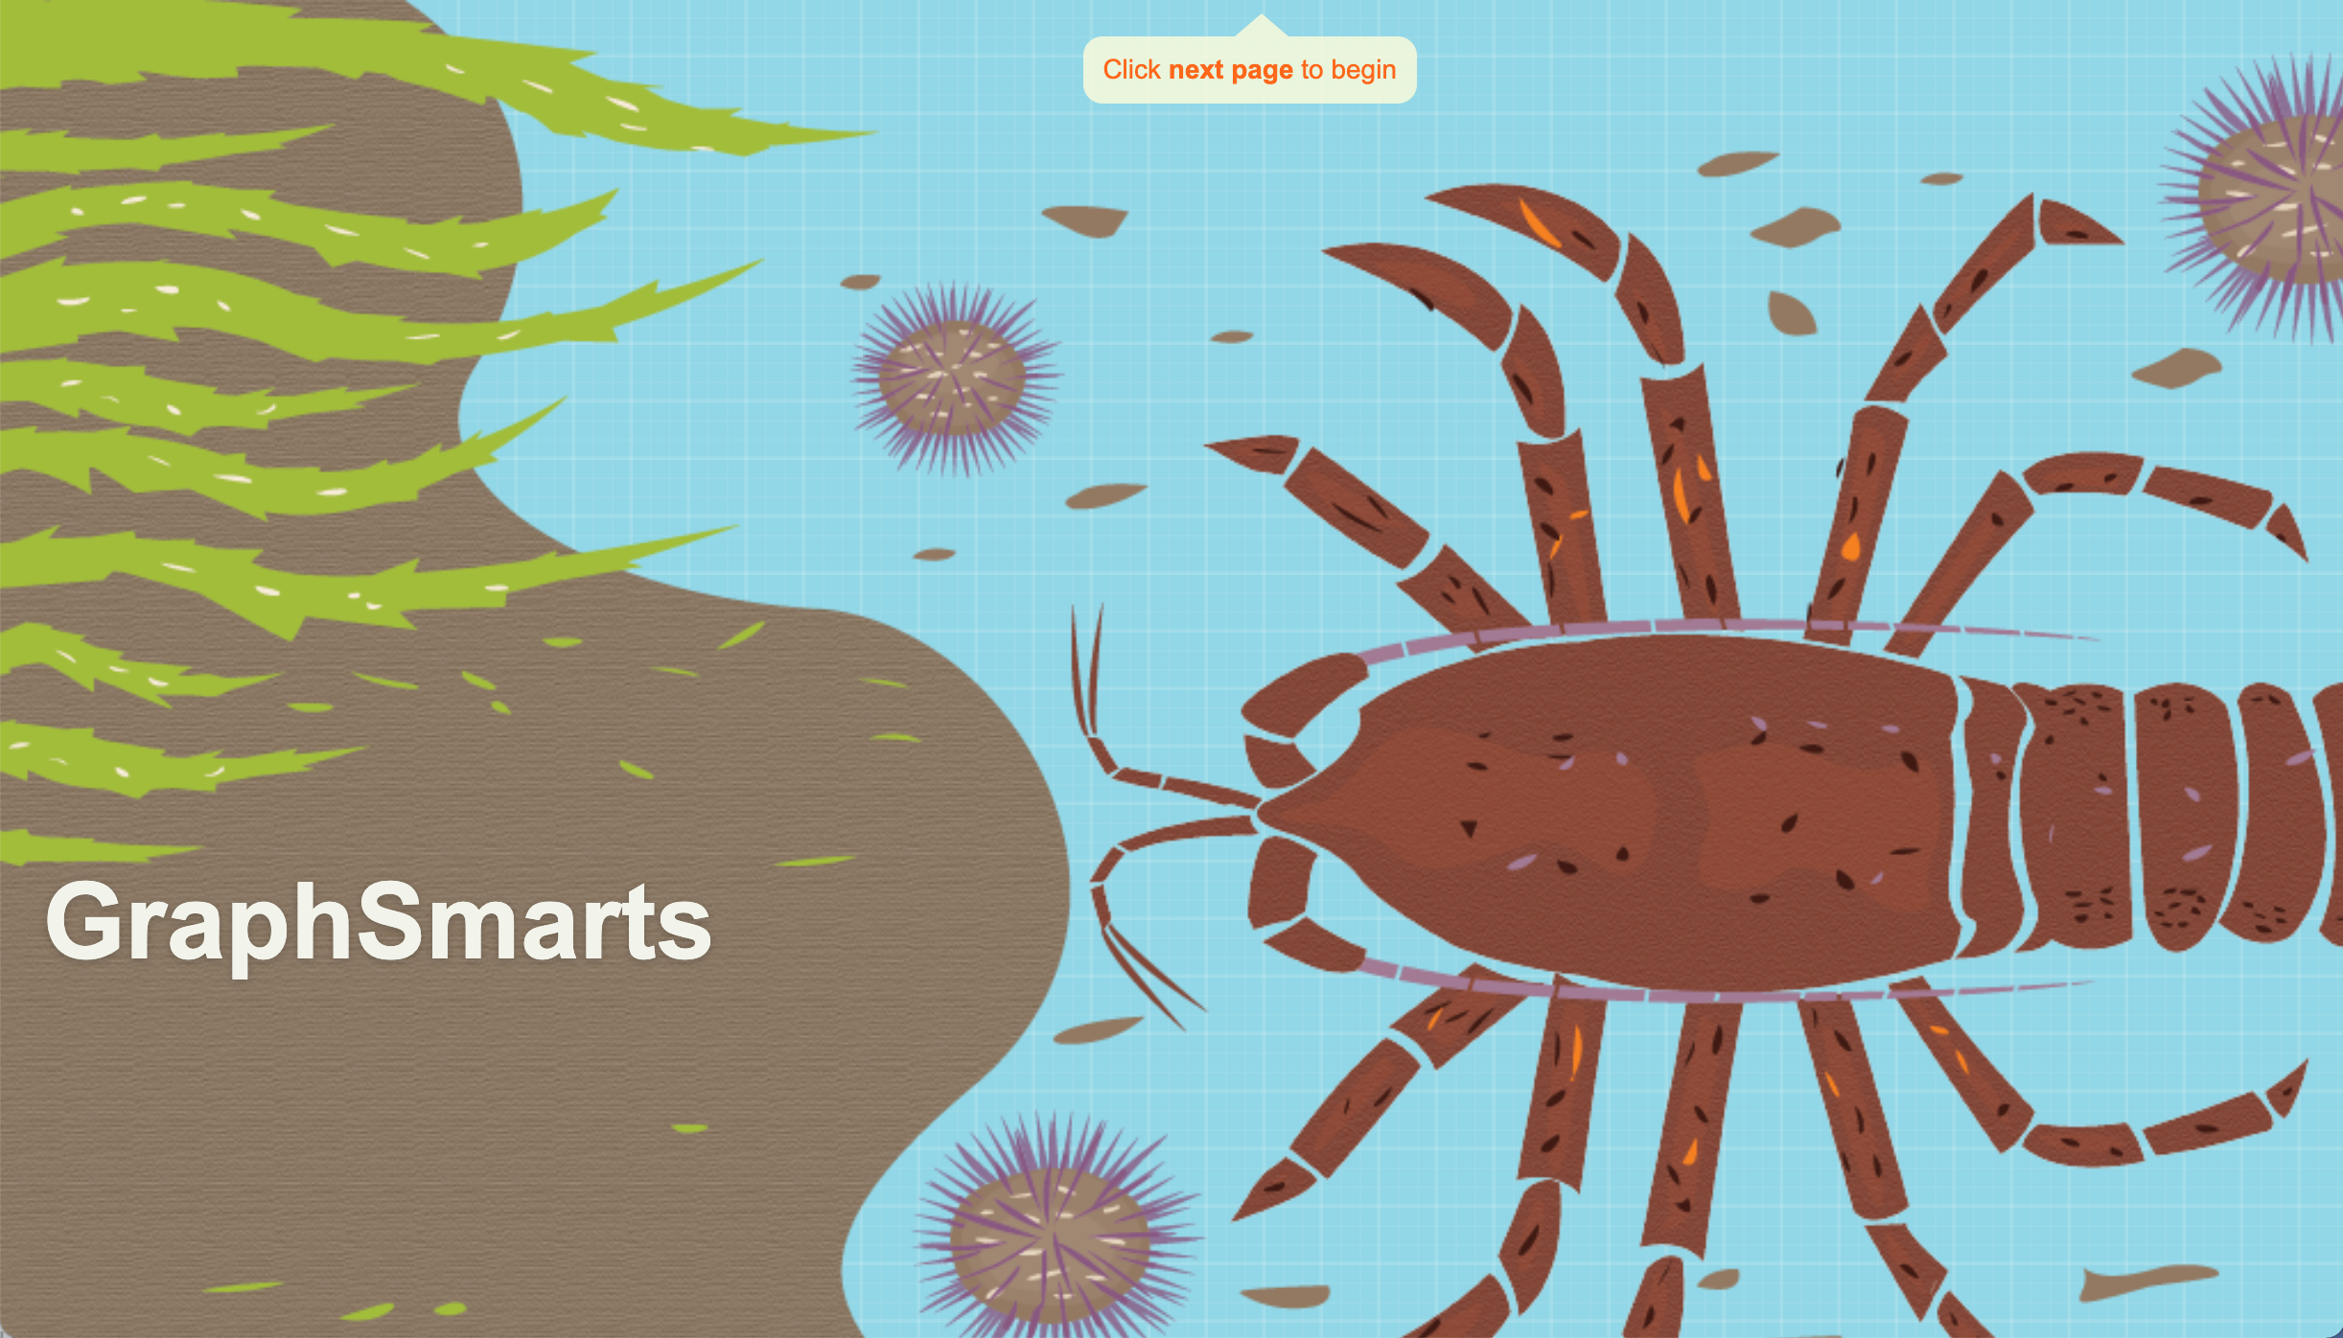
Can My Students Make a Graph?
Testing a new performance-based assessment
Eli Meir, SimBiotic Software
Joel Abraham, CSU Fullerton
Elizabeth Suazo-Flores, Purdue University
Susan Maruca, SimBiotic Software,
Anupriya Karippadath, Purdue University
Nouran E Amin, Purdue University
Rou Rouvere, CSU Fullerton
Stephanie Gardner, Purdue University

Slide 2
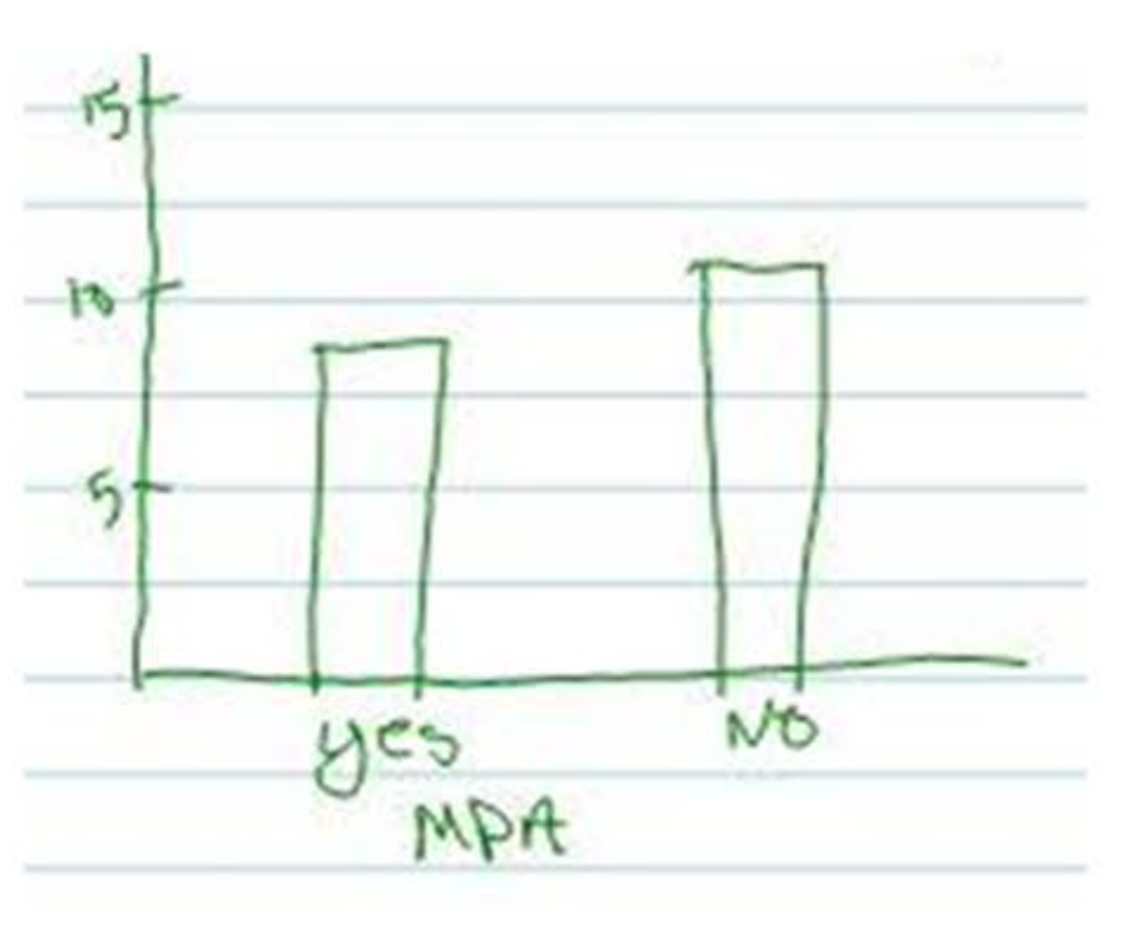
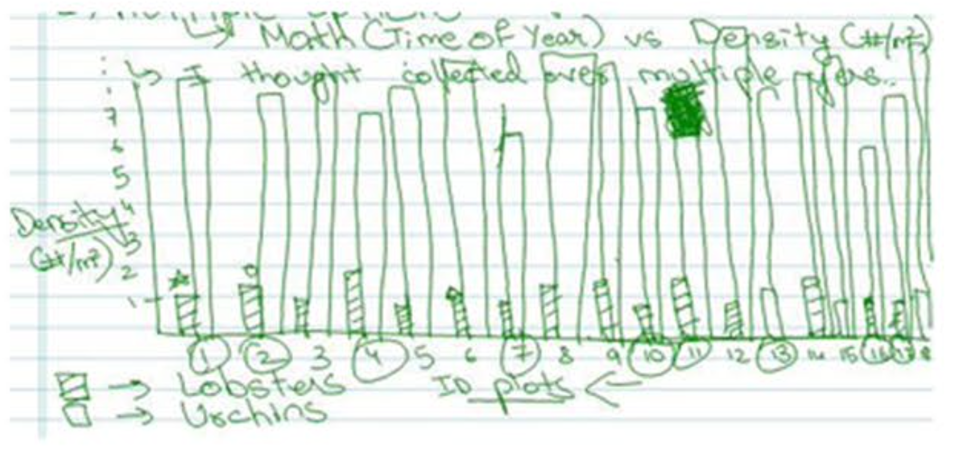
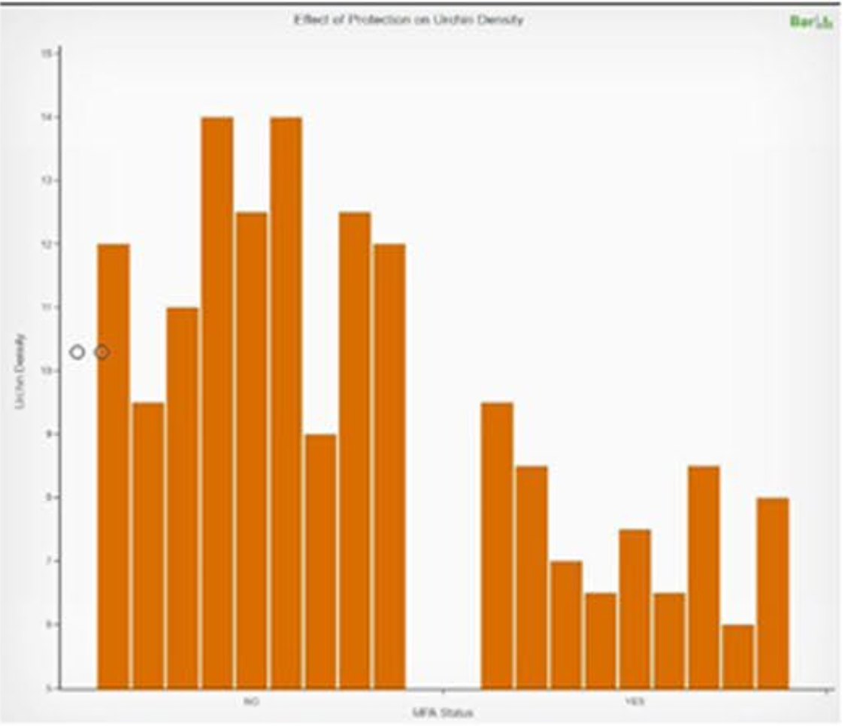
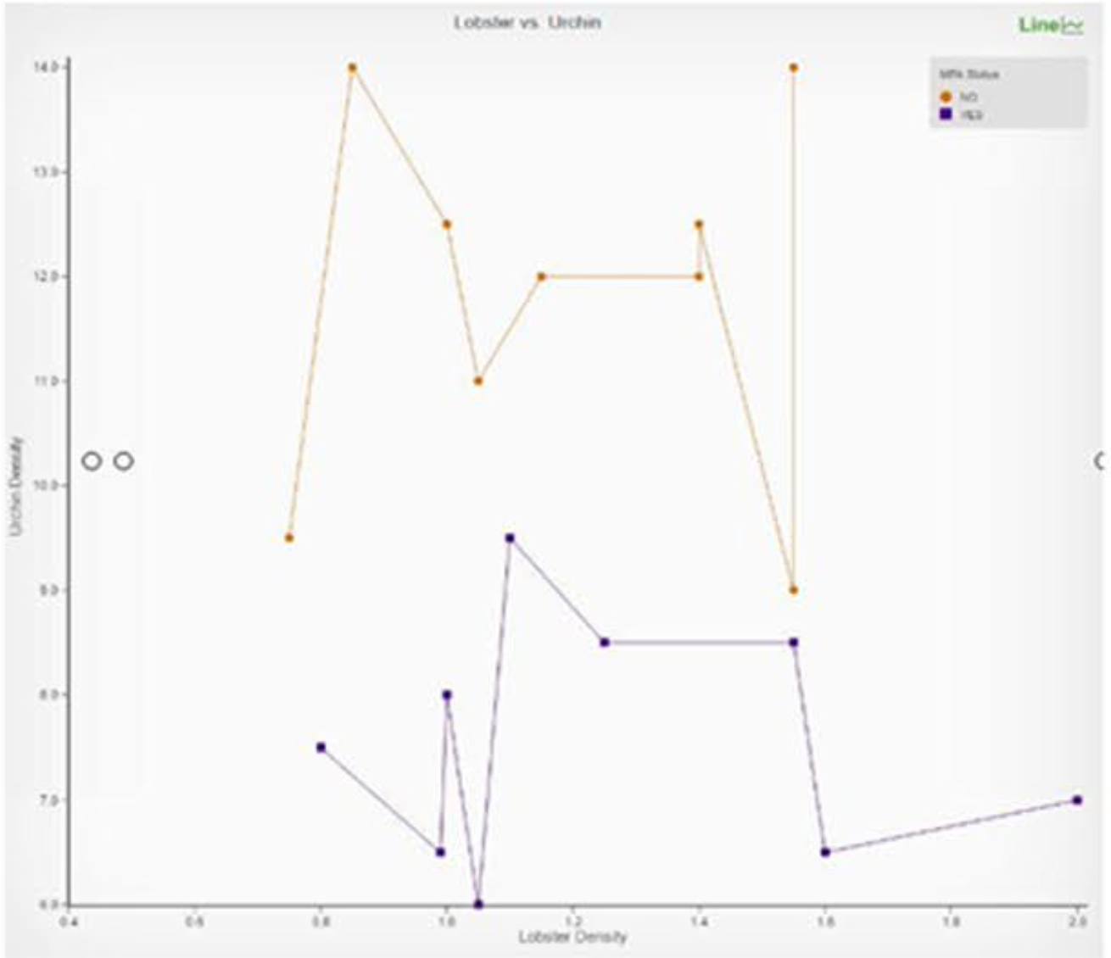
Student’s have trouble constructing graphs
Gardner, S.M., Suazo-Flores, E., Maruca, S., Abraham J.K., Karippadath, A., Meir, E. (2021) Biology Undergraduate Students’ Graphing Practice in Digital Versus Pen and Paper Graphing Environments. J Sci Educ Technol

Slide 3
Assessment is Key
Hard to improve what you can’t assess
Performance-based
Intermediate Constraint
Multiple Choice
Maxes Out
Ability to help students learn
Power and validity of assessment
*
Complex skills like graph construction are hard to assess with simple test items like multiple choice.
What I want to talk about today - does it work?
Validity & Reliability

Slide 4
Graph Construction Conceptual Model
Abraham et al, in prep
Category | Practice | Practice Description
Data Selection |  | Four practices related to understanding the structure of the data being plotted and its relation to the research question
 | Data Type | Differentiates between quantitative (i.e. ratio, interval) and qualitative (i.e. ordinal, nominal) data types
 | Variable Relevance | Selects variables for the graph that are relevant to a scientific claim in the context of a given research question, hypothesis, prediction, or objective
 | Variable Categorization | Identifies variables as related or causally linked in the context of a stated research question, hypothesis, prediction, or objective
 | Data Filtering / Prioritization | Plots appropriate data points, and appropriately excludes data points (e.g. missing data, corrupted samples), from each variable based on data characteristics
Data Exploration |  | Four practices related to manipulating and characterizing data on a graph (e.g. individual points vs. summary statistics, showing variance)
Graph Assembly |  | Five practices related to drawing the graph (e.g. choosing type of graph, plotting points, following conventions)
Graph Reflection |  | Four practices related to interpreting and evaluating the graph (e.g. identifying trends, drawing conclusions)

Slide 5
GraphSmarts – Auto-scored Performance-based Assessment for Graph Construction

Slide 6
Assessment validity
Measuring what we intend to measure
Easy to use
Capture range of student competencies
Show expected differences between populations
Faculty more competent than undergraduates
Majors more competent than non-majors
Upper level students more competent than intro students
No item ordering effects
Correlation between similar items
Correlation of performance and non-performance based items
Correlation with non-digital performance assessment

Slide 7
Measuring what we intend to measure?
Evidence-Centered Design
Student Model
Interface Task
Evidence Model
Design research process using the Evidence Centered Design framework
6 Iterations over 5 years
> 100 student interviews

Slide 8
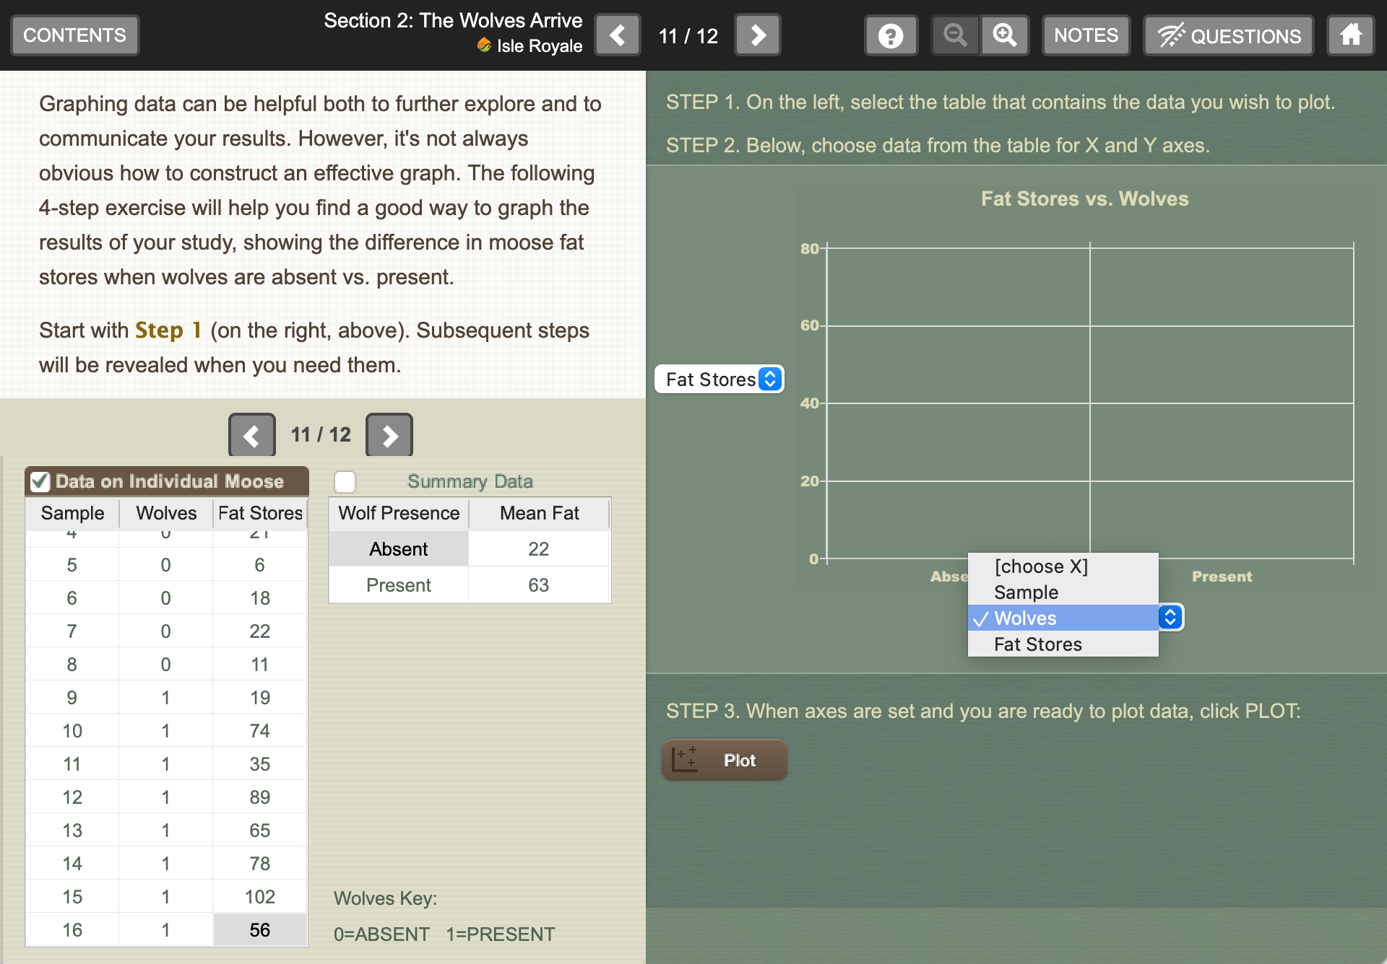
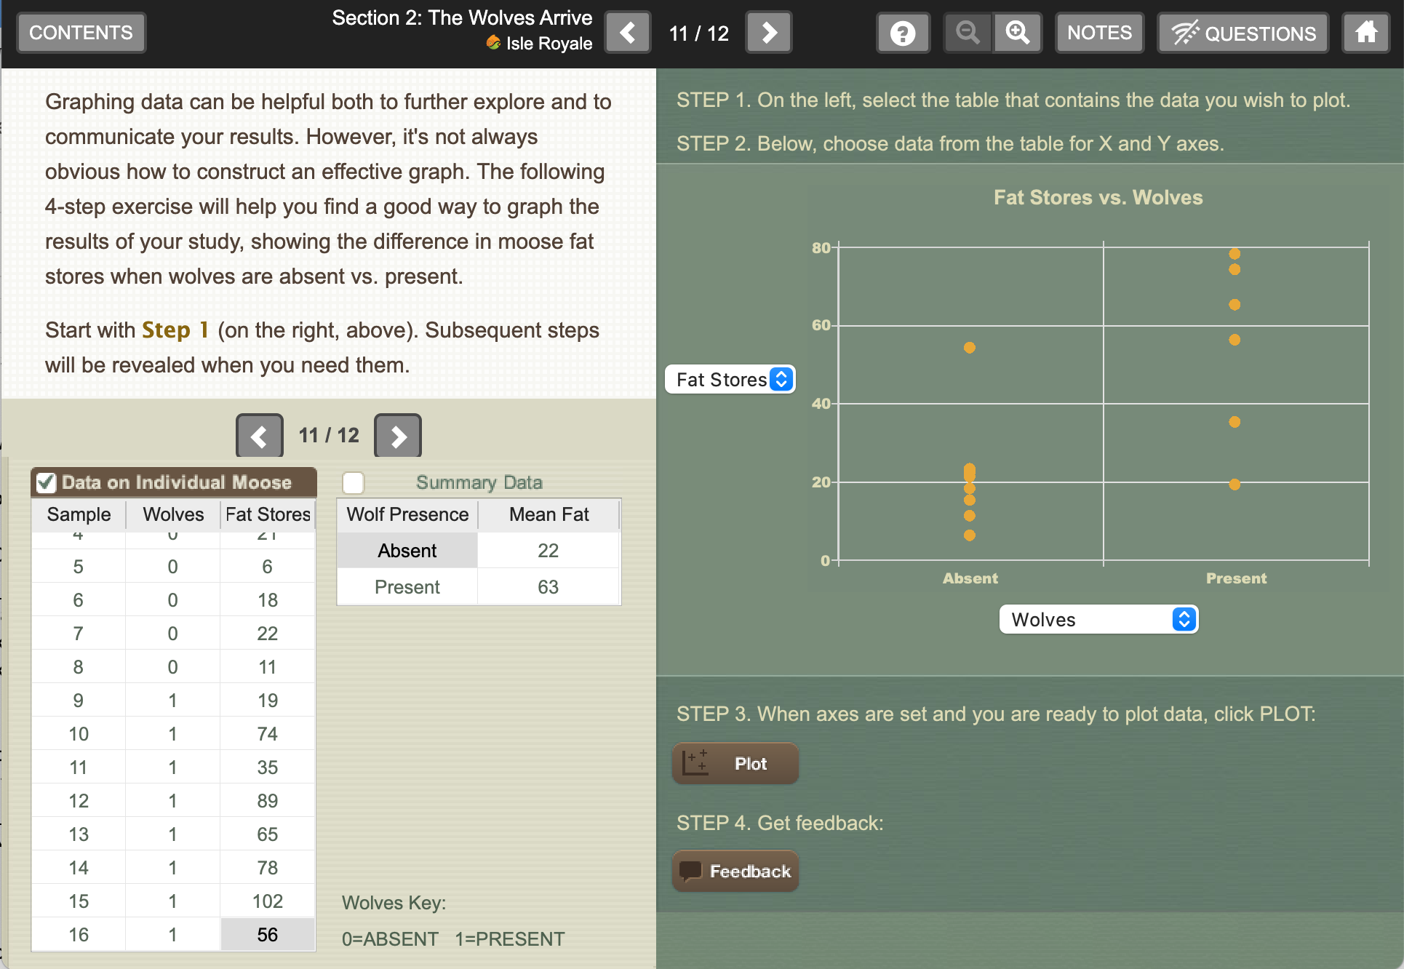
Isle Royale

Slide 9
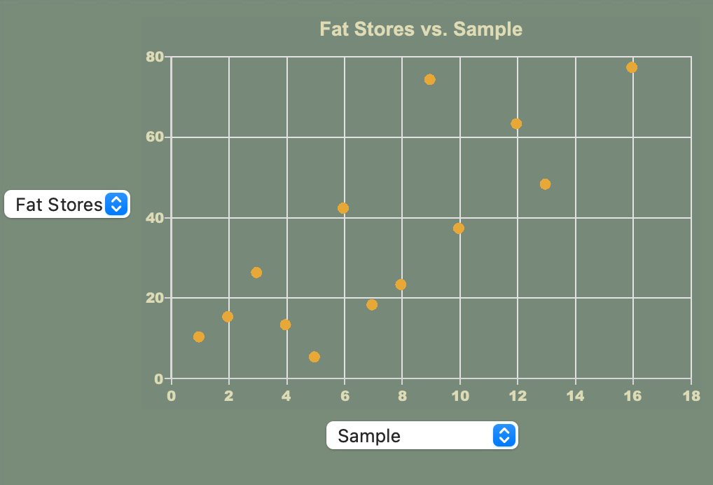
Simple graphing = simple assessment
Only 3 graphing practices measured
Variable Relevance
Data Aggregation
Axis Conventions
Lack of Choice = Lack of Assessment Power

Slide 10
Manipulating Constraint
Meir, E. Strategies for targeting the learning of complex skills like experimentation to different student levels: The intermediate constraint hypothesis. In Trends in Teaching Experimentation in Life Sciences. Eds. N. J. Pelaez, S. M. Gardner, & T. R. Anderson. Springer Nature Switzerland AG, Cham, Switzerland.
Yes
Meir E., Wendel, D., Pope D.S., Hsiao L., Chen D., Kim K.J. Are intermediate constraint question formats useful for evaluating student thinking and promoting learning in formative assessments? Computers & Education DOI: 10.1016/j.compedu.2019.103606
No

Slide 11
New Scenario – Lobsters! Urchins!

Slide 12
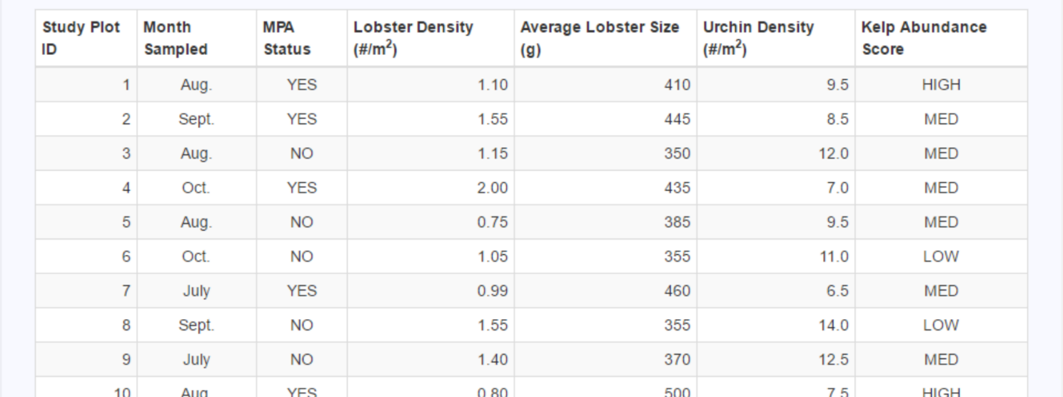
Data Provided

Slide 13
Explicit Predictions

Slide 14
Try GraphSmarts

Slide 15
Graph Construction Conceptual Model
Abraham et al, in prep
Practice | Practice Description
Variable Relevance | Selects variables for the graph that are relevant to a scientific claim in the context of a given research question, hypothesis, prediction, or objective
Variable Categorization | Identifies variables as related or causally linked in the context of a stated research question, hypothesis, prediction, or objective
Data Summarization | Plots individual or summarized data to communicate information efficiently for a given data set and intended purpose
Data Variability | Displays variation in data in a form appropriate for a given graph type and intended purpose
Graph Type | Selects a graph appropriate for the data type and intended purpose
Graph Structure: Axis Conventions | Follows disciplinary conventions in assignment of axes of graph
Graph Structure: Scaling | Follows disciplinary conventions in scaling of graph
Data Description | Describes the characteristics (i.e. central tendency, variability) and patterns of the graphed data for the plotted values and graph type
Graph Selection | When one or more graphs are constructed, evaluates the affordances and limitations of each graph for exploring data characteristics or for supporting a scientific claim
Scientific Claim | Interprets the constructed graph to support a scientific claim in the context of a given research question, hypothesis, prediction, or objective

Slide 16
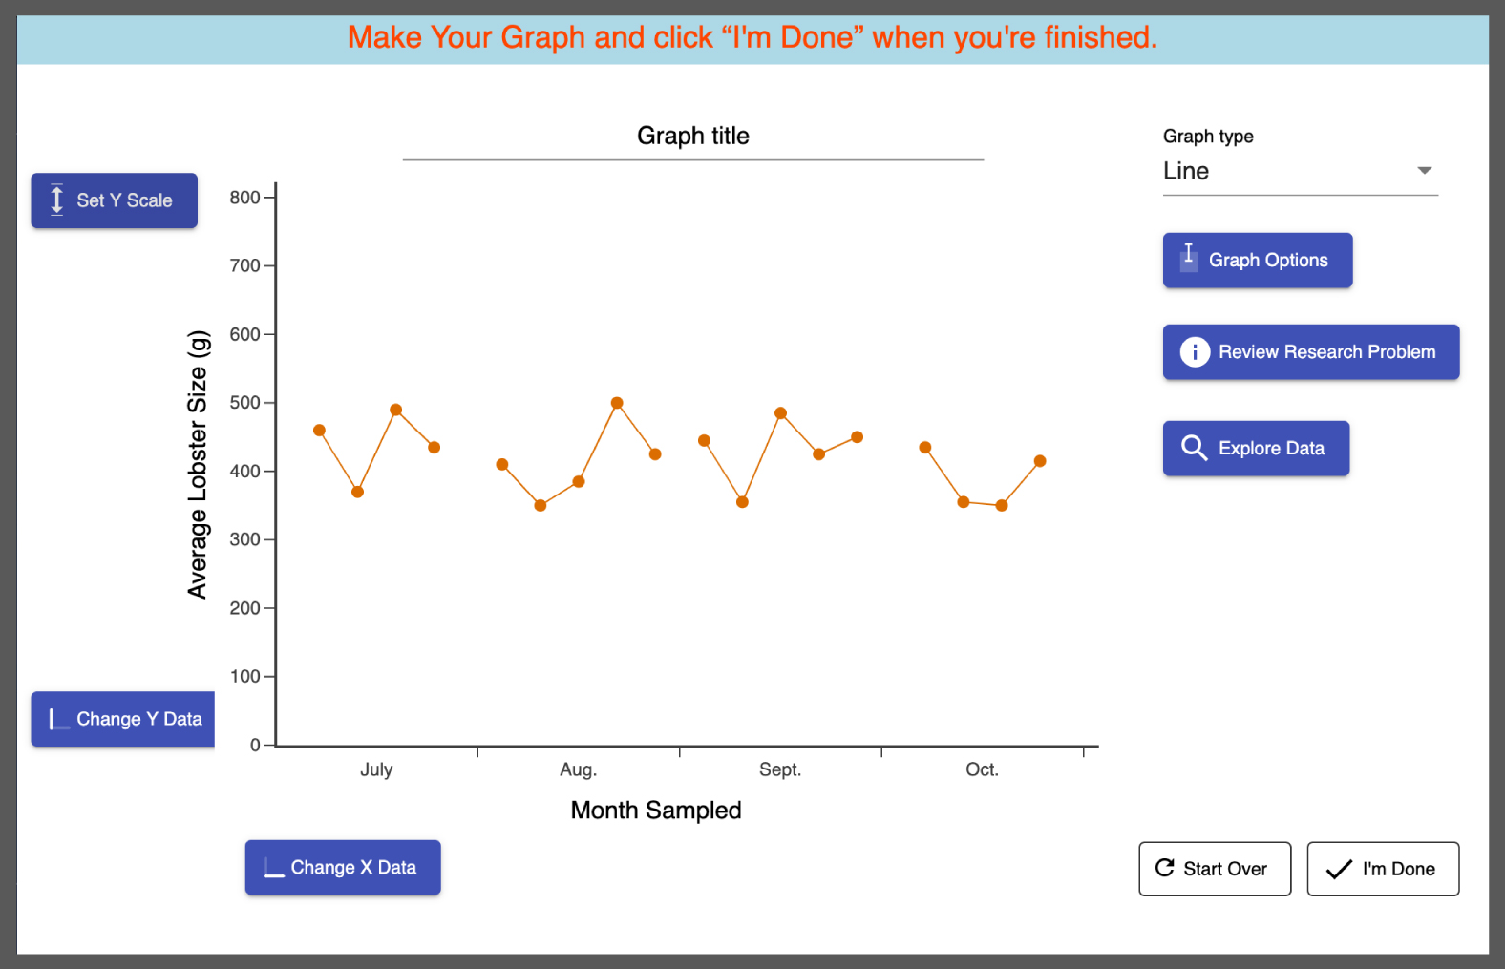
Less Constraint => More Data, Harder Interpretation
Selected Design Choices
Surround Performance by embedded questions
Seven variables
Three Graph Types
Three very explicit predictions
Stats vs no stats but no stat selection
No manual axis labels

Slide 17
Measuring what we intend to measure?
YES (mostly)
Evidence-Centered Design
Student Model
Interface Task
> 100 Student Interviews
9 Instructor interviews
Evidence Model
6 iterations
Meir, E., Gardner, S.M., Maruca, S., Suazo-Flores, E., Abraham, J.K. (in press). Can My Students Make A Graph? Using Evidence-Based Design to Build an Auto-Scored Performance-Based Assessment of Graph Construction. In J.M. Spector, B. B. Lockee, & M.D. Childress (Eds.) Learning, Design, and Technology. An International Compendium of Theory, Research, Practice, and Policy. Springer Nature, New Dehli, India.
Design research process using the Evidence Centered Design framework
6 Iterations over 5 years
> 100 student interviews

Slide 18
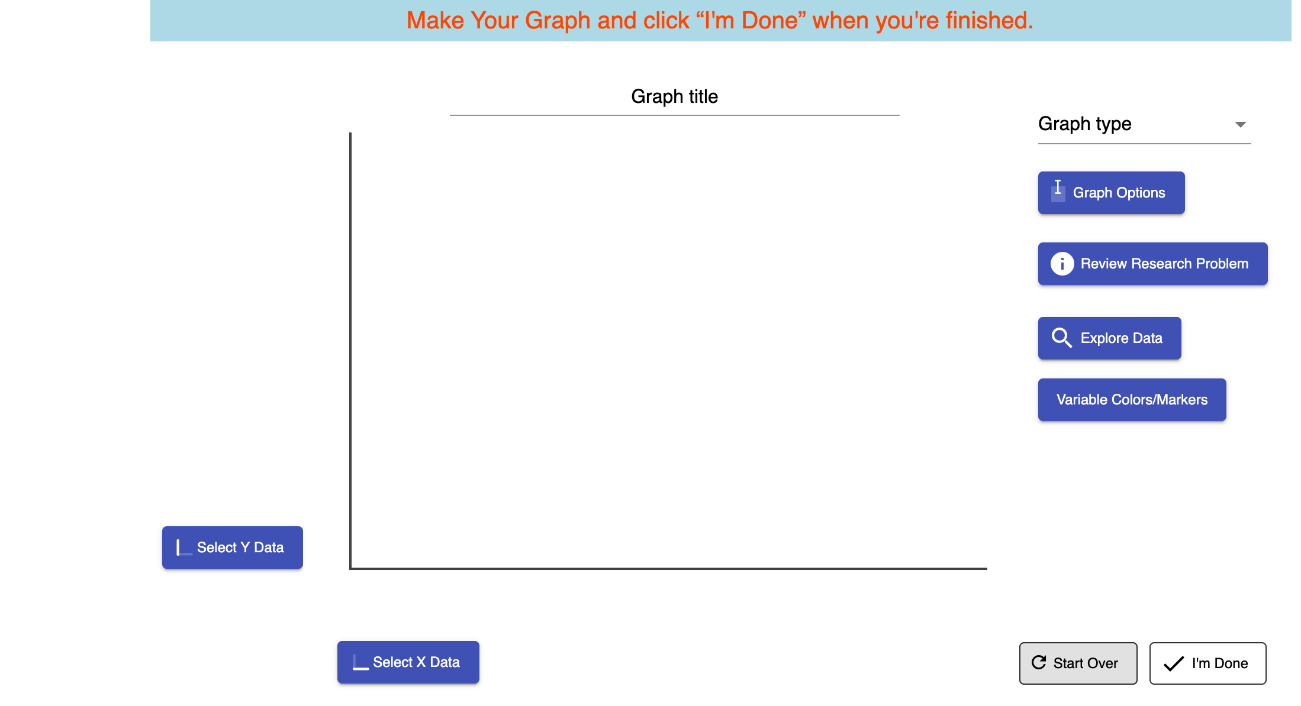
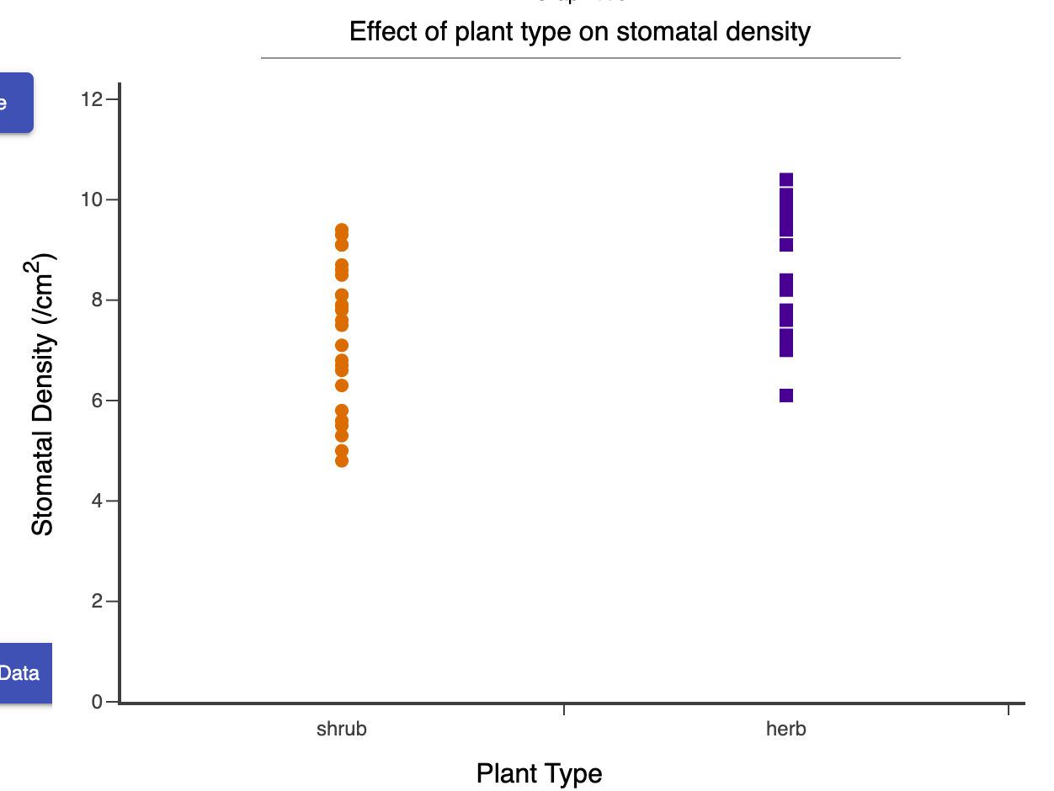
Easy to use?
YES (mostly)
Example Graph
Now you make it
8 Testers
Variables, aggregation, graph type, most other features – no problem
A few small issues addressed in revisions
Some students had trouble finding error bars – not yet addressed

Slide 19
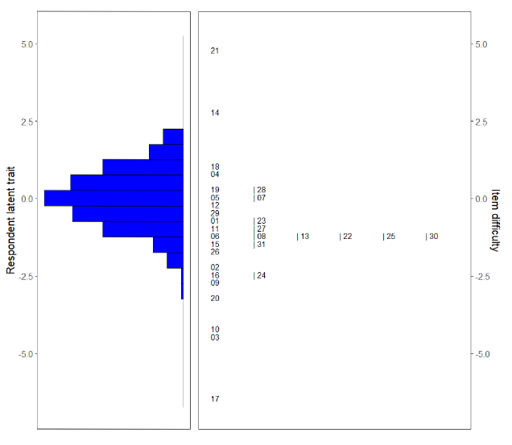
Capture Range of Student Competencies?
YES
(if students aren’t too competent)

Slide 20
Show Expected Population Differences?

Slide 21
Show Expected Population Differences?

Slide 22
Show Expected Population Differences?

Slide 23
Show Expected Population Differences?

Slide 24
Reliability?

Slide 25
Performance vs. Non-Performance Correlation
R^2 0.34
Pearson’s r 0.58

Slide 26
Ready for use? We say yes!
Information
Perfection
Iteration 6
Iteration 5
Iteration 4
Iteration 3
Iteration 2
Iteration 1
Usability Perfection

Slide 27
Scores by practice

Slide 28
Question: Content validity of new versions
GraphSmarts versions situated in
Ecology (all data shown today)
Physiology
Molecular Biology
TAKE OUR ASSESSMENTS – THIS SUMMER eli@simbio.com
(We won’t judge, we promise)

Slide 29
Question: How Do Students Learn To Graph?
Intro Bio Syllabus
Day 1
Midterm 1
Midterm 2
Final
Homework:
GraphSmarts A
Homework:
GraphSmarts B
Use 2 – 3 GraphSmarts versions in a class
Versions available this year: Ecology, Physiology, Molecular Biology
We provide reports to instructors for each assessment.
Change between assessments -> hypotheses of learning trajectories

Slide 30
Aim: Find Learning Trajectories Use Those To Build Learning Tools
Intro Bio Syllabus
Day 1
Midterm 1
Midterm 2
Final
Homework:
Graph Construction Tutorial A
Homework:
Graph Construction Tutorial B

Slide 31
Get Info On Your Students’ Graphing This Year!
Eli Meir: eli@simbio.com
Knowledgeable about implementing in your class
Stephanie Gardner: sgardne@purdue.edu
Knowledgeable about graphing
Funded in part by the U.S. National Science Foundation Grants #1726180, 2111150
Thanks to all the instructors and students who participated and the many SimBio people who worked on GraphSmarts, esp. Amy Gallagher, Steve Allison-Bunnell, and Kerry Kim

Slide 32
Several flavors of GraphSmarts
GraphSmarts versions situated in
Ecology (all data shown today)
Physiology
Molecular Biology
Goal: graphing assessments across the intro bio curriculum to track learning about graphing over time

Slide 33
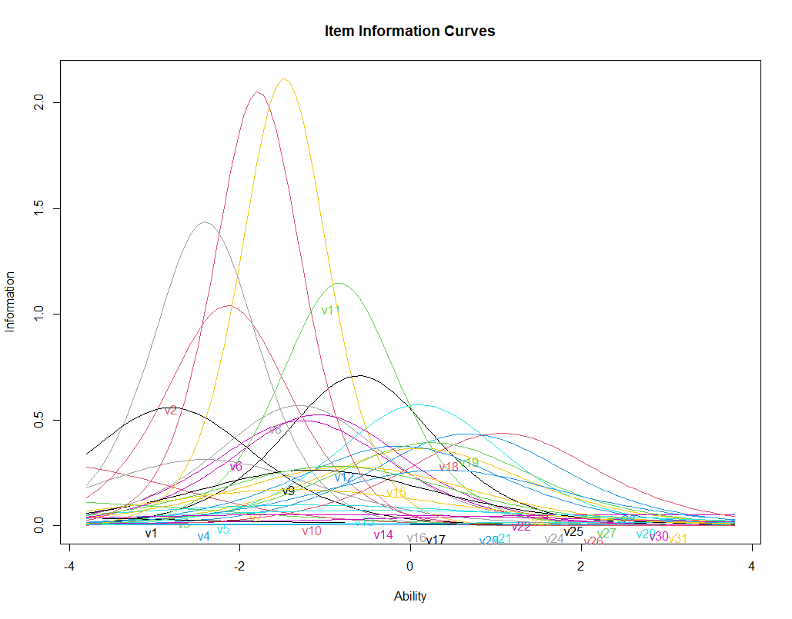
Capture Range of Student Competencies?
-4
-2
0
2
4
Competency

