Slide 1
STEM Writing Project: Using Reflective Feedback on Scientific Writing to Increase Student Self-Efficacy
Dan Johnson
Wake Forest University
Notes:
1920 x 1080

Slide 2
Goals & Outline for Today
Tour SEM, introduce reflective coaching feedback
Regrade 2 reports using reflective coaching
Document questions, problems
Discuss outcomes, participant questions
Talk about:
Logistics; implementing coaching in multi-section courses
Reinforcing reflection comments in student follow-ups
Compiled comments = data to refine writing instruction
Training GTAs to use reflective coaching
Reflection as a component of UDL

Slide 3
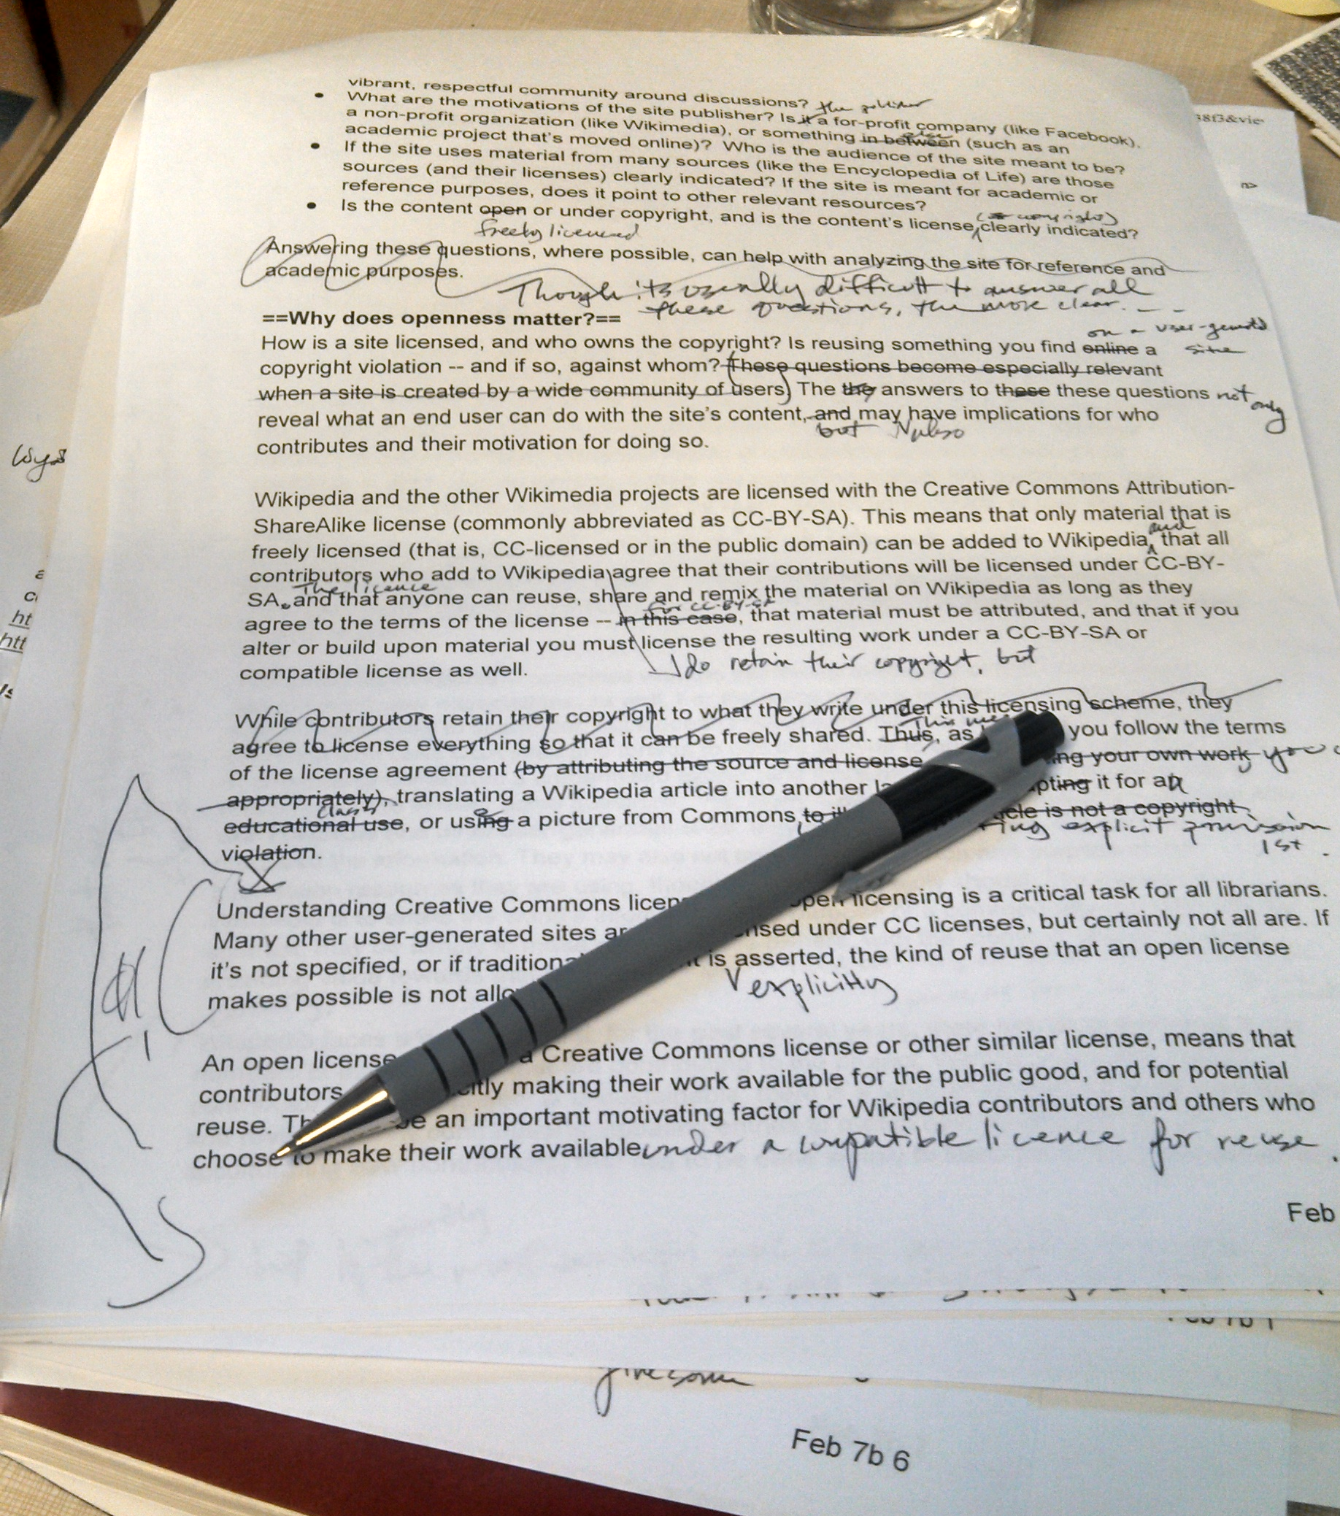
Tell the Truth…Is THIS Your Reality?

Slide 4
…Or Is THIS Closer to Your Reality?

Slide 5
How STEM Teaches Writing is NOT How Pros Do It
Program Design Differences |  |  | Instructor Differences
STEM Programs | Writing Programs |  | STEM Programs | Writing Programs
100s of students/ sem. | 15/sec., 60/sem. |  | Extensive copy-editing | Less editing, more coaching to self-correct
GTAs; add-on goal | Professionals; 1 goal |  | Overload students with corrections | Limit feedback, priority is biggest errors first
Ad hoc approach | Evidence-based best practices |  | Mechanics >> structure | Structure >> mechanics
Assume goals, purpose are clear | Assess students; do they see goals, purpose? |  | What else??

Slide 6
Goals & Outline for Today
Tour SEM, introduce reflective coaching feedback
Regrade 2 reports using reflective coaching
Document questions, problems
Review outcomes, participant questions
Talk about:
Logistics; implementing coaching in multi-section courses
Reinforcing reflection comments in follow-up
Compiled comments = data to refine writing instruction.
Incorporating more UDL

Slide 7
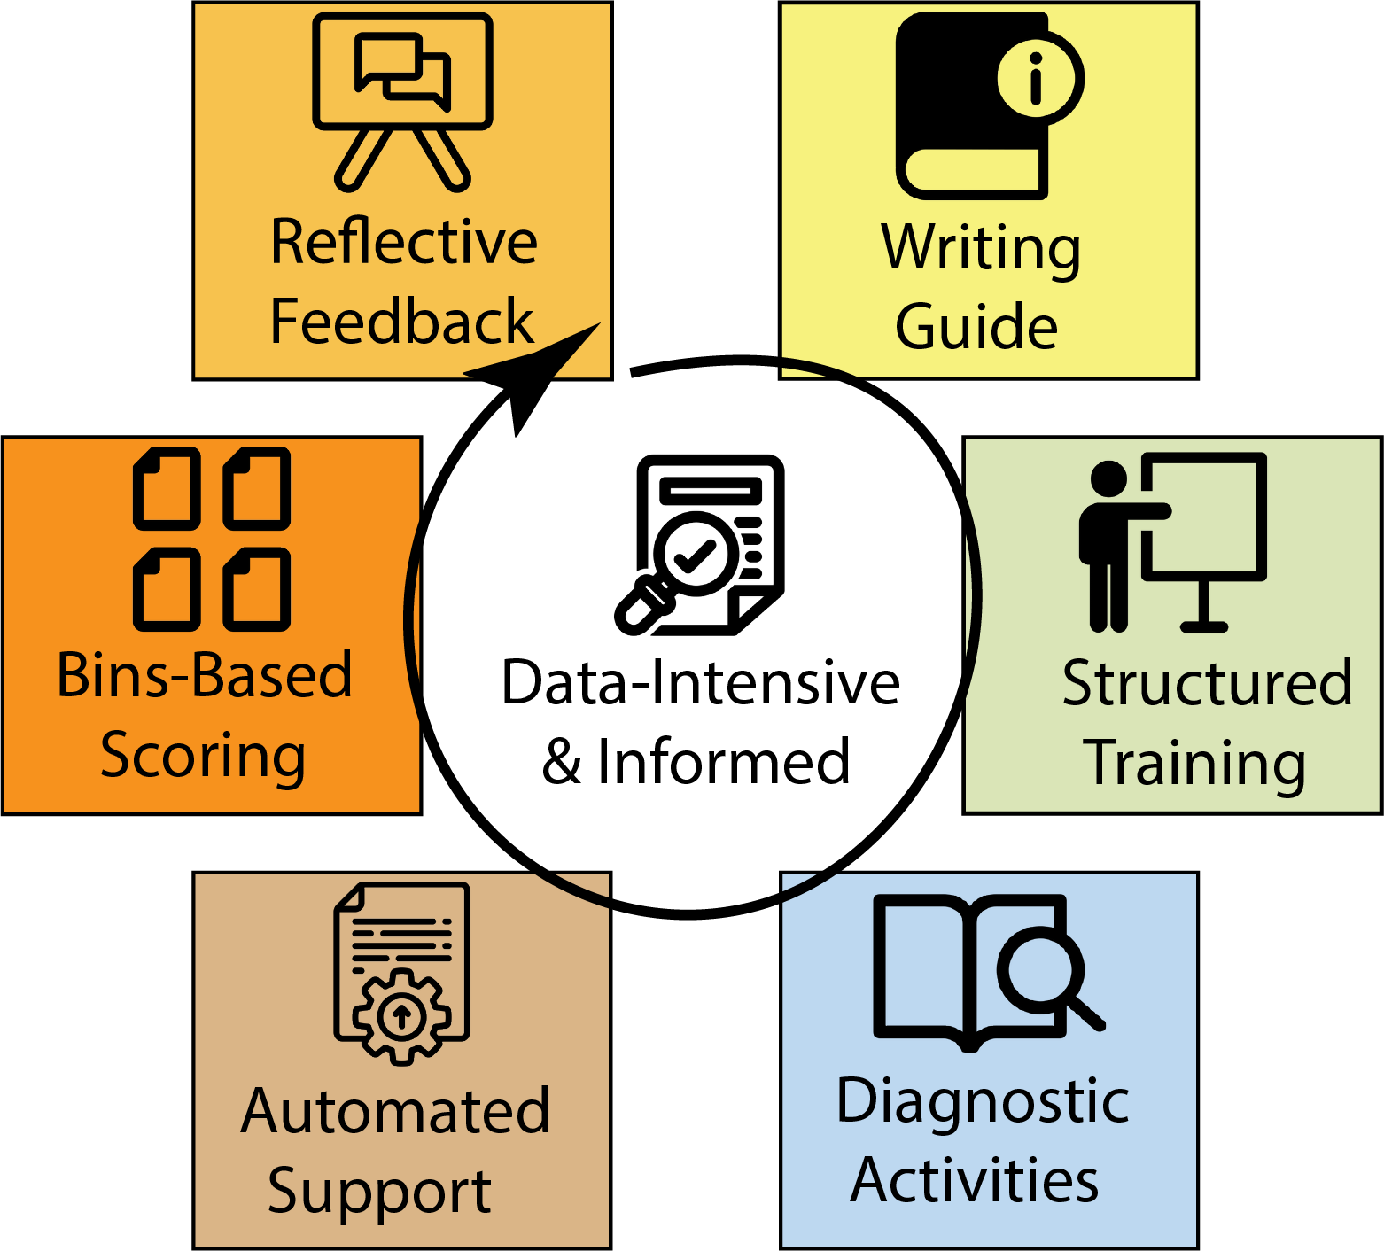
Our Approach: Six Elements Model (SEM)
Adapt WAC/WID practices to STEM’s reality
Improve on what works
Remove what doesn’t
Leverage data science, computational methods
Make student experience more “authentic”
Give instructors time back
https://stemwritingproject.org/

Slide 8
Our Approach: Bins-Based Scoring
Scores based on ~20 binary features:
Meets all basic criteria?
Are there flaws in writing, logic, or technical requirements?
Faster, fairer grading:
Time for submission/revision
Points arguments change to deeper discussions

Slide 9
Our Approach: Reflective Feedback, Coaching
Student is in charge of improving, correcting
Helps students learn to ask right questions about their OWN work
Limited/no copy editing
Refer authors back to Writing Guide, training activities
Look to 1º lit. for examples

Slide 10
Goals & Outline for Today
Tour SEM, introduce reflective coaching feedback
Regrade 2 reports using reflective coaching
Document questions, problems
Go into break-outs
Discuss as you work
Post questions (I’ll monitor, respond)

Slide 11
Goals & Outline for Today
Tour SEM, introduce reflective coaching feedback
Regrade 2 reports using reflective coaching
Document questions, problems
Review outcomes, participant questions
Talk about:
Logistics; implementing coaching in multi-section courses
Reinforcing reflection comments in follow-up
Compiled comments = data to refine writing instruction.
Incorporating more UDL

Slide 12
Goals & Outline for Today
Tour SEM, introduce reflective coaching feedback
Regrade 2 reports using reflective coaching
Document questions, problems
Review outcomes, participant questions
Participants’ choice:
Logistics; implementing coaching in multi-section courses
Reinforcing reflection comments in follow-up
Compiled comments = data to refine writing instruction
Training GTAs
Reflection as UDL

Slide 13
THANKS for coming today!
Fill out evaluation!
Check out more project resources at:
stemwritingproject.org (links to BioQUEST Hub)
Notes:
1920 x 1080

