Slide 1
Quantitative Analysis Exercise II
Investigating Human Impacts on Stream Ecology: Locally and Nationally
CITATION FOR QUESTIONS IN THIS POWERPOINT
Amelia Nuding and Stephanie Hampton. March 2012, posting date. Investigating human impacts on stream ecology: locally and nationallyTeaching Issues and Experiments in Ecology, Vol. 8: Practice #1 [online].
http://tiee.esa.org/vol/v8/issues/data_sets/nuding/abstract.html

Slide 2
Stream Ecology Pre- and Post-test Questions
1. Fertilizers containing nutrients to promote plant growth are commonly applied to farm crops and to gardens and yards. When these fertilizers reach aquatic environments, they:
  Frequently cause microorganisms in the water to grow because many of these microorganisms use the same nutrients for photosynthesis as do crops
  Mostly do not affect microorganisms in the water because aquatic microorganisms require different nutrients than crops
  Mostly do not affect microorganisms in the water because the nitrogen and phosphorus in fertilizers is not biologically available to aquatic microorganisms

Slide 3
Stream Ecology Pre- and Post-test Questions
1. Fertilizers containing nutrients to promote plant growth are commonly applied to farm crops and to gardens and yards. When these fertilizers reach aquatic environments, they:
  Frequently cause microorganisms in the water to grow because many of these microorganisms use the same nutrients for photosynthesis as do crops
  Mostly do not affect microorganisms in the water because aquatic microorganisms require different nutrients than crops
  Mostly do not affect microorganisms in the water because the nitrogen and phosphorus in fertilizers is not biologically available to aquatic microorganisms

Slide 4
Stream Ecology Pre- and Post-test Questions
2. Larger (macroscopic) invertebrates living in streams, like larval mayflies and stoneflies:
  Are generally only affected by fertilizers applied to the land if their adult life stage is terrestrial (like mayflies and stoneflies)
  Are frequently affected by fertilizers applied to land because fertilizers provide nutrients to the microorganisms that photosynthesize in streams
  Are frequently affected by fertilizers applied to land because the invertebrates can directly use these inorganic nutrients for growth

Slide 5
Stream Ecology Pre- and Post-test Questions
2. Larger (macroscopic) invertebrates living in streams, like larval mayflies and stoneflies:
  Are generally only affected by fertilizers applied to the land if their adult life stage is terrestrial (like mayflies and stoneflies)
  Are frequently affected by fertilizers applied to land because fertilizers provide nutrients to the microorganisms that photosynthesize in streams
  Are frequently affected by fertilizers applied to land because the invertebrates can directly use these inorganic nutrients for growth

Slide 6
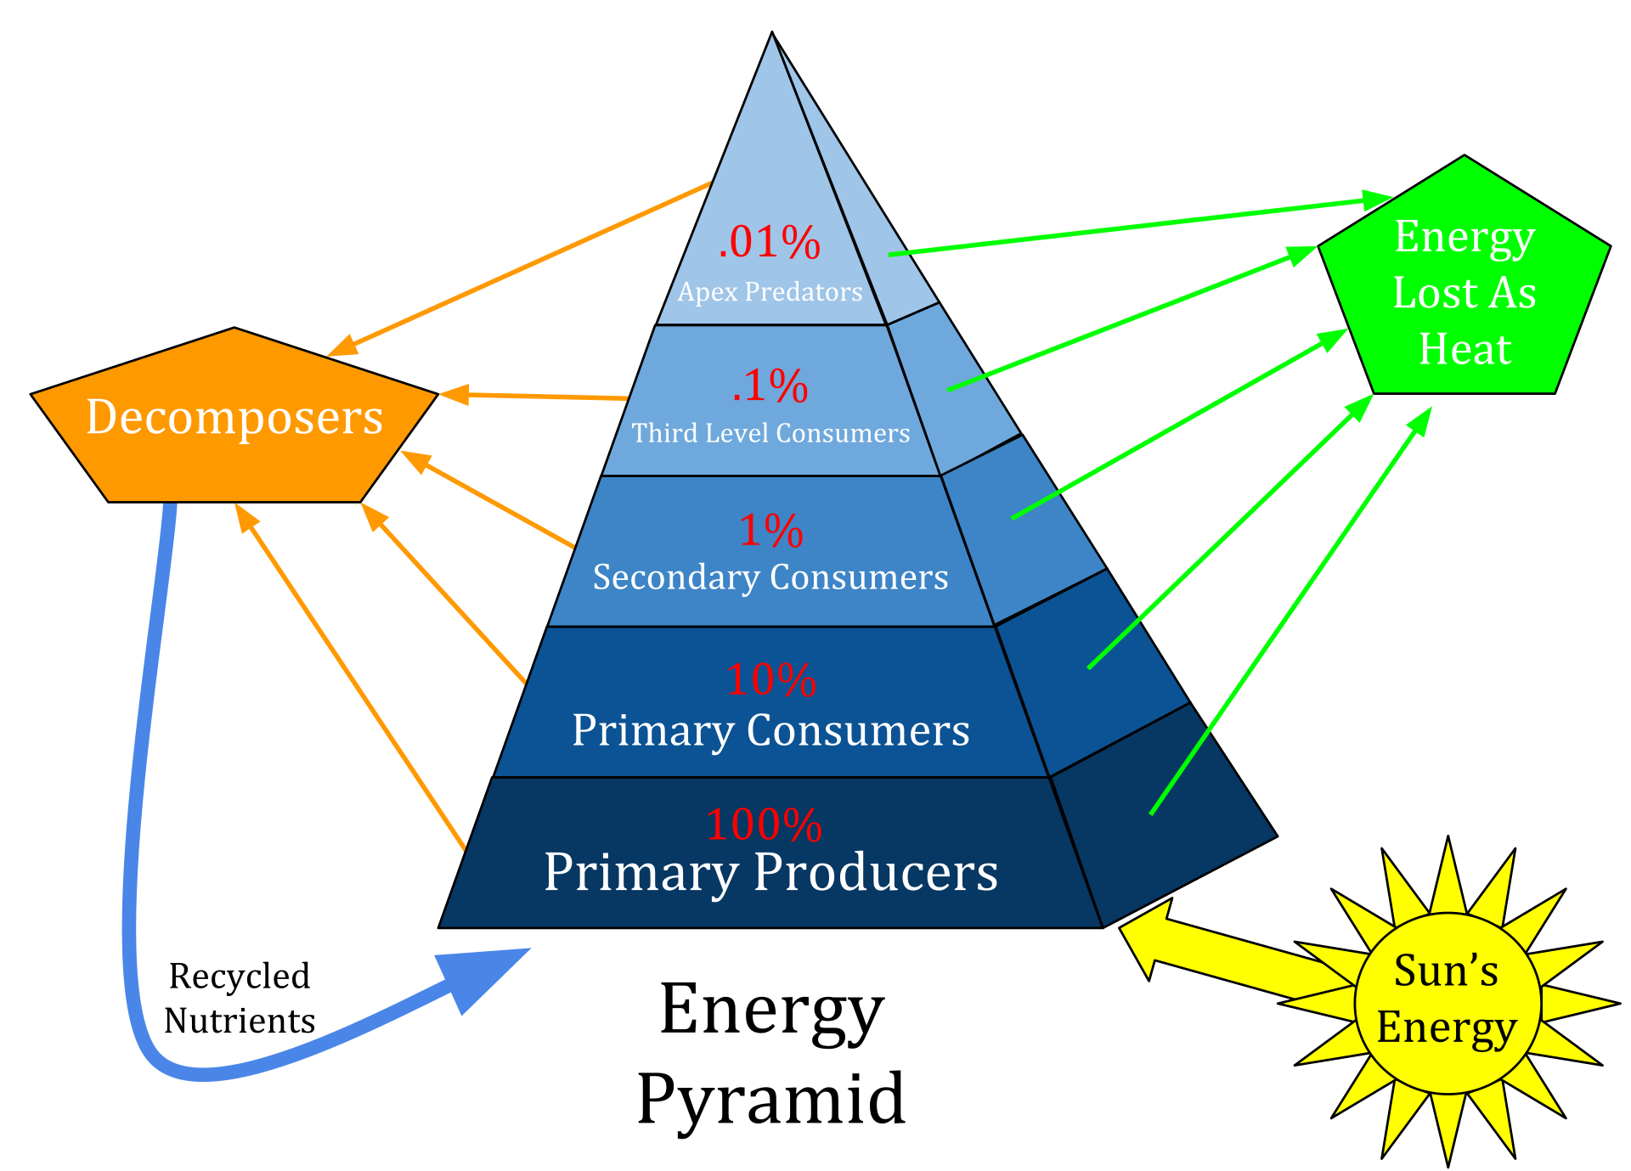
Energy Flow in Ecosystems
CC BY-SA 4.0
File:Ecological Pyramid.svg
Created: 1 June 2015

Slide 7
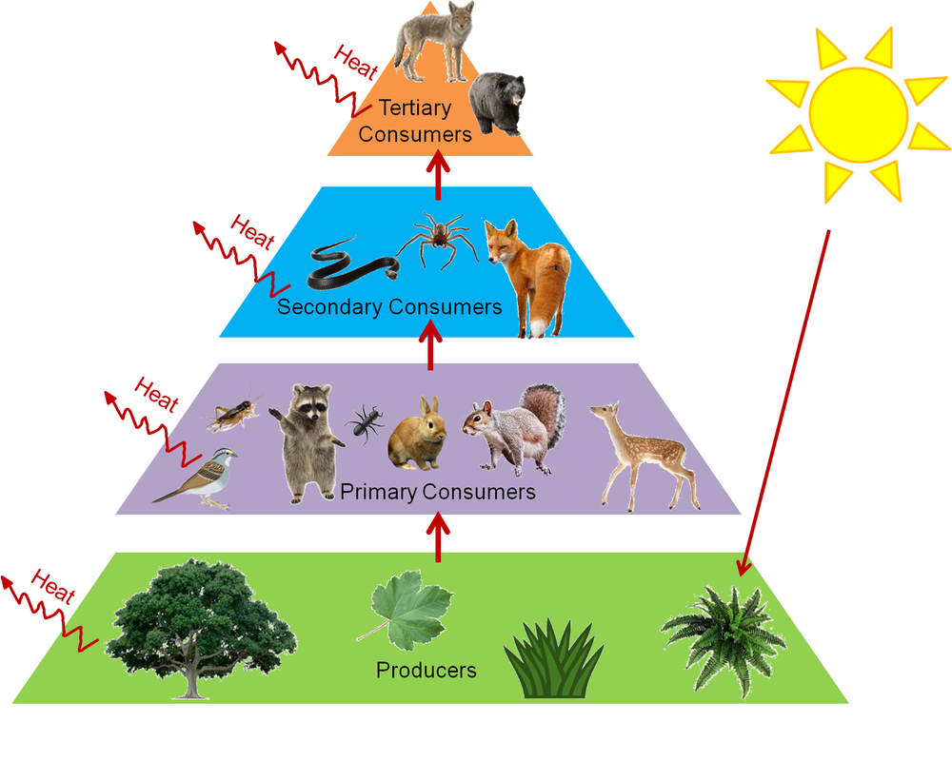
Energy Flow in Ecosystems
https://dumielauxepices.net/wallpaper-2688523

Slide 8
Stream Ecology Pre- and Post-test Questions
3. If you were to predict the level of nutrients in a local stream, it would be most useful to know:
extent of fertilizer use directly around the stream
extent of fertilizer use upstream and also directly around the stream
extent of fertilizer use upstream

Slide 9
Stream Ecology Pre- and Post-test Questions
3. If you were to predict the level of nutrients in a local stream, it would be most useful to know:
extent of fertilizer use directly around the stream
extent of fertilizer use upstream and also directly around the stream
extent of fertilizer use upstream

Slide 10
Stream Ecology Pre- and Post-test Questions
4. If you wanted to do research that relates stream conditions to fertilizer application, briefly describe an approach you might take in gathering data.

Slide 11
Regional Data
Look at regional EPA land-use maps provided and develop a hypothesis that you test during this lecture.

Slide 12
Local data
https://nysdec.maps.arcgis.com/apps/webappviewer/index.html?id=53dd7bd66b4643db9f326bd1b821dacd
https://www.arcgis.com/home/webmap/viewer.html?webmap=f1f297bb6c584d7486dd7a565bbe2ef2&extent=-80.1129,38.7988,-67.3467,46.2348

Slide 13
Local Data
HRECOS (https://www.hrecos.org)
Riverkeeper (https://riverkeeper.org/water-quality/)
USGS (https://waterdata.usgs.gov/nwis/sw)
****See next three slides*****

Slide 14
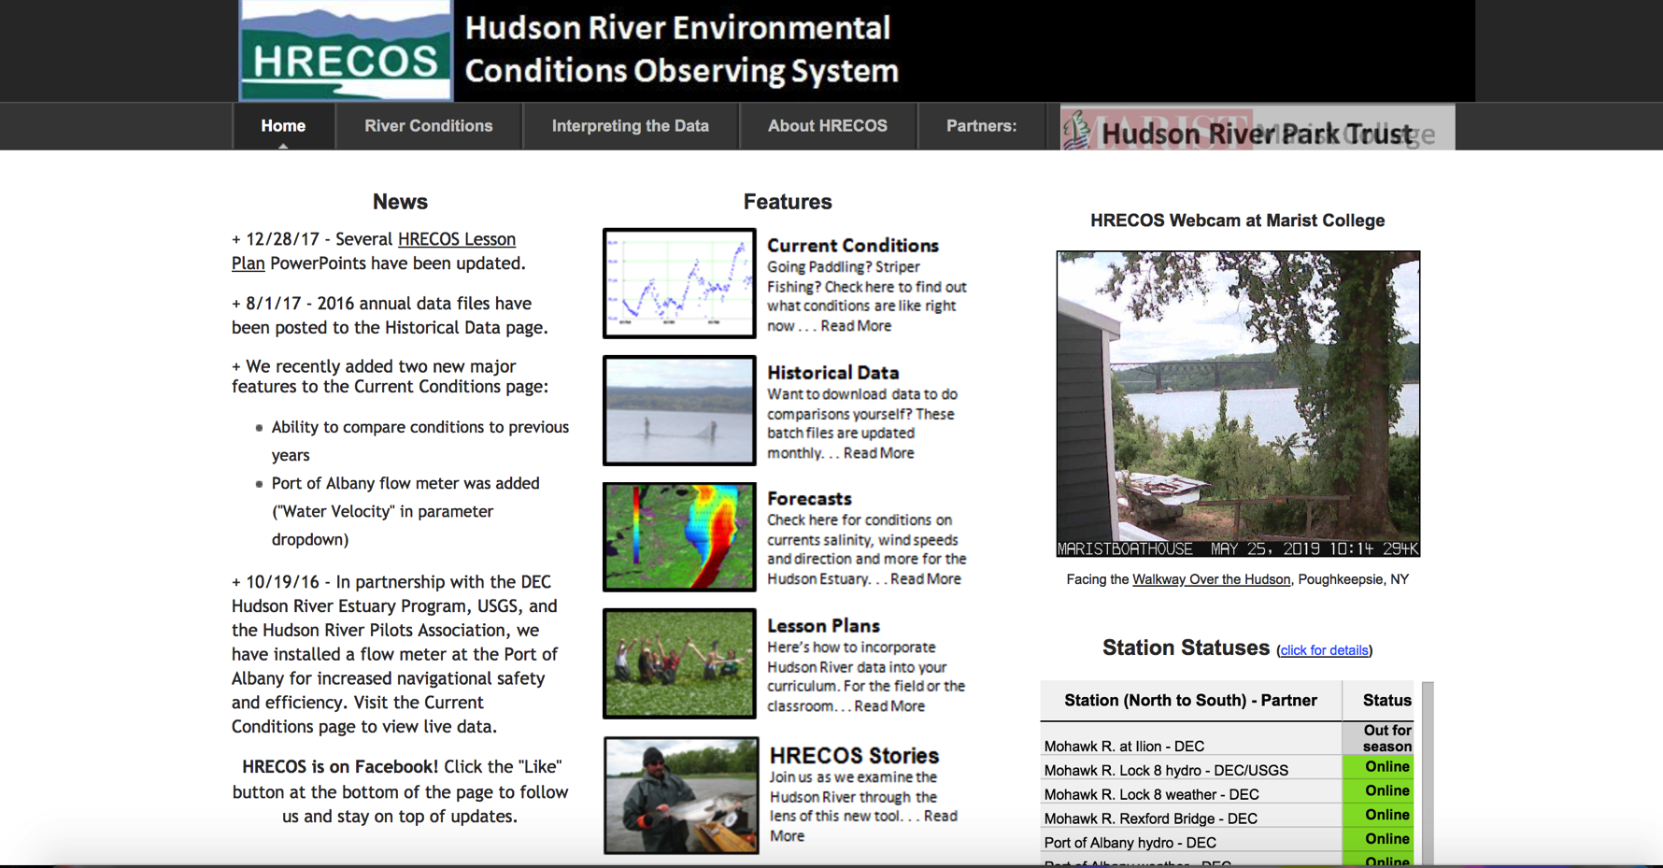
Local data: HRECOS

Slide 15
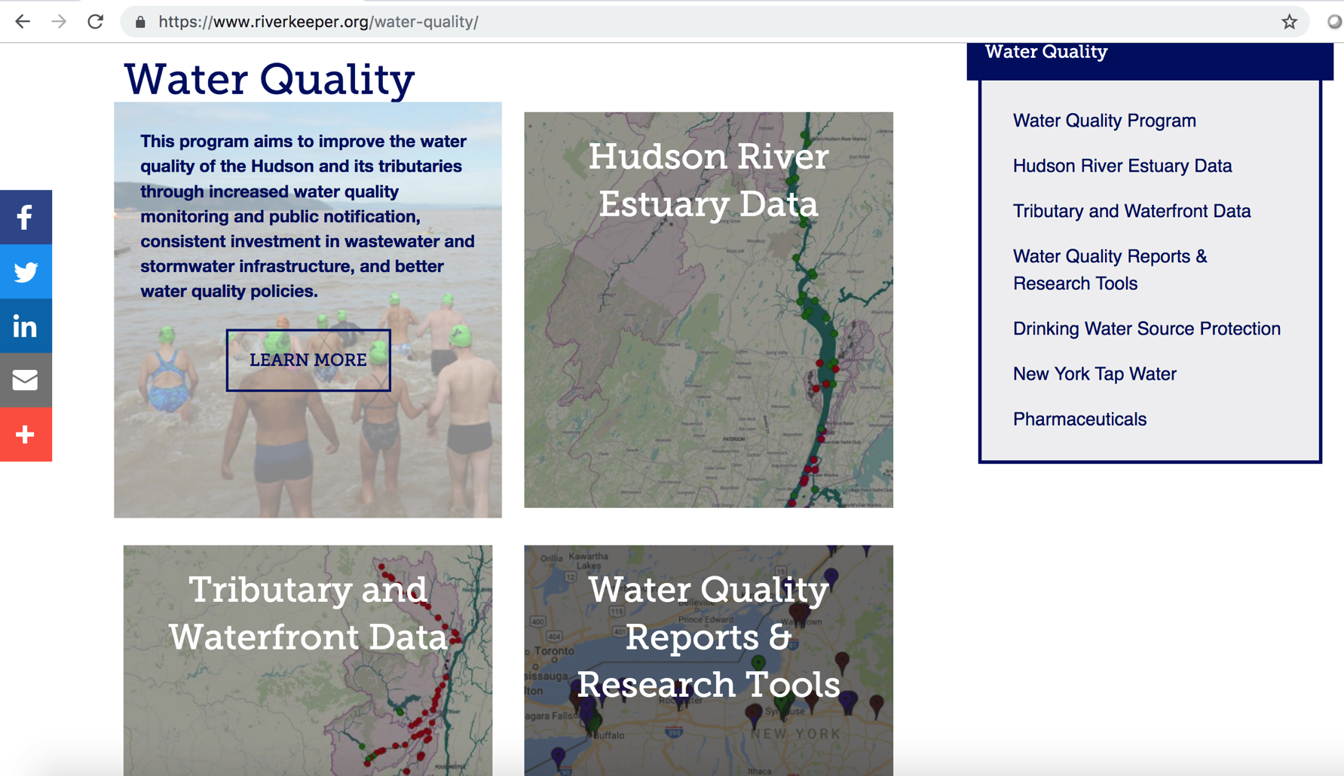
Local data: RIVERKEEPER

Slide 16
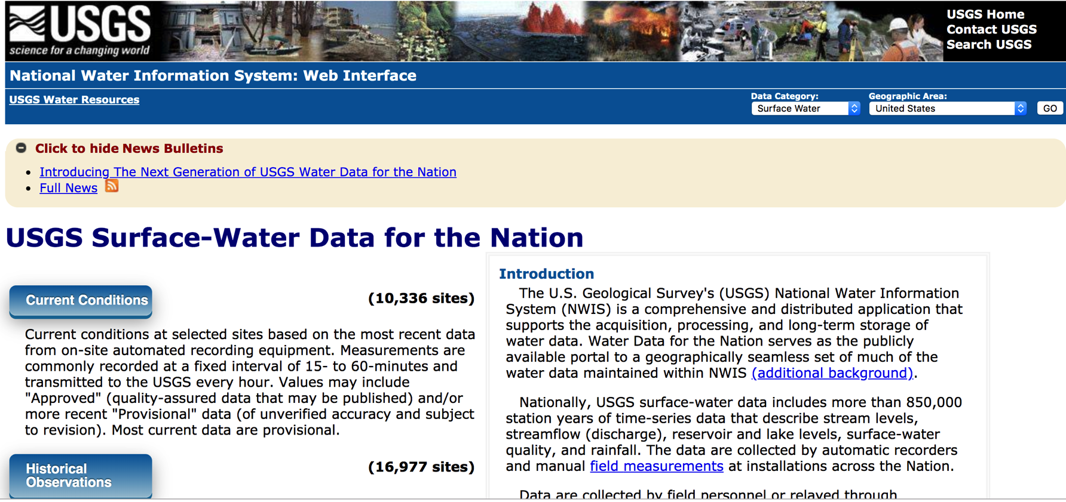
Local data: USGS

