Slide 1
Introduction to PyMol molecular modeling using SARS-CoV-2 S-protein with ACE2 receptor
Nicholas Lorusso, Maria Shumskaya, Kean University, 1000 Morris Ave, Union, NJ 07083

Slide 2
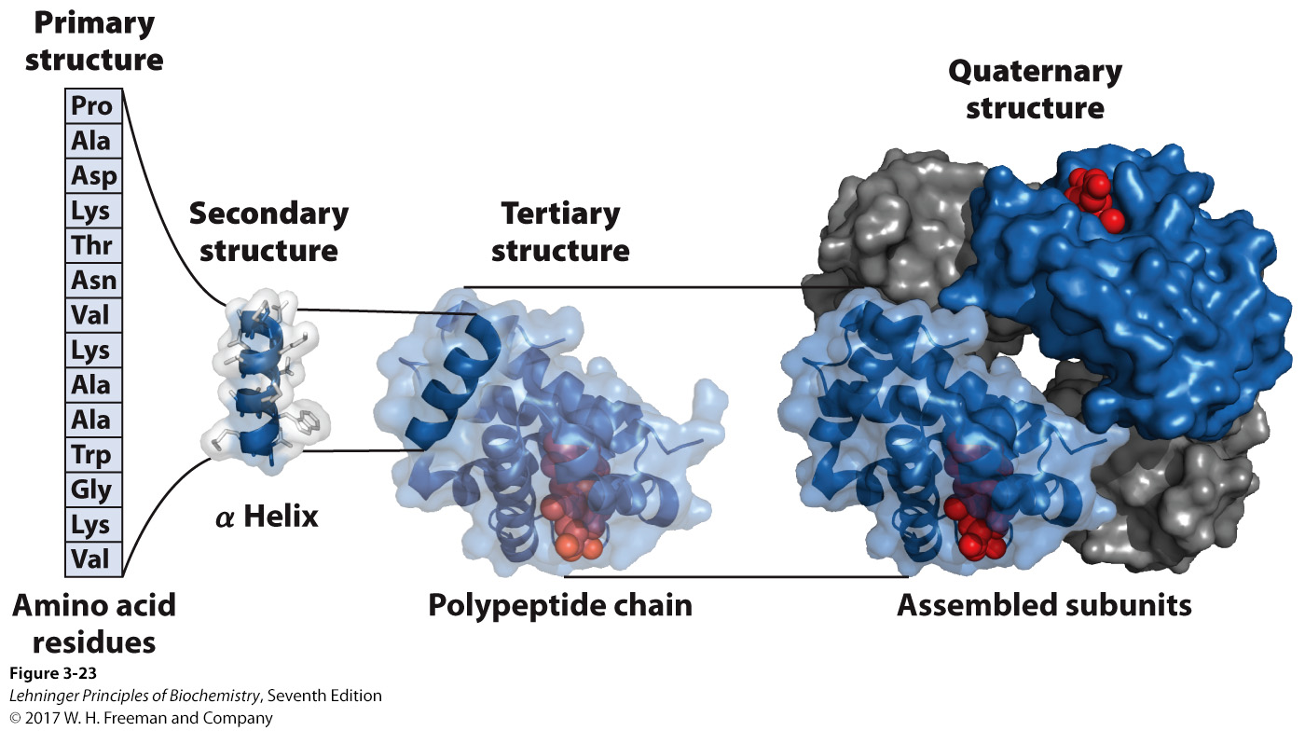
Four levels of protein structure
Linear sequence of amino acids
Local 3-dimensional structure of the peptide backbone, interactions between atoms of the backbone: a-helix, b-sheet
Global arrangement of secondary structure, interactions between side chains of amino acids (R groups), and other prosthetic groups (e.g. metals)
Arrangement of multiple proteins into complexes
Campbell Biology, 11th ed

Slide 3
Why determine protein structure?
protein tertiary structure (3D) can be predicted, but not (yet) be 100% determined based on primary amino acid sequence alone
Tertiary structure is ultimately responsible for its biological function
Understanding tertiary structure provides a lot of insight into how it functions, and can highlight potential targets for therapeutic benefit

Slide 4
Methods for determining protein 3D structure
There are two main methods for determining a protein’s structure: protein NMR (Nuclear Magnetic Resonance) and X-ray crystallography
These methods determine how the atoms of a macromolecule are arranged relative one to another
This helps us understand how they interact/how the protein works
Both methods require very pure protein – this can be achieved by chromatographic methods on native extracts (difficult) or by over-expression in E. coli etc.

Slide 5
X-ray crystallography
Crystal growth
typically hundreds of crystallization conditions must be tested
Polyethylene glycol (PEG) is commonly used to foster crystallization
X-ray diffraction pattern collection
done in a powerful X-ray beam from a synchrotron
detection on photographic film or via CCD cameras
many “views” of crystal made in goniometer (instrument to measure angles)
Electron density map generation
Fourier transforms and other methods used to generate an electron density map of the macromolecule
Atomic modelling
based on the electron map and prior knowledge of the amino acid sequence, an atomic model is generated
atomic coordinates are deposited in the PDB database

Slide 6
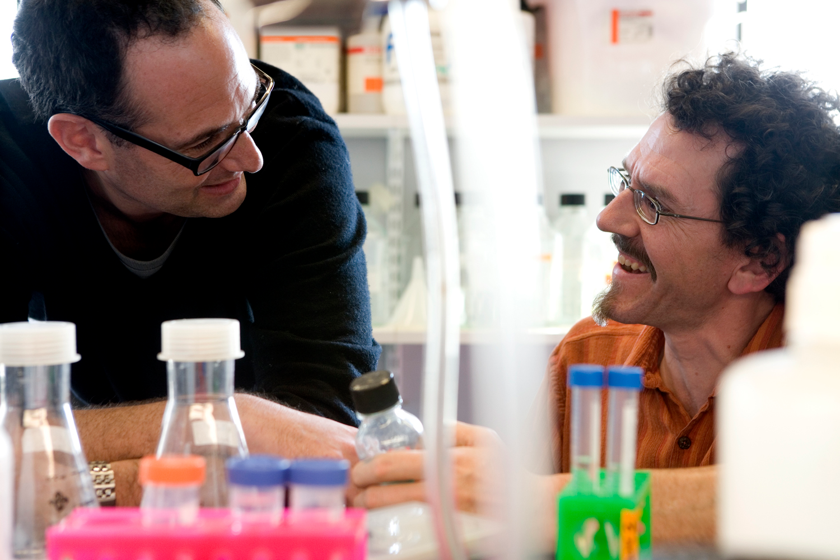
Naturally obsessed
Movie about three PhD students working in the protein crystallography lab:
https://www.thirteen.org/naturally-obsessed/

Slide 7
Structure databases
Several protein structure databases have reached an agreement to share their files via the wwPDB, the world-wide Protein Databank
Information about how a given structure was determined is deposited in PDB records (how the protein was expressed, crystallization conditions etc).
PDB.org is the main repository for macromolecular structure information
Other structure databases: for chemicals, for pharmaceuticals (these structures can also determined by NMR and X-ray crystallography, and other methods)

Slide 8
Tools for exploring 3D structures
Many programs exist for exploring 3D molecular structures
PyMOL: one of the most widely used is the open-source, used in ~25% of all structure publications
Py in PyMOL: Python programming language that was used to create the software.

Slide 9
Ways to represent the 3D structure of a protein
Cartoon Stick model and close-up
Solvent-accessible surface model
Coils = α-helices
Arrows = β−strands (direction shown by arrow) – together make β−sheets
Ribbons = bends, loops

Slide 10
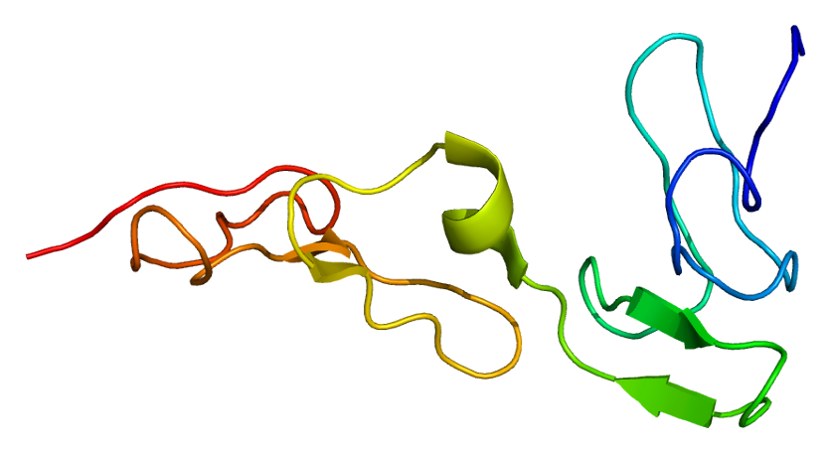
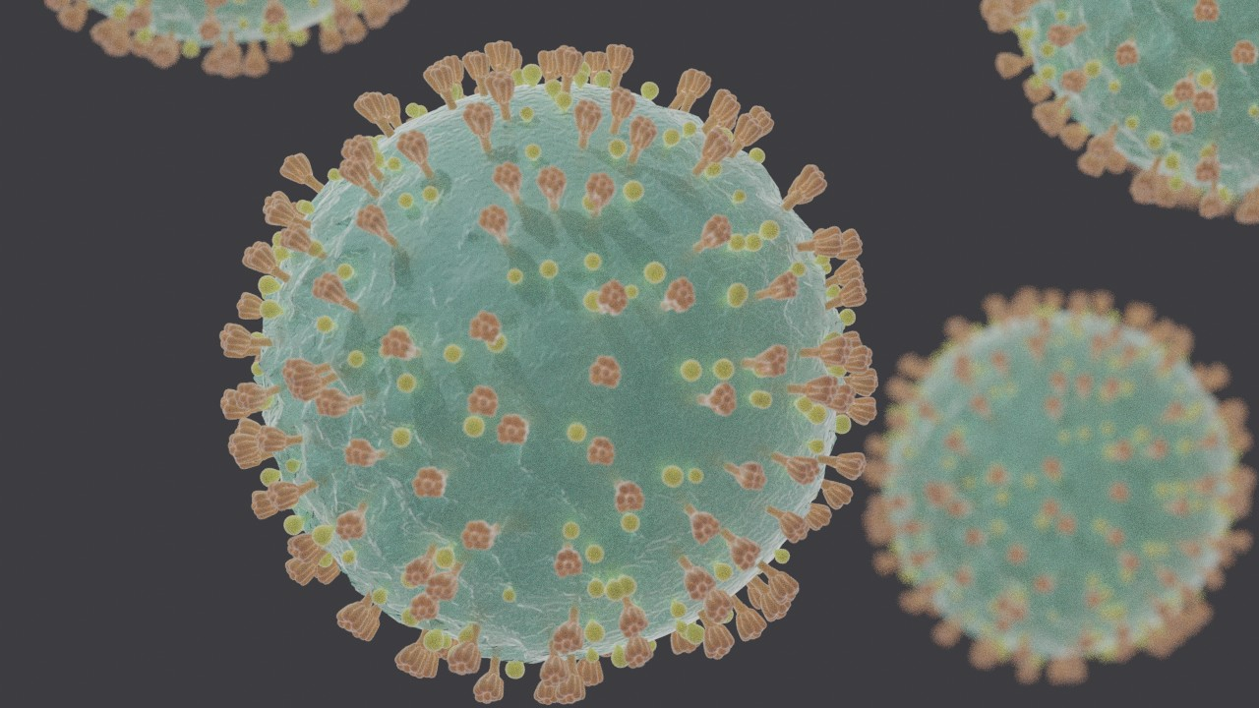
Using PyMol and protein structure to understand SARS-CoV-2
Viruses in the group Coronaviridae mostly use the S-protein to enter host cells
If we understand its structure we can come up with vaccines or tests that might help us respond to this sort of outbreak
We’ll use PyMol to evaluate the structure of the S1 subunit of the S protein and consider it’s key binding points that allow it to invade its host

