Slide 1






STEM Inclusive Teaching Practices Webinar Series Episode One

Slide 2
Thank you sponsors!
For more information see:
+ =
edsin.qubeshub.org + qubeshub.org = builds.qubeshub.org
Open Education Community for
Biological
(Universal and Inclusive) Data Science
biodiversityliteracy.com
idigbio.org

Slide 3
Webinar Series Goals
Initiate discussion on topics related to inclusive teaching practices
Build community among a diversity of STEM disciplines
Raise awareness of the existing knowledge base and existing resources
Support our educators in thinking about inclusion in the time of COVID-19

Slide 4
Ground Rules
Add your names and pronouns to your Zoom name.
Mics will be muted at first, but we can enable them during discussion.
Private chat and file share are also disabled for participants.
Please return to mute after you speak.
Feel free to participate in whatever works best for you (verbally or through chat).
We will try to pause in our discussion section to let people who may not always jump right in contribute, so don’t be alarmed if there is “dead air”.
Expect the unexpected (video/audio lag, freezing) but let us know in the chat if you are experiencing any issues.
If we lose a speaker because of connection issues, they will return!

Slide 5
Survey
Improving these experiences is really important to us. We will be sharing a link to a quick (less than 5 minutes) survey at the end of the webinar -- please consider filling it out!
Link: https://tinyurl.com/w6dd8pt

Slide 6
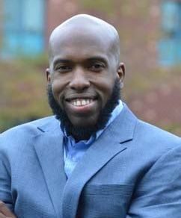
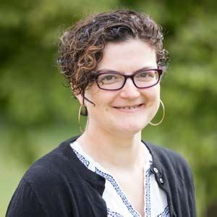
Episode One: Inclusive teaching practices in the time of COVID-19
Guest Speaker: Bryan Dewsbury
Moderator: Carrie Diaz Eaton

Slide 7
Speaker introduction: Dr. Bryan Dewsbury
Dr. Dewsbury is an Assistant professor of Biological Sciences at the University of Rhode Island. His background is in marine ecology and ecological economics. He has experience developing approaches and programs relating to social belonging and higher education, and co-authored the CBE-LSE guide to Inclusive Teaching.
“I am personally inspired by the possibilities ​of education as a force for intellectual liberation, and as a means to increase critical consumerism.”

Slide 8

THE PROMISE AND PRACTICE OF INCLUSIVE TEACHING
Bryan M. Dewsbury
Assistant Professor of Biology
University of Rhode Island

Slide 9
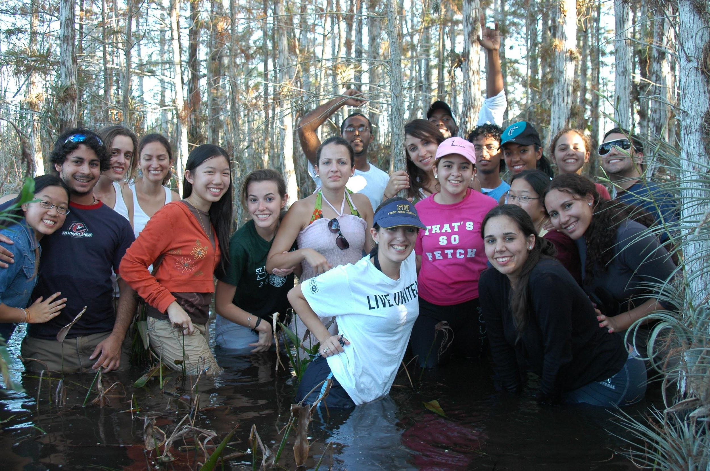

Slide 10
DISCUSSION QUESTIONS
How have you transitioned your classroom during covid?

Slide 11
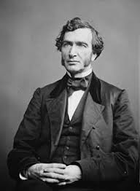
Justin Smith Morrill
“He wanted to assure that education would be available to those in all social classes.”

Slide 12
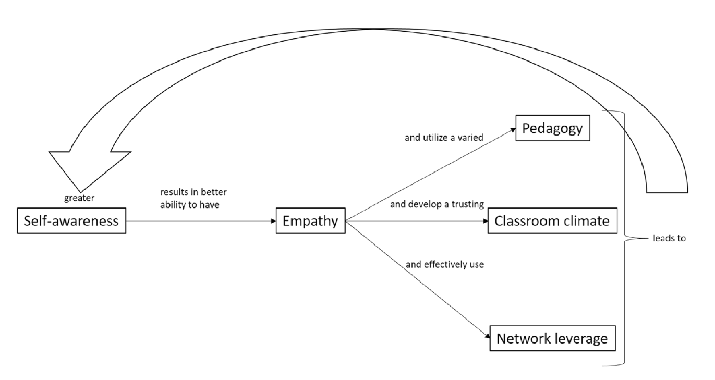
Relationships
Dewsbury 2019, CSSE

Slide 13
Inclusive pedagogy in Introductory Biology

Slide 14
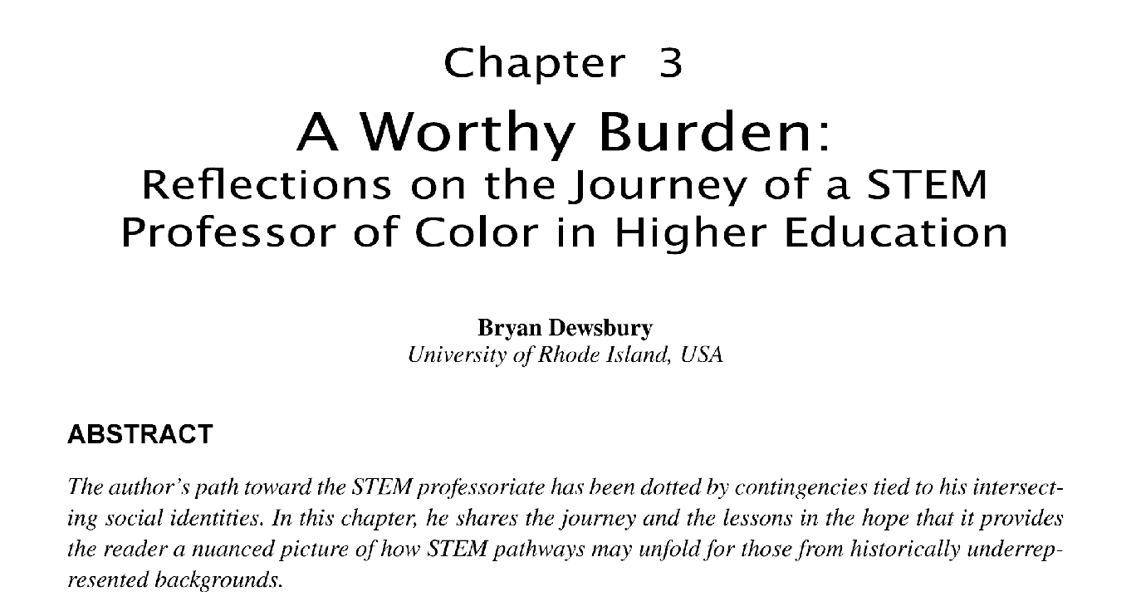
Self-awareness
In S. Brand, & L. Ciccomascolo (Eds.), Social Justice and Putting Theory Into Practice in Schools and Communities (pp. 29-43).

Slide 15


Encouraging dialogue
Institutional Research Office
https://thisibelieve.org/guidelines/

Slide 16


CLASSROOM CLIMATE | PEDAGOGY | NETWORK LEVERAGE
Early alert
Career services
Affinity groups
Housing
Opportunities for dialogue
Web-enhanced course design
Campus networks

Slide 17
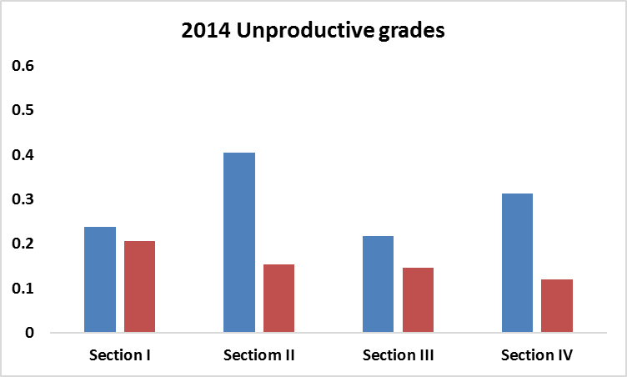
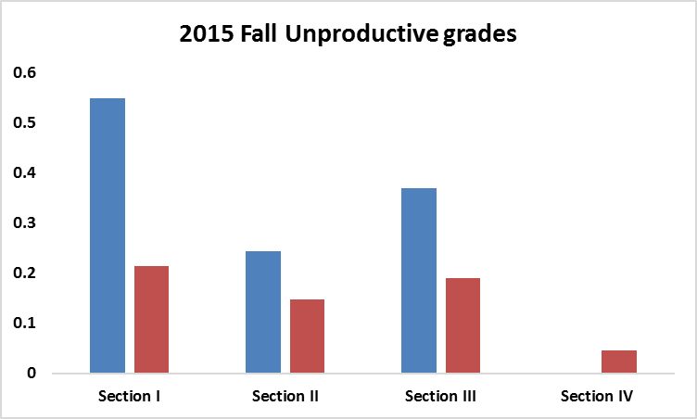
URM
White

Slide 18
1
200-level courses
**
2
3
S
B

Slide 19
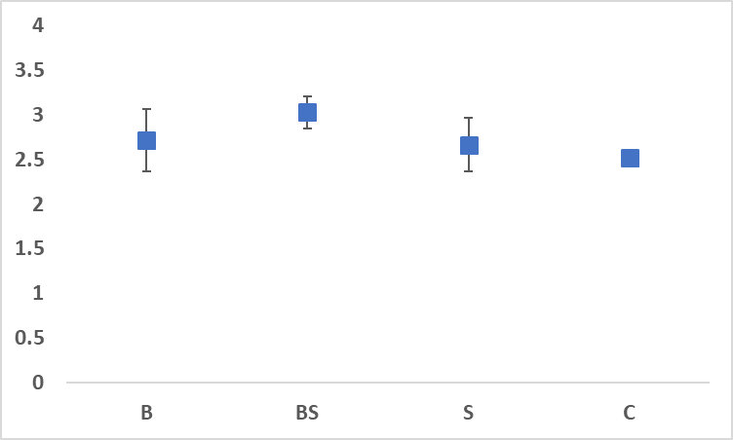
B = just Bryan
BS = Bryan + S
S = Just S
C = Neither
a
b

Slide 20
THE REVOLUTION WILL BE BACKWARD DESIGNED

Slide 21
dewsbury@uri.edu
Twitter | @bmdewsbury
Instagram | @scienceeduri

Slide 22
Thank you for attending!!
Improving these experiences is really important to us. We will be sharing a link to a quick (less than 5 minutes) survey at the end of the webinar -- please consider filling it out!
Link: https://tinyurl.com/w6dd8pt

